Slide 1
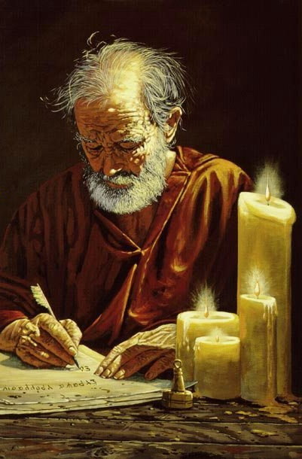
Ministry from Paul’s perspective (Titus 3:12-15): Five Observations
The blessings of orderly ministry
The blessings of shared ministry
The blessings of brotherly ministry
The blessings of resourceful ministry
The blessings of doctrinal ministry
Outline adapted from R. Caldwell, “A Window Into the Work,” 2019.

Slide 2
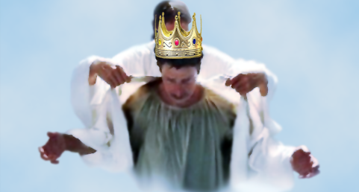
The Bema Seat of Christ

Slide 3
6 Questions About the Bema Seat of Christ
Who?
What?
When?
Where?
Why?
How?
Outline adapted from Mark Hitchcock, The End: A Complete Overview of Bible Prophecy and the End of Days (Carol Stream, IL: Tyndale, 2012), 207-217.

Slide 4
2 Corinthians 5:9-10 (NASB)
9 Therefore we also have as our ambition, whether at home or absent, to be pleasing to Him.
10 For we must all appear before the judgment seat of Christ, so that each one may be recompensed for his deeds in the body, according to what he has done, whether good or bad.

Slide 5
6 Questions About the Bema Seat of Christ
Who?
What?
When?
Where?
Why?
How?
Outline adapted from Mark Hitchcock, The End: A Complete Overview of Bible Prophecy and the End of Days (Carol Stream, IL: Tyndale, 2012), 207-217.

Slide 6
2 Corinthians 5:9-10 (NASB)
9 Therefore we also have as our ambition, whether at home or absent, to be pleasing to Him.
10 For we must all appear before the judgment seat of Christ, so that each one may be recompensed for his deeds in the body, according to what he has done, whether good or bad.

Slide 7
2 Corinthians 5:9-10 (NASB)
9 Therefore we also have as our ambition, whether at home or absent, to be pleasing to Him.
10 For we must all appear before the judgment seat of Christ, so that each one may be recompensed for his deeds in the body, according to what he has done, whether good or bad.

Slide 8
Romans 14:10-12
But you, why do you judge your brother? Or you again, why do you regard your brother with contempt? For we will all stand before the judgment seat of God. For it is written, “AS I LIVE, SAYS THE LORD, EVERY KNEE SHALL BOW TO ME, AND EVERY TONGUE SHALL GIVE PRAISE TO GOD.” So then each one of us will give an account of himself to God.

Slide 9
Romans 14:10-12
But you, why do you judge your brother? Or you again, why do you regard your brother with contempt? For we will all stand before the judgment seat of God. For it is written, “AS I LIVE, SAYS THE LORD, EVERY KNEE SHALL BOW TO ME, AND EVERY TONGUE SHALL GIVE PRAISE TO GOD.” So then each one of us will give an account of himself to God.

Slide 10
2 Corinthians 5:9-10 (NASB)
9 Therefore we also have as our ambition, whether at home or absent, to be pleasing to Him.
10 For we must all appear before the judgment seat of Christ, so that each one may be recompensed for his deeds in the body, according to what he has done, whether good or bad.

Slide 11
2 Corinthians 5:9-10 (NASB)
9 Therefore we also have as our ambition, whether at home or absent, to be pleasing to Him.
10 For we must all appear before the judgment seat of Christ, so that each one may be recompensed for his deeds in the body, according to what he has done, whether good or bad.

Slide 12
2 Corinthians 5:9-10 (NASB)
9 Therefore we also have as our ambition, whether at home or absent, to be pleasing to Him.
10 For we must all appear before the judgment seat of Christ, so that each one may be recompensed for his deeds in the body, according to what he has done, whether good or bad.

Slide 13
6 Questions About the Bema Seat of Christ
Who?
What?
When?
Where?
Why?
How?
Outline adapted from Mark Hitchcock, The End: A Complete Overview of Bible Prophecy and the End of Days (Carol Stream, IL: Tyndale, 2012), 207-217.

Slide 14
Scripture’s Four Judgments (for mankind)
Name | Sheep and Goat | Judgment of the Jews | Bema Seat of Christ | Great White Throne
Scripture | Matt 25:31-46 | Ezek 20:33-44 | 1 Cor 3:10-15 | Rev 20:11-15
Place | Earth, Jerusalem | Earth, wilderness | Heaven | Earth
Audience | Gentile Tribulation survivors | Jewish Tribulation survivors | Church Age believers | All unsaved
When | After Tribulation | After Tribulation | After rapture | After Millennium
Purpose | Saved Gentiles enter kingdom | Saved Jews enter kingdom | Reward believers | Degree of punishment in hell
Evaluation | Treatment of Christ’s brethren | Passing under shepherd’s rod | Works taken through fire | Not in the book; judged by books

Slide 15
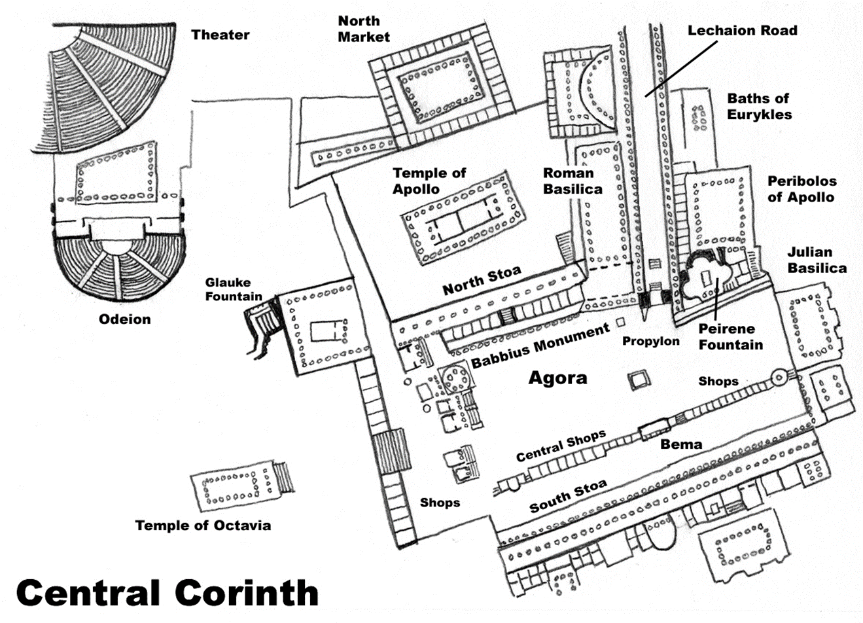
Source: http://timwoodroof.com/wp-content/uploads/2010/09/central-corinth.jpg

Slide 16
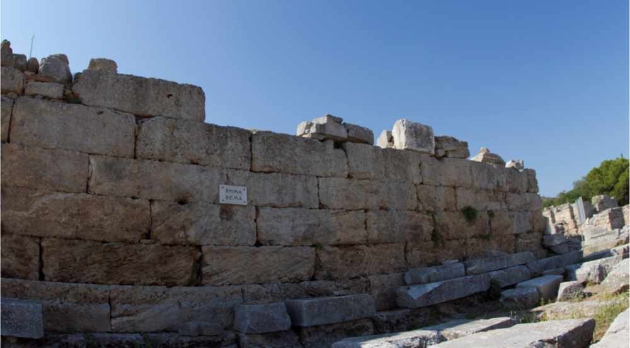
Bema Seat in Corinth

Slide 17
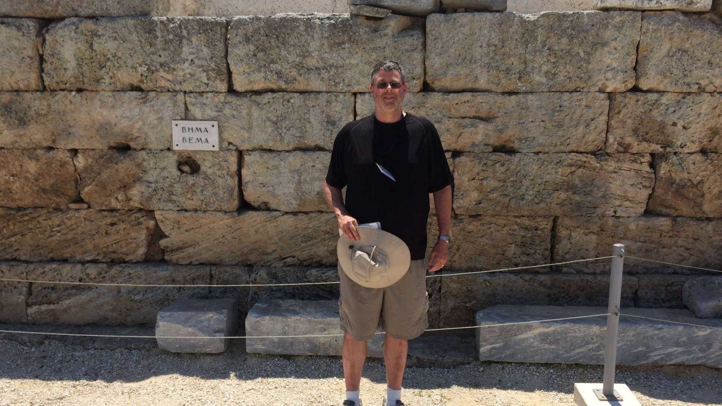

Slide 18
6 Questions About the Bema Seat of Christ
Who?
What?
When?
Where?
Why?
How?
Outline adapted from Mark Hitchcock, The End: A Complete Overview of Bible Prophecy and the End of Days (Carol Stream, IL: Tyndale, 2012), 207-217.

Slide 19
Luke 14:13-14
And He also went on to say to the one who had invited Him, “When you give a luncheon or a dinner, do not invite your friends or your brothers or your relatives or rich neighbors, otherwise they may also invite you in return and that will be your repayment. “But when you give a reception, invite the poor, the crippled, the lame, the blind, and you will be blessed, since they do not have the means to repay you; for you will be repaid at the resurrection of the righteous.”

Slide 20
RAPTURE VIEW COMPARISION
RAPTURE
PRETRIBULATION
7 YEAR TRIBULATION
1000 years Millennium
RAPTURE
MIDTRIBULATION
7 YEAR TRIBULATION
1000 years Millennium
RAPTURE & REVELATION
ETERNITY
POSTTRIBULATION
7 YEAR TRIBULATION
1000 years Millennium
RAPTURE
PREWRATH
No Wrath
Beginning of Sorrows
Great Tribulation
1000 years Millennium

Slide 21
1 Corinthians 4:5
Therefore do not go on passing judgment before the time, but wait until the Lord comes who will both bring to light the things hidden in the darkness and disclose the motives of men’s hearts; and then each man’s praise will come to him from God.

Slide 22
Titus 2:12-13
instructing us to deny ungodliness and worldly desires and to live sensibly, righteously and godly in the present age, looking for the blessed hope and the appearing of the glory of our great God and Savior, Christ Jesus,

Slide 23
2 Timothy 4:8
In the future there is laid up for me the crown of righteousness, which the Lord, the righteous Judge, will award to me on that day; and not only to me, but also to all who have loved His appearing
Revelation 22:12
Behold, I am coming quickly, and My reward is with Me, to render to every man according to what he has done.

Slide 24
6 Questions About the Bema Seat of Christ
Who?
What?
When?
Where?
Why?
How?
Outline adapted from Mark Hitchcock, The End: A Complete Overview of Bible Prophecy and the End of Days (Carol Stream, IL: Tyndale, 2012), 207-217.

Slide 25
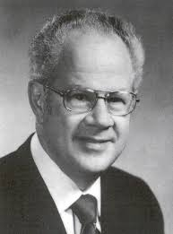
Where?
J. Dwight Pentecost ~ 1915-2014
“It is scarcely necessary to point out that this examination must take place in the sphere of the heavenlies. It is said in 1 Thessalonians 4:17 that ‘we shall be caught up…in the clouds, to meet the Lord in the air.’ Since the bema seat follows the translation, the ‘air’ must be the scene of it. This is further supported by 2 Corinthians 5:1-8, where Paul is describing events that take place when the believer is ‘absent from the body, and…present with the Lord.’ Thus, this event must take place in the Lord’s presence in the sphere of the ‘heavenlies.’”
J. Dwight Pentecost, Things to Come (Grand Rapids, MI: Zondervan Publishing House, 1958), 221.

Slide 26
2 Corinthians 5:10
For we must all appear before the judgment seat of Christ, so that each one may be recompensed for his deeds in the body, according to what he has done, whether good or bad.

Slide 27
2 Corinthians 5:10
For we must all appear before the judgment seat of Christ, so that each one may be recompensed for his deeds in the body, according to what he has done, whether good or bad.

Slide 28
John 5:24
Truly, truly, I say to you, he who hears My word, and believes Him who sent Me, has eternal life, and does not come into judgment, but has passed out of death into life

Slide 29
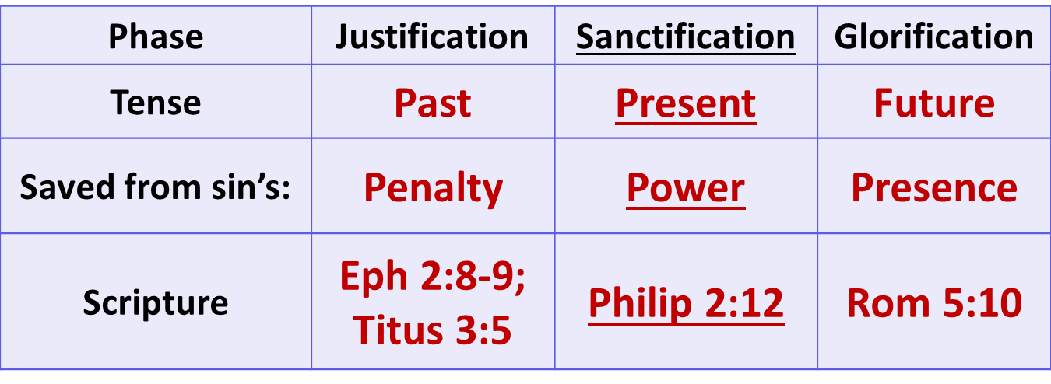
3 Phases of our Salvation

Slide 30
2 Corinthians 5:10
For we must all appear before the judgment seat of Christ, so that each one may be recompensed for his deeds in the body, according to what he has done, whether good or bad.

Slide 31
1 Corinthians 3:12-15
12 Now if any man builds on the foundation with gold, silver, precious stones, wood, hay, straw,
13 each man’s work will become evident; for the day will show it because it is to be revealed with fire, and the fire itself will test the quality of each man’s work.
14 If any man’s work which he has built on it remains, he will receive a reward.
15 If any man’s work is burned up, he will suffer loss; but he himself will be saved, yet so as through fire.

Slide 32
2 Corinthians 5:10
For we must all appear before the judgment seat of Christ, so that each one may be recompensed for his deeds in the body, according to what he has done, whether good or bad.

Slide 33
Matthew 6:1-7
Beware of practicing your righteousness before men to be noticed by them; otherwise you have no reward with your Father who is in heaven.
So when you give to the poor, do not sound a trumpet before you, as the hypocrites do in the synagogues and in the streets, so that they may be honored by men. Truly I say to you, they have their reward in full.
But when you give to the poor, do not let your left hand know what your right hand is doing, so that your giving will be in secret; and your Father who sees what is done in secret will reward you. “When you pray, you are not to be like the hypocrites; for they love to stand and pray in the synagogues and on the street corners so that they may be seen by men. Truly I say to you, they have their reward in full. “But you, when you pray, go into your inner room, close your door and pray to your Father who is in secret, and your Father who sees what is done in secret will reward you. And when you are praying, do not use meaningless repetition as the Gentiles do, for they suppose that they will be heard for their many words.

Slide 34
1 Corinthians 3:10-15
10 According to the grace of God which was given to me, like a wise master builder I laid a foundation, and another is building on it. But each man must be careful how he builds on it.
11 For no man can lay a foundation other than the one which is laid, which is Jesus Christ.
12 Now if any man builds on the foundation with gold, silver, precious stones, wood, hay, straw,
13 each man’s work will become evident; for the day will show it because it is to be revealed with fire, and the fire itself will test the quality of each man’s work.
14 If any man’s work which he has built on it remains, he will receive a reward.
15 If any man’s work is burned up, he will suffer loss; but he himself will be saved, yet so as through fire.

Slide 35
“The judgment seat of Christ might be compared to a commencement ceremony. At graduation there is some measure of disappointment and remorse that one did not do better and work harder. However, at such an event the overwhelming emotion is joy, not remorse. The graduates do not leave the auditorium weeping because they did not earn better grades. Rather, they are thankful that they have been graduated, and they are grateful for what they did achieve. To overdo the sorrow aspect of the judgment seat of Christ is to make heaven hell. To under do the sorrow aspect is to make faithfulness inconsequential.”
Samuel Hoyt, “The Judgment Seat of Christ in Theological Perspective,” Part 2, Bibliotheca Sacra, electronic media.

Slide 36
1 Corinthians 4:5
Therefore do not go on passing judgment before the time, but wait until the Lord comes who will both bring to light the things hidden in the darkness and disclose the motives of men’s hearts; and then each man’s praise will come to him from God.

Slide 37
Crowns found in the Bible
Crown | Reference | Description
The Incorruptible Crown | 1 Cor. 9:24,25 | For the one who masters the old nature
The crown of rejoicing | 1 Thess. 2:19 – 20; Dan 12:3 | For the one who leads people to Christ
The crown of life (or crown of Martyrs – Rev 2:8-11) | James 1:12 | For those who endure trials, tribulations, and severe suffering, even unto death
The crown of righteousness | 2 Tim. 4:8 | For those who love and anxiously wait and look forward to the day of His return at the Rapture.
The crown of glory | 1 Pet. 5:1 – 4 | For those who faithfully teach the flock.

Slide 38
Hebrews 11:6
And without faith it is impossible to please Him, for he who comes to God must believe that He is and that He is a rewarder of those who seek Him.

Slide 39
6 Questions About the Bema Seat of Christ
Who?
What?
When?
Where?
Why?
How?
Outline adapted from Mark Hitchcock, The End: A Complete Overview of Bible Prophecy and the End of Days (Carol Stream, IL: Tyndale, 2012), 207-217.

Slide 40
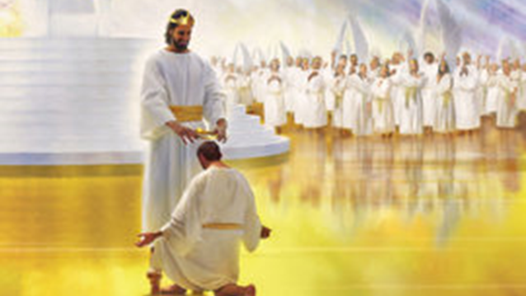
Preparation for the Bema Seat of Christ
How we treat other believers (Hebrews 6:10)
How we use our God given talents, abilities and opportunities (Luke 19)
How we use our money (1 Tim 6:17-18)
How well we take injustice and mistreatment (Matt 5:11-12)
How we endure sufferings and trials (James 1:12 )

Slide 41
Preparation for the Bema Seat of Christ
How we spend our time (Psalm 90:12; Eph 5:16)
How we run the race (Heb 12:1; 1 Cor 9:24)
How effectively we control our sin nature (1 Cor 9:27)
How much souls we win for Christ (Dan 12:3; 1 Thess 2)
How much the doctrine of the Rapture means to us (2 Tim 4:8)

Slide 42
Preparation for the Bema Seat of Christ
How faithful we are to God’s word and His people (2 Tim 4:1-2)
How hospitable we are to strangers (Luke 14:12)
How we support other people in ministry (Matt 10:40-41)
How faithful we are at our occupations or anything we put our hands to (Col 3:23)
How we use our tongue (Matt 12:36)

Slide 43
Conclusion

Slide 44
6 Questions About the Bema Seat of Christ
Who are the participants? Believers
What is the Bema Seat? An evaluation
When is the Bema Seat? After the Rapture
Where will this Judgment take place? In the heavenlies
Why are believers evaluated? Rewards
How do we prepare for the Bema Seat of Christ? 15 ways
Outline adapted from Mark Hitchcock, The End: A Complete Overview of Bible Prophecy and the End of Days (Carol Stream, IL: Tyndale, 2012), 207-217.

Slide 45
The Bema Seat of Christ

