Slide 1
Law and Grace: An Overview Jim McGowan, Th.D. Sugar Land Bible Church 10-16-2022
…but grace and truth were realized through Jesus Christ - John 1:17
For the Law was given through Moses…
Special thanks to Dr. Vern Peterman for access to his insights and resources.

Slide 2
Session 35 Outline
Review
Purpose, Aim, and Objective
Session 34
Don’t Worry About It – Matt. 6:25-34
General Information
Matt. 6:25-34
Concluding Observations

Slide 3
OUR PURPOSE, AIM AND OBJECTIVE
Law and Grace
…is to Compare and Contrast Law and Grace so as to properly understand these two important themes and how they are related to the life of the New Testament Believer.

Slide 4
C. I. Scofield, D. D.
The Grace of God, The Fundamentals Vol. 3, Chapter VII, p. 98
We have, most of us, been reared and now live under the influence of Galatianism. Protestant theology, alas, is for the most part, thoroughly Galatianized, in that neither law nor grace are given their distinct and separated places, as in the counsels of God, but are mingled together in one incoherent system.
The law is no longer, as in the Divine intent, a ministration of death (2 Cor. 3:7), of cursing (Gal. 3:10), of conviction (Rom. 3:19), because we are taught that we must try to keep it, and that by Divine help we may.
Nor, on the other hand, does grace bring us blessed deliverance from the dominion of sin, for we are kept under the law as a rule of life despite the plain declaration, “Sin shall not have dominion over you: for ye are not under the law, but under grace” (Rom. 6:14). (emphasis mine)

Slide 5
William R. Newell
Romans Verse-by-Verse (p. 274).
Grand Rapids, MI: Christian Classics Ethereal Library.
It is because Reformed theology has kept us Gentiles under the Law,—if not as a means of righteousness, then as “a rule of life,” that all the trouble has arisen. The Law is no more a rule of life than it is a means of righteousness. Walking in the Spirit has now taken the place of walking by ordinances. God has another principle under which He has put his saints: “Ye are not under law, but, under grace! (Rom. 6:14)” (italics mine)
PDF Download Here: https://archive.org/details/Romans_Verse_By_Verse-NewellWR

Slide 6
Henry Ironside
The Continual Burnt Offering: Daily Meditations on the Word of God (p. 265). Neptune, NJ: Loizeaux Brothers.
In Romans 7 we have a man renewed by the Spirit of God, but struggling under law, hoping thereby to subdue or find deliverance from the power of the old Adamic nature. In chapter 8 we have God’s way of deliverance through the death and resurrection of Christ with which the believer is identified before God. The chapter begins with “no condemnation” and ends with “no separation.” All who are in Christ Jesus are accepted in the Beloved and as free from every charge of guilt as He is Himself. He paid our penalty on the cross. Now we are linked up with Him in resurrection, not under law but under grace.

Slide 7
Matthew’s 3-Fold Purpose
Law and Grace: Review The SOM – Matthew 5:1–8:1 (Luke 6:17–49)
To explain:
that Jesus in whom they had believed was the long-awaited Jewish Messiah
why the kingdom had been postponed despite the fact that the king had arrived
the interim program of God during the kingdom’s absence

Slide 8
Matthew and the Kingdom
Law and Grace: Review The SOM – Matthew 5:1–8:1 (Luke 6:17–49)
 | offered
 | rejected
 | postponed Interim program
 | ultimately accepted

Slide 9
Matthew’s Message
Law and Grace: Review The SOM – Matthew 5:1–8:1 (Luke 6:17–49)
Jesus is the predicted Jewish king who ushered in an interim program by building the sons of the kingdom into the Church in between Israel’s past rejection and future acceptance of her king.

Slide 10
Session 35 Outline
Review
Purpose, Aim, and Objective
Session 34
Don’t Worry About It – Matt. 6:25-34
General Information
Matt. 6:25-34
Concluding Observations

Slide 11
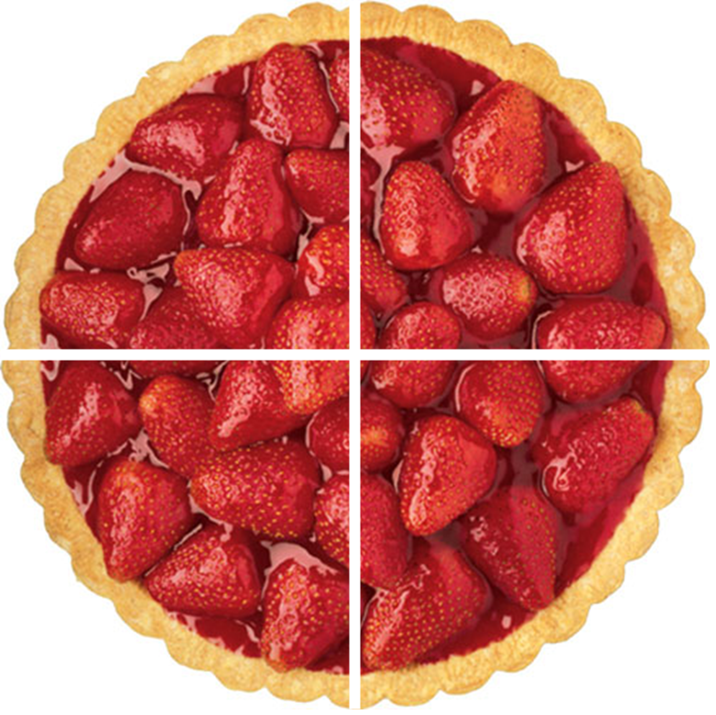
Law and Grace: The SOM – Matthew 5:1–8:1 (Luke 6:17–49)
Hearts, Eyes, & What One Cannot Do
Matthew 6:16-24
Matthew 6:16-24 has four parts to it:
Fasting – vv. 16-18
Earthly vs. Heavenly Treasures – vv. 19-21
Physical vs Spiritual Insight – vv. 22-23
Serving Two Masters – v. 24

Slide 12
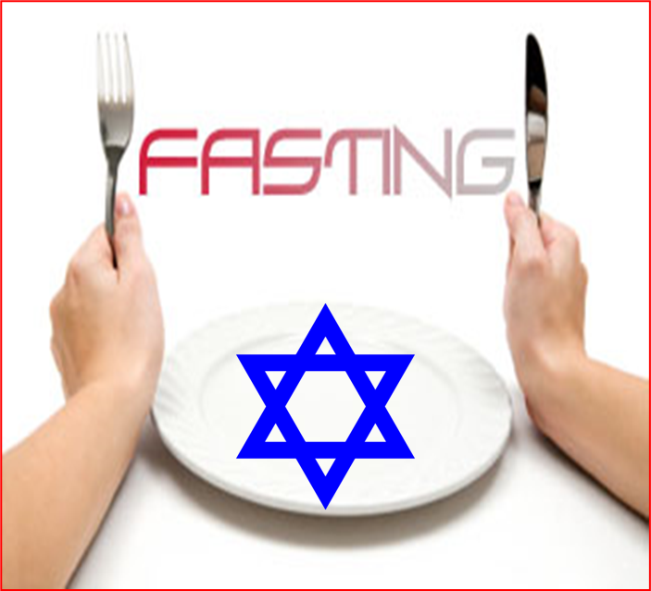
Law and Grace: The SOM – Matthew 5:1–8:1 (Luke 6:17–49)
“Whenever you fast…”
Matthew 6:16-18
The Law of Moses contained 613 laws 365 of them being things not to do, but the practice of fasting was not a part of the Law of Moses.
Jesus says, “Whenever you fast…” because over time, fasts had become custom and a traditional part of a vow.

Slide 13
Law and Grace: The SOM – Matthew 5:1–8:1 (Luke 6:17–49)
“Fasting Under Grace’…”
Matthew 6:16-18
Fasting is not required for Jews or believers, but believers, living and functioning under the ‘reigning principle of grace’ (cf. Romans 5:20-21), may fast – that is, we are free to do so to focus on the Lord.

Slide 14
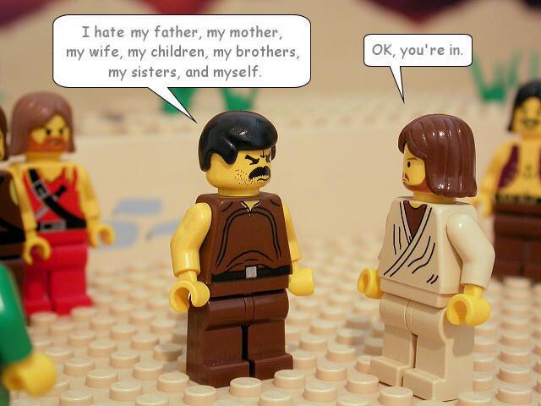
Law and Grace: The SOM – Matthew 5:1–8:1 (Luke 6:17–49)
“Don’t store up – anything?”
Matthew 6:19-21
Jesus was not saying that we shouldn’t save up for a real and valid future needs.
Jesus was using hyperbole (cf. Luke 14:26).
* hyperbole an obvious and intentional exaggeration used for stress or emphasis; not intended to be taken literally…i.e. I’m so hungry, I could eat a horse.

Slide 15
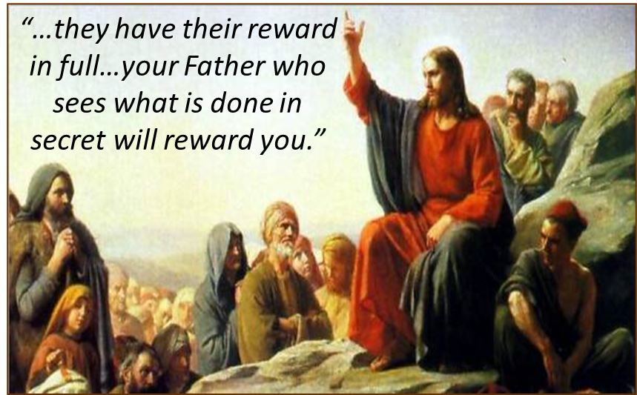
Law and Grace: Review The SOM – Matthew 5:1–8:1 (Luke 6:17–49)
“Store up heavenly treasures”
Matthew 6:19-21
Jesus was telling His audience to place a greater value on spiritual rewards than on physical things.
For Israelites, living in the land of Israel, under the Law of Moses, this would be realized through earthly blessing and protection in the Land, and exaltation as a nation, among the nations, by God.

Slide 16
Law and Grace: The SOM – Matthew 5:1–8:1 (Luke 6:17–49)
“Heavenly Crowns and Rewards”
Matthew 6:19-21
Scripture’s Five Crowns (Rev 4:10: 3:11; 2 John 8)
CROWN | SCRIPTURE | PURPOSE
Victor’s / Incorruptible | 1 Cor. 9:24-27 | Gaining mastery over the flesh
Church Founder’s / Rejoicing | 1 Thess. 2:19-20 | Soul winning
Trial / Life | Jas. 1:12; Rev. 2:10 | Enduring trials
Elder’s / Glory | 1 Pet. 5:2-4 | Shepherding God’s people
Rapture Lover’s / Righteousness | 2 Tim. 4:8 | Longing for His appearing

Slide 17
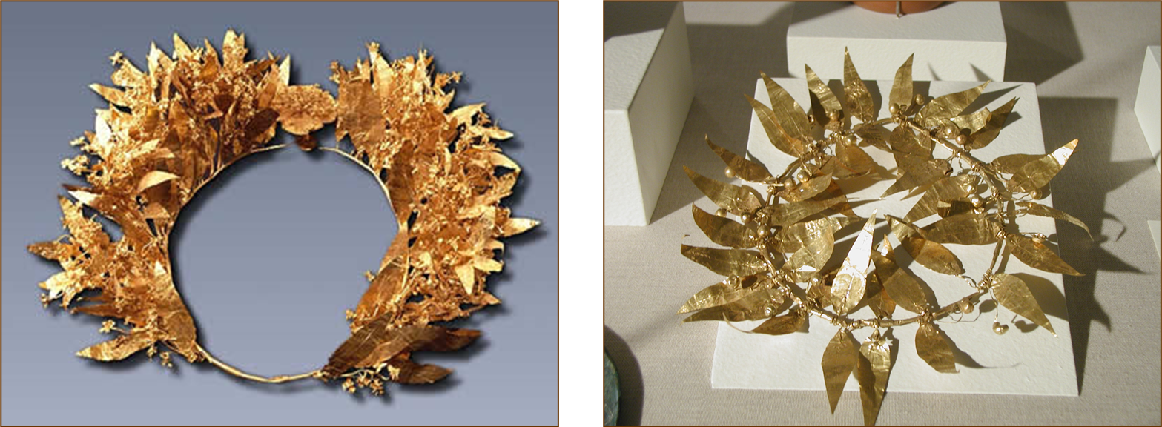
Law and Grace: The SOM – Matthew 5:1–8:1 (Luke 6:17–49)
“Heavenly Crowns and Rewards”
Matthew 6:19-21
Stefanos = victor’s crown in athletic competition

Slide 18
Law and Grace: The SOM – Matthew 5:1–8:1 (Luke 6:17–49)
“Heavenly Crowns and Rewards”
Matthew 6:19-21
Three Rewards
CRITERIA | SCRIPTURE
Building on the Solid Foundation | 1 Corinthians 3:14
Voluntary Service | 1 Corinthians 9:17
Inheritance | Colossians 3:23-24
1

Slide 19
Law and Grace: The SOM – Matthew 5:1–8:1 (Luke 6:17–49)
Hearts, Eyes, & What One Cannot Do
Matthew 6:22-23

Slide 20
Law and Grace: The SOM – Matthew 5:1–8:1 (Luke 6:17–49)

Slide 21
Law and Grace: The SOM – Matthew 5:1–8:1 (Luke 6:17–49)
PHYSICAL REALM
SPIRITUAL REALM
BODY
SPIRIT
FIVE SENSES
MIND
FIVE SENSES
BRAIN
EMOTIONS
SOUL
 HEBREWS 4:12
WILL
A BIBLICAL PHYSICAL / SPIRITUAL ANATOMY

Slide 22
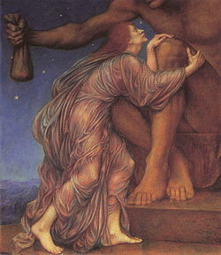
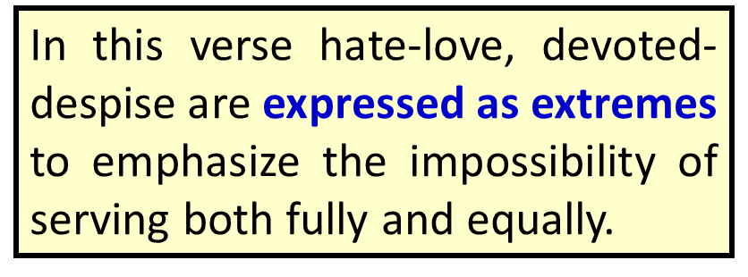
Law and Grace: The SOM – Matthew 5:1–8:1 (Luke 6:17–49)
Matthew 6:24 in poetic pattern
No one can serve two masters;
for either
he will hate the one and
love the other,
or
he will be devoted to one and
despise the other.
You cannot serve God and wealth.
* hyperbole an obvious and intentional exaggeration used for stress or emphasis; not intended to be taken literally…i.e. I’m so hungry, I could eat a horse.

Slide 23
Law and Grace: The SOM – Matthew 5:1–8:1 (Luke 6:17–49)
“What do these have in common? ”
Matthew 6:16-24
So, what do these four parts in vv. 16-24, have in common?

Slide 24
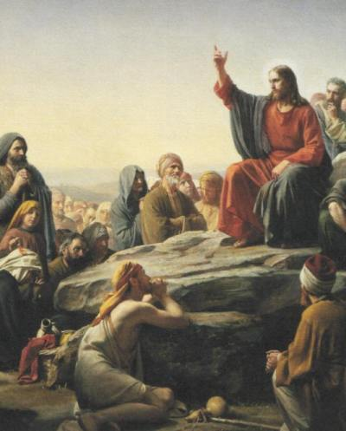
Law and Grace: The SOM – Matthew 5:1–8:1 (Luke 6:17–49)
“What do these have in common? ”
Matthew 6:16-24
Verses 16-18 – optional fasting for the body of Christ, and prayer (which is not optional), are to be focused on the Lord, and from the heart – not toward other people or just to enhance one’s sense of self worth.
Verses 19-24 – is about placing the highest value on spiritual relationships, the first of which is our relationship with the Lord Himself.

Slide 25
Session 34 Outline
Review
Purpose, Aim, and Objective
Session 33
Don’t Worry About It – Matt. 6:25-34
General Information
Matt. 6:25-34
Concluding Observations

Slide 26
Matthew 6:25-34
²⁵ “For this reason I say to you, do not be worried about your life, as to what you will eat or what you will drink; nor for your body, as to what you will put on. Is not life more than food, and the body more than clothing? ²⁶ “Look at the birds of the air, that they do not sow, nor reap nor gather into barns, and yet your heavenly Father feeds them. Are you not worth much more than they? ²⁷ “And who of you by being worried can add a single hour to his life? ²⁸ “And why are you worried about clothing? Observe how the lilies of the field grow; they do not toil nor do they spin, ²⁹ yet I say to you that not even Solomon in all his glory clothed himself like one of these. ³⁰ “But if God so clothes the grass of the field, which is alive . . .

Slide 27
Matthew 6:25-34
. . . today and tomorrow is thrown into the furnace, will He not much more clothe you? You of little faith! ³¹ “Do not worry then, saying, ‘What will we eat?’ or ‘What will we drink?’ or ‘What will we wear for clothing?’ ³² “For the Gentiles eagerly seek all these things; for your heavenly Father knows that you need all these things. ³³ “But seek first His kingdom and His righteousness, and all these things will be added to you. ³⁴ “So do not worry about tomorrow; for tomorrow will care for itself. Each day has enough trouble of its own.

Slide 28
Don’t worry about it! Matthew 6:25-34
Law and Grace: The SOM – Matthew 5:1–8:1 (Luke 6:17–49)
Jesus says, ‘do not worry’ in the beginning v. 25, in the middle v. 31, and at the end of this passage v. 34.

Slide 29
Matthew 6:25-34
²⁵ “For this reason I say to you, do not be worried about your life, as to what you will eat or what you will drink; nor for your body, as to what you will put on. Is not life more than food, and the body more than clothing? ²⁶ “Look at the birds of the air, that they do not sow, nor reap nor gather into barns, and yet your heavenly Father feeds them. Are you not worth much more than they? ²⁷ “And who of you by being worried can add a single hour to his life? ²⁸ “And why are you worried about clothing? Observe how the lilies of the field grow; they do not toil nor do they spin, ²⁹ yet I say to you that not even Solomon in all his glory clothed himself like one of these. ³⁰ “But if God so clothes the grass of the field, which is alive today and tomorrow is thrown into the furnace, will He not much more clothe you? You of little faith! ³¹ “Do not worry then, saying, ‘What will we eat?’ or ‘What will we drink?’ or ‘What will we wear for clothing?’ ³² “For the Gentiles eagerly seek all these things; for your heavenly Father knows that you need all these things. ³³ “But seek first His kingdom and His righteousness, and all these things will be added to you. ³⁴ “So do not worry about tomorrow; for tomorrow will care for itself. Each day has enough trouble of its own.

Slide 30
Don’t worry about it! Matthew 6:25-34
Law and Grace: The SOM – Matthew 5:1–8:1 (Luke 6:17–49)
In between His ‘do not worry’ commands, Jesus sandwiches the phrase, ‘your heavenly Father’, and explains why not to worry’ addressing the central focus of their worry.

Slide 31
Matthew 6:25-34
²⁵ “For this reason I say to you, do not be worried about your life, as to what you will eat or what you will drink; nor for your body, as to what you will put on. Is not life more than food, and the body more than clothing? ²⁶ “Look at the birds of the air, that they do not sow, nor reap nor gather into barns, and yet your heavenly Father feeds them. Are you not worth much more than they? ²⁷ “And who of you by being worried can add a single hour to his life? ²⁸ “And why are you worried about clothing? Observe how the lilies of the field grow; they do not toil nor do they spin, ²⁹ yet I say to you that not even Solomon in all his glory clothed himself like one of these. ³⁰ “But if God so clothes the grass of the field, which is alive today and tomorrow is thrown into the furnace, will He not much more clothe you? You of little faith! ³¹ “Do not worry then, saying, ‘What will we eat?’ or ‘What will we drink?’ or ‘What will we wear for clothing?’ ³² “For the Gentiles eagerly seek all these things; for your heavenly Father knows that you need all these things. ³³ “But seek first His kingdom and His righteousness, and all these things will be added to you. ³⁴ “So do not worry about tomorrow; for tomorrow will care for itself. Each day has enough trouble of its own.

Slide 32
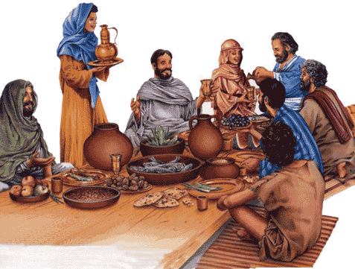
Don’t worry about it! Matthew 6:25-34
Law and Grace: The SOM – Matthew 5:1–8:1 (Luke 6:17–49)
One of the primary observations to be made in what Jesus says is that He centers His words on worry about physical needs – basic provisions of food and clothing…and there is a reason.

Slide 33
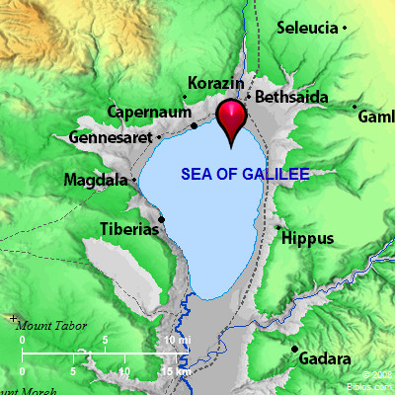
Jesus spoke to the Israelites… Matthew 6:25-34
Law and Grace: The SOM – Matthew 5:1–8:1 (Luke 6:17–49)
Jesus was speaking to Israelites, living in the land of Israel…

Slide 34
Jesus spoke to the Israelites… Matthew 6:25-34
Law and Grace: The SOM – Matthew 5:1–8:1 (Luke 6:17–49)
Jesus was speaking with a view to His reigning as their King in the coming kingdom.

Slide 35
Jesus spoke to the Israelites… Matthew 6:25-34
Law and Grace: The SOM – Matthew 5:1–8:1 (Luke 6:17–49)
Jesus was speaking to Israelites, under the Law, who were fixated on and inclined to worry about the physical and earthly blessings contained in the Mosaic Covenant.
If an Israelite was obedient to the entire Law of Moses (613 laws), he would be blessed in earthly ways, and there would be no reason to worry. (cf. Deuteronomy 28:1-14)

Slide 36
Deuteronomy 28:1-6
¹ “Now it shall be, if you diligently obey the Lord your God, being careful to do all His commandments which I command you today, the Lord your God will set you high above all the nations of the earth. ² “All these blessings will come upon you and overtake you if you obey the Lord your God: ³ “Blessed shall you be in the city, and blessed shall you be in the country. ⁴ “Blessed shall be the offspring of your body and the produce of your ground and the offspring of your beasts, the increase of your herd and the young of your flock. ⁵ “Blessed shall be your basket and your kneading bowl. ⁶ “Blessed shall you be when you come in, and blessed shall you be when you go out. (Blessings continue through verse 14)

Slide 37
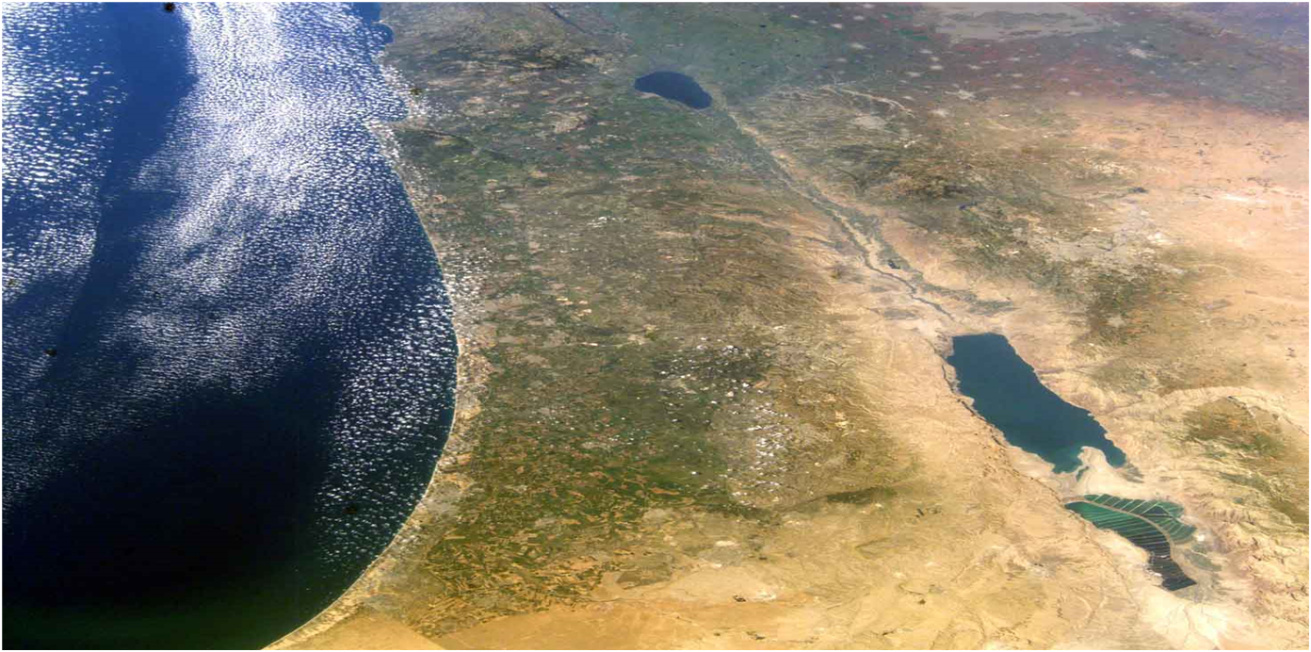
Deuteronomy 28:8, 11
⁸ The Lord will command the blessing upon you in your barns and in all that you put your hand to, and He will bless you in the land which the Lord your God gives you…¹¹ The Lord will make you abound in prosperity, in the offspring of your body and in the offspring of your beast and in the produce of your ground, in the land which the Lord swore to your fathers to give you.
Blessing under the Law of
Moses is in the land.

Slide 38
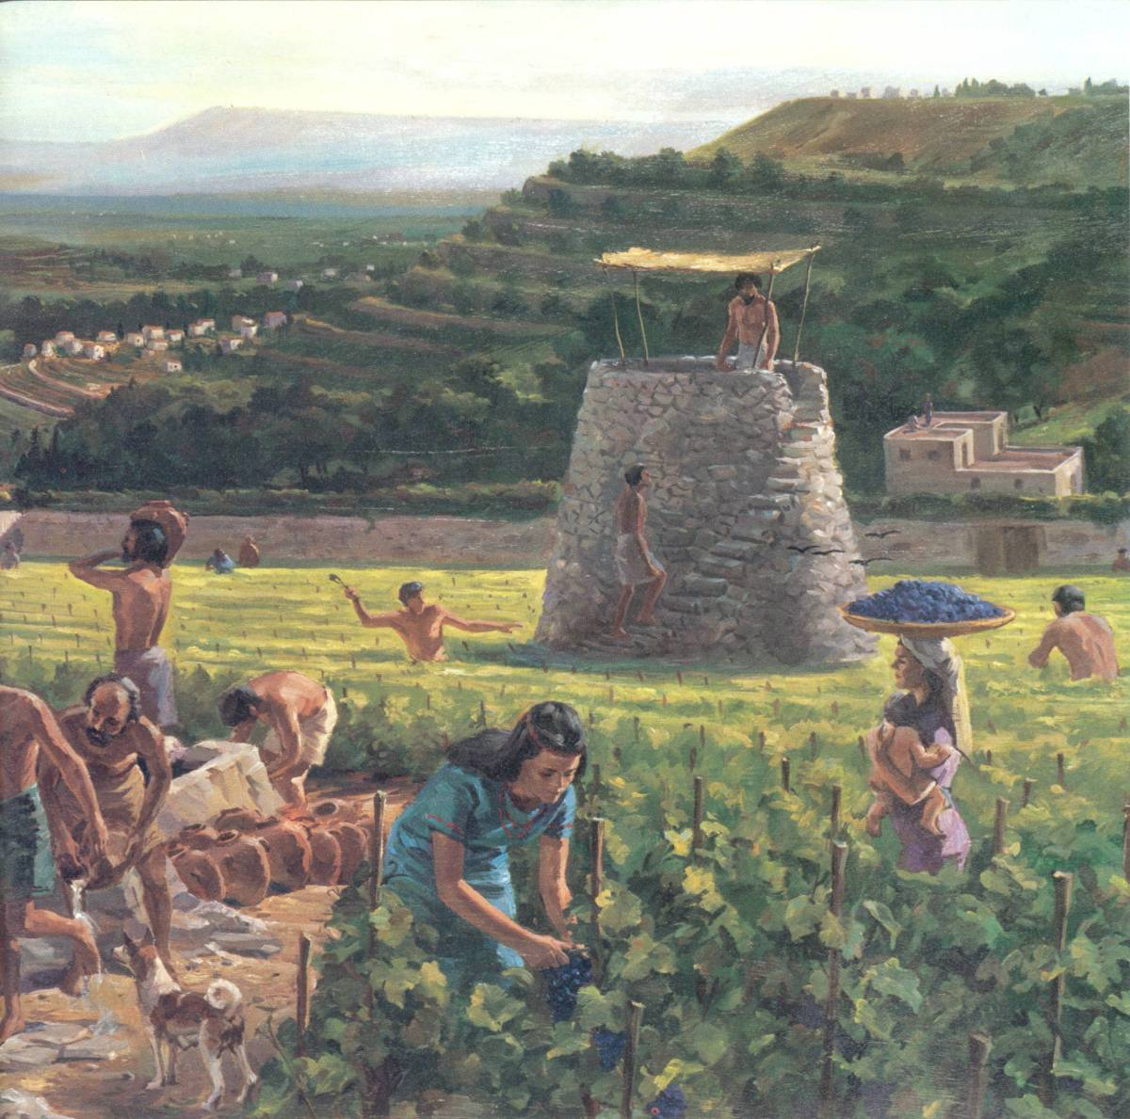
Deuteronomy 28 isn’t the only passage!
Law and Grace: The SOM – Matthew 5:1–8:1 (Luke 6:17–49)
There are other passages that give blessings and curses:
Deuteronomy 7:12-16; 14:28-15:6, 18; 16:15; 23:19-20; 24:19; 26:15, et al, are all blessings.
There is even a curse in Deuteronomy 29, for the individual rebellious Israelite.

Slide 39
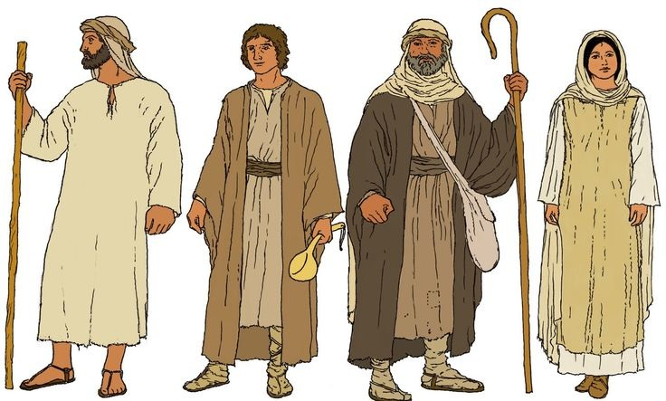
Deuteronomy 29:18, 21
¹⁸ so that there will not be among you a man or woman, or family or tribe, whose heart turns away today from the LORD our God,…²¹ Then the Lord will single him out for adversity from all the tribes of Israel, according to all the curses of the covenant which are written in this book of the law.

Slide 40
Session 34 Outline
Review
Purpose, Aim, and Objective
Session 33
Don’t Worry About It – Matt. 6:25-34
General Information
Matt. 6:25-34
Concluding Observations

Slide 41
Matthew 6:25-34
²⁵ “For this reason I say to you, do not be worried about your life, as to what you will eat or what you will drink; nor for your body, as to what you will put on. Is not life more than food, and the body more than clothing? ²⁶ “Look at the birds of the air, that they do not sow, nor reap nor gather into barns, and yet your heavenly Father feeds them. Are you not worth much more than they? ²⁷ “And who of you by being worried can add a single hour to his life? ²⁸ “And why are you worried about clothing? Observe how the lilies of the field grow; they do not toil nor do they spin, ²⁹ yet I say to you that not even Solomon in all his glory clothed himself like one of these. ³⁰ “But if God so clothes the grass of the field, which is alive . . .

Slide 42
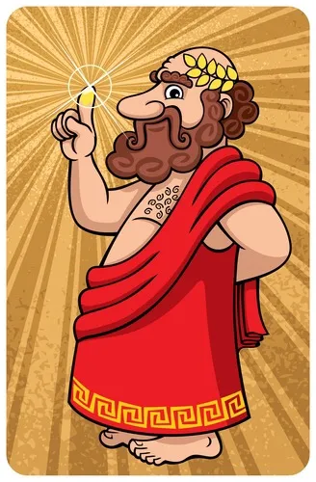
“For this reason” True vs. Pharisaical Righteousness Matthew 6:25-34
Law and Grace: The SOM – Matthew 5:1–8:1 (Luke 6:17–49)
From our last session we learned in vv.19-24, that a person’s mindset regarding wealth frequently dictates one’s perception of righteousness which:
often leads to spiritual blindness and,
often places that person in the position of being a slave to the wrong master.
“If a person seeks biblical righteousness and commits to follow the Lord, how will he then provide for daily needs like food, clothing, and shelter?

Slide 43
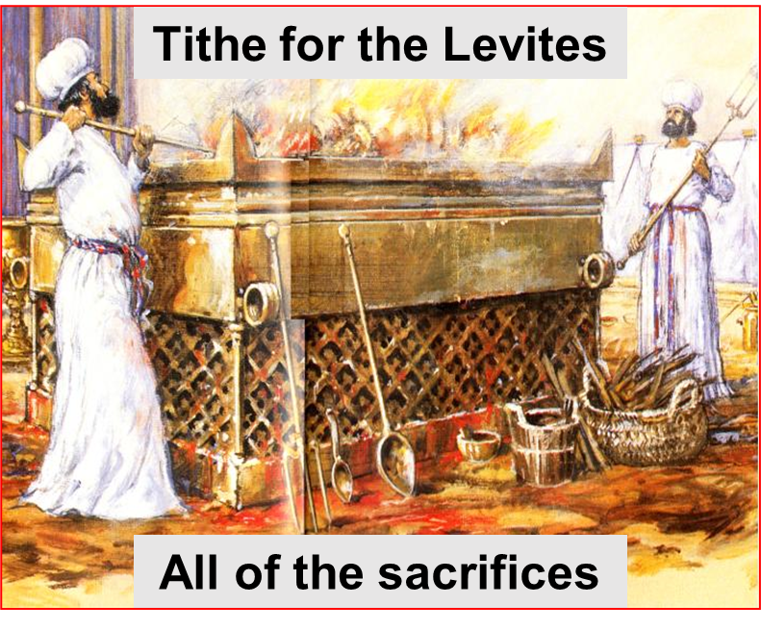
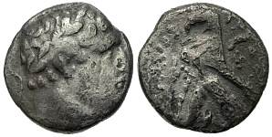
One more reason for the Israelites to worry Matthew 6:25-34
Law and Grace: The SOM – Matthew 5:1–8:1 (Luke 6:17–49)
Many of the Israelites were likely to to worry concerning their physical provisions because they had to pay for temple and synagogues services as well as taxes.

Slide 44
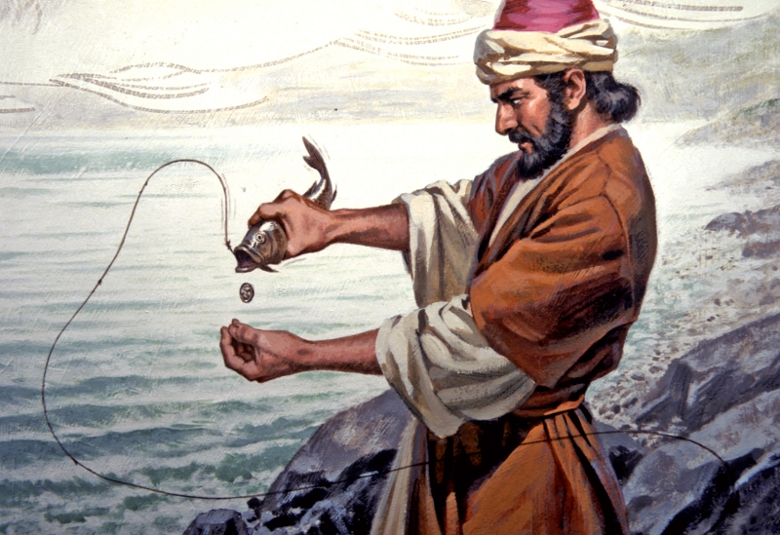
One more reason for the Israelites to worry Matthew 6:25-34
Law and Grace: The SOM – Matthew 5:1–8:1 (Luke 6:17–49)
You may recall the account of the temple tax issue in Matthew 17:24-27 where Jesus sent Peter off to catch the ‘money fish’.
This was to pay for the 1/2 shekel Jewish tax that every male Jew between the ages of 20 and 50 had to pay toward the maintenance of the temple and its services (Exod. 30:13; Neh. 10:32).

Slide 45
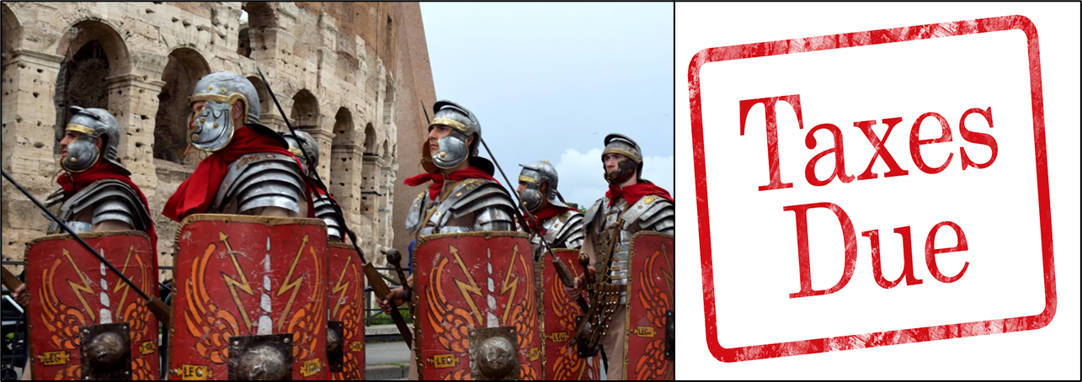
One more reason for the Israelites to worry Matthew 6:25-34
Law and Grace: The SOM – Matthew 5:1–8:1 (Luke 6:17–49)
There were taxes to the Romans so, the Jews actually paid for their own oppression.

Slide 46
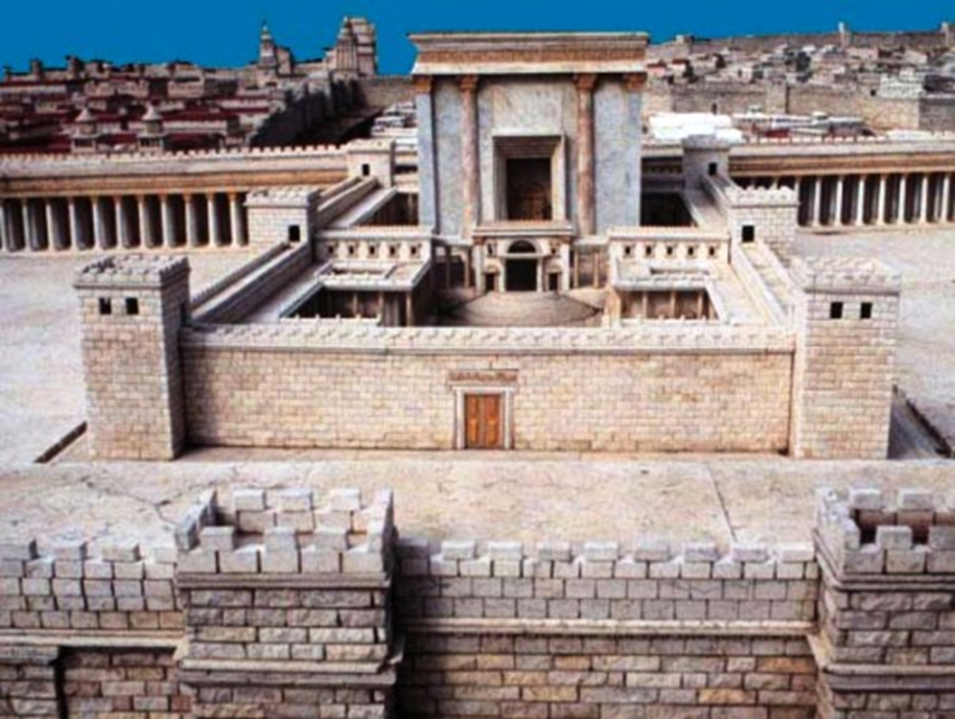
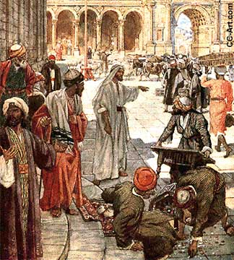
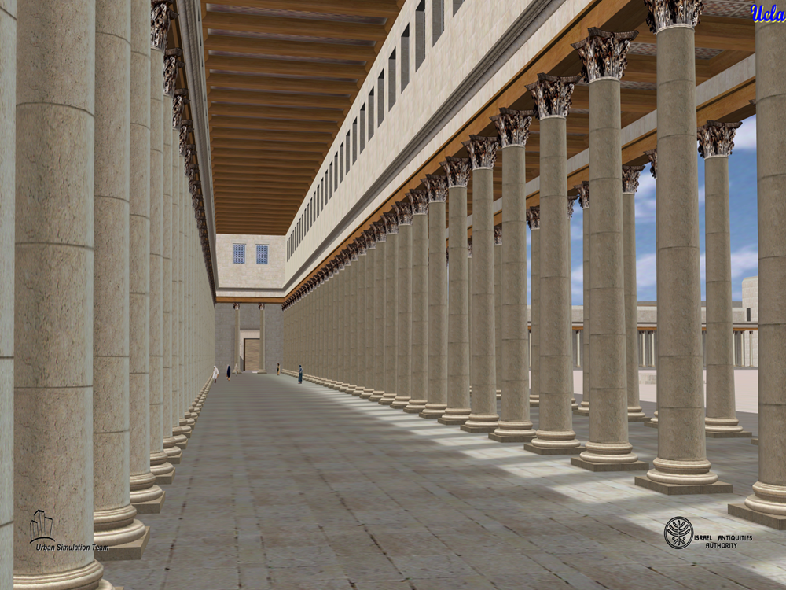
One more reason for the Israelites to worry Matthew 6:25-34
Law and Grace: The SOM – Matthew 5:1–8:1 (Luke 6:17–49)
There were taxes paid to Herod the Great, who built things and ‘volunteered’ the Jews to pay for their projects.

Slide 47
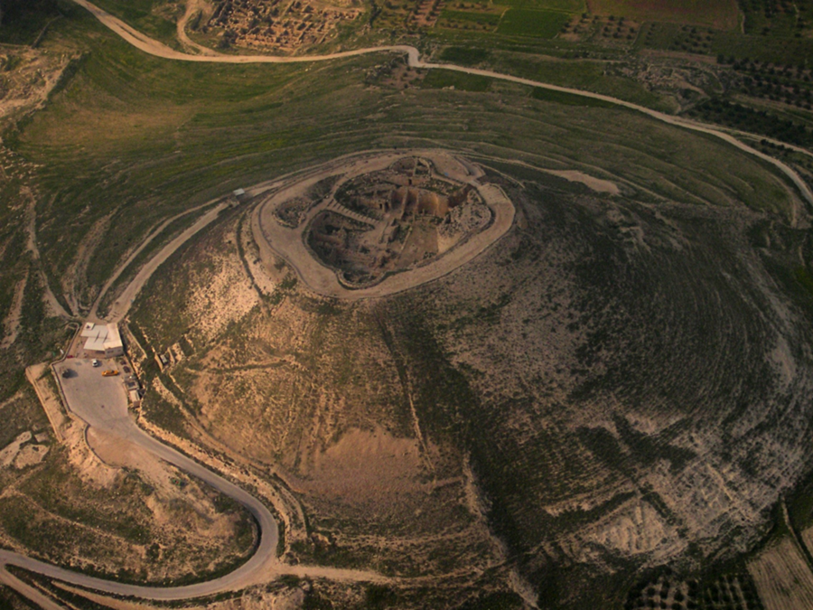
One more reason for the Israelites to worry Matthew 6:25-34
Law and Grace: The SOM – Matthew 5:1–8:1 (Luke 6:17–49)
Herod’s Herodium fortress, located only 3 miles southeast of Bethlehem is a recent discovery. He (the Jews) artificially extended the height of the hill to make it the tallest mountain in the Judean desert. His tomb was also recently discovered on the side of this mountain.

Slide 48
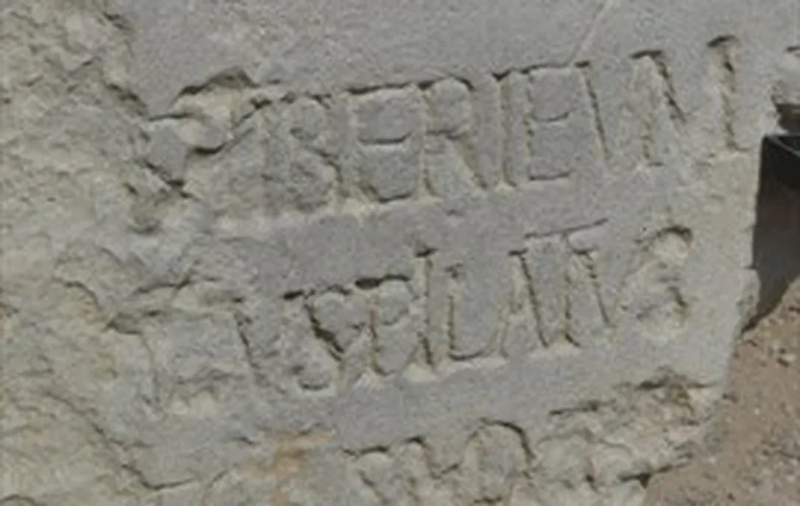
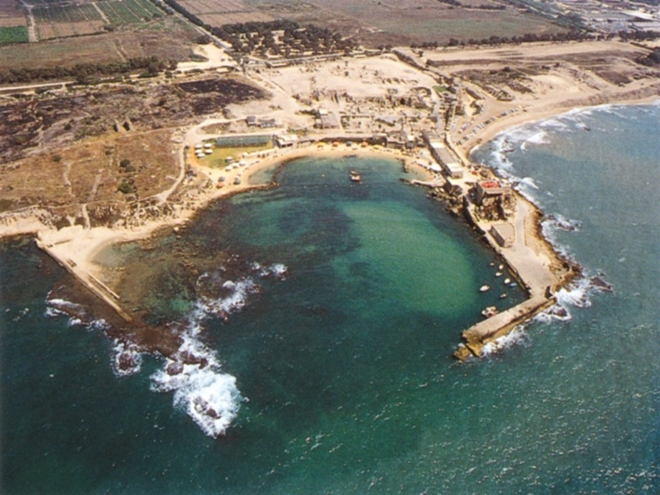
One more reason for the Israelites to worry Matthew 6:25-34
Law and Grace: The SOM – Matthew 5:1–8:1 (Luke 6:17–49)
Herod the Great started construction of his capital city, Caesarea, located on the coast of the sea of Galilee, in 22 B.C. He also constructed 4,000 seat amphitheater.

Slide 49
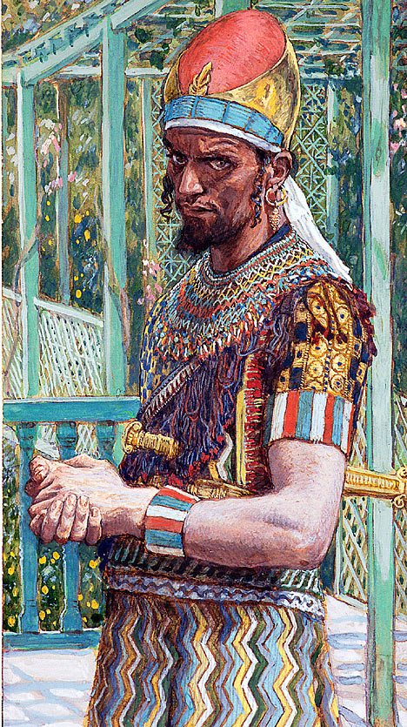
Law and Grace: The SOM – Matthew 5:1–8:1 (Luke 6:17–49)
Herod the Great was not that great! Matthew 6:25-34
In our last session I also mentioned that Herod the Great had the Jews pay for the Olympics.
“Unlike their modern counterparts, the ancient Olympic Games were not a secular competition. The games were a quadrennial affair held in honor of the supreme god of the Greek pantheon, Zeus. At a sacred site marked by temples to Zeus and his consort Hera, athletes would compete for five days amid a ritual sacrifice of 100 bulls to the father god.”
https://www.timesofisrael.com/how-herod-the-tyrant-saved-the-olympics/

Slide 50
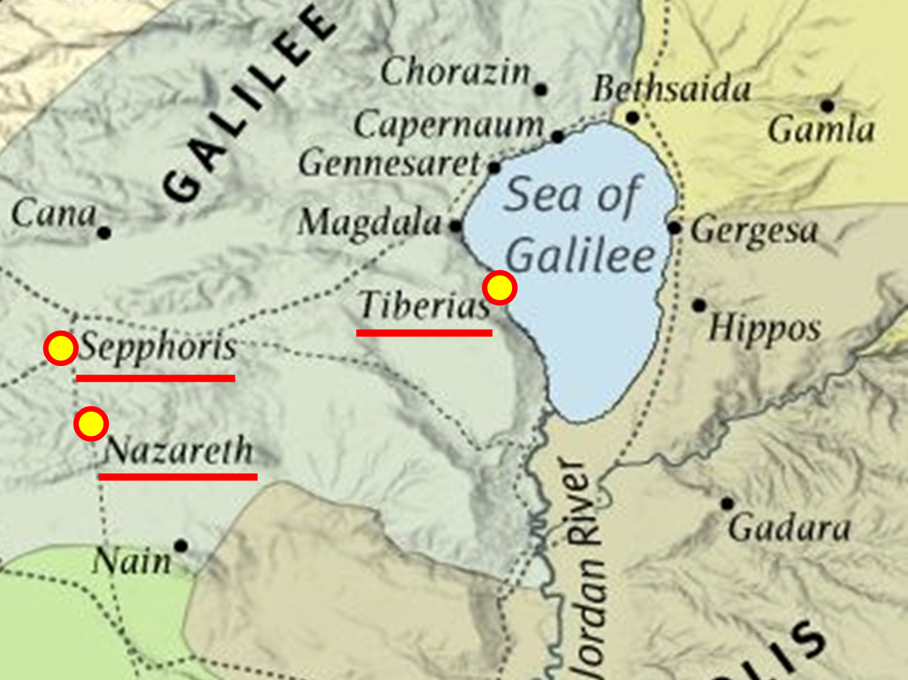
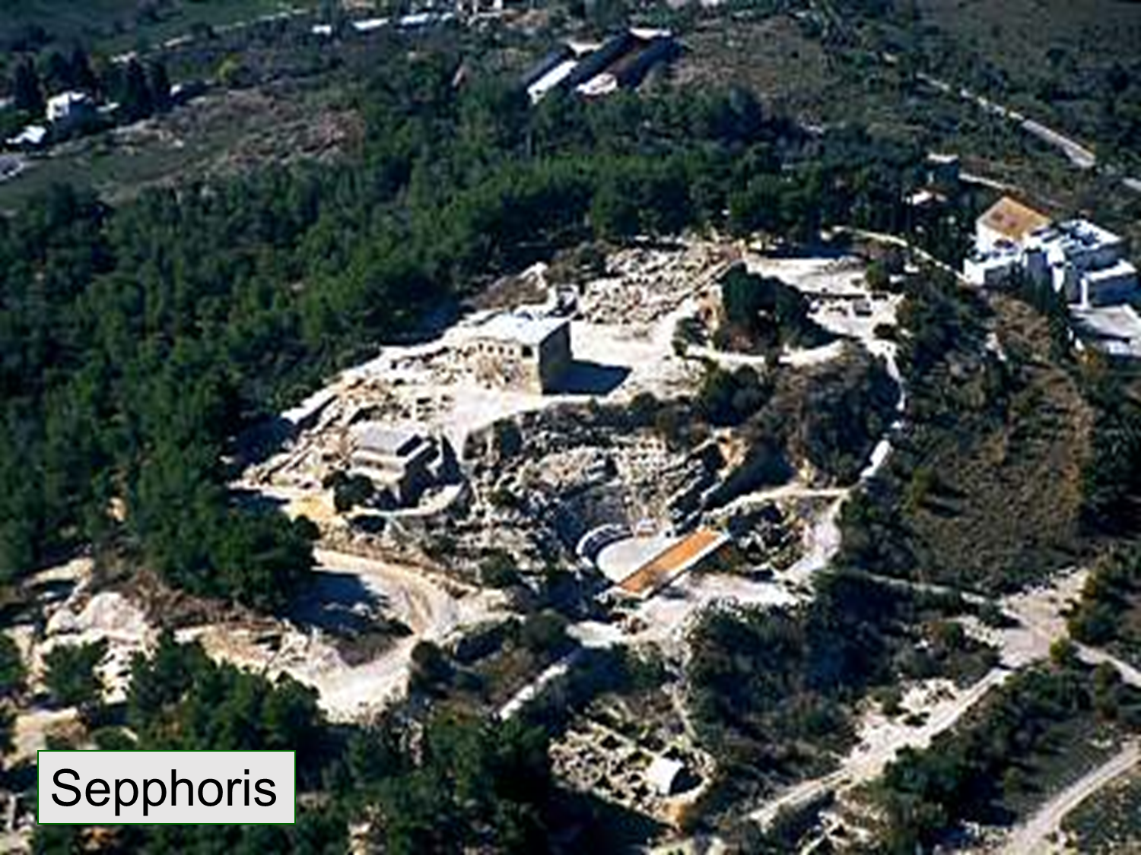
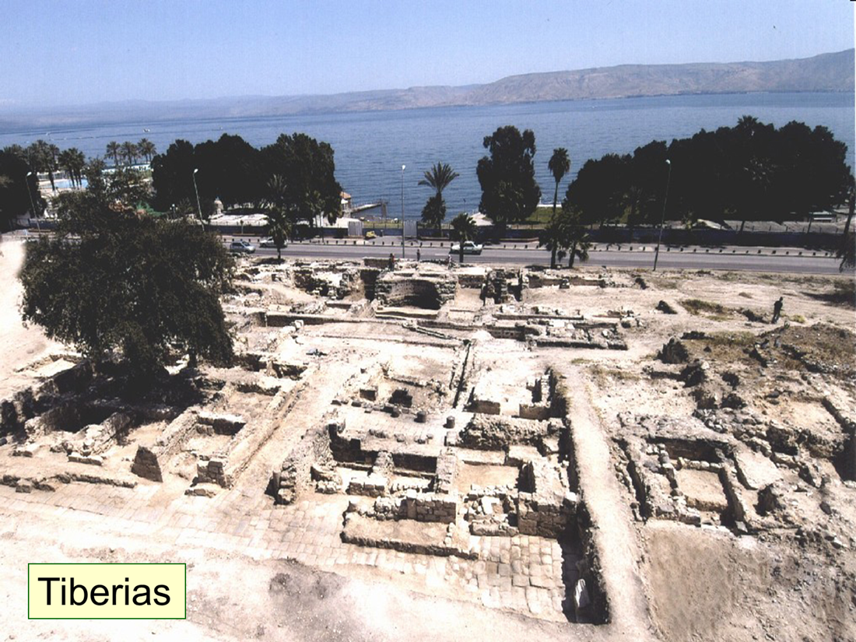
Law and Grace: The SOM – Matthew 5:1–8:1 (Luke 6:17–49)
One more reason for the Israelites to worry Matthew 6:25-34
On the map you can see the Nazareth, where Jesus was raised. Just north of that was the city of Sephoris and nearby the city Tiberias.

Slide 51
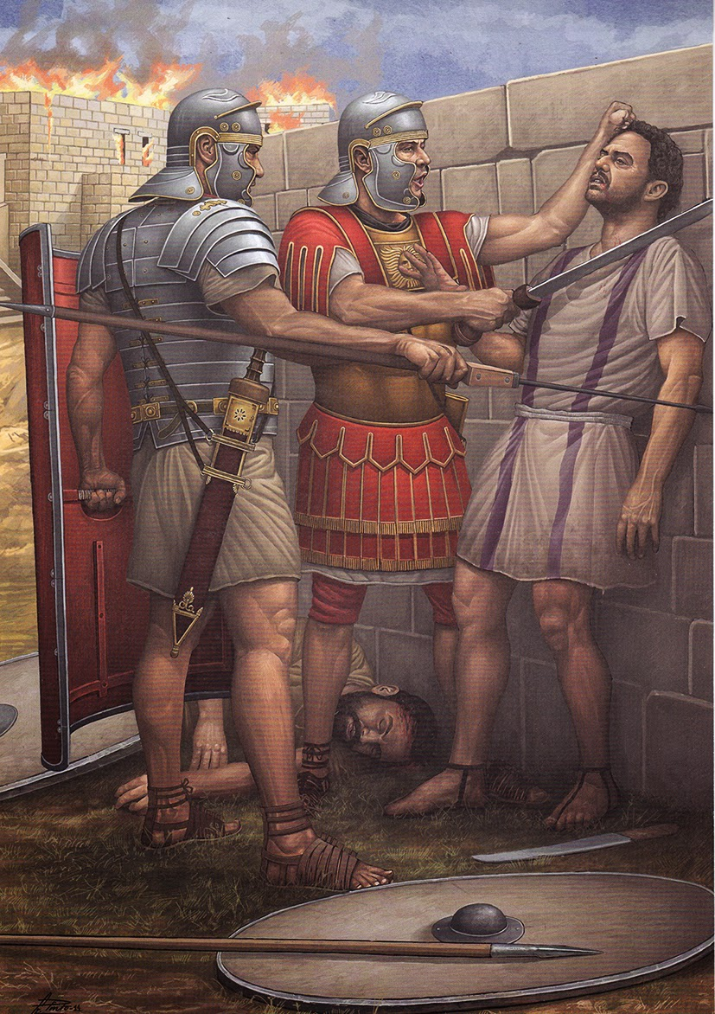
Law and Grace: The SOM – Matthew 5:1–8:1 (Luke 6:17–49)
One more reason for the Israelites to worry Matthew 6:25-34
And if someone decided to forego the paying of their taxes, Rome was ready, willing, and able to motivate your consistent follow through.

Slide 52
Matthew 6:25-34
²⁵ “For this reason I say to you, do not be worried about your life, as to what you will eat or what you will drink; nor for your body, as to what you will put on. Is not life more than food, and the body more than clothing? ²⁶ “Look at the birds of the air, that they do not sow, nor reap nor gather into barns, and yet your heavenly Father feeds them. Are you not worth much more than they? ²⁷ “And who of you by being worried can add a single hour to his life? ²⁸ “And why are you worried about clothing? Observe how the lilies of the field grow; they do not toil nor do they spin, ²⁹ yet I say to you that not even Solomon in all his glory clothed himself like one of these. ³⁰ “But if God so clothes the grass of the. . .

Slide 53
Matthew 6:25-34
. . . field, which is alive today and tomorrow is thrown into the furnace, will He not much more clothe you? You of little faith! ³¹ “Do not worry then, saying, ‘What will we eat?’ or ‘What will we drink?’ or ‘What will we wear for clothing?’ ³² “For the Gentiles eagerly seek all these things; for your heavenly Father knows that you need all these things. ³³ “But seek first His kingdom and His righteousness, and all these things will be added to you. ³⁴ “So do not worry about tomorrow; for tomorrow will care for itself. Each day has enough trouble of its own.

Slide 54
Law and Grace: The SOM – Matthew 5:1–8:1 (Luke 6:17–49)
Law and Grace: The SOM – Matthew 5:1–8:1 (Luke 6:17–49)
God’s provision & human pursuit Matthew 6:26-33
Jesus compares the care of God for the birds and the flowers to the care of God for the Israelites.

Slide 55
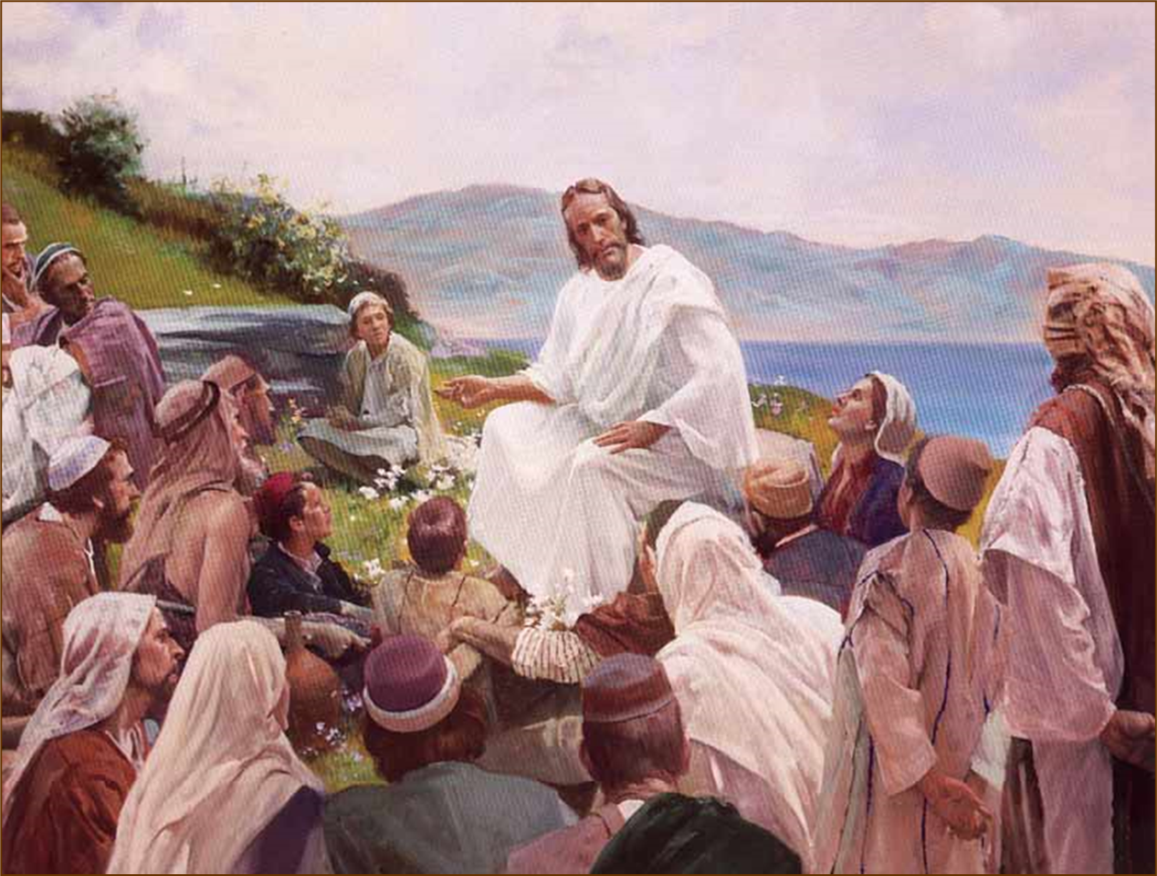
Law and Grace: The SOM – Matthew 5:1–8:1 (Luke 6:17–49)
God’s provision & human pursuit Matthew 6:26-33
Jesus contrasts the Gentiles’ pursuit of earthly needs with what the Israelites ought to pursue and He tells them:
that God knows their needs and will provide and
the greater need is to seek God’s Kingdom and [true] righteousness.

Slide 56
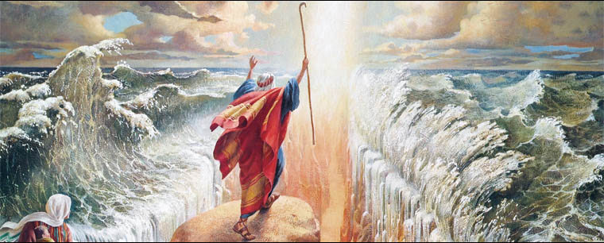
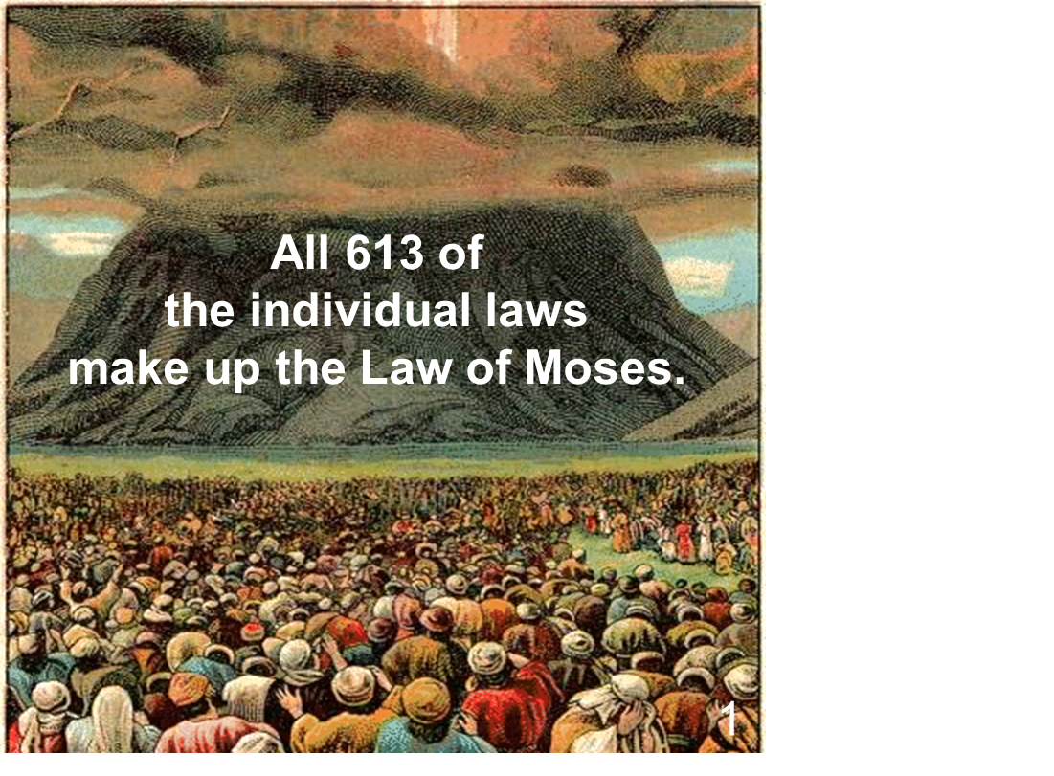
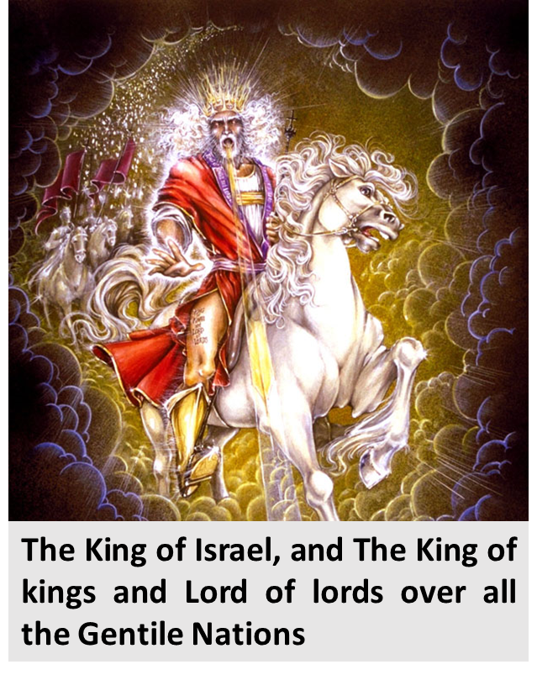
Law and Grace: The SOM – Matthew 5:1–8:1 (Luke 6:17–49)
His kingdom & His righteousness Matthew 6:33
The Israelites who were baptized into Moses, and were all under the Law of Moses, and whose hope was in the coming kingdom reign of Messiah their King, were to seek that kingdom.

Slide 57
Law and Grace: The SOM – Matthew 5:1–8:1 (Luke 6:17–49)
His kingdom & His righteousness Matthew 6:33
The Israelites were also to seek the kind of righteousness that is defined by the Law of Moses – true righteousness.
Interestingly, Jesus has used the word ‘righteousness’, as defined by the Law, five times in the Sermon on the Mount…this is the last time.

Slide 58
Law and Grace: The SOM – Matthew 5:1–8:1 (Luke 6:17–49)
Material things ≠ life’s fulfillment Matthew 6:25-34
In v. 32, Jesus says “…the Gentiles eagerly seek all these things” i.e., the Gentiles directly pursue physical provisions to the point of worshipping Mammon, the god of wealth (cf. Matt. 6:24 ).

Slide 59
Law and Grace: The SOM – Matthew 5:1–8:1 (Luke 6:17–49)
Material things ≠ life’s fulfillment Matthew 6:25-34
Of course, the Jews all needed physical provisions just like we do, but the real issue is not about physical needs, but what is the goal of this life – what are we aiming towards while we are here?

Slide 60
Session 34 Outline
Review
Purpose, Aim, and Objective
Session 33
Don’t Worry About It – Matt. 6:25-34
General Information
Matt. 6:25-34
Concluding Observations

Slide 61
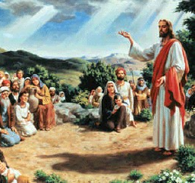
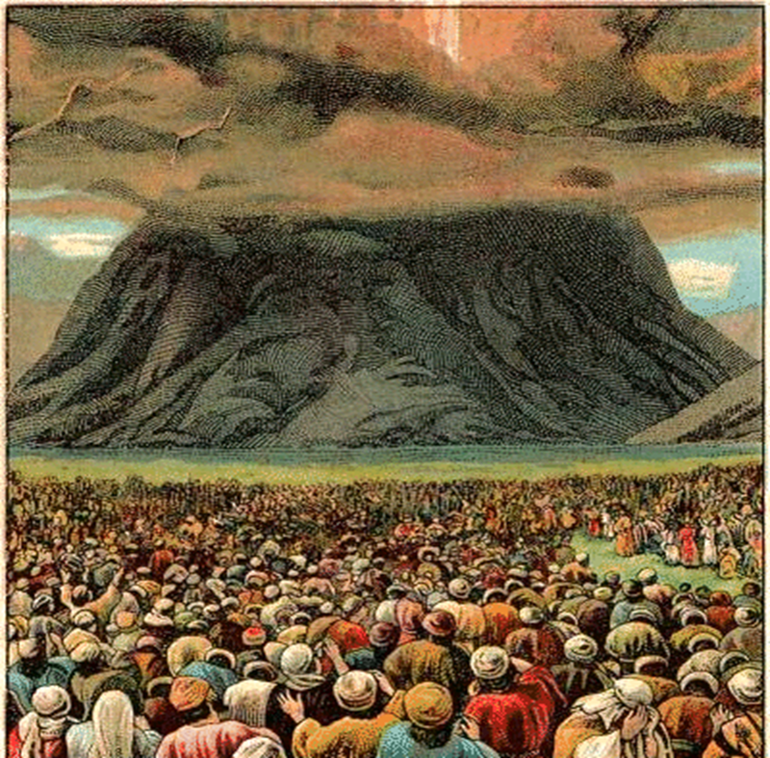
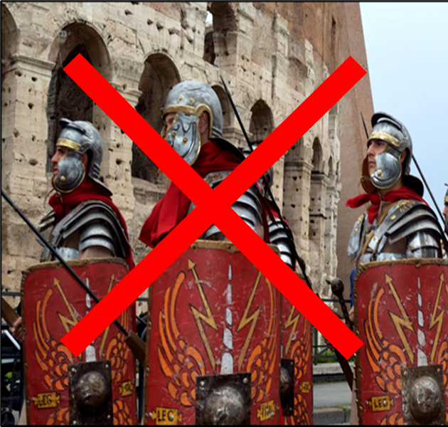
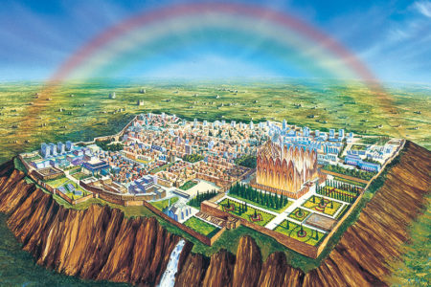
Law and Grace: The SOM – Matthew 5:1–8:1 (Luke 6:17–49)
An Important Contrast!
Jesus spoke to Israelites, who were:
baptized differently (into Moses),
blessed differently (if they obeyed the Law),
hoped differently (were looking for a physical kingdom), and,
viewed Christ differently (as a conquering King),
and worry was not God’s will for them.

Slide 62
Law and Grace: The SOM – Matthew 5:1–8:1 (Luke 6:17–49)
An Important Comparison!
Though we are not Israelites, we likewise are not to worry, even though our perspective on why we are not to worry is different.
God is the same God, and our need is the same as Israel’s.

Slide 63
Philippians 4:6-7
⁶ Be anxious for nothing, but in everything by prayer and supplication with thanksgiving let your requests be made known to God. ⁷ And the peace of God, which surpasses all comprehension, will guard your hearts and your minds in Christ Jesus.

Slide 64
Philippians 4:6-7
⁶ Be anxious for nothing, but in everything by prayer and supplication with thanksgiving let your requests be made known to God. ⁷ And the peace of God, which surpasses all comprehension, will guard your hearts and your minds in Christ Jesus.

Slide 65
Law and Grace: The SOM – Matthew 5:1–8:1 (Luke 6:17–49)
The ‘advantages’ of worrying

Slide 66
Law and Grace: The SOM – Matthew 5:1–8:1 (Luke 6:17–49)
The ‘advantages’ of worrying
So just what are the advantages of worrying about things in our life?
Why is it that worrying seems to have such a universal appeal?

Slide 67
Law and Grace: The SOM – Matthew 5:1–8:1 (Luke 6:17–49)
The ‘advantages’ of worrying
Jesus, and Paul are telling us that the advantages of worrying are an illusion – there are none.
Worry is an activity of the sin nature.
Worry is a primary way of worshipping the idol of ‘stuff’; it is ‘another master’.

Slide 68
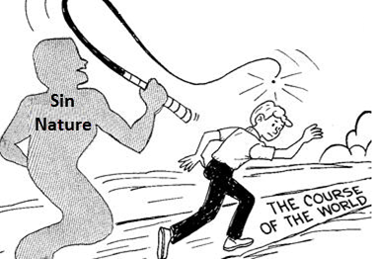
Law and Grace: The SOM – Matthew 5:1–8:1 (Luke 6:17–49)
What are our responsibilities?
Each of us is to understand clearly just what we are responsible for.
Failing to take on responsibilities that are ours to take on or taking on any responsibility that is not ours – both are sin and originate with the sin nature.

Slide 69
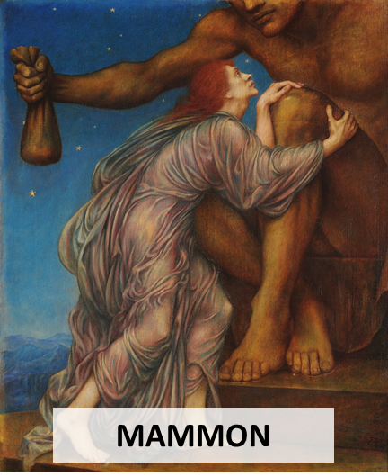
Law and Grace: The SOM – Matthew 5:1–8:1 (Luke 6:17–49)
What are our responsibilities?
For a believer to worry is to attempt to serve two masters and to have two gods.

Slide 70
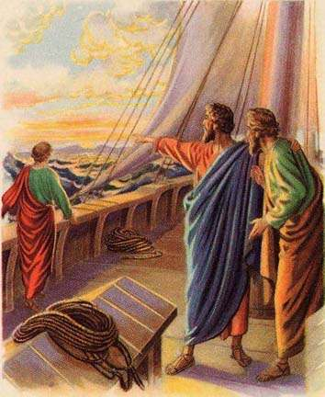
Law and Grace: The SOM – Matthew 5:1–8:1 (Luke 6:17–49)
Should we make any plans?
Yes, we can find examples in the New Testament of both Christ and Paul making plans and considering what will happen next.
We too are to make plans and attempt to anticipate what will or could happen next.
But our greatest need is to trust God.

Slide 71
James 4:13-15
¹³ Come now, you who say, “Today or tomorrow we will go to such and such a city, and spend a year there and engage in business and make a profit.” ¹⁴ Yet you do not know what your life will be like tomorrow. You are just a vapor that appears for a little while and then vanishes away. ¹⁵ Instead, you ought to say, "If the Lord wills, we will live and also do this or that."

Slide 72
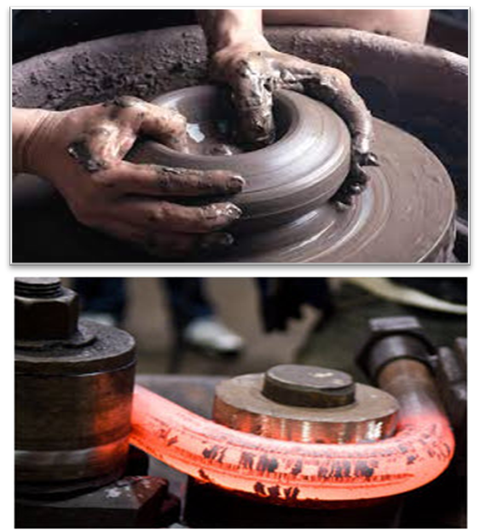
Law and Grace: The SOM – Matthew 5:1–8:1 (Luke 6:17–49)
Should we make any plans?
Making appropriate plans for what we can and ought to do, and for what could happen, are fine.
But all those plans ought to be made with an understanding of what God has in mind.…

Slide 73
Philippians 4:11-13
¹¹ Not that I speak from want, for I have learned to be content in whatever circumstances I am. ¹² I know how to get along with humble means, and I also know how to live in prosperity; in any and every circumstance I have learned the secret of being filled and going hungry, both of having abundance and suffering need. ¹³ I can do all things through Him who strengthens me.

Slide 74
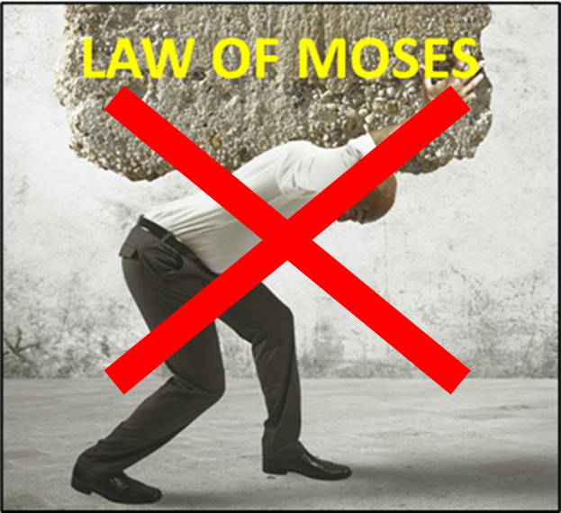
Law and Grace: The SOM – Matthew 5:1–8:1 (Luke 6:17–49)
Should we make any plans?
Paul does not write as if we live under the same ‘earthly blessing if you obey the Law’ principle as the Israelites. Why?
God is doing something different with the Body of Christ!

Slide 75
Romans 8:28-29ab
²⁸ And we know that God causes all things to work together for good to those who love God, to those who are called according to His purpose. ²⁹ For those whom He foreknew, He also predestined to become conformed to the image of His Son…

Slide 76
Law and Grace: An Overview Jim McGowan, Th.D. Sugar Land Bible Church 10-16-2022
…but grace and truth were realized through Jesus Christ - John 1:17
For the Law was given through Moses…
Special thanks to Dr. Vern Peterman for access to his insights and resources.

