Slide 1
Biblical Dispensationalism
Jim McGowan, MTS, Th.D.

Slide 2
What We’ve Covered…
Session | Topic | Date
001 | Introduction to Biblical Dispensationalism | 10‐03‐2018
002 | Introduction to Biblical Dispensationalism | 11‐07‐2018
003 | Introduction to Biblical Dispensationalism | 11‐14‐2018
004 | History of Biblical Dispensationalism | 02‐06‐2019
005 | History of Biblical Dispensationalism | 02‐13‐2019
006 | History of Biblical Dispensationalism | 03‐20‐2019
007 | History of Biblical Dispensationalism | 04‐03‐2019
008 | False Charges Against Biblical Dispensationalism | 10‐02‐2019
009 | False Charges Against Biblical Dispensationalism | 02‐26‐2020
010 | False Charges Against Biblical Dispensationalism | 09‐30‐2020
011 | Israel & The Church | 10‐14‐2020
012 | Fundamental Aspects & The Biblical Covenants | 12‐09‐2020
013 | Biblical Dispensations ‐ Innocence thru Conscience | 10‐06‐2021
014 | Biblical Dispensations ‐ Human Government - Promise - Law | 09-21-2022
015 | Biblical Dispensations ‐ Church Age - Grace | 09-28-2022

Slide 3
The Story of the Bible:
From a Garden to a City, and Beyond!

Slide 4
Biblical Dispensationalism
Session 15 - The Dispensations
Review – Church Age / Grace

Slide 5
The Dispensations
Innocence / Innocency
Conscience
Human / Civil Government
Promise / Patriarchal Rule
Law-Israel / Mosaic Law
Church Age / Grace
***The Tribulation***
Millennial Kingdom / Millennium
***Eternal State***

Slide 6
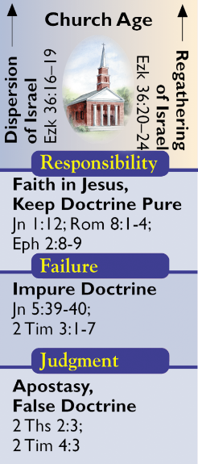
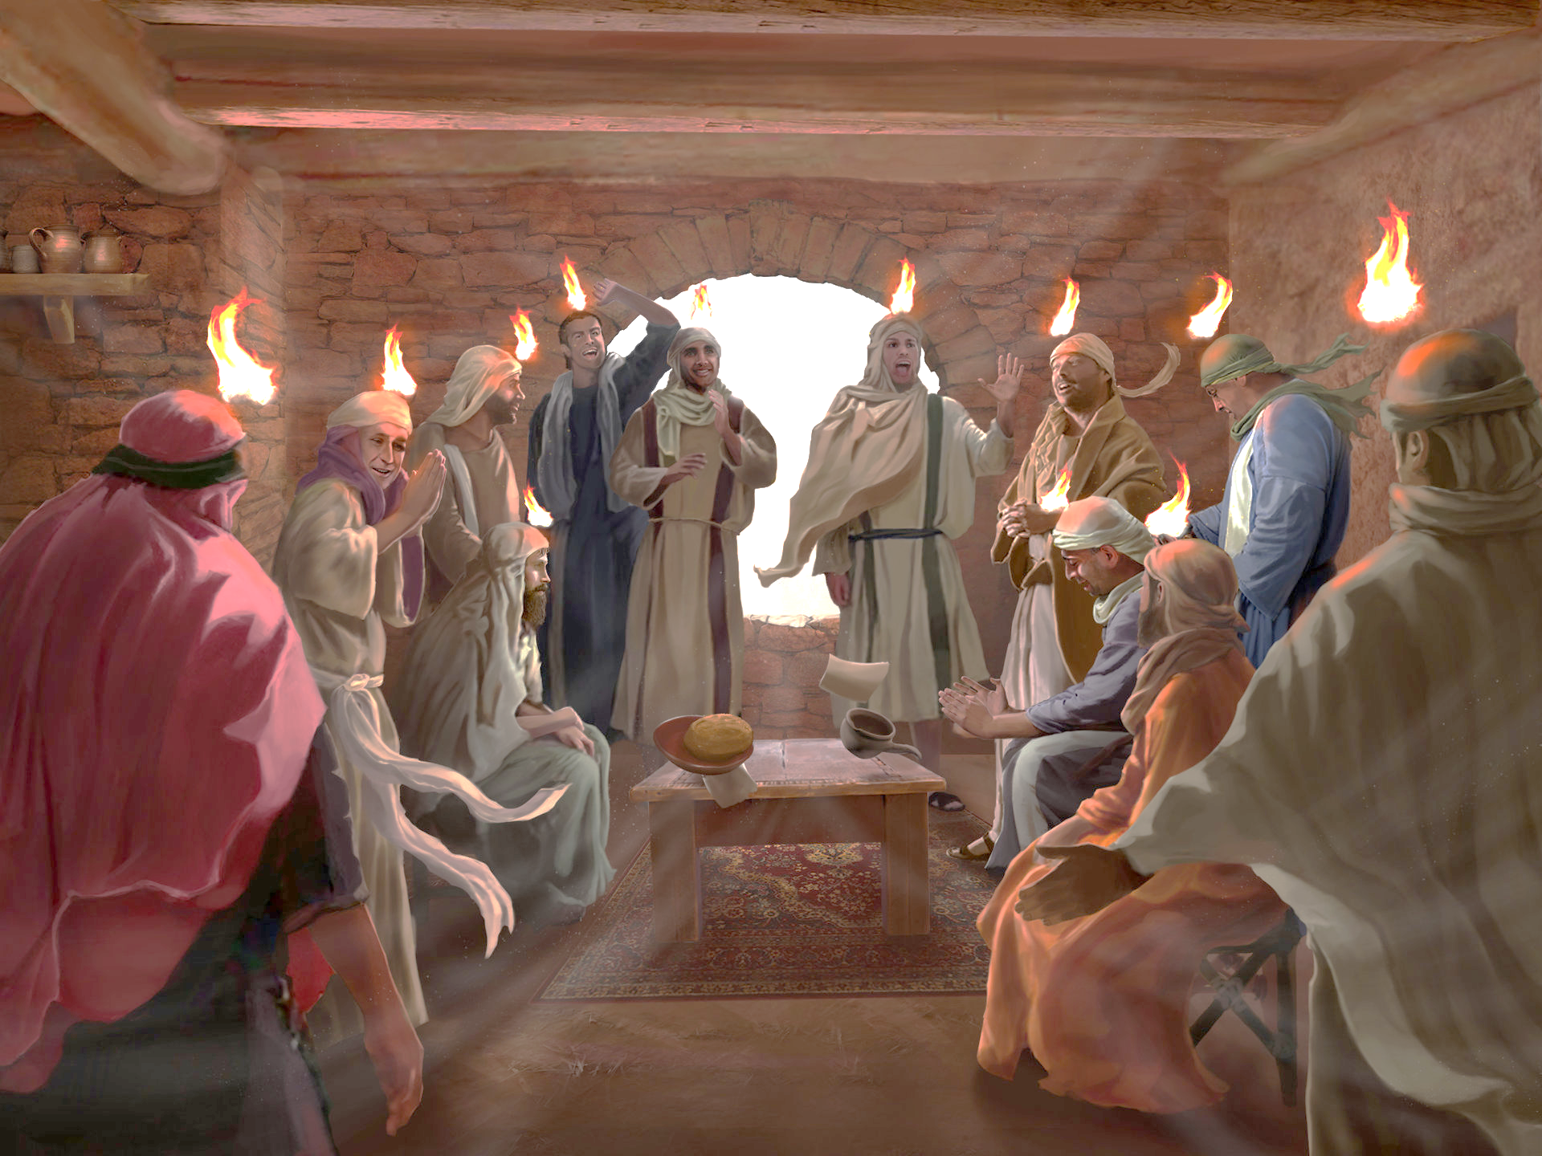
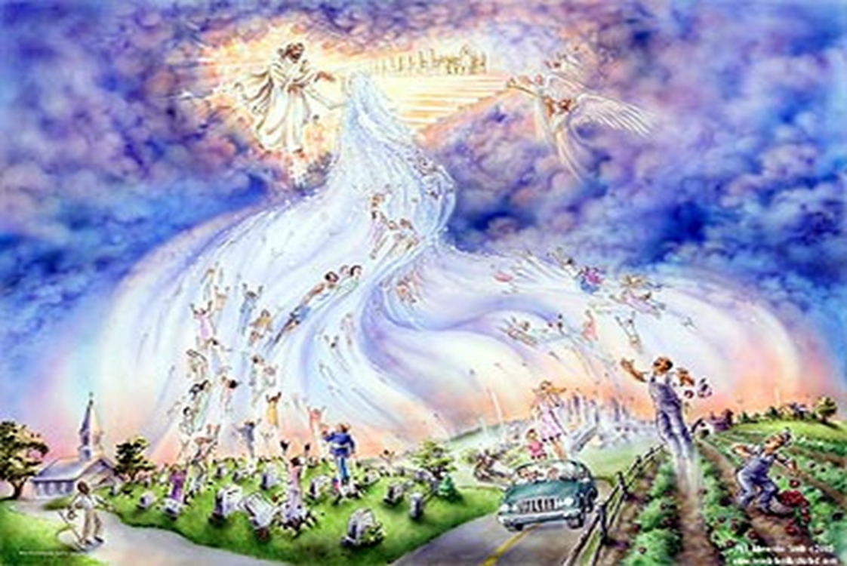
Grace/Church Age

Slide 7
Grace/Church Age (Acts 2:1-Rev. 19:21)
The church age began on the Day of Pentecost (Acts 2). The rule of life [reigning principle] for the church is grace. All aspects of life are to spring forth from grace for the church age believer and the extent of God's grace is expanded to all peoples through the worldwide offer of the gospel. This does not mean that there was no grace before the events of Acts 2, rather that this is a time in which God magnifies His grace through the global preaching of the gospel to all mankind.
Man's responsibility during the current age is to accept the gift of Christ's righteousness which is freely offered to all mankind (Rom. 5:15-18).
https://www.pre-trib.org/dr-thomas-ice/message/covenants-and-dispensations-part-10/read

Slide 8
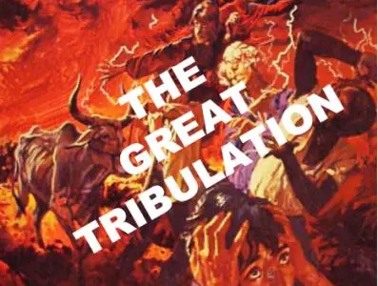
Grace/Church Age (Acts 2:1-Rev. 19:21)
The Church age ends with the Rapture of the church when the last member of the body of Christ comes to faith in Jesus as their Messiah.
This dispensation ends in the judgment of the tribulation upon a Christ-rejecting world.
https://www.pre-trib.org/dr-thomas-ice/message/covenants-and-dispensations-part-10/read

Slide 9
Grace/Church Age (Acts 2:1-Rev. 19:21)
There are two aspects of the grace of God in this economy:
the blessing is entirely of grace and
that grace is for all.
God is no longer dealing with just one nation as a sample but with all mankind. The vast majority have rejected Him and as a result will be judged. The [Grace] dispensation will end at the second coming of Christ since, as suggested, the tribulation period itself is not a separate dispensation but is the judgment on those living persons who are Christ rejecters at the end of this present dispensation. The Scripture involved is Acts 2:1 to Revelation 19:21.
Ryrie, C. C. (1995). Dispensationalism (Rev. and expanded., p. 64). Chicago: Moody Publishers.

Slide 10
Grace/Church Age (Acts 2:1-Rev. 19:21)
Man’s Responsibilities
Under Grace the responsibility on man is to accept the gift of righteousness that God freely offers to all (Rom. 5:15–18).
Man’s Failures
The vast majority have rejected Him and as a result will be judged. The Dispensation of Grace will end at the Second Coming of Christ.
The Resulting Judgment
The judgment of non-believers is spiritual death.
The judgment of believers for not walking with Christ is a loss of rewards.
The earth, which was to be controlled by Adam and handed over to Satan, will be ruled by the Lord Jesus Christ.

Slide 11
The Church was a “Mystery” “MYSTERY” DEFINED
“In the N.T, it [mystērion] denotes, not the mysterious (as with the Eng. word), but that which, being outside the range of unassisted natural apprehension, can be made known only by Divine revelation, and is made known in a manner and at a time appointed by God, and to those who are illumined by His Spirit.”
W. E. Vine, Merrill F. Unger, and William White, Vine's Complete Expository Dictionary of the Old and New Testament Words (Nashville: Nelson, 1996), 424.

Slide 12
Grace-Church Age (Acts 2:1-Rev. 19:21)

Slide 13
Grace-Church Age (Acts 2:1-Rev. 19:21)

Slide 14
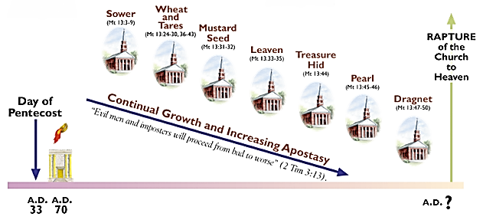
Grace-Church Age (Acts 2:1-Rev. 19:21)

Slide 15
Grace-Church Age (Acts 2:1-Rev. 19:21)

Slide 16
Grace-Church Age (Acts 2:1-Rev. 19:21)

Slide 17
‘Order’ or Tagma (1 Cor. 15:23)
Grace-Church Age (Acts 2:1-Rev. 19:21)
BELIEVERS
General / First Fruits: Christ’s resurrection (1 Cor 15:23)
Officer / Rapture: Church Age Believers (1 Thess 4:13-18)
Soldiers / Gleanings: OT saints & Tribulation martyrs (Rev 20:4)
UNBELIEVERS
Captives: Unsaved of all ages (Rev 20:5)

Slide 18
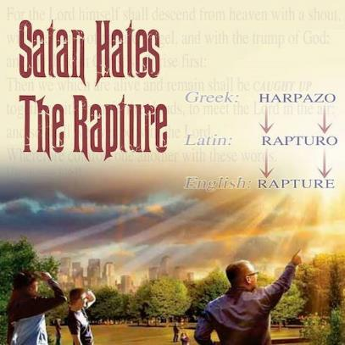
Catching Away of All Living Believers (1 Thess 4:17)
Grace-Church Age (Acts 2:1-Rev. 19:21)
Harpadzo = seized or caught up by force
Harpadzo (Greek) = Rapturo (Latin) = Rapture (English)

Slide 19
Grace-Church Age (Acts 2:1-Rev. 19:21)

Slide 20
7 Arguments Favoring the Pre-Tribulation Rapture View
Grace-Church Age (Acts 2:1-Rev. 19:21)
Tribulation's purpose concerns Israel (Jer 30:7; Dan 9:24)
Absolutely no biblical reference to the church on earth during the Tribulation period (Rev 4-22)
Church is promised an exemption from divine wrath (1 Thess 1:10; 5:9; Rom 5:9; Rev 3:10; 6:17)
Rapture is imminent (1 Cor 15:51; 1 Thess 4:15)
Rapture is a comfort (1 Thess 4:18)
Antichrist cannot come to power until the restrainer is removed (2 Thess 2:6-7)
Symbolic Biblical parallels (2 Peter 2:5-9)

Slide 21
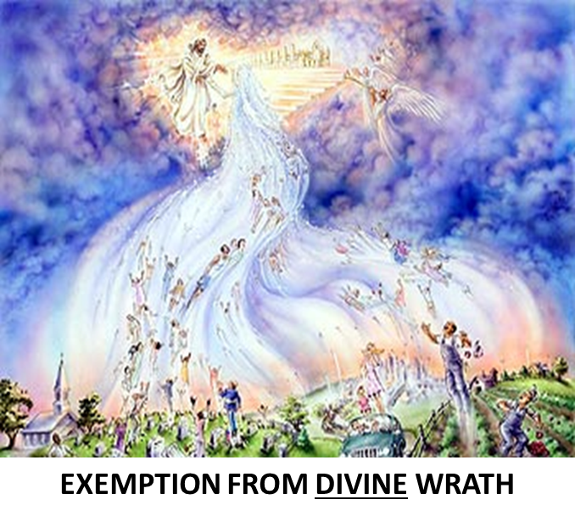
Pretribulationism is not Escapism
Grace-Church Age (Acts 2:1-Rev. 19:21)
Trials (John 16:33)
Man’s wrath (2 Tim 3:12)
Satan’s wrath (Ephesians 6:11-12)
World’s wrath (John 15:18-19)

Slide 22
Grace-Church Age (Acts 2:1-Rev. 19:21)

Slide 23
The Bema Seat – For Whom?
Grace-Church Age (Acts 2:1-Rev. 19:21)
Church Age believers
2 Corinthians 5:10
For we must all appear before the judgment seat of Christ, so that each one may be recompensed for his deeds in the body, according to what he has done, whether good or bad.

Slide 24
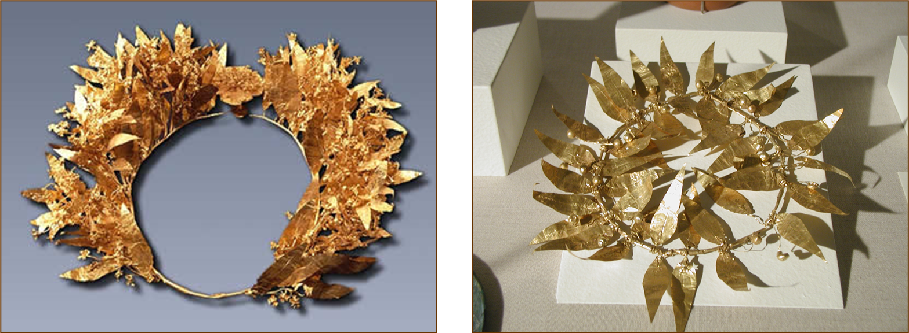
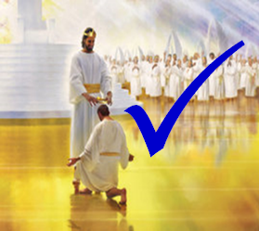
The Bema Seat – Why?
Grace-Church Age (Acts 2:1-Rev. 19:21)
Not to judge sin (John 19:30)
Not to determine salvation (John 5:24)
But to dispense or deny rewards

Slide 25
Grace-Church Age (Acts 2:1-Rev. 19:21)
SCRIPTURE’S FIVE CROWNS (Rev 4:10: 3:11; 2 John 8)
CROWN | SCRIPTURE | PURPOSE
Victor’s / Incorruptible | 1 Cor. 9:24-27 | Gaining mastery over the flesh
Church Founder’s / Rejoicing | 1 Thess. 2:19-20 | Soul winning
Trial / Life | Jas. 1:12; Rev. 2:10 | Enduring trials
Elder’s / Glory | 1 Pet. 5:2-4 | Shepherding God’s people
Rapture Lover’s / Righteousness | 2 Tim. 4:8 | Longing for His appearing

Slide 26
Grace-Church Age (Acts 2:1-Rev. 19:21)
Stefanos = victor’s crown in athletic competition

Slide 27
Grace-Church Age (Acts 2:1-Rev. 19:21)
THREE REWARDS
CRITERIA | SCRIPTURE
Building on the Solid Foundation | 1 Corinthians 3:14
Voluntary Service | 1 Corinthians 9:17
Inheritance | Colossians 3:23-24

Slide 28
Samuel Hoyt
“The Judgment Seat of Christ in Theological Perspective,” Part 2, Bibliotheca Sacra, electronic media.
“The judgment seat of Christ might be compared to a commencement ceremony. At graduation there is some measure of disappointment and remorse that one did not do better and work harder. However, at such an event the overwhelming emotion is joy, not remorse. The graduates do not leave the auditorium weeping because they did not earn better grades. Rather, they are thankful that they have been graduated, and they are grateful for what they did achieve. To overdo the sorrow aspect of the judgment seat of Christ is to make heaven hell. To under do the sorrow aspect is to make faithfulness inconsequential” (underlining mine).

Slide 29
Grace-Church Age (Acts 2:1-Rev. 19:21)
Rapture Distinct from Second Advent
RAPTURE (1 Thess 4:13-17; 1 Cor 15:51-57) | SECOND COMING (Rev 19:11-16)
Christ comes in the air (1 Thess 4:16-17) | Christ comes to the earth (Zech 14:4)
For His saints (1 Thess 4:15-17) | With His saints (Rev 19:14)
Blessing (1 Thess 4:18) | Judgment (Rev 19:15)
Effects only believers (1 Thess 4:16) | Effects both believers and unbelievers (Rev 19:15)

Slide 30
Grace-Church Age (Acts 2:1-Rev. 19:21)
Rapture Distinct from Second Advent
RAPTURE (1 Thess 4:13-17; 1 Cor 15:51-57) | SECOND COMING (Rev 19:11-16)
Invisible (1 Thess 4:16) | Visible to all (Rev 1:7)
Announced only by an archangel (1 Thess 4:16) | Involves myriads of angels (Jude 14)
Resurrection (1 Cor 15: 51) | No resurrection
Rescue of the church (1 Thess 1:10) | Rescue of Israel (Matt 23:37-39)

Slide 31
END OF REVIEW!

Slide 32
Biblical Dispensationalism
Session 15 - The Dispensations
The Tribulation & the Millennial Kingdom
thru the Eternal State

Slide 33
The Dispensations
Innocence / Innocency
Conscience
Human / Civil Government
Promise / Patriarchal Rule
Law-Israel / Mosaic Law
Church Age / Grace
***The Tribulation***
Millennial Kingdom / Millennium
***Eternal State***

Slide 34
***The Tribulation*** Concerns Israel

Slide 35
***The Tribulation*** Concerns Israel

Slide 36
Jeremiah 30:7
‘Alas! for that day is great, There is none like it; And it is the time of Jacob’s distress, But he will be saved from it.
Daniel 9:24
²⁴ “Seventy weeks have been decreed for your people and your holy city, to finish the transgression, to make an end of sin, to make atonement for iniquity, to bring in everlasting righteousness, to seal up vision and prophecy and to anoint the most holy place.

Slide 37
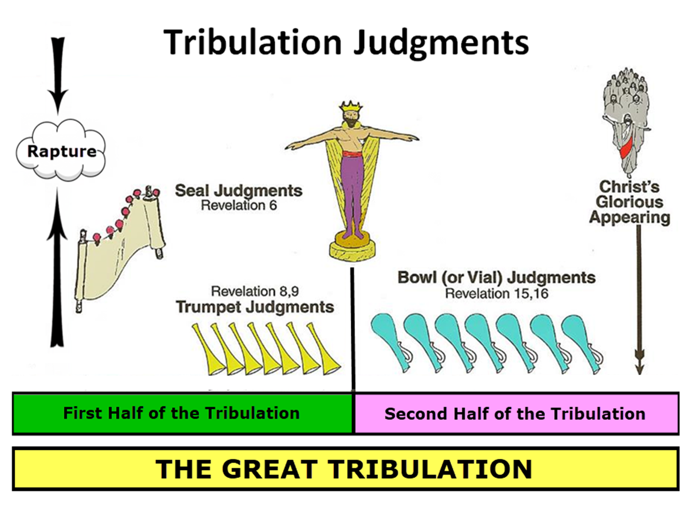
***The Tribulation*** Concerns Israel

Slide 38
***The Tribulation*** The Law/Israel dispensation – Two Stages?
Some wrongly teach that the seven-year tribulation period is either a separate dispensation or conclusion of the church age.
The tribulation is the completion of the Law/Israel dispensation since it is the 70th week of Daniel (Dan. (9:24-27) which is for Israel. Law/Israel is the only dispensation in history that is not completed consecutively or has two stages to it.
Since the tribulation is the completion of Israel's dispensation, this provides a strong reason why the church will be raptured before the tribulation.
http://www.pre-trib.org/articles/view/covenants-dispensations-part-10#_ednref3

Slide 39
***The Tribulation*** The Dispensation of Mosaic Law – Abrogated!
God instituted the reigning principle of Mosaic Law as a way and means of dealing with the nation of Israel (Exodus 20:1). However, the Mosaic Law as a reigning principle was abrogated, annulled, done away with, through the propitiation of Christ on the Cross. (Col. 2:14)
Christ is the end of the Law and the Redeemer from the Law for all who believe! (Rom. 10:4; Gal. 3:13; 5:2-4, cf. Deu. 21:23)
God instituted the Church and the reigning principle of Grace (John 1:17; Rom. 5:21).
The reigning principle of Grace is still in effect during the Tribulation.
Unbelieving Israel’s attempt to reinstitute the abrogated Mosaic Law during the Tribulation is an illegitimate and misguided endeavor.

Slide 40
***The Tribulation*** The reigning principle of the Mosaic Law – Terminated!
“Jesus Christ both fulfilled the demands of the Mosaic Law [becoming a curse on our behalf], and He terminated it…. Paul evidently meant that the Mosaic Law ended when Jesus Christ died…. God has terminated the whole Mosaic Law. It is one unified code (cf. Rom. 7:6; 10:4).
Constable, T. (2003). Tom Constable’s Expository Notes on the Bible (Ro 10:4). Galaxie Software.

Slide 41
***The Tribulation*** Where does it fit?
Where does the tribulation period fit into the usual dispensational scheme?...it seems more natural to consider the Tribulation as that time when [God] is bringing to a conclusion the economy of Grace, with judgments on men who have rejected Him and grace upon the many who will accept Him, rather than to consider it a separate dispensation.…the tribulation period itself is not a separate dispensation but is the judgment on those living persons [Jew and Gentile] who are Christ rejecters at the end of this present dispensation (Grace).
Ryrie, C. C. (1995). Dispensationalism (Rev. and expanded., p. 56, 64). Chicago: Moody Publishers.

Slide 42
***The Tribulation*** Concerns Israel
Israel’s Two Regatherings
the present regathering 1st | the permanent regathering 2nd
Return to part of the land | Return to all the land
Return in unbelief | Return in faith
Restored to land only | Restored to land & the Lord
Sets the stage for Tribulation (discipline) | Sets the stage for Millennium (blessing)
Adapted from: Price, Jerusalem In Prophecy, 219

Slide 43
***The Tribulation*** Concerns Israel
Distinctions Between 144,000 & Multitude
REVELATION 7:1-8 | REVELATION 7:9-17
Numbered | Innumerable
Saved Jews | Saved Gentiles from all nations
Sealed | Slain
Sealed before the Tribulation | Converted out of the Tribulation
Hitchcock and Ice, The Truth Behind Left Behind, 77

Slide 44
The Dispensations
Innocence / Innocency
Conscience
Human / Civil Government
Promise / Patriarchal Rule
Law-Israel / Mosaic Law
Grace-Church Age / Grace
***The Tribulation***
Millennial Kingdom / Millennium
***Eternal State***

Slide 45
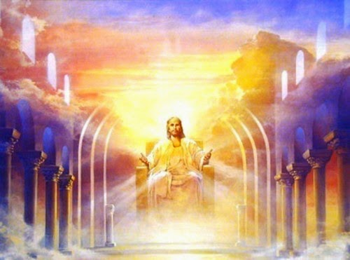
Millennial Kingdom

Slide 46
Millennial Kingdom (Rev. 20:1-15)
During Messiah's 1,000 year reign from Jerusalem all of the promises made to Israel will be fulfilled by Christ, on behalf of a then converted Israel. The Church will also reign and rule with Christ as His bride.
The responsibility during this age will focus on obedience to Christ the King and His laws, since Jesus will Himself be present during the thousand years as He reigns and rules the world from Jerusalem.
http://www.pre-trib.org/articles/view/covenants-dispensations-part-10#_ednref3

Slide 47
Millennial Kingdom (Rev. 20:1-15)
Dr. Ryrie notes: "Satan will be bound, Christ will be ruling, righteousness will prevail, overt disobedience will be quickly punished. Yet at the end of the period enough rebels will be found to make a formidable army that will dare to attack the seat of government (Rev. 20:7-9).
The revolt will be unsuccessful, and the rebels will be cast into everlasting punishment."
http://www.pre-trib.org/articles/view/covenants-dispensations-part-10#_ednref3

Slide 48
Millennial Kingdom (Rev. 20:1-15)
After the second advent of Christ, the millennial kingdom will be set up in fulfillment of all the promises given in both Testaments and particularly those contained in the Abrahamic and Davidic covenants. The Lord Jesus Christ, who will personally take charge of the running of the affairs of the world during that age, will be the chief personage of the dispensation. It will continue for a thousand years, and man will be responsible for obedience to the King and His laws. Satan will be bound, Christ will be ruling, righteousness will prevail, overt disobedience will be quickly punished. Yet at the end of the period enough rebels will be found to make a formidable army that will dare to attack the seat of government (Rev. 20:7–9). The revolt will be unsuccessful, and the rebels will be cast into everlasting punishment.
Ryrie, C. C. (1995). Dispensationalism (Rev. and expanded., pp. 64–65). Chicago: Moody Publishers.

Slide 49
Millennial Kingdom (Rev. 20:1-15)
Man’s Responsibilities
Man will be responsible for obedience to the King and His laws. Satan will be bound, Christ will be ruling, righteousness will prevail, overt disobedience will be quickly punished.
Man’s Failures
At the end of the period enough rebels will be found to make a formidable army that will dare to attack the seat of government (Rev. 20:7–9). The revolt will be unsuccessful, and the rebels will be cast into everlasting punishment.
The Resulting Judgment
The Great White Throne Judgment

Slide 50
The Dispensations
Innocence / Innocency
Conscience
Human / Civil Government
Promise / Patriarchal Rule
Law-Israel / Mosaic Law
Grace-Church Age / Grace
***The Tribulation***
Millennial Kingdom / Millennium
***Eternal State***

Slide 51
***Eternal State*** (Rev. 21-22)
Another question that has arisen in some writings is whether or not the eternal state is to be considered a dispensation.…it would seem from the concept of a dispensation as related to God’s running the affairs of His household (the world) that, when temporal history ends, the household arrangement, which is the basis for a dispensational stewardship, also ends.
In other words, the dispensational economies are related to the affairs of this present world, and they are no longer needed when the history of this world comes to a conclusion. Thus, in eternity there is no need for the economic arrangements of a dispensation as they are known in history.
Ryrie, C. C. (1995). Dispensationalism (Rev. and expanded., pp. 55). Chicago: Moody Publishers.

Slide 52
***Eternal State*** (Rev. 21-22)
Dispensations deal with God's plan for history; therefore the Eternal State is not considered a dispensation, similar to Eternity Past. Present history ends with the destruction of the present heavens and earth (2 Pet. 3:10) and the creation of the new heavens and new earth (Rev. 21:1).
The transitional event will be the Great White Throne Judgment where all unbelievers throughout history will have to give an account of their rejection of Jesus Christ as their Savior and who will be judged according to their works (Rev. 20:11-15). The result will be that everyone who appears at the Great White Throne Judgment will be cast into the Lake of Fire for all eternity (Rev. 20:14-15).
http://www.pre-trib.org/articles/view/covenants-dispensations-part-10#_ednref3

Slide 53
***Eternal State*** (Rev. 21-22)
GREAT WHITE THRONE JUDGMENT

Slide 54
***Eternal State*** (Rev. 21-22)
All the believers throughout the ages will dwell with God the Father, God the Son and God the Holy Spirit in bliss in the New Jerusalem for all eternity (Rev. 21:1-8). As the Bride of Christ, we shall spend eternity getting to know the Lamb and the Father (Rev. 22:4). There will be no more testing since that is the purpose of history not eternity. Believer’s have a great future in Christ for all eternity. Maranatha!
http://www.pre-trib.org/articles/view/covenants-dispensations-part-10#_ednref3

Slide 55
The Dispensations
Innocence / Innocency
Conscience
Human / Civil Government
Promise / Patriarchal Rule
Law-Israel / Mosaic Law
Church Age / Grace
***The Tribulation***
Millennial Kingdom / Millennium
***Eternal State***

Slide 56
The Story of the Bible:
From a Garden to a City, and Beyond!

Slide 57
Resources Used & Suggested
Alva J. McClain, Law & Grace, Moody, 1967 978-088469-001-6
A. G. Fruchtenbaum, Israelology: The Missing Link in Systematic Theology, Ariel Ministries 1994, 978-0914863052
Charles C. Ryrie, Dispensationalism, Moody, 2007, 080242189X
Christopher Cone, gen. ed., Dispensationalism Tomorrow & Beyond, Tyndale Seminary Press, 2008 9780981479101
Christopher Cone, gen. ed., An Introduction To The New Covenant, Tyndale Seminary Press, 2013, 9781938484100
Thomas Ice, Covenants and Dispensations (Part 10), https://www.pre-trib.org/dr-thomas-ice/message/covenants-and-dispensations-part-10
Lewis S. Chafer, Major Bible Themes, Zondervan, 1974, 0-310-22390-3
Mike Stallard, gen .ed., Dispensational Understanding of the New Covenant, Regular Baptist Books, 2012, 9781607764946
Paul Enns, The Moody Handbook of Theology, Moody 1989,
Renald E. Showers, There Really Is A Difference, Friend of Israel Gospel Ministry, 1990, 0915540509
Rene Pache, The Inspiration and Authority of Scripture, Sheffield Pub Co, 1992
Roy B. Zuck, Basic Bible Interpretation, SP Publications, 1991
Walvoord, J. F., The Prophecy Knowledge Handbook. Wheaton, IL: Victor Books. 1990.
Charting the End Times CD-Rom: A Visual Guide to Understanding Bible Prophecy, ISBN-10: 0736917624
Materials from:
Ed Allsteadt, https://job42ministry.org/dispensational-clarity
Dr. Andy Woods, Sugar Land Bible Church, www.slbc.org
Dr. Vern Peterman, Holly Hills Bible Church, www.hollyhillsbiblechurch.org
George Zeller, Middletown Bible Church, www.middletownbiblechurch.org

