Slide 1
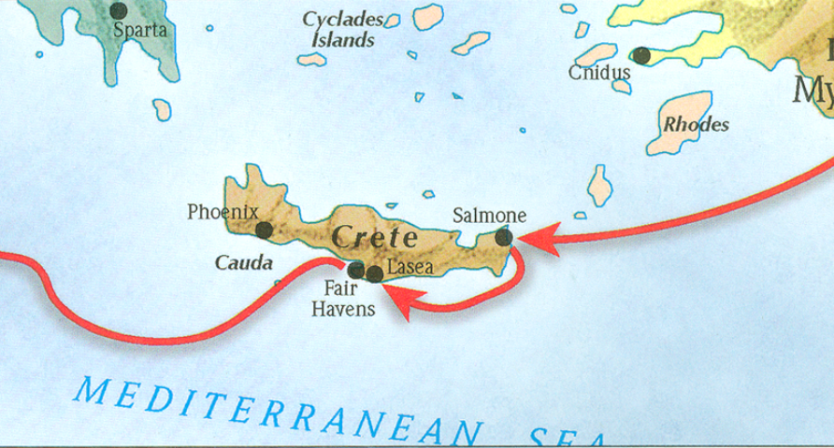
The book of Titus
Worthy of the Gospel

Slide 2
b. Addressing Doctrinal Issues (Titus 2:1-3:11)
Our Responsibilities? (3:1-8)
To civil authorities – 3.1
To the world in general – 3.2
Reasons for our behavior – 3.3-8
Handling false teachers – 3.9-11
False teacher described (3.9)
Prescription for handling False teachers (3.10-11)
Conclusion/Benediction – 3:12-15
Outline adapted from Titus Argument, Article by Andy Woods, 2007.

Slide 3
Prescription for Handling False Teachers…
Strike 1: who must be silenced because they are upsetting whole families, teaching things they should not teach for the sake of sordid gain (Titus 1:11).
Strike 2: For this reason, reprove them severely so that they may be sound in the faith (Titus 1:13)
Strike 3: Reject a factious man after a first and second warning… (Titus 3:10-11).

Slide 4
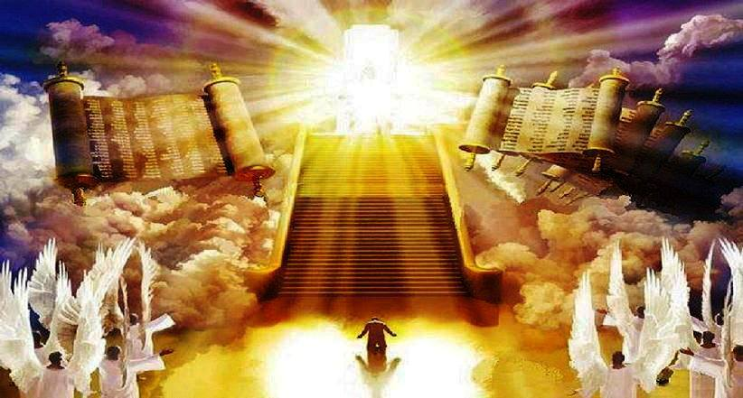
The Judgment Seat of Christ

Slide 5
Scripture’s Four Judgments (for mankind)
Name | Sheep and Goat | Judgment of the Jews | Bema Seat Judgment of Christ | Great White Throne
Scripture | Matt 25:31-46 | Ezek 20:33-44 | 1 Cor 3:10-15 | Rev 20:11-15
Place | Earth, Jerusalem | Earth, wilderness | Heaven | Earth
Audience | Gentile Tribulation survivors | Jewish Tribulation survivors | Church Age believers | All unsaved
When | After Tribulation | After Tribulation | After rapture | After Millennium
Purpose | Saved Gentiles enter kingdom | Saved Jews enter kingdom | Reward believers | Degree of punishment in hell
Evaluation | Treatment of Christ’s brethren | Passing under shepherd’s rod | Works taken through fire | Not in the book; judged by books

Slide 6
The Judgment Seat of Christ

Slide 7
Membership Qualifications, Question #3
“I have read, understood, and agree with the Church’s Philosophy and Statements of Faith (Articles II and III of the Constitution). I have also read the Position Statements, and fully agree with all (except_____). I understand that, while I do not have to agree with them, these are the Church’s positions about several issues, and the teaching of the Church will be consistent with these positions.

Slide 8
b. Addressing Doctrinal Issues (Titus 2:1-3:11)
Our Responsibilities? (3:1-8)
To civil authorities – 3.1
To the world in general – 3.2
Reasons for our behavior – 3.3-8
Handling false teachers – 3.9-11
False teacher described (3.9)
Prescription for handling False teachers (3.10-11)
Conclusion/Benediction – 3:12-15
Outline adapted from Titus Argument, Article by Andy Woods, 2007.

Slide 9
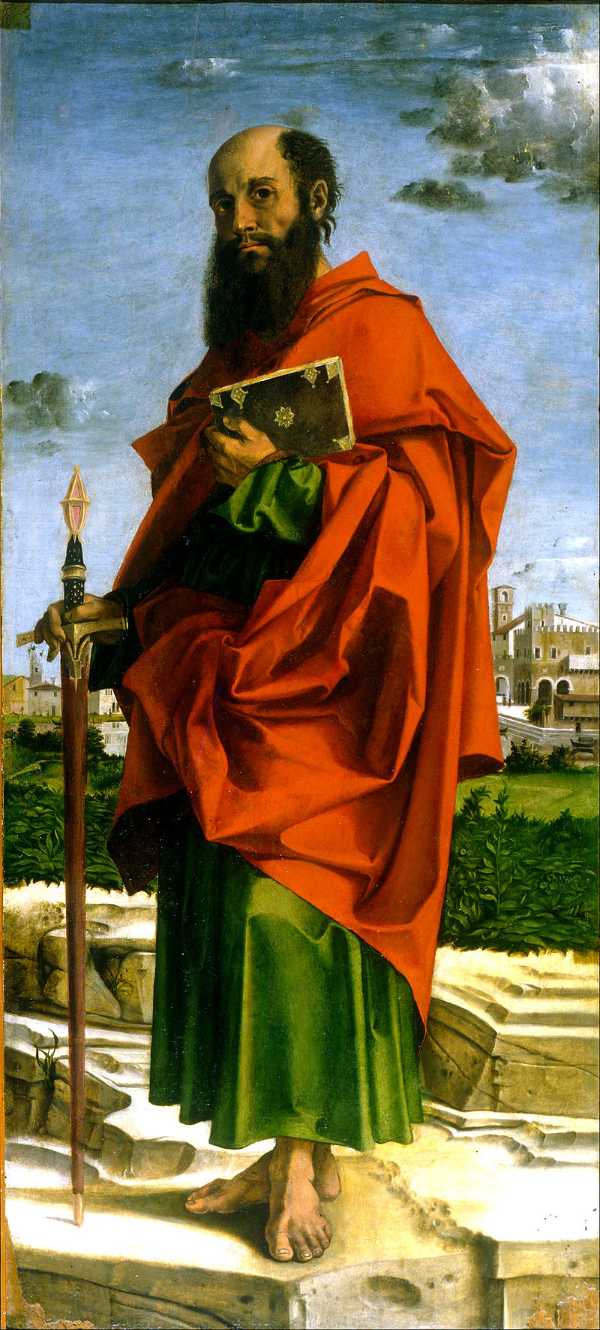
What do we know about Paul?
Born around AD 10
An Israelite, Tribe of Benjamin, Pharisee (Phil 3:5)
Raised in Jerusalem, educated in Tarsus (Acts 26:4-5)
Mentored by Gamaliel (Acts 21:40)
Fluent in Hebrew (Acts 21:40)
From Tarsus of Cecilia (Acts 9:11; 21:39)
Roman citizen (Acts 22:25-28)
Saul (Hebrew- šā˒ûl) / Paul (Grk – Paulos)
Persecutor of the Church
Converted by Christ Himself (Acts 9)
Instrument and sufferer of Christ (Acts 9:16)
Greatest missionary and theologian
Greatest contributor to the Bible (13 books)
Bartolomeo Montagna - Saint Paul

Slide 10
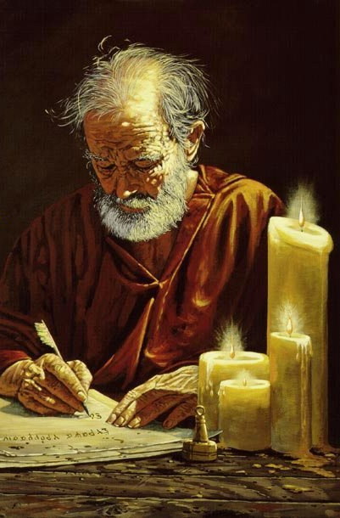
Ministry from Paul’s perspective (Titus 3:12-15): Five Observations
Outline adapted from R. Caldwell, “A Window Into the Work,” 2019.

Slide 11
Ministry from Paul’s perspective (Titus 3:12-15): Five Observations
The blessings of orderly ministry
Outline adapted from R. Caldwell, “A Window Into the Work,” 2019.

Slide 12
Ministry from Paul’s perspective (Titus 3:12-15): Five Observations
The blessings of orderly ministry
The blessings of shared ministry
Outline adapted from R. Caldwell, “A Window Into the Work,” 2019.

Slide 13
1 Corinthians 16:15-17
Now I urge you, brethren (you know the household of Stephanas, that they were the first fruits of Achaia, and that they have devoted themselves for ministry to the saints), that you also be in subjection to such men and to everyone who helps in the work and labors. I rejoice over the coming of Stephanas and Fortunatus and Achaicus, because they have supplied what was lacking on your part. For they have refreshed my spirit and yours. Therefore acknowledge such men.

Slide 14
1 Corinthians 3:6-9 cont.
I planted, Apollos watered, but God was causing the growth. So then neither the one who plants nor the one who waters is anything, but God who causes the growth. Now he who plants and he who waters are one; but each will receive his own reward according to his own labor. For we are God’s fellow workers; you are God’s field, God’s building.

Slide 15
1 Corinthians 3:10-11 cont.
According to the grace of God which was given to me, like a wise master builder I laid a foundation, and another is building on it. But each man must be careful how he builds on it. For no man can lay a foundation other than the one which is laid, which is Jesus Christ.

Slide 16
1 Corinthians 3:12-15 cont.
Now if any man builds on the foundation with gold, silver, precious stones, wood, hay, straw,
each man’s work will become evident; for the day will show it because it is to be revealed with fire, and the fire itself will test the quality of each man’s work. If any man’s work which he has built on it remains, he will receive a reward. If any man’s work is burned up, he will suffer loss; but he himself will be saved, yet so as through fire.

Slide 17
1 Corinthians 16:15-17
Now I urge you, brethren (you know the household of Stephanas, that they were the first fruits of Achaia, and that they have devoted themselves for ministry to the saints), that you also be in subjection to such men and to everyone who helps in the work and labors. I rejoice over the coming of Stephanas and Fortunatus and Achaicus, because they have supplied what was lacking on your part. For they have refreshed my spirit and yours. Therefore acknowledge such men.

Slide 18
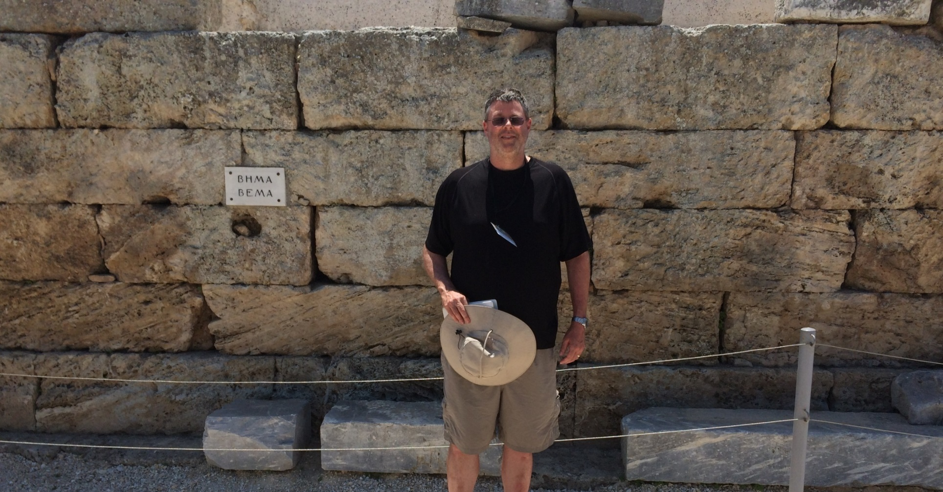
Andy at the Bema Seat in Corinth

Slide 19
Ministry from Paul’s perspective (Titus 3:12-15): Five Observations
The blessings of orderly ministry
The blessings of shared ministry
The blessings of brotherly ministry
Outline adapted from R. Caldwell, “A Window Into the Work,” 2019.

Slide 20
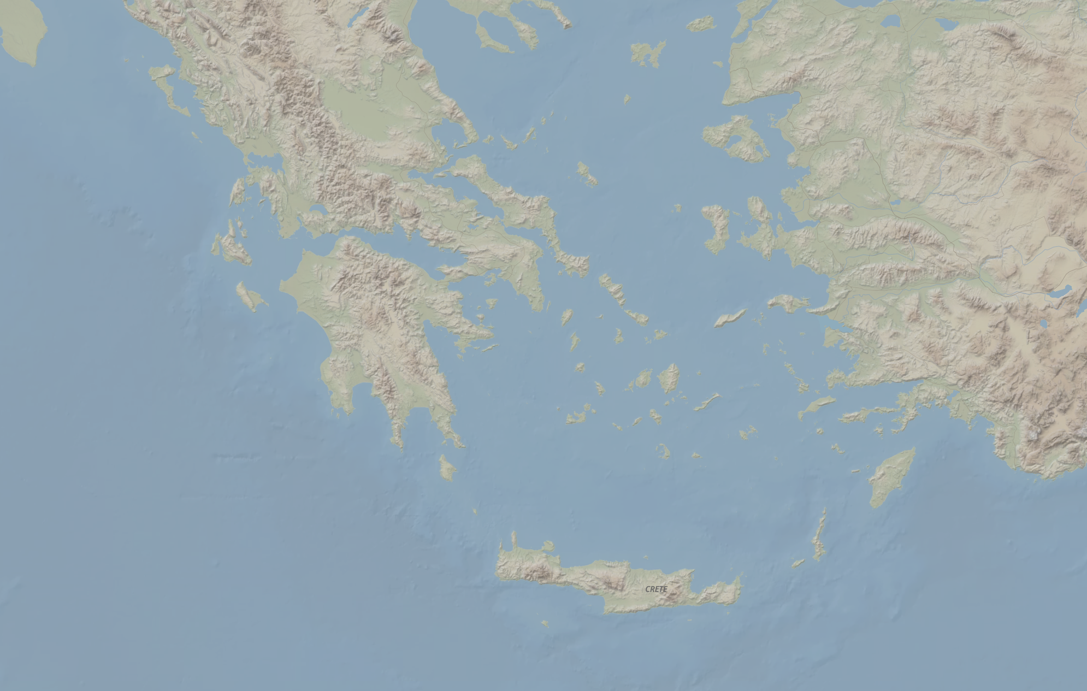
Nicopolis
Greece
Corinth
Ephesus
Crete

Slide 21
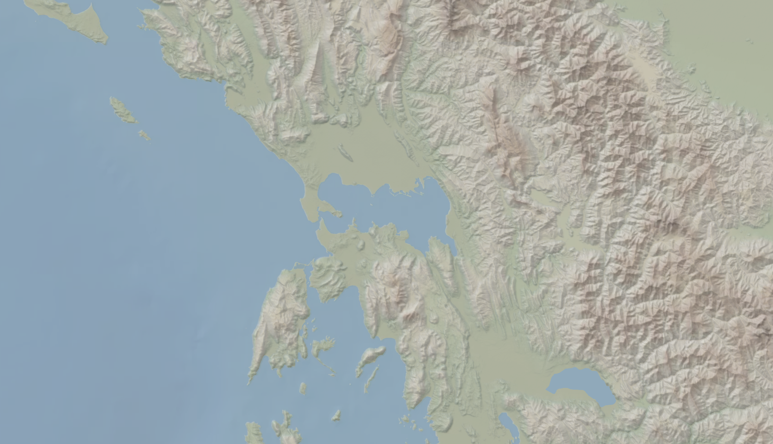
Nicopolis

Slide 22
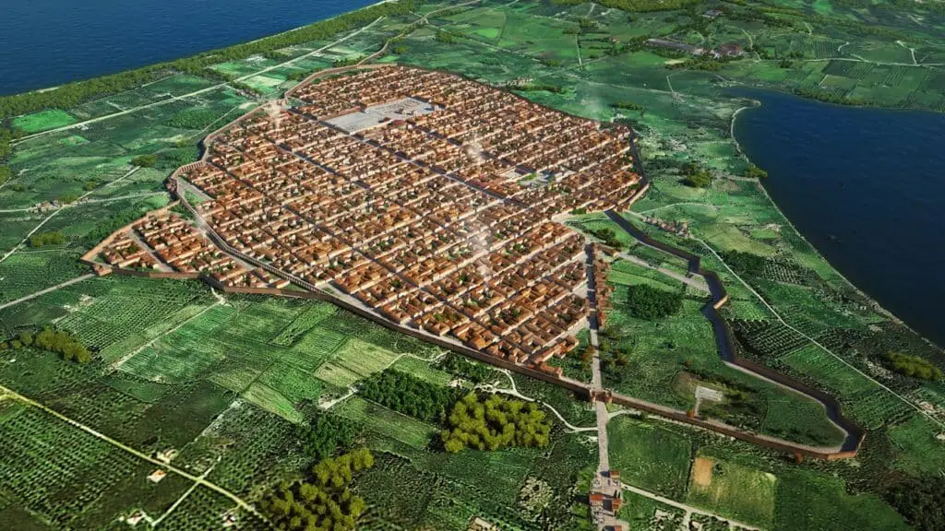
https://actianicopolisarchaeopark.gr/en/nikopolis/romaiki-nikopoli/

Slide 23
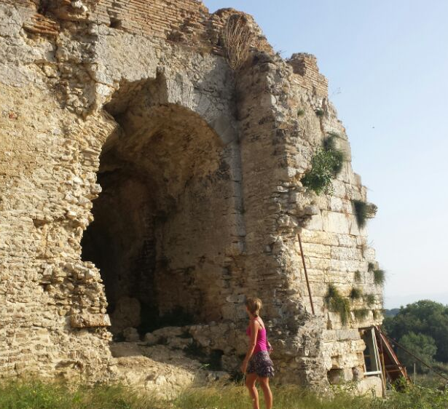
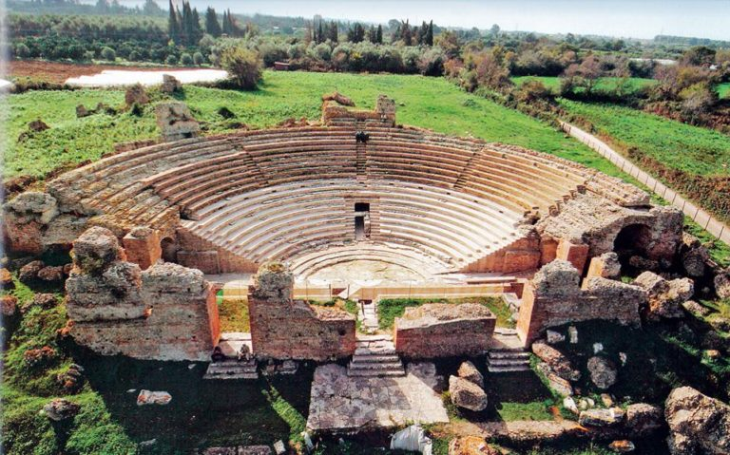
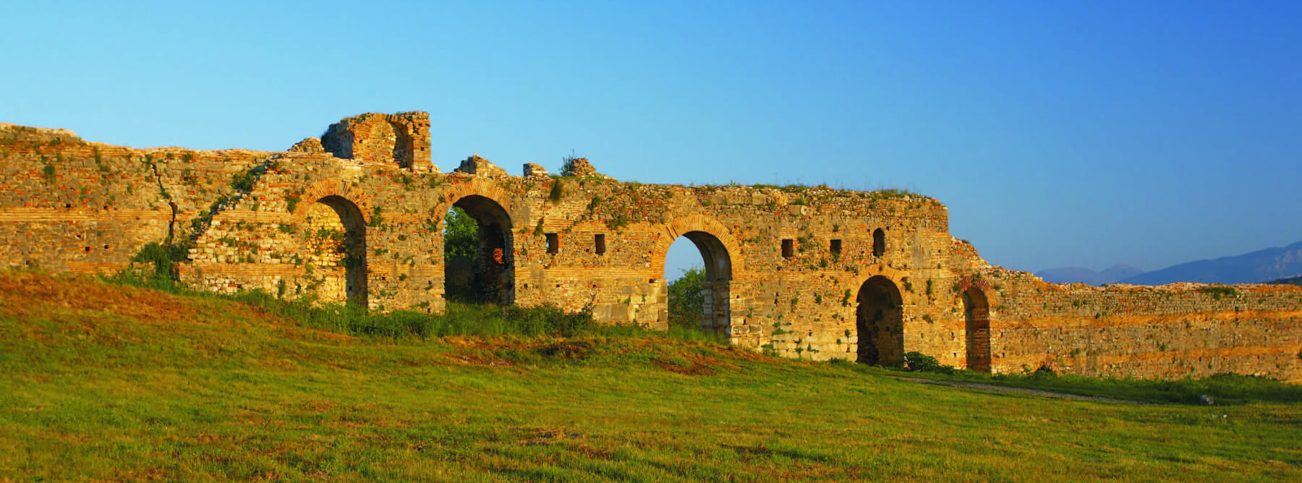

Slide 24
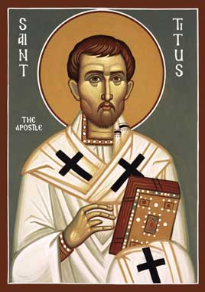
Who was the book written to?
Titus
A believer in Christ (1:4)
Brother to Paul (2 Cor 2:13)
Reliable (2 Cor 7:6)
Greek Gentile (Gal 2:3)
Test case in the Jerusalem Council of AD 49 (Gal2:1-4; Acts 11:27-30)
Courier for 2 Corinthians letter
Minister to Corinth believers
Loved God’s people (2 Cor 8:16-17)
Joy to Paul (2 Cor 7:13)
Prominent church leader in Crete (Titus 1:5)

Slide 25
2 Corinthains 7:6-7
But God, who comforts the depressed, comforted us by the coming of Titus; and not only by his coming, but also by the comfort with which he was comforted in you, as he reported to us your longing, your mourning, your zeal for me; so that I rejoiced even more.

Slide 26
8 Questions?
Who wrote it? - Paul the Apostle
What do we know about the author? – Greatest missionary, theologian, and contributor of the NT.
Who was the book written to? – Titus
When was the book written? - AD 63-66

Slide 27
Paul’s Journeys
Journey | Date | Scripture Location
1st Missionary Journey | AD 47-49 | Acts 13.1-14.28
Jerusalem Council | AD 49 | Acts 15.1-35
2nd Missionary Journey | AD 49-52 | Acts 15.36-18.22
3rd Missionary Journey | AD 52-56 | Acts 18.23-20.38
Arrest and Imprisonment | AD 56-60 | Acts 21.27-26.32
Voyage to Rome to death | AD 60-68 | Acts 27.1-28.29
Adapted from House, H Wayne. Chronological and Background Charts of the New Testament. Grand Rapids, MI: Zondervan, 1981, 124.

Slide 28
2 Corinthains 7:13
For this reason we have been comforted. And besides our comfort, we rejoiced even much more for the joy of Titus, because his spirit has been refreshed by you all.

Slide 29
2 Corinthains 7:6-7
But God, who comforts the depressed, comforted us by the coming of Titus; and not only by his coming, but also by the comfort with which he was comforted in you, as he reported to us your longing, your mourning, your zeal for me; so that I rejoiced even more.

Slide 30
Ministry from Paul’s perspective (Titus 3:12-15): Five Observations
The blessings of orderly ministry
The blessings of shared ministry
The blessings of brotherly ministry
The blessings of resourceful ministry
Outline adapted from R. Caldwell, “A Window Into the Work,” 2019.

Slide 31
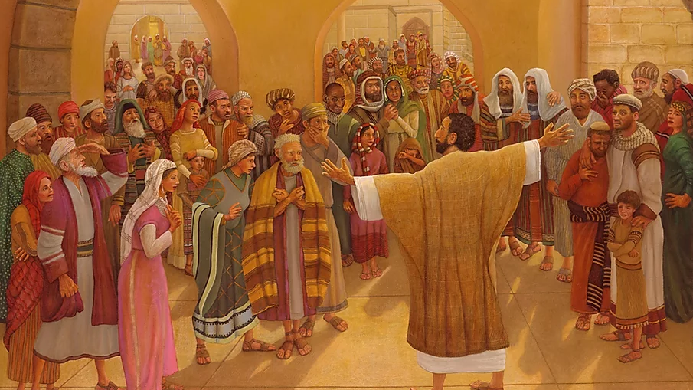
And all those who had believed were together and had all things in common; and they began selling their property and possessions and were sharing them with all, as anyone might have need. -Acts 2:44-45

Slide 32
Romans 12:6-13
Since we have gifts that differ according to the grace given to us, each of us is to exercise them accordingly: if prophecy, according to the proportion of his faith; if service, in his serving; or he who teaches, in his teaching; or he who exhorts, in his exhortation; he who gives, with liberality; he who leads, with diligence; he who shows mercy, with cheerfulness. Let love be without hypocrisy. Abhor what is evil; cling to what is good. Be devoted to one another in brotherly love; give preference to one another in honor; not lagging behind in diligence, fervent in spirit, serving the Lord; rejoicing in hope, persevering in tribulation, devoted to prayer, contributing to the needs of the saints, practicing hospitality.

Slide 33
Ministry from Paul’s perspective (Titus 3:12-15): Five Observations
The blessings of orderly ministry
The blessings of shared ministry
The blessings of brotherly ministry
The blessings of resourceful ministry
The blessings of doctrinal ministry
Outline adapted from R. Caldwell, “A Window Into the Work,” 2019.

Slide 34
Titus 2:7-8; 10
7 in all things show yourself to be an example of good deeds, with purity in doctrine, dignified, 8 sound in speech which is beyond reproach, so that the opponent will be put to shame, having nothing bad to say about us….10 but showing all good faith so that they will adorn the doctrine of God our Savior in every respect.

Slide 35
The book of Titus
Worthy of the Gospel

Slide 36
CONCLUSION

Slide 37
Ministry from Paul’s perspective (Titus 3:12-15): Five Observations
The blessings of orderly ministry
The blessings of shared ministry
The blessings of brotherly ministry
The blessings of resourceful ministry
The blessings of doctrinal ministry
Outline adapted from R. Caldwell, “A Window Into the Work,” 2019.

Slide 38
The book of Titus
Worthy of the Gospel

Slide 39
Believe.

