Slide 1
Law and Grace: An Overview Jim McGowan, Th.D. Sugar Land Bible Church 10-02-2022
…but grace and truth were realized through Jesus Christ - John 1:17
For the Law was given through Moses…
Special thanks to Dr. Vern Peterman for access to his insights and resources.

Slide 2
Session 34 Outline
Review
Purpose, Aim, and Objective
Session 33
Hearts, Eyes & What One Cannot Do – Matt. 6:16-24
General Information
Matt. 6:16-24
Concluding Observations

Slide 3
OUR PURPOSE, AIM AND OBJECTIVE
Law and Grace
…is to Compare and Contrast Law and Grace so as to properly understand these two important themes and how they are related to the life of the New Testament Believer.

Slide 4
C. I. Scofield, D. D.
The Grace of God, The Fundamentals Vol. 3, Chapter VII, p. 98
We have, most of us, been reared and now live under the influence of Galatianism. Protestant theology, alas, is for the most part, thoroughly Galatianized, in that neither law nor grace are given their distinct and separated places, as in the counsels of God, but are mingled together in one incoherent system.
The law is no longer, as in the Divine intent, a ministration of death (2 Cor. 3:7), of cursing (Gal. 3:10), of conviction (Rom. 3:19), because we are taught that we must try to keep it, and that by Divine help we may.
Nor, on the other hand, does grace bring us blessed deliverance from the dominion of sin, for we are kept under the law as a rule of life despite the plain declaration, “Sin shall not have dominion over you: for ye are not under the law, but under grace” (Rom. 6:14). (emphasis mine)

Slide 5
William R. Newell
Romans Verse-by-Verse (p. 274).
Grand Rapids, MI: Christian Classics Ethereal Library.
It is because Reformed theology has kept us Gentiles under the Law,—if not as a means of righteousness, then as “a rule of life,” that all the trouble has arisen. The Law is no more a rule of life than it is a means of righteousness. Walking in the Spirit has now taken the place of walking by ordinances. God has another principle under which He has put his saints: “Ye are not under law, but, under grace! (Rom. 6:14)” (italics mine)
PDF Download Here: https://archive.org/details/Romans_Verse_By_Verse-NewellWR

Slide 6
Henry Ironside
The Continual Burnt Offering: Daily Meditations on the Word of God (p. 265). Neptune, NJ: Loizeaux Brothers.
In Romans 7 we have a man renewed by the Spirit of God, but struggling under law, hoping thereby to subdue or find deliverance from the power of the old Adamic nature. In chapter 8 we have God’s way of deliverance through the death and resurrection of Christ with which the believer is identified before God. The chapter begins with “no condemnation” and ends with “no separation.” All who are in Christ Jesus are accepted in the Beloved and as free from every charge of guilt as He is Himself. He paid our penalty on the cross. Now we are linked up with Him in resurrection, not under law but under grace.

Slide 7
Matthew’s 3-Fold Purpose
Law and Grace: Review The SOM – Matthew 5:1–8:1 (Luke 6:17–49)
To explain:
that Jesus in whom they had believed was the long-awaited Jewish Messiah
why the kingdom had been postponed despite the fact that the king had arrived
the interim program of God during the kingdom’s absence

Slide 8
Matthew and the Kingdom
Law and Grace: Review The SOM – Matthew 5:1–8:1 (Luke 6:17–49)
 | offered
 | rejected
 | postponed Interim program
 | ultimately accepted

Slide 9
Matthew’s Message
Law and Grace: Review The SOM – Matthew 5:1–8:1 (Luke 6:17–49)
Jesus is the predicted Jewish king who ushered in an interim program by building the sons of the kingdom into the Church in between Israel’s past rejection and future acceptance of her king.

Slide 10
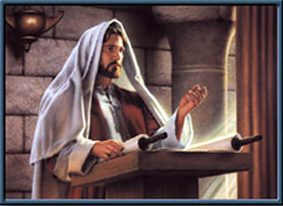
Law and Grace: Review The SOM – Matthew 5:1–8:1 (Luke 6:17–49)
Jesus contrasted with the Scribes & Pharisees
Jesus made the Law of Moses apply to the whole person, all the way from the heart and thoughts, to all of the outward expressions and even in the relationships between Jews, and with God.
True Righteousness vs. Pharisaical Righteousness

Slide 11
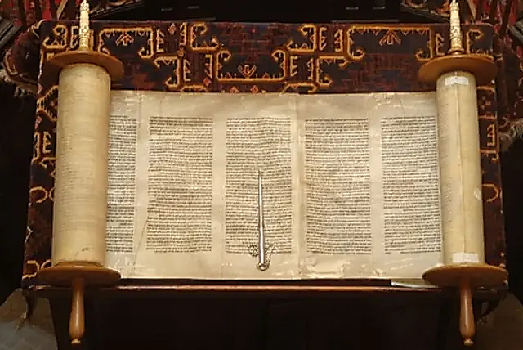
Law and Grace: Review The SOM – Matthew 5:1–8:1 (Luke 6:17–49)
Two Primary Patterns in Jesus’ Statements
Jesus will quote Old Testament passages and include those laws that require full heart-level and relationship compliance when appropriate.
Jesus will quote Old Testament passages along with one of the traditions that have been added to the Law of Moses, and then correct the tradition by taking the application deeper and/or back to the original intent of the Law of Moses.

Slide 12
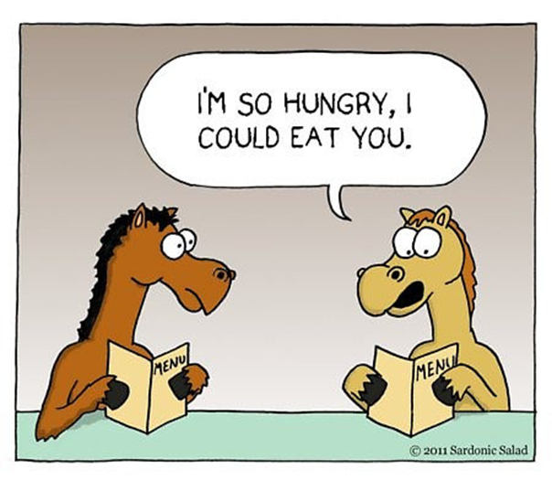
Law and Grace: Review The SOM – Matthew 5:1–8:1 (Luke 6:17–49)
Jesus Used Hyperbole
Matthew 5:21-26
Jesus sometimes uses *hyperbole in the Sermon on the Mount, for the sake of emphasis and as an aid to memory.
* hyperbole an obvious and intentional exaggeration used for stress or emphasis; not intended to be taken literally…i.e. I’m so hungry, I could eat a horse.

Slide 13
Context, Context, Context Matthew 5:21-48
Law and Grace: Review The SOM – Matthew 5:1–8:1 (Luke 6:17–49)
The Sermon on the Mount was directed to Israelites, living in Israel, who were all under the Law of Moses.
To understand what Christ says we should keep in mind that: proper interpretation requires identifying the cultural context.

Slide 14
The Sermon on the Mount
Law and Grace: Review The SOM – Matthew 5:1–8:1 (Luke 6:17–49)
Matthew unfolds matters concerning the kingdom in a special way. That is the reason for placing the Sermon on the Mount early in the book—connecting it with the announcement of the kingdom—and the reason for the manner of its unfolding as a whole. It is connected with the special presentation of Christ as King, [to Israel]…before His rejection became evident in Matt. 12. It is connected with the presentation of the kingdom [to Israel] as entailing the acceptance of the Person of the meek and lowly One, just as the presentation of the kingdom [to Israel] was bound up with the acceptance of His Person come in humiliation and grace.
Elements of Dispensational Truth, Vol. 4, The Sermon on the Mount: Its
Dispensational Place and Meaning; Roy A. Huebner, 2007 Present Truth Publishers, pg. 14

Slide 15
Session 34 Outline
Review
Purpose, Aim, and Objective
Session 33
Hearts, Eyes & What One Cannot Do – Matt. 6:16-24
General Information
Matt. 6:16-24
Concluding Observations

Slide 16
Matthew 6:12, 14–15
⁹ “Pray, then, in this way: ‘Our Father who is in heaven, Hallowed be Your name. ¹⁰ ‘Your kingdom come. Your will be done, On earth as it is in heaven. ¹¹ ‘Give us this day our daily bread. ¹² ‘And forgive us our debts, as we also have forgiven our debtors. ¹³ ‘And do not lead us into temptation, but deliver us from evil. For Yours is the kingdom and the power and the glory forever. Amen.’ ¹⁴ “For if you forgive others for their transgressions, your heavenly Father will also forgive you. ¹⁵ “But if you do not forgive others, then your Father will not forgive your transgressions.

Slide 17
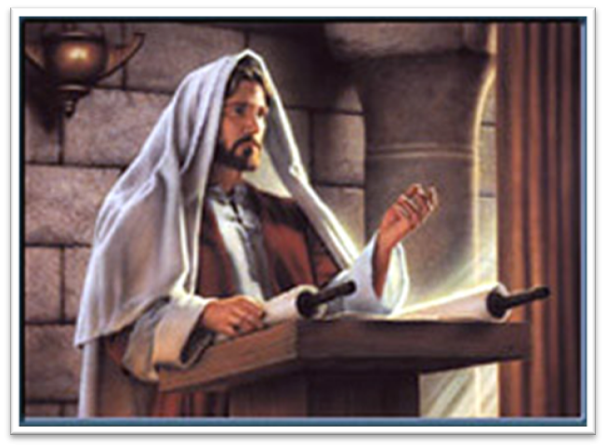
Law and Grace: The SOM – Matthew 5:1–8:1 (Luke 6:17–49)
‘Forgiven, if you forgive…’
Matthew 6:14-15
In Matthew 6:14-15, Jesus clarified the intent of verse 12 in the Lord’s Prayer, which is that personal forgiveness came UNDER THE LAW, if an Israelite forgave his fellow Israelite.

Slide 18
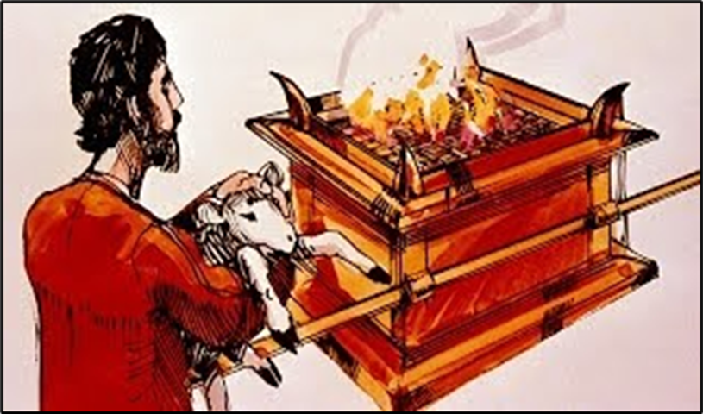
Matthew 5:23–24
²³ “Therefore if you are presenting your offering at the altar, and there remember that your brother has something against you, ²⁴ leave your offering there before the altar and go; first be reconciled to your brother, and then come and present your offering.

Slide 19
Law and Grace: The SOM – Matthew 5:1–8:1 (Luke 6:17–49)
‘Forgive us our debts’
Matthew 6:14-15
Sins, in Jewish tradition, were looked upon as spiritual debts to God that required payment, and we see this concept in Luke 11:2-4.

Slide 20
Law and Grace: The SOM – Matthew 5:1–8:1 (Luke 6:17–49)
‘Forgive us our debts’
Matthew 6:14-15
However, for us in the body of Christ, living under grace, our sin debts as spiritual obligations (past, present, and future), were nailed to the cross of Christ, an IOU that was cancelled on the day we died with Christ. (cf. Colossians 2:12-14)

Slide 21
Law and Grace: The SOM – Matthew 5:1–8:1 (Luke 6:17–49)
‘MOTIVE, MEANS & OPPORTUNITY – THE ESSENTIAL KEY’
Matthew 6:14-15
For us who are in the Body of Christ, unconditional forgiveness and blessing is a part of the grace package which we received when we believed. (Ephesians 1:3, 7; 4:32) therefore our motive to forgive others comes from our understanding of what Christ did for us on the Cross.

Slide 22
Law and Grace: The SOM – Matthew 5:1–8:1 (Luke 6:17–49)
‘MOTIVE, MEANS & OPPORTUNITY – THE ESSENTIAL KEY’
Matthew 6:14-15
God has provided the means for us in the Body of Christ to do what God desires of us. It’s the energizing, enabling and empowering by the Holy Spirit and the life of Christ in and through us.

Slide 23
Law and Grace: The SOM – Matthew 5:1–8:1 (Luke 6:17–49)
‘MOTIVE, MEANS & OPPORTUNITY – THE ESSENTIAL KEY’
Matthew 6:14-15
And the opportunity for we who are already blessed is to be used of God.

Slide 24
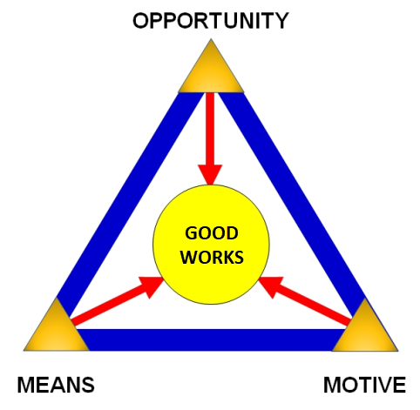
Law and Grace: The SOM – Matthew 5:1–8:1 (Luke 6:17–49)
‘MOTIVE, MEANS & OPPORTUNITY – THE ESSENTIAL KEY’
Matthew 6:14-15
ABBA, Father has given us the motive! He's given us the means! And He's even provided us with the opportunities!

Slide 25
Session 34 Outline
Review
Purpose, Aim, and Objective
Session 33
Hearts, Eyes & What One Cannot Do – Matt. 6:16-24
General Information
Matt. 6:16-24
Concluding Observations

Slide 26
Matthew 6:16-24
¹⁶ “Whenever you fast, do not put on a gloomy face as the hypocrites do, for they neglect their appearance so that they will be noticed by men when they are fasting. Truly I say to you, they have their reward in full. ¹⁷ “But you, when you fast, anoint your head and wash your face ¹⁸ so that your fasting will not be noticed by men, but by your Father who is in secret; and your Father who sees what is done in secret will reward you. ¹⁹ “Do not store up for yourselves treasures on earth, where moth and rust destroy, and where thieves break in and steal. ²⁰ “But store up for yourselves treasures in heaven, where neither moth nor rust destroys, and where thieves do not break in or steal; ²¹ for where your treasure is, . . .

Slide 27
Matthew 6:16-24
. . . there your heart will be also. ²² “The eye is the lamp of the body; so then if your eye is clear, your whole body will be full of light. ²³ “But if your eye is bad, your whole body will be full of darkness. If then the light that is in you is darkness, how great is the darkness! ²⁴ “No one can serve two masters; for either he will hate the one and love the other, or he will be devoted to one and despise the other. You cannot serve God and wealth.

Slide 28
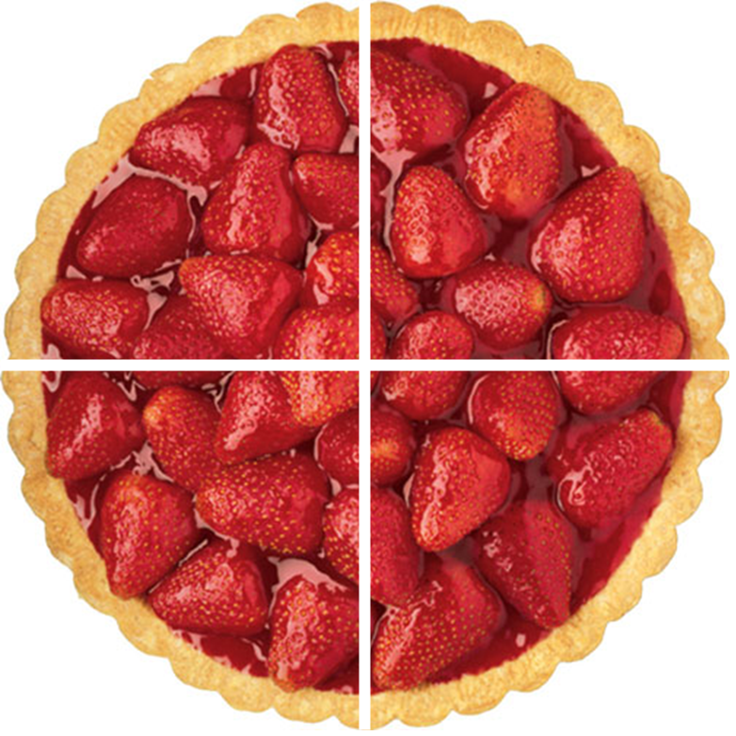
Law and Grace: The SOM – Matthew 5:1–8:1 (Luke 6:17–49)
Hearts, Eyes, & What One Cannot Do
Matthew 6:16-24
Today’s passage has four parts to it:

Slide 29
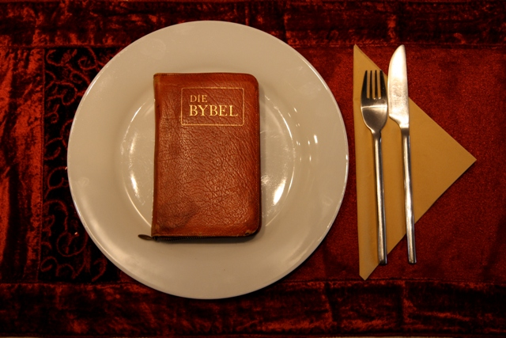
Law and Grace: The SOM – Matthew 5:1–8:1 (Luke 6:17–49)
Hearts, Eyes, & What One Cannot Do
Matthew 6:16-24
Verses 16-18 are about the subject of fasting, which, like prayer, is to be done with a focus on God, and not on gaining the attention of others.
The Word of God

Slide 30
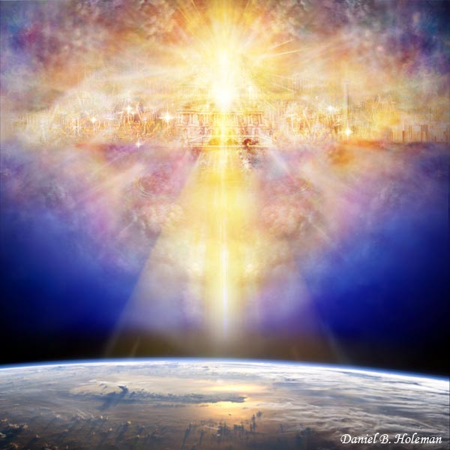
Law and Grace: The SOM – Matthew 5:1–8:1 (Luke 6:17–49)
Hearts, Eyes, & What One Cannot Do
Matthew 6:16-24
Verses 19-21 say to store up treasures in heaven, and not to store up treasures on earth.

Slide 31
Law and Grace: The SOM – Matthew 5:1–8:1 (Luke 6:17–49)
Hearts, Eyes, & What One Cannot Do
Matthew 6:16-24
Verses 22-23 give us spiritual insight about our ‘eyes’.

Slide 32
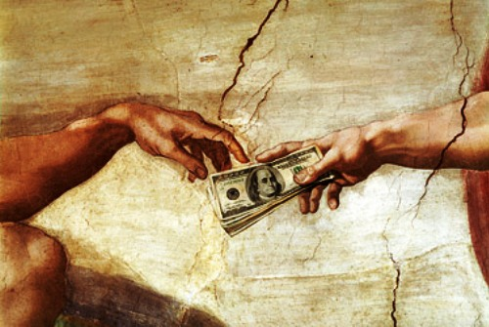
Law and Grace: The SOM – Matthew 5:1–8:1 (Luke 6:17–49)
Hearts, Eyes, & What One Cannot Do
Matthew 6:16-24
Verse 24 tells us that we can’t serve both God and money.

Slide 33
Session 33 Outline
Review
Purpose, Aim, and Objective
Session 32
Hearts, Eyes & What One Cannot Do – Matt. 6:16-24
General Information
Matt. 6:16-24
Concluding Observations

Slide 34
Matthew 6:16-24
¹⁶ “Whenever you fast, do not put on a gloomy face as the hypocrites do, for they neglect their appearance so that they will be noticed by men when they are fasting. Truly I say to you, they have their reward in full. ¹⁷ “But you, when you fast, anoint your head and wash your face ¹⁸ so that your fasting will not be noticed by men, but by your Father who is in secret; and your Father who sees what is done in secret will reward you. ¹⁹ “Do not store up for yourselves treasures on earth, where moth and rust destroy, and where thieves break in and steal. ²⁰ “But store up for yourselves treasures in heaven, where neither moth nor rust destroys, and where thieves do not break in or steal; ²¹ for where your treasure is, . . .

Slide 35
Law and Grace: The SOM – Matthew 5:1–8:1 (Luke 6:17–49)
“Whenever you fast…”
Matthew 6:16-18

Slide 36
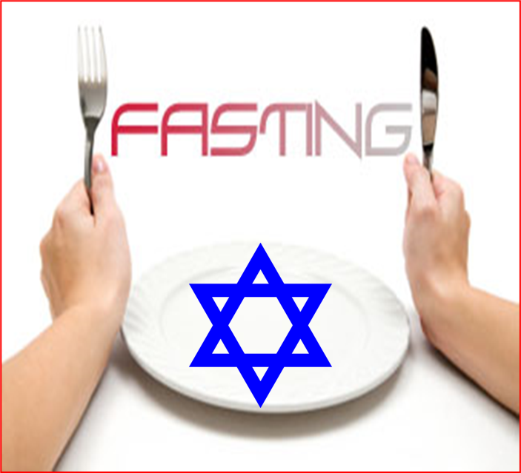
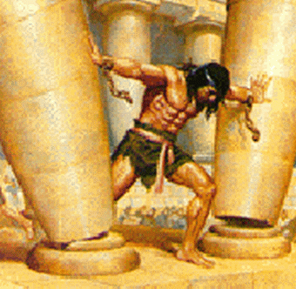
Law and Grace: The SOM – Matthew 5:1–8:1 (Luke 6:17–49)
“Whenever you fast…”
Matthew 6:16-18
The Law of Moses contained 613 laws 365 of them being things not to do, but the practice of fasting was not a part of the Law of Moses.
Fasting however, was commanded at times by various kings of Israel and was, a custom among the Jews since at least the time of the judges.

Slide 37
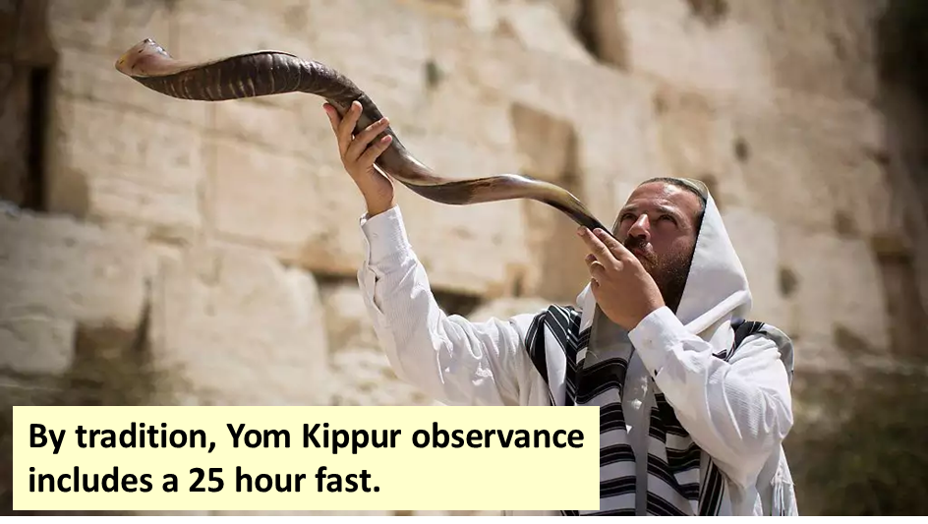
Law and Grace: The SOM – Matthew 5:1–8:1 (Luke 6:17–49)
“Whenever you fast…”
Matthew 6:16-18
So, we see that Jesus says, “Whenever you fast…” because fasts were never required by the Law of Moses, but over time, had become custom and a traditional part of a vow.

Slide 38
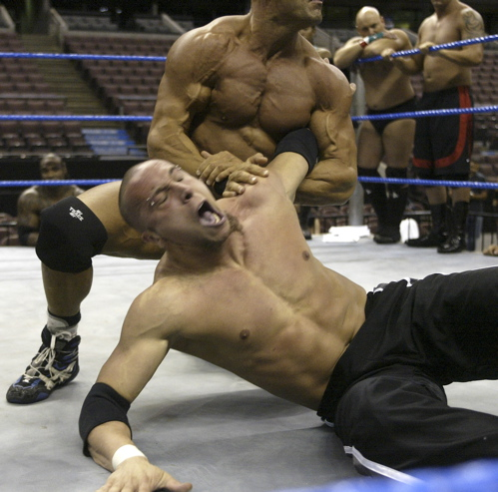
Law and Grace: The SOM – Matthew 5:1–8:1 (Luke 6:17–49)
“What fasting is not for…”
Matthew 6:16-18
Fasting is not a way to ‘put God over a barrel’ or to ‘force His hand’, as if we could do such a thing.
Fasting is not a way to pursue a ‘spiritual feeling’, even if others do.

Slide 39
Law and Grace: The SOM – Matthew 5:1–8:1 (Luke 6:17–49)
“What fasting is not for…”
Matthew 6:16-18
Fasting is not to become a point of legalism or human accomplishment for our satisfaction or to impress others, setting oneself up for condemnation if the set goal is not achieved.

Slide 40
Law and Grace: The SOM – Matthew 5:1–8:1 (Luke 6:17–49)
“Fasting is not uniquely Jewish, Christian, or even ‘religious’…”
Matthew 6:16-18
Fasting is practiced in Buddhism, Hinduism, Judaism, Islam and Christianity, and has been done for health purposes.

Slide 41
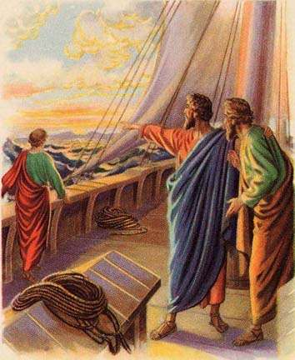
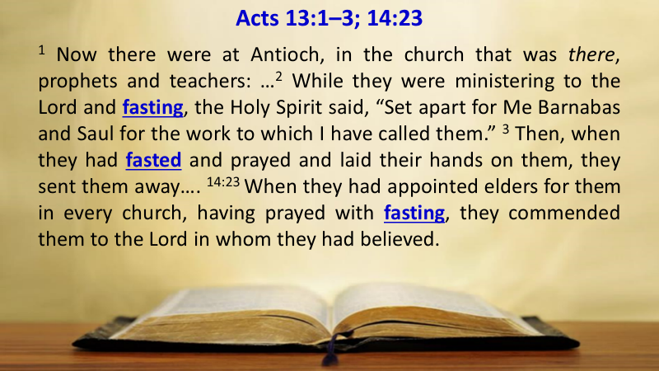
Law and Grace: The SOM – Matthew 5:1–8:1 (Luke 6:17–49)
“Fasting is not uniquely Jewish, Christian, or even ‘religious’…”
Matthew 6:16-18
The last mention of fasting in the Bible was in a church context in in the book of Acts, chapters 13 and 14.

Slide 42
Law and Grace: The SOM – Matthew 5:1–8:1 (Luke 6:17–49)
“Fasting is not uniquely Jewish, Christian, or even ‘religious’…”
Matthew 6:16-18
So, fasting is not required for Jews or Christians, but believers, living and functioning under the ‘reigning principle of grace’ (cf. Romans 5:20-21), may fast – that is, we are free to do so to focus on the Lord.

Slide 43
Matthew 6:19-24
¹⁹ “Do not store up for yourselves treasures on earth, where moth and rust destroy, and where thieves break in and steal. ²⁰ “But store up for yourselves treasures in heaven, where neither moth nor rust destroys, and where thieves do not break in or steal; ²¹ for where your treasure is, there your heart will be also. ²² “The eye is the lamp of the body; so then if your eye is clear, your whole body will be full of light. ²³ “But if your eye is bad, your whole body will be full of darkness. If then the light that is in you is darkness, how great is the darkness! ²⁴ “No one can serve two masters; for either he will hate the one and love the other, or he will be devoted to one and despise the other. You cannot serve God and wealth.

Slide 44
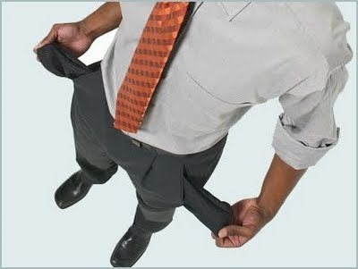
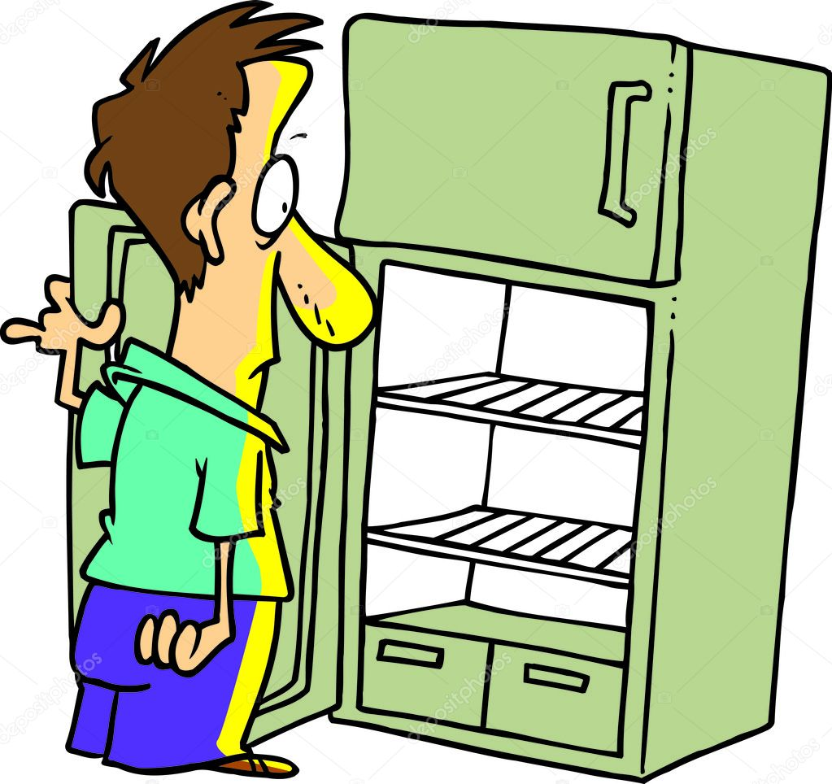
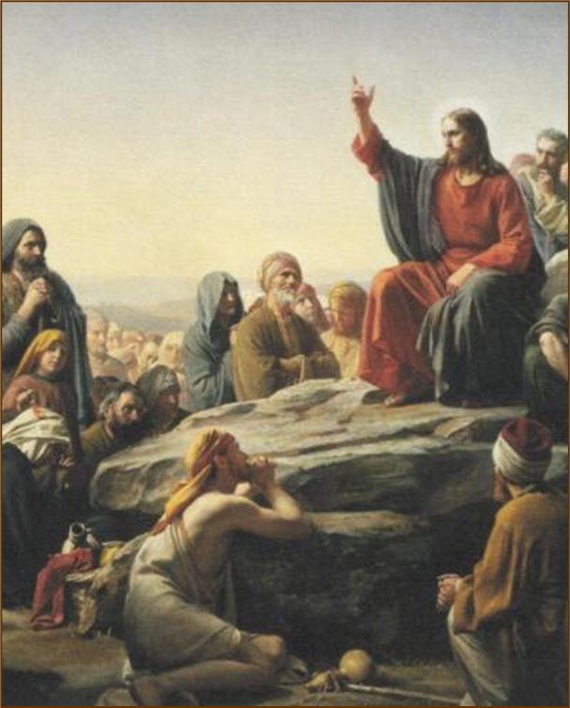
Law and Grace: The SOM – Matthew 5:1–8:1 (Luke 6:17–49)
“Don’t store up – anything?”
Matthew 6:19-21
So, is Jesus saying that we shouldn’t save up for anything – even for a real and valid future needs?
No, He is making a comparison in the extreme*, as in hating mother and father vs. loving God (cf. Luke 14:26).
* hyperbole an obvious and intentional exaggeration used for stress or emphasis; not intended to be taken literally…i.e. I’m so hungry, I could eat a horse.

Slide 45
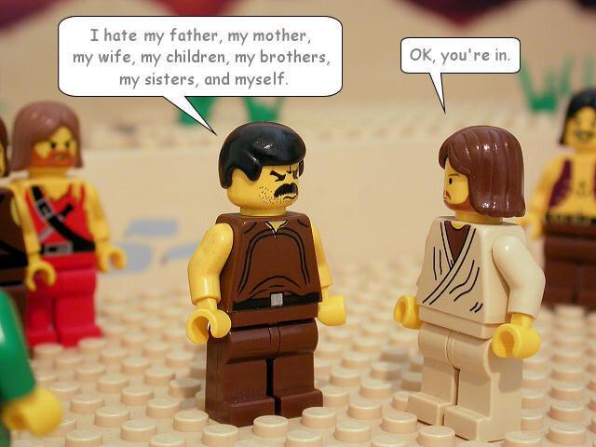
Luke 14:26
If anyone comes to Me, and does not hate his own father and mother and wife and children and brothers and sisters, yes, and even his own life, he cannot be My disciple.

Slide 46
Law and Grace: The SOM – Matthew 5:1–8:1 (Luke 6:17–49)
“Don’t store up – anything?”
Matthew 6:19-21
So, Jesus is not telling them that they shouldn’t save up to provide for the anticipated needs of oneself and family.
He is saying to place a greater value on spiritual things than the physical things.

Slide 47
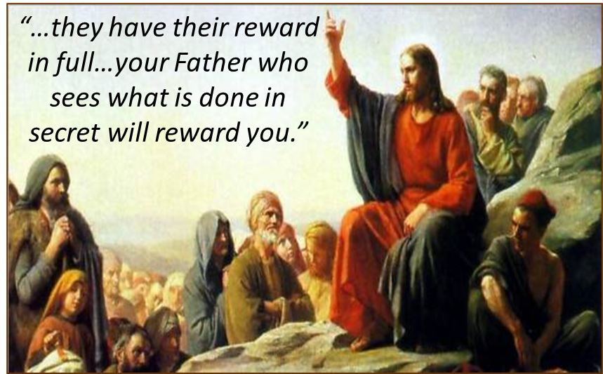
Law and Grace: The SOM – Matthew 5:1–8:1 (Luke 6:17–49)
“Don’t store up – anything?”
Matthew 6:19-21
In the Sermon on the Mount, Jesus speaks of rewards nine times, and at times that the reward is from heaven.
Jesus is, of course, speaking directly to Israelites, in the land of Israel, as their Messiah and promised King (cf. 6:2, 4, 5, 6, 16-18).

Slide 48
Law and Grace: The SOM – Matthew 5:1–8:1 (Luke 6:17–49)
“Don’t store up – anything?”
Matthew 6:19-21
Scripture’s Five Crowns (Rev 4:10: 3:11; 2 John 8)
CROWN | SCRIPTURE | PURPOSE
Victor’s / Incorruptible | 1 Cor. 9:24-27 | Gaining mastery over the flesh
Church Founder’s / Rejoicing | 1 Thess. 2:19-20 | Soul winning
Trial / Life | Jas. 1:12; Rev. 2:10 | Enduring trials
Elder’s / Glory | 1 Pet. 5:2-4 | Shepherding God’s people
Rapture Lover’s / Righteousness | 2 Tim. 4:8 | Longing for His appearing

Slide 49
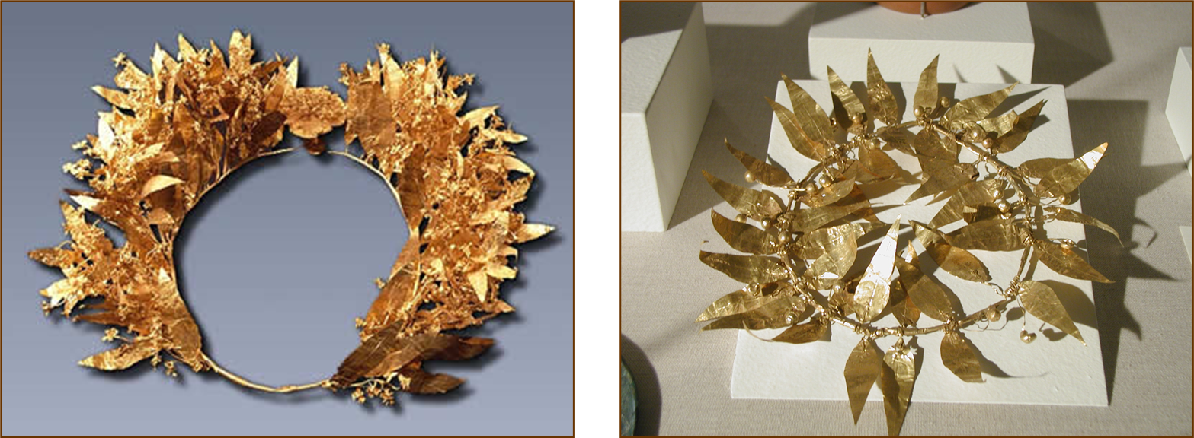
Law and Grace: The SOM – Matthew 5:1–8:1 (Luke 6:17–49)
“Don’t store up – anything?”
Matthew 6:19-21
Stefanos = victor’s crown in athletic competition

Slide 50
Law and Grace: The SOM – Matthew 5:1–8:1 (Luke 6:17–49)
“Don’t store up – anything?”
Matthew 6:19-21
Three Rewards
CRITERIA | SCRIPTURE
Building on the Solid Foundation | 1 Corinthians 3:14
Voluntary Service | 1 Corinthians 9:17
Inheritance | Colossians 3:23-24
1

Slide 51
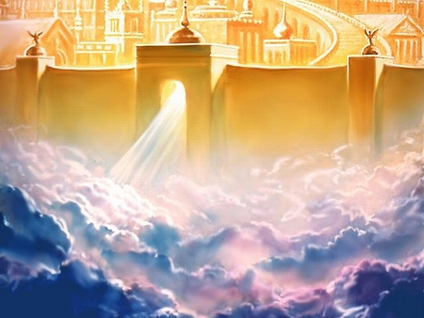
Ephesians 1:3
Blessed be the God and Father of our Lord Jesus Christ, who has blessed us with every spiritual blessing in the heavenly places in Christ…

Slide 52
Ephesians 2:6-7
⁶…and raised us up with Him, and seated us with Him in the heavenly places in Christ Jesus, ⁷ so that in the ages to come He might show the surpassing riches of His grace in kindness toward us in Christ Jesus.

Slide 53
Philippians 3:20
For our citizenship is in heaven, from which also we eagerly wait for a Savior, the Lord Jesus Christ;

Slide 54
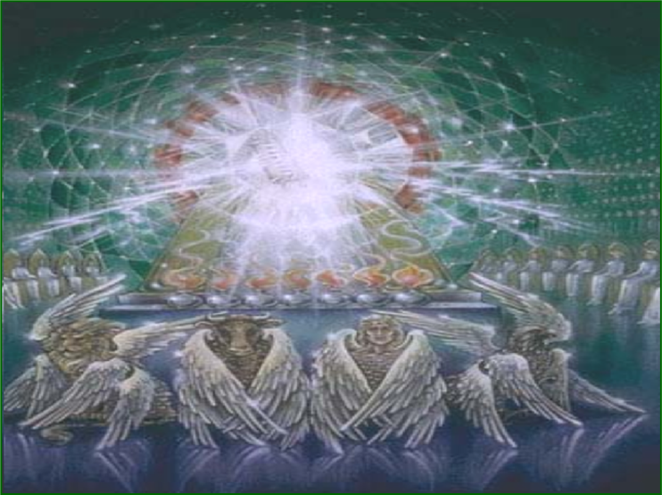
Colossians 3:2-4
² Set your mind on the things above, not on the things that are on earth. ³ For you have died and your life is hidden with Christ in God. ⁴ When Christ, who is our life, is revealed, then you also will be revealed with Him in glory.

Slide 55
Matthew 6:16-24
¹⁹ “Do not store up for yourselves treasures on earth, where moth and rust destroy, and where thieves break in and steal. ²⁰ “But store up for yourselves treasures in heaven, where neither moth nor rust destroys, and where thieves do not break in or steal; ²¹ for where your treasure is, there your heart will be also. ²² “The eye is the lamp of the body; so then if your eye is clear, your whole body will be full of light. ²³ “But if your eye is bad, your whole body will be full of darkness. If then the light that is in you is darkness, how great is the darkness! ²⁴ “No one can serve two masters; for either he will hate the one and love the other, or he will be devoted to one and despise the other. You cannot serve God and wealth.

Slide 56
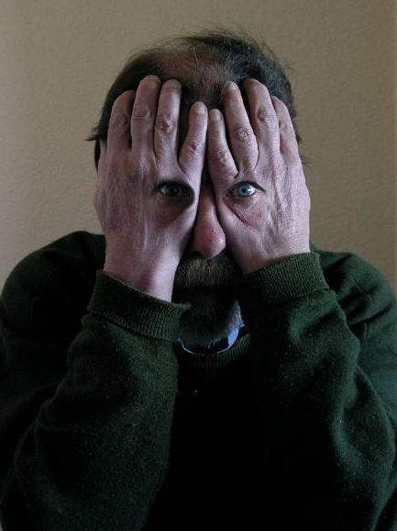
Law and Grace: The SOM – Matthew 5:1–8:1 (Luke 6:17–49)
“The eyes have it …”
Matthew 6:22-23
In the Sermon on the Mount (chapters 5-7 of Matthew) Jesus speaks of ‘eyes’ more than once in each chapter.

Slide 57
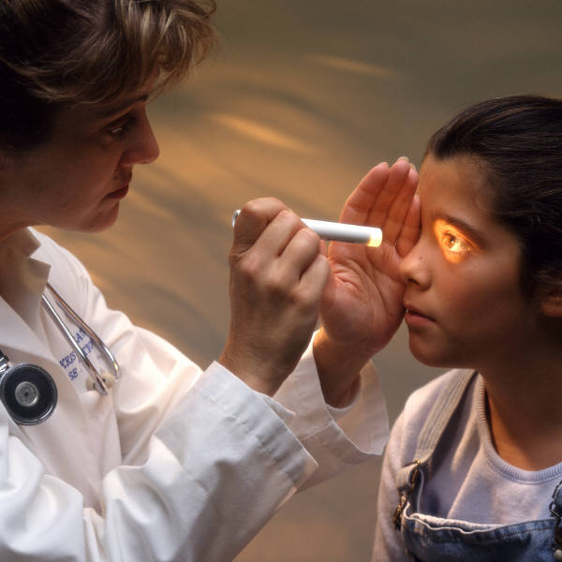
Law and Grace: The SOM – Matthew 5:1–8:1 (Luke 6:17–49)
“The eyes have it …”
Matthew 6:22-23
In verses 22-23 Jesus is not telling people to take good care of their eyes, He’s talking about how one views the world, spiritually speaking, contrasting darkness and light.

Slide 58
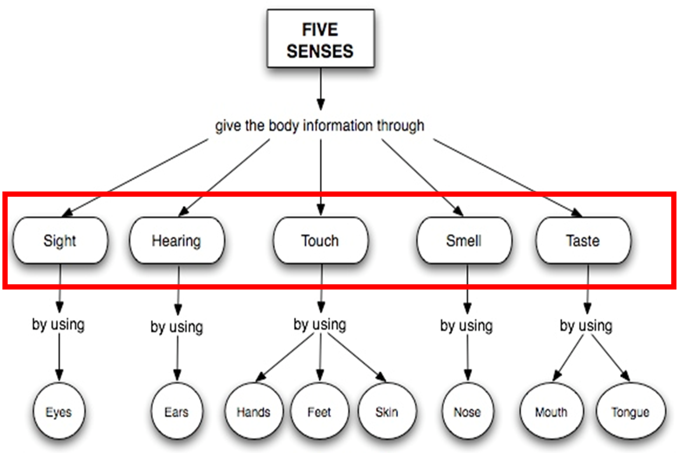
Law and Grace: The SOM – Matthew 5:1–8:1 (Luke 6:17–49)

Slide 59
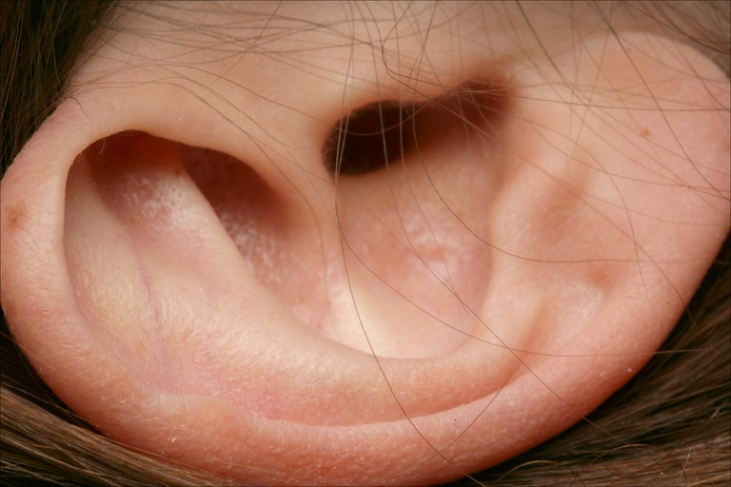
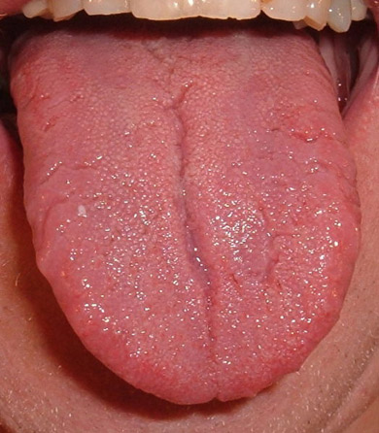
Law and Grace: The SOM – Matthew 5:1–8:1 (Luke 6:17–49)
We have five senses in the physical realm…
…and we have the ‘analog’ of these five in the spiritual realm!

Slide 60
Law and Grace: The SOM – Matthew 5:1–8:1 (Luke 6:17–49)

Slide 61
Law and Grace: The SOM – Matthew 5:1–8:1 (Luke 6:17–49)
PHYSICAL REALM
SPIRITUAL REALM
BODY
SPIRIT
BRAIN
SOUL
A BIBLICAL PHYSICAL / SPIRITUAL ANATOMY

Slide 62
Law and Grace: The SOM – Matthew 5:1–8:1 (Luke 6:17–49)
PHYSICAL REALM
SPIRITUAL REALM
BODY
SPIRIT
MIND
BRAIN
EMOTIONS
SOUL
WILL
A BIBLICAL PHYSICAL / SPIRITUAL ANATOMY

Slide 63
Law and Grace: The SOM – Matthew 5:1–8:1 (Luke 6:17–49)
PHYSICAL REALM
SPIRITUAL REALM
BODY
SPIRIT
MIND
BRAIN
EMOTIONS
SOUL
 HEBREWS 4:12
WILL
A BIBLICAL PHYSICAL / SPIRITUAL ANATOMY

Slide 64
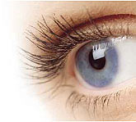
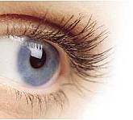
Law and Grace: The SOM – Matthew 5:1–8:1 (Luke 6:17–49)
PHYSICAL REALM
SPIRITUAL REALM
BODY
SPIRIT
FIVE SENSES
MIND
FIVE SENSES
BRAIN
EMOTIONS
SOUL
 HEBREWS 4:12
WILL
A BIBLICAL PHYSICAL / SPIRITUAL ANATOMY

Slide 65
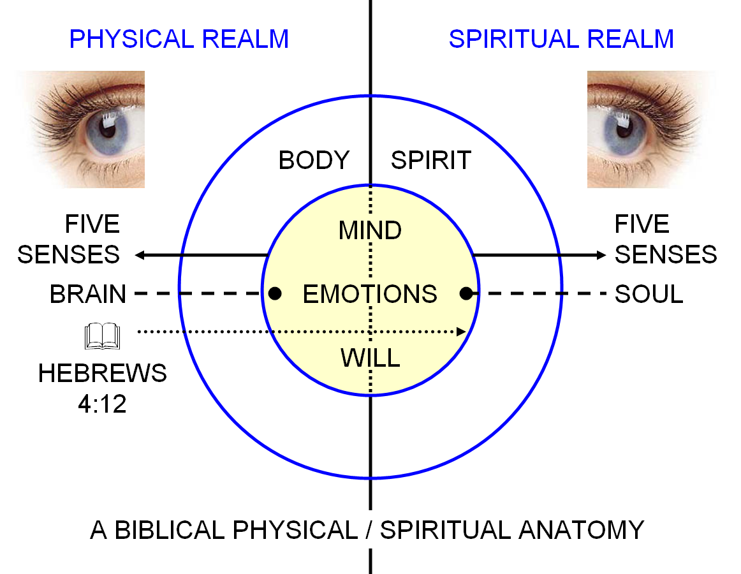
Ephesians 1:18
I pray that the eyes of your heart may be [literally, ‘having been’], enlightened, so that you will know what is the hope of His calling, what are the riches of the glory of His inheritance in the saints,…”

Slide 66
Matthew 6:16-24
¹⁹ “Do not store up for yourselves treasures on earth, where moth and rust destroy, and where thieves break in and steal. ²⁰ “But store up for yourselves treasures in heaven, where neither moth nor rust destroys, and where thieves do not break in or steal; ²¹ for where your treasure is, there your heart will be also. ²² “The eye is the lamp of the body; so then if your eye is clear, your whole body will be full of light. ²³ “But if your eye is bad, your whole body will be full of darkness. If then the light that is in you is darkness, how great is the darkness! ²⁴ “No one can serve two masters; for either he will hate the one and love the other, or he will be devoted to one and despise the other. You cannot serve God and wealth.

Slide 67
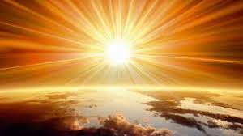
Ephesians 5:8
…for you were formerly darkness, but now you are Light in the Lord; walk as children*of Light [God is Light: 1 John 1:5].
* to be a ‘child of’ or a ‘son of’ in the Bible, unless it is a literal relationship, means: “to be like in character and close in relationship”.

Slide 68
Matthew 6:16-24
¹⁹ “Do not store up for yourselves treasures on earth, where moth and rust destroy, and where thieves break in and steal. ²⁰ “But store up for yourselves treasures in heaven, where neither moth nor rust destroys, and where thieves do not break in or steal; ²¹ for where your treasure is, there your heart will be also. ²² “The eye is the lamp of the body; so then if your eye is clear, your whole body will be full of light. ²³ “But if your eye is bad, your whole body will be full of darkness. If then the light that is in you is darkness, how great is the darkness! ²⁴ “No one can serve two masters; for either he will hate the one and love the other, or he will be devoted to one and despise the other. You cannot serve God and wealth.

Slide 69
Law and Grace: The SOM – Matthew 5:1–8:1 (Luke 6:17–49)
“The Servant of Two Masters”
Matthew 6:24

Slide 70
Law and Grace: The SOM – Matthew 5:1–8:1 (Luke 6:17–49)
Matthew 6:24 in poetic pattern
No one can serve two masters;
for either
he will hate the one and
love the other,
or
he will be devoted to one and
despise the other.
You cannot serve God and wealth.

Slide 71
Law and Grace: The SOM – Matthew 5:1–8:1 (Luke 6:17–49)
Matthew 6:24 in poetic pattern
No one can serve two masters;
for either
he will hate the one and
love the other,
or
he will be devoted to one and
despise the other.
You cannot serve God and wealth.

Slide 72
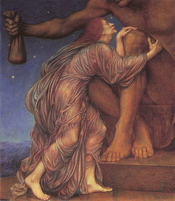
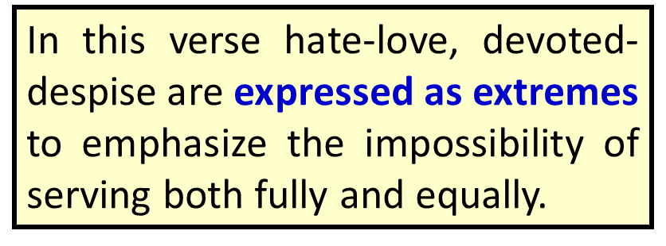
Law and Grace: The SOM – Matthew 5:1–8:1 (Luke 6:17–49)
Matthew 6:24 in poetic pattern
No one can serve two masters;
for either
he will hate the one and
love the other,
or
he will be devoted to one and
despise the other.
You cannot serve God and wealth.
* hyperbole an obvious and intentional exaggeration used for stress or emphasis; not intended to be taken literally…i.e. I’m so hungry, I could eat a horse.

Slide 73
Session 34 Outline
Review
Purpose, Aim, and Objective
Session 33
Hearts, Eyes & What One Cannot Do – Matt. 6:16-24
General Information
Matt. 6:16-24
Concluding Observations

Slide 74
Law and Grace: The SOM – Matthew 5:1–8:1 (Luke 6:17–49)
“What do these have in common? ”
Matthew 6:16-24
So, what do vv. 16-24, these four parts, have in common?

Slide 75
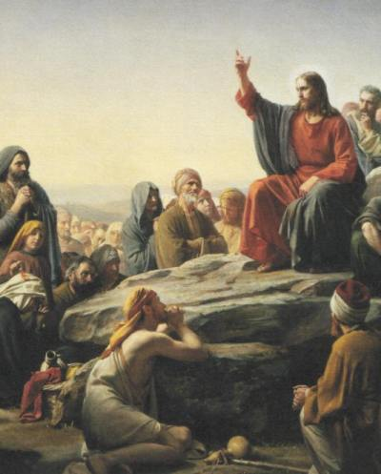
Law and Grace: The SOM – Matthew 5:1–8:1 (Luke 6:17–49)
“What do these have in common? ”
Matthew 6:16-24
Optional fasting for us in the body of Christ, and prayer (which is not optional), are to be focused on the Lord, and from the heart – not toward other people or just to enhance one’s sense of self worth.

Slide 76
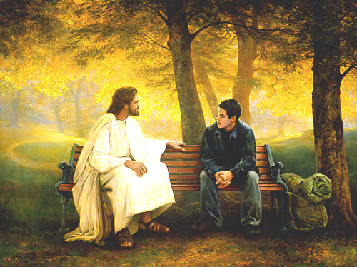
Law and Grace: The SOM – Matthew 5:1–8:1 (Luke 6:17–49)
“What do these have in common? ”
Matthew 6:16-24
The rest of this passage is about placing the highest value on spiritual relationships, the first of which is our relationship with the Lord Himself.
Only then does our life here make sense.

Slide 77
We who are in the Body of Christ – the Church - have been baptized into Christ, so that we are in Christ by God’s doing.
We who are in the Body of Christ – the Church – have Christ in us.

Slide 78
Law and Grace: An Overview Jim McGowan, Th.D. Sugar Land Bible Church 10-02-2022
…but grace and truth were realized through Jesus Christ - John 1:17
For the Law was given through Moses…
Special thanks to Dr. Vern Peterman for access to his insights and resources.

