Slide 1
Biblical Dispensationalism
Jim McGowan, MTS, Th.D.

Slide 2
What We’ve Covered…
Session | Topic | Date
001 | Introduction to Biblical Dispensationalism | 10‐03‐2018
002 | Introduction to Biblical Dispensationalism | 11‐07‐2018
003 | Introduction to Biblical Dispensationalism | 11‐14‐2018
004 | History of Biblical Dispensationalism | 02‐06‐2019
005 | History of Biblical Dispensationalism | 02‐13‐2019
006 | History of Biblical Dispensationalism | 03‐20‐2019
007 | History of Biblical Dispensationalism | 04‐03‐2019
008 | False Charges Against Biblical Dispensationalism | 10‐02‐2019
009 | False Charges Against Biblical Dispensationalism | 02‐26‐2020
010 | False Charges Against Biblical Dispensationalism | 09‐30‐2020
011 | Israel & The Church | 10‐14‐2020
012 | Fundamental Aspects & The Biblical Covenants | 12‐09‐2020
013 | Biblical Dispensations ‐ Innocence thru Conscience | 10‐06‐2021
014 | Biblical Dispensations ‐ Human Government - Promise - Law | 09-21-2022

Slide 3
The Story of the Bible:
From a Garden to a City, and Beyond!

Slide 4
Biblical Dispensationalism
Session 14 - The Dispensations
Review - Human Government – Promise – Law

Slide 5
The Dispensations
Innocence / Innocency
Conscience
Human / Civil Government
Promise / Patriarchal Rule
Law-Israel / Mosaic Law
Church Age / Grace
***The Tribulation***
Millennial Kingdom / Millennium
***Eternal State***

Slide 6
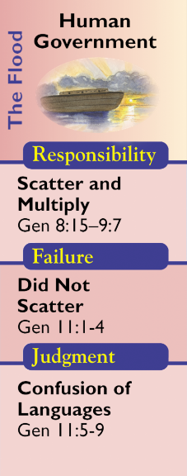
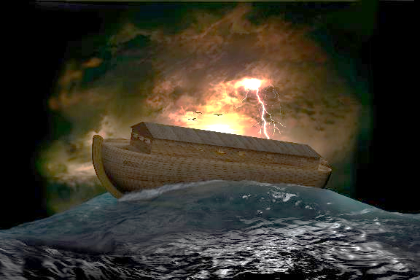
Human Government

Slide 7
Human Government (Gen. 8:15-11:9)
The Dispensation of Human Government begins when Noah and his family leave the ark. Civil Government was not invented by mankind but was instituted by God Himself.
God's revealed will is that evil is to be restrained through the corporate institution of civil government (and corporal punishment) instead of personal vengeance (Lamech - Genesis 4:24).
https://www.pre-trib.org/dr-thomas-ice/message/covenants-and-dispensations-part-10/read
… God gave man the right to take the life of man, which…gave man the authority to govern others. Unless government has the right to the highest form of punishment, its basic authority is questionable and insufficient to protect properly those it governs…
Ryrie, C. C. (1995). Dispensationalism (Rev. and expanded., p. 61). Chicago: Moody Publishers.

Slide 8
Genesis 9:6
⁶ “Whoever sheds man’s blood, By man his blood shall be shed, For in the image of God He made man. (cf. Rom. 13:1-7; 1 Pet. 2:13-17)
God instituted
capital punishment for Murder!

Slide 9
Human Government (Gen. 8:15-11:9)
With the absence of a threat of God's direct intervention through an instrument like the flood, man's responsibility is to mediate and restrain mankind's evil through capital punishment of certain offenses (Gen. 9:6; Rom. 13:1-7; 1 Pet. 2:13-17).
The consequences relate to man's failure to carry out God's will to restrain evil. Because of this God intervened in the tower of Babel incident (Gen. 11:1-9). The chief personage during this economy was Noah. The new revelation of this time included animals’ fear of man, animals given to man to eat, the promise of no further floods, and the institution of capital punishment. It is the latter [capital punishment] that gives the distinctive basis to this dispensation as that of human, or civil, government. . . .
https://www.pre-trib.org/dr-thomas-ice/message/covenants-and-dispensations-part-10/read

Slide 10
Human Government (Gen. 8:15-11:9)
…The people, instead of obeying God’s command to scatter and fill the earth [Noahic Covenant], conceived the idea of staying together and building the tower of Babel to help achieve their aim. Fellowship with man replaced fellowship with God. As a result, God sent the judgment of the tower of Babel and the confusion of languages.
Ryrie, C. C. (1995). Dispensationalism (Rev. and expanded., p. 61). Chicago: Moody Publishers.

Slide 11
The Biblical Covenants
Noahic Covenant (Genesis 9:1-17)
Parties to the Covenant
Conditions of the Covenant
God and Noah as the representative for mankind
Rainbow
Be fruitful, multiply and fill the earth
Token of the Covenant
Mankind to be feared by animals
Mankind allowed to eat meat
Mankind not to eat or drink blood
Institution of capital punishment
Never again a universal flood

Slide 12
Human Government (Gen. 8:15-11:9)
Man’s Responsibilities
Man’s responsibilities were to fulfill the Noahic covenant.
Man’s Failures
The people, instead of obeying God’s command to scatter and fill the earth, conceived the idea of staying together and building the tower of Babel to help achieve their aim. Fellowship with man replaced fellowship with God.
The Resulting Judgment
As a result, God sent the judgment of the tower of Babel and the confusion of languages. He also graciously intervened in that He did not utterly destroy the nations but chose to deal graciously with Abraham and his descendants.

Slide 13
The Dispensations
Innocence / Innocency
Conscience
Human / Civil Government
Promise / Patriarchal Rule
Law-Israel / Mosaic Law
Grace-Church Age / Grace
***The Tribulation***
Millennial Kingdom / Millennium
***Eternal State***

Slide 14
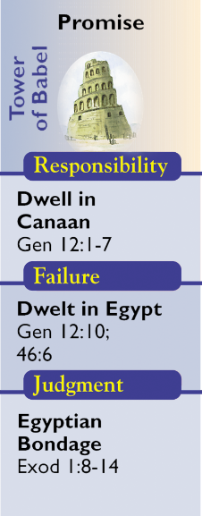
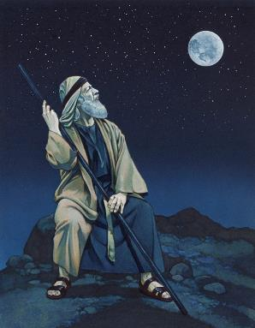
Promise

Slide 15
Promise (Gen. 11:10-Ex. 18:27)
The Dispensation of Promise (so named by Paul in Galatians 3:15-22; 4:23,28; cf. also, Hebrews 6:15 and 11:9) begins with the call of Abram and ends with the foundation of Israel as a nation through the giving of the Law at Mount Sinai (Ex. 19).
During the age of Promise God revealed His will through the giving of the Abrahamic Covenant and its outworking in history. Abram's responsibility was to dwell in the land. The consequences were that when Israel disobeyed God He would discipline His people.
https://www.pre-trib.org/dr-thomas-ice/message/covenants-and-dispensations-part-10/read

Slide 16
The Biblical Covenants
Abrahamic Covenant (Genesis 9:1-17)
Parties to the Covenant
Conditions of the Covenant
God and Abram as the representative for mankind
Circumcision
Fourteen Provisions
Token of the Covenant

Slide 17
14 PROVISIONS OF THE ABRAHAMIC COVENANT
Fruchtenbaum, A. G. (2001). Israelology: The missing link in systematic theology (p. 575). Ariel Ministries.

Slide 18
Promise (Gen. 11:10-Ex. 18:27)
The governmental feature of the economy is best emphasized by the designation Dispensation of Patriarchal Rule. Until this dispensation, all mankind had been directly related to God’s governing principles. Now God marked out one family and one nation and in them made a representative test of all.
The responsibility of the patriarchs was simply to believe and serve God, and God gave them every material and spiritual provision to encourage them to do this. The Promised Land was theirs, and blessing was theirs as long as they remained in the land. But,…Jacob led the people to Egypt, and soon the judgment of slavery was brought on them.
Ryrie, C. C. (1995). Dispensationalism (Rev. and expanded., p. 61). Chicago: Moody Publishers.

Slide 19
Promise (Gen. 11:10-Ex. 18:27)
The responsibility of the patriarchs was simply to believe and serve God, and God gave them every material and spiritual provision to encourage them to do this. The Promised Land was theirs, and blessing was theirs as long as they remained in the land. But,…Jacob led the people to Egypt, and soon the judgment of slavery was brought on them.
Ryrie, C. C. (1995). Dispensationalism (Rev. and expanded., p. 62). Chicago: Moody Publishers.

Slide 20
Promise (Gen. 11:10-Ex. 18:27)
Abrahamic Covenant (Genesis 12:1-3)
Man’s Responsibilities
The responsibility of the patriarchs was simply to believe and serve God. The Promised Land was theirs, and blessing was theirs as long as they remained in the land. The people of the promise; Abraham, Isaac, Jacob, and the children of Jacob (Israel) were to stay separate from the nations around them.
Man’s Failures
Abraham, Isaac, Jacob and his twelve sons continued to intermingle with the Canaanites and surrounding nations.
The Resulting Judgment
God sent the family down to Egypt where the surrounding Egyptians would not associate with them. Soon after they would be enslaved.

Slide 21
The Dispensations
Innocence / Innocency
Conscience
Human / Civil Government
Promise / Patriarchal Rule
Law-Israel / Mosaic Law
Grace-Church Age / Grace
***The Tribulation***
Millennial Kingdom / Millennium
***Eternal State***

Slide 22
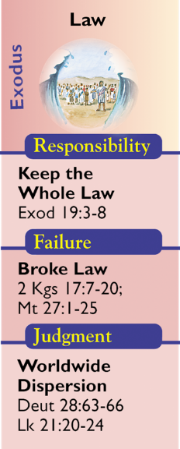
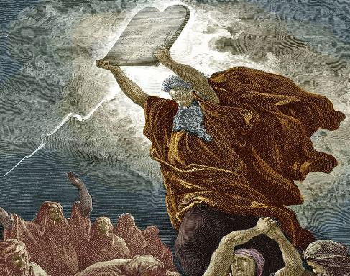
Law-Israel

Slide 23
Law (Ex. 19:1 – Acts 1:26)
This dispensation began when Israel is established as a nation at the Exodus and given the Law.…[The Law] was their rule of life that governed ever aspect of life. But it was temporary until the coming and fulfillment by Christ.
Israel's responsibility was to obey the Mosaic Law in order to show their loyalty to the Lord.
Israel, as a nation, [miserably] failed to keep the Mosaic Law which resulted in the many judgments spelled out in Deuteronomy 28 and Leviticus 26, the ultimate judgment resulting in their captivity while scattered among the nations.
https://www.pre-trib.org/dr-thomas-ice/message/covenants-and-dispensations-part-10/read

Slide 24
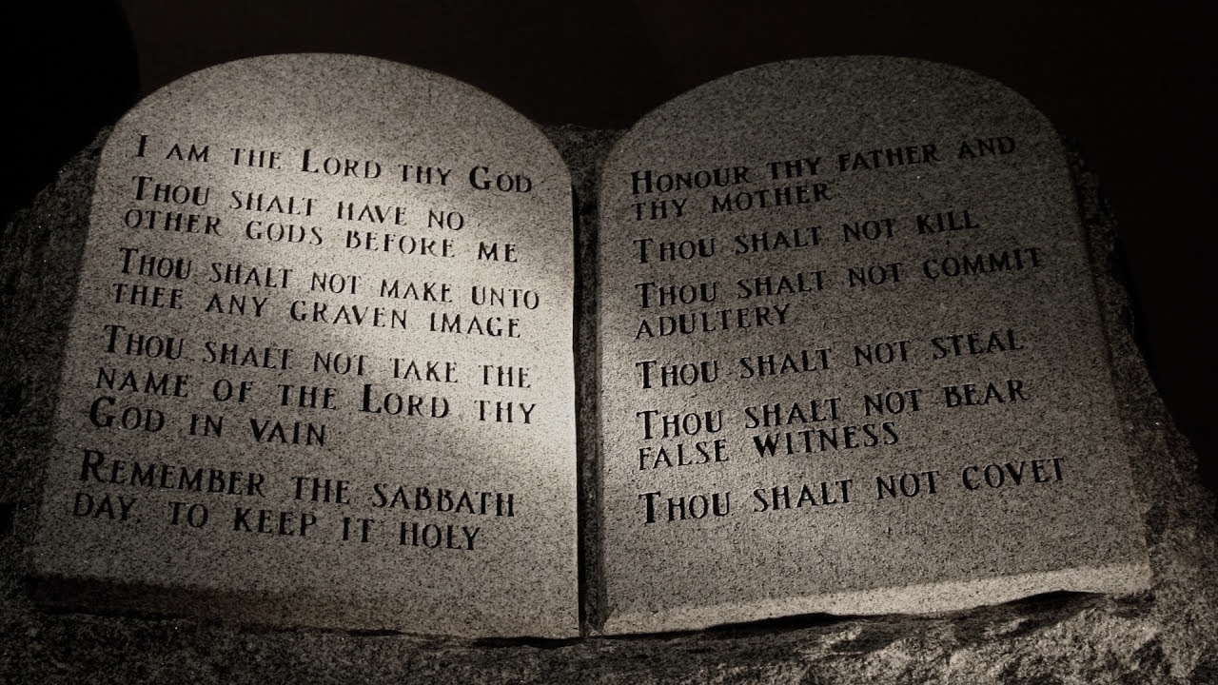
Law (Ex. 19:1 – Acts 1:26)
To the children of Israel through Moses were given the great code that we call the Mosaic Law. It consisted of 613 commandments covering all phases of life and activity. It revealed in specific detail God’s will in that economy. The period covered was from Moses until the death of Christ, or from Exodus 19:1 to Acts 1:26 (~1,500 years).
Ryrie, C. C. (1995). Dispensationalism (Rev. and expanded., p. 63). Chicago: Moody Publishers.

Slide 25
Law (Ex. 19:1 – Acts 1:26)
The people were responsible to keep all the Law (James 2:10), but they failed (Rom. 10:1–3). As a result,...The ten tribes were carried into Assyrian captivity; the two tribes [Judah & Benjamin] were carried into Babylonian captivity; and later, because of their rejection of Jesus of Nazareth, the people were dispersed into all the world (Matt. 23:37–39)... [their] promises of a glorious future are guaranteed secure by the Abrahamic promises,…(Gal. 3:3–25). We are also told clearly in the New Testament (Rom. 3:20) that the law was not a means of justification but of condemnation. . . .

Slide 26
The Biblical Covenants
Mosaic Covenant (Exodus 20:1 – Deut. 28:68)
Parties to the Covenant
Conditions of the Covenant
God and Israel with Moses acting as a representative
Sabbath
Law of Moses which contained a total 613 commandments. Being a conditional covenant, it provided blessings for obedience and curses for disobedience. (Ex. 15:26) The key element of the entire Mosaic Law was the blood sacrifice. (Lev. 17:11)
Token of the Covenant

Slide 27
Law (Ex. 19:1 – Acts 1:26)
Man’s Responsibilities
The responsibility of the Nation of Israel along with Gentile proselytes was to keep the Mosaic Law.
Man’s Failures
The Nation of Israel was continually disobedient, yet God continued to bring them back through discipline. They continued to reject the ordinances of God. (2 Kings 17:7-23)
The Resulting Judgment
As a result, there were many judgments throughout this long period. The ten tribes were carried into Assyrian captivity; the two tribes were carried into Babylonian captivity; and later, because of their rejection of Jesus of Nazareth, the people were dispersed into all the world (Matt. 23:37–39).

Slide 29
Biblical Dispensationalism
Session 15 - The Dispensations
Church Age – Grace

Slide 30
The Dispensations
Innocence / Innocency
Conscience
Human / Civil Government
Promise / Patriarchal Rule
Law-Israel / Mosaic Law
Church Age / Grace
***The Tribulation***
Millennial Kingdom / Millennium
***Eternal State***

Slide 31
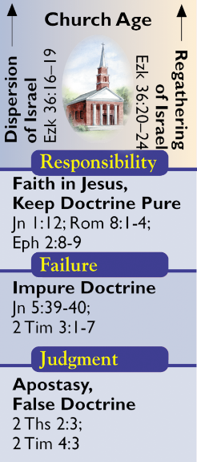
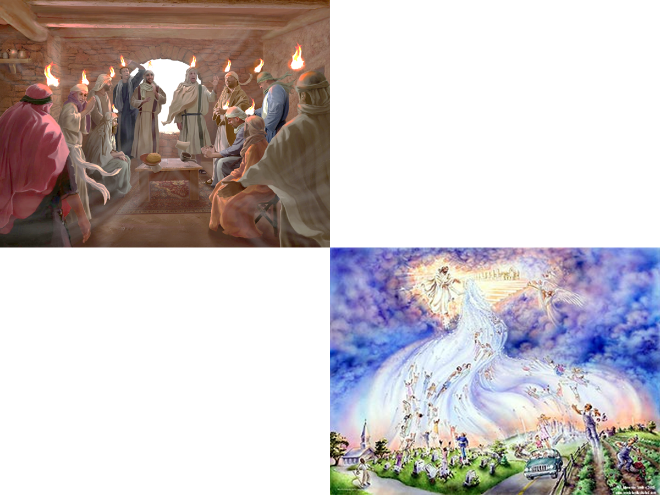
Grace/Church Age

Slide 32
Grace/Church Age (Acts 2:1-Rev. 19:21)
The church age began on the Day of Pentecost (Acts 2). The rule of life for the church is grace. All aspects of life are to spring forth from grace for the church age believer and the extent of God's grace is expanded to all peoples through the worldwide offer of the gospel. This does not mean that there was no grace before the events of Acts 2, rather that this is a time in which God magnifies His grace through the global preaching of the gospel to all mankind.
Man's responsibility during the current age is to accept the gift of Christ's righteousness which is freely offered to all mankind (Rom. 5:15-18).
https://www.pre-trib.org/dr-thomas-ice/message/covenants-and-dispensations-part-10/read

Slide 33
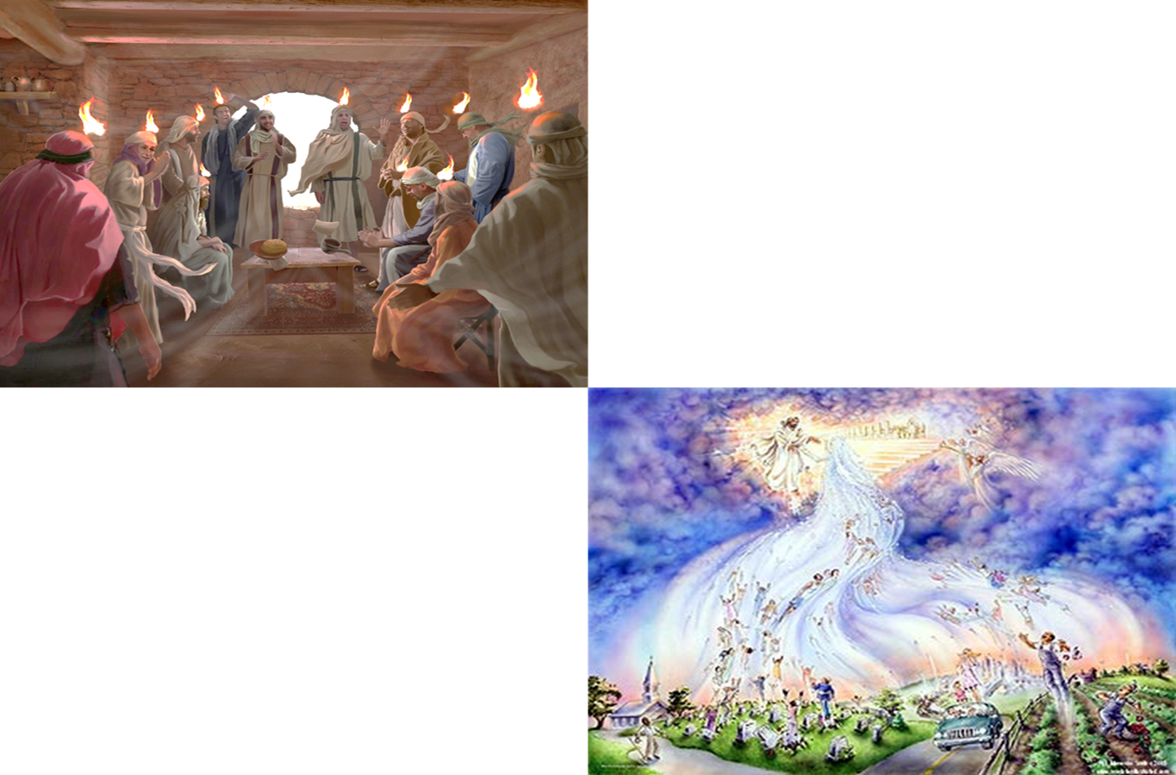
Grace/Church Age (Acts 2:1-Rev. 19:21)
The Church Age ends with the Rapture of the church when the last member of the Body of Christ comes to faith in Jesus as their Messiah.
The Grace Dispensation ends in the judgment of the tribulation upon a Christ-rejecting world.
https://www.pre-trib.org/dr-thomas-ice/message/covenants-and-dispensations-part-10/read

Slide 34
Grace/Church Age (Acts 2:1-Rev. 19:21)
The apostle Paul was principally, though not exclusively, the agent of the revelation of the grace of God for this dispensation. Christ Himself brought the grace of God to mankind in His incarnation (Titus 2:11), but Paul was the one who expounded it. To be sure, the dispensationalist does not say that there was no grace ever displayed before the coming of Christ (any more than he says there is no law after His coming), but the Scriptures do say that His coming displayed the grace of God in such brightness that all previous displays could be considered as nothing. Under Grace the responsibility on man is to accept the gift of righteousness that God freely offers to all (Rom. 5:15–18).
https://www.pre-trib.org/dr-thomas-ice/message/covenants-and-dispensations-part-10/read

Slide 35
Grace/Church Age (Acts 2:1-Rev. 19:21)
There are two aspects of the grace of God in this economy:
the blessing [the gift of righteousness] is entirely of grace and
that grace is for all.
God is no longer dealing with just one nation as a sample but with all mankind. The vast majority have rejected Him and as a result will be judged. The dispensation will end at the Second Coming of Christ since, as suggested, the tribulation period itself is not a separate dispensation but is the judgment on those living persons who are Christ rejecters at the end of this present dispensation. The Scripture involved is Acts 2:1 to Revelation 19:21.
Ryrie, C. C. (1995). Dispensationalism (Rev. and expanded., p. 64). Chicago: Moody Publishers.

Slide 36
Grace/Church Age (Acts 2:1-Rev. 19:21)
Man’s Responsibilities
Under Grace the responsibility on man is to accept the gift of righteousness that God freely offers to all (Rom. 5:15–18).
Man’s Failures
The vast majority have rejected Him and as a result will be judged. The dispensation will end at the Second Coming of Christ.
The Resulting Judgment
The judgment of non-believers is death.
The judgment of believers for not walking with Christ is a loss of rewards.
The earth, which was to be controlled by Adam but was handed over to Satan, will be ruled by the Lord Jesus Christ.

Slide 37
John 1:12
But as many as received Him, to them He gave the right to become children of God, even to those who believe in His name,
Romans 8:1–4
¹ Therefore there is now no condemnation for those who are in Christ Jesus. ² For the law of the Spirit of life in Christ Jesus has set you free from the law of sin and of death. ³ For what the [Mosaic] Law could not do, weak as it was through the flesh, God did: sending His own Son in the likeness of sinful flesh and as an offering for sin, He condemned sin in the flesh, ⁴ so that the requirement of the [Mosaic] Law might be fulfilled in us, who do not walk according to the flesh but according to the Spirit.

Slide 38
Ephesians 2:8–9
⁸ For by grace (fem.) you have been saved through faith (fem.); and that (καὶ τοῦτο neu.) not of yourselves, it is the gift (neu.) of God; ⁹ not as a result of works, so that no one may boast.
“SALVATION BY GRACE THROUGH FAITH”
IS “THE GIFT OF GOD”!

Slide 39
τοῦτο…What’s the Antecedent?
…The standard interpretations include: (1) “grace” as antecedent [of τοῦτο], (2) “faith” as antecedent [of τοῦτο], (3) the concept of a grace-by-faith salvation as antecedent [of τοῦτο], and (4) καὶ τοῦτο [taken together] having an adverbial force with no antecedent (“and especially”)…More plausible is the third view, viz., that τοῦτο refers to the concept of a grace-by-faith salvation.
A fourth view is that καὶ τοῦτο is adverbial,…If this is the force in Eph 2:8, the text means “for by grace you are saved through faith, and [you are saved] especially not by your own doing; it is the gift of God.”…syntactical considerations do tend toward one of the latter two views (3 or 4).
Wallace, D. B. (1996). Greek Grammar beyond the Basics:
An Exegetical Syntax of the New Testament (p. 334). Zondervan.

Slide 40
John 5:39–40
³⁹ “You search the Scriptures because you think that in them you have eternal life; it is these that testify about Me; ⁴⁰ and you are unwilling to come to Me so that you may have life.
Unwilling!

Slide 41
2 Timothy 4:3-4
³ For the time will come when they will not endure sound doctrine; but wanting to have their ears tickled, they will accumulate for themselves teachers in accordance to their own desires, ⁴ and will turn away their ears from the truth and will turn aside to myths. (cf. 2 Timothy 3:1–7)

Slide 42
The Church was a “Mystery” “MYSTERY” DEFINED
“In the N.T, it [mystērion] denotes, not the mysterious (as with the Eng. word), but that which, being outside the range of unassisted natural apprehension, can be made known only by Divine revelation, and is made known in a manner and at a time appointed by God, and to those who are illumined by His Spirit.”
W. E. Vine, Merrill F. Unger, and William White, Vine's Complete Expository Dictionary of the Old and New Testament Words (Nashville: Nelson, 1996), 424.

Slide 43
Grace-Church Age (Acts 2:1-Rev. 19:21)
Notes:
Shows that Church Age and Grace Age are different.

Slide 44
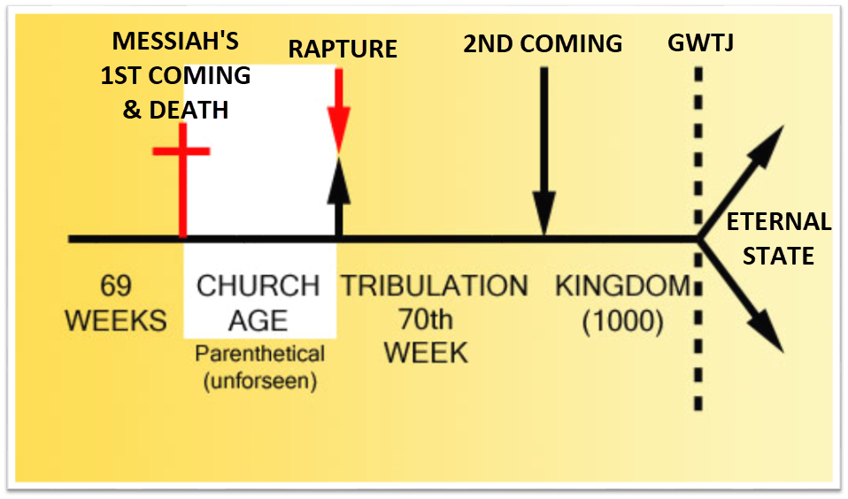
Grace-Church Age (Acts 2:1-Rev. 19:21)

Slide 45
Grace-Church Age (Acts 2:1-Rev. 19:21)

Slide 46
Grace-Church Age (Acts 2:1-Rev. 19:21)

Slide 47
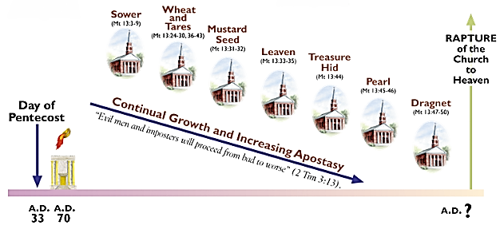
Grace-Church Age (Acts 2:1-Rev. 19:21)

Slide 48
Grace-Church Age (Acts 2:1-Rev. 19:21)
The parables of this chapter [Mat. 13] were spoken by Christ “the same day” as when the Pharisees had taken council together to destroy Him, as when they had committed the unpardonable sin, as when He had pronounced solemn judgment upon the Nation, and as when He had severed the fleshly ties which united Him to the Jews and had intimated that henceforth there should be a people united to Him by spiritual bonds. Thus, the relation between Matthew 12 and Matthew 13 is that of cause to effect; in other words, Matthew 12 makes known the cause which led up to Christ’s acting as He did in the thirteenth chapter: that cause was Israel’s rejection of their King and His rejection of them. His action in Matthew 13:1 was indicative of a great dispensational crisis, it was an anticipation of what is found developed at length in the books of Acts—God, temporarily, turning away from the Jews and turning unto the Gentiles.
A. W. Pink (2005). The Prophetic Parables of Matthew Thirteen. Bellingham, WA: Logos Bible Software.

Slide 49
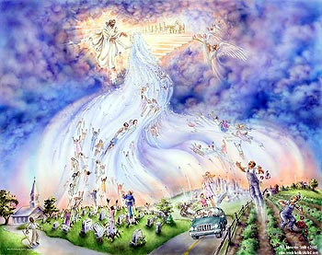
Grace-Church Age (Acts 2:1-Rev. 19:21)

Slide 50
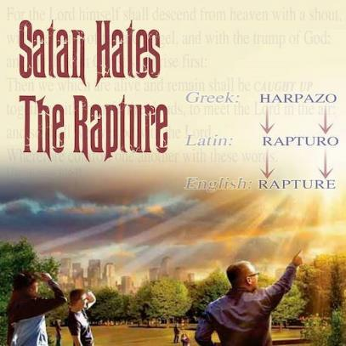
Catching Away of All Living Believers (1 Thess 4:17)
Grace-Church Age (Acts 2:1-Rev. 19:21)
Harpadzo = seized or caught up by force
Harpadzo (Greek)
Rapturo (Latin)
Rapture (English)

Slide 51
1 Thessalonians 4:17-18
¹⁷ Then we who are alive and remain will be caught up together with them in the clouds to meet the Lord in the air, and so we shall always be with the Lord. ¹⁸ Therefore comfort one another with these words.

Slide 52
RAPTURE VS. SECOND ADVENT
RAPTURE (1 Thess 4:13-17; 1 Cor 15:51-57) | SECOND COMING (Rev 19:11-16)
Christ comes in the air (1 Thess 4:16-17) | Christ comes to the earth (Zech 14:4)
For His saints (1 Thess 4:15-17) | With His saints (Rev 19:14)
Blessing (1 Thess 4:18) | Judgment (Rev 19:15)
Effects only believers (1 Thess 4:16) | Effects both believers and unbelievers (Rev 19:15)
Invisible (1 Thess 4:16) | Visible to all (Rev 1:7)
Announced only by an archangel (1 Thess 4:16) | Involves myriads of angels (Jude 14)
Resurrection (1 Cor 15: 51) | No resurrection
Rescue of the church (1 Thess 1:10) | Rescue of Israel (Matt 23:37-39)

Slide 53
Grace-Church Age (Acts 2:1-Rev. 19:21)

Slide 54
2 Corinthians 5:10
“For we must all appear before the judgment seat of Christ, so that each one may be recompensed for his deeds in the body, according to what he has done, whether good or bad.” (cf. Romans 14:12; 1 Cor. 4:2; John 15:5, 8)

Slide 55
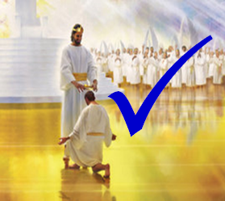
The Bema Seat – Why?
Grace-Church Age (Acts 2:1-Rev. 19:21)
Not to judge sin (John 19:30)
Not to determine salvation (John 5:24)
But to dispense or deny rewards

Slide 56
John 19:30
THE BEMA SEAT IS NOT TO JUDGE SIN
Therefore when Jesus had received the sour wine, He said, “It is finished!” And He bowed His head and gave up His spirit.
John 5:24
THE BEMA SEAT IS NOT TO DETERMINE SALVATION
“Truly, truly, I say to you, he who hears My word, and believes Him who sent Me, has eternal life, and does not come into judgment, but has passed out of death into life.

Slide 57
1 Corinthians 3:10–15
THE BEMA SEAT IS TO DISPENSE OR DENY REWARDS
¹⁰ According to the grace of God which was given to me, like a wise master builder I laid a foundation, and another is building on it. But each man must be careful how he builds on it. ¹¹ For no man can lay a foundation other than the one which is laid, which is Jesus Christ. ¹² Now if any man builds on the foundation with gold, silver, precious stones, wood, hay, straw, ¹³ each man’s work will become evident; for the day will show it because it is to be revealed with fire, and the fire itself will test the quality of each man’s work. ¹⁴ If any man’s work which he has built on it remains, he will receive a reward. ¹⁵ If any man’s work is burned up, he will suffer loss; but he himself will be saved, yet so as through fire.

Slide 58
Grace-Church Age (Acts 2:1-Rev. 19:21)
Scripture’s Five Crowns (Rev 4:10: 3:11; 2 John 8)
Scripture | Crown | Purpose
1 Cor. 9:24-27 | Incorruptible | Gaining mastery over the flesh
1 Thess. 2:19-20 | Rejoicing | Soul winning
Jas. 1:12; Rev. 2:10 | Life | Enduring trials
1 Pet. 5:2-4 | Glory | Shepherding God’s people
2 Tim. 4:8 | Righteousness | Longing for His appearing

Slide 59
Samuel Hoyt
“The Judgment Seat of Christ in Theological Perspective,” Part 2, Bibliotheca Sacra, vol. 137, Issue 546 electronic media.
The judgment seat of Christ might be compared to a commencement ceremony. At graduation there is some measure of disappointment and remorse that one did not do better and work harder. However, at such an event the overwhelming emotion is joy, not remorse. The graduates do not leave the auditorium weeping because they did not earn better grades. Rather, they are thankful that they have been graduated, and they are grateful for what they did achieve. To overdo the sorrow aspect of the judgment seat of Christ is to make heaven hell. To underdo the sorrow aspect is to make faithfulness inconsequential. (bold & underline mine)

Slide 60
Grace-Church Age (Acts 2:1-Rev. 19:21)

Slide 61
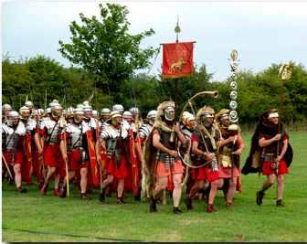
‘Order’ or Tagma (1 Cor. 15:23)
Grace-Church Age (Acts 2:1-Rev. 19:21)
BELIEVERS
General / First Fruits: Christ’s resurrection (1 Cor 15:23)
Officer / Rapture: Church Age Believers (1 Thess 4:13-18)
Soldiers / Gleanings: OT saints & Tribulation martyrs (Rev 20:4)
UNBELIEVERS
Captives: Unsaved of all ages (Rev 20:5)

Slide 62
Grace-Church Age (Acts 2:1-Rev. 19:21)
God’s Resurrection Program – Believers - Gleanings
Tribulational saints who die in the Tribulation cannot be raised until after the Tribulation. Rev. 6:10-11 pictures the disembodied souls of martyred Tribulational saints as crying out for vengeance during the Tribulation. According to Rev. 20:4-6 these souls were “beheaded because of the testimony of Jesus” and “come to life” just before the 1,000-year Kingdom and share in Christ’s rule.
In the context, this resurrection occurs after the Second Coming and after Armageddon (Rev. 19:11ff.). Although the Bible does not specifically give a time for the rewarding of the Tribulational saints, presumably they are rewarded in conjunction with the resurrection during the transition between Tribulation and Kingdom.
Steven W. Waterhouse, Not By Bread Alone, pg. 464, Third Edition 2006

Slide 63
The Tribulation's Concerns Israel.
Grace-Church Age (Acts 2:1-Rev. 19:21)
7 Arguments Favoring the Pre-Tribulation Rapture View
Jer 30:7; Dan 9:24
God uses Israel and the Church on a mutually exclusive basis

Slide 64
Absolutely no biblical reference to the church on earth during the Tribulation.
Grace-Church Age (Acts 2:1-Rev. 19:21)
7 Arguments Favoring the Pre-Tribulation Rapture View
Rev 4-19
Rev 13:9
Revelation’s Jewish nature

Slide 65
Church is promised an exemption from divine wrath.
Grace-Church Age (Acts 2:1-Rev. 19:21)
7 Arguments Favoring the Pre-Tribulation Rapture View
The promise (1 Thess 1:10; 5:9; Rom 5:9; Rev 3:10)
Tribulation = divine wrath (Rev 6:16-17; 11:18; 15:1, 7; 16:19)

Slide 66
The Rapture is imminent (1 Cor 15:51; 1 Thess 4:15).
Grace-Church Age (Acts 2:1-Rev. 19:21)
7 Arguments Favoring the Pre-Tribulation Rapture View
Imminency definition
James 5:8; 1 Thess 1:10; 1 Cor 1:7; Philip 3:20
We are to be looking for Jesus Christ and not the Antichrist!
Motivator (Holiness, Evangelism)

Slide 67
The Rapture is Comfort (1 Thess. 4:18)
Grace-Church Age (Acts 2:1-Rev. 19:21)
7 Arguments Favoring the Pre-Tribulation Rapture View
John 14:1; 1 Thess. 4:18; Titus 2:13
Other rapture views are not comforting since they place the church into divine wrath.

Slide 68
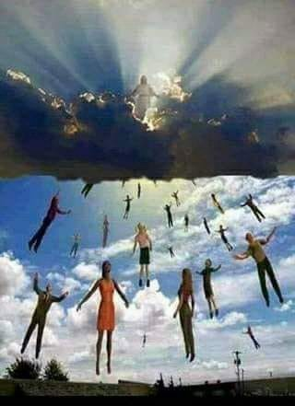
The Antichrist cannot come to power until the restrainer is removed.
Grace-Church Age (Acts 2:1-Rev. 19:21)
7 Arguments Favoring the Pre-Tribulation Rapture View
Restrainer holds back the Antichrist (2 Thess 2:6-7)
Restrainer = the omnipotent Holy Spirit (2 Thess 2:9)
Holy Spirit permanently indwells all Christians (John 14:16; Rom 8:9)
Spirit indwelt Christians must first be removed prior to the Antichrist's advent

Slide 69
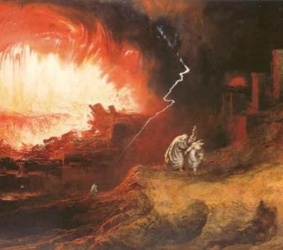
Symbolic Biblical Parallels
Grace-Church Age (Acts 2:1-Rev. 19:21)
7 Arguments Favoring the Pre-Tribulation Rapture View
2 Peter 2:5-9
Enoch taken before the flood (Gen 5:24)
Noah protected before the flood (Gen 7:6-7)
Lot taken before judgment upon Sodom (2 Pet 2:7; Gen 19:22)

Slide 70
CONCLUSION

Slide 71
The Dispensations
Innocence / Innocency
Conscience
Human / Civil Government
Promise / Patriarchal Rule
Law-Israel / Mosaic Law
Church Age / Grace
***The Tribulation***
Millennial Kingdom / Millennium
***Eternal State***

Slide 72
Resources Used & Suggested
Alva J. McClain, Law & Grace, Moody, 1967 978-088469-001-6
A. G. Fruchtenbaum, Israelology: The Missing Link in Systematic Theology, Ariel Ministries 1994, 978-0914863052
Charles C. Ryrie, Dispensationalism, Moody, 2007, 080242189X
Christopher Cone, gen. ed., Dispensationalism Tomorrow & Beyond, Tyndale Seminary Press, 2008 9780981479101
Christopher Cone, gen. ed., An Introduction To The New Covenant, Tyndale Seminary Press, 2013, 9781938484100
Thomas Ice, Covenants and Dispensations (Part 10), https://www.pre-trib.org/dr-thomas-ice/message/covenants-and-dispensations-part-10
Lewis S. Chafer, Major Bible Themes, Zondervan, 1974, 0-310-22390-3
Mike Stallard, gen .ed., Dispensational Understanding of the New Covenant, Regular Baptist Books, 2012, 9781607764946
Paul Enns, The Moody Handbook of Theology, Moody 1989,
Renald E. Showers, There Really Is A Difference, Friend of Israel Gospel Ministry, 1990, 0915540509
Rene Pache, The Inspiration and Authority of Scripture, Sheffield Pub Co, 1992
Roy B. Zuck, Basic Bible Interpretation, SP Publications, 1991
Walvoord, J. F., The Prophecy Knowledge Handbook. Wheaton, IL: Victor Books. 1990.
Charting the End Times CD-Rom: A Visual Guide to Understanding Bible Prophecy, ISBN-10: 0736917624
Materials from:
Ed Allsteadt, https://job42ministry.org/dispensational-clarity
Dr. Andy Woods, Sugar Land Bible Church, www.slbc.org
Dr. Vern Peterman, Holly Hills Bible Church, www.hollyhillsbiblechurch.org
George Zeller, Middletown Bible Church, www.middletownbiblechurch.org

