Slide 1
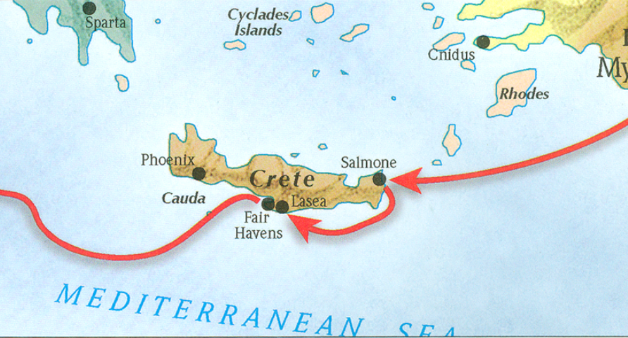
The book of Titus
Worthy of the Gospel

Slide 2
b. Addressing Doctrinal Issues (Titus 2:1-3:11)
Our Responsibilities? (3:1-8)
To civil authorities – 3.1
To the world in general – 3.2
Reasons for our behavior – 3.3-8
Handling false teachers – 3.9-11
Conclusion/Benediction – 3:12-15
Outline adapted from Titus Argument, Article by Andy Woods, 2007.

Slide 3
b. Addressing Doctrinal Issues (Titus 2:1-3:11)
Our Responsibilities? (3:1-8)
To civil authorities – 3.1
To the world in general – 3.2
Reasons for our behavior – 3.3-8
Handling false teachers – 3.9-11
Conclusion/Benediction – 3:12-15
Outline adapted from Titus Argument, Article by Andy Woods, 2007.

Slide 4
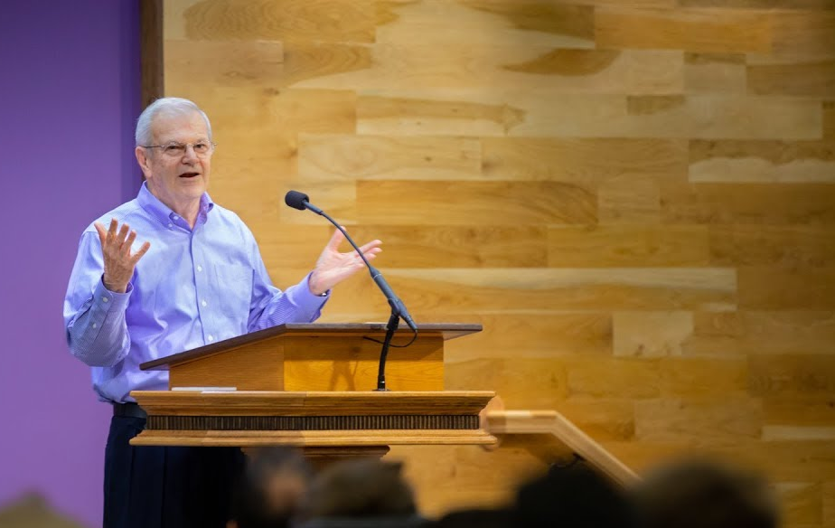
“Usually ‘grace’ refers to the principle by which God operates. Yet it also describes the sphere in which the believer lives, as here (cf. 5:2), as ‘the Law’ describes the old realm. ‘Under grace’ is not, however, a condition in which we are free from any responsibility (cf. Matt. 11:28-30; Titus 2:11-12), as Paul proceeded to clarify in verses 15-23.”
Thomas Constable, Notes on Romans – Romans 6:14, www.planobiblechapel.org.

Slide 5
Titus 3:4-7
But when the kindness of God our Savior and His love for mankind appeared, He saved us, not on the basis of deeds which we have done in righteousness, but according to His mercy, by the washing of regeneration and renewing by the Holy Spirit, whom He poured out upon us richly through Jesus Christ our Savior, so that being justified by His grace we would be made heirs according to the hope of eternal life

Slide 6
Titus 3:4-7
But when the kindness of God our Savior and His love for mankind appeared, He saved us, not on the basis of deeds which we have done in righteousness, but according to His mercy, by the washing of regeneration and renewing by the Holy Spirit, whom He poured out upon us richly through Jesus Christ our Savior, so that being justified by His grace we would be made heirs according to the hope of eternal life

Slide 7
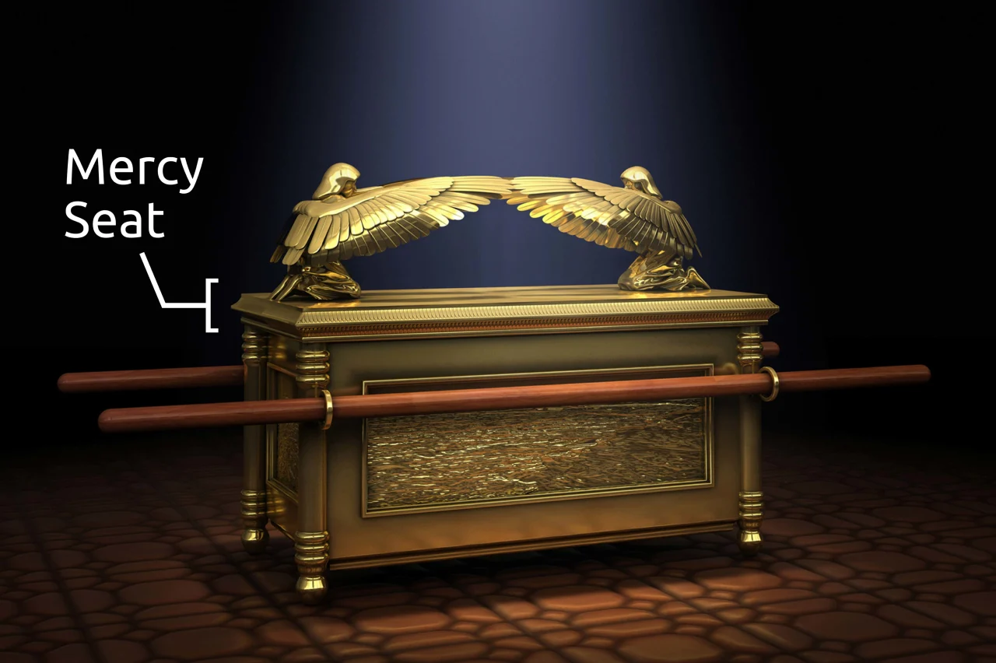
The ark of the covenant
The ark of the covenant

Slide 8
The ark of the covenant
“Of crucial importance is that above the atonement cover between the two cherubim God would meet with His people. There on the Day of Atonement (Lev. 16:1–20) the high priest sprinkled blood on the lid. The blood then covered (kāp̱ar, “to cover, make atonement for”; cf. Ex. 30:10) Israel’s sin. The atonement cover symbolized for Israel what was later accomplished by Christ, who as the Lamb of God (John 1:29) made atonement for sin (Rom. 3:25; Heb. 9:11–14) by His shed blood (Eph. 1:7; 1 Peter 1:18–19).”
John D. Hannah, “Exodus,” The Bible Knowledge Commentary, ed. J. F. Walvoord and R. B. Zuck, vol. 1, 147–148.

Slide 9
Galatians 1:11-12
For I would have you know, brethren, that the gospel which was preached by me is not according to man. For I neither received it from man, nor was I taught it, but I received it through a revelation of Jesus Christ.

Slide 10
1 Timothy 2:5-8
For there is one God, and one mediator also between God and men, the man Christ Jesus, who gave Himself as a ransom for all, the testimony given at the proper time. For this I was appointed a preacher and an apostle (I am telling the truth, I am not lying) as a teacher of the Gentiles in faith and truth. Therefore I want the men in every place to pray, lifting up holy hands, without wrath and dissension.

Slide 11
Calvinism | Arminianism
Total Depravity – sinner unable to respond to God | Total Depravity/Free will – sinner able to respond to God
Unconditional Election – God elects/saves according to His will | Prevenient/Conditional Grace – God elects/saves on foreknowledge. Man can choose to believe or not
Limited Atonement – Christ died for the elect only | Unlimited Atonement – Christ died for all. Effectual by belief
Irresistible Grace – An exclusive call to the elect, which cannot be rejected | Resistible Grace – man can reject God’s grace
Perseverance of the Saints – since elected, believer will persevere in good works and will not deny or turn away from God. | Conditional Salvation – believer can lose salvation if they apostatize. Eternal Security

Slide 12
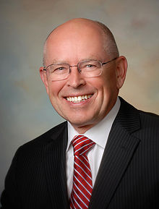
On the Perseverance of the Saints
“The perseverance of the saints means that all those who are truly born again will be kept by God’s power and will persevere as Christians until the end of their lives, and that only those who persevere until the end have been truly born again.”.
Wayne Grudem, Systematic Theology: An Introduction to Biblical Doctrine (Grand Rapids: Zondervan Publishing House, 1994), 788.

Slide 13
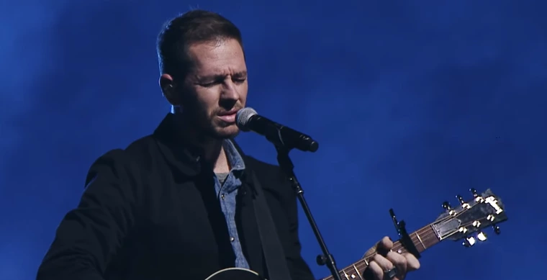

Slide 14
“Time for some real talk... I’m genuinely losing my faith ... and it doesn’t bother me… like, what bothers me now is nothing… I am so happy now, so at peace with the world... It’s crazy. This is a soapbox moment so here I go… how many preachers fall? Many. No one talks about it. How many miracles happen. Not many. No one talks about it. Why is the Bible full of contradictions? No one talks about it. How can God be love yet send four billion people to a place, all coz they don’t believe? No one talks about it. Christians can be the most judgmental people on the planet – they can also be some of the most beautiful and loving people… but it’s not for me. I am not in anymore; I want genuine truth. Not the ‘I just believe it’ kind of truth. Science keeps piercing the truth of every religion. Lots of things help people change their lives, not just one version of God. Got so much more to say, but for me, I’m keeping it real. Unfollow if you want, I’ve never been about living my life for others. All I know is what’s true to me right now, and Christianity just seems to me like another religion at this point.” -Mart Sampson,

Slide 15
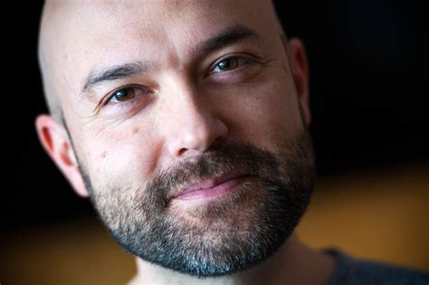
Joshua Harris
“I have undergone a massive shift in regard to my faith in Jesus. The popular phrase for this is ‘deconstruction,’ the biblical phrase is ‘falling away,’…By all the measurements that I have for defining a Christian, I am not a Christian."

Slide 16
Titus 1:13-16
This testimony is true. For this reason reprove them severely so that they may be sound in the faith, not paying attention to Jewish myths and commandments of men who turn away from the truth. To the pure, all things are pure; but to those who are defiled and unbelieving, nothing is pure, but both their mind and their conscience are defiled. They profess to know God, but by their deeds they deny Him, being detestable and disobedient and worthless for any good deed.

Slide 17
Titus 1:13-16
This testimony is true. For this reason reprove them severely so that they may be sound in the faith, not paying attention to Jewish myths and commandments of men who turn away from the truth. To the pure, all things are pure; but to those who are defiled and unbelieving, nothing is pure, but both their mind and their conscience are defiled. They profess to know God, but by their deeds they deny Him, being detestable and disobedient and worthless for any good deed.

Slide 18
Titus 1:13-16
This testimony is true. For this reason reprove them severely so that they may be sound in the faith, not paying attention to Jewish myths and commandments of men who turn away from the truth. To the pure, all things are pure; but to those who are defiled and unbelieving, nothing is pure, but both their mind and their conscience are defiled. They profess to know God, but by their deeds they deny Him, being detestable and disobedient and worthless for any good deed.

Slide 19
1 John 1:6-10
If we say that we have fellowship with Him and yet walk in the darkness, we lie and do not practice the truth; but if we walk in the Light as He Himself is in the Light, we have fellowship with one another, and the blood of Jesus His Son cleanses us from all sin. If we say that we have no sin, we are deceiving ourselves and the truth is not in us. If we confess our sins, He is faithful and righteous to forgive us our sins and to cleanse us from all unrighteousness. If we say that we have not sinned, we make Him a liar and His word is not in us.

Slide 20
On the Perseverance of the Saints
“The perseverance of the saints means that all those who are truly born again will be kept by God’s power and will persevere as Christians until the end of their lives, and that only those who persevere until the end have been truly born again.”.
Wayne Grudem, Systematic Theology: An Introduction to Biblical Doctrine (Grand Rapids: Zondervan Publishing House, 1994), 788.

Slide 21
b. Addressing Doctrinal Issues (Titus 2:1-3:11)
Our Responsibilities? (3:1-8)
To civil authorities – 3.1
To the world in general – 3.2
Reasons for our behavior – 3.3-8
Handling false teachers – 3.9-11
Conclusion/Benediction – 3:12-15
Outline adapted from Titus Argument, Article by Andy Woods, 2007.

Slide 22
False Teachers in the Crete Churches…
Titus 1:10-11: For there are many rebellious men, empty talkers and deceivers, especially those of the circumcision, who must be silenced because they are upsetting whole families, teaching things they should not teach for the sake of sordid gain.
Titus 1:16: They profess to know God, but by their deeds they deny Him, being detestable and disobedient and worthless for any good deed.

Slide 23
b. Addressing Doctrinal Issues (Titus 2:1-3:11)
Our Responsibilities? (3:1-8)
To civil authorities – 3.1
To the world in general – 3.2
Reasons for our behavior – 3.3-8
Handling false teachers – 3.9-11
False teacher described (3.9)
Prescription for handling False teachers (3.10-11)
Conclusion/Benediction – 3:12-15
Outline adapted from Titus Argument, Article by Andy Woods, 2007.

Slide 24
False Teachers in the Crete Churches…
Titus 1:10-11: For there are many rebellious men, empty talkers and deceivers, especially those of the circumcision, who must be silenced because they are upsetting whole families, teaching things they should not teach for the sake of sordid gain.
Titus 1:16: They profess to know God, but by their deeds they deny Him, being detestable and disobedient and worthless for any good deed.

Slide 25
1 Timothy 1:3-4
As I urged you upon my departure for Macedonia, remain on at Ephesus so that you may instruct certain men not to teach strange doctrines, nor to pay attention to myths and endless genealogies, which give rise to mere speculation rather than furthering the administration of God which is by faith.
2 Timothy 2:23
But refuse foolish and ignorant speculations, knowing that they produce quarrels.

Slide 26
Matthew 5:17-22
“Do not think that I came to abolish the Law or the Prophets; I did not come to abolish but to fulfill.”

Slide 27
Romans 8:3-4
“For what the Law could not do, weak as it was through the flesh, God did: sending His own Son in the likeness of sinful flesh and as an offering for sin, He condemned sin in the flesh, so that the requirement of the Law might be fulfilled in us, who do not walk according to the flesh but according to the Spirit.”

Slide 28
Hebrews 8:13
When He said, “A new covenant,” He has made the first obsolete. But whatever is becoming obsolete and growing old is ready to disappear.

Slide 29
b. Addressing Doctrinal Issues (Titus 2:1-3:11)
Our Responsibilities? (3:1-8)
To civil authorities – 3.1
To the world in general – 3.2
Reasons for our behavior – 3.3-8
Handling false teachers – 3.9-11
False teacher described (3.9)
Prescription for handling False teachers (3.10-11)
Conclusion/Benediction – 3:12-15
Outline adapted from Titus Argument, Article by Andy Woods, 2007.

Slide 30
Prescription for Handling False Teachers…
Strike 1: who must be silenced because they are upsetting whole families, teaching things they should not teach for the sake of sordid gain (Titus 1:11).
Strike 2: For this reason, reprove them severely so that they may be sound in the faith (Titus 1:13)
Strike 3: Reject a factious man after a first and second warning… (Titus 3:10-11).

Slide 31
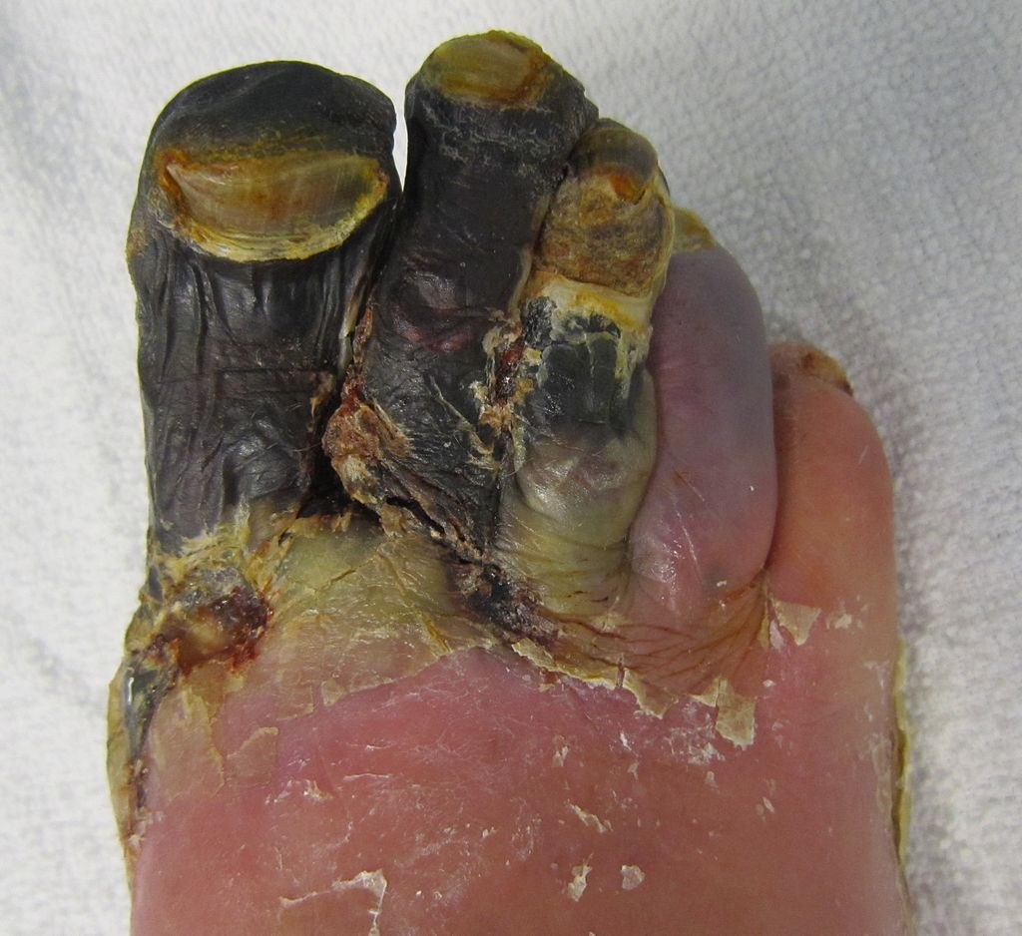
2 Timothy 2:17-18
…and their talk will spread like gangrene. Among them are Hymenaeus and Philetus, men who have gone astray from the truth saying that the resurrection has already taken place, and they upset the faith of some.”
Gangrene Patient. Source: Wikipedia

Slide 32
Prescription for Handling False Teachers…
Strike 1: who must be silenced because they are upsetting whole families, teaching things they should not teach for the sake of sordid gain (Titus 1:11).
Strike 2: For this reason, reprove them severely so that they may be sound in the faith (Titus 1:13)
Strike 3: Reject a factious man after a first and second warning… (Titus 3:10-11).

Slide 33
Hebrews 12:6
“For whom the Lord loves He disciplines.”

Slide 34
1 Thessalonians 3:14
If anyone does not obey our instruction in this letter, take special note of that person and do not associate with him, so that he will be put to shame. Yet do not regard him as an enemy, but admonish him as a brother.

Slide 35
Prescription for Handling False Teachers…
Strike 1: who must be silenced because they are upsetting whole families, teaching things they should not teach for the sake of sordid gain (Titus 1:11).
Strike 2: For this reason, reprove them severely so that they may be sound in the faith (Titus 1:13)
Strike 3: Reject a factious man after a first and second warning… (Titus 3:10-11).

Slide 36
Membership Qualifications, Question #3
“I have read, understood, and agree with the Church’s Philosophy and Statements of Faith (Articles II and III of the Constitution). I have also read the Position Statements, and fully agree with all (except_____). I understand that, while I do not have to agree with them, these are the Church’s positions about several issues, and the teaching of the Church will be consistent with these positions.

Slide 37
b. Addressing Doctrinal Issues (Titus 2:1-3:11)
Our Responsibilities? (3:1-8)
To civil authorities – 3.1
To the world in general – 3.2
Reasons for our behavior – 3.3-8
Handling false teachers – 3.9-11
False teacher described (3.9)
Prescription for handling False teachers (3.10-11)
Conclusion/Benediction – 3:12-15
Outline adapted from Titus Argument, Article by Andy Woods, 2007.

Slide 38
Conclusion/benediction - Titus 3:12-15
Conclusion/Benediction – 3:12-15
Requests (3:12-14)
Greetings (3:15a-b)
Benediction (3:15c)
Outline adapted from Titus Argument, Article by Andy Woods, 2007.

Slide 39
CONCLUSION

Slide 40
The book of Titus
Worthy of the Gospel

Slide 41
Jude 24-25
Now to Him who is able to keep you from stumbling, and to make you stand in the presence of His glory blameless with great joy, to the only God our Savior, through Jesus Christ our Lord, be glory, majesty, dominion and authority, before all time and now and forever. Amen.

