Slide 1
Law and Grace: An Overview Jim McGowan, Th.D. Sugar Land Bible Church 09-25-2022
…but grace and truth were realized through Jesus Christ - John 1:17
For the Law was given through Moses…
Special thanks to Dr. Vern Peterman for access to his insights and resources.

Slide 2
Session 33 Outline
Review
Purpose, Aim, and Objective
Session 32 – TSL & TLP – Part 1 (Matt. 6:1-13a)
The Secret Life & the Lord’s Prayer – Part 2
Matthew 6:13b-15
Concluding Observations

Slide 3
OUR PURPOSE, AIM AND OBJECTIVE
Law and Grace
…is to Compare and Contrast Law and Grace so as to properly understand these two important themes and how they are related to the life of the New Testament Believer.

Slide 4
C. I. Scofield, D. D.
The Grace of God, The Fundamentals Vol. 3, Chapter VII, p. 98
We have, most of us, been reared and now live under the influence of Galatianism. Protestant theology, alas, is for the most part, thoroughly Galatianized, in that neither law nor grace are given their distinct and separated places, as in the counsels of God, but are mingled together in one incoherent system.
The law is no longer, as in the Divine intent, a ministration of death (2 Cor. 3:7), of cursing (Gal. 3:10), of conviction (Rom. 3:19), because we are taught that we must try to keep it, and that by Divine help we may.
Nor, on the other hand, does grace bring us blessed deliverance from the dominion of sin, for we are kept under the law as a rule of life despite the plain declaration, “Sin shall not have dominion over you: for ye are not under the law, but under grace” (Rom. 6:14). (emphasis mine)

Slide 5
William R. Newell
Romans Verse-by-Verse (p. 274).
Grand Rapids, MI: Christian Classics Ethereal Library.
It is because Reformed theology has kept us Gentiles under the Law,—if not as a means of righteousness, then as “a rule of life,” that all the trouble has arisen. The Law is no more a rule of life than it is a means of righteousness. Walking in the Spirit has now taken the place of walking by ordinances. God has another principle under which He has put his saints: “Ye are not under law, but, under grace! (Rom. 6:14)” (italics mine)
PDF Download Here: https://archive.org/details/Romans_Verse_By_Verse-NewellWR

Slide 6
Henry Ironside
The Continual Burnt Offering: Daily Meditations on the Word of God (p. 265). Neptune, NJ: Loizeaux Brothers.
In Romans 7 we have a man renewed by the Spirit of God, but struggling under law, hoping thereby to subdue or find deliverance from the power of the old Adamic nature. In chapter 8 we have God’s way of deliverance through the death and resurrection of Christ with which the believer is identified before God. The chapter begins with “no condemnation” and ends with “no separation.” All who are in Christ Jesus are accepted in the Beloved and as free from every charge of guilt as He is Himself. He paid our penalty on the cross. Now we are linked up with Him in resurrection, not under law but under grace.

Slide 7
Matthew’s 3-Fold Purpose
Law and Grace: Review The SOM – Matthew 5:1–8:1 (Luke 6:17–49)
To explain:
that Jesus in whom they had believed was the long-awaited Jewish Messiah
why the kingdom had been postponed despite the fact that the king had arrived
the interim program of God during the kingdom’s absence

Slide 8
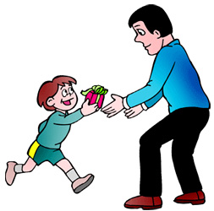
Matthew and the Kingdom
Law and Grace: Review The SOM – Matthew 5:1–8:1 (Luke 6:17–49)
 | offered
 | rejected
 | postponed Interim program
 | ultimately accepted

Slide 9
Matthew’s Message
Law and Grace: Review The SOM – Matthew 5:1–8:1 (Luke 6:17–49)
Jesus is the predicted Jewish king who ushered in an interim program by building the sons of the kingdom into the Church in between Israel’s past rejection and future acceptance of her king.

Slide 10
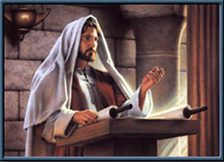
Law and Grace: Review The SOM – Matthew 5:1–8:1 (Luke 6:17–49)
Jesus contrasted with the Scribes & Pharisees
Jesus made the Law of Moses apply to the whole person, all the way from the heart and thoughts, to all of the outward expressions and even in the relationships between Jews, and with God.
True Righteousness vs. Pharisaical Righteousness

Slide 11
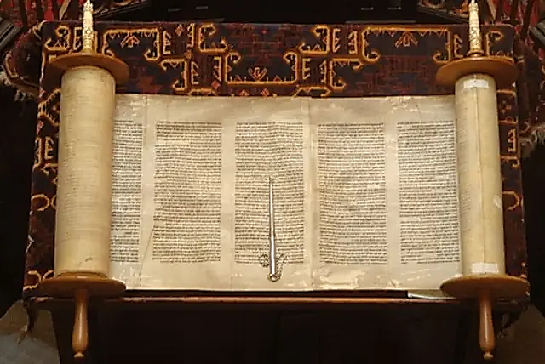
Law and Grace: Review The SOM – Matthew 5:1–8:1 (Luke 6:17–49)
Two Primary Patterns in Jesus’ Statements
Jesus will quote Old Testament passages and include those laws that require full heart-level and relationship compliance when appropriate.
Jesus will quote Old Testament passages along with one of the traditions that have been added to the Law of Moses, and then correct the tradition by taking the application deeper and/or back to the original intent of the Law of Moses.

Slide 12
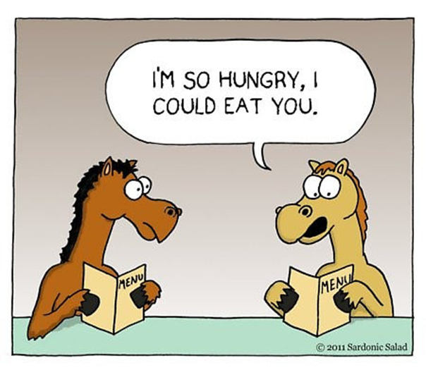
Law and Grace: Review The SOM – Matthew 5:1–8:1 (Luke 6:17–49)
Jesus Used Hyperbole
Matthew 5:21-26
Jesus sometimes uses *hyperbole in the Sermon on the Mount, for the sake of emphasis and as an aid to memory.
* hyperbole an obvious and intentional exaggeration used for stress or emphasis; not intended to be taken literally…i.e. I’m so hungry, I could eat a horse.

Slide 13
Context, Context, Context Matthew 5:21-48
Law and Grace: Review The SOM – Matthew 5:1–8:1 (Luke 6:17–49)
The Sermon on the Mount was directed to Israelites, living in Israel, who were all under the Law of Moses.
To understand what Christ says we should keep in mind that: proper interpretation requires identifying the cultural context.

Slide 14
The Sermon on the Mount
Law and Grace: Review The SOM – Matthew 5:1–8:1 (Luke 6:17–49)
Matthew unfolds matters concerning the kingdom in a special way. That is the reason for placing the Sermon on the Mount early in the book—connecting it with the announcement of the kingdom—and the reason for the manner of its unfolding as a whole. It is connected with the special presentation of Christ as King, [to Israel]…before His rejection became evident in Matt. 12. It is connected with the presentation of the kingdom [to Israel] as entailing the acceptance of the Person of the meek and lowly One, just as the presentation of the kingdom [to Israel] was bound up with the acceptance of His Person come in humiliation and grace.
Elements of Dispensational Truth, Vol. 4, The Sermon on the Mount: Its
Dispensational Place and Meaning; Roy A. Huebner, 2007 Present Truth Publishers, pg. 14

Slide 15
Session 33 Outline
Review
Purpose, Aim, and Objective
Session 32 – TSL & TLP – Part 1 (Matt. 6:1-13a)
The Secret Life & the Lord’s Prayer – Part 2
Matthew 6:13b-15
Concluding Observations

Slide 16
Matthew 6:1–4
¹ “Beware of practicing your righteousness before men to be noticed by them; otherwise you have no reward with your Father who is in heaven. ² “So when you give to the poor, do not sound a trumpet before you, as the hypocrites do in the synagogues and in the streets, so that they may be honored by men. Truly I say to you, they have their reward in full. ³ “But when you give to the poor, do not let your left hand know what your right hand is doing, ⁴ so that your giving will be in secret; and your Father who sees what is done in secret will reward you. ⁵ “When you pray, you are not to be like the hypocrites; for they love to stand and pray in the synagogues and on the street corners so that they may be seen by men. Truly I say to you, they have their reward in full. ⁶ “But you, when you pray, go into your inner room, close your door and pray to your Father who is in secret, and your Father who sees what is done in secret will reward you….

Slide 17
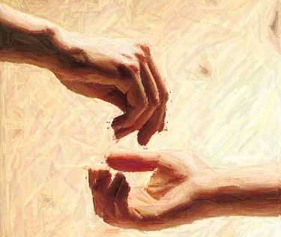
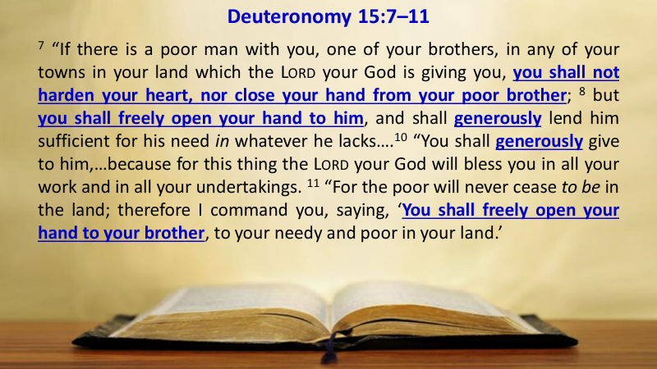
Law and Grace: The SOM – Matthew 5:1–8:1 (Luke 6:17–49)
What not to do & what to do instead
Matthew 6:1-4
Giving to the poor was to be done generously under the Law of Moses (Deut. 15:7-11).

Slide 18
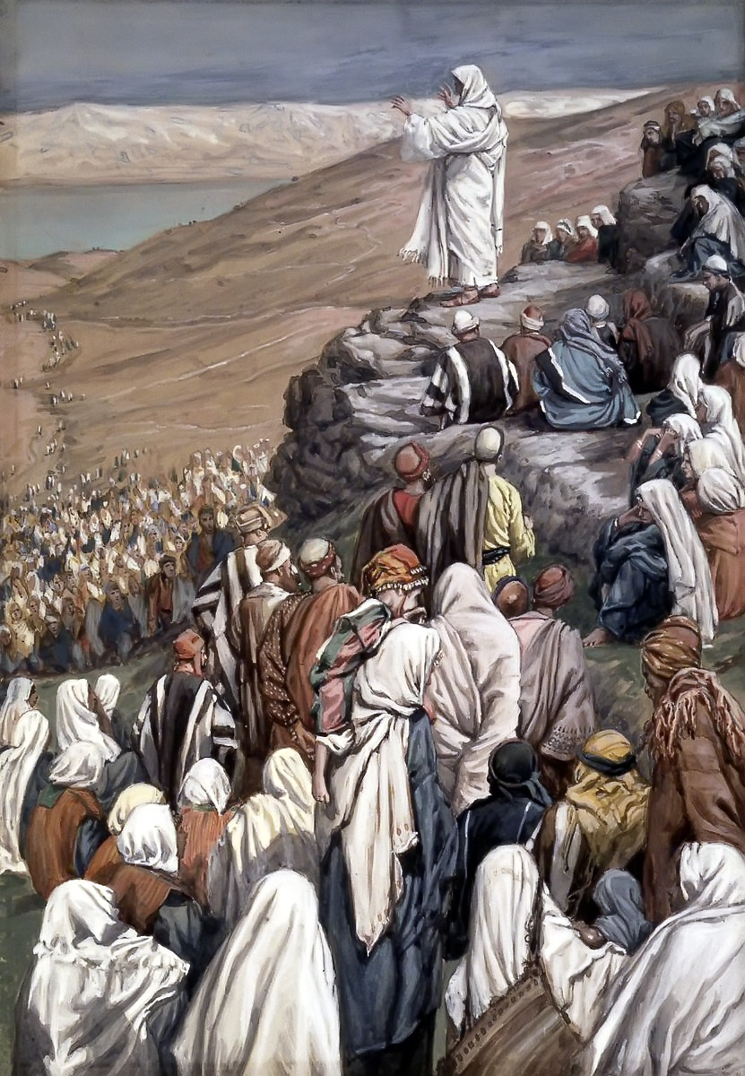
Law and Grace: The SOM – Matthew 5:1–8:1 (Luke 6:17–49)
What not to do & what to do instead
Matthew 6:1-4
The rabbis came to place great value on the giving of alms to the poor in Israel, and there were many who were poor.
But Jesus said that the Israelites who gave alms to the poor ought to seek reward from God rather than recognition from others.

Slide 19
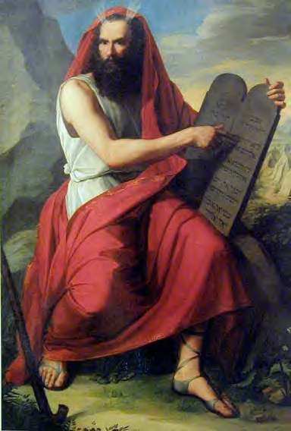
Law and Grace: The SOM – Matthew 5:1–8:1 (Luke 6:17–49)
Blessed & Rewarded – How & From Where?
Matthew 6:1-4
The people of Israel were all blessed in earthly ways if they obeyed the Law of Moses (cf. Deuteronomy 28:1-14).
Deuteronomy 28:1–2ff
¹ “Now it shall be, if you diligently obey the Lord your God, being careful to do all His commandments which I command you today, the Lord your God will set you high above all the nations of the earth. ² “All these blessings will come upon you and overtake you if you obey the Lord your God:…

Slide 20
Law and Grace: The SOM – Matthew 5:1–8:1 (Luke 6:17–49)
Blessed & Rewarded – How & From Where?
Matthew 6:1-4
Church-Age believers already possess and enjoy unconditional, promised, guaranteed, assured, spiritual blessings which are Heaven centered and sourced.
Blessings which are not conditioned upon our behavior or our works! (cf. Eph. 1:3) Church-Age believers are blessed because of our position ‘in Christ’!
Ephesians 1:3
Blessed be the God and Father of our Lord Jesus Christ, who has blessed us with every spiritual blessing in the heavenly places in Christ,

Slide 21
Matthew 6:5–6
¹ “Beware of practicing your righteousness before men to be noticed by them; otherwise you have no reward with your Father who is in heaven. ² “So when you give to the poor, do not sound a trumpet before you, as the hypocrites do in the synagogues and in the streets, so that they may be honored by men. Truly I say to you, they have their reward in full. ³ “But when you give to the poor, do not let your left hand know what your right hand is doing, ⁴ so that your giving will be in secret; and your Father who sees what is done in secret will reward you. ⁵ “When you pray, you are not to be like the hypocrites; for they love to stand and pray in the synagogues and on the street corners so that they may be seen by men. Truly I say to you, they have their reward in full. ⁶ “But you, when you pray, go into your inner room, close your door and pray to your Father who is in secret, and your Father who sees what is done in secret will reward you.

Slide 22
Law and Grace: The SOM – Matthew 5:1–8:1 (Luke 6:17–49)
Praying in public – is it sinful?
Matthew 6:5-6
So, did Jesus tell them that praying in public is ‘off limits’? No! Jesus Himself often prayed in public, sometimes in small groups and sometimes in large gatherings.

Slide 23
Law and Grace: The SOM – Matthew 5:1–8:1 (Luke 6:17–49)
Praying in public – is it sinful?
Matthew 6:5-6
Jesus says that public praying, so as to be seen, with the hope of making a good impression on others, is not rewardable but is hypocritical.

Slide 24
Law and Grace: The SOM – Matthew 5:1–8:1 (Luke 6:17–49)
Praying in public – is it sinful?
Matthew 6:5-6
So, the issue Jesus is addressing is our motives and God knows the motive because He sees into the heart of a believer who is praying.

Slide 25
Matthew 6:7–8
…⁷ “And when you are praying, do not use meaningless repetition as the Gentiles do, for they suppose that they will be heard for their many words. ⁸ “So do not be like them; for your Father knows what you need before you ask Him. ⁹ “Pray, then, in this way: ‘Our Father who is in heaven, Hallowed be Your name. ¹⁰ ‘Your kingdom come. Your will be done, On earth as it is in heaven. ¹¹ ‘Give us this day our daily bread. ¹² ‘And forgive us our debts, as we also have forgiven our debtors. ¹³ ‘And do not lead us into temptation, but deliver us from evil. For Yours is the kingdom and the power and the glory forever. Amen.’ ¹⁴ “For if you forgive others for their transgressions, your heavenly Father will also forgive you. ¹⁵ “But if you do not forgive others, then your Father will not forgive your transgressions.

Slide 26
Law and Grace: The SOM – Matthew 5:1–8:1 (Luke 6:17–49)
As the Gentiles do...
Matthew 6:7-8

Slide 27
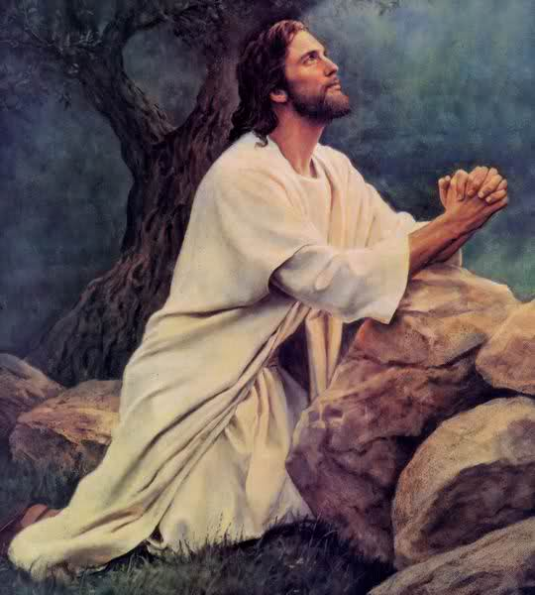
Law and Grace: The SOM – Matthew 5:1–8:1 (Luke 6:17–49)
As the Gentiles do...
Matthew 6:7-8
Jesus lets His Israelite audience know that it is not just the number of times that a prayer is said that will have an influence on God, rather, it is prayer from the heart.

Slide 28
Matthew 6:9–13
…⁷ “And when you are praying, do not use meaningless repetition as the Gentiles do, for they suppose that they will be heard for their many words. ⁸ “So do not be like them; for your Father knows what you need before you ask Him. ⁹ “Pray, then, in this way: ‘Our Father who is in heaven, Hallowed be Your name. ¹⁰ ‘Your kingdom come. Your will be done, On earth as it is in heaven. ¹¹ ‘Give us this day our daily bread. ¹² ‘And forgive us our debts, as we also have forgiven our debtors. ¹³ ‘And do not lead us into temptation, but deliver us from evil. For Yours is the kingdom and the power and the glory forever. Amen.’ ¹⁴ “For if you forgive others for their transgressions, your heavenly Father will also forgive you. ¹⁵ “But if you do not forgive others, then your Father will not forgive your transgressions.

Slide 29
Law and Grace: The SOM – Matthew 5:1–8:1 (Luke 6:17–49)
Traditional Jewish Prayers

Slide 30
Matthew 6:9
…⁷ “And when you are praying, do not use meaningless repetition as the Gentiles do, for they suppose that they will be heard for their many words. ⁸ “So do not be like them; for your Father knows what you need before you ask Him. ⁹ “Pray, then, in this way: ‘Our Father who is in heaven, Hallowed be Your name. ¹⁰ ‘Your kingdom come. Your will be done, On earth as it is in heaven. ¹¹ ‘Give us this day our daily bread. ¹² ‘And forgive us our debts, as we also have forgiven our debtors. ¹³ ‘And do not lead us into temptation, but deliver us from evil. For Yours is the kingdom and the power and the glory forever. Amen.’ ¹⁴ “For if you forgive others for their transgressions, your heavenly Father will also forgive you. ¹⁵ “But if you do not forgive others, then your Father will not forgive your transgressions.

Slide 31
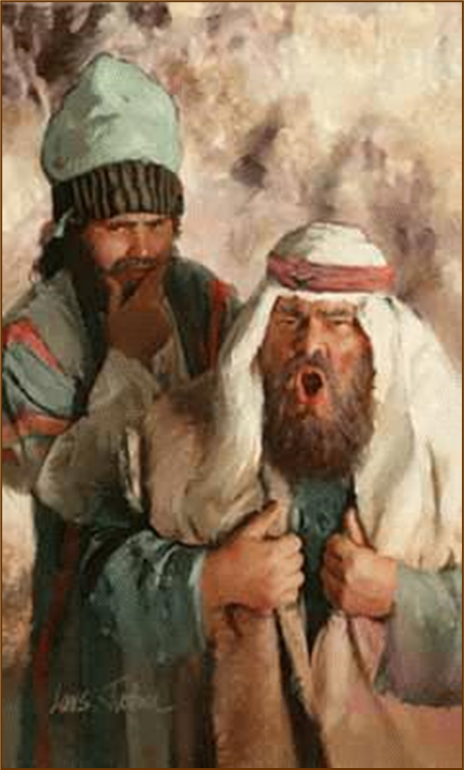
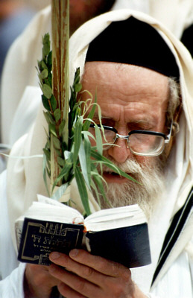
Law and Grace: The SOM – Matthew 5:1–8:1 (Luke 6:17–49)
‘Our Father’
Matthew 6:9
‘Our Father’ is a term that would be taken as an appropriate way to address God. But Jesus would soon shock all the Jews by referring to God as ‘My Father’ (Matt. 7:21; 10:32-33; 11:27; 12:50; 16:17; 18:10; 20:23; 26:29, 39, 42, 52; John 20:17)
No Rabbi, nor any Jew, would dare refer to God as ‘My Father’ because to do so was to imply a unique and special relationship with God the Father.

Slide 32
Matthew 6:9
…⁷ “And when you are praying, do not use meaningless repetition as the Gentiles do, for they suppose that they will be heard for their many words. ⁸ “So do not be like them; for your Father knows what you need before you ask Him. ⁹ “Pray, then, in this way: ‘Our Father who is in heaven, Hallowed be Your name. ¹⁰ ‘Your kingdom come. Your will be done, On earth as it is in heaven. ¹¹ ‘Give us this day our daily bread. ¹² ‘And forgive us our debts, as we also have forgiven our debtors. ¹³ ‘And do not lead us into temptation, but deliver us from evil. For Yours is the kingdom and the power and the glory forever. Amen.’ ¹⁴ “For if you forgive others for their transgressions, your heavenly Father will also forgive you. ¹⁵ “But if you do not forgive others, then your Father will not forgive your transgressions.

Slide 33
Law and Grace: The SOM – Matthew 5:1–8:1 (Luke 6:17–49)
The Bible’s three heavens

Slide 34
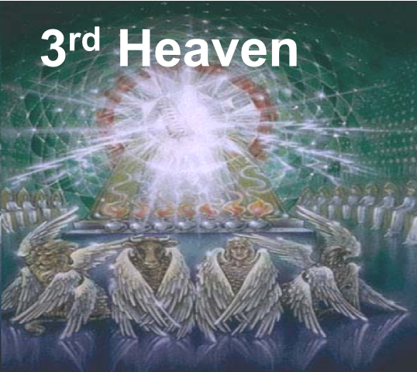
Law and Grace: The SOM – Matthew 5:1–8:1 (Luke 6:17–49)
The Bible’s three heavens
Matthew 6:9
“Heaven is the abode of God; it is the abode of the elect or good angels; it is the abode of believers who have passed away; and it is the abode of the dead saints. It is the present place of Paradise. At one time Paradise was located in Abraham’s bosom, but now Paradise is in Heaven.
Fruchtenbaum, A. G. (1983). The Messianic Bible Study Collection (Vol. 107, p. 18). Ariel Ministries.

Slide 35
Matthew 6:9
…⁷ “And when you are praying, do not use meaningless repetition as the Gentiles do, for they suppose that they will be heard for their many words. ⁸ “So do not be like them; for your Father knows what you need before you ask Him. ⁹ “Pray, then, in this way: ‘Our Father who is in heaven, Hallowed be Your name. ¹⁰ ‘Your kingdom come. Your will be done, On earth as it is in heaven. ¹¹ ‘Give us this day our daily bread. ¹² ‘And forgive us our debts, as we also have forgiven our debtors. ¹³ ‘And do not lead us into temptation, but deliver us from evil. For Yours is the kingdom and the power and the glory forever. Amen.’ ¹⁴ “For if you forgive others for their transgressions, your heavenly Father will also forgive you. ¹⁵ “But if you do not forgive others, then your Father will not forgive your transgressions.

Slide 36
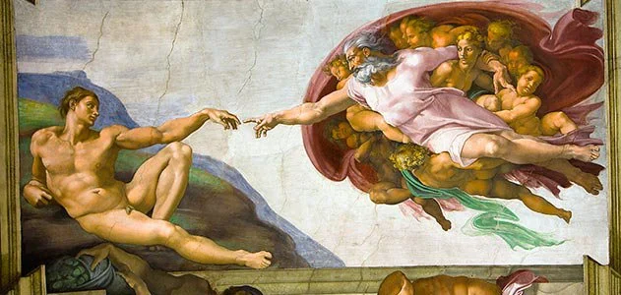
Law and Grace: The SOM – Matthew 5:1–8:1 (Luke 6:17–49)
‘Hallowed be your name’
Matthew 6:9
In Jewish culture and thinking a ‘name’ reflected the nature and character associated with a person (Exo. 3:14-15).
‘Hallowed be your name’ is a desire or wish that God’s name is treated as holy – set apart, as God Himself is set apart from the rest of His creation. So, Jesus says, “May your name, signifying Your character and essence, as the One who is Eternal and Active in the affairs of mankind, be revered and regarded as unique, distinct, Holy.”
CREATOR - Creature Distinction

Slide 37
Matthew 6:10
…⁷ “And when you are praying, do not use meaningless repetition as the Gentiles do, for they suppose that they will be heard for their many words. ⁸ “So do not be like them; for your Father knows what you need before you ask Him. ⁹ “Pray, then, in this way: ‘Our Father who is in heaven, Hallowed be Your name. ¹⁰ ‘Your kingdom come. Your will be done, On earth as it is in heaven. ¹¹ ‘Give us this day our daily bread. ¹² ‘And forgive us our debts, as we also have forgiven our debtors. ¹³ ‘And do not lead us into temptation, but deliver us from evil. For Yours is the kingdom and the power and the glory forever. Amen.’ ¹⁴ “For if you forgive others for their transgressions, your heavenly Father will also forgive you. ¹⁵ “But if you do not forgive others, then your Father will not forgive your transgressions.

Slide 38
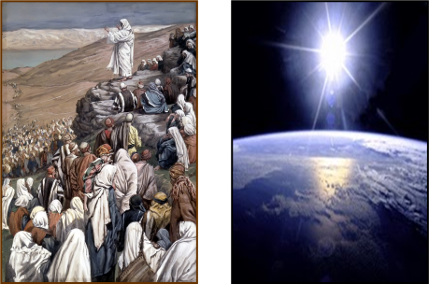
Law and Grace: The SOM – Matthew 5:1–8:1 (Luke 6:17–49)
‘Your kingdom come, Your will be done’
Matthew 6:10
Jesus expressed a desire for the Father’s kingdom and will to come and be done on earth, which was still an imminent possibility because the nation had not yet officially rejected Jesus and the Kingdom (Matt. 12)
God’s coming kingdom is also Christ’s kingdom. (Luke 1:30-33; Matt. 13:41-42; 2 Tim. 4:1) and will be expressed in the form of Kingdom Law.

Slide 39
Law and Grace: The SOM – Matthew 5:1–8:1 (Luke 6:17–49)
‘Your kingdom come, Your will be done’
Matthew 6:10
The Messianic Kingdom will be administered through an absolute monarchy with a definite chain of command and lines of authority. The absolute monarch will be the Person of Yeshua the Messiah. Delegated authority will be split between two branches of government: a Jewish branch and a Gentile branch, each in turn having a chain of command….A number of passages portray the characteristics of the reign of the Messianic King. One major characteristic, stemming from the absolute monarchy that will exist, is that the Messiah will rule with a rod of iron (Rev. 12:5, cf. Rev. 19:15)…This iron handed rule is rooted in Psalm 2:9 and will be necessary due to the fact that nations will exist and the people populating them will still have their sin nature. After the first . . .

Slide 40
Law and Grace: The SOM – Matthew 5:1–8:1 (Luke 6:17–49)
‘Your kingdom come, Your will be done’
Matthew 6:10
. . . generation, there will be unbelievers present in the Kingdom. The natural outworking of their sin nature will have to be restrained. The Kingdom will not be a democracy, but an absolute monarchy. The reign of the Messianic King will be a strict one, and the righteous and just laws emanating from Jerusalem will have to be obeyed.
Fruchtenbaum, A. G. (1983). The Messianic Bible Study Collection (Vol. 17, p. 10, 13). Ariel Ministries.

Slide 41
Matthew 6:11
…⁷ “And when you are praying, do not use meaningless repetition as the Gentiles do, for they suppose that they will be heard for their many words. ⁸ “So do not be like them; for your Father knows what you need before you ask Him. ⁹ “Pray, then, in this way: ‘Our Father who is in heaven, Hallowed be Your name. ¹⁰ ‘Your kingdom come. Your will be done, On earth as it is in heaven. ¹¹ ‘Give us this day our daily bread. ¹² ‘And forgive us our debts, as we also have forgiven our debtors. ¹³ ‘And do not lead us into temptation, but deliver us from evil. For Yours is the kingdom and the power and the glory forever. Amen.’ ¹⁴ “For if you forgive others for their transgressions, your heavenly Father will also forgive you. ¹⁵ “But if you do not forgive others, then your Father will not forgive your transgressions.

Slide 42
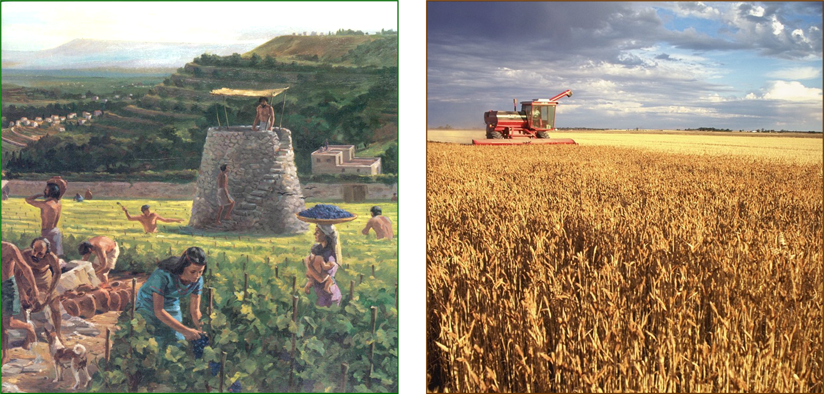
Law and Grace: The SOM – Matthew 5:1–8:1 (Luke 6:17–49)
‘Daily bread’
Matthew 6:11
It’s easy to forget that all blessings come from God’s hand, and we often think that we should get the credit. So, Jesus here reminds the Israelites and us, that we would have nothing were it not for the Lord's provision.

Slide 43
Matthew 6:1–15
…⁷ “And when you are praying, do not use meaningless repetition as the Gentiles do, for they suppose that they will be heard for their many words. ⁸ “So do not be like them; for your Father knows what you need before you ask Him. ⁹ “Pray, then, in this way: ‘Our Father who is in heaven, Hallowed be Your name. ¹⁰ ‘Your kingdom come. Your will be done, On earth as it is in heaven. ¹¹ ‘Give us this day our daily bread. ¹² ‘And forgive us our debts, as we also have forgiven our debtors. ¹³ ‘And do not lead us into temptation, but deliver us from evil. For Yours is the kingdom and the power and the glory forever. Amen.’ ¹⁴ “For if you forgive others for their transgressions, your heavenly Father will also forgive you. ¹⁵ “But if you do not forgive others, then your Father will not forgive your transgressions.

Slide 44
Law and Grace: The SOM – Matthew 5:1–8:1 (Luke 6:17–49)
‘Debts & Forgiveness’
Matthew 6:12
Christ is the God-Man, uniquely born without a sin nature. He therefore could not and did not sin. So, He had no need to ask for forgiveness. In fact, His sinlessness was what qualified Him to die on our behalf and to pay the penalty rightfully due us.

Slide 45
Matthew 6:1–15
…⁷ “And when you are praying, do not use meaningless repetition as the Gentiles do, for they suppose that they will be heard for their many words. ⁸ “So do not be like them; for your Father knows what you need before you ask Him. ⁹ “Pray, then, in this way: ‘Our Father who is in heaven, Hallowed be Your name. ¹⁰ ‘Your kingdom come. Your will be done, On earth as it is in heaven. ¹¹ ‘Give us this day our daily bread. ¹² ‘And forgive us our debts, as we also have forgiven our debtors. ¹³ ‘And do not lead us into temptation, but deliver us from evil. For Yours is the kingdom and the power and the glory forever. Amen.’ ¹⁴ “For if you forgive others for their transgressions, your heavenly Father will also forgive you. ¹⁵ “But if you do not forgive others, then your Father will not forgive your transgressions.

Slide 46
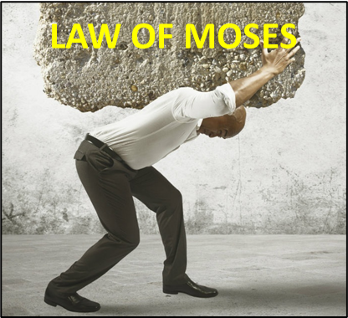
Law and Grace: The SOM – Matthew 5:1–8:1 (Luke 6:17–49)
‘Temptation & Deliverance ’
Matthew 6:13
At this point in Matthew, Jesus was still offering the Kingdom to the nation and the Holy Spirit had not yet been given so there was no ‘permanent’ provision or enablement available to the disciples to deal with temptation or for dealing with Satan. They were still living and operating under the principal of Law.

Slide 47
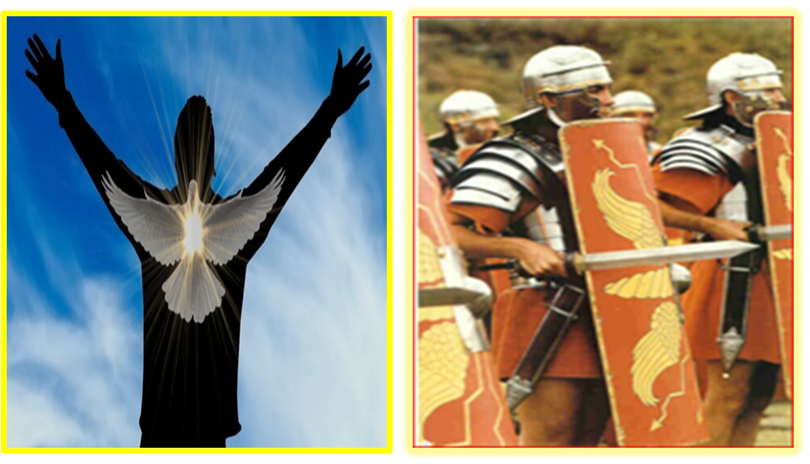
Law and Grace: The SOM – Matthew 5:1–8:1 (Luke 6:17–49)
‘Temptation & Deliverance ’
Matthew 6:13
But believers are all living under the principal of Grace, during the Church Age, and have the ‘permanent’ indwelling presence of the Holy Spirit and a completed canon of Scripture with additional information and instructions.

Slide 48
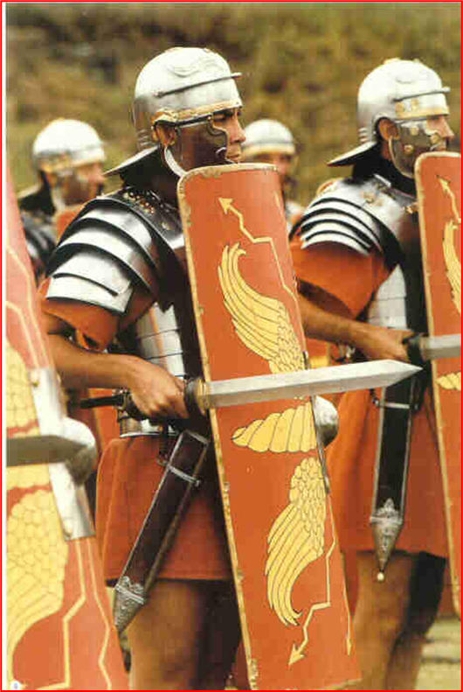
Ephesians 6:11
Therefore, take up the full armor of God, so that you will be able to resist in the evil day, and having done everything, to stand firm.
James 4:7
Submit therefore to God. Resist the devil and he will flee from you.
1 Peter 5:9
But resist him, firm in your faith, knowing that the same experiences of suffering are being accomplished by your brethren who are in the world.

Slide 49
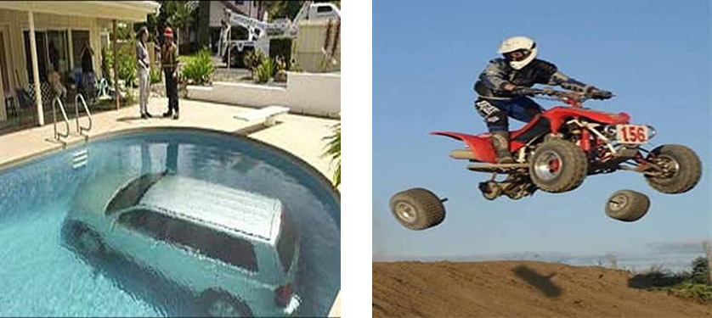
Law and Grace: The SOM – Matthew 5:1–8:1 (Luke 6:17–49)
‘Temptation & Deliverance ’
Matthew 6:13
James 1:2-3
² Consider it all joy, my brethren, when you encounter various trials, ³ knowing that the testing of your faith produces endurance.

Slide 50
Law and Grace: Review The SOM – Matthew 5:1–8:1 (Luke 6:17–49)
“Review Over”

Slide 51
Session 33 Outline
Review
Purpose, Aim, and Objective
Session 32 – TSL & TLP – Part 1 (Matt. 6:1-13a)
The Secret Life & the Lord’s Prayer – Part 2
Matthew 6:13b-15
Concluding Observations

Slide 52
Matthew 6:13
…⁷ “And when you are praying, do not use meaningless repetition as the Gentiles do, for they suppose that they will be heard for their many words. ⁸ “So do not be like them; for your Father knows what you need before you ask Him. ⁹ “Pray, then, in this way: ‘Our Father who is in heaven, Hallowed be Your name. ¹⁰ ‘Your kingdom come. Your will be done, On earth as it is in heaven. ¹¹ ‘Give us this day our daily bread. ¹² ‘And forgive us our debts, as we also have forgiven our debtors. ¹³ ‘And do not lead us into temptation, but deliver us from evil. For Yours is the kingdom and the power and the glory forever. Amen.’ ¹⁴ “For if you forgive others for their transgressions, your heavenly Father will also forgive you. ¹⁵ “But if you do not forgive others, then your Father will not forgive your transgressions.

Slide 53
1 Chronicles 29:10-13
¹⁰ So David blessed the Lord in the sight of all the assembly; and David said, "Blessed are You, O Lord God of Israel our father, forever and ever. ¹¹ Yours, O Lord, is the greatness and the power and the glory and the victory and the majesty, indeed everything that is in the heavens and the earth; Yours is the dominion, O Lord, and You exalt Yourself as head over all. ¹² Both riches and honor come from You, and You rule over all, and in Your hand is power and might; and it lies in Your hand to make great and to strengthen everyone. ¹³ Now therefore, our God, we thank You, and praise Your glorious name."

Slide 54
Matthew 6:14–15
…⁷ “And when you are praying, do not use meaningless repetition as the Gentiles do, for they suppose that they will be heard for their many words. ⁸ “So do not be like them; for your Father knows what you need before you ask Him. ⁹ “Pray, then, in this way: ‘Our Father who is in heaven, Hallowed be Your name. ¹⁰ ‘Your kingdom come. Your will be done, On earth as it is in heaven. ¹¹ ‘Give us this day our daily bread. ¹² ‘And forgive us our debts, as we also have forgiven our debtors. ¹³ ‘And do not lead us into temptation, but deliver us from evil. For Yours is the kingdom and the power and the glory forever. Amen.’ ¹⁴ “For if you forgive others for their transgressions, your heavenly Father will also forgive you. ¹⁵ “But if you do not forgive others, then your Father will not forgive your transgressions.

Slide 55
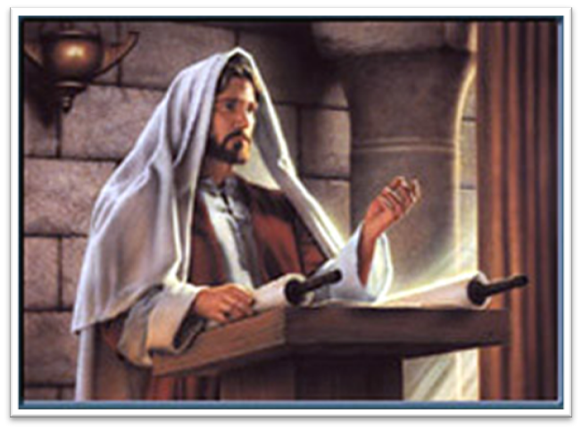
Law and Grace: The SOM – Matthew 5:1–8:1 (Luke 6:17–49)
‘Forgiven, if you forgive…’
Matthew 6:14-15
In these two verses Jesus clarified the intent of verse 12 in the Lord’s Prayer, which is that personal forgiveness came UNDER THE LAW, if an Israelite forgave his fellow Israelite.

Slide 56
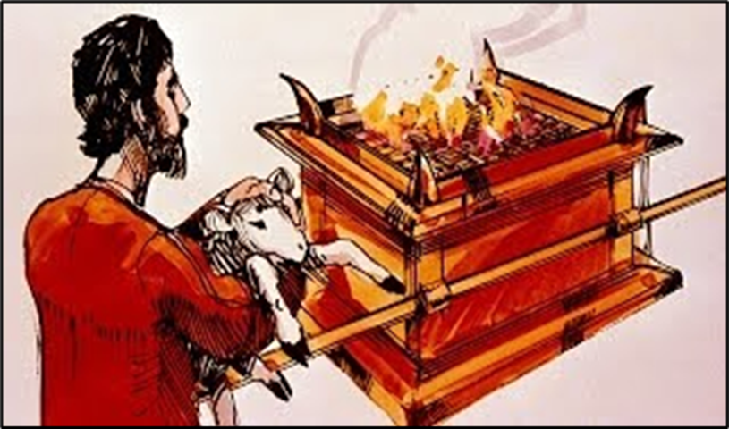
Matthew 5:23–24
²³ “Therefore if you are presenting your offering at the altar, and there remember that your brother has something against you, ²⁴ leave your offering there before the altar and go; first be reconciled to your brother, and then come and present your offering.

Slide 57
Law and Grace: The SOM – Matthew 5:1–8:1 (Luke 6:17–49)
‘Forgiven, if you forgive…’
Matthew 6:14-15
For us who are in the Body of Christ, unconditional forgiveness and blessing is a part of the grace package which we received when we believed. (Ephesians 1:3, 7; 4:32) therefore our motive to forgive others comes from our understanding of what Christ did for us on the Cross.

Slide 58
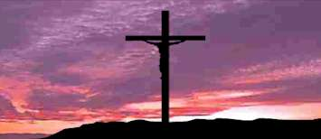
Ephesians 1:3, 7
³Blessed be the God and Father of our Lord Jesus Christ, who has blessed us with every spiritual blessing in the heavenly places in Christ… ⁷ In Him we have redemption through His blood, the forgiveness of our trespasses, according to the riches of His grace…

Slide 59
Ephesians 4:32
Be kind to one another, tender-hearted, forgiving each other, just as God in Christ also has forgiven you.

Slide 60
Law and Grace: The SOM – Matthew 5:1–8:1 (Luke 6:17–49)
‘Forgive us our debts’
Matthew 6:14-15
Sins, in Jewish tradition, were looked upon as spiritual debts to God that required payment, and we see this concept in Luke 11:2-4.

Slide 61
Law and Grace: The SOM – Matthew 5:1–8:1 (Luke 6:17–49)
‘Forgive us our debts’
Matthew 6:14-15
However, for us in the body of Christ, living under grace, our sin debts as spiritual obligations (past, present, and future), were nailed to the cross of Christ, an IOU that was cancelled on the day we died with Christ. (cf. Colossians 2:12-14)

Slide 62
Session 33 Outline
Review
Purpose, Aim, and Objective
Session 32 – TSL & TLP – Part 1 (Matt. 6:1-13a)
The Secret Life & the Lord’s Prayer – Part 2
Matthew 6:13b-15
Concluding Observations

Slide 63
Law and Grace: The SOM – Matthew 5:1–8:1 (Luke 6:17–49)
‘Motive, Means & Opportunity ’
Matthew 6:14-15

Slide 64
Law and Grace: The SOM – Matthew 5:1–8:1 (Luke 6:17–49)
‘Motive, Means & Opportunity ’
Matthew 6:14-15
God is concerned with the heart so, motives matter, and for us in the Body of Christ, grace is our motive.

Slide 65
Law and Grace: The SOM – Matthew 5:1–8:1 (Luke 6:17–49)
‘Motive, Means & Opportunity ’
Matthew 6:14-15

Slide 66
Law and Grace: The SOM – Matthew 5:1–8:1 (Luke 6:17–49)
‘Motive, Means & Opportunity ’
Matthew 6:14-15
God has provided the means for us in the Body of Christ to do what God desires of us. It’s the energizing, enabling and empowering by the Holy Spirit and the life of Christ in and through us.

Slide 67
Law and Grace: The SOM – Matthew 5:1–8:1 (Luke 6:17–49)
‘Motive, Means & Opportunity ’
Matthew 6:14-15
And the opportunity for we who are already blessed is to be used of God.

Slide 68
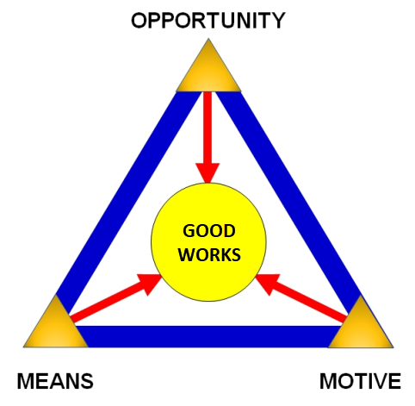
Law and Grace: The SOM – Matthew 5:1–8:1 (Luke 6:17–49)
‘Motive, Means & Opportunity ’
Matthew 6:14-15
ABBA, Father has given us the motive! He's given us the means! And He's even provided us with the opportunities!

Slide 69
Law and Grace: The SOM – Matthew 5:1–8:1 (Luke 6:17–49)
‘That I May Know Him as Ruler And Sustainer’
‘Not only did our Lord Jesus create and redeem, but He ever upholds that which is His. Not only is He the Sustainer of the universe which He created, but He also coordinates and directs all within the realm and unto the consummation of His Father’s eternal purposes—and that includes each of His own.’
Stanford, M. J. (2002). Complete Works of Miles J. Stanford. Galaxie Software.

Slide 70
Law and Grace: An Overview Jim McGowan, Th.D. Sugar Land Bible Church 09-25-2022
…but grace and truth were realized through Jesus Christ - John 1:17
For the Law was given through Moses…
Special thanks to Dr. Vern Peterman for access to his insights and resources.

