Slide 1
Biblical Dispensationalism
Jim McGowan, MTS, Th.D.

Slide 2
What We’ve Covered…
Session | Topic | Date
001 | Introduction to Biblical Dispensationalism | 10‐03‐2018
002 | Introduction to Biblical Dispensationalism | 11‐07‐2018
003 | Introduction to Biblical Dispensationalism | 11‐14‐2018
004 | History of Biblical Dispensationalism | 02‐06‐2019
005 | History of Biblical Dispensationalism | 02‐13‐2019
006 | History of Biblical Dispensationalism | 03‐20‐2019
007 | History of Biblical Dispensationalism | 04‐03‐2019
008 | False Charges Against Biblical Dispensationalism | 10‐02‐2019
009 | False Charges Against Biblical Dispensationalism | 02‐26‐2020
010 | False Charges Against Biblical Dispensationalism | 09‐30‐2020
011 | Israel & The Church | 10‐14‐2020
012 | Fundamental Aspects & The Biblical Covenants | 12‐09‐2020
013 | Biblical Dispensations ‐ Innocence thru Conscience | 10‐06‐2021

Slide 3
The Story of the Bible:
From a Garden to a City, and Beyond!

Slide 4
Biblical Dispensationalism
Session 13 - The Dispensations
Review - Innocence - Conscience

Slide 5
The 7 Dispensations
Innocence / Innocency
Conscience
Human / Civil Government
Promise / Patriarchal Rule
Law-Israel / Mosaic Law
Grace-Church Age / Grace
***The Tribulation***
Millennial Kingdom / Millennium
***Eternal State***

Slide 6
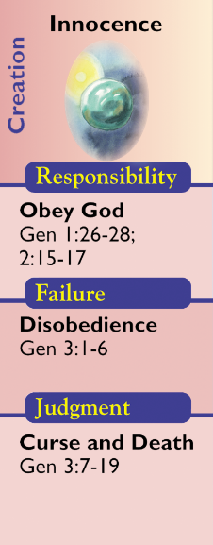
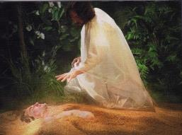
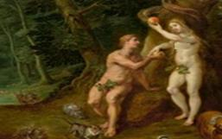
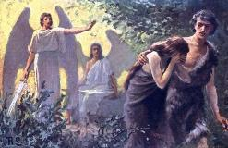
Innocence

Slide 7
Innocence (Genesis 1:28–3:6; 1:3-3:6)
The Dispensation of Innocence begins with the creation of Adam and Eve and God's commissioning of them. The dispensation of Innocence was a time when mankind, through Adam (Rom. 5:12-21; 1 Cor. 15:21,22), was created morally good but able to fall into sin. This apparently short-lived age ceased at the Fall into sin as recorded in Genesis 3.
God's revelation of His will was "from the tree of the knowledge of good and evil you shall not eat" (Gen. 2:17). Man's responsibility was to obey God and not partake. The consequences were: "for in the day that you eat from it you shall surely die" (Gen. 2:17).
https://www.pre-trib.org/dr-thomas-ice/message/covenants-and-dispensations-part-10/read

Slide 8
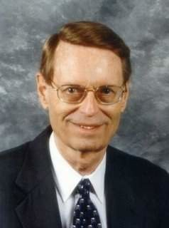
Innocence (Genesis 1:28–3:6; 1:3-3:6)
This first dispensation is usually called Innocency. Although this term is not a good description of Adam’s condition before the Fall, it may be the best single word. Yet the word innocent seems too neutral. Adam was not created merely innocent but with a positive holiness that enabled him to have face-to-face communication with God. Nevertheless, his holiness was not the same as the Creator’s, for it was limited by virtue of Adam’s being a creature. Also, his holiness was unconfirmed until he could successfully pass the tests placed before him. Therefore, it seems that Adam’s moral condition before God in those days of “innocency” was that of “unconfirmed creaturely holiness”. In this economy the key person . . .
Ryrie, C. C. (1995). Dispensationalism (Rev. and expanded., p. 59). Chicago: Moody Publishers.

Slide 9
Innocence (Genesis 1:28–3:6; 1:3-3:6)
. . . was Adam; indeed, we ought to consider it a dispensation, or stewardship, to Adam (as all the dispensations from the human viewpoint are stewardships). His responsibilities involved maintaining the garden and not eating of the fruit of the Tree of Knowledge of Good and Evil. He failed the test about eating, and, as a result, far-reaching judgments were pronounced on him, his wife, mankind, the serpent, and the creation. At the same time that God pronounced judgment, He also graciously intervened, promised a Redeemer, and made immediate provision for the acceptability of Adam and Eve in their sinful condition before God.
Ryrie, C. C. (1995). Dispensationalism (Rev. and expanded., p. 59). Chicago: Moody Publishers.

Slide 10
The 8 Biblical Covenants – Session 12
COVENANT | SCRIPTURE
Edenic (Conditional) | (Gen 1:28-30; 2:15-17; Hos 6:7)
Adamic (Uncond. / Universal) | (Gen 3:14–3:21)
Noahic (Uncond. / Universal) | (Gen. 8:20–9:17)
Abrahamic (Uncond. / Israel) | (Gen. 12:1–3; Chap. 15)
Mosaic (Conditional) | (Exo. 20:1–Deut. 28:68)
Land (Uncond. / Israel) | (Deut. 29:1–30:20)
Davidic (Uncond. / Israel) | (2 Sam. 7:11b-17; 1 Chr. 17:10b-15)
New (Uncond. / Israel) | (Jeremiah 31:31-34)
Fruchtenbaum, A. G. (1994). Israelology: The Missing Link in Systematic Theology (Rev. ed., p. 570). Tustin, CA: Ariel Ministries. / Lewis S. Chafer, Major Bible Themes (Rev. 1974., pgs. 139-149: DTS)
Notes:
2 – Conditional (Edenic & Mosaic)
Edenic made with Adam
Mosaic made with Moses (as Israel’s representative)
6 – Unconditional
2 – Unconditional & Universal - Adamic & Noahic
4 – Unconditional & Unique to Israel – Abrahamic, Land, Davidic, & New

Slide 11
The Biblical Covenants
Edenic Covenant (Gen 1:28-30; 2:15-17; Hos 6:7)
Parties to the Covenant
Conditions of the Covenant
God and Adam as the representative for mankind
Tree of Life
Be fruitful, multiply, fill the earth
Rule over the animal kingdom
Plants are for food (vegetarian)
Defined roles
Guard the garden
Do not eat from one tree
Penalty for violating the commands is death
Subdue the Earth
Token of the Covenant

Slide 12
Innocence (Genesis 1:28–3:6; 1:3-3:6)
Man’s Responsibilities
Man’s Failures
The Resulting Judgment
Man’s responsibilities in the garden were to fulfill the Edenic Covenant.
Pain in childbirth, Spousal authority struggle, Earth antagonistic to man, Man’s rule over the animal kingdom marred, Plants of the field for food, Expelled from Eden, Spiritual and physical death
Man’s failure was eating of the fruit of the Tree of Knowledge of Good and Evil.

Slide 13
The 7 Dispensations
Innocence / Innocency
Conscience
Human / Civil Government
Promise / Patriarchal Rule
Law-Israel / Mosaic Law
Grace-Church Age / Grace
***The Tribulation***
Millennial Kingdom / Millennium
***Eternal State***

Slide 14
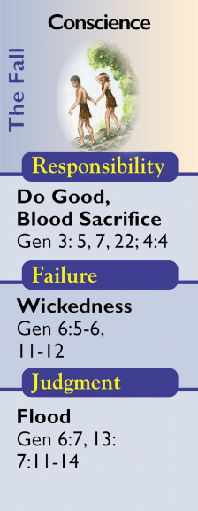
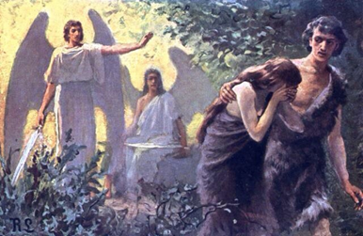
Conscience

Slide 15
Conscience (Gen 3:7-8:14)
The Dispensation of Conscience begins with the fall into sin leading to the Flood of Noah. This dispensation demonstrates that man needs more than his conscience to walk upright before God. During this dispensation God revealed His will through the curse (Gen. 3:14-24).
Man's responsibility was to master sin that desired to rule over him (Gen. 4:6-7).
The consequences of neglecting his conscience would be the global flood of Noah (Gen. 6:5-7). The title conscience comes from Romans 2:15 and aptly designates the period between the Fall and the Flood.
All persons have an innate, inherent, perception of what is right and what is wrong!
https://www.pre-trib.org/dr-thomas-ice/message/covenants-and-dispensations-part-10/read

Slide 16
Conscience (Gen 3:7-8:14)
The average dispensationalist has been schooled to designate the second economy as Conscience. The title comes from Romans 2:15 and is a proper designation of the stewardship. The title does not imply that man had no conscience before or after this time, any more than the dispensation of Law (which even covenant theologians recognize) implies that there was no law before or after the period. It simply means that this was the principal way God governed mankind during this economy, and obedience to the dictates of conscience was man’s chief stewardship responsibility…During this stewardship man was responsible to respond to God through the promptings of his conscience, and part of a proper response was to bring an acceptable blood sacrifice as God had taught him to do (Gen. 3:21; 4:4). We have a record of only a few responding, and . . .

Slide 17
Conscience (Gen 3:7-8:14)
... and Abel, Enoch, and Noah are especially cited as heroes of faith. We also have the record of those who did not respond and who by their evil deeds brought judgment on the world. Cain refused to acknowledge himself a sinner even when God continued to admonish him (Gen. 4:3, 7). So murder came on the scene of human history. Unnatural affection was widespread (Gen. 6:2). Finally, there was open violence and corruption and widespread evil desire and purpose of heart (Gen. 6:5). The longsuffering of God (1 Peter 3:20) came to an end, and He brought the Flood as judgment on the universal wickedness of man. But at the same time God graciously intervened; Noah found grace (the first use of the word in the Bible) in His sight (Gen. 6:8), and he and his family were saved. The revelation of this economy is preserved in Genesis 4:1–8:14.

Slide 18
Conscience (Gen 3:7 to Gen 8:14)
Man’s Responsibilities
Mankind was to respond to God through the prompting of his conscience as evidence of his faith in the promised seed, to bring an acceptable blood sacrifice.
Man’s Failures
Mankind, having been given the ability, through their conscience, to desire a relationship with God and through blood sacrifices, to approach God, failed. Wickedness and evil became widespread.
The Resulting Judgment
God, being true to His word, spared the only faithful humans and a small remnant of air breathing creatures and started over in order to fulfill his promise of redemption

Slide 19
END OF REVIEW

Slide 20
Biblical Dispensationalism
Session 14 - The Dispensations
Human Government – Promise – Law

Slide 21
The Dispensations
Innocence / Innocency
Conscience
Human / Civil Government
Promise / Patriarchal Rule
Law-Israel / Mosaic Law
Grace-Church Age / Grace
***The Tribulation***
Millennial Kingdom / Millennium
***Eternal State***

Slide 22
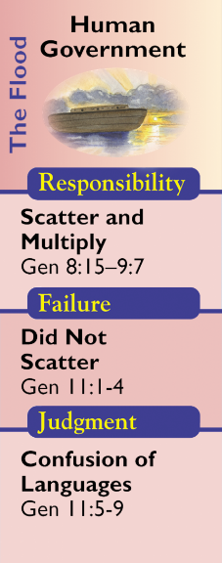
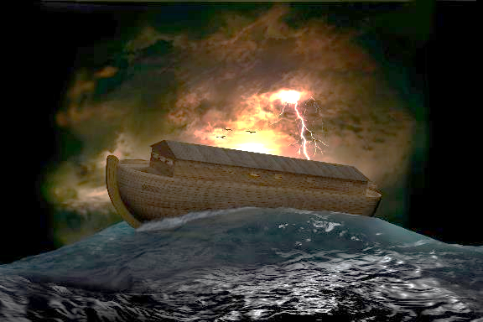
Human Government

Slide 23
Human Government (Gen. 8:15-11:9)
The Dispensation of Human Government begins after the flood when Noah and his family leave the ark. Civil Government was not invented by mankind as the need developed, instead, it was instituted by God Himself after the flood as seen in Genesis 8 and 9.
God's revealed will is that evil is to be restrained through the corporate institution of civil government (and corporal punishment) instead of personal vengeance (Lamech - Genesis 4:24).
https://www.pre-trib.org/dr-thomas-ice/message/covenants-and-dispensations-part-10/read

Slide 24
Human Government (Gen. 8:15-11:9)
With the absence of a threat of God's direct intervention through an instrument like the flood, man's responsibility is to mediate and restrain mankind's evil through capital punishment of certain offenses (Gen. 9:6; Rom. 13:1-7; 1 Pet. 2:13-17).
The consequences relate to man's failure to carry out God's will to restrain evil. Because of this God intervened in the tower of Babel incident (Gen. 11:1-9). The chief personage during this economy was Noah. The new revelation of this time included animals’ fear of man, animals given to man to eat, the promise of no further floods, and the institution of capital punishment. It is the latter [capital punishment] that gives the distinctive basis to this dispensation as that of human, or civil, government. . . .
https://www.pre-trib.org/dr-thomas-ice/message/covenants-and-dispensations-part-10/read

Slide 25
Human Government (Gen. 8:15-11:9)
… God gave man the right to take the life of man, which in the very nature of the case gave man the authority to govern others. Unless government has the right to the highest form of punishment, its basic authority is questionable and insufficient to protect properly those it governs…
Ryrie, C. C. (1995). Dispensationalism (Rev. and expanded., p. 61). Chicago: Moody Publishers.

Slide 26
Genesis 9:6
⁶ “Whoever sheds man’s blood, By man his blood shall be shed, For in the image of God He made man. (cf. Rom. 13:1-7; 1 Pet. 2:13-17)
God instituted
capital punishment!

Slide 27
1 Pet. 2:13-17
¹³ Submit yourselves for the Lord’s sake to every human institution, whether to a king as the one in authority, ¹⁴ or to governors as sent by him for the punishment of evildoers and the praise of those who do right. ¹⁵ For such is the will of God that by doing right you may silence the ignorance of foolish men. ¹⁶ Act as free men, and do not use your freedom as a covering for evil, but use it as bondslaves of God. ¹⁷ Honor all people, love the brotherhood, fear God, honor the king.

Slide 28
Romans 13:1-7
¹ Every person is to be in subjection to the governing authorities. For there is no authority except from God, and those which exist are established by God. ² Therefore whoever resists authority has opposed the ordinance of God; and they who have opposed will receive condemnation upon themselves. ³ For rulers are not a cause of fear for good behavior, but for evil. Do you want to have no fear of authority? Do what is good and you will have praise from the same; ⁴ for it is a minister of God to you for good. But if you do what is evil, be afraid; for it does not bear the sword for nothing; for it is a minister of God, an avenger who brings wrath on the one who practices evil. ⁵ Therefore it is necessary to be in subjection, not only because of wrath, but also for conscience’ sake. ⁶ For because of this you also pay taxes, for rulers are servants of God, devoting themselves to this very thing. ⁷ Render to all what is due them: tax to whom tax is due; custom to whom custom; fear to whom fear; honor to whom honor.

Slide 29
Human Government (Gen. 8:15-11:9)
…Failure to govern successfully appeared on the scene almost immediately, for Noah became drunk and incapable of ruling. The people, instead of obeying God’s command to scatter and fill the earth, conceived the idea of staying together and building the tower of Babel to help achieve their aim. Fellowship with man replaced fellowship with God. As a result, God sent the judgment of the tower of Babel and the confusion of languages. He also graciously intervened in that He did not utterly destroy the nations but chose to deal graciously with Abraham and his descendants. The scriptural revelation of this stewardship is found in Genesis 8:15–11:9.
Ryrie, C. C. (1995). Dispensationalism (Rev. and expanded., p. 61). Chicago: Moody Publishers.

Slide 30
The Biblical Covenants
Noahic Covenant (Genesis 9:1-17)
Parties to the Covenant
Conditions of the Covenant
God and Noah as the representative for mankind
Rainbow
Be fruitful, multiply and fill the earth
Token of the Covenant
Mankind to be feared by animals
Mankind allowed to eat meat
Mankind not to eat or drink blood
Institution of capital punishment
Never again a universal flood

Slide 31
Human Government (Gen. 8:15-11:9)
Man’s Responsibilities
Man’s responsibilities were to fulfill the Noahic covenant.
Man’s Failures
The people, instead of obeying God’s command to scatter and fill the earth, conceived the idea of staying together and building the tower of Babel to help achieve their aim. Fellowship with man replaced fellowship with God.
The Resulting Judgment
As a result, God sent the judgment of the tower of Babel and the confusion of languages. He also graciously intervened in that He did not utterly destroy the nations but chose to deal graciously with Abraham and his descendants.

Slide 32
Genesis 11:1–4
¹ Now the whole earth used the same language and the same words. ² It came about as they journeyed east, that they found a plain in the land of Shinar and settled there. ³ They said to one another, “Come, let us make bricks and burn them thoroughly.” And they used brick for stone, and they used tar for mortar. ⁴ They said, “Come, let us build for ourselves a city, and a tower whose top will reach into heaven, and let us make for ourselves a name, otherwise we will be scattered abroad over the face of the whole earth.”

Slide 33
Genesis 11:5–9
⁵ The Lord came down to see the city and the tower which the sons of men had built. ⁶ The Lord said, “Behold, they are one people, and they all have the same language. And this is what they began to do, and now nothing which they purpose to do will be impossible for them. ⁷ “Come, let Us go down and there confuse their language, so that they will not understand one another’s speech.” ⁸ So the Lord scattered them abroad from there over the face of the whole earth; and they stopped building the city. ⁹ Therefore its name was called Babel, because there the Lord confused the language of the whole earth; and from there the Lord scattered them abroad over the face of the whole earth.

Slide 34
The Dispensations
Innocence / Innocency
Conscience
Human / Civil Government
Promise / Patriarchal Rule
Law-Israel / Mosaic Law
Grace-Church Age / Grace
***The Tribulation***
Millennial Kingdom / Millennium
***Eternal State***

Slide 35
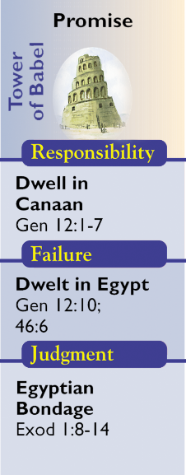
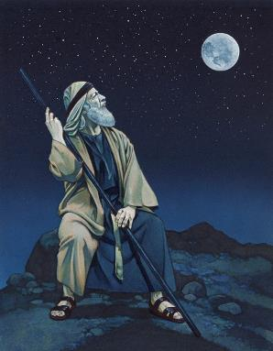
Promise

Slide 36
Promise (Gen. 11:10-Ex. 18:27)
The Dispensation of Promise (so named by Paul in Galatians 3:15-22; 4:23,28) begins with the call of Abram and ends with the foundation of Israel as a nation through the giving of the Law at Mount Sinai (Ex. 19). This period is dominated by the call of Abram and the promise made to him and his descendants, both physical and spiritual. The outworking of God's promise to Abraham, Isaac and his descendants is tracked through Genesis and Exodus.
https://www.pre-trib.org/dr-thomas-ice/message/covenants-and-dispensations-part-10/read

Slide 37
Promise (Gen. 11:10-Ex. 18:27)
During the age of Promise God revealed His will through the giving of the Abrahamic Covenant and its outworking in history.
Abram's responsibility was to dwell in the land.
The consequences were that when Israel disobeyed God He would discipline His people.
https://www.pre-trib.org/dr-thomas-ice/message/covenants-and-dispensations-part-10/read

Slide 38
Promise (Gen. 11:10-Ex. 18:27)
The title Promise comes from Hebrews 6:15 and 11:9, where it is said that Abraham obtained the promise and sojourned in the land of promise. The title emphasizes the revelation of the economy. The governmental feature of the economy is best emphasized by the designation Dispensation of Patriarchal Rule. Until this dispensation, all mankind had been directly related to God’s governing principles. Now God marked out one family and one nation and in them made a representative test of all.
Ryrie, C. C. (1995). Dispensationalism (Rev. and expanded., p. 61). Chicago: Moody Publishers.

Slide 39
Promise (Gen. 11:10-Ex. 18:27)
The responsibility of the patriarchs was simply to believe and serve God, and God gave them every material and spiritual provision to encourage them to do this. The Promised Land was theirs, and blessing was theirs as long as they remained in the land. But, of course, there was failure soon and often. Finally, Jacob led the people to Egypt, and soon the judgment of slavery was brought on them. But God again graciously provided a deliverer and in the process of deliverance killed their oppressors. The Scripture involved in this dispensation is Genesis 11:10–Exodus 18:27.
Ryrie, C. C. (1995). Dispensationalism (Rev. and expanded., p. 62). Chicago: Moody Publishers.

Slide 40
The Biblical Covenants
Abrahamic Covenant (Genesis 9:1-17)
Parties to the Covenant
Conditions of the Covenant
God and Abram as the representative for mankind
Circumcision
Fourteen Provisions
Token of the Covenant

Slide 41
14 PROVISIONS OF THE ABRAHAMIC COVENANT
Fruchtenbaum, A. G. (2001). Israelology: The missing link in systematic theology (p. 575). Ariel Ministries.

Slide 42
Promise (Gen. 11:10-Ex. 18:27)
Abrahamic Covenant (Genesis 12:1-3)
Man’s Responsibilities
The responsibility of the patriarchs was simply to believe and serve God. The Promised Land was theirs, and blessing was theirs as long as they remained in the land. The people of the promise; Abraham, Isaac, Jacob, and the children of Jacob (Israel) were to stay separate from the nations around them.
Man’s Failures
Abraham, Isaac, Jacob and his twelve sons continued to intermingle with the Canaanites and surrounding nations.
The Resulting Judgment
God sent the family down to Egypt where the surrounding Egyptians would not associate with them. Soon after they would be enslaved.

Slide 43
Genesis 12:1-7
¹ Now the Lord said to Abram, “Go forth from your country, And from your relatives And from your father’s house, To the land which I will show you; ² And I will make you a great nation, And I will bless you, And make your name great; And so you shall be a blessing; ³ And I will bless those who bless you, And the one who curses you I will curse. And in you all the families of the earth will be blessed.” ⁴ So Abram went forth as the Lord had spoken to him; . . . ⁷ The Lord appeared to Abram and said, “To your descendants I will give this land.” So he built an altar there to the Lord who had appeared to him.

Slide 44
Genesis 12:10
Now there was a famine in the land; so Abram went down to Egypt to sojourn there, for the famine was severe in the land.
Genesis 46:6
They took their livestock and their property, which they had acquired in the land of Canaan, and came to Egypt, Jacob and all his descendants with him:

Slide 45
Exo. 1:8-14
⁸ Now a new king arose over Egypt, who did not know Joseph….¹¹ So they appointed taskmasters over them to afflict them with hard labor….¹³ The Egyptians compelled the sons of Israel to labor rigorously; ¹⁴ and they made their lives bitter with hard labor in mortar and bricks and at all kinds of labor in the field, all their labors which they rigorously imposed on them.

Slide 46
The Dispensations
Innocence / Innocency
Conscience
Human / Civil Government
Promise / Patriarchal Rule
Law-Israel / Mosaic Law
Grace-Church Age / Grace
***The Tribulation***
Millennial Kingdom / Millennium
***Eternal State***

Slide 47
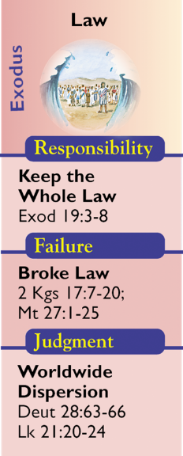
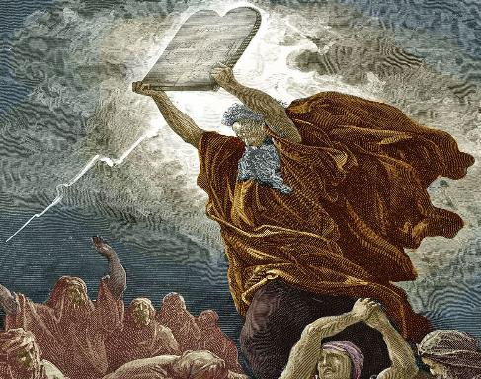
Law-Israel

Slide 48
Law (Ex. 19:1 – Acts 1:26)
This dispensation began when Israel is established as a nation at the Exodus and given the Law. Israel was not and never was saved by keeping the Law, instead, it was how they as a redeemed people were to live. It was their rule of life that governed ever aspect of life. But it was temporary until the coming and fulfillment by Christ.
Israel's responsibility was to obey the Mosaic Law in order to show their loyalty to the Lord.
https://www.pre-trib.org/dr-thomas-ice/message/covenants-and-dispensations-part-10/read

Slide 49
Law (Ex. 19:1 – Acts 1:26)
Israel, as a nation, [miserably] failed to keep the Mosaic Law which resulted in the many judgments spelled out in Deuteronomy 28 and Leviticus 26, the ultimate judgment resulting in their captivity while scattered among the nations.
Today we are in a transition period during which Israel is partially regathered into her land and still partially scattered among the nations.
https://www.pre-trib.org/dr-thomas-ice/message/covenants-and-dispensations-part-10/read

Slide 50
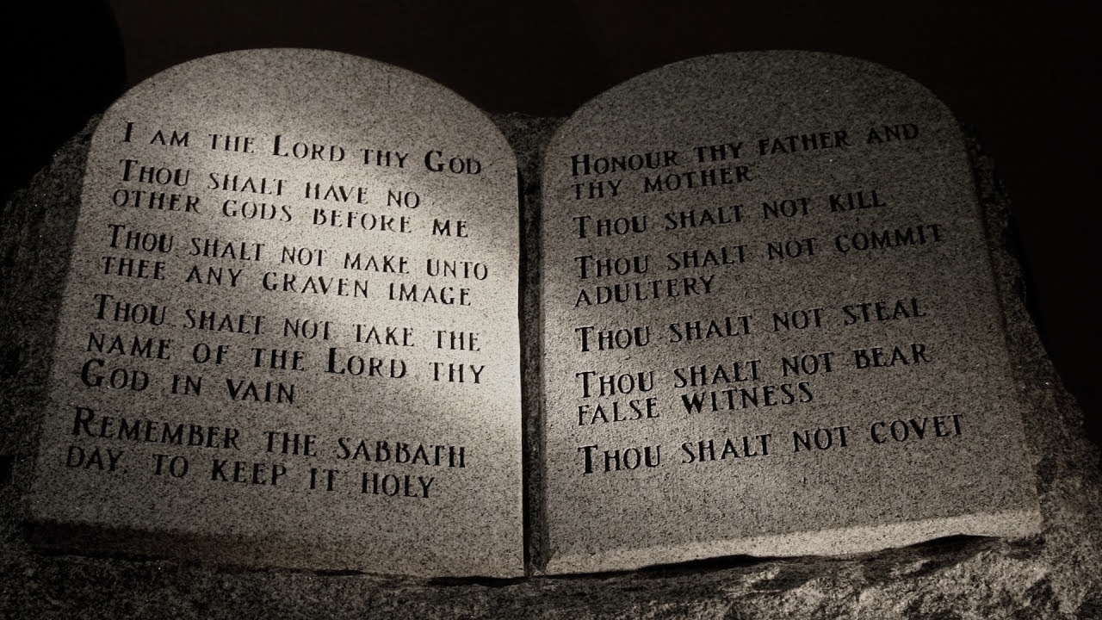
Law (Ex. 19:1 – Acts 1:26)
To the children of Israel through Moses were given the great code that we call the Mosaic Law. It consisted of 613 commandments covering all phases of life and activity. It revealed in specific detail God’s will in that economy. The period covered was from Moses until the death of Christ, or from Exodus 19:1 to Acts 1:26 (~1,500 years).
Ryrie, C. C. (1995). Dispensationalism (Rev. and expanded., p. 63). Chicago: Moody Publishers.

Slide 51
Law (Ex. 19:1 – Acts 1:26)
The people were responsible to keep all the law (James 2:10), but they failed (Rom. 10:1–3). As a result, there were many judgments throughout this long period. The ten tribes were carried into Assyrian captivity; the two tribes were carried into Babylonian captivity; and later, because of their rejection of Jesus of Nazareth, the people were dispersed into all the world (Matt. 23:37–39). All during their many periods of declension and backsliding, God dealt with them graciously from the very first apostasy with the golden calf, when the law was being delivered to Moses, to the gracious promises of final regathering and restoration in the millennial age to come. . . .

Slide 52
Law (Ex. 19:1 – Acts 1:26)
. . . These promises of a glorious future are guaranteed secure by the Abrahamic promises, which the law in no way abrogated (Gal. 3:3–25). We are also told clearly in the New Testament (Rom. 3:20) that the law was not a means of justification but of condemnation. . . .
CONDEMNATION
Ryrie, C. C. (1995). Dispensationalism (Rev. and expanded., p. 63-64). Chicago: Moody Publishers.

Slide 53
The Biblical Covenants
Mosaic Covenant (Exodus 20:1 – Deut. 28:68)
Parties to the Covenant
Conditions of the Covenant
God and Israel with Moses acting as a representative
Sabbath
Law of Moses which contained a total 613 commandments. Being a conditional covenant, it provided blessings for obedience and curses for disobedience. (Ex. 15:26) The key element of the entire Mosaic Law was the blood sacrifice. (Lev. 17:11)
Token of the Covenant

Slide 54
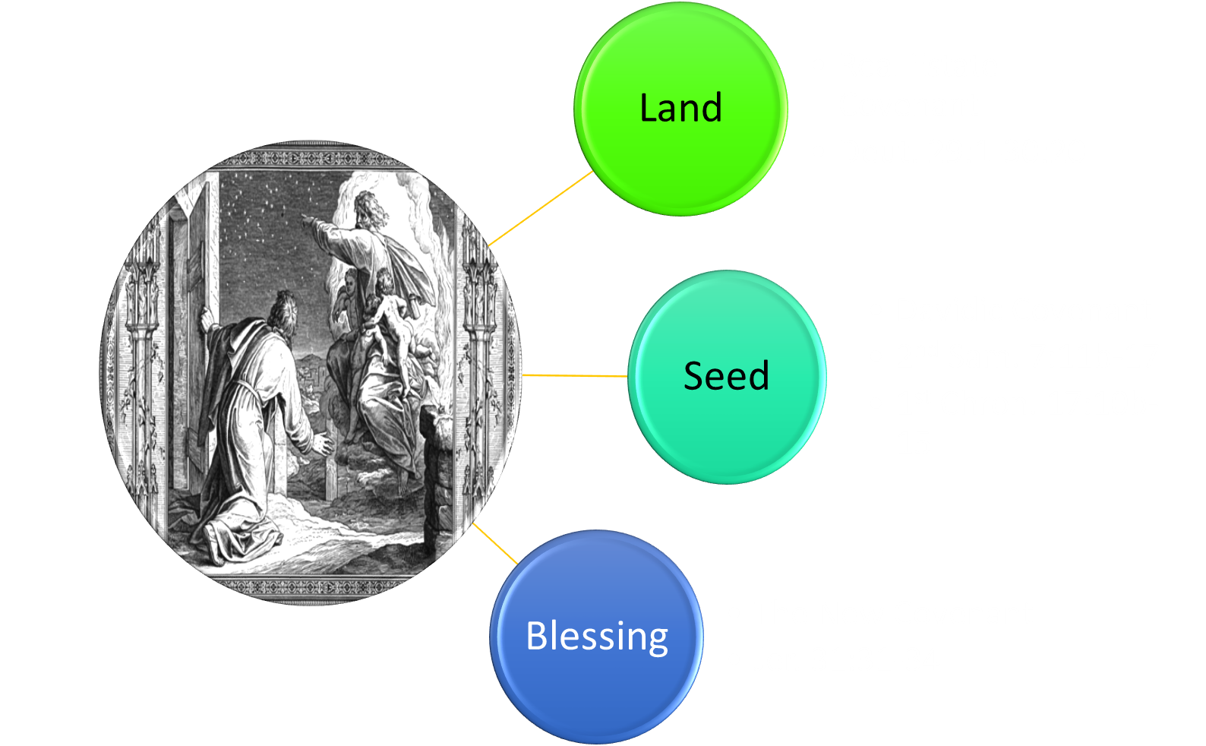
Law (Ex. 19:1 – Acts 1:26)
Mosaic Covenant (Exodus 20:1 – Deut. 28:68)

Slide 55
Law (Ex. 19:1 – Acts 1:26)
Man’s Responsibilities
The responsibility of the Nation of Israel along with Gentile proselytes was to keep the Mosaic Law.
Man’s Failures
The Nation of Israel was continually disobedient and God continued to bring them back through discipline. They continued to reject the ordinances of God. (2 Kings 17:7-23)
The Resulting Judgment
As a result, there were many judgments throughout this long period. The ten tribes were carried into Assyrian captivity; the two tribes were carried into Babylonian captivity; and later, because of their rejection of Jesus of Nazareth, the people were dispersed into all the world (Matt. 23:37–39).

Slide 56
Exo. 19:3-8
³ Moses went up to God, and the Lord called to him from the mountain, saying, “Thus you shall say to the house of Jacob and tell the sons of Israel: ⁴ ‘You yourselves have seen what I did to the Egyptians, and how I bore you on eagles’ wings, and brought you to Myself. ⁵ ‘Now then, if you will indeed obey My voice and keep My covenant, then you shall be My own possession among all the peoples, for all the earth is Mine; ⁶ and you shall be to Me a kingdom of priests and a holy nation.’ These are the words that you shall speak to the sons of Israel.” ⁷ So Moses came and called the elders of the people, and set before them all these words which the Lord had commanded him. ⁸ All the people answered together and said, “All that the Lord has spoken we will do!” And Moses brought back the words of the people to the Lord.

Slide 57
2 Kings 17:7–20
. . . Judah did not keep the commandments of the Lord their God, but walked in the customs which Israel had introduced. ²⁰ The Lord rejected all the descendants of Israel and afflicted them and gave them into the hand of plunderers, until He had cast them out of His sight.

Slide 58
CONCLUSION

Slide 59
The Dispensations
Innocence / Innocency
Conscience
Human / Civil Government
Promise / Patriarchal Rule
Law-Israel / Mosaic Law
Grace-Church Age / Grace
***The Tribulation***
Millennial Kingdom / Millennium
***Eternal State***

Slide 60
The Dispensations
Innocence / Innocency
Conscience
Human / Civil Government
Promise / Patriarchal Rule
Law-Israel / Mosaic Law
Grace-Church Age / Grace
***The Tribulation***
Millennial Kingdom / Millennium
***Eternal State***

Slide 61
Resources Used & Suggested
Alva J. McClain, Law & Grace, Moody, 1967 978-088469-001-6
A. G. Fruchtenbaum, Israelology: The Missing Link in Systematic Theology, Ariel Ministries 1994, 978-0914863052
Charles C. Ryrie, Dispensationalism, Moody, 2007, 080242189X
Christopher Cone, gen. ed., Dispensationalism Tomorrow & Beyond, Tyndale Seminary Press, 2008 9780981479101
Christopher Cone, gen. ed., An Introduction To The New Covenant, Tyndale Seminary Press, 2013, 9781938484100
Thomas Ice, Covenants and Dispensations (Part 10), https://www.pre-trib.org/dr-thomas-ice/message/covenants-and-dispensations-part-10
Lewis S. Chafer, Major Bible Themes, Zondervan, 1974, 0-310-22390-3
Mike Stallard, gen .ed., Dispensational Understanding of the New Covenant, Regular Baptist Books, 2012, 9781607764946
Paul Enns, The Moody Handbook of Theology, Moody 1989,
Renald E. Showers, There Really Is A Difference, Friend of Israel Gospel Ministry, 1990, 0915540509
Rene Pache, The Inspiration and Authority of Scripture, Sheffield Pub Co, 1992
Roy B. Zuck, Basic Bible Interpretation, SP Publications, 1991
Walvoord, J. F., The Prophecy Knowledge Handbook. Wheaton, IL: Victor Books. 1990.
Charting the End Times CD-Rom: A Visual Guide to Understanding Bible Prophecy, ISBN-10: 0736917624
Materials from:
Ed Allsteadt, https://job42ministry.org/dispensational-clarity
Dr. Andy Woods, Sugar Land Bible Church, www.slbc.org
Dr. Vern Peterman, Holly Hills Bible Church, www.hollyhillsbiblechurch.org
George Zeller, Middletown Bible Church, www.middletownbiblechurch.org

