Slide 1
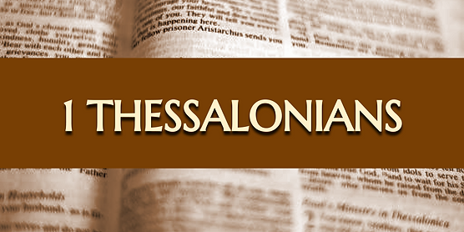

1 Thessalonians
Living Considering His Soon Return
Dr. Andy Woods
Senior Pastor – Sugar Land Bible Church
President – Chafer Theological Seminary

Slide 2
Introductory Matters
Authorship |  | Occasion
Recipients |  | Structure
Place of writing |  | Unique characteristics
Date |  | Purpose
Audience |  | Message

Slide 3
Introductory Matters
Authorship |  | Occasion
Recipients |  | Structure
Place of writing |  | Unique characteristics
Date |  | Purpose
Audience |  | Message

Slide 4

Pauline Authorship
1:1; 2:18
Acts 17–18
NT scholarship

Slide 5
Introductory Matters
Authorship |  | Occasion
Recipients |  | Structure
Place of writing |  | Unique characteristics
Date |  | Purpose
Audience |  | Message

Slide 6
Thessalonica
1:1
Chief seaport of Macedonia
Received status as a free city in 42 B.C.

Slide 7
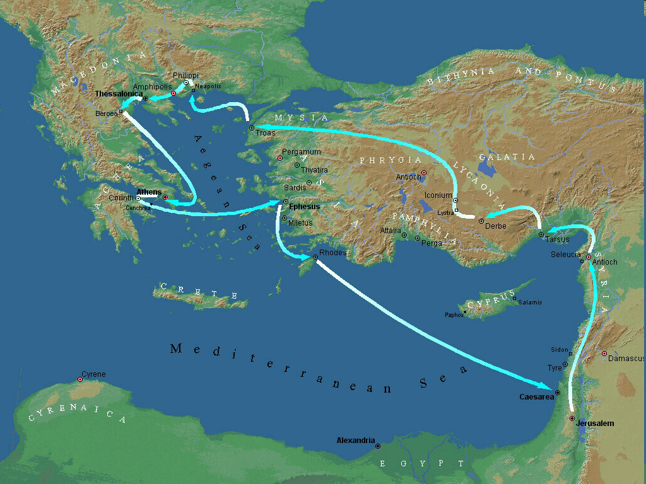

Second Missionary Journey

Slide 8
Introductory Matters
Authorship |  | Occasion
Recipients |  | Structure
Place of writing |  | Unique characteristics
Date |  | Purpose
Audience |  | Message

Slide 9
Second Missionary Journey

Slide 10
Presumed Knowledge
Trinity | 1:1, 5-6
Holy Spirit | 1:5-6; 4:8; 5:19
Second Advent | 1:10; 2:19; 3:13; 4:14-17; 5:23
Day of the Lord | 5:1-3
Eschatology | 2 Thess 2:5
Assurance | 1:5
Conversion | 1:9
Election | 1:4
Resurrection | 4:14-18
Sanctification | 4:3; 5:23
Christian behavior | 2:12; 4:1
Adapted from Scofield Study Bible, 1640

Slide 11


2 Thessalonians 2:5
“Do you not remember that while I was still with you, I was telling you these things?”

Slide 12
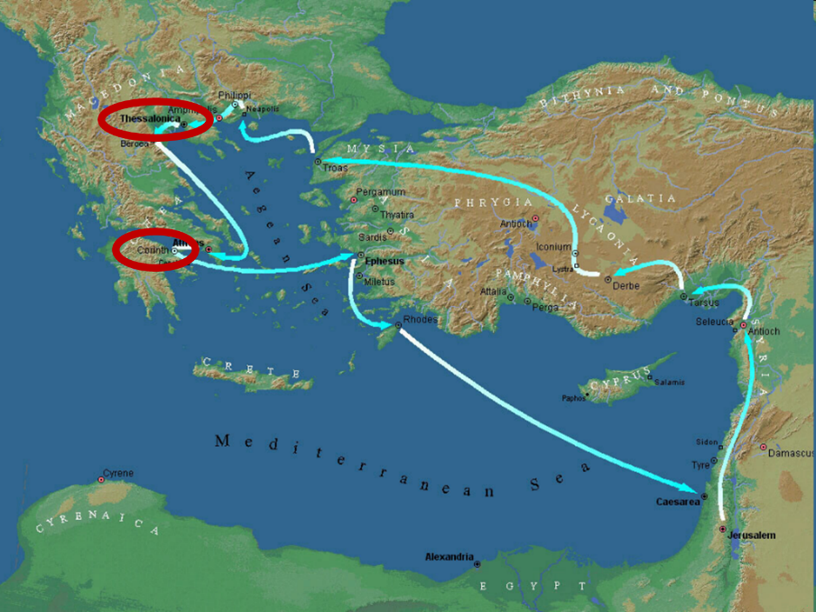

Slide 13
Introductory Matters
Authorship |  | Occasion
Recipients |  | Structure
Place of writing |  | Unique characteristics
Date |  | Purpose
Audience |  | Message

Slide 14
Date
A.D. 51
Paul’s second letter

Slide 15
Paul’s Ministry Chronology
# of books | Journey | Acts | Date | Books
1 | 1 | 13–14 | 48–49 | Gal
2 | 2 | 15:36–18:22 | 50–52 | 1–2 Thess
3 | 3 | 18:23–21:17 | 53–57 | 1–2 Cor, Rom
4 | 4 | 28:16-31 | 60–62 | Eph, Col, Phlm, Phlp
2 | Between Imprisonments | Post Acts | 62–66 | 1 Tim, Titus
1 | 2nd Imprisonment | Post Acts | 67 | 2 Tim

Slide 16
Order of Paul’s Letters
Galatians (A.D. 49)
1‒2 Thessalonians (A.D. 51)
1‒2 Corinthians (A.D. 56)
Romans (A.D. 57)
Ephesians, Colossians, Philemon, Philippians (A.D. 60‒62)
1 Timothy, Titus (A.D. 62‒66)
2 Timothy (A.D. 67)

Slide 17
Introductory Matters
Authorship |  | Occasion
Recipients |  | Structure
Place of writing |  | Unique characteristics
Date |  | Purpose
Audience |  | Message

Slide 18
Audience
Believers – 1:3
Some Jews – Acts 17:2, 4, 12
Mostly gentile – 1:9

Slide 19


Slide 20
Introductory Matters
Authorship |  | Occasion
Recipients |  | Structure
Place of writing |  | Unique characteristics
Date |  | Purpose
Audience |  | Message

Slide 21
Occasion
Under persecution
Ad hominem attack against Paul
Other problems

Slide 22
Introductory Matters
Authorship |  | Occasion
Recipients |  | Structure
Place of writing |  | Unique characteristics
Date |  | Purpose
Audience |  | Message

Slide 23
Structure
Personal (1–3)
  Genuine conversion (1)
  Impure motives (2:1-16)
  Lack of concern (2:17–3:13)
Practical (4–5)
  Immorality (4:1-8)
  Laziness (4:9-12)
  Eschatology (4:13–5:11)
  Ministry imbalances (5:12-15)
  Progressive sanctification (5:16-28)

Slide 24
Structure
1 THESSALONIANS 1-3 | 1 THESSALONIANS 4-5
Personal Experience | Practical Exhortation
Looking Back | Looking Forward

Slide 25
Introductory Matters
Authorship |  | Occasion
Recipients |  | Structure
Place of writing |  | Unique characteristics
Date |  | Purpose
Audience |  | Message

Slide 26
Unique Characteristics
Every chapter ends with a reference to the Second Advent
Small amount of time in between planting of the church and the first letter to the church

Slide 27
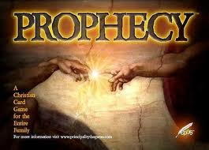
BIBLICAL PROPHECY: IMPORTANCE
27% of Scripture was prophetic at the time it was written
2 Pet 1:19

Slide 28

J. Dwight Pentecost
Prophecy For Today, Page 20
“A short time ago, I took occasion to go through the New Testament to mark each reference to the coming of the Lord Jesus Christ and to observe the use made of that teaching about His coming. I was struck a new with the fact that almost without exception, when the coming of Christ is mentioned in the New Testament, it is followed by an exhortation to godliness and holy living.”

Slide 29
Introductory Matters
Authorship |  | Occasion
Recipients |  | Structure
Place of writing |  | Unique characteristics
Date |  | Purpose
Audience |  | Message

Slide 30
Purpose
Continued spiritual growth despite persecution from the unbelieving Jews

Slide 31
Introductory Matters
Authorship |  | Occasion
Recipients |  | Structure
Place of writing |  | Unique characteristics
Date |  | Purpose
Audience |  | Message

Slide 32
Message
Continued growth in faith, hope, and love in view of the Lord’s imminent return

Slide 33
Conclusion

Slide 34
Introductory Matters
Authorship |  | Occasion
Recipients |  | Structure
Place of writing |  | Unique characteristics
Date |  | Purpose
Audience |  | Message

