Slide 1
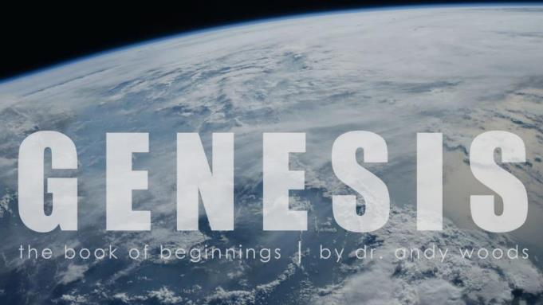
Genesis 12‒50
Israel’s Birth & Preservation

Slide 2
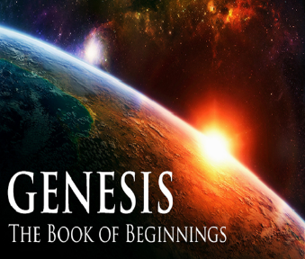
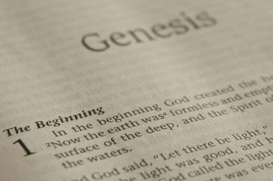
GENESIS STRUCTURE
Beginning of the Human race (Gen. 1‒11)
Beginning of the Hebrew race (Gen. 12‒50)

Slide 3
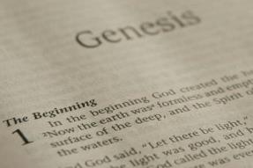
GENESIS STRUCTURE
Genesis 1-11 (four events)
Creation (1-2)
Fall (3-5)
Flood (6-9)
National dispersion (10-11)

Slide 4
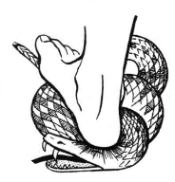
Genesis 3:15
“And I will put enmity Between you and the woman, And between your seed and her seed; He shall bruise you on the head, And you shall bruise him on the heel.”

Slide 5
GENESIS STRUCTURE
Beginning of the Human race (Gen. 1‒11)
Beginning of the Hebrew race (Gen. 12‒50)

Slide 6
GENESIS STRUCTURE
Genesis 12-50 (four people)
Abraham (12:1–25:11)
Isaac (25:12–26:35)
Jacob (27–36)
Joseph (37–50)

Slide 7
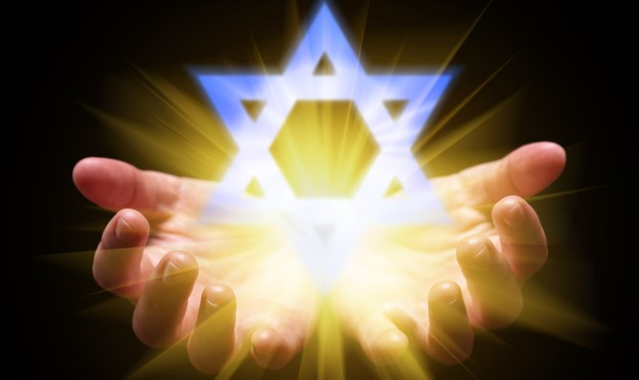
Isaiah 43:1
“But now, thus says the Lord, your Creator, O Jacob, And He who formed you, O Israel, 'Do not fear, for I have redeemed you; I have called you by name; you are Mine!'”

Slide 8
GENESIS STRUCTURE
Genesis 12-50 (four people)
Abraham (12:1–25:11)
Isaac (25:12–26:35)
Jacob (27–36)
Joseph (37–50)

Slide 9
Genesis 12‒24 Abraham’s Early Journeys
Unconditional promises (Gen. 12:1-3) From Haran to Canaan (Gen. 12:4-5) In Canaan (Gen. 12:6-9) In Egypt (Gen. 12:10-20) Abram and Lot Separate (Gen. 13:1-13) Reaffirmation of Abram’s promises (Gen. 13:14-18) Abram Rescues Lot (14:1-24) Abrahamic Covenant (15:1-21) Hagar & Ishmael (16:1-16) Circumcision (Gen. 17:1-27) | Sodom & Gomorrah (Gen. 18‒19) Abraham & Abimelech (Gen. 20) Isaac’s birth (Gen. 21:1-7) Ishmael’s expulsion (21:8-21) Abraham & Abimelech’s covenant (21:22-34) Abraham sacrifices Isaac (22) Sarah’s death (23) Isaac’s marriage (24)

Slide 10
Genesis 24 Isaac’s Marriage
Abraham’s instructions (1-9)
Servant prays (10-14)
Servant meets Rebekah (15-27)
Servant and Laban (28-49)
Betrothal of Isaac & Rebekah (50-60)
Marriage of Isaac & Rebekah (61-67)

Slide 11
Genesis 24 Isaac’s Marriage
Abraham’s instructions (1-9)
Servant prays (10-14)
Servant meets Rebekah (15-27)
Servant and Laban (28-49)
Betrothal of Isaac & Rebekah (50-60)
Marriage of Isaac & Rebekah (61-67)

Slide 12
Genesis 24:1-9 Abraham instructs servant
Occasion (1)
Oath (2-4)
Servant’s question (5)
Abraham’s answer (6-8)
Oath taken (9)

Slide 13
Genesis 24 Isaac’s Marriage
Abraham’s instructions (1-9)
Servant prays (10-14)
Servant meets Rebekah (15-27)
Servant and Laban (28-49)
Betrothal of Isaac & Rebekah (50-60)
Marriage of Isaac & Rebekah (61-67)

Slide 14
Genesis 24:10-14 Servant’s prayer
Journey (10)
Arrival (11)
Prayer (12)
Request (13-14)

Slide 15
Genesis 24 Isaac’s Marriage
Abraham’s instructions (1-9)
Servant prays (10-14)
Servant meets Rebekah (15-27)
Servant and Laban (28-49)
Betrothal of Isaac & Rebekah (50-60)
Marriage of Isaac & Rebekah (61-67)

Slide 16
Genesis 24:15-27 Servant meets Rebekah
Introduction to Rebekah (15-16)
Servant’s question (17)
Rebekah’s response (18-20)
Servant’s observation (21)
Servant’s action (22)
Servant’s inquiry (23)
Rebekah’s answers (24-25)
Servant’s responses (26-27)

Slide 17
Genesis 24 Isaac’s Marriage
Abraham’s instructions (1-9)
Servant prays (10-14)
Servant meets Rebekah (15-27)
Servant and Laban (28-49)
Betrothal of Isaac & Rebekah (50-60)
Marriage of Isaac & Rebekah (61-67)

Slide 18
Genesis 24:28-49 Servant & Laban
In the house (28-33)
Retelling the story (34-49)

Slide 19
Genesis 24:28-49 Servant & Laban
In the house (28-33)
Retelling the story (34-49)

Slide 20
Genesis 24:28-33 In the house
Rebekah’s report (28)
Laban’s response (29-30)
Laban’s invitation (31)
Laban’s hospitality (32-33)

Slide 21
Genesis 24:28-33 In the house
Rebekah’s report (28)
Laban’s response (29-30)
Laban’s invitation (31)
Laban’s hospitality (32-33)

Slide 22
Genesis 24:28-33 In the house
Rebekah’s report (28)
Laban’s response (29-30)
Laban’s invitation (31)
Laban’s hospitality (32-33)

Slide 23
Genesis 24:28-33 In the house
Rebekah’s report (28)
Laban’s response (29-30)
Laban’s invitation (31)
Laban’s hospitality (32-33)

Slide 24
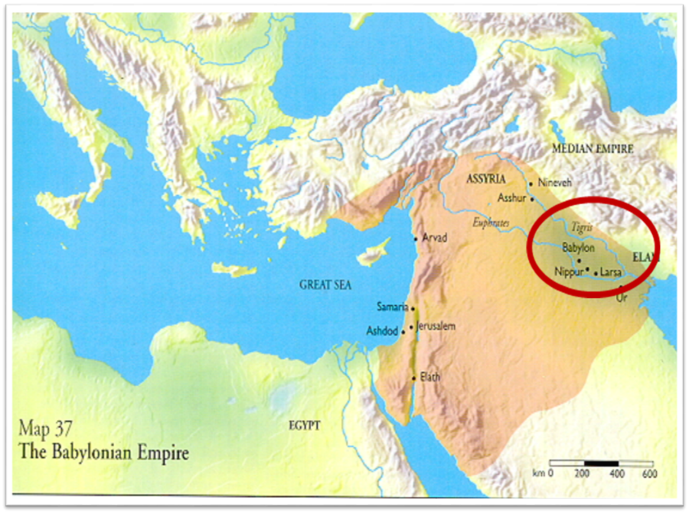

Slide 25
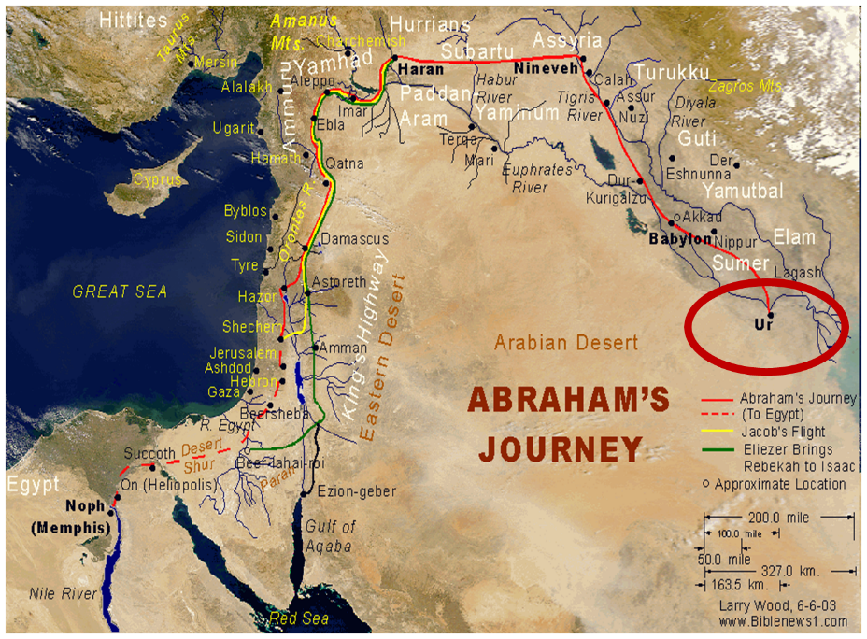

Slide 26
Genesis 24:28-33 In the house
Rebekah’s report (28)
Laban’s response (29-30)
Laban’s invitation (31)
Laban’s hospitality (32-33)

Slide 27
Genesis 24:28-49 Servant & Laban
In the house (28-33)
Retelling the story (34-49)

Slide 28
Genesis 24:34-49 Retelling the story
Servant identifies himself (34)
Abraham’s blessings (35)
Abraham’s son (36)
Servant’s oath (37-41)
Servant’s prayer (42-44)
Prayer answered (45-48)
Servant’s request (49)

Slide 29
Genesis 24:34-49 Retelling the story
Servant identifies himself (34)
Abraham’s blessings (35)
Abraham’s son (36)
Servant’s oath (37-41)
Servant’s prayer (42-44)
Prayer answered (45-48)
Servant’s request (49)

Slide 30
Genesis 24:34-49 Retelling the story
Servant identifies himself (34)
Abraham’s blessings (35)
Abraham’s son (36)
Servant’s oath (37-41)
Servant’s prayer (42-44)
Prayer answered (45-48)
Servant’s request (49)

Slide 31
8 New Promises Genesis 12:1-3
Land (Gen. 12:1b)
Great nation (Gen. 12:2a)
Personal blessing (Gen. 12:2b)
Great name (Gen. 12:2c)
Blessing to others (Gen. 12:2d)
Blessing to blessers (Gen. 12:3a)
Cursing to cursers (Gen. 12:3b)
Blessing to the world (Gen. 12:3c)

Slide 32
Genesis 24:34-49 Retelling the story
Servant identifies himself (34)
Abraham’s blessings (35)
Abraham’s son (36)
Servant’s oath (37-41)
Servant’s prayer (42-44)
Prayer answered (45-48)
Servant’s request (49)

Slide 33
Genesis 24:34-49 Retelling the story
Servant identifies himself (34)
Abraham’s blessings (35)
Abraham’s son (36)
Servant’s oath (37-41)
Servant’s prayer (42-44)
Prayer answered (45-48)
Servant’s request (49)

Slide 36
Genesis 24:34-49 Retelling the story
Servant identifies himself (34)
Abraham’s blessings (35)
Abraham’s son (36)
Servant’s oath (37-41)
Servant’s prayer (42-44)
Prayer answered (45-48)
Servant’s request (49)

Slide 37
Isaiah 7:13-14
“Then he said, “Listen now, O house of David! Is it too slight a thing for you to try the patience of men, that you will try the patience of my God as well? ¹⁴ Therefore the Lord Himself will give you a sign: Behold, a virgin will be with child and bear a son, and she will call His name Immanuel.”

Slide 38
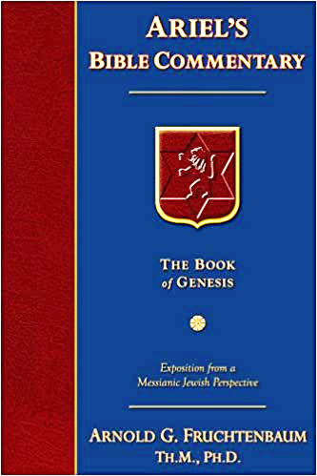
Dr. Arnold G. Fruchtenbaum
The Book of Genesis, 383
“Behold, I am standing by the fountain of water; and let it come to pass, that the maiden that comes forth to draw. Here the word for maiden is not the same word used earlier. Instead, almah is used, which is the actual word for virgin; and because it does clearly imply virginity, it did not require the explanatory statement as with betulah in verse 16.”

Slide 39
Genesis 24:34-49 Retelling the story
Servant identifies himself (34)
Abraham’s blessings (35)
Abraham’s son (36)
Servant’s oath (37-41)
Servant’s prayer (42-44)
Prayer answered (45-48)
Servant’s request (49)

Slide 40
Genesis 24:34-49 Retelling the story
Servant identifies himself (34)
Abraham’s blessings (35)
Abraham’s son (36)
Servant’s oath (37-41)
Servant’s prayer (42-44)
Prayer answered (45-48)
Servant’s request (49)

Slide 41
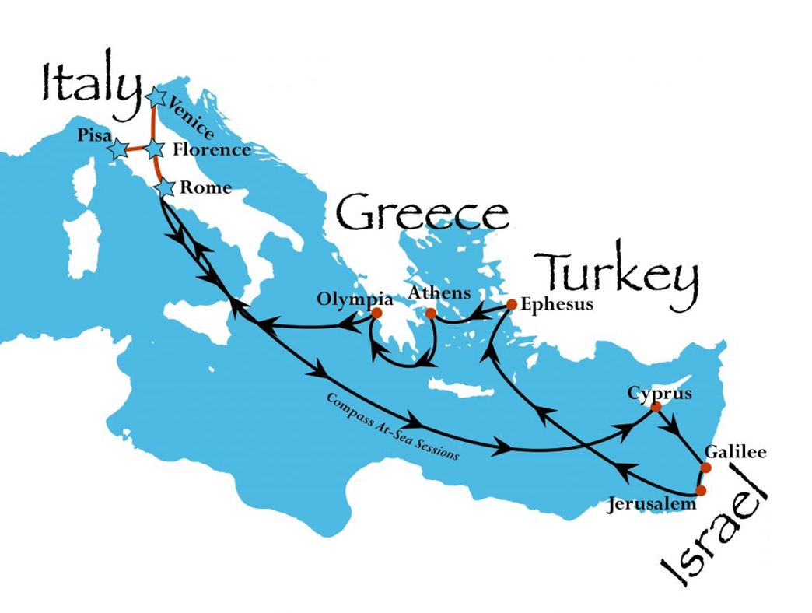

Slide 42
Genesis 24 Isaac’s Marriage
Abraham’s instructions (1-9)
Servant prays (10-14)
Servant meets Rebekah (15-27)
Servant and Laban (28-49)
Betrothal of Isaac & Rebekah (50-60)
Marriage of Isaac & Rebekah (61-67)

Slide 43
Genesis 24:50-56 Isaac & Rebekah’s betrothal
Consent of Laban & Bethuel (50-51)
Servant’s thanksgiving (52)
Bride price paid (53)
Servant partakes & requests (54)
Request for delay (55)
Servant’s rejection of delay (56)
Rebekah’s consent (57-58)
Departure for Canaan (59-60)

Slide 44
Genesis 24:50-56 Isaac & Rebekah’s betrothal
Consent of Laban & Bethuel (50-51)
Servant’s thanksgiving (52)
Bride price paid (53)
Servant partakes & requests (54)
Request for delay (55)
Servant’s rejection of delay (56)
Rebekah’s consent (57-58)
Departure for Canaan (59-60)

Slide 45
Genesis 22:20-24 Rebekah’s Lineage
Timing (20a)
Nahor’s children (20b-24)
From Milcah (20b-23)
From Reumah (24)

Slide 46
Nahor’s children through Milcah (Gen. 22:20b-23)
1. Uz (Job 1:1) | 5. Hazo
2. Buz | 6. Pildash
3. Aram | 7. Jidlaph
4. Chesed | 8. Bethuel (Gen. 24)

Slide 47
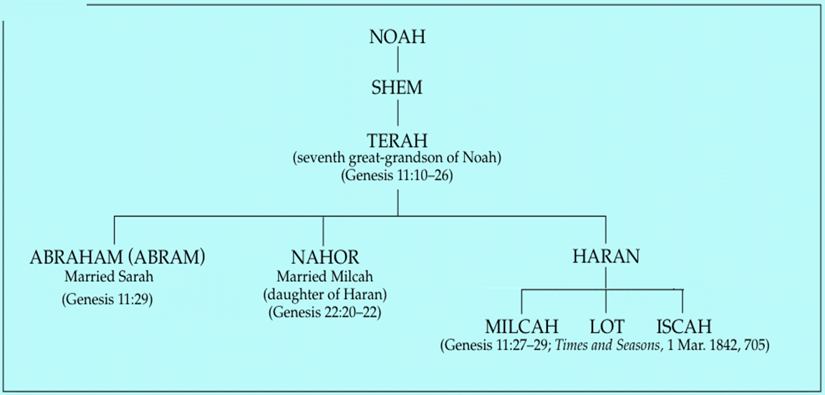

Slide 48
Genesis 24:50-56 Isaac & Rebekah’s betrothal
Consent of Laban & Bethuel (50-51)
Servant’s thanksgiving (52)
Bride price paid (53)
Servant partakes & requests (54)
Request for delay (55)
Servant’s rejection of delay (56)
Rebekah’s consent (57-58)
Departure for Canaan (59-60)

Slide 49
Genesis 24:50-56 Isaac & Rebekah’s betrothal
Consent of Laban & Bethuel (50-51)
Servant’s thanksgiving (52)
Bride price paid (53)
Servant partakes & requests (54)
Request for delay (55)
Servant’s rejection of delay (56)
Rebekah’s consent (57-58)
Departure for Canaan (59-60)

Slide 50
Genesis 24:50-56 Isaac & Rebekah’s betrothal
Consent of Laban & Bethuel (50-51)
Servant’s thanksgiving (52)
Bride price paid (53)
Servant partakes & requests (54)
Request for delay (55)
Servant’s rejection of delay (56)
Rebekah’s consent (57-58)
Departure for Canaan (59-60)

Slide 51
Genesis 24:50-56 Isaac & Rebekah’s betrothal
Consent of Laban & Bethuel (50-51)
Servant’s thanksgiving (52)
Bride price paid (53)
Servant partakes & requests (54)
Request for delay (55)
Servant’s rejection of delay (56)
Rebekah’s consent (57-58)
Departure for Canaan (59-60)

Slide 52
Genesis 24:50-56 Isaac & Rebekah’s betrothal
Consent of Laban & Bethuel (50-51)
Servant’s thanksgiving (52)
Bride price paid (53)
Servant partakes & requests (54)
Request for delay (55)
Servant’s rejection of delay (56)
Rebekah’s consent (57-58)
Departure for Canaan (59-60)

Slide 53
Genesis 24:50-56 Isaac & Rebekah’s betrothal
Consent of Laban & Bethuel (50-51)
Servant’s thanksgiving (52)
Bride price paid (53)
Servant partakes & requests (54)
Request for delay (55)
Servant’s rejection of delay (56)
Rebekah’s consent (57-58)
Departure for Canaan (59-60)

Slide 54
Dr. Arnold G. Fruchtenbaum
The Book of Genesis, 386
“She was asked: Will you go with this man? Normally in ancient Middle East practices, the daughter’s consent was not required; but under Hurrian Law, which was in effect here, the consent of the daughter was required. Her answer was: I will go.”

Slide 55
Genesis 24:50-56 Isaac & Rebekah’s betrothal
Consent of Laban & Bethuel (50-51)
Servant’s thanksgiving (52)
Bride price paid (53)
Servant partakes & requests (54)
Request for delay (55)
Servant’s rejection of delay (56)
Rebekah’s consent (57-58)
Departure for Canaan (59-60)

Slide 56
Genesis 24 Isaac’s Marriage
Abraham’s instructions (1-9)
Servant prays (10-14)
Servant meets Rebekah (15-27)
Servant and Laban (28-49)
Betrothal of Isaac & Rebekah (50-60)
Marriage of Isaac & Rebekah (61-67)

Slide 57
Genesis 24:61-67 Isaac & Rebekah’s marriage
Journey & arrival (61)
Isaac’s encounter (62-63)
Rebekah’s encounter (64-65)
Servant reports to Isaac (66)
Marriage (67)

Slide 58
Genesis 24:61-67 Isaac & Rebekah’s marriage
Journey & arrival (61)
Isaac’s encounter (62-63)
Rebekah’s encounter (64-65)
Servant reports to Isaac (66)
Marriage (67)

Slide 60
Genesis 24:61-67 Isaac & Rebekah’s marriage
Journey & arrival (61)
Isaac’s encounter (62-63)
Rebekah’s encounter (64-65)
Servant reports to Isaac (66)
Marriage (67)

Slide 61
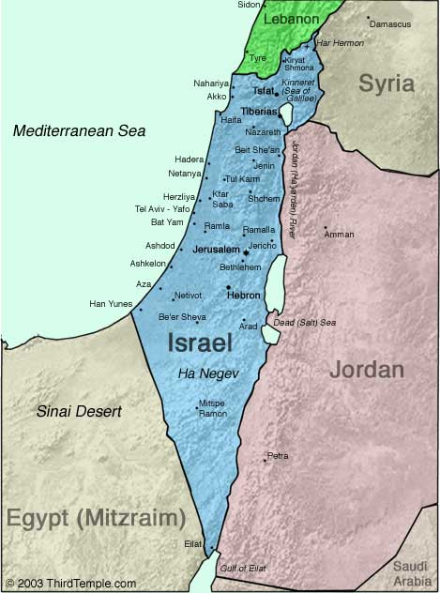
Negev

Slide 62
Genesis 12‒24 Abraham’s Early Journeys
Unconditional promises (Gen. 12:1-3) From Haran to Canaan (Gen. 12:4-5) In Canaan (Gen. 12:6-9) In Egypt (Gen. 12:10-20) Abram and Lot Separate (Gen. 13:1-13) Reaffirmation of Abram’s promises (Gen. 13:14-18) Abram Rescues Lot (14:1-24) Abrahamic Covenant (15:1-21) Hagar & Ishmael (16:1-16) Circumcision (Gen. 17:1-27) | Sodom & Gomorrah (Gen. 18‒19) Abraham & Abimelech (Gen. 20) Isaac’s birth (Gen. 21:1-7) Ishmael’s expulsion (21:8-21) Abraham & Abimelech’s covenant (21:22-34) Abraham sacrifices Isaac (22) Sarah’s death (23) Isaac’s marriage (24)

Slide 63
Genesis 24:61-67 Isaac & Rebekah’s marriage
Journey & arrival (61)
Isaac’s encounter (62-63)
Rebekah’s encounter (64-65)
Servant reports to Isaac (66)
Marriage (67)

Slide 64
Dr. Arnold G. Fruchtenbaum
The Book of Genesis, 387
“Genesis 24:64–65 records Rebekah’s encounter, with verse 64 giving the occasion: And Rebekah lifted up her eyes, and when she saw Isaac, she alighted from the camel. The Hebrew word for alighted is naphal, which normally means “to fall.” The picture being conveyed is that when she saw Isaac, she “fell off” her camel. This did not happen because she knew who he was, because the event happened before she knew who he was. Therefore, when she saw Isaac, something about Isaac’s demeanor or looks or whatever caused her to fall off her camel. If ever there was any implication of love at first sight, this may very well be it. Again, this was before she knew who he was; because only in verse 65 is Isaac identified to her.”

Slide 65
Dr. Arnold G. Fruchtenbaum
The Book of Genesis, 388
“That was in keeping with the custom of those days in that the bride’s face was veiled on the wedding night…Nevertheless, realizing that Isaac is the one she is going to marry, in keeping with the tradition of a bride veiling her face on the wedding night, she veiled herself.”

Slide 66
Genesis 24:61-67 Isaac & Rebekah’s marriage
Journey & arrival (61)
Isaac’s encounter (62-63)
Rebekah’s encounter (64-65)
Servant reports to Isaac (66)
Marriage (67)

Slide 67
Genesis 24:61-67 Isaac & Rebekah’s marriage
Journey & arrival (61)
Isaac’s encounter (62-63)
Rebekah’s encounter (64-65)
Servant reports to Isaac (66)
Marriage (67)

Slide 68
Dr. Arnold G. Fruchtenbaum
The Book of Genesis, 388-89
“This helps to clarify exactly what a biblical marriage is and is not. A biblical marriage is not merely living together; nor is a biblical marriage merely sexual union. It was possible to have sexual union without marriage even within the biblical context. However, there were three elements in a biblical marriage. First, there had to be a commitment to one another; she was committed to Isaac, and Isaac was committed to her. There may not have been any love at this point because, as in the case here, they had only just met. This shows it is possible to make a commitment without the feeling of love per se, but the commitment to love the one you marry.”

Slide 69
Dr. Arnold G. Fruchtenbaum
The Book of Genesis, 388-89
“The second necessary element is the marriage ceremony, a ceremony recognized by society to be a marriage ceremony. With different societies there are different customs, but every society has a ceremony for marriage, such as marrying under a canopy or the custom of exchanging rings and exchanging vows. The third element for a biblical marriage is the first sexual union by which the couple becomes one.”

Slide 70
Conclusion

Slide 71
Genesis 12‒24 Abraham’s Early Journeys
Unconditional promises (Gen. 12:1-3) From Haran to Canaan (Gen. 12:4-5) In Canaan (Gen. 12:6-9) In Egypt (Gen. 12:10-20) Abram and Lot Separate (Gen. 13:1-13) Reaffirmation of Abram’s promises (Gen. 13:14-18) Abram Rescues Lot (14:1-24) Abrahamic Covenant (15:1-21) Hagar & Ishmael (16:1-16) Circumcision (Gen. 17:1-27) | Sodom & Gomorrah (Gen. 18‒19) Abraham & Abimelech (Gen. 20) Isaac’s birth (Gen. 21:1-7) Ishmael’s expulsion (21:8-21) Abraham & Abimelech’s covenant (21:22-34) Abraham sacrifices Isaac (22) Sarah’s death (23) Isaac’s marriage (24)

Slide 72
Genesis 24 Isaac’s Marriage
Abraham’s instructions (1-9)
Servant prays (10-14)
Servant meets Rebekah (15-27)
Servant and Laban (28-49)
Betrothal of Isaac & Rebekah (50-60)
Marriage of Isaac & Rebekah (61-67)

Slide 73
Genesis 12‒25 Abraham’s Early Journeys
Unconditional promises (Gen. 12:1-3) From Haran to Canaan (Gen. 12:4-5) In Canaan (Gen. 12:6-9) In Egypt (Gen. 12:10-20) Abram and Lot Separate (Gen. 13:1-13) Reaffirmation of Abram’s promises (Gen. 13:14-18) Abram Rescues Lot (14:1-24) Abrahamic Covenant (15:1-21) Hagar & Ishmael (16:1-16) Circumcision (Gen. 17:1-27) | Sodom & Gomorrah (Gen. 18‒19) Abraham & Abimelech (Gen. 20) Isaac’s birth (Gen. 21:1-7) Ishmael’s expulsion (21:8-21) Abraham & Abimelech’s covenant (21:22-34) Abraham sacrifices Isaac (22) Sarah’s death (23) Isaac’s marriage (24) Abraham’s death (25)

Slide 74
²⁴ The Lord bless you, and keep you; ²⁵ The Lord make His face shine on you, And be gracious to you; ²⁶ The Lord lift up His countenance on you, And give you peace.
Numbers 6:24–26 (NASB95)

