Slide 1


Zechariah
God Remembers!

Slide 2

Occasion
538 B.C. ‒ Cyrus’ decree
536 B.C. ‒ Temple foundation laid
534 B.C. ‒ Temple building interrupted
Temple project stalled for 15 years
520‒518 B.C. ‒ Ministries of Zechariah & Haggai
519 B.C. ‒ Darius confirmation of Cyrus’ decree
Resumption of Temple building
516 B.C. ‒ Temple completed

Slide 3
Purposes
  To encourage the returnees to rebuild the Temple
  To provide eschatological hope in the challenging post-exilic world
  To prepare the returnees for Temple worship
  To exhort the returnees toward covenant obedience

Slide 4

Structure
Introductory call to repentance (1:1-6)
Eight-night visions (1:7–6:15)
Question and answers about fasting (7–8)
Two burdens (9–14)

Slide 5
Structure
Introductory call to repentance (1:1-6)
Eight-night visions (1:7–6:15)
Question and answers about fasting (7–8)
Two burdens (9–14)

Slide 6
Structure
Introductory call to repentance (1:1-6)
Eight-night visions (1:7–6:15)
Question and answers about fasting (7–8)
Two burdens (9–14)

Slide 7
ZECHARIAH’S EIGHT NIGHT VISIONS
Vision | Reference | Meaning
The Red-horse Rider among the Myrtles | 1:7-17 | God’s anger against the nations & blessing on restored Israel.
The Four Horns & the Four Craftsmen | 1:18-21 | God’s judgment on the nations that afflict Israel.
The Surveyor with a Measuring Line | Chapter 2 | God’s future blessing on restored Israel.
The Cleansing & Crowning of Joshua the Hight Priest. | Chapter 3 | Israel’s future cleansing from sin & reinstatement as a priestly nation.
The Golden Lampstand & the Two Olive Trees | Chapter 4 | Israel as the light to the nations under Messiah, the King-Priest.
The Flying Scroll | 5:1-4 | The severity & totality of divine judgment on individual Israelites.
The Woman in the Ephah | 5:5-11 | The removal of national Israel’s sin of rebellion against God.
The Four Chariots | 6:1-8 | Divine judgment on Gentile nations.

Slide 8
II. Eight Night Visions
(1:7‒6:15)
  Riders & horses among the myrtle trees (1:7-17)
  Four horns & four craftsmen (1:18-21)
  Man with the measuring line (2)
  Cleansing of the High Priest Joshua (3)
  Lampstand & olive tree (4)
  Flying scroll (5:1-4)
  Woman in the basket (5:5-11)
  Four chariots (6:1-8)
  Conclusion: crowning of Joshua (6:9-15)

Slide 9
Structure
Introductory call to repentance (1:1-6)
Eight-night visions (1:7–6:15)
Question and answers about fasting (7–8)
Two burdens (9–14)

Slide 10
III. Questions & Answers Concerning Fasting
(7‒8)
  Question (7:1-3)
  Four divine answers (7:4‒8:23)
    Condemnation of empty ritualism (7:4-7)
    Condemnation of past covenant failure (7:8-14)
    Prediction of Jerusalem’s restoration (8:1-17)
    Prediction of future blessing (8:18-23)

Slide 11
Structure
Introductory call to repentance (1:1-6)
Eight-night visions (1:7–6:15)
Question and answers about fasting (7–8)
Two burdens (9–14)

Slide 12
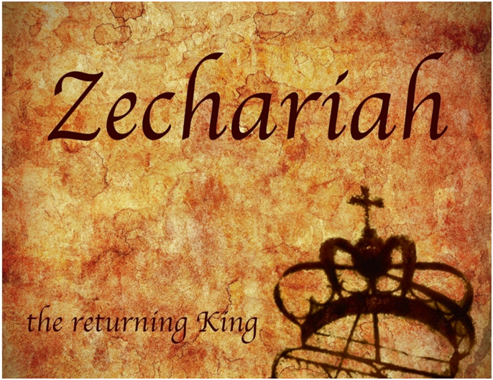
IV. Two Burdens
(9‒14)
  Israel’s postponed deliverance due to her rejection of her Messiah (9‒11)
  Israel’s future deliverance due to her acceptance of her Messiah (12‒14)

Slide 13
IV. Two Burdens
(9‒14)
  Israel’s postponed deliverance due to her rejection of her Messiah (9‒11)
  Israel’s future deliverance due to her acceptance of her Messiah (12‒14)

Slide 14

First Burden Outline
(9‒11)
    Divine warrior hymn (9)
    True shepherd (10)
    False shepherd (11)

Slide 15
IV. Two Burdens
(9‒14)
  Israel’s postponed deliverance due to her rejection of her Messiah (9‒11)
  Israel’s future deliverance due to her acceptance of her Messiah (12‒14)

Slide 16
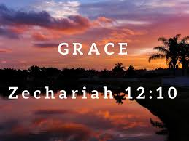
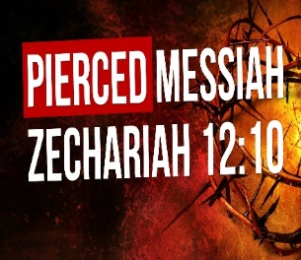
Zechariah 12
(Israel’s Physical & Spiritual Salvation)
Israel’s physical deliverance (12:1-9)
  The nations that will attack Israel (1-3)
  The God who will protect Israel (4-9)
Israel’s spiritual deliverance (12:10-14)
  God’s Spirit: the cause of revival (10a)
  Israel’s remorse: the result of revival (11-14)

Slide 17
Zechariah 13
(Israel’s Physical & Spiritual Salvation)
Spiritual cleansing (13:1-5)
Comprehensive deliverance (13:6-9)

Slide 18
Zechariah 14
(Israel’s Kingdom)
Jerusalem’s deliverance (14:1-7)
Kingdom conditions (14:8-11)
Enemies’ judgment (12-15)
Kingdom worship (16-21)

Slide 19
Zechariah 14
(Israel’s Kingdom)
Jerusalem’s deliverance (14:1-7)
Kingdom conditions (14:8-11)
Enemies’ judgment (12-15)
Kingdom worship (16-21)

Slide 20
I. Jerusalem’s Deliverance
(Zechariah 14:1-7)
  The theme (1)
  The crisis (2)
  The warrior (3)
  The return (4)
  The remnant (5)
  The darkness (6)
  The Uniqueness (7)

Slide 21
I. Jerusalem’s Deliverance
(Zechariah 14:1-7)
  The theme (1)
  The crisis (2)
  The warrior (3)
  The return (4)
  The remnant (5)
  The darkness (6)
  The Uniqueness (7)

Slide 22
I. Jerusalem’s Deliverance
(Zechariah 14:1-7)
  The theme (1)
  The crisis (2)
  The warrior (3)
  The return (4)
  The remnant (5)
  The darkness (6)
  The Uniqueness (7)

Slide 23

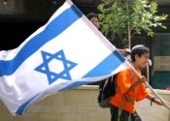
Zechariah 14:2-3
“² For I will gather all the nations against Jerusalem to battle, and the city will be captured, the houses plundered, the women ravished and half of the city exiled, but the rest of the people will not be cut off from the city. ³ Then the Lord will go forth and fight against those nations, as when He fights on a day of battle.”

Slide 24

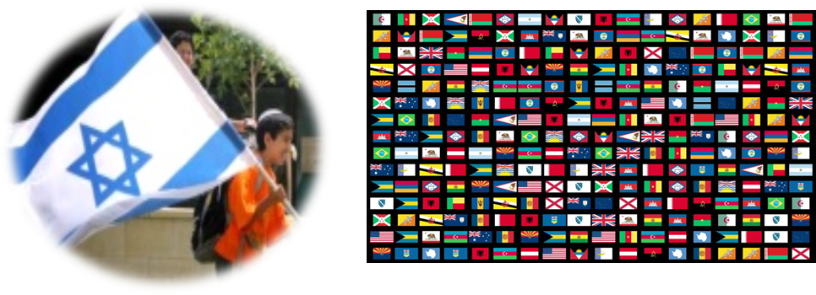
Zechariah 12:3
“It will come about in that day that I will make Jerusalem a heavy stone for all the peoples; all who lift it will be severely injured. And all the nations of the earth will be gathered against it.”

Slide 25

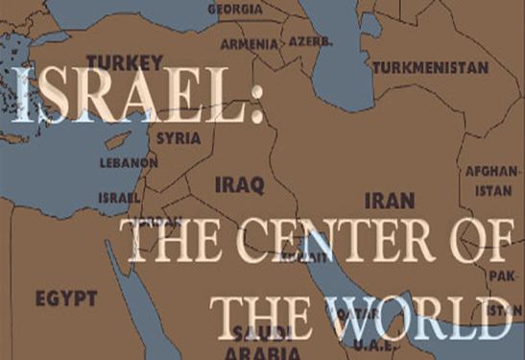
Ezekiel 5:5
“Thus says the Lord God, ‘This is Jerusalem; I have set her at the center of the nations, with lands around her.'”

Slide 26

Ezekiel 38:12
“to capture spoil and to seize plunder, to turn your hand against the waste places which are now inhabited, and against the people who are gathered from the nations, who have acquired cattle and goods, who live at the center of the world.”

Slide 27

Charles L. Feinberg
The Prophecy of Ezekiel: The Glory of the Lord, Paperback ed. (Chicago: Moody, 1969; reprint, Chicago: Moody, 1984), 223.
“An interesting phrase is employed to define the place where God’s people will be dwelling. It is called the middle (literally, the navel) of the earth as explained in 5:5. The land of Israel is in the center of the earth as far as God’s purposes for the world are concerned (cf. Deut. 32:8). Rabbinic literature states: ‘As the navel is set in the center of the human body, so the land of Israel is the navel of the world…Situated in the center of the world, in Jerusalem in the center of the land of Israel, and the sanctuary in the center of Jerusalem, and the holy place in the center of the sanctuary, and the ark in the center of the holy place, and the foundation stone before the holy place, because from it the world was founded.’ Midrash, Tanachma, Qedoshim.”

Slide 28
Zechariah 14:2-3
“² For I will gather all the nations against Jerusalem to battle, and the city will be captured, the houses plundered, the women ravished and half of the city exiled, but the rest of the people will not be cut off from the city. ³ Then the Lord will go forth and fight against those nations, as when He fights on a day of battle.”

Slide 29
Zechariah 14:2-3
“² For I will gather all the nations against Jerusalem to battle, and the city will be captured, the houses plundered, the women ravished and half of the city exiled, but the rest of the people will not be cut off from the city. ³ Then the Lord will go forth and fight against those nations, as when He fights on a day of battle.”

Slide 30
I. Jerusalem’s Deliverance
(Zechariah 14:1-7)
  The theme (1)
  The crisis (2)
  The warrior (3)
  The return (4)
  The remnant (5)
  The darkness (6)
  The Uniqueness (7)

Slide 31
Zechariah 14:2-3
“² For I will gather all the nations against Jerusalem to battle, and the city will be captured, the houses plundered, the women ravished and half of the city exiled, but the rest of the people will not be cut off from the city. ³ Then the Lord will go forth and fight against those nations, as when He fights on a day of battle.”

Slide 32
I. Jerusalem’s Deliverance
(Zechariah 14:1-7)
  The theme (1)
  The crisis (2)
  The warrior (3)
  The return (4)
  The remnant (5)
  The darkness (6)
  The Uniqueness (7)

Slide 33

1 Thessalonians 4:16-17
. . . have fallen asleep. ¹⁶ For the Lord Himself will descend from heaven with a shout, with the voice of the archangel and with the trumpet of God, and the dead in Christ will rise first. ¹⁷ Then we who are alive and remain will be caught up together with them in the clouds to meet the Lord in the air, and so we shall always be with the Lord. ¹⁸ Therefore comfort one another with these words."

Slide 34
Christ’s Return
(Acts 1:11)
Physical
Visible
Bodily
Earthly
To the Mount of Olives (Zech. 14:4)

Slide 35

The Foot
“Jesus’ feet will first touch the earth where they left the earth, on the Mount of Olives. The mountain will split into with a great earthquake the instant that Jesus’ foot touches it. The great crevice which results will run east and west through the center of the mountain. It will go east to the north tip of the Dead Sea and west to the Mediterranean Sea (Zechariah 14). It was reported to me that an oil company doing seismic studies of this area in quest of oil discovered a gigantic fault running east and west precisely through the center of the Mount of Olives. The fault is so severe that it could split at any time. It is awaiting ‘the foot.’”
Hal Lindsey, The Late Great Planet Earth, 163.

Slide 36

Ezekiel 38:18-19
“¹⁸ It will come about on that day, when Gog comes against the land of Israel,” declares the Lord God, “that My fury will mount up in My anger. ¹⁹ In My zeal and in My blazing wrath I declare that on that day there will surely be a great earthquake in the land of Israel.”

Slide 37
After tremors, experts warn a huge quake is the greatest threat facing Israel
“Scientists say thousands could die because Israel, which sits on a major fault line, has ignored warnings to strengthen homes and schools. After a series of minor tremors rattled northern Israel over the last two weeks, experts warned that the country is negligently unprepared for a major earthquake that would likely kill thousands of people, including many children. ‘The threat of an earthquake, is in my eyes, the greatest threat facing the state of Israel,’ geologist Ariel Heimann told Hadashot news on Friday. ‘It is definitely a greater threat than the Qassam [rockets] fired from Gaza, and it is a far greater danger than the Iranian . . .

Slide 38
After tremors, experts warn a huge quake is the greatest threat facing Israel
… threat.’ Israel sits on the Syrian-African rift, a tear in the earth’s crust running the length of the border separating Israel and Jordan, and is part of the Great Rift Valley, which extends from northern Syria to Mozambique. ‘If, God forbid, we have an earthquake like this, it will leave thousands dead and hundreds of thousands of people will have to leave their homes. Houses will be destroyed, there will be massive economic damage that will set the country back dozens of years,’ Heimann warned.”
Times of Israel Staff: https://www.timesofisrael.com/after-tremors-experts-warn-a-huge-quake-is-the-greatest-threat-facing-israel/ 14 July 2018.

Slide 39
I. Jerusalem’s Deliverance
(Zechariah 14:1-7)
  The theme (1)
  The crisis (2)
  The warrior (3)
  The return (4)
  The remnant (5)
  The darkness (6)
  The Uniqueness (7)

Slide 40

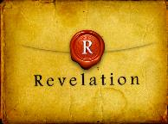
Revelation 1:6; 5:10
“and He has made us to be a kingdom, priests to His God and Father—to Him be the glory and the dominion forever and ever. Amen…You have made them to be a kingdom and priests to our God; and they will reign [basileuō] upon the earth [gē].”

Slide 41
I. Jerusalem’s Deliverance
(Zechariah 14:1-7)
  The theme (1)
  The crisis (2)
  The warrior (3)
  The return (4)
  The remnant (5)
  The darkness (6)
  The Uniqueness (7)

Slide 42
I. Jerusalem’s Deliverance
(Zechariah 14:1-7)
  The theme (1)
  The crisis (2)
  The warrior (3)
  The return (4)
  The remnant (5)
  The darkness (6)
  The Uniqueness (7)

Slide 43
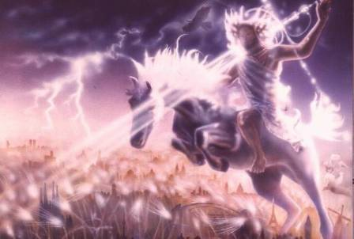
Isaiah 13-14
Day of the Lord (13:6-9)
Cosmic disturbances (13:10-13)
Global judgment (13:11-12)
Sodom and Gomorrah (13:19)
Complete and final desolation (13:20-22)
Universal peace and rest (14:5-8)
Israel’s regeneration (14:1-4)
Henry Morris, Revelation Record, 348.

Slide 44
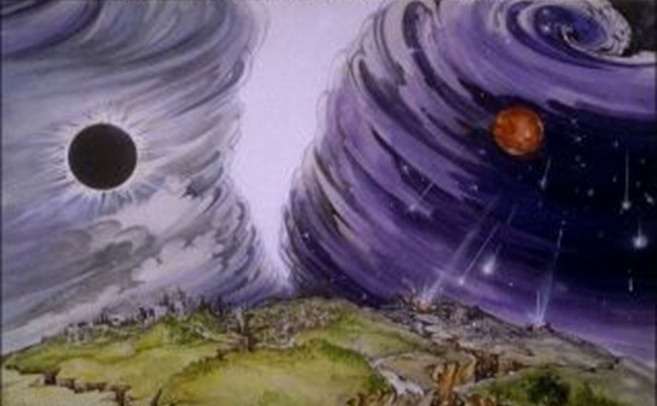
Isaiah 13/Matthew 24 Connection
Isaiah 13:10; Matthew 24:29
Isaiah 13:12; Matthew 24:21-22

Slide 45
Zechariah 14
(Israel’s Kingdom)
Jerusalem’s deliverance (14:1-7)
Kingdom conditions (14:8-11)
Enemies’ judgment (12-15)
Kingdom worship (16-21)

Slide 46


Slide 47
II. Kingdom Conditions
(Zechariah 14:8-11)
  Jerusalem’s waters (8)
  Earthly reign (9)
  Topographical changes (10)
  Millennial Jerusalem (11)

Slide 48
II. Kingdom Conditions
(Zechariah 14:8-11)
  Jerusalem’s waters (8)
  Earthly reign (9)
  Topographical changes (10)
  Millennial Jerusalem (11)

Slide 49
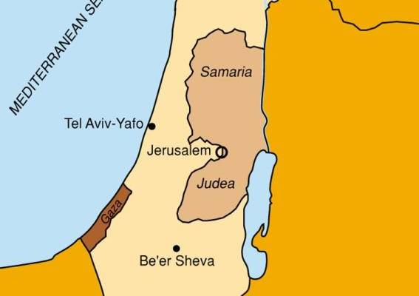


Slide 50


Slide 51
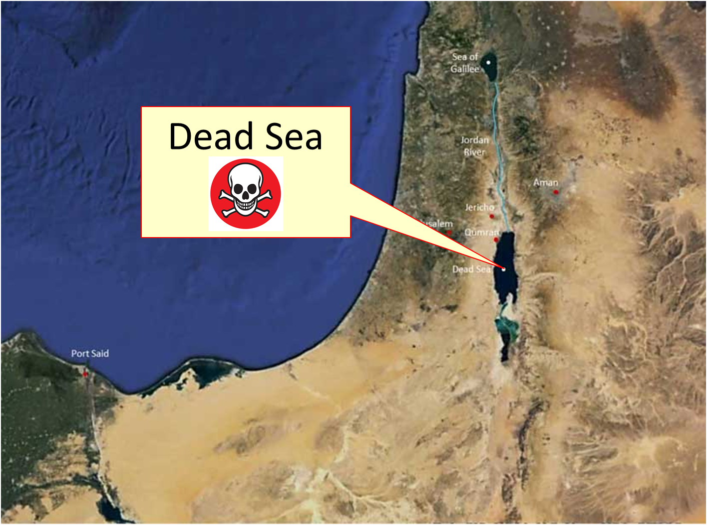

Slide 52
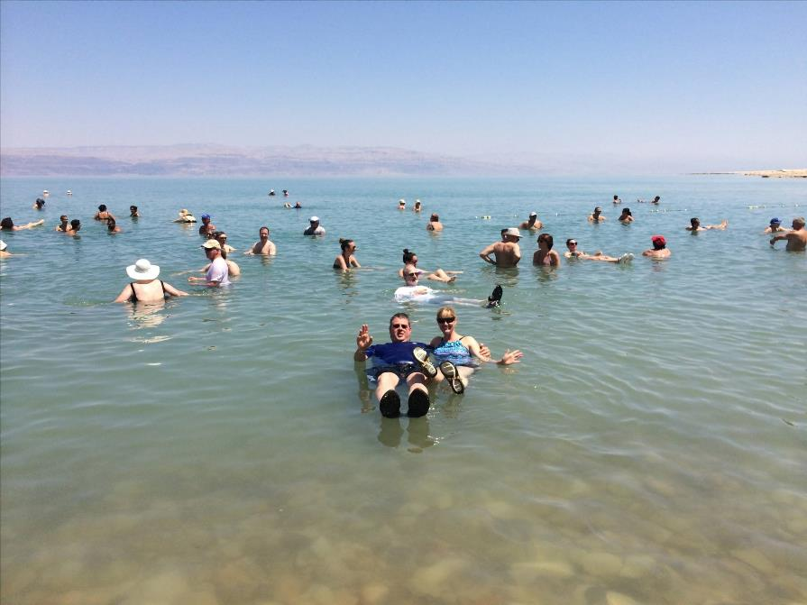

Slide 53
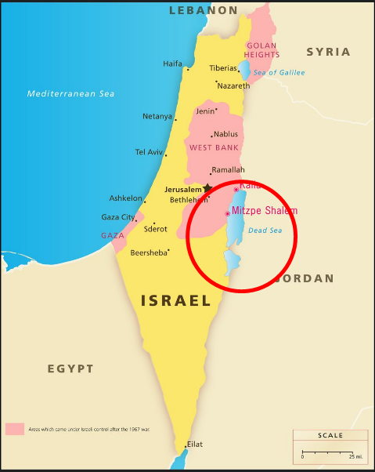
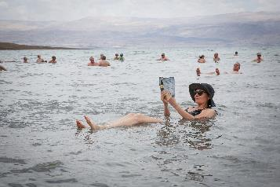
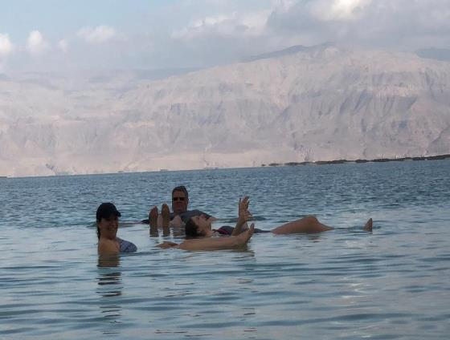
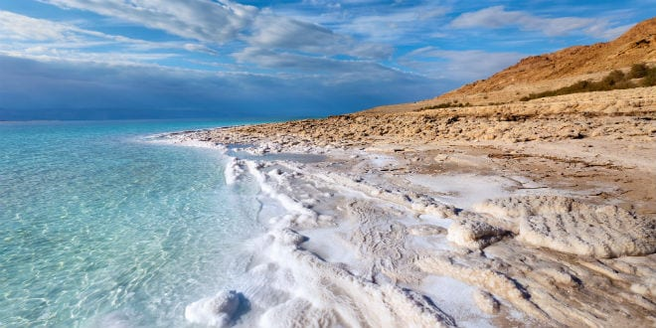
DEAD SEA

Slide 54
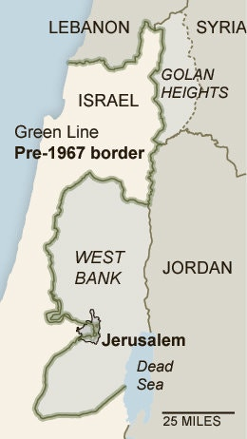

Slide 55
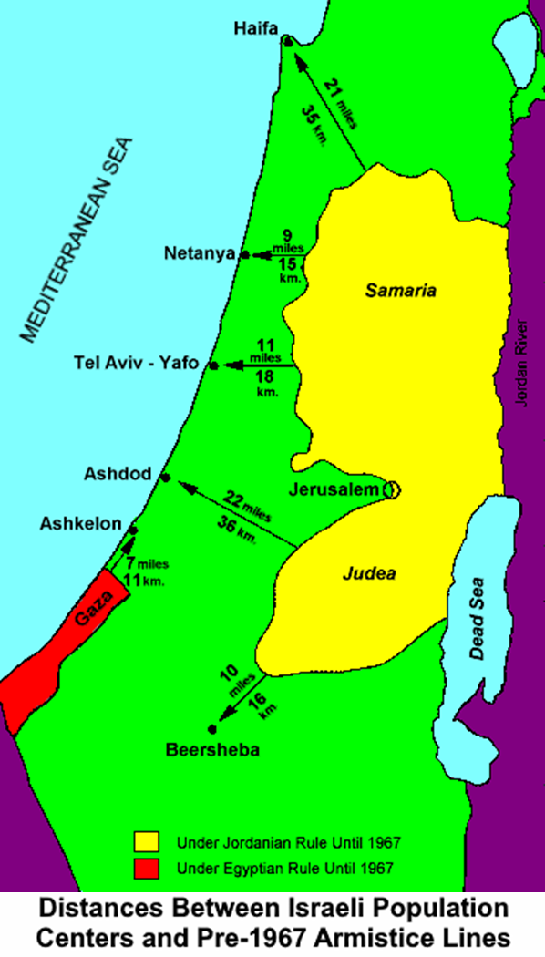

Slide 57
II. Kingdom Conditions
(Zechariah 14:8-11)
  Jerusalem’s waters (8)
  Earthly reign (9)
  Topographical changes (10)
  Millennial Jerusalem (11)

Slide 58
Christ’s Three Offices
Prophet (First Coming)
Priest (Present Session)
King (Second Coming)

Slide 60
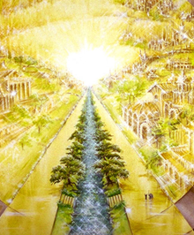
Eternal State is Future
No Satan (Rev 20:10)
No sea (Rev 21:1)
No death, crying, or pain (Rev 21:4)
No Sun (Rev 22:5)
No Moon (Rev 21:23)
No temple (Rev. 21:22)
No night (Rev 21:25)
No evil (Rev 21:27)
No curse (Rev 22:3)

Slide 61

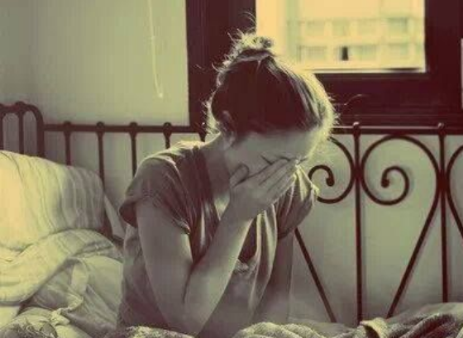
Revelation 21:4
“and He will wipe away every tear from their eyes; and there will no longer be any death; there will no longer be any mourning, or crying, or pain; the first things have passed away.”

Slide 62
Zechariah 14:16-18
“Then it will come about that any who are left of all the nations that went against Jerusalem will go up from year to year to worship the King, the Lord of hosts, and to celebrate the Feast of Booths. ¹⁷ And it will be that whichever of the families of the earth does not go up to Jerusalem to worship the King, the Lord of hosts, there will be no rain on them. ¹⁸ If the family of Egypt does not go up or enter, then no rain will fall on them; it will be the plague with which the Lord smites the nations who do not go up to celebrate the Feast of Booths.”

Slide 63
II. Kingdom Conditions
(Zechariah 14:8-11)
  Jerusalem’s waters (8)
  Earthly reign (9)
  Topographical changes (10)
  Millennial Jerusalem (11)

Slide 64
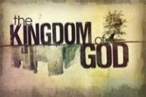
Topographical Changes
(Ezek. 47:1-12)
Abundant rainfall (Ezek. 34:26-27)
Water in the desert (Isa. 35:6-7)
Life to the Dead Sea (Ezek. 47:1-12)
Sun seven times brighter (Isa. 30:26)
Physical healing (Isa. 35:5-6)

Slide 65

Isaiah 2:1-4
¹ “The word which Isaiah the son of Amoz saw concerning Judah and Jerusalem.² Now it will come about that In the last days The mountain of the house of the Lord Will be established as the chief of the mountains, And will be raised above the hills; And all the nations will stream to it.³ And many peoples will come and say, “Come, let us go up to the mountain of the Lord, To the house of the God of Jacob; That He may teach us concerning His ways And that we may . . .

Slide 66

Isaiah 2:1-4
. . . in His paths.” For the law will go forth from Zion And the word of the Lord from Jerusalem.⁴ And He will judge between the nations, And will render decisions for many peoples; And they will hammer their swords into plowshares and their spears into pruning hooks. Nation will not lift up sword against nation, And never again will they learn war.”

Slide 67
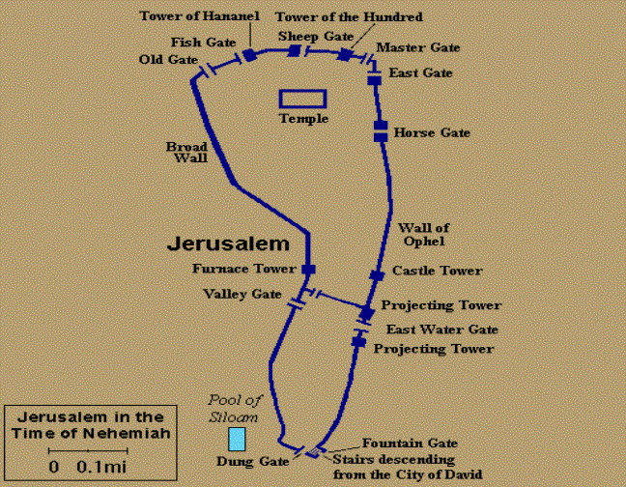

Slide 68
II. Kingdom Conditions
(Zechariah 14:8-11)
  Jerusalem’s waters (8)
  Earthly reign (9)
  Topographical changes (10)
  Millennial Jerusalem (11)

Slide 69
Millennium Rev.20 | Eternal State Rev.21-22
Sin restrained | Sin removed
Curse restrained | Curse removed
Death | No death
Mortals / resurrected | Resurrected only
Mortals Destinies undecided | All Destinies sealed
Renovation | Recreation
Temporary | Eternal
Transitional | Non-transitional

Slide 70
Millennium and Eternal State
 | Rev 20:1-10 | Rev 21–22
Time | 20:4 | 22:5
Luminaries | Isa 30:26 | 21:23; 22:5
Temple | Ezek 40–48 | 21:22
Death | Isa 65:20 | 21:4
Satanic activity | 20:7 | 20:10
Rebellion | 20:8-9 | 21:27

Slide 71
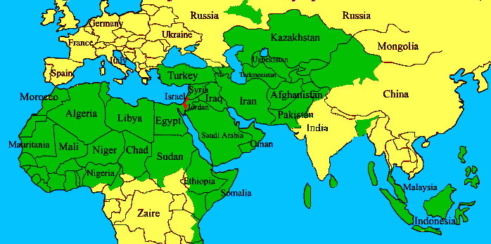
ISRAEL

Slide 72

1st Six Seals (Revelation 6)
SEAL 1 – 6:1-2 – Advent of antichrist
SEAL 2 – 6:3-4 – War
SEAL 3 – 6:5-6 – Famine
SEAL 4 – 6:7-8 – Death
SEAL 5 – 6:9-11 – Martyrdoms
SEAL 6 – 6:12-17 – Cosmic disturbances

Slide 73

Ezekiel 38:8, 11
“⁸ After many days you will be summoned; in the latter years you will come into the land that is restored from the sword, whose inhabitants have been gathered from many nations to the mountains of Israel which had been a continual waste; but its people were brought out from the nations, and they are living securely [batach], all of them…. ¹¹ and you will say, ‘I will go up against the land of unwalled villages. I will go against those who are at rest [shacat], that live securely [batach], all of them living without walls and having no bars or gates.”

Slide 74
Zechariah 14
(Israel’s Kingdom)
Jerusalem’s deliverance (14:1-7)
Kingdom conditions (14:8-11)
Enemies’ judgment (12-15)
Kingdom worship (16-21)

Slide 75
III. Enemies’ Judgment
(Zechariah 14:12-15)
  Plague (12)
  Panic (13)
  Plunder (14)
  Pets (15)

Slide 76
III. Enemies’ Judgment
(Zechariah 14:12-15)
  Plague (12)
  Panic (13)
  Plunder (14)
  Pets (15)

Slide 77


Genesis 12:3
“And I will bless those who bless you, And the one who curses [kalal] you I will curse [aor]. And in you all the families of the earth will be blessed.”

Slide 78
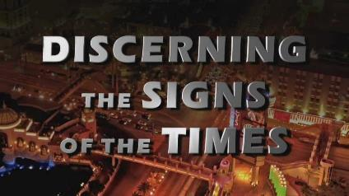
Signs of the Second Coming
Israel
International Politics
Economics
Technology
Spirituality
Society
Understanding Bible Prophecy

Slide 79
III. Enemies’ Judgment
(Zechariah 14:12-15)
  Plague (12)
  Panic (13)
  Plunder (14)
  Pets (15)

Slide 80
III. Enemies’ Judgment
(Zechariah 14:12-15)
  Plague (12)
  Panic (13)
  Plunder (14)
  Pets (15)

Slide 81
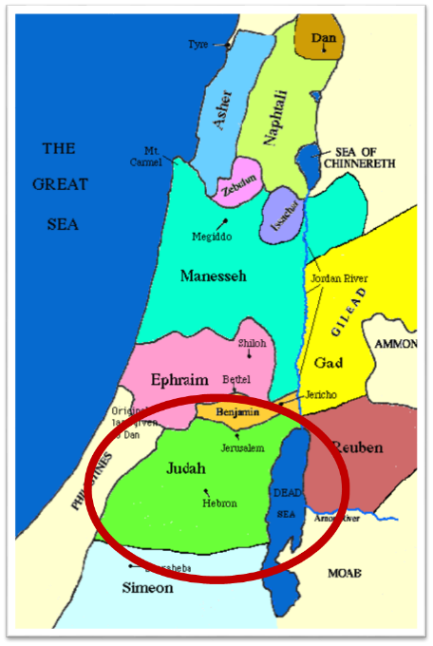

Slide 82

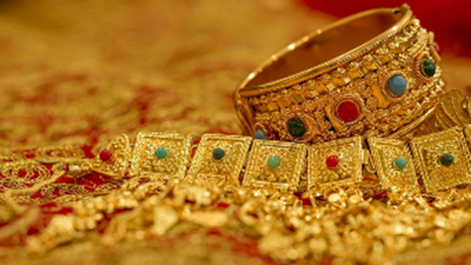
Ezekiel 38:12
“to capture spoil and to seize plunder, to turn your hand against the waste places which are now inhabited, and against the people who are gathered from the nations, who have acquired cattle and goods, who live at the center of the world.”

Slide 83
Ezekiel 38:13
“Sheba and Dedan and the merchants of Tarshish with all its villages will say to you, ‘Have you come to capture spoil? Have you assembled your company to seize plunder, to carry away silver and gold, to take away cattle and goods, to capture great spoil?’”

Slide 84
III. Enemies’ Judgment
(Zechariah 14:12-15)
  Plague (12)
  Panic (13)
  Plunder (14)
  Pets (15)

Slide 85


Slide 86
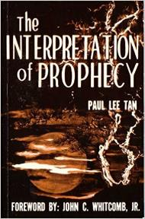
Paul Lee Tan
The Interpretation of Prophecy, 223-24
“Interestingly, these prophesied military instruments though centuries old have not been made obsolete. The horse, for instance, is still used in warfare on certain kinds of terrain.”

Slide 87
Zechariah 14
(Israel’s Kingdom)
Jerusalem’s deliverance (14:1-7)
Kingdom conditions (14:8-11)
Enemies’ judgment (12-15)
Kingdom worship (16-21)

Slide 88
IV. Kingdom Worship
(Zechariah 14:16-21)
  The pilgrimage (16)
  The punishment (17-19)
  The purity (20-21)

Slide 89
IV. Kingdom Worship
(Zechariah 14:16-21)
  The pilgrimage (16)
  The punishment (17-19)
  The purity (20-21)

Slide 90
Zechariah 14:16-18
“Then it will come about that any who are left of all the nations that went against Jerusalem will go up from year to year to worship the King, the Lord of hosts, and to celebrate the Feast of Booths. ¹⁷ And it will be that whichever of the families of the earth does not go up to Jerusalem to worship the King, the Lord of hosts, there will be no rain on them. ¹⁸ If the family of Egypt does not go up or enter, then no rain will fall on them; it will be the plague with which the Lord smites the nations who do not go up to celebrate the Feast of Booths.”

Slide 91
Christ’s Three Offices
Prophet (First Coming)
Priest (Present Session)
King (Second Coming)

Slide 92
Isaiah 2:1-4
¹ “The word which Isaiah the son of Amoz saw concerning Judah and Jerusalem.² Now it will come about that In the last days The mountain of the house of the Lord Will be established as the chief of the mountains, And will be raised above the hills; And all the nations will stream to it.³ And many peoples will come and say, “Come, let us go up to the mountain of the Lord, To the house of the God of Jacob; That He may teach us concerning His ways And that we may . . .

Slide 93
Isaiah 2:1-4
. . . walk in His paths.” For the law will go forth from Zion And the word of the Lord from Jerusalem.⁴ And He will judge between the nations, And will render decisions for many peoples; And they will hammer their swords into plowshares and their spears into pruning hooks. Nation will not lift up sword against nation, And never again will they learn war.”

Slide 94

Revelation 20:7-9
“⁷ When the thousand years are completed [teleō], Satan will be released from his prison, ⁸ and will come out to deceive the nations which are in the four corners of the earth, Gog and Magog, to gather them together for the war; the number of them is like the sand of the seashore. ⁹ And they came up on the broad plain of the earth and surrounded the camp of the saints and the beloved city, and fire came down from heaven and devoured them.”

Slide 95
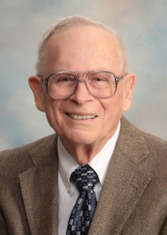
Robert Thomas
Four Views on the Book of Revelation, page 207.
“At the end of the Millennium that city will be Satan’s prime objective with his rebel army, because Israel will be a leader among the nations.”

Slide 96
Levitical Feasts (Leviticus 23)
Feast | Season | Purpose | Type
Passover | Spring | Redemption | 1 Cor 5:7
Unleavened Bread | Spring | Separation | John 6:35
1st fruits | Spring | Praise | 1 Cor 15:20
Pentecost | Spring | Praise | Acts 2:1-4
Trumpets | Fall | New Year | Matt 24:31
Atonement | Fall | Lev 16 | Zech 12:10
Booths | Fall | Wilderness provision | Zech 14:16-18

Slide 97


Dr. Arnold G. Fruchtenbaum
Footsteps of the Messiah, 456-57
“There are usually three main objections to taking these sacrifices literally. First objection: This would mean a return to the sacrificial system of the Mosaic Law which ended when Messiah died and therefore violates all that the New Testament teaches about the termination of the Law as a rule of life. Answer: While there are many similarities with the sacrifices of the Mosaic Law, as there are between the sacrifices of Noah and Moses, the differences show they are not the same. It was these very differences that kept the rabbis from accepting Ezekiel into the Hebrew Canon for some time. These differences include the following…All these differences show that this is not a return to the Law of Moses, but it is a new system under Kingdom Law and so it does not violate what the New Testament teaches concerning the termination of the Law with Messiah’s death.”

Slide 98
IV. Kingdom Worship
(Zechariah 14:16-21)
  The pilgrimage (16)
  The punishment (17-19)
  The purity (20-21)

Slide 100
Eternal State is Future
No Satan (Rev 20:10)
No sea (Rev 21:1)
No death, crying, or pain (Rev 21:4)
No Sun (Rev 22:5)
No Moon (Rev 21:23)
No temple (Rev. 21:22)
No night (Rev 21:25)
No evil (Rev 21:27)
No curse (Rev 22:3)

Slide 101
Revelation 21:4
“and He will wipe away every tear from their eyes; and there will no longer be any death; there will no longer be any mourning, or crying, or pain; the first things have passed away.”

Slide 102
Millennium Rev.20 | Eternal State Rev.21-22
Sin restrained | Sin removed
Curse restrained | Curse removed
Death | No death
Mortals / resurrected | Resurrected only
Mortals Destinies undecided | All Destinies sealed
Renovation | Recreation
Temporary | Eternal
Transitional | Non-transitional

Slide 103
Millennium and Eternal State
 | Rev 20:1-10 | Rev 21–22
Time | 20:4 | 22:5
Luminaries | Isa 30:26 | 21:23; 22:5
Temple | Ezek 40–48 | 21:22
Death | Isa 65:20 | 21:4
Satanic activity | 20:7 | 20:10
Rebellion | 20:8-9 | 21:27

Slide 104

Ezekiel 20:33-38
³³ “As I live,” declares the Lord God, “surely with a mighty hand and with an outstretched arm and with wrath poured out, I shall be king over you. ³⁴ I will bring you out from the peoples and gather you from the lands where you are scattered, with a mighty hand and with an outstretched arm and with wrath poured out; ³⁵ and I will bring you into the wilderness of the peoples, and there I will enter into judgment with you face to face. ³⁶ As I entered into . . .

Slide 105
Ezekiel 20:33-38
. . . judgment with your fathers in the in the wilderness of the land of Egypt, so I will enter into judgment with you,” declares the Lord God. ³⁷ “I will make you pass under the rod, and I will bring you into the bond of the covenant; ³⁸ and I will purge from you the rebels and those who transgress against Me; I will bring them out of the land where they sojourn, but they will not enter the land of Israel. Thus you will know that I am the Lord.

Slide 106
Christ’s Three Offices
Prophet (First Coming)
Priest (Present Session)
King (Second Coming)

Slide 107
Zechariah 14:16-18
“Then it will come about that any who are left of all the nations that went against Jerusalem will go up from year to year to worship the King, the Lord of hosts, and to celebrate the Feast of Booths. ¹⁷ And it will be that whichever of the families of the earth does not go up to Jerusalem to worship the King, the Lord of hosts, there will be no rain on them. ¹⁸ If the family of Egypt does not go up or enter, then no rain will fall on them; it will be the plague with which the Lord smites the nations who do not go up to celebrate the Feast of Booths.”

Slide 108
Revelation 20:7-9
“⁷ When the thousand years are completed [teleō], Satan will be released from his prison, ⁸ and will come out to deceive the nations which are in the four corners of the earth, Gog and Magog, to gather them together for the war; the number of them is like the sand of the seashore. ⁹ And they came up on the broad plain of the earth and surrounded the camp of the saints and the beloved city, and fire came down from heaven and devoured them.”

Slide 109


Slide 110
IV. Kingdom Worship
(Zechariah 14:16-21)
  The pilgrimage (16)
  The punishment (17-19)
  The purity (20-21)

Slide 111
Eternal State is Future
No Satan (Rev 20:10)
No sea (Rev 21:1)
No death, crying, or pain (Rev 21:4)
No Sun (Rev 22:5)
No Moon (Rev 21:23)
No temple (Rev. 21:22)
No night (Rev 21:25)
No evil (Rev 21:27)
No curse (Rev 22:3)

Slide 112
ISRAEL’S FOUR TEMPLES
Solomon’s pre-exilic temple (Kings and Chronicles)
Zerubbabel’s post exilic temple (Ezra 1-6; John 2:20)
Antichrist's temple (Dan. 9:27; Matt. 24:15; 2 Thess. 2:4; Rev. 11:1-2)
Millennial temple (Ezek. 40-48)

Slide 114


Slide 115
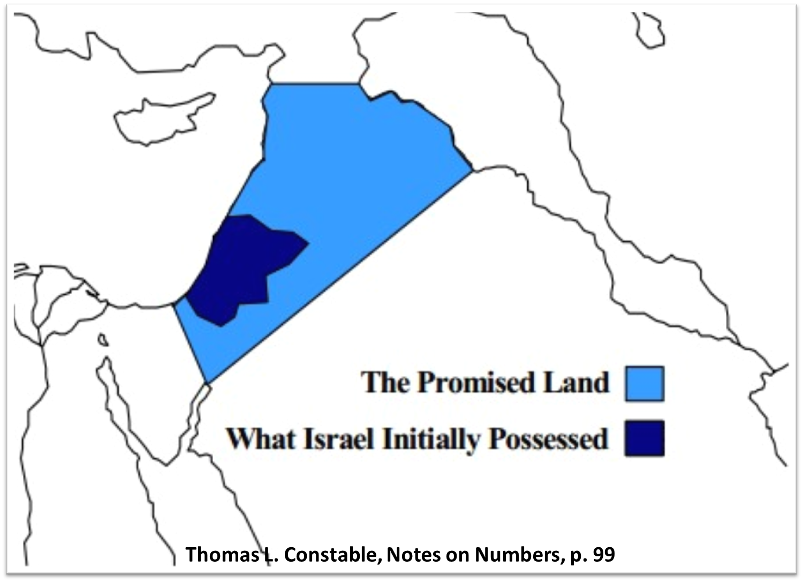

Slide 116
Conclusion

Slide 117
Zechariah 14
(Israel’s Kingdom)
Jerusalem’s deliverance (14:1-7)
Kingdom conditions (14:8-11)
Enemies’ judgment (12-15)
Kingdom worship (16-21)

