Slide 1

Ezekiel 36‒39
The Middle East Meltdown 2022
Dr. Andy Woods
Senior Pastor – Sugar Land Bible Church
President – Chafer Theological Seminary

Slide 2
Ezekiel 33‒48
Ezekiel recommissioned (33)
False shepherds removed (34)
Edom destroyed (35)
Israel’s restoration: physical & spiritual (36)
Israel’s restoration illustrated (37)
Means of restoration: Northern invasion (38)
Results of the Northern invasion: conversion (39)
Millennial Temple (40‒46)
Tribal land allotment (47‒48)

Slide 3

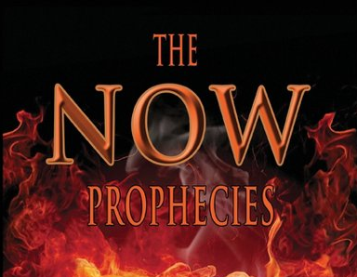
MAIL BAG
The Now Prophecies (Elam, Damascus, Ps. 83)?

Slide 4

Charles Ryrie
Footsteps of the Messiah, Foreword, page XXV
“Eschatology seems to suffer at the hands both of its friends and foes. Those who play it down usually avoid assigning specific meaning to prophetic texts. Those who play it up often assign too much.”

Slide 5
The Now Prophecies?
Elam, Damascus, Ps. 83
  Elam
    Jer. 49:34-39
    Ezek. 32:24-25
  Damascus
    Isa. 17:1-2
    Jer. 49:23-27
  Psalm 83

Slide 6
The Now Prophecies?
Elam, Damascus, Ps. 83
  Elam
    Jer. 49:34-39
    Ezek. 32:24-25
  Damascus
    Isa. 17:1-2
    Jer. 49:23-27
  Psalm 83

Slide 7
The Now Prophecies?
Elam, Damascus, Ps. 83
  Elam
    Jer. 49:34-39
    Ezek. 32:24-25
  Damascus
    Isa. 17:1-2
    Jer. 49:23-27
  Psalm 83

Slide 8
The Now Prophecies?
Elam, Damascus, Ps. 83
  Elam
    Jer. 49:34-39
    Ezek. 32:24-25
  Damascus
    Isa. 17:1-2
    Jer. 49:23-27
  Psalm 83

Slide 9
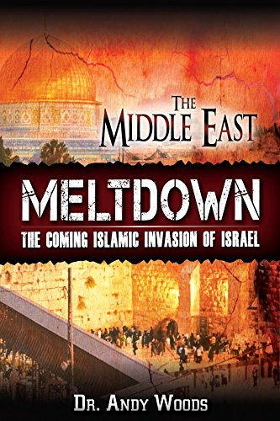

Slide 10
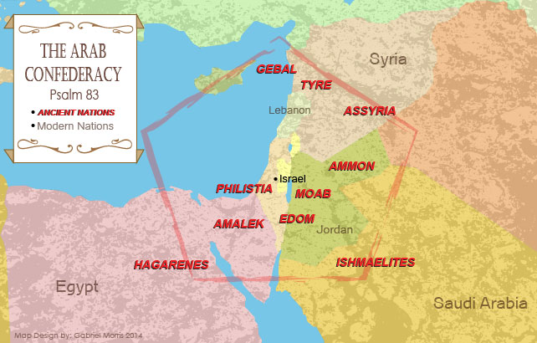

Slide 11
Psalm 83 War?
Five Problems
    Nations listed in Ezek. 38‒39 are not exhaustive
    Psalm 83 is an imprecatory prayer & not prophecy
    No war or battle is found in Psalm 83
    Psalm 83 nations existed in Asaph’s day (950 B.C.)
    Other imprecatory prayers are not prophecies

Slide 12
Psalm 83 War?
Five Problems
    Nations listed in Ezek. 38‒39 are not exhaustive
    Psalm 83 is an imprecatory prayer & not prophecy
    No war or battle is found in Psalm 83
    Psalm 83 nations existed in Asaph’s day (950 B.C.)
    Other imprecatory prayers are not prophecies

Slide 13
Psalm 83 War?
Five Problems
    Nations listed in Ezek. 38‒39 are not exhaustive
    Psalm 83 is an imprecatory prayer & not prophecy
    No war or battle is found in Psalm 83
    Psalm 83 nations existed in Asaph’s day (950 B.C.)
    Other imprecatory prayers are not prophecies

Slide 14

Ezekiel 38:8
“After many days you will be summoned; in the latter years you will come into the land that is restored from the sword, whose inhabitants have been gathered from many nations to the mountains of Israel which had been a continual waste; but its people were brought out from the nations, and they are living securely, all of them.”

Slide 15
Ezekiel 38:16
“and you will come up against My people Israel like a cloud to cover the land. It shall come about in the last days that I will bring you against My land, so that the nations may know Me when I am sanctified through you before their eyes, O Gog.”

Slide 16
Psalm 83 War?
Five Problems
    Nations listed in Ezek. 38‒39 are not exhaustive
    Psalm 83 is an imprecatory prayer & not prophecy
    No war or battle is found in Psalm 83
    Psalm 83 nations existed in Asaph’s day (950 B.C.)
    Other imprecatory prayers are not prophecies

Slide 17


Slide 18
Ezekiel 38‒39
Invasion planned (38:1-13)
Invasion executed (38:14-16)
Invasion defeated (38:17‒39:20)
Invasion’s results (39:21-29)

Slide 19
What?
Divine annihilation of the coalition (38:19-22)
Birds and beasts feast on the carnage (39:4-5, 17-20)
Seven-month burying of the dead (39:11-12, 14-16)
Seven-year burning of weapons (39:9-10)
Israel’s salvation and restoration (39:22, 29)

Slide 20
Psalm 83 War?
Five Problems
    Nations listed in Ezek. 38‒39 are not exhaustive
    Psalm 83 is an imprecatory prayer & not prophecy
    No war or battle is found in Psalm 83
    Psalm 83 nations existed in Asaph’s day (950 B.C.)
    Other imprecatory prayers are not prophecies

Slide 21
Psalm 83 War?
Five Problems
    Nations listed in Ezek. 38‒39 are not exhaustive
    Psalm 83 is an imprecatory prayer & not prophecy
    No war or battle is found in Psalm 83
    Psalm 83 nations existed in Asaph’s day (950 B.C.)
    Other imprecatory prayers are not prophecies

Slide 22

Stanley A. Maughan Quoting Mark Hitchcock
“Selected Expert Perspectives on Ezekiel 38‒39 Related to Current World Events with Resulting Influence on Ministry Practices” (D. Min. diss., Dallas Theological Seminary, 2012), 257.
“Psalm 83 is kind of like Psalm 2, it is just saying that (there is similar language — why did the nations rage against Israel in Psalm 83) look there are people who are always against Israel. Israel is always going to have these enemies, they are always going to be against them and God is going to deal with them someday. We don’t see a separate Psalm 2 war.”

Slide 23
CONCLUSION

Slide 24
MAIL BAG
The Now Prophecies (Elam, Damascus, Ps. 83)?

Slide 25
The Now Prophecies?
Elam, Damascus, Ps. 83
  Elam
    Jer. 49:34-39
    Ezek. 32:24-25
  Damascus
    Isa. 17:1-2
    Jer. 49:23-27
  Psalm 83

