Slide 1

Ezekiel 36‒39
The Middle East Meltdown 2022
Dr. Andy Woods
Senior Pastor – Sugar Land Bible Church
President – Chafer Theological Seminary

Slide 2
Ezekiel 33‒48
Ezekiel recommissioned (33)
False shepherds removed (34)
Edom destroyed (35)
Israel’s restoration: physical & spiritual (36)
Israel’s restoration illustrated (37)
Means of restoration: Northern invasion (38)
Results of the Northern invasion: conversion (39)
Millennial Temple (40‒46)
Tribal land allotment (47‒48)

Slide 3

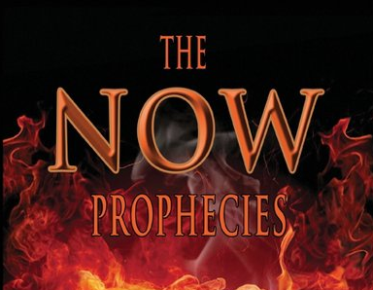
MAIL BAG
The Now Prophecies (Elam, Damascus, Ps. 83)?

Slide 4


Slide 5

Charles Ryrie
Footsteps of the Messiah, Foreword, page XXV
“Eschatology seems to suffer at the hands both of its friends and foes. Those who play it down usually avoid assigning specific meaning to prophetic texts. Those who play it up often assign too much.”

Slide 6
The Now Prophecies?
Elam, Damascus, Ps. 83
  Elam
    Jer. 49:34-39
    Ezek. 32:24-25
  Damascus
    Isa. 17:1-2
    Jer. 49:23-27
  Psalm 83

Slide 7
The Now Prophecies?
Elam, Damascus, Ps. 83
  Elam
    Jer. 49:34-39
    Ezek. 32:24-25
  Damascus
    Isa. 17:1-2
    Jer. 49:23-27
  Psalm 83

Slide 8
The Now Prophecies?
Elam, Damascus, Ps. 83
  Elam
    Jer. 49:34-39
    Ezek. 32:24-25
  Damascus
    Isa. 17:1-2
    Jer. 49:23-27
  Psalm 83

Slide 9
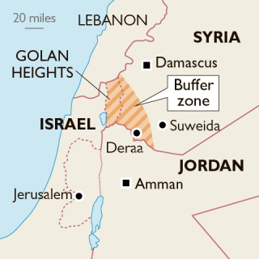

Slide 10
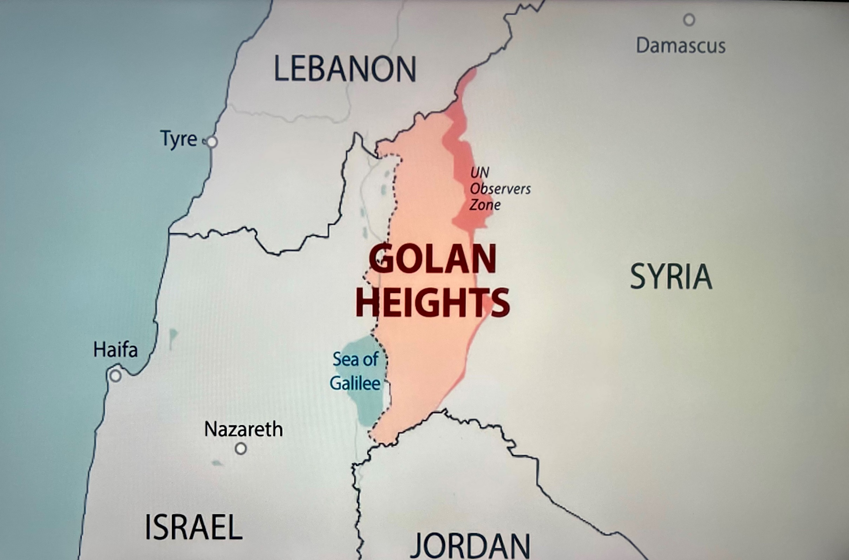

Slide 11
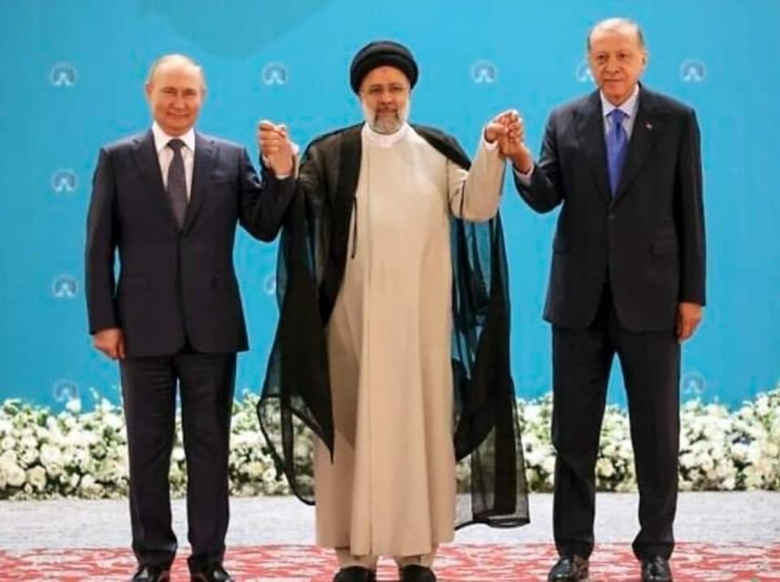

Slide 12
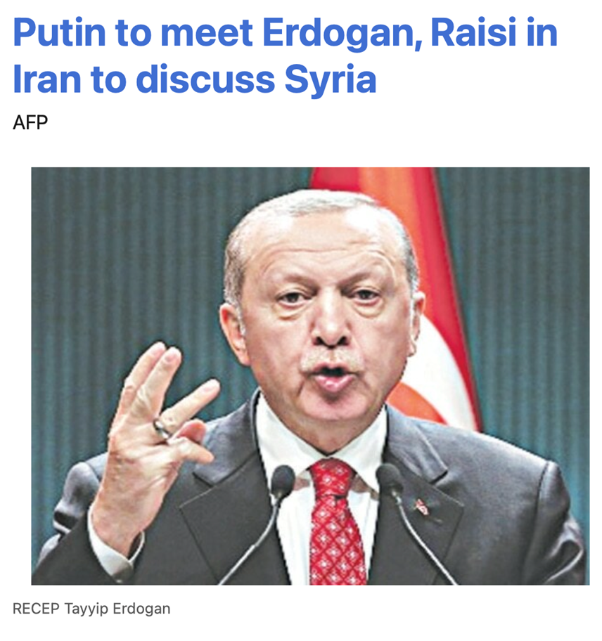

Slide 13
The Now Prophecies?
Elam, Damascus, Ps. 83
  Elam
    Jer. 49:34-39
    Ezek. 32:24-25
  Damascus
    Isa. 17:1-2
    Jer. 49:23-27
  Psalm 83

Slide 14
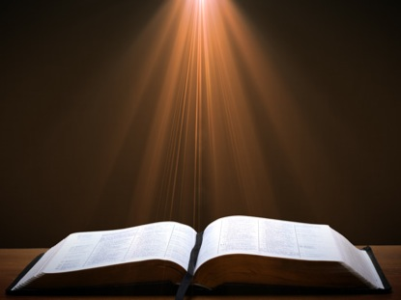
Isaiah 17:1-2
¹ “The oracle concerning Damascus. ‘Behold, Damascus is about to be removed from being a city And will become a fallen ruin. ² The cities of Aroer are forsaken; They will be for flocks to lie down in, And there will be no one to frighten them.’”

Slide 15
The Now Prophecies?
Elam, Damascus, Ps. 83
  Elam
    Jer. 49:34-39
    Ezek. 32:24-25
  Damascus
    Isa. 17:1-2
    Jer. 49:23-27
  Psalm 83

Slide 16
Joel C. Rosenberg
Joel C. Rosenberg, “Notes on the Future of Damascus According to Bible Prophecy,” updated: September 9, 2013, http://www.joelrosenberg.com/files/2013/09/STUDY-Damascus-prophecies-R.pdf
“When viewed together, we can say the following about the prophecies concerning Damascus found in Isaiah 17 and Jeremiah 49:
The prophecies refer to a divine judgment by God against the city of Damascus. . . .
The prophecies refer to the utter, catastrophic destruction of Damascus.
Both are eschatological passages, referring to End Times events that have yet to occur.
  Isaiah’s prophecy was given to him in 715 BC, well after the conquering of Damascus in 732 by Tiglath-pileser.
  Likewise, Jeremiah’s ministry occurred between 626 BC and 586 BC, long after Tiglath-pileser conquered Damascus in 732 BC.”

Slide 17
Joel C. Rosenberg
Joel C. Rosenberg, “Notes on the Future of Damascus According to Bible Prophecy,” updated: September 9, 2013, http://www.joelrosenberg.com/files/2013/09/STUDY-Damascus-prophecies-R.pdf
“Damascus has certainly been attacked, conquered, and burned at various points in history, including Biblical history—but it is clear that the prophecies of Isaiah 17 and Jeremiah 49 have not yet been fulfilled. Damascus is, after all, one of the oldest continuously inhabited cities on the planet.
We cannot be certain when these judgments will happen, and the prophecies will be fulfilled.
They could come to pass before, during or after the War of Gog & Magog (Ezekiel 38–39); before, during, or after the Rapture; or before or during the Tribulation. The texts simply do not say, so we cannot be definitive.
It is possibly that the prophecies could come to pass in the not-too-distant future. But they certainly will come to pass at some point before the Second Coming of Christ (the ‘Day of the Lord.’).”

Slide 18
Jeremiah 49:23-27?
Charles H. Dyer, “Jeremiah,” The Bible Knowledge Commentary, vol. 2, ed. John F. Walvoord and Roy B. Zuck (Wheaton, IL: Victor Books, 1985), 1198.
“Three of the major cities of Syria—Hamath…Arpad, and Damascus…were dismayed because of the bad news of Babylon’s advance. Damascus’ pain was like that of a woman in labor (cf. comments on 4:31). In Nebuchadnezzar’s attack on Damascus the soldiers of Damascus were silenced (i.e., killed) and her fortifications burned (cf. Amos 1:4). God vowed to consume the fortresses of Ben-Hadad. ‘Ben-Hadad’ (lit., ‘son of [the god] Hadad’) was the name of the dynasty that ruled in Damascus in the ninth and eighth centuries b.c. (cf. 1 Kings 15:18, 20; 20:1–34; 2 Kings 6:24; 8:7; 13:3, 24...”

Slide 19

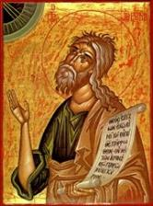
Jeremiah 49:27
“I will set fire to the wall of Damascus, And it will devour the fortified towers of Ben-hadad.”

Slide 20
Jeremiah 49:23-27?
Charles H. Dyer, “Jeremiah,” The Bible Knowledge Commentary, vol. 2, ed. John F. Walvoord and Roy B. Zuck (Wheaton, IL: Victor Books, 1985), 1198.
“Three of the major cities of Syria—Hamath…Arpad, and Damascus…were dismayed because of the bad news of Babylon’s advance. Damascus’ pain was like that of a woman in labor (cf. comments on 4:31). In Nebuchadnezzar’s attack on Damascus the soldiers of Damascus were silenced (i.e., killed) and her fortifications burned (cf. Amos 1:4). God vowed to consume the fortresses of Ben-Hadad. ‘Ben-Hadad’ (lit., ‘son of [the god] Hadad’) was the name of the dynasty that ruled in Damascus in the ninth and eighth centuries b.c. (cf. 1 Kings 15:18, 20; 20:1–34; 2 Kings 6:24; 8:7; 13:3, 24...”

Slide 21
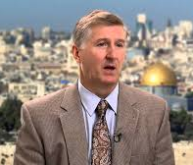
Jeremiah 49:23-27?
Mark Hitchcock, Showdown with Iran (Nashville, TN, 2020), Appendix 2, n. 8.
“Jeremiah 49:23–27 (BKC): God vowed to consume the fortresses of Ben-Hadad. ‘Ben-Hadad’ (lit., ‘son of [the god] Hadad’) was the name of the dynasty that ruled in Damascus in the ninth and eighth centuries b.c.” “Dyer notes the mention of ‘Benhadad,’ which ‘was the name of the dynasty that ruled in Damascus in the ninth and eighth centuries BC.’ The use of that name would be strange if this refers to an end-time event. The towers of Ben-hadad are long gone today.”

Slide 22

Dr. John F. Walvoord
The Nations in Prophecy, 164
“Damascus was one of the most ancient cities of the Middle East and one of the few to have a continuous history down to modern times. First mentioned in Genesis 14:15, it continued to have a relationship to Israel throughout the Old Testament period where there are more than forty references and in the New Testament where it is mentioned fifteen times. The more extended prophecies as found in Isaiah 17:1–14 and Jeremiah 49:23–27 have all been fulfilled as well as the occasional references found in Isaiah 7:8; 8:4; Amos 1:3–5; 3:12; 5:27.”
https://walvoord.com/article/306

Slide 23


Slide 28
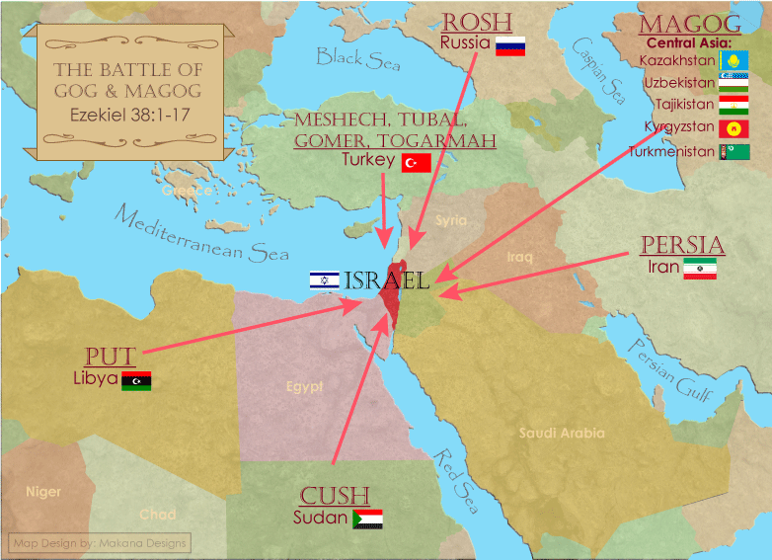

Slide 29
The Now Prophecies?
Elam, Damascus, Ps. 83
  Elam
    Jer. 49:34-39
    Ezek. 32:24-25
  Damascus
    Isa. 17:1-2
    Jer. 49:23-27
  Psalm 83

Slide 30
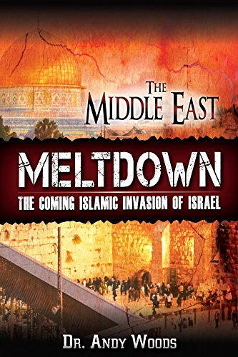

Slide 31
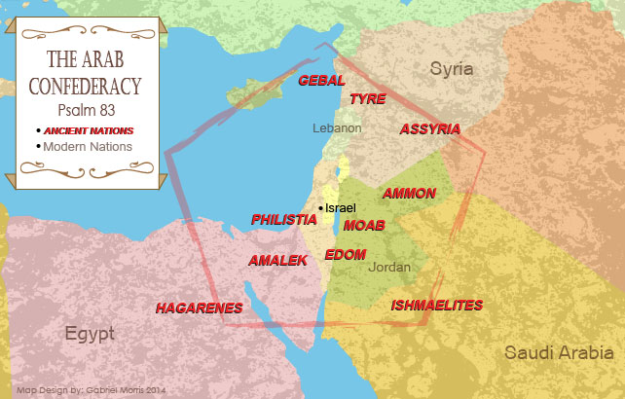

Slide 32
Psalm 83 War?
Five Problems
    Nations listed in Ezek. 38‒39 are not exhaustive
    Psalm 83 is an imprecatory prayer & not prophecy
    No war or battle is found in Psalm 83
    Psalm 83 nations existed in Asaph’s day (950 B.C.)
    Other imprecatory prayers are not prophecies

Slide 33
Psalm 83 War?
Five Problems
    Nations listed in Ezek. 38‒39 are not exhaustive
    Psalm 83 is an imprecatory prayer & not prophecy
    No war or battle is found in Psalm 83
    Psalm 83 nations existed in Asaph’s day (950 B.C.)
    Other imprecatory prayers are not prophecies

Slide 34
Psalm 83 War?
Five Problems
    Nations listed in Ezek. 38‒39 are not exhaustive
    Psalm 83 is an imprecatory prayer & not prophecy
    No war or battle is found in Psalm 83
    Psalm 83 nations existed in Asaph’s day (950 B.C.)
    Other imprecatory prayers are not prophecies

Slide 35

Ezekiel 38:8
“After many days you will be summoned; in the latter years you will come into the land that is restored from the sword, whose inhabitants have been gathered from many nations to the mountains of Israel which had been a continual waste; but its people were brought out from the nations, and they are living securely, all of them.”

Slide 36
Ezekiel 38:16
“and you will come up against My people Israel like a cloud to cover the land. It shall come about in the last days that I will bring you against My land, so that the nations may know Me when I am sanctified through you before their eyes, O Gog.”

Slide 37
Psalm 83 War?
Five Problems
    Nations listed in Ezek. 38‒39 are not exhaustive
    Psalm 83 is an imprecatory prayer & not prophecy
    No war or battle is found in Psalm 83
    Psalm 83 nations existed in Asaph’s day (950 B.C.)
    Other imprecatory prayers are not prophecies

Slide 39
Ezekiel 38‒39
Invasion planned (38:1-13)
Invasion executed (38:14-16)
Invasion defeated (38:17‒39:20)
Invasion’s results (39:21-29)

Slide 40
What?
Divine annihilation of the coalition (38:19-22)
Birds and beasts feast on the carnage (39:4-5, 17-20)
Seven-month burying of the dead (39:11-12, 14-16)
Seven-year burning of weapons (39:9-10)
Israel’s salvation and restoration (39:22, 29)

Slide 41
Psalm 83 War?
Five Problems
    Nations listed in Ezek. 38‒39 are not exhaustive
    Psalm 83 is an imprecatory prayer & not prophecy
    No war or battle is found in Psalm 83
    Psalm 83 nations existed in Asaph’s day (950 B.C.)
    Other imprecatory prayers are not prophecies

Slide 42
Psalm 83 War?
Five Problems
    Nations listed in Ezek. 38‒39 are not exhaustive
    Psalm 83 is an imprecatory prayer & not prophecy
    No war or battle is found in Psalm 83
    Psalm 83 nations existed in Asaph’s day (950 B.C.)
    Other imprecatory prayers are not prophecies

Slide 43

Stanley A. Maughan Quoting Mark Hitchcock
“Selected Expert Perspectives on Ezekiel 38‒39 Related to Current World Events with Resulting Influence on Ministry Practices” (D. Min. diss., Dallas Theological Seminary, 2012), 257.
“Psalm 83 is kind of like Psalm 2, it is just saying that (there is similar language — why did the nations rage against Israel in Psalm 83) look there are people who are always against Israel. Israel is always going to have these enemies, they are always going to be against them and God is going to deal with them someday. We don’t see a separate Psalm 2 war.”

Slide 44
CONCLUSION

Slide 45
MAIL BAG
The Now Prophecies (Elam, Damascus, Ps. 83)?

Slide 46
The Now Prophecies?
Elam, Damascus, Ps. 83
  Elam
    Jer. 49:34-39
    Ezek. 32:24-25
  Damascus
    Isa. 17:1-2
    Jer. 49:23-27
  Psalm 83

