Slide 1
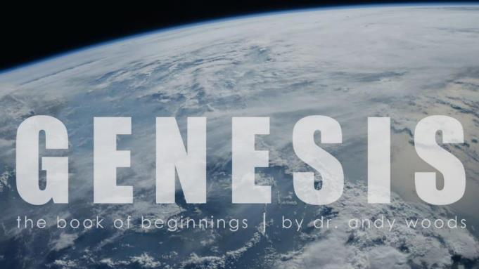
Genesis 12‒50
Israel’s Birth & Preservation

Slide 2
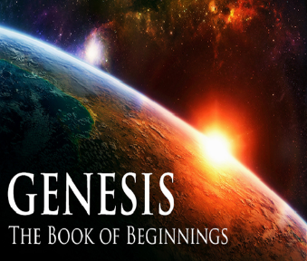
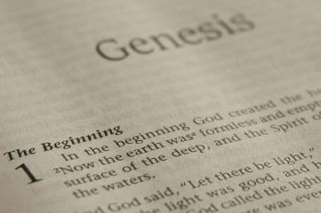
GENESIS STRUCTURE
Beginning of the Human race (Gen. 1‒11)
Beginning of the Hebrew race (Gen. 12‒50)

Slide 3
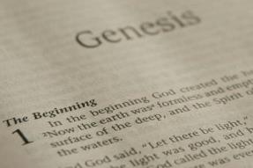
GENESIS STRUCTURE
Genesis 1-11 (four events)
Creation (1-2)
Fall (3-5)
Flood (6-9)
National dispersion (10-11)

Slide 4
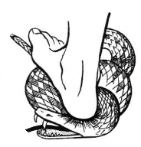
Genesis 3:15
“And I will put enmity Between you and the woman, And between your seed and her seed; He shall bruise you on the head, And you shall bruise him on the heel.”

Slide 5
GENESIS STRUCTURE
Beginning of the Human race (Gen. 1‒11)
Beginning of the Hebrew race (Gen. 12‒50)

Slide 6
GENESIS STRUCTURE
Genesis 12-50 (four people)
Abraham (12:1–25:11)
Isaac (25:12–26:35)
Jacob (27–36)
Joseph (37–50)

Slide 7
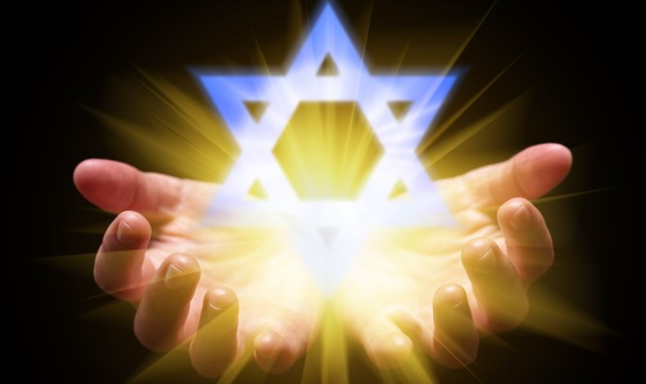
Isaiah 43:1
“But now, thus says the Lord, your Creator, O Jacob, And He who formed you, O Israel, 'Do not fear, for I have redeemed you; I have called you by name; you are Mine!'”

Slide 8
GENESIS STRUCTURE
Genesis 12-50 (four people)
Abraham (12:1–25:11)
Isaac (25:12–26:35)
Jacob (27–36)
Joseph (37–50)

Slide 9
Genesis 12‒24 Abraham’s Early Journeys
Unconditional promises (Gen. 12:1-3) From Haran to Canaan (Gen. 12:4-5) In Canaan (Gen. 12:6-9) In Egypt (Gen. 12:10-20) Abram and Lot Separate (Gen. 13:1-13) Reaffirmation of Abram’s promises (Gen. 13:14-18) Abram Rescues Lot (14:1-24) Abrahamic Covenant (15:1-21) Hagar & Ishmael (16:1-16) Circumcision (Gen. 17:1-27) | Sodom & Gomorrah (Gen. 18‒19) Abraham & Abimelech (Gen. 20) Isaac’s birth (Gen. 21:1-7) Ishmael’s expulsion (21:8-21) Abraham & Abimelech’s covenant (21:22-34) Abraham sacrifices Isaac (22) Sarah’s death (23) Isaac’s marriage (24)

Slide 10
Genesis 24 Isaac’s Marriage
Abraham’s instructions (1-9)
Servant prays (10-14)
Servant meets Rebekah (15-27)
Servant and Laban (28-49)
Betrothal of Isaac & Rebekah (50-60)
Marriage of Isaac & Rebekah (61-67)

Slide 11
Genesis 24 Isaac’s Marriage
Abraham’s instructions (1-9)
Servant prays (10-14)
Servant meets Rebekah (15-27)
Servant and Laban (28-49)
Betrothal of Isaac & Rebekah (50-60)
Marriage of Isaac & Rebekah (61-67)

Slide 12
Genesis 24:1-9 Abraham instructs servant
Occasion (1)
Oath (2-4)
Servant’s question (5)
Abraham’s answer (6-8)
Oath taken (9)

Slide 13
Genesis 24:1-9 Abraham instructs servant
Occasion (1)
Oath (2-4)
Servant’s question (5)
Abraham’s answer (6-8)
Oath taken (9)

Slide 14
8 New Promises Genesis 12:1-3
Land (Gen. 12:1b)
Great nation (Gen. 12:2a)
Personal blessing (Gen. 12:2b)
Great name (Gen. 12:2c)
Blessing to others (Gen. 12:2d)
Blessing to blessers (Gen. 12:3a)
Cursing to cursers (Gen. 12:3b)
Blessing to the world (Gen. 12:3c)

Slide 15
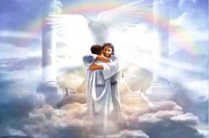
Ephesians 1:3
“Blessed be the God and Father of our Lord Jesus Christ, who has blessed us with every spiritual blessing in the heavenly places in Christ.”

Slide 16
Genesis 24:1-9 Abraham instructs servant
Occasion (1)
Oath (2-4)
Servant’s question (5)
Abraham’s answer (6-8)
Oath taken (9)

Slide 17
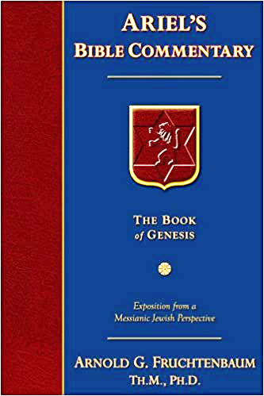
Dr. Arnold G. Fruchtenbaum
The Book of Genesis, 372
“Verse 2b describes the sign of the oath: Put, I pray you, your hand under my thigh. This was a euphemism for genitals and actually meant the holding of the genitals. It is the same word that is translated as ‘loins’ in 46:26. One reason for this procedure was due to the fact that the genitals are the source of life and the seat of vital power, and so this would solemnize the oath at the point of the very source of life. It was a solemn sign that if the oath was not carried out, the children will avenge the oath-taker’s unfaithfulness. This may be related to the covenant of circumcision, which was on the same part of the body. This procedure will be mentioned one more time, in 49:29.”

Slide 18
Genesis 1:1-3
“¹ In the beginning God created the heavens and the earth. ² The earth was formless and void, and darkness was over the surface of the deep, and the Spirit of God was moving over the surface of the waters. ³ Then God said, ‘Let there be light’; and there was light.”

Slide 19
GENESIS 10 Outline
Introduction (1)
Japheth's line (2-5)
Ham’s Line (6-20)
Shem’s line (21-31)
Conclusion (32)

Slide 20
Ham’s Sons (vs. 6)
Cush
Mizraim
Put
Canaan

Slide 21
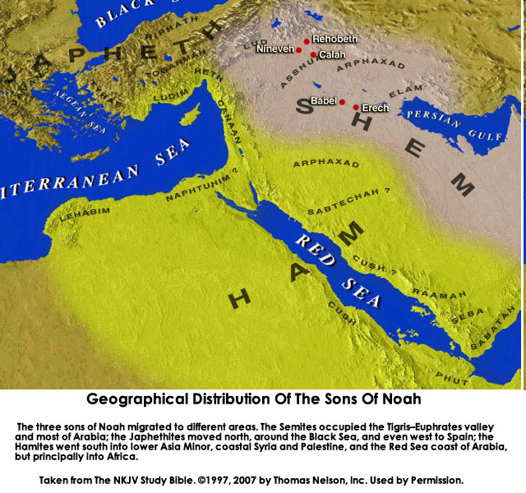

Slide 22
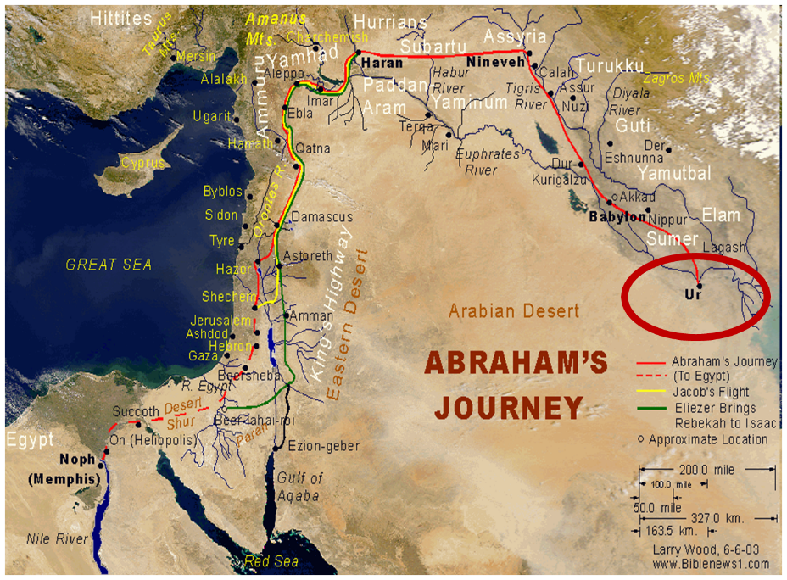

Slide 23
Genesis 22:20-24 Rebekah’s Lineage
Timing (20a)
Nahor’s children (20b-24)
From Milcah (20b-23)
From Reumah (24)

Slide 24
Nahor’s children through Milcah (Gen. 22:20b-23)
1. Uz (Job 1:1) | 5. Hazo
2. Buz | 6. Pildash
3. Aram | 7. Jidlaph
4. Chesed | 8. Bethuel (Gen. 24)

Slide 25
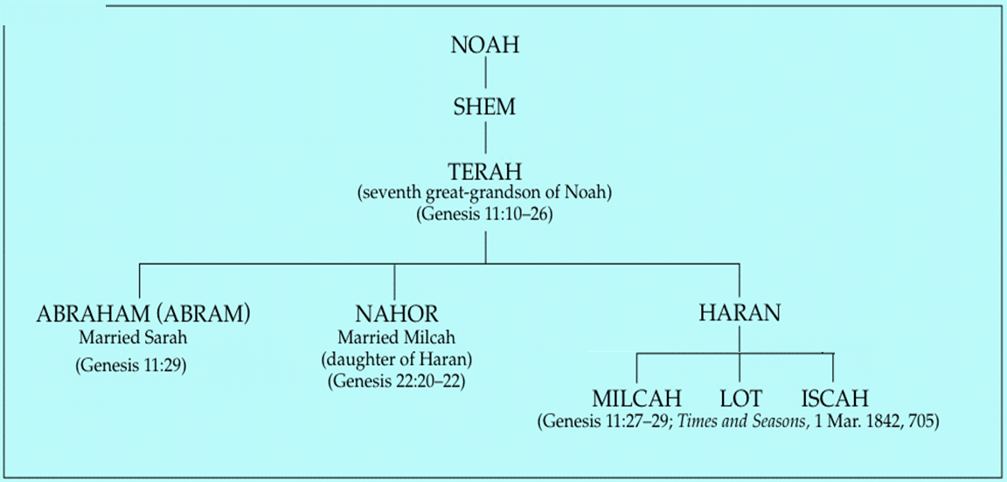

Slide 26
Genesis 24:1-9 Abraham instructs servant
Occasion (1)
Oath (2-4)
Servant’s question (5)
Abraham’s answer (6-8)
Oath taken (9)

Slide 27
Genesis 24:1-9 Abraham instructs servant
Occasion (1)
Oath (2-4)
Servant’s question (5)
Abraham’s answer (6-8)
Oath taken (9)

Slide 28
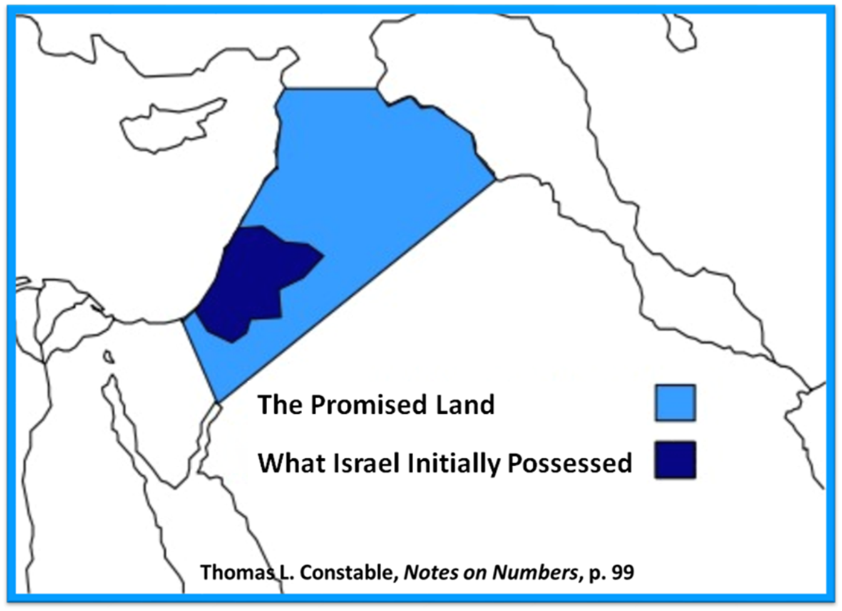

Slide 29
Genesis 1:1-3
“¹ In the beginning God created the heavens and the earth. ² The earth was formless and void, and darkness was over the surface of the deep, and the Spirit of God was moving over the surface of the waters. ³ Then God said, ‘Let there be light’; and there was light.”

Slide 31
8 New Promises Genesis 12:1-3
Land (Gen. 12:1b)
Great nation (Gen. 12:2a)
Personal blessing (Gen. 12:2b)
Great name (Gen. 12:2c)
Blessing to others (Gen. 12:2d)
Blessing to blessers (Gen. 12:3a)
Cursing to cursers (Gen. 12:3b)
Blessing to the world (Gen. 12:3c)

Slide 32
Dr. Arnold G. Fruchtenbaum
The Book of Genesis, 240
“This is the first of seven times that Abraham receives a direct revelation from God. In 12:1–3 is God’s initial call to Abram outside the Land of Canaan; in 12:7 is the first appearance to Abraham in the Land; in 13:14–17, Abraham encounters God after the separation of Lot; in 15:1–21, God signs and seals the Abrahamic Covenant; in 17:1–21, Abraham receives the token of the covenant; in 18:1–33, God speaks to him in conjunction with the destruction of Sodom; and in 22:1–2 and 22:11–18, God directs Abraham to offer Isaac.”

Slide 33
Evidence of Abrahamic Covenant’s Unconditional Nature
ANE covenant ratification ceremony (Gen 15)
Lack of stated conditions for Israel’s obedience (Gen 15)
Covenant's eternality (Gen 17:7, 13, 19; Ps. 90:2)
Covenant's immutability (Heb 6:13-18; Mal. 3:6)
Trans-generational reaffirmation despite perpetual national disobedience (Jer 31:35-37)
Walvoord, The Millennial Kingdom, 149-52

Slide 36
Genesis 24:1-9 Abraham instructs servant
Occasion (1)
Oath (2-4)
Servant’s question (5)
Abraham’s answer (6-8)
Oath taken (9)

Slide 37
Genesis 24 Isaac’s Marriage
Abraham’s instructions (1-9)
Servant prays (10-14)
Servant meets Rebekah (15-27)
Servant and Laban (28-49)
Betrothal of Isaac & Rebekah (50-60)
Marriage of Isaac & Rebekah (61-67)

Slide 38
Genesis 24:10-14 Servant’s prayer
Journey (10)
Arrival (11)
Prayer (12)
Request (13-14)

Slide 39
Genesis 24:10-14 Servant’s prayer
Journey (10)
Arrival (11)
Prayer (12)
Request (13-14)

Slide 40
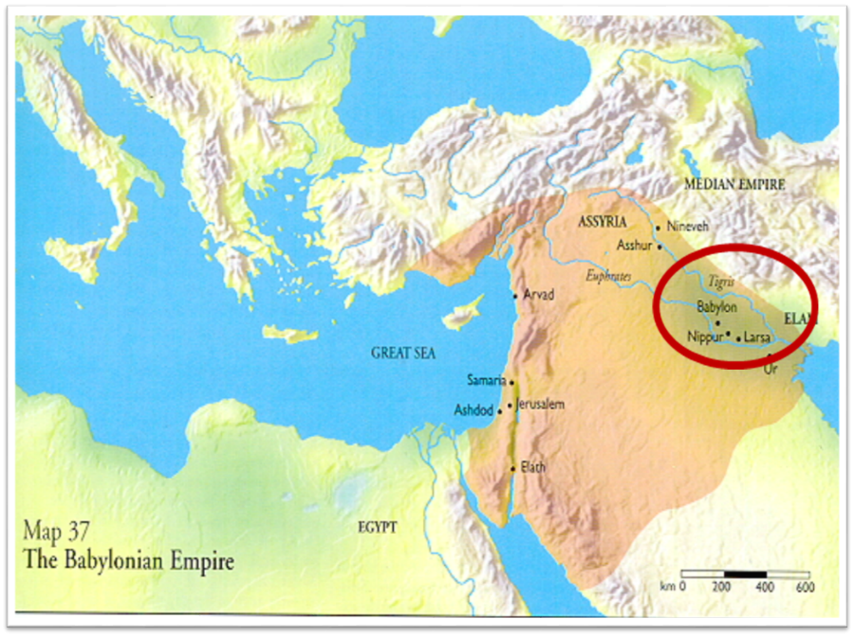

Slide 42
Genesis 24:10-14 Servant’s prayer
Journey (10)
Arrival (11)
Prayer (12)
Request (13-14)

Slide 43
Genesis 24:10-14 Servant’s prayer
Journey (10)
Arrival (11)
Prayer (12)
Request (13-14)

Slide 44
Genesis 24:10-14 Servant’s prayer
Journey (10)
Arrival (11)
Prayer (12)
Request (13-14)

Slide 45
Genesis 24 Isaac’s Marriage
Abraham’s instructions (1-9)
Servant prays (10-14)
Servant meets Rebekah (15-27)
Servant and Laban (28-49)
Betrothal of Isaac & Rebekah (50-60)
Marriage of Isaac & Rebekah (61-67)

Slide 46
Genesis 24:15-27 Servant meets Rebekah
Introduction to Rebekah (15-16)
Servant’s question (17)
Rebekah’s response (18-20)
Servant’s observation (21)
Servant’s action (22)
Servant’s inquiry (23)
Rebekah’s answers (24-25)
Servant’s responses (26-27)

Slide 47
Genesis 24:15-27 Servant meets Rebekah
Introduction to Rebekah (15-16)
Servant’s question (17)
Rebekah’s response (18-20)
Servant’s observation (21)
Servant’s action (22)
Servant’s inquiry (23)
Rebekah’s answers (24-25)
Servant’s responses (26-27)

Slide 49
Dr. Arnold G. Fruchtenbaum
The Book of Genesis, 377
“Second, she was a virgin. The Hebrew word here is betulah, from the Hebrew root batal, which means ‘to separate,’ ‘to keep oneself in modesty,’ ‘to be marriageable.’ Since the word itself does not denote absolute virginity, this is why the author had to add an explanation: neither had any man known her, an explanation that would not have been necessary if the word betulah by itself was sufficient to denote absolute virginity. The Talmud also recognized this fact: Betulah by itself does not imply the characteristic of virgin purity, but only states age and condition. The word almah, as in Isaiah 7:14, is a better word to convey that truth. Verse 16b states her arrival: and she went down to the fountain, and filled her pitcher, and came up.”

Slide 50
Isaiah 7:13-14
“Then he said, “Listen now, O house of David! Is it too slight a thing for you to try the patience of men, that you will try the patience of my God as well? ¹⁴ Therefore the Lord Himself will give you a sign: Behold, a virgin will be with child and bear a son, and she will call His name Immanuel.”

Slide 51
Genesis 24:15-27 Servant meets Rebekah
Introduction to Rebekah (15-16)
Servant’s question (17)
Rebekah’s response (18-20)
Servant’s observation (21)
Servant’s action (22)
Servant’s inquiry (23)
Rebekah’s answers (24-25)
Servant’s responses (26-27)

Slide 52
Genesis 24:15-27 Servant meets Rebekah
Introduction to Rebekah (15-16)
Servant’s question (17)
Rebekah’s response (18-20)
Servant’s observation (21)
Servant’s action (22)
Servant’s inquiry (23)
Rebekah’s answers (24-25)
Servant’s responses (26-27)

Slide 53
Dr. Arnold G. Fruchtenbaum
The Book of Genesis, 378
“In verse 20 is the fulfillment: And she hasted, meaning she was expeditious, and emptied her pitcher into the trough, the first of many times she had to do so, and ran again unto the well to draw. This required many repeated actions: and drew for all his camels. In verses 16–20, Rebekah is viewed as being very active. The Hebrew text here has only one verb for speech, but Rebekah is the subject of eleven verbs of action.”

Slide 54
Genesis 24:15-27 Servant meets Rebekah
Introduction to Rebekah (15-16)
Servant’s question (17)
Rebekah’s response (18-20)
Servant’s observation (21)
Servant’s action (22)
Servant’s inquiry (23)
Rebekah’s answers (24-25)
Servant’s responses (26-27)

Slide 55
Genesis 24:15-27 Servant meets Rebekah
Introduction to Rebekah (15-16)
Servant’s question (17)
Rebekah’s response (18-20)
Servant’s observation (21)
Servant’s action (22)
Servant’s inquiry (23)
Rebekah’s answers (24-25)
Servant’s responses (26-27)

Slide 56
Genesis 24:15-27 Servant meets Rebekah
Introduction to Rebekah (15-16)
Servant’s question (17)
Rebekah’s response (18-20)
Servant’s observation (21)
Servant’s action (22)
Servant’s inquiry (23)
Rebekah’s answers (24-25)
Servant’s responses (26-27)

Slide 57
Genesis 24:15-27 Servant meets Rebekah
Introduction to Rebekah (15-16)
Servant’s question (17)
Rebekah’s response (18-20)
Servant’s observation (21)
Servant’s action (22)
Servant’s inquiry (23)
Rebekah’s answers (24-25)
Servant’s responses (26-27)

Slide 58
Genesis 22:20-24 Rebekah’s Lineage
Timing (20a)
Nahor’s children (20b-24)
From Milcah (20b-23)
From Reumah (24)

Slide 59
Nahor’s children through Milcah (Gen. 22:20b-23)
1. Uz (Job 1:1) | 5. Hazo
2. Buz | 6. Pildash
3. Aram | 7. Jidlaph
4. Chesed | 8. Bethuel (Gen. 24)

Slide 61
Genesis 24:15-27 Servant meets Rebekah
Introduction to Rebekah (15-16)
Servant’s question (17)
Rebekah’s response (18-20)
Servant’s observation (21)
Servant’s action (22)
Servant’s inquiry (23)
Rebekah’s answers (24-25)
Servant’s responses (26-27)

Slide 62
Genesis 24 Isaac’s Marriage
Abraham’s instructions (1-9)
Servant prays (10-14)
Servant meets Rebekah (15-27)
Servant and Laban (28-49)
Betrothal of Isaac & Rebekah (50-60)
Marriage of Isaac & Rebekah (61-67)

Slide 63
Genesis 24:28-49 Servant & Laban
In the house (28-33)
Retelling the story (34-49)

Slide 64
Genesis 24:28-49 Servant & Laban
In the house (28-33)
Retelling the story (34-49)

Slide 65
Genesis 24:28-33 In the house
Rebekah’s report (28)
Laban’s response (29-30)
Laban’s invitation (31)
Laban’s hospitality (32-33)

Slide 66
Genesis 24:28-33 In the house
Rebekah’s report (28)
Laban’s response (29-30)
Laban’s invitation (31)
Laban’s hospitality (32-33)

Slide 67
Genesis 24:28-33 In the house
Rebekah’s report (28)
Laban’s response (29-30)
Laban’s invitation (31)
Laban’s hospitality (32-33)

Slide 68
Genesis 24:28-33 In the house
Rebekah’s report (28)
Laban’s response (29-30)
Laban’s invitation (31)
Laban’s hospitality (32-33)

Slide 70
Genesis 24:28-33 In the house
Rebekah’s report (28)
Laban’s response (29-30)
Laban’s invitation (31)
Laban’s hospitality (32-33)

Slide 71
Genesis 24:28-49 Servant & Laban
In the house (28-33)
Retelling the story (34-49)

Slide 72
Genesis 24:34-49 Retelling the story
Servant identifies himself (34)
Abraham’s blessings (35)
Abraham’s son (36)
Servant’s oath (37-41)
Servant’s prayer (42-44)
Prayer answered (45-48)
Servant’s request (49)

Slide 73
Genesis 24:34-49 Retelling the story
Servant identifies himself (34)
Abraham’s blessings (35)
Abraham’s son (36)
Servant’s oath (37-41)
Servant’s prayer (42-44)
Prayer answered (45-48)
Servant’s request (49)

Slide 74
Genesis 24:34-49 Retelling the story
Servant identifies himself (34)
Abraham’s blessings (35)
Abraham’s son (36)
Servant’s oath (37-41)
Servant’s prayer (42-44)
Prayer answered (45-48)
Servant’s request (49)

Slide 75
VI. 8 New Promises Genesis 12:1-3
Land (Gen. 12:1b)
Great nation (Gen. 12:2a)
Personal blessing (Gen. 12:2b)
Great name (Gen. 12:2c)
Blessing to others (Gen. 12:2d)
Blessing to blessers (Gen. 12:3a)
Cursing to cursers (Gen. 12:3b)
Blessing to the world (Gen. 12:3c)

Slide 76
Genesis 24:34-49 Retelling the story
Servant identifies himself (34)
Abraham’s blessings (35)
Abraham’s son (36)
Servant’s oath (37-41)
Servant’s prayer (42-44)
Prayer answered (45-48)
Servant’s request (49)

Slide 77
Genesis 24:34-49 Retelling the story
Servant identifies himself (34)
Abraham’s blessings (35)
Abraham’s son (36)
Servant’s oath (37-41)
Servant’s prayer (42-44)
Prayer answered (45-48)
Servant’s request (49)

Slide 79
Genesis 24:34-49 Retelling the story
Servant identifies himself (34)
Abraham’s blessings (35)
Abraham’s son (36)
Servant’s oath (37-41)
Servant’s prayer (42-44)
Prayer answered (45-48)
Servant’s request (49)

Slide 80
Dr. Arnold G. Fruchtenbaum
The Book of Genesis, 383
“Behold, I am standing by the fountain of water; and let it come to pass, that the maiden that comes forth to draw. Here the word for maiden is not the same word used earlier. Instead, almah is used, which is the actual word for virgin; and because it does clearly imply virginity, it did not require the explanatory statement as with betulah in verse 16.”

Slide 81
Genesis 24:34-49 Retelling the story
Servant identifies himself (34)
Abraham’s blessings (35)
Abraham’s son (36)
Servant’s oath (37-41)
Servant’s prayer (42-44)
Prayer answered (45-48)
Servant’s request (49)

Slide 82
Genesis 24:34-49 Retelling the story
Servant identifies himself (34)
Abraham’s blessings (35)
Abraham’s son (36)
Servant’s oath (37-41)
Servant’s prayer (42-44)
Prayer answered (45-48)
Servant’s request (49)

Slide 83
Genesis 24 Isaac’s Marriage
Abraham’s instructions (1-9)
Servant prays (10-14)
Servant meets Rebekah (15-27)
Servant and Laban (28-49)
Betrothal of Isaac & Rebekah (50-60)
Marriage of Isaac & Rebekah (61-67)

Slide 84
Genesis 24:50-56 Isaac & Rebekah’s betrothal
Consent of Laban & Bethuel (50-51)
Servant’s thanksgiving (52)
Bride price paid (53)
Servant partakes & requests (54)
Request for delay (55)
Servant’s rejection of delay (56)
Rebekah’s consent (57-58)
Departure for Canaan (59-60)

Slide 85
Genesis 24:50-56 Isaac & Rebekah’s betrothal
Consent of Laban & Bethuel (50-51)
Servant’s thanksgiving (52)
Bride price paid (53)
Servant partakes & requests (54)
Request for delay (55)
Servant’s rejection of delay (56)
Rebekah’s consent (57-58)
Departure for Canaan (59-60)

Slide 86
Genesis 22:20-24 Rebekah’s Lineage
Timing (20a)
Nahor’s children (20b-24)
From Milcah (20b-23)
From Reumah (24)

Slide 87
Nahor’s children through Milcah (Gen. 22:20b-23)
1. Uz (Job 1:1) | 5. Hazo
2. Buz | 6. Pildash
3. Aram | 7. Jidlaph
4. Chesed | 8. Bethuel (Gen. 24)

Slide 89
Genesis 24:50-56 Isaac & Rebekah’s betrothal
Consent of Laban & Bethuel (50-51)
Servant’s thanksgiving (52)
Bride price paid (53)
Servant partakes & requests (54)
Request for delay (55)
Servant’s rejection of delay (56)
Rebekah’s consent (57-58)
Departure for Canaan (59-60)

Slide 90
Genesis 24:50-56 Isaac & Rebekah’s betrothal
Consent of Laban & Bethuel (50-51)
Servant’s thanksgiving (52)
Bride price paid (53)
Servant partakes & requests (54)
Request for delay (55)
Servant’s rejection of delay (56)
Rebekah’s consent (57-58)
Departure for Canaan (59-60)

Slide 91
Genesis 24:50-56 Isaac & Rebekah’s betrothal
Consent of Laban & Bethuel (50-51)
Servant’s thanksgiving (52)
Bride price paid (53)
Servant partakes & requests (54)
Request for delay (55)
Servant’s rejection of delay (56)
Rebekah’s consent (57-58)
Departure for Canaan (59-60)

Slide 92
Genesis 24:50-56 Isaac & Rebekah’s betrothal
Consent of Laban & Bethuel (50-51)
Servant’s thanksgiving (52)
Bride price paid (53)
Servant partakes & requests (54)
Request for delay (55)
Servant’s rejection of delay (56)
Rebekah’s consent (57-58)
Departure for Canaan (59-60)

Slide 93
Genesis 24:50-56 Isaac & Rebekah’s betrothal
Consent of Laban & Bethuel (50-51)
Servant’s thanksgiving (52)
Bride price paid (53)
Servant partakes & requests (54)
Request for delay (55)
Servant’s rejection of delay (56)
Rebekah’s consent (57-58)
Departure for Canaan (59-60)

Slide 94
Genesis 24:50-56 Isaac & Rebekah’s betrothal
Consent of Laban & Bethuel (50-51)
Servant’s thanksgiving (52)
Bride price paid (53)
Servant partakes & requests (54)
Request for delay (55)
Servant’s rejection of delay (56)
Rebekah’s consent (57-58)
Departure for Canaan (59-60)

Slide 95
Dr. Arnold G. Fruchtenbaum
The Book of Genesis, 386
“She was asked: Will you go with this man? Normally in ancient Middle East practices, the daughter’s consent was not required; but under Hurrian Law, which was in effect here, the consent of the daughter was required. Her answer was: I will go.”

Slide 96
Genesis 24:50-56 Isaac & Rebekah’s betrothal
Consent of Laban & Bethuel (50-51)
Servant’s thanksgiving (52)
Bride price paid (53)
Servant partakes & requests (54)
Request for delay (55)
Servant’s rejection of delay (56)
Rebekah’s consent (57-58)
Departure for Canaan (59-60)

Slide 97
Genesis 24 Isaac’s Marriage
Abraham’s instructions (1-9)
Servant prays (10-14)
Servant meets Rebekah (15-27)
Servant and Laban (28-49)
Betrothal of Isaac & Rebekah (50-60)
Marriage of Isaac & Rebekah (61-67)

Slide 98
Genesis 24:61-67 Isaac & Rebekah’s marriage
Journey & arrival (61)
Isaac’s encounter (62-63)
Rebekah’s encounter (64-65)
Servant reports to Isaac (66)
Marriage (67)

Slide 99
Genesis 24:61-67 Isaac & Rebekah’s marriage
Journey & arrival (61)
Isaac’s encounter (62-63)
Rebekah’s encounter (64-65)
Servant reports to Isaac (66)
Marriage (67)

Slide 101
Genesis 24:61-67 Isaac & Rebekah’s marriage
Journey & arrival (61)
Isaac’s encounter (62-63)
Rebekah’s encounter (64-65)
Servant reports to Isaac (66)
Marriage (67)

Slide 102
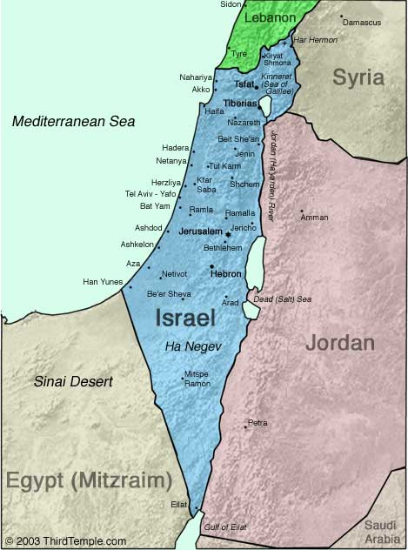
Negev

Slide 103
Genesis 12‒24 Abraham’s Early Journeys
Unconditional promises (Gen. 12:1-3) From Haran to Canaan (Gen. 12:4-5) In Canaan (Gen. 12:6-9) In Egypt (Gen. 12:10-20) Abram and Lot Separate (Gen. 13:1-13) Reaffirmation of Abram’s promises (Gen. 13:14-18) Abram Rescues Lot (14:1-24) Abrahamic Covenant (15:1-21) Hagar & Ishmael (16:1-16) Circumcision (Gen. 17:1-27) | Sodom & Gomorrah (Gen. 18‒19) Abraham & Abimelech (Gen. 20) Isaac’s birth (Gen. 21:1-7) Ishmael’s expulsion (21:8-21) Abraham & Abimelech’s covenant (21:22-34) Abraham sacrifices Isaac (22) Sarah’s death (23) Isaac’s marriage (24)

Slide 104
Genesis 24:61-67 Isaac & Rebekah’s marriage
Journey & arrival (61)
Isaac’s encounter (62-63)
Rebekah’s encounter (64-65)
Servant reports to Isaac (66)
Marriage (67)

Slide 105
Dr. Arnold G. Fruchtenbaum
The Book of Genesis, 387
“Genesis 24:64–65 records Rebekah’s encounter, with verse 64 giving the occasion: And Rebekah lifted up her eyes, and when she saw Isaac, she alighted from the camel. The Hebrew word for alighted is naphal, which normally means “to fall.” The picture being conveyed is that when she saw Isaac, she “fell off” her camel. This did not happen because she knew who he was, because the event happened before she knew who he was. Therefore, when she saw Isaac, something about Isaac’s demeanor or looks or whatever caused her to fall off her camel. If ever there was any implication of love at first sight, this may very well be it. Again, this was before she knew who he was; because only in verse 65 is Isaac identified to her.”

Slide 106
Dr. Arnold G. Fruchtenbaum
The Book of Genesis, 388
“That was in keeping with the custom of those days in that the bride’s face was veiled on the wedding night…Nevertheless, realizing that Isaac is the one she is going to marry, in keeping with the tradition of a bride veiling her face on the wedding night, she veiled herself.”

Slide 107
Genesis 24:61-67 Isaac & Rebekah’s marriage
Journey & arrival (61)
Isaac’s encounter (62-63)
Rebekah’s encounter (64-65)
Servant reports to Isaac (66)
Marriage (67)

Slide 108
Genesis 24:61-67 Isaac & Rebekah’s marriage
Journey & arrival (61)
Isaac’s encounter (62-63)
Rebekah’s encounter (64-65)
Servant reports to Isaac (66)
Marriage (67)

Slide 109
Dr. Arnold G. Fruchtenbaum
The Book of Genesis, 388-89
“This helps to clarify exactly what a biblical marriage is and is not. A biblical marriage is not merely living together; nor is a biblical marriage merely sexual union. It was possible to have sexual union without marriage even within the biblical context. However, there were three elements in a biblical marriage. First, there had to be a commitment to one another; she was committed to Isaac, and Isaac was committed to her. There may not have been any love at this point because, as in the case here, they had only just met. This shows it is possible to make a commitment without the feeling of love per se, but the commitment to love the one you marry.”

Slide 110
Dr. Arnold G. Fruchtenbaum
The Book of Genesis, 388-89
“The second necessary element is the marriage ceremony, a ceremony recognized by society to be a marriage ceremony. With different societies there are different customs, but every society has a ceremony for marriage, such as marrying under a canopy or the custom of exchanging rings and exchanging vows. The third element for a biblical marriage is the first sexual union by which the couple becomes one.”

Slide 111
Conclusion

Slide 112
Genesis 12‒24 Abraham’s Early Journeys
Unconditional promises (Gen. 12:1-3) From Haran to Canaan (Gen. 12:4-5) In Canaan (Gen. 12:6-9) In Egypt (Gen. 12:10-20) Abram and Lot Separate (Gen. 13:1-13) Reaffirmation of Abram’s promises (Gen. 13:14-18) Abram Rescues Lot (14:1-24) Abrahamic Covenant (15:1-21) Hagar & Ishmael (16:1-16) Circumcision (Gen. 17:1-27) | Sodom & Gomorrah (Gen. 18‒19) Abraham & Abimelech (Gen. 20) Isaac’s birth (Gen. 21:1-7) Ishmael’s expulsion (21:8-21) Abraham & Abimelech’s covenant (21:22-34) Abraham sacrifices Isaac (22) Sarah’s death (23) Isaac’s marriage (24)

Slide 113
Genesis 24 Isaac’s Marriage
Abraham’s instructions (1-9)
Servant prays (10-14)
Servant meets Rebekah (15-27)
Servant and Laban (28-49)
Betrothal of Isaac & Rebekah (50-60)
Marriage of Isaac & Rebekah (61-67)

Slide 114
Genesis 12‒25 Abraham’s Early Journeys
Unconditional promises (Gen. 12:1-3) From Haran to Canaan (Gen. 12:4-5) In Canaan (Gen. 12:6-9) In Egypt (Gen. 12:10-20) Abram and Lot Separate (Gen. 13:1-13) Reaffirmation of Abram’s promises (Gen. 13:14-18) Abram Rescues Lot (14:1-24) Abrahamic Covenant (15:1-21) Hagar & Ishmael (16:1-16) Circumcision (Gen. 17:1-27) | Sodom & Gomorrah (Gen. 18‒19) Abraham & Abimelech (Gen. 20) Isaac’s birth (Gen. 21:1-7) Ishmael’s expulsion (21:8-21) Abraham & Abimelech’s covenant (21:22-34) Abraham sacrifices Isaac (22) Sarah’s death (23) Isaac’s marriage (24) Abraham’s death (25)

Slide 115
²⁴ The Lord bless you, and keep you; ²⁵ The Lord make His face shine on you, And be gracious to you; ²⁶ The Lord lift up His countenance on you, And give you peace.
Numbers 6:24–26 (NASB95)

