Slide 1

Ezekiel 36‒39
The Middle East Meltdown 2022
Dr. Andy Woods
Senior Pastor – Sugar Land Bible Church
President – Chafer Theological Seminary

Slide 2
Ezekiel 33‒48
Ezekiel recommissioned (33)
False shepherds removed (34)
Edom destroyed (35)
Israel’s restoration: physical & spiritual (36)
Israel’s restoration illustrated (37)
Means of restoration: Northern invasion (38)
Results of the Northern invasion: conversion (39)
Millennial Temple (40‒46)
Tribal land allotment (47‒48)

Slide 3

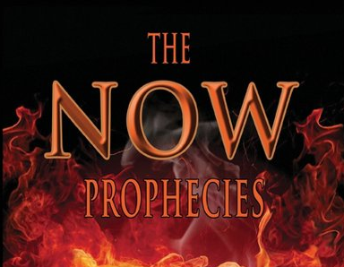
MAIL BAG
The Now Prophecies (Elam, Damascus, Ps. 83)?

Slide 4


Slide 5

Charles Ryrie
Footsteps of the Messiah, Foreword, page XXV
“Eschatology seems to suffer at the hands both of its friends and foes. Those who play it down usually avoid assigning specific meaning to prophetic texts. Those who play it up often assign too much.”

Slide 6
The Now Prophecies?
Elam, Damascus, Ps. 83
  Elam
    Jer. 49:34-39
    Ezek. 32:24-25
  Damascus
    Isa. 17:1-2
    Jer. 49:23-27
  Psalm 83

Slide 7
The Now Prophecies?
Elam, Damascus, Ps. 83
  Elam
    Jer. 49:34-39
    Ezek. 32:24-25
  Damascus
    Isa. 17:1-2
    Jer. 49:23-27
  Psalm 83

Slide 8
The Now Prophecies?
Elam, Damascus, Ps. 83
  Elam
    Jer. 49:34-39
    Ezek. 32:24-25
  Damascus
    Isa. 17:1-2
    Jer. 49:23-27
  Psalm 83

Slide 9
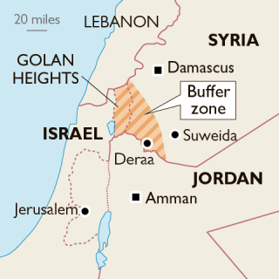

Slide 10
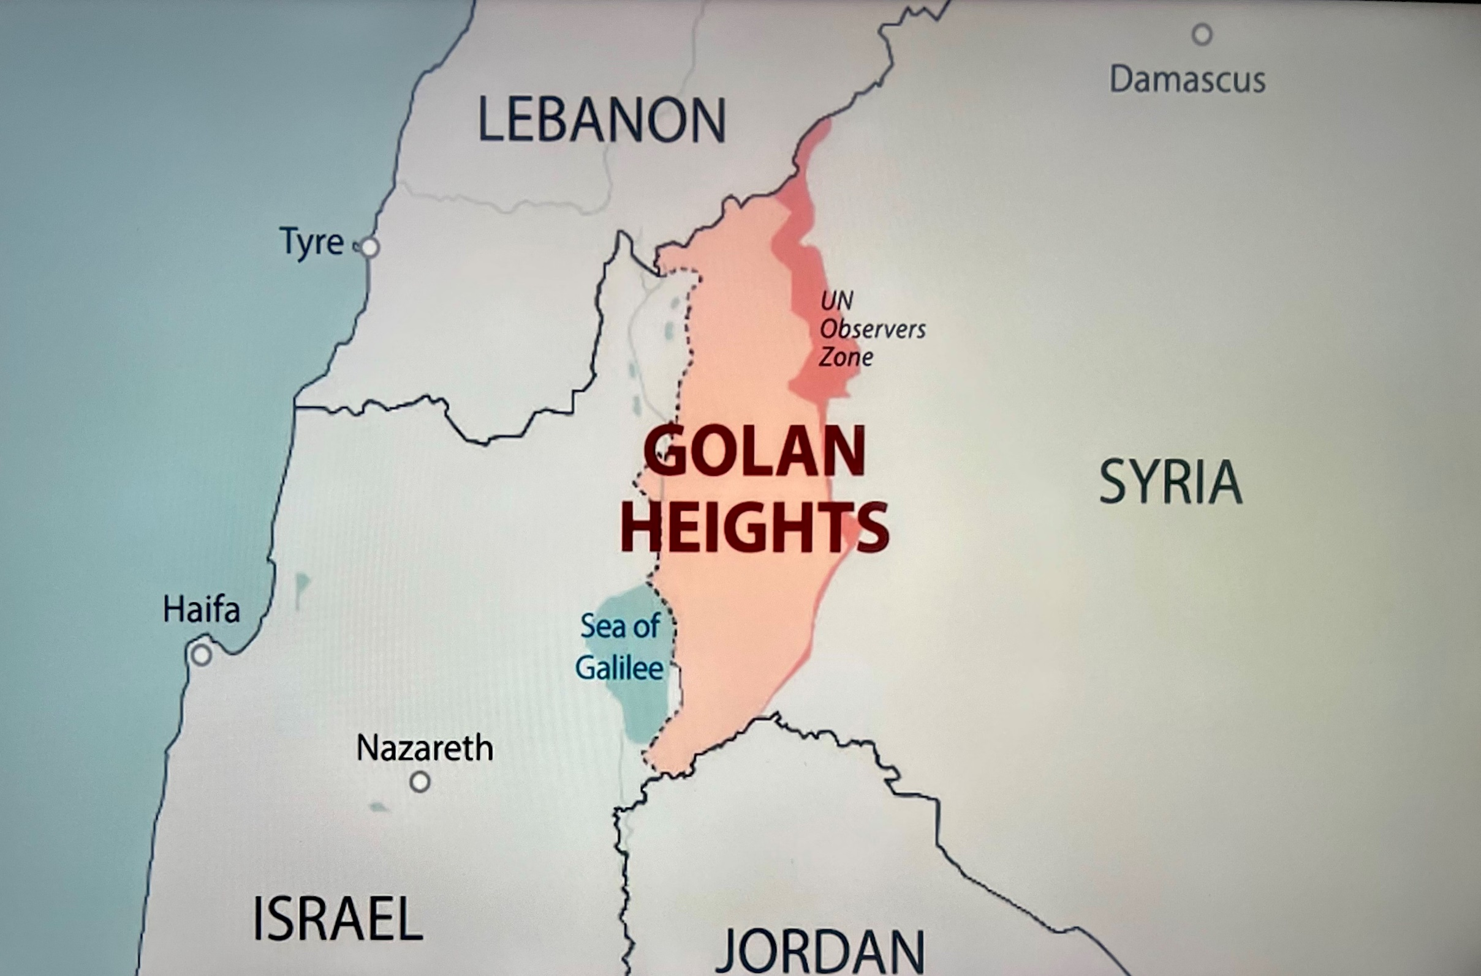

Slide 11


Slide 12


Slide 13
The Now Prophecies?
Elam, Damascus, Ps. 83
  Elam
    Jer. 49:34-39
    Ezek. 32:24-25
  Damascus
    Isa. 17:1-2
    Jer. 49:23-27
  Psalm 83

Slide 14

Isaiah 17:1-2
¹ “The oracle concerning Damascus. ‘Behold, Damascus is about to be removed from being a city And will become a fallen ruin. ² The cities of Aroer are forsaken; They will be for flocks to lie down in, And there will be no one to frighten them.’”

Slide 15
Joel C. Rosenberg
Joel C. Rosenberg, “Notes on the Future of Damascus According to Bible Prophecy,” updated: September 9, 2013, http://www.joelrosenberg.com/files/2013/09/STUDY-Damascus-prophecies-R.pdf
When viewed together, we can say the following about the prophecies concerning Damascus found in Isaiah 17 and Jeremiah 49:
The prophecies refer to a divine judgment by God against the city of Damascus. . . .
The prophecies refer to the utter, catastrophic destruction of Damascus.
Both are eschatological passages, referring to End Times events that have yet to occur.
  Isaiah’s prophecy was given to him in 715 BC, well after the conquering of Damascus in 732 by Tiglath-pileser.
  Likewise, Jeremiah’s ministry occurred between 626 BC and 586 BC, long after Tiglath-pileser conquered Damascus in 732 BC.

Slide 16
Joel C. Rosenberg
Joel C. Rosenberg, “Notes on the Future of Damascus According to Bible Prophecy,” updated: September 9, 2013, http://www.joelrosenberg.com/files/2013/09/STUDY-Damascus-prophecies-R.pdf
Damascus has certainly been attacked, conquered, and burned at various points in history, including Biblical history—but it is clear that the prophecies of Isaiah 17 and Jeremiah 49 have not yet been fulfilled. Damascus is, after all, one of the oldest continuously inhabited cities on the planet.
We cannot be certain when these judgments will happen, and the prophecies will be fulfilled.
They could come to pass before, during or after the War of Gog & Magog (Ezekiel 38–39); before, during, or after the Rapture; or before or during the Tribulation. The texts simply do not say, so we cannot be definitive.
It is possibly that the prophecies could come to pass in the not-too-distant future. But they certainly will come to pass at some point before the Second Coming of Christ (the ‘Day of the Lord.’).

Slide 17
Britt Gillette
Britt Gillette, “Isaiah 17: Destruction of Damascus,” Rapture Ready, November 15, 2011, https://www.raptureready.com/2011/11/15/isaiah-17-destruction-of-damascus-by-britt-gillette/
“In the last days, the Bible tells us of a horrible series of events that will take place in the lands of Israel and Syria. One of these events is the disappearance of Damascus as one of the premiere cities in the world. . . .In the very near future, Damascus will once again play a major role in human events. The prophet Isaiah provides us with God’s commentary on a future conflict between Damascus and Israel, and in so doing, he reveals certain prophecies which have been partially fulfilled in the past. However, the ultimate fulfillment of Isaiah 17 remains in the future. The current existence of Damascus, which will one day cease to be a city, as well as the historical absence of the coalition of nations prophesied to attack Israel and be destroyed by God, is proof that Isaiah 17 prophesies events yet future.”

Slide 18
Joel C. Rosenberg
Joel C. Rosenberg, “Notes on the Future of Damascus According to Bible Prophecy,” updated: September 9, 2013, http://www.joelrosenberg.com/files/2013/09/STUDY-Damascus-prophecies-R.pdf
“In Isaiah 13 to Isaiah 24, the Lord speaks directly to the future of Gentile nations near or surrounding Israel. These prophecies are also End Times matters—that is, they are events that will take place just before the Tribulation, or during the Tribulation, and come to complete fulfillment on or about the Day of the Lord (the literal, physical Second Coming of the Lord Jesus Christ). We know these are End Times prophecies—and not near-term prophecies that would take place during Isaiah’s lifetime or even in the generations that would immediately follow—because of the numerous eschatological references that Isaiah makes.”

Slide 19
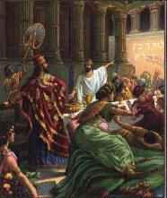
Isaiah’s Oracles Against the Nations (Isa 13–23)
Babylon (13:1-14:23) Assyria (14:24-27) Philistia (14:28-32) Moab (15-16) Damascus and Samaria (17) Ethiopia (18) | Egypt (19-20) Babylon (21:1-10) Edom (21:11-12) Arabia (21:13-17) Jerusalem (22) Tyre (23)

Slide 20
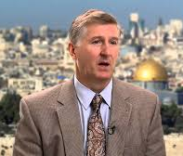
Isaiah 17:1-2?
Mark Hitchcock, Showdown with Iran (Nashville, TN, 2020), Appendix 2.
“Since the context before Isaiah 17:1–2 is a near future fulfillment and the context after it is also a near fulfillment, it would be strange for Isaiah 17:1–2 to have a distant fulfillment in the end times.
Isaiah 16:14 Prophecy of Moab’s Destruction (fulfilled within three years)
Isaiah 17:1–11 Prophecy of the Destruction of Damascus
Isaiah 17:12–14 Prophecy of the Destruction of the Assyrian army in one night (fulfilled within about thirty years in 701 BC).”

Slide 21
Isaiah 17:1-2
¹ “The oracle concerning Damascus. ‘Behold, Damascus is about to be removed from being a city And will become a fallen ruin. ² The cities of Aroer are forsaken; They will be for flocks to lie down in, And there will be no one to frighten them.’”

Slide 22
Warren Wiersbe
Wiersbe, The Wiersbe Bible Commentary: Old Testament, 1166.
“In 17:1–2, he warned Damascus, the capital city of Aram (Syria), that the city would be taken by the enemy. This occurred when the Assyrians conquered Aram in 732 BC. Following their usual custom, the Assyrians deported many of the citizens, which left the land and cities deserted.”

Slide 23
Joel C. Rosenberg
Joel C. Rosenberg, “Notes on the Future of Damascus According to Bible Prophecy,” updated: September 9, 2013, http://www.joelrosenberg.com/files/2013/09/STUDY-Damascus-prophecies-R.pdf
When viewed together, we can say the following about the prophecies concerning Damascus found in Isaiah 17 and Jeremiah 49:
The prophecies refer to a divine judgment by God against the city of Damascus. . . .
The prophecies refer to the utter, catastrophic destruction of Damascus.
Both are eschatological passages, referring to End Times events that have yet to occur.
  Isaiah’s prophecy was given to him in 715 BC, well after the conquering of Damascus in 732 by Tiglath-pileser.
  Likewise, Jeremiah’s ministry occurred between 626 BC and 586 BC, long after Tiglath-pileser conquered Damascus in 732 BC.

Slide 24
Isaiah’s Oracles Against the Nations (Isa 13–23)
Babylon (13:1-14:23) Assyria (14:24-27) Philistia (14:28-32) Moab (15-16) Damascus and Samaria (17) Ethiopia (18) | Egypt (19-20) Babylon (21:1-10) Edom (21:11-12) Arabia (21:13-17) Jerusalem (22) Tyre (23)

Slide 25
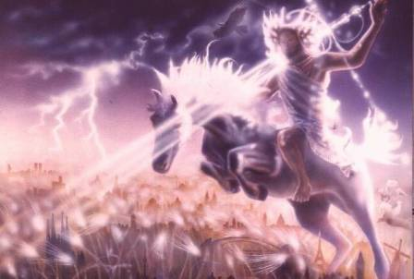
Isaiah 13‒14
Day of the Lord (13:6-9)
Cosmic disturbances (13:10-13)
Global judgment (13:11-12)
Sodom and Gomorrah (13:19)
Complete and final desolation (13:20-22)
Universal peace and rest (14:5-8)
Israel’s regeneration (14:1-4)
Henry Morris, Revelation Record, 348.

Slide 26
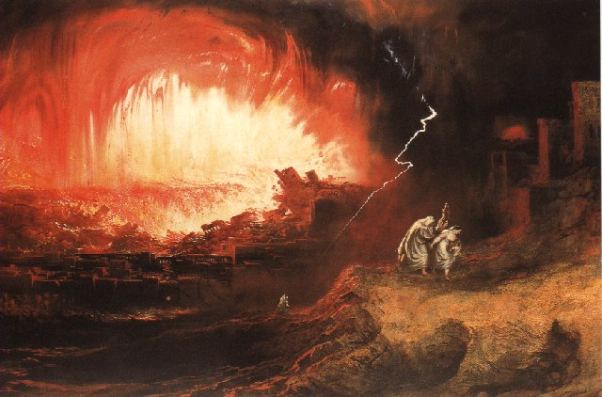
Jeremiah 50‒51
Sudden destruction (51:8)
Complete destruction (50:3, 13, 26, 39-40; 51:29, 43, 62)
No reuse of building materials (51:26)
Believers flee (50:8; 51:6, 45)
Israel’s regeneration (50:2, 4-5, 20; 51:50)
Dyer, "The Identity of Babylon in Revelation 17–18 (Part 2)," 443-49.

Slide 27

Herodotus, Histories, 1:191 (450 B.C.)
“…he (Cyrus) conducted the river by a channel into the lake…and so he made the former course of the river passable by the sinking of the stream. When this had been done, the Persians who had been posted for this very purpose entered by the bed of the river Euphrates into Babylon, the stream having sunk so far that it reached about to the middle of a man’s thigh…those Babylonians who dwelt in the middle did not know that they had been captured…”

Slide 28
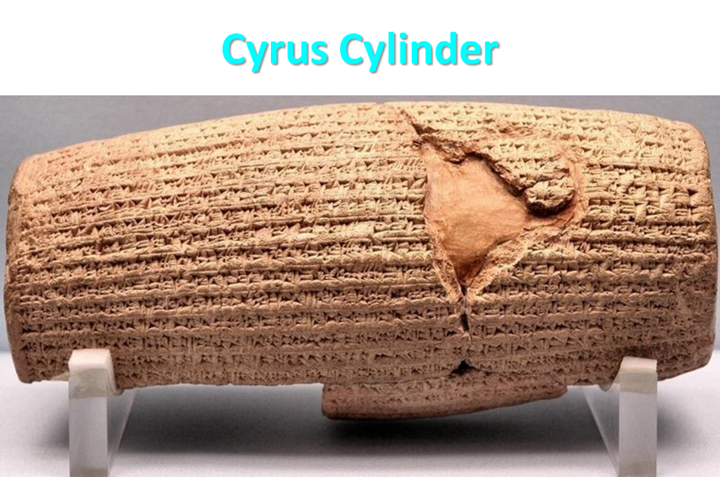

Slide 29

James Pritchard
The Ancient Near East Texts Relating to the Old Testament, 315-16.
Without any battle... sparing Babylon... any calamity....I am Cyrus...king of Babylon....When I entered Babylon...under jubilation and rejoicing...troops walked around Babylon...in peace, I did not allow anybody to terrorize (any place) of the [country of Sumer] and Akkad. I strove for peace in Babylon...and in all his (other) sacred cities....I returned to (these) sacred cities on the other side of the Tigris, the sanctuaries of which have been in ruins for a long time, the images which (used) to live therein and established for them permanent sanctuaries.

Slide 30
James Pritchard
The Ancient Near East Texts Relating to the Old Testament, 315-16.
I (also) gathered all their (former) inhabitants and returned (to them) their habitations. Furthermore, I resettled... unharmed, in their (former) chapels, the places which make them happy. May all the gods whom I have resettled in their sacred cities ask daily Bel and Nebo for a long life for me...all of them I resettled in a peaceful place... ducks and doves,...I endeavoured to fortify/repair their dwelling places . . .

Slide 31

Dr. John Walvoord
The Nations in Prophecy, 63-64
“As far as the historic fulfillment is concerned, it is obvious from both Scripture and history that these verses have not been literally fulfilled. The city of Babylon continued to flourish after the Medes conquered it, and though its glory dwindled, especially after the control of the Medes and the Persians ended in 323 B.C., the city continued in some form or substance until A.D. 1000 and did not experience a sudden termination such as anticipated in this prophecy.”

Slide 32

Psalm 90:2
“Before the mountains were born Or You gave birth to the earth and the world, Even from everlasting (olam) to everlasting (olam), You are God.”

Slide 33
Parallels Between Jeremiah 50-51 & Revelation 17-18
 | Jeremiah | Revelation
Associated with a Golden cup | 51:7a | 17:3-4; 18:6
Dwelling on many waters | 51:13 | 17:1
Intoxicating the nations | 51:7b | 17:2
Same name | 50:1 | 17:5
Persecuting the saints | 51:48 | 17:6; 18:24
Stone sinking into Euphrates | 51:63-64 | 18:21
Sudden destruction | 51:8 | 18:8
Destroyed by fire | 51:30 | 17:16
Final, uninhabitable | 50:39 | 18:21
Deserved | 50:29 | 18:6
God’s people flee | 51:6, 45 | 18:4
Heaven rejoices | 51:48 | 18:20
Dyer, "The Identity of Babylon in Revelation 17–18 (Part 2)," 441-43.

Slide 34
Isaiah’s Oracles Against the Nations (Isa 13–23)
Babylon (13:1-14:23) Assyria (14:24-27) Philistia (14:28-32) Moab (15-16) Damascus and Samaria (17) Ethiopia (18) | Egypt (19-20) Babylon (21:1-10) Edom (21:11-12) Arabia (21:13-17) Jerusalem (22) Tyre (23)

Slide 35
Isaiah 13-14
Day of the Lord (13:6-9)
Cosmic disturbances (13:10-13)
Global judgment (13:11-12)
Sodom and Gomorrah (13:19)
Complete and final desolation (13:20-22)
Universal peace and rest (14:5-8)
Israel’s regeneration (14:1-4)
Henry Morris, Revelation Record, 348.

Slide 36
Jeremiah 50-51
Sudden destruction (51:8)
Complete destruction (50:3, 13, 26, 39-40; 51:29, 43, 62)
No reuse of building materials (51:26)
Believers flee (50:8; 51:6, 45)
Israel’s regeneration (50:2, 4-5, 20; 51:50)
Dyer, "The Identity of Babylon in Revelation 17–18 (Part 2)," 443-49.

Slide 37
Isaiah 17:3-4
³ “The fortified city will disappear from Ephraim, And sovereignty from Damascus And the remnant of Aram; They will be like the glory of the sons of Israel,” Declares the Lord of hosts. ⁴ Now in that day the glory of Jacob will fade, And the fatness of his flesh will become lean.

Slide 38
Ezekiel 37
Vision: Valley of the Dry Bones (1-14)
  Vision (1-10)
  Interpretation (11-14)
Sign: Two Sticks (15-28)
  Sign (15-17)
  Interpretation (18-28)

Slide 39
Israel's Judgments
Division of the kingdom in 931 B.C. (1 Kgs. 12)
Assyrian judgment in 722 B.C. (2 Kgs. 17)
Babylonian captivity in 586 B.C. (2 Kgs. 25)
Rome Diaspora in A.D. 70 (Luke 19:41-44)

Slide 40


Jeremiah 30:7
“Alas! for that day is great, There is none like it; And it is the time of Jacob’s distress (Gen. 32:8; 35:10), But he will be saved from it.”

Slide 41
Topic | Damascus | Babylon
Subject: | Damascus | Babylon
Scripture: | Isaiah 17 | Isaiah 13‒14
Destroyed forever: | No | Yes
Revelation: | No | Yes
Number of oracles: | One | Two
Israel’s restoration: | No | Yes
Time frame: | Past | Future

Slide 42
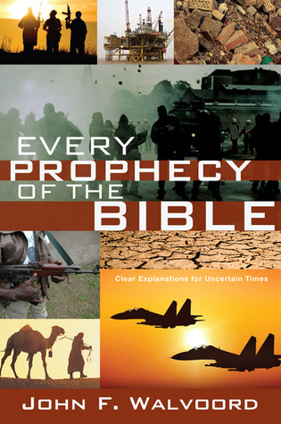

Slide 43
Dr. John F. Walvoord
Every Prophecy of the Bible, 91
“Isaiah 17:1–8. The coming destruction of Damascus, one of the ancient cities of the Middle East, the capital city of Aram, is predicted (vv. 1–2). Damascus was allied with Israel in fighting the Assyrians, but it was to no avail because the Assyrians would triumph. Jacob would be like a person with a fat body that wasted away (v. 4). The destruction of Damascus was fulfilled in history and prophecy. As a result of their discipline by the conquering Assyrians, Israel would turn from their false gods and Asherah poles to the true God (vv. 7–8).”

Slide 44
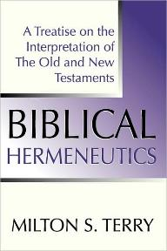
Milton Terry
Biblical Hermeneutics: A Treatise on the Interpretation of the Old and New Testaments (1885; reprint, Grand Rapids: Zondervan, 1947), 205.
Milton Terry explains: “A fundamental principle in grammatico-historical exposition is that the words and sentences can have but one significance in one and the same connection. The moment we neglect this principle we drift upon a sea of uncertainty and conjecture.”

Slide 45
Dr. Bernard Ramm
Bernard Ramm, Protestant Biblical Interpretation, 3rd rev. ed. (Grand Rapids: Baker, 1970), 113.
“But here we must remember the old adage: ‘Interpretation is one, application is many.’ This means that there is only one meaning to a passage of Scripture which is determined by careful study. But a given text or a given passage may speak to a number of problems or issues. Five or six different kinds of sermons could be preached from the text, ‘You must be born again’ (John 3:7). What application the preacher makes of the text is determined by the purposes of the sermon. But the preacher must always distinguish the initial primary meaning of the text from the particular application he makes with it.”

Slide 46

Isaiah 53:3–6
³ He was despised and forsaken of men, A man of sorrows and acquainted with grief; And like one from whom men hide their face He was despised, and we did not esteem Him. ⁴ Surely our griefs He Himself bore, And our sorrows He carried; Yet we ourselves esteemed Him stricken, Smitten of God, and afflicted. ⁵ But He was pierced through for our transgressions, He was crushed for our iniquities; The chastening for our well-being fell upon Him, And by His scourging we are healed. ⁶ All of us like sheep have gone astray, Each of us has turned to his own way; But the Lord has caused the iniquity of us all To fall on Him.

Slide 48
The Now Prophecies?
Elam, Damascus, Ps. 83
  Elam
    Jer. 49:34-39
    Ezek. 32:24-25
  Damascus
    Isa. 17:1-2
    Jer. 49:23-27
  Psalm 83

Slide 49
Joel C. Rosenberg
Joel C. Rosenberg, “Notes on the Future of Damascus According to Bible Prophecy,” updated: September 9, 2013, http://www.joelrosenberg.com/files/2013/09/STUDY-Damascus-prophecies-R.pdf
“When viewed together, we can say the following about the prophecies concerning Damascus found in Isaiah 17 and Jeremiah 49:
The prophecies refer to a divine judgment by God against the city of Damascus. . . .
The prophecies refer to the utter, catastrophic destruction of Damascus.
Both are eschatological passages, referring to End Times events that have yet to occur.
  Isaiah’s prophecy was given to him in 715 BC, well after the conquering of Damascus in 732 by Tiglath-pileser.
  Likewise, Jeremiah’s ministry occurred between 626 BC and 586 BC, long after Tiglath-pileser conquered Damascus in 732 BC.”

Slide 50
Joel C. Rosenberg
Joel C. Rosenberg, “Notes on the Future of Damascus According to Bible Prophecy,” updated: September 9, 2013, http://www.joelrosenberg.com/files/2013/09/STUDY-Damascus-prophecies-R.pdf
“Damascus has certainly been attacked, conquered, and burned at various points in history, including Biblical history—but it is clear that the prophecies of Isaiah 17 and Jeremiah 49 have not yet been fulfilled. Damascus is, after all, one of the oldest continuously inhabited cities on the planet.
We cannot be certain when these judgments will happen, and the prophecies will be fulfilled.
They could come to pass before, during or after the War of Gog & Magog (Ezekiel 38–39); before, during, or after the Rapture; or before or during the Tribulation. The texts simply do not say, so we cannot be definitive.
It is possibly that the prophecies could come to pass in the not-too-distant future. But they certainly will come to pass at some point before the Second Coming of Christ (the ‘Day of the Lord.’).”

Slide 51
Jeremiah 49:27
“I will set fire to the wall of Damascus, And it will devour the fortified towers of Ben-hadad.”

Slide 52
Jeremiah 49:23-27?
Mark Hitchcock, Showdown with Iran (Nashville, TN, 2020), Appendix 2, n. 8.
“Jeremiah 49:23–27 (BKC): God vowed to consume the fortresses of Ben-Hadad. ‘Ben-Hadad’ (lit., ‘son of [the god] Hadad’) was the name of the dynasty that ruled in Damascus in the ninth and eighth centuries b.c.” “Dyer notes the mention of ‘Benhadad,’ which ‘was the name of the dynasty that ruled in Damascus in the ninth and eighth centuries BC.’ The use of that name would be strange if this refers to an end-time event. The towers of Ben-hadad are long gone today.”

Slide 53
Dr. John F. Walvoord
The Nations in Prophecy, 164
“Damascus was one of the most ancient cities of the Middle East and one of the few to have a continuous history down to modern times. First mentioned in Genesis 14:15, it continued to have a relationship to Israel throughout the Old Testament period where there are more than forty references and in the New Testament where it is mentioned fifteen times. The more extended prophecies as found in Isaiah 17:1–14 and Jeremiah 49:23–27 have all been fulfilled as well as the occasional references found in Isaiah 7:8; 8:4; Amos 1:3–5; 3:12; 5:27.”
https://walvoord.com/article/306

Slide 54


Slide 59


Slide 60
The Now Prophecies?
Elam, Damascus, Ps. 83
  Elam
    Jer. 49:34-39
    Ezek. 32:24-25
  Damascus
    Isa. 17:1-2
    Jer. 49:23-27
  Psalm 83

Slide 61
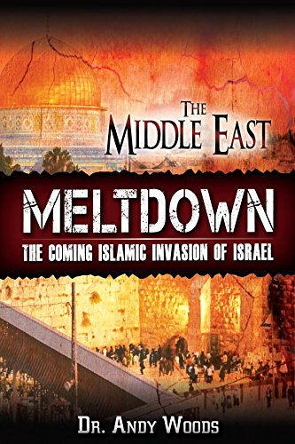

Slide 62
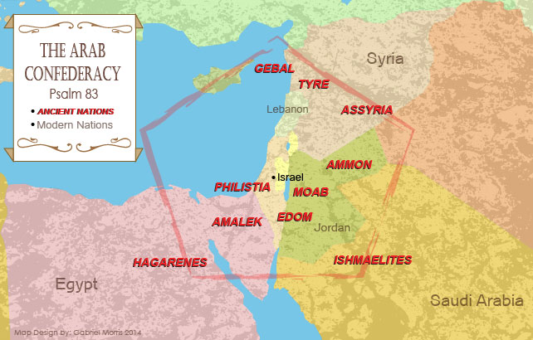

Slide 63
Psalm 83 War?
Five Problems
    Nations listed in Ezek. 38‒39 are not exhaustive
    Psalm 83 is an imprecatory prayer & not prophecy
    No war or battle is found in Psalm 83
    Psalm 83 nations existed in Asaph’s day (950 B.C.)
    Other imprecatory prayers are not prophecies

Slide 64
Psalm 83 War?
Five Problems
    Nations listed in Ezek. 38‒39 are not exhaustive
    Psalm 83 is an imprecatory prayer & not prophecy
    No war or battle is found in Psalm 83
    Psalm 83 nations existed in Asaph’s day (950 B.C.)
    Other imprecatory prayers are not prophecies

Slide 65
Psalm 83 War?
Five Problems
    Nations listed in Ezek. 38‒39 are not exhaustive
    Psalm 83 is an imprecatory prayer & not prophecy
    No war or battle is found in Psalm 83
    Psalm 83 nations existed in Asaph’s day (950 B.C.)
    Other imprecatory prayers are not prophecies

Slide 66

Ezekiel 38:8
“After many days you will be summoned; in the latter years you will come into the land that is restored from the sword, whose inhabitants have been gathered from many nations to the mountains of Israel which had been a continual waste; but its people were brought out from the nations, and they are living securely, all of them.”

Slide 67
Ezekiel 38:16
“and you will come up against My people Israel like a cloud to cover the land. It shall come about in the last days that I will bring you against My land, so that the nations may know Me when I am sanctified through you before their eyes, O Gog.”

Slide 68
Psalm 83 War?
Five Problems
    Nations listed in Ezek. 38‒39 are not exhaustive
    Psalm 83 is an imprecatory prayer & not prophecy
    No war or battle is found in Psalm 83
    Psalm 83 nations existed in Asaph’s day (950 B.C.)
    Other imprecatory prayers are not prophecies

Slide 70
Ezekiel 38‒39
Invasion planned (38:1-13)
Invasion executed (38:14-16)
Invasion defeated (38:17‒39:20)
Invasion’s results (39:21-29)

Slide 71
What?
Divine annihilation of the coalition (38:19-22)
Birds and beasts feast on the carnage (39:4-5, 17-20)
Seven-month burying of the dead (39:11-12, 14-16)
Seven-year burning of weapons (39:9-10)
Israel’s salvation and restoration (39:22, 29)

Slide 72
Psalm 83 War?
Five Problems
    Nations listed in Ezek. 38‒39 are not exhaustive
    Psalm 83 is an imprecatory prayer & not prophecy
    No war or battle is found in Psalm 83
    Psalm 83 nations existed in Asaph’s day (950 B.C.)
    Other imprecatory prayers are not prophecies

Slide 73
Psalm 83 War?
Five Problems
    Nations listed in Ezek. 38‒39 are not exhaustive
    Psalm 83 is an imprecatory prayer & not prophecy
    No war or battle is found in Psalm 83
    Psalm 83 nations existed in Asaph’s day (950 B.C.)
    Other imprecatory prayers are not prophecies

Slide 74

Stanley A. Maughan Quoting Mark Hitchcock
“Selected Expert Perspectives on Ezekiel 38‒39 Related to Current World Events with Resulting Influence on Ministry Practices” (D. Min. diss., Dallas Theological Seminary, 2012), 257.
“Psalm 83 is kind of like Psalm 2, it is just saying that (there is similar language — why did the nations rage against Israel in Psalm 83) look there are people who are always against Israel. Israel is always going to have these enemies, they are always going to be against them and God is going to deal with them someday. We don’t see a separate Psalm 2 war.”

Slide 75
CONCLUSION

Slide 76
MAIL BAG
The Now Prophecies (Elam, Damascus, Ps. 83)?

Slide 77
The Now Prophecies?
Elam, Damascus, Ps. 83
  Elam
    Jer. 49:34-39
    Ezek. 32:24-25
  Damascus
    Isa. 17:1-2
    Jer. 49:23-27
  Psalm 83

