Slide 1
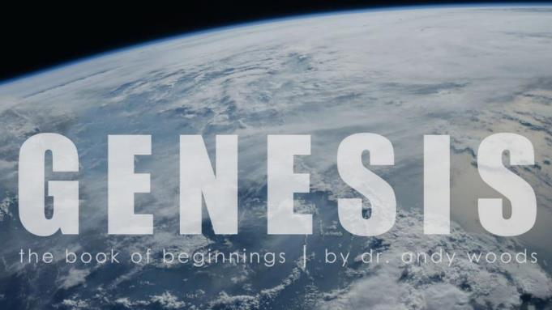
Genesis 12‒50
Israel’s Birth & Preservation

Slide 2
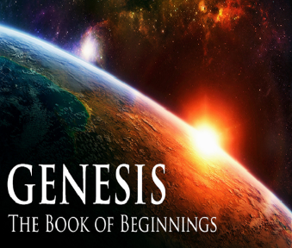
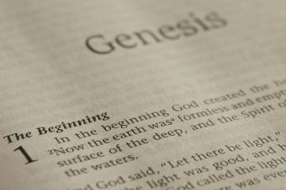
GENESIS STRUCTURE
Beginning of the Human race (Gen. 1‒11)
Beginning of the Hebrew race (Gen. 12‒50)

Slide 3
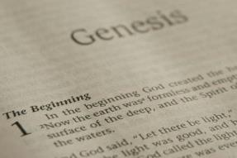
GENESIS STRUCTURE
Genesis 1-11 (four events)
Creation (1-2)
Fall (3-5)
Flood (6-9)
National dispersion (10-11)

Slide 4
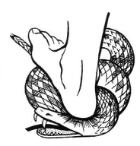
Genesis 3:15
“And I will put enmity Between you and the woman, And between your seed and her seed; He shall bruise you on the head, And you shall bruise him on the heel.”

Slide 5
GENESIS STRUCTURE
Beginning of the Human race (Gen. 1‒11)
Beginning of the Hebrew race (Gen. 12‒50)

Slide 6
GENESIS STRUCTURE
Genesis 12-50 (four people)
Abraham (12:1–25:11)
Isaac (25:12–26:35)
Jacob (27–36)
Joseph (37–50)

Slide 7
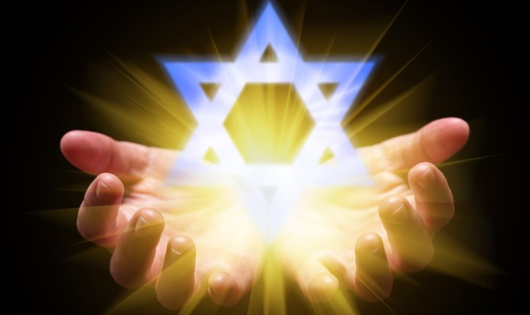
Isaiah 43:1
“But now, thus says the Lord, your Creator, O Jacob, And He who formed you, O Israel, 'Do not fear, for I have redeemed you; I have called you by name; you are Mine!'”

Slide 8
GENESIS STRUCTURE
Genesis 12-50 (four people)
Abraham (12:1–25:11)
Isaac (25:12–26:35)
Jacob (27–36)
Joseph (37–50)

Slide 9
Genesis 12‒21 Abraham’s Early Journeys
Unconditional promises (Gen. 12:1-3) From Haran to Canaan (Gen. 12:4-5) In Canaan (Gen. 12:6-9) In Egypt (Gen. 12:10-20) Abram and Lot Separate (Gen. 13:1-13) Reaffirmation of Abram’s promises (Gen. 13:14-18) Abram Rescues Lot (14:1-24) Abrahamic Covenant (15:1-21) Hagar & Ishmael (16:1-16) | Circumcision (Gen. 17:1-27) Sodom & Gomorrah (Gen. 18‒19) Abraham & Abimelech (Gen. 20) Isaac’s birth (Gen. 21:1-7) Ishmael’s expulsion (21:8-21) Abraham & Abimelech’s covenant (21:22-34) Abraham sacrifices Isaac (22) Sarah’s death (23)

Slide 10
Genesis 22 Abraham Sacrifices Isaac
Abraham tested (1-10)
Substitutionary provision (11-14)
Covenant reaffirmed (15-19)
Rebekah’s lineage (20-24)

Slide 11
Genesis 22 Abraham Sacrifices Isaac
Abraham tested (1-10)
Substitutionary provision (11-14)
Covenant reaffirmed (15-19)
Rebekah’s lineage (20-24)

Slide 12
Genesis 22:1-10 Abraham Tested
Abraham instructed (1-2)
Abraham's obedience (3)
Arrival at destination (4)
Abraham’s instructions (5)
Continuation of journey (6)
Conversation (7-8)
Offering prepared (9-10)

Slide 13
Genesis 22 Abraham Sacrifices Isaac
Abraham tested (1-10)
Substitutionary provision (11-14)
Covenant reaffirmed (15-19)
Rebekah’s lineage (20-24)

Slide 14
Genesis 22:11-14 Substitutionary Provision
Call to Abraham (11)
New instructions (12)
Provision of the ram (13)
Naming (14)

Slide 15
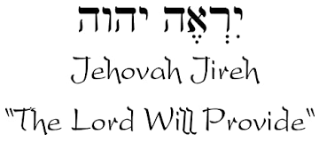

Slide 16
Genesis 22 Abraham Sacrifices Isaac
Abraham tested (1-10)
Substitutionary provision (11-14)
Covenant reaffirmed (15-19)
Rebekah’s lineage (20-24)

Slide 17
Genesis 22:15-19 Covenant Reaffirmed
Call to Abraham (15)
Basis (16)
Provisions (17-18a)
Basis restated (18b)
Return to Beersheba (19)

Slide 18
Genesis 22 Abraham Sacrifices Isaac
Abraham tested (1-10)
Substitutionary provision (11-14)
Covenant reaffirmed (15-19)
Rebekah’s lineage (20-24)

Slide 19
Genesis 22:20-24 Rebekah’s Lineage
Timing (20a)
Nahor’s children (20b-24)
From Milcah (20b-23)
From Reumah (24)

Slide 20
Genesis 22:20-24 Rebekah’s Lineage
Timing (20a)
Nahor’s children (20b-24)
From Milcah (20b-23)
From Reumah (24)

Slide 21
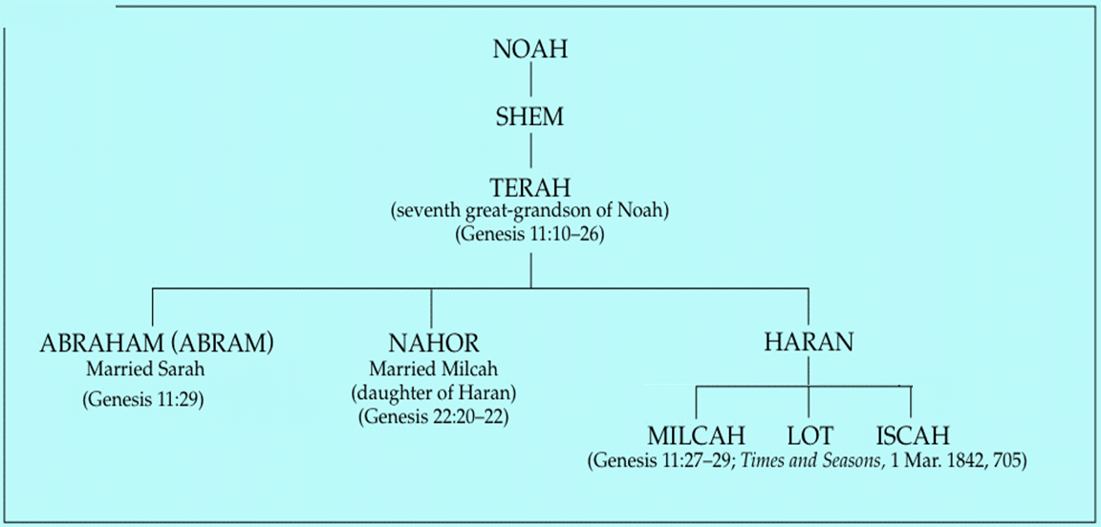

Slide 22
Genesis 22:20-24 Rebekah’s Lineage
Timing (20a)
Nahor’s children (20b-24)
From Milcah (20b-23)
From Reumah (24)

Slide 24
Genesis 22:20-24 Rebekah’s Lineage
Timing (20a)
Nahor’s children (20b-24)
From Milcah (20b-23)
From Reumah (24)

Slide 25
Nahor’s children through Milcah (Gen. 22:20b-23)
1. Uz (Job 1:1) | 5. Hazo
2. Buz | 6. Pildash
3. Aram | 7. Jidlaph
4. Chesed | 8. Bethuel (Gen. 24)

Slide 26
Genesis 22:20-24 Rebekah’s Lineage
Timing (20a)
Nahor’s children (20b-24)
From Milcah (20b-23)
From Reumah (24)

Slide 27
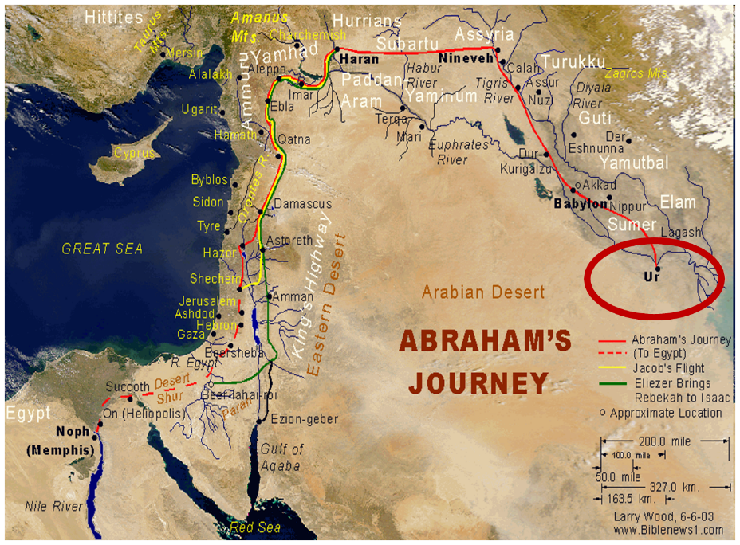

Slide 28
Nahor’s children through Reumah (Gen. 22:20b-23)
1. Tebah
2. Gaham
3. Tahash
4. Maacah

Slide 29
Genesis 12‒21 Abraham’s Early Journeys
Unconditional promises (Gen. 12:1-3) From Haran to Canaan (Gen. 12:4-5) In Canaan (Gen. 12:6-9) In Egypt (Gen. 12:10-20) Abram and Lot Separate (Gen. 13:1-13) Reaffirmation of Abram’s promises (Gen. 13:14-18) Abram Rescues Lot (14:1-24) Abrahamic Covenant (15:1-21) Hagar & Ishmael (16:1-16) | Circumcision (Gen. 17:1-27) Sodom & Gomorrah (Gen. 18‒19) Abraham & Abimelech (Gen. 20) Isaac’s birth (Gen. 21:1-7) Ishmael’s expulsion (21:8-21) Abraham & Abimelech’s covenant (21:22-34) Abraham sacrifices Isaac (22) Sarah’s death (23)

Slide 30
Genesis 23 Sarah’s Death
Sarah’s death (1-2)
Sarah’s burial site (3-18)
Sarah’s burial (19-20)

Slide 31
Genesis 23 Sarah’s Death
Sarah’s death (1-2)
Sarah’s burial site (3-18)
Sarah’s burial (19-20)

Slide 32
Genesis 23:1-2 Sarah’s Death
Sarah’s age (1)
Sarah’s death (2)

Slide 33
Genesis 23:1-2 Sarah’s Death
Sarah’s age (1)
Sarah’s death (2)

Slide 34
Genesis 23:1-2 Sarah’s Death
Sarah’s age (1)
Sarah’s death (2)

Slide 35
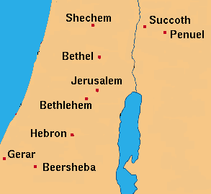

Slide 36
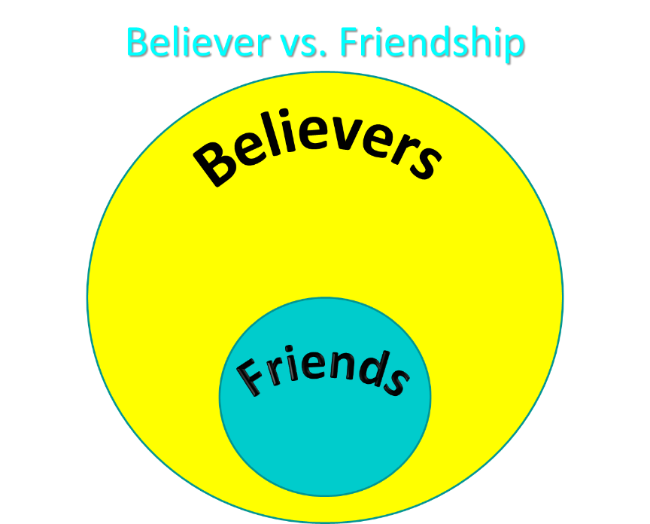

Slide 37
1 Thessalonians 4:13-18
¹³ "But we do not want you to be uninformed, brethren, about those who are asleep, so that you will not grieve as do the rest who have no hope. ¹⁴ For if we believe that Jesus died and rose again, even so God will bring with Him those who have fallen asleep in Jesus. ¹⁵ For this we say to you by the word of the Lord, that we who are alive and remain until the coming of the Lord, will not precede...

Slide 38
1 Thessalonians 4:13-18
. . . those who have fallen asleep. ¹⁶ For the Lord Himself will descend from heaven with a shout, with the voice of the archangel and with the trumpet of God, and the dead in Christ will rise first. ¹⁷ Then we who are alive and remain will be caught up together with them in the clouds to meet the Lord in the air, and so we shall always be with the Lord. ¹⁸ Therefore comfort one another with these words."

Slide 39
Genesis 23 Sarah’s Death
Sarah’s death (1-2)
Sarah’s burial site (3-18)
Sarah’s burial (19-20)

Slide 40
Genesis 23:3-18 Sarah’s Burial Site
Abraham’s request (3-4)
Hittites’ response (5-6)
Abraham’s offer (7-9)
Ephron’s counter-offer (10-11)
Abraham’s counter-offer (12-13)
Ephron’s asking price (14-15)
Abraham accepts Ephron’s price (16)
Sealing of the purchase 17-18)

Slide 41
Genesis 23:3-18 Sarah’s Burial Site
Abraham’s request (3-4)
Hittites’ response (5-6)
Abraham’s offer (7-9)
Ephron’s counter-offer (10-11)
Abraham’s counter-offer (12-13)
Ephron’s asking price (14-15)
Abraham accepts Ephron’s price (16)
Sealing of the purchase 17-18)

Slide 42
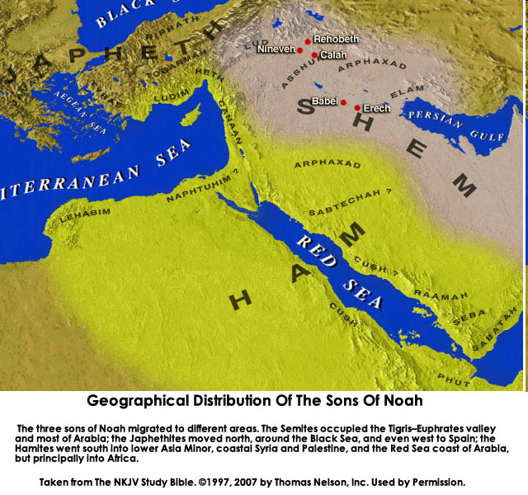

Slide 43
Genesis 23:3-18 Sarah’s Burial Site
Abraham’s request (3-4)
Hittites’ response (5-6)
Abraham’s offer (7-9)
Ephron’s counter-offer (10-11)
Abraham’s counter-offer (12-13)
Ephron’s asking price (14-15)
Abraham accepts Ephron’s price (16)
Sealing of the purchase 17-18)

Slide 44
8 New Promises Genesis 12:1-3
Land (Gen. 12:1b)
Great nation (Gen. 12:2a)
Personal blessing (Gen. 12:2b)
Great name (Gen. 12:2c)
Blessing to others (Gen. 12:2d)
Blessing to blessers (Gen. 12:3a)
Cursing to cursers (Gen. 12:3b)
Blessing to the world (Gen. 12:3c)

Slide 45
Genesis 23:3-18 Sarah’s Burial Site
Abraham’s request (3-4)
Hittites’ response (5-6)
Abraham’s offer (7-9)
Ephron’s counter-offer (10-11)
Abraham’s counter-offer (12-13)
Ephron’s asking price (14-15)
Abraham accepts Ephron’s price (16)
Sealing of the purchase 17-18)

Slide 46
Genesis 23:3-18 Sarah’s Burial Site
Abraham’s request (3-4)
Hittites’ response (5-6)
Abraham’s offer (7-9)
Ephron’s counter-offer (10-11)
Abraham’s counter-offer (12-13)
Ephron’s asking price (14-15)
Abraham accepts Ephron’s price (16)
Sealing of the purchase 17-18)

Slide 47
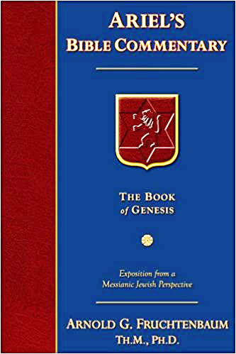
Dr. Arnold G. Fruchtenbaum
The Book of Genesis, 368
“Verse 11 gives the offer: Nay, my lord, hear me: the field give I you, and the cave that is therein, I give it [to] you; in the presence of the children of my people give I it to you: bury your dead. Here again is what appears to be an offer of a free place to bury, but the free offer was not intended to be taken seriously because that was just the way things were done in the ancient Middle East. Abraham understood that he was not to accept the offer as given.”

Slide 48
Genesis 23:3-18 Sarah’s Burial Site
Abraham’s request (3-4)
Hittites’ response (5-6)
Abraham’s offer (7-9)
Ephron’s counter-offer (10-11)
Abraham’s counter-offer (12-13)
Ephron’s asking price (14-15)
Abraham accepts Ephron’s price (16)
Sealing of the purchase 17-18)

Slide 49
Genesis 23:3-18 Sarah’s Burial Site
Abraham’s request (3-4)
Hittites’ response (5-6)
Abraham’s offer (7-9)
Ephron’s counter-offer (10-11)
Abraham’s counter-offer (12-13)
Ephron’s asking price (14-15)
Abraham accepts Ephron’s price (16)
Sealing of the purchase 17-18)

Slide 50
Genesis 23:3-18 Sarah’s Burial Site
Abraham’s request (3-4)
Hittites’ response (5-6)
Abraham’s offer (7-9)
Ephron’s counter-offer (10-11)
Abraham’s counter-offer (12-13)
Ephron’s asking price (14-15)
Abraham accepts Ephron’s price (16)
Sealing of the purchase 17-18)

Slide 51
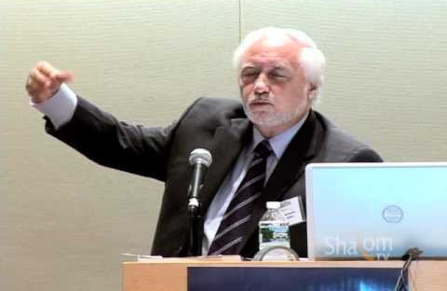
Jacques Paul Gauthier, “Sovereignty Over The Old City of Jerusalem: A Study of the Historical, Religious, Political and Legal Aspects of the Question of the Old City,”
PhD Thesis, University of Geneva International Law School, 2007).

Slide 52
Genesis 23:3-18 Sarah’s Burial Site
Abraham’s request (3-4)
Hittites’ response (5-6)
Abraham’s offer (7-9)
Ephron’s counter-offer (10-11)
Abraham’s counter-offer (12-13)
Ephron’s asking price (14-15)
Abraham accepts Ephron’s price (16)
Sealing of the purchase 17-18)

Slide 53
Dr. Arnold G. Fruchtenbaum
The Book of Genesis, 369-70
“The reason was that Hittite law included feudal responsibilities for landowners, in that service to be rendered to kings by landowners fell only if one purchased a complete lot but not on someone who purchased only part of the lot. Therefore, if Abraham purchased only the cave, then Ephron would still have feudal responsibilities to the king regarding it. The Hittite Law Code required the owner of a complete unit of the land to perform the king’s ilku or feudal services The reason Ephron did not want to sell only the cave is . . . ”

Slide 54
Dr. Arnold G. Fruchtenbaum
The Book of Genesis, 369-70
“…is that he would still be obligated to render feudal services. Therefore, by getting rid of all of it, the whole unit, that would free him from paying feudal responsibilities to the king for that section. As part of the deed, he also mentioned the trees, and the mention of trees is characteristic of Hittite business documents. It all fits well into the second millennium b.c.”

Slide 55
Genesis 23 Sarah’s Death
Sarah’s death (1-2)
Sarah’s burial site (3-18)
Sarah’s burial (19-20)

Slide 56
Genesis 23:19-20 Sarah’s Burial
The timing (19a)
The act (19b)
Abraham’s only land possession (20)

Slide 57
Genesis 23:19-20 Sarah’s Burial
The timing (19a)
The act (19b)
Abraham’s only land possession (20)

Slide 58
Genesis 23:19-20 Sarah’s Burial
The timing (19a)
The act (19b)
Abraham’s only land possession (20)

Slide 59
Genesis 23:19-20 Sarah’s Burial
The timing (19a)
The act (19b)
Abraham’s only land possession (20)

Slide 60
Charles Ryrie Ryrie Study Bible, page 30
Genesis 22:19: “Not only Sarah, but Abraham, Isaac, Rebekah, Leah, and Jacob were buried there (see 25:9; 49:31; 50:13).”﻿

Slide 63
Conclusion

Slide 64
Genesis 12‒21 Abraham’s Early Journeys
Unconditional promises (Gen. 12:1-3) From Haran to Canaan (Gen. 12:4-5) In Canaan (Gen. 12:6-9) In Egypt (Gen. 12:10-20) Abram and Lot Separate (Gen. 13:1-13) Reaffirmation of Abram’s promises (Gen. 13:14-18) Abram Rescues Lot (14:1-24) Abrahamic Covenant (15:1-21) Hagar & Ishmael (16:1-16) | Circumcision (Gen. 17:1-27) Sodom & Gomorrah (Gen. 18‒19) Abraham & Abimelech (Gen. 20) Isaac’s birth (Gen. 21:1-7) Ishmael’s expulsion (21:8-21) Abraham & Abimelech’s covenant (21:22-34) Abraham sacrifices Isaac (22) Sarah’s death (23)

Slide 65
Genesis 23 Sarah’s Death
Sarah’s death (1-2)
Sarah’s burial site (3-18)
Sarah’s burial (19-20)

Slide 66
Genesis 12‒21 Abraham’s Early Journeys
Unconditional promises (Gen. 12:1-3) From Haran to Canaan (Gen. 12:4-5) In Canaan (Gen. 12:6-9) In Egypt (Gen. 12:10-20) Abram and Lot Separate (Gen. 13:1-13) Reaffirmation of Abram’s promises (Gen. 13:14-18) Abram Rescues Lot (14:1-24) Abrahamic Covenant (15:1-21) Hagar & Ishmael (16:1-16) | Circumcision (Gen. 17:1-27) Sodom & Gomorrah (Gen. 18‒19) Abraham & Abimelech (Gen. 20) Isaac’s birth (Gen. 21:1-7) Ishmael’s expulsion (21:8-21) Abraham & Abimelech’s covenant (21:22-34) Abraham sacrifices Isaac (22) Sarah’s death (23) Isaac’s marriage (24)

Slide 67
²⁴ The Lord bless you, and keep you; ²⁵ The Lord make His face shine on you, And be gracious to you; ²⁶ The Lord lift up His countenance on you, And give you peace.
Numbers 6:24–26 (NASB95)

