Slide 1


Genesis 12‒50
Israel’s Birth & Preservation

Slide 2


GENESIS STRUCTURE
  Beginning of the Human race (Gen. 1‒11)
  Beginning of the Hebrew race (Gen. 12‒50)

Slide 3

GENESIS STRUCTURE
  Genesis 1-11 (four events)
    Creation (1-2)
    Fall (3-5)
    Flood (6-9)
    National dispersion (10-11)

Slide 4


Genesis 3:15
“And I will put enmity Between you and the woman, And between your seed and her seed; He shall bruise you on the head, And you shall bruise him on the heel.”

Slide 5
GENESIS STRUCTURE
  Beginning of the Human race (Gen. 1‒11)
  Beginning of the Hebrew race (Gen. 12‒50)

Slide 6

GENESIS STRUCTURE
  Genesis 12-50 (four people)
    Abraham (12:1–25:11)
    Isaac (25:12–26:35)
    Jacob (27–36)
    Joseph (37–50)

Slide 7


Isaiah 43:1
“But now, thus says the Lord, your Creator, O Jacob, And He who formed you, O Israel, 'Do not fear, for I have redeemed you; I have called you by name; you are Mine!'”

Slide 8
GENESIS STRUCTURE
  Genesis 12-50 (four people)
    Abraham (12:1–25:11)
    Isaac (25:12–26:35)
    Jacob (27–36)
    Joseph (37–50)

Slide 9
Genesis 12‒21
Abraham’s Early Journeys
Unconditional promises (Gen. 12:1-3) From Haran to Canaan (Gen. 12:4-5) In Canaan (Gen. 12:6-9) In Egypt (Gen. 12:10-20) Abram and Lot Separate (Gen. 13:1-13) Reaffirmation of Abram’s promises (Gen. 13:14-18) Abram Rescues Lot (14:1-24) Abrahamic Covenant (15:1-21) Hagar & Ishmael (16:1-16) | Circumcision (Gen. 17:1-27) Sodom & Gomorrah (Gen. 18‒19) Abraham & Abimelech (Gen. 20) Isaac’s birth (Gen. 21:1-7) Ishmael’s expulsion (21:8-21) Abraham & Abimelech’s covenant (21:22-34) Abraham sacrifices Isaac (22) Sarah’s death (23)

Slide 10
Genesis 22
Abraham Sacrifices Isaac
    Abraham tested (1-10)
    Substitutionary provision (11-14)
    Covenant reaffirmed (15-19)
    Rebekah’s lineage (20-24)

Slide 11
Genesis 22
Abraham Sacrifices Isaac
    Abraham tested (1-10)
    Substitutionary provision (11-14)
    Covenant reaffirmed (15-19)
    Rebekah’s lineage (20-24)

Slide 12
Genesis 22:1-10
Abraham Tested
    Abraham instructed (1-2)
    Abraham's obedience (3)
    Arrival at destination (4)
    Abraham’s instructions (5)
    Continuation of journey (6)
    Conversation (7-8)
    Offering prepared (9-10)

Slide 13
Genesis 22
Abraham Sacrifices Isaac
    Abraham tested (1-10)
    Substitutionary provision (11-14)
    Covenant reaffirmed (15-19)
    Rebekah’s lineage (20-24)

Slide 14
Genesis 22:11-14
Substitutionary Provision
    Call to Abraham (11)
    New instructions (12)
    Provision of the ram (13)
    Naming (14)

Slide 15
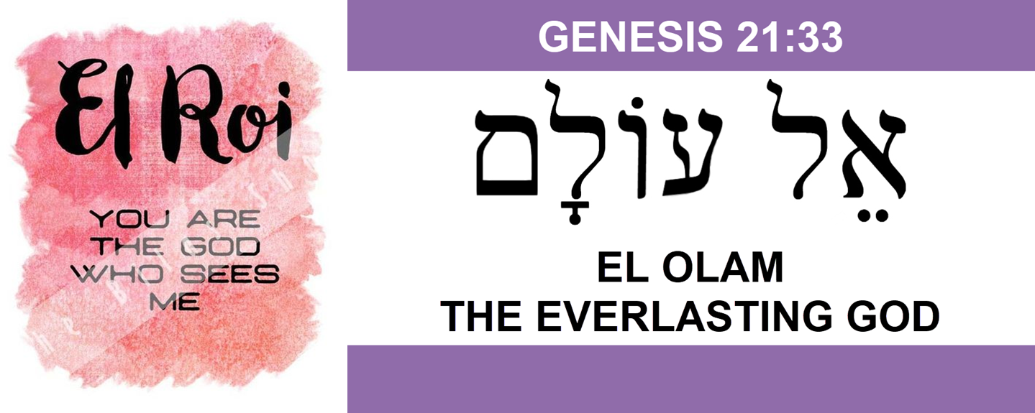

Slide 17
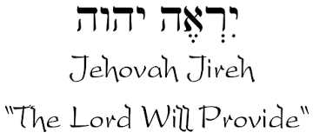

Slide 18
Genesis 22
Abraham Sacrifices Isaac
    Abraham tested (1-10)
    Substitutionary provision (11-14)
    Covenant reaffirmed (15-19)
    Rebekah’s lineage (20-24)

Slide 19
Genesis 22:15-19
Covenant Reaffirmed
    Call to Abraham (15)
    Basis (16)
    Provisions (17-18a)
    Basis restated (18b)
    Return to Beersheba (19)

Slide 20
Genesis 22:15-19
Covenant Reaffirmed
    Call to Abraham (15)
    Basis (16)
    Provisions (17-18a)
    Basis restated (18b)
    Return to Beersheba (19)

Slide 21
VI. 8 New Promises
Genesis 12:1-3
    Land (Gen. 12:1b)
    Great nation (Gen. 12:2a)
    Personal blessing (Gen. 12:2b)
    Great name (Gen. 12:2c)
    Blessing to others (Gen. 12:2d)
    Blessing to blessers (Gen. 12:3a)
    Cursing to cursers (Gen. 12:3b)
    Blessing to the world (Gen. 12:3c)

Slide 22


Dr. Arnold G. Fruchtenbaum
The Book of Genesis, 240
“This is the first of seven times that Abraham receives a direct revelation from God. In 12:1–3 is God’s initial call to Abram outside the Land of Canaan; in 12:7 is the first appearance to Abraham in the Land; in 13:14–17, Abraham encounters God after the separation of Lot; in 15:1–21, God signs and seals the Abrahamic Covenant; in 17:1–21, Abraham receives the token of the covenant; in 18:1–33, God speaks to him in conjunction with the destruction of Sodom; and in 22:1–2 and 22:11–18, God directs Abraham to offer Isaac.”

Slide 23
Genesis 22:15-19
Covenant Reaffirmed
    Call to Abraham (15)
    Basis (16)
    Provisions (17-18a)
    Basis restated (18b)
    Return to Beersheba (19)

Slide 24

Evidence of Abrahamic Covenant’s Unconditional Nature
ANE covenant ratification ceremony (Gen 15)
Lack of stated conditions for Israel’s obedience (Gen 15)
Covenant's eternality (Gen 17:7, 13, 19; Ps. 90:2)
Covenant's immutability (Heb 6:13-18; Mal. 3:6)
Trans-generational reaffirmation despite perpetual national disobedience (Jer 31:35-37)
Walvoord, The Millennial Kingdom, 149-52

Slide 25

J. Dwight Pentecost
Thy Kingdom Come, Page 66-67
“As before, God responded to the obedience of faith. He said to Abraham, ‘I swear by Myself, declares the Lord, that because you have done this and have not withheld your son, your only son, I will surely bless you and make your descendants as numerous as the stars in the sky and as the sand on the seashore. Your descendants will take possession of the cities of their enemies, and through your offspring all nations on earth will be blessed, because you have obeyed Me’ (Gen. 22:16–18).”

Slide 26
J. Dwight Pentecost
Thy Kingdom Come, Page 66-67
“Here again God promised Abraham that he would become the recipient of the covenant blessings. The covenant was not based on obedience, nor was the perpetuity of the covenant based on obedience—but rather the reception of covenant blessings was conditioned on obedience. Remember, an unconditional covenant may have conditional blessings. Thus, on the basis of faith that had produced obedience, Abraham would experience the blessings of the promises and the covenant.”

Slide 27

Charles Ryrie
Basic Theology, page 529
Genesis 22:16-18; 26:5: “Since the covenant had been firmly established several times before these events, it would be incongruous to view these passages as conditions imposed after the clear statements of unconditionality. Rather, in these instances God acknowledged the worthiness of Abraham to remind him and his descendants that faith and obedience were necessary for participation in the benefits of the unconditional promises of the covenant.”﻿

Slide 28


Slide 29
Six Parts of a Suzerain-Vassal Treaty in Deuteronomy
Preamble (1:1-5)
Prologue (1:6–4:40)
Covenant obligations (5–26)
Storage and reading instructions (27:2-3; 31:9, 24, 26)
Witnesses (32:1)
Blessings and curses (28)

Slide 30
Genesis 22:15-19
Covenant Reaffirmed
    Call to Abraham (15)
    Basis (16)
    Provisions (17-18a)
    Basis restated (18b)
    Return to Beersheba (19)

Slide 31
VI. 8 New Promises
Genesis 12:1-3
    Land (Gen. 12:1b)
    Great nation (Gen. 12:2a)
    Personal blessing (Gen. 12:2b)
    Great name (Gen. 12:2c)
    Blessing to others (Gen. 12:2d)
    Blessing to blessers (Gen. 12:3a)
    Cursing to cursers (Gen. 12:3b)
    Blessing to the world (Gen. 12:3c)

Slide 32
Charles Ryrie
The Ryrie Study Bible, page 28
Genesis 22:16-18 (RSB:NASB1995U): Genesis 22:16-18. “your seed shall possess the gate of their enemies. This anticipates the conquest of Canaan under Joshua.”

Slide 33
New Promises
Genesis 12:1-3
    Land (Gen. 12:1b)
    Great nation (Gen. 12:2a)
    Personal blessing (Gen. 12:2b)
    Great name (Gen. 12:2c)
    Blessing to others (Gen. 12:2d)
    Blessing to blessers (Gen. 12:3a)
    Cursing to cursers (Gen. 12:3b)
    Blessing to the world (Gen. 12:3c)

Slide 34


Genesis 12:3
“And I will bless those who bless you, And the one who curses you I will curse. And in you all the families of the earth will be blessed.”

Slide 35
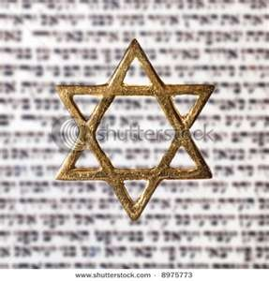
Israel’s Three Blessings to the World
(Gen 12:3b)
Scripture (Rom 3:2)
Savior (John 4:22)
Kingdom (Isa 2:2-3)

Slide 36
Genesis 22:15-19
Covenant Reaffirmed
    Call to Abraham (15)
    Basis (16)
    Provisions (17-18a)
    Basis restated (18b)
    Return to Beersheba (19)

Slide 37
J. Dwight Pentecost
Thy Kingdom Come, Page 66-67
“As before, God responded to the obedience of faith. He said to Abraham, ‘I swear by Myself, declares the Lord, that because you have done this and have not withheld your son, your only son, I will surely bless you and make your descendants as numerous as the stars in the sky and as the sand on the seashore. Your descendants will take possession of the cities of their enemies, and through your offspring all nations on earth will be blessed, because you have obeyed Me’ (Gen. 22:16–18).”

Slide 38
J. Dwight Pentecost
Thy Kingdom Come, Page 66-67
“Here again God promised Abraham that he would become the recipient of the covenant blessings. The covenant was not based on obedience, nor was the perpetuity of the covenant based on obedience—but rather the reception of covenant blessings was conditioned on obedience. Remember, an unconditional covenant may have conditional blessings. Thus, on the basis of faith that had produced obedience, Abraham would experience the blessings of the promises and the covenant.”

Slide 39
Charles Ryrie
Basic Theology, page 529
Genesis 22:16-18; 26:5: “Since the covenant had been firmly established several times before these events, it would be incongruous to view these passages as conditions imposed after the clear statements of unconditionality. Rather, in these instances God acknowledged the worthiness of Abraham to remind him and his descendants that faith and obedience were necessary for participation in the benefits of the unconditional promises of the covenant.”﻿

Slide 40
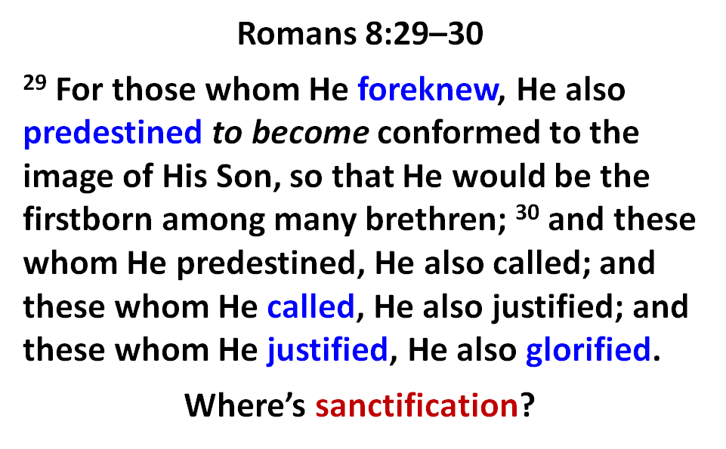

Slide 41
Genesis 22:15-19
Covenant Reaffirmed
    Call to Abraham (15)
    Basis (16)
    Provisions (17-18a)
    Basis restated (18b)
    Return to Beersheba (19)

Slide 42
Covenant’s Results
Genesis 21:33-34
    Abraham plants (33a)
    Abraham worships (33b)
    Abraham sojourns (34)

Slide 43
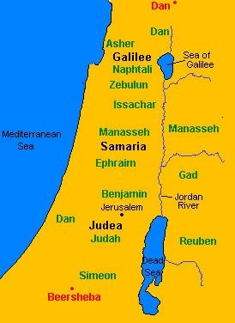

Slide 44
Genesis 22
Abraham Sacrifices Isaac
    Abraham tested (1-10)
    Substitutionary provision (11-14)
    Covenant reaffirmed (15-19)
    Rebekah’s lineage (20-24)

Slide 45
Genesis 22:20-24
Rebekah’s Lineage
    Timing (20a)
    Nahor’s children (20b-24)
      From Milcah (20b-23)
      From Reumah (24)

Slide 46
Genesis 22:20-24
Rebekah’s Lineage
    Timing (20a)
    Nahor’s children (20b-24)
      From Milcah (20b-23)
      From Reumah (24)

Slide 47
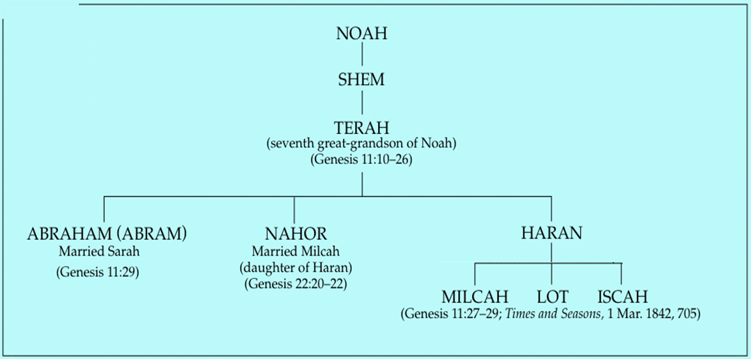

Slide 48
Genesis 22:20-24
Rebekah’s Lineage
    Timing (20a)
    Nahor’s children (20b-24)
      From Milcah (20b-23)
      From Reumah (24)

Slide 50
Genesis 22:20-24
Rebekah’s Lineage
    Timing (20a)
    Nahor’s children (20b-24)
      From Milcah (20b-23)
      From Reumah (24)

Slide 51

Nahor’s children through Milcah (Gen. 22:20b-23)
1. Uz (Job 1:1) | 5. Hazo
2. Buz | 6. Pildash
3. Aram | 7. Jidlaph
4. Chesed | 8. Bethuel (Gen. 24)

Slide 52
Genesis 22:20-24
Rebekah’s Lineage
    Timing (20a)
    Nahor’s children (20b-24)
      From Milcah (20b-23)
      From Reumah (24)

Slide 53


Slide 54
Nahor’s children through Reumah (Gen. 22:20b-23)
1. Tebah
2. Gaham
3. Tahash
4. Maacah

Slide 55
Conclusion

Slide 56
Genesis 12‒21
Abraham’s Early Journeys
Unconditional promises (Gen. 12:1-3) From Haran to Canaan (Gen. 12:4-5) In Canaan (Gen. 12:6-9) In Egypt (Gen. 12:10-20) Abram and Lot Separate (Gen. 13:1-13) Reaffirmation of Abram’s promises (Gen. 13:14-18) Abram Rescues Lot (14:1-24) Abrahamic Covenant (15:1-21) Hagar & Ishmael (16:1-16) | Circumcision (Gen. 17:1-27) Sodom & Gomorrah (Gen. 18‒19) Abraham & Abimelech (Gen. 20) Isaac’s birth (Gen. 21:1-7) Ishmael’s expulsion (21:8-21) Abraham & Abimelech’s covenant (21:22-34) Abraham sacrifices Isaac (22) Sarah’s death (23)

Slide 57
Genesis 22
Abraham Sacrifices Isaac
    Abraham tested (1-10)
    Substitutionary provision (11-14)
    Covenant reaffirmed (15-19)
    Rebekah’s lineage (20-24)

Slide 58
Genesis 12‒21
Abraham’s Early Journeys
Unconditional promises (Gen. 12:1-3) From Haran to Canaan (Gen. 12:4-5) In Canaan (Gen. 12:6-9) In Egypt (Gen. 12:10-20) Abram and Lot Separate (Gen. 13:1-13) Reaffirmation of Abram’s promises (Gen. 13:14-18) Abram Rescues Lot (14:1-24) Abrahamic Covenant (15:1-21) Hagar & Ishmael (16:1-16) | Circumcision (Gen. 17:1-27) Sodom & Gomorrah (Gen. 18‒19) Abraham & Abimelech (Gen. 20) Isaac’s birth (Gen. 21:1-7) Ishmael’s expulsion (21:8-21) Abraham & Abimelech’s covenant (21:22-34) Abraham sacrifices Isaac (22) Sarah’s death (23)

Slide 59

²⁴ The Lord bless you, and keep you; ²⁵ The Lord make His face shine on you, And be gracious to you; ²⁶ The Lord lift up His countenance on you, And give you peace.
Numbers 6:24–26 (NASB95)

