Slide 1
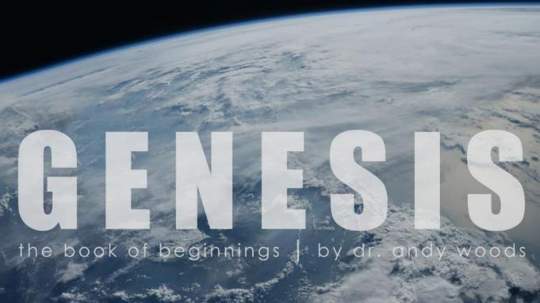
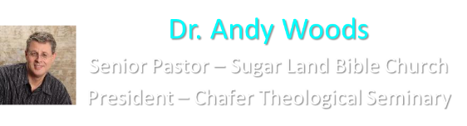
Genesis 12‒50
Israel’s Birth & Preservation

Slide 2
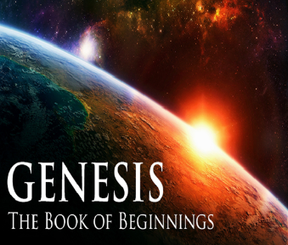
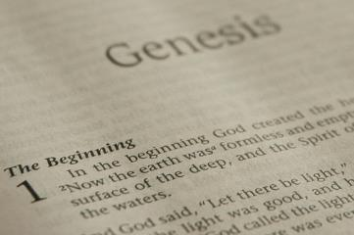
GENESIS STRUCTURE
  Beginning of the Human race (Gen. 1‒11)
  Beginning of the Hebrew race (Gen. 12‒50)

Slide 3
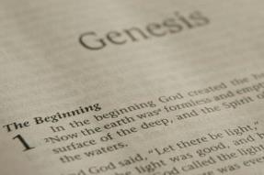
GENESIS STRUCTURE
  Genesis 1-11 (four events)
    Creation (1-2)
    Fall (3-5)
    Flood (6-9)
    National dispersion (10-11)

Slide 4
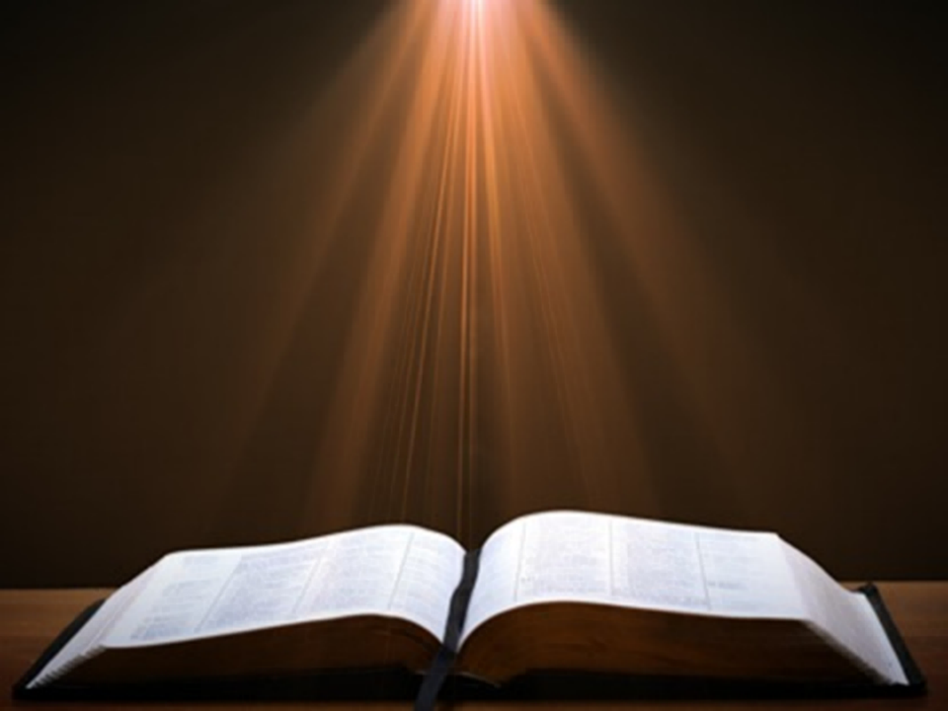
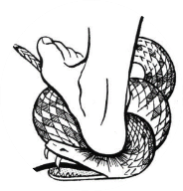
Genesis 3:15
“And I will put enmity Between you and the woman, And between your seed and her seed; He shall bruise you on the head, And you shall bruise him on the heel.”

Slide 5
GENESIS STRUCTURE
  Beginning of the Human race (Gen. 1‒11)
  Beginning of the Hebrew race (Gen. 12‒50)

Slide 6

GENESIS STRUCTURE
  Genesis 12-50 (four people)
    Abraham (12:1–25:11)
    Isaac (25:12–26:35)
    Jacob (27–36)
    Joseph (37–50)

Slide 7

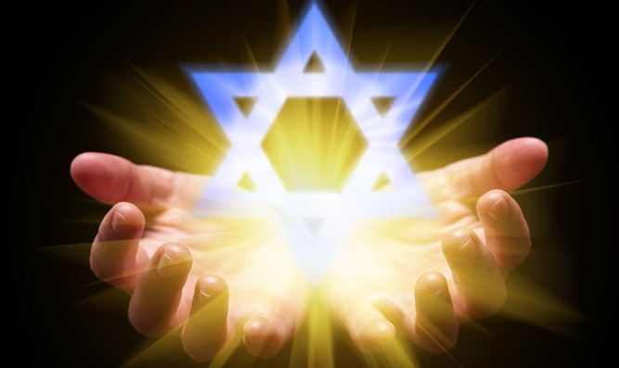
Isaiah 43:1
“But now, thus says the Lord, your Creator, O Jacob, And He who formed you, O Israel, 'Do not fear, for I have redeemed you; I have called you by name; you are Mine!'”

Slide 8
GENESIS STRUCTURE
  Genesis 12-50 (four people)
    Abraham (12:1–25:11)
    Isaac (25:12–26:35)
    Jacob (27–36)
    Joseph (37–50)

Slide 9
Genesis 12‒21
Abraham’s Early Journeys
Unconditional promises (Gen. 12:1-3) From Haran to Canaan (Gen. 12:4-5) In Canaan (Gen. 12:6-9) In Egypt (Gen. 12:10-20) Abram and Lot Separate (Gen. 13:1-13) Reaffirmation of Abram’s promises (Gen. 13:14-18) Abram Rescues Lot (14:1-24) Abrahamic Covenant (15:1-21) Hagar & Ishmael (16:1-16) | Circumcision (Gen. 17:1-27) Sodom & Gomorrah (Gen. 18‒19) Abraham & Abimelech (Gen. 20) Isaac’s birth (Gen. 21:1-7) Ishmael’s expulsion (21:8-21) Abraham & Abimelech’s covenant (21:22-34) Abraham sacrifices Isaac (22) Sarah’s death (23)

Slide 10
Genesis 22
Abraham Sacrifices Isaac
    Abraham tested (1-10)
    Substitutionary provision (11-14)
    Covenant reaffirmed (15-19)
    Rebekah’s lineage (20-24)

Slide 11
Genesis 22
Abraham Sacrifices Isaac
    Abraham tested (1-10)
    Substitutionary provision (11-14)
    Covenant reaffirmed (15-19)
    Rebekah’s lineage (20-24)

Slide 12
Genesis 22:1-10
Abraham Tested
    Abraham instructed (1-2)
    Abraham's obedience (3)
    Arrival at destination (4)
    Abraham’s instructions (5)
    Continuation of journey (6)
    Conversation (7-8)
    Offering prepared (9-10)

Slide 13
Genesis 22
Abraham Sacrifices Isaac
    Abraham tested (1-10)
    Substitutionary provision (11-14)
    Covenant reaffirmed (15-19)
    Rebekah’s lineage (20-24)

Slide 14
Genesis 22:11-14
Substitutionary Provision
    Call to Abraham (11)
    New instructions (12)
    Provision of the ram (13)
    Naming (14)

Slide 15
Genesis 22:11-14
Substitutionary Provision
    Call to Abraham (11)
    New instructions (12)
    Provision of the ram (13)
    Naming (14)

Slide 16
VI. 8 New Promises
Genesis 12:1-3
    Land (Gen. 12:1b)
    Great nation (Gen. 12:2a)
    Personal blessing (Gen. 12:2b)
    Great name (Gen. 12:2c)
    Blessing to others (Gen. 12:2d)
    Blessing to blessers (Gen. 12:3a)
    Cursing to cursers (Gen. 12:3b)
    Blessing to the world (Gen. 12:3c)

Slide 17

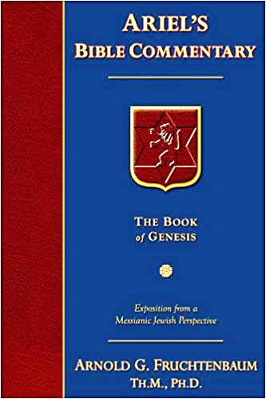
Dr. Arnold G. Fruchtenbaum
The Book of Genesis, 240
“This is the first of seven times that Abraham receives a direct revelation from God. In 12:1–3 is God’s initial call to Abram outside the Land of Canaan; in 12:7 is the first appearance to Abraham in the Land; in 13:14–17, Abraham encounters God after the separation of Lot; in 15:1–21, God signs and seals the Abrahamic Covenant; in 17:1–21, Abraham receives the token of the covenant; in 18:1–33, God speaks to him in conjunction with the destruction of Sodom; and in 22:1–2 and 22:11–18, God directs Abraham to offer Isaac.”

Slide 18
Genesis 22:11-14
Substitutionary Provision
    Call to Abraham (11)
    New instructions (12)
    Provision of the ram (13)
    Naming (14)

Slide 19
Dr. Arnold G. Fruchtenbaum
The Book of Genesis, 355
“Then God gave the reason: For now I know that you fear God. God already knew this, but now it is known by experience. The evidence was: seeing you have not withheld your son, your only son, from me.”

Slide 20

Thomas L. Constable
James notes, www.soniclight.com, 58.
“‘Abraham’ was declared righteous more than once. Most interpreters understand the first scriptural statement of his justification as describing his ‘new birth,’ to use the New Testament term (Gen. 15:6). This is when God declared Abraham righteous. James explained that about 20 years after Abraham was declared righteous, he was ‘justified’ again. Scripture consistently teaches that believers whom God declares righteous never lose their righteous standing before God (Rom. 5:1; 8:1; et al.). They do not need to be saved again. Abraham's subsequent, second ‘justification,’ evidently refers to a second declaration. . .

Slide 21
Thomas L. Constable
James notes, www.soniclight.com, 58.
“... of his righteousness. James said this second time Abraham's works declared him righteous. They gave testimony (bore witness) to his faith. Works do not always evidence faith (v. 19), but sometimes they do. They do so, whenever a person who has become a believer by faith, continues to live by faith. Abraham is a good example of a believer whose good works (obedience to God) bore witness to his righteousness. He continued to live by faith, just as he had been declared righteous by faith.”

Slide 22

John Calvin
James 2:23 (Calvin Cath Epist)
“They who seek to prove from this passage of James that the works of Abraham were imputed for righteousness, must necessarily confess that Scripture is perverted by him; for however they may turn and twist, they can never make the effect to be its own cause. The passage is quoted from Moses. (Gen. 15:6.) The imputation of righteousness which Moses mentions, preceded more than thirty years the work by which they would have Abraham to have been justified. Since faith was imputed to Abraham fifteen years before the birth of Isaac, this could not surely have been done through the work of sacrificing him.”
Notes:
Outline

Slide 23
John Calvin
James 2:23 (Calvin Cath Epist)
“I consider that all those are bound fast by an indissoluble knot, who imagine that righteousness was imputed to Abraham before God, because he sacrificed his son Isaac, who was not yet born when the Holy Spirit declared that Abraham was justified. It hence necessarily follows that something posterior is pointed out here.”
Notes:
Outline

Slide 24

Faith Manifesting Works
(James 2:14-26)
Thesis: works accompany useful faith (2:14)
Five illustrations (2:15-26)
  Needy brother (2:15-17)
  Demonic monotheist (2:18-19)
  Abraham (2:20-24)
  Rahab (2:25)
  Lifeless corpse (2:26)

Slide 25
How Genesis 22 is About Jesus Christ
Typology | Genesis 22 | Jesus
Isaac’s age | Gen. 22:1 | Luke 3:23
Only Son | Gen. 22:2, 12, 16 | John 1:14
Place of execution | Gen. 22:2 | 2 Chron. 3:1
Donkey | Gen. 22:3 | Matt. 21:1-7
Third day | Genesis 22:4 | Matt. 16:21
Resurrection | Gen. 22:5 | 1 Cor. 15:20, 23

Slide 26

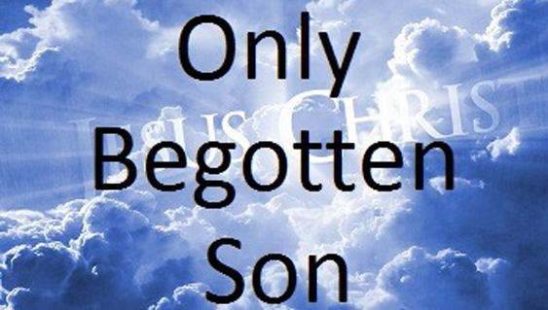
John 1:14
“And the Word became flesh, and dwelt among us, and we saw His glory, glory as of the only begotten [monogenēs] from the Father, full of grace and truth.”

Slide 27
Genesis 22:11-14
Substitutionary Provision
    Call to Abraham (11)
    New instructions (12)
    Provision of the ram (13)
    Naming (14)

Slide 28
How Genesis 22 is About Jesus Christ
Typology | Genesis 22 | Jesus
Isaac’s carries the wood | Gen. 22:5 | Matt. 27:32
Father offers the Son | Gen. 22:6 | Matt. 27:46
Isaac’s volition | Gen. 22:6, 9 | John 10:17-18
Substitution | Genesis 22:8 | Isa. 53:3-6
Male sacrifice | Gen. 22:13 | John 1:29
Propitiation | Gen. 22:14 | Rom. 3:25

Slide 29
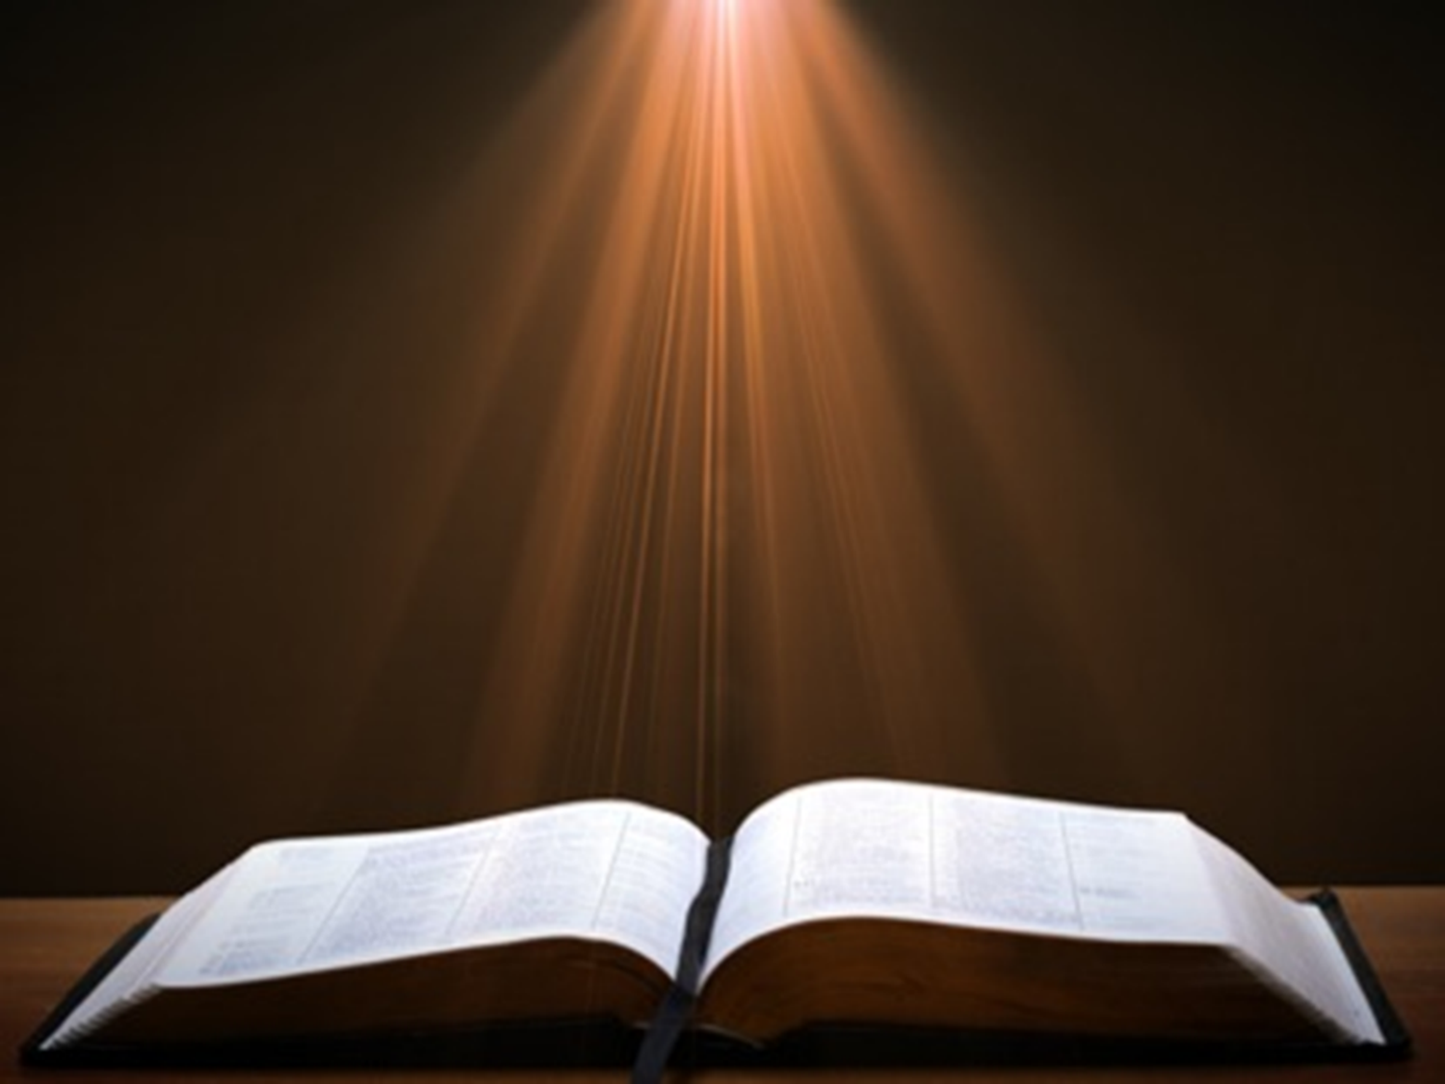
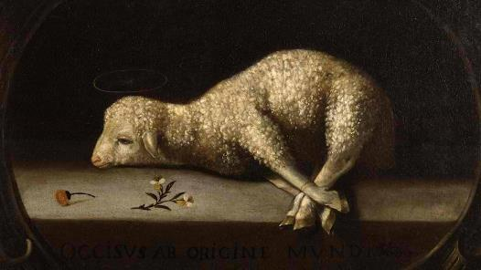
Exodus 12:5
“Your lamb shall be an unblemished male a year old; you may take it from the sheep or from the goats.”

Slide 30
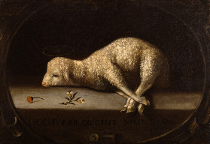
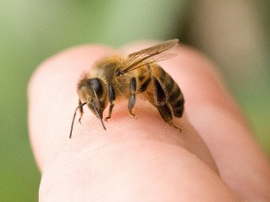
Christ’s Atoning Death
Substitution – Isa 53:3-6
Illustrations
  Secret serviceman
  Bee sting

Slide 31

Isaiah 53:3–6
³ He was despised and forsaken of men, A man of sorrows and acquainted with grief; And like one from whom men hide their face He was despised, and we did not esteem Him. ⁴ Surely our griefs He Himself bore, And our sorrows He carried; Yet we ourselves esteemed Him stricken, Smitten of God, and afflicted. ⁵ But He was pierced through for our transgressions, He was crushed for our iniquities; The chastening for our well-being fell upon Him, And by His scourging we are healed. ⁶ All of us like sheep have gone astray, Each of us has turned to his own way; But the Lord has caused the iniquity of us all To fall on Him.

Slide 32
Christ’s Atoning Death
False views of the atonement
  Ransom to Satan – Christ’s death is a ransom to Satan and not the Father (A.D. 185‒54)
  Moral influence – Christ’s death is an expression of God’s love (A.D. 1079‒1142)
  Moral example – Christ’s death inspires us to be sacrificial (A.D. 1539‒1604)
  Governmental – Christ’s death promotes respect for God’s Law (A.D. 1583‒1645)
  Accidental – Fate accidently ended Christ’s life

Slide 33
Genesis 22:11-14
Substitutionary Provision
    Call to Abraham (11)
    New instructions (12)
    Provision of the ram (13)
    Naming (14)

Slide 34
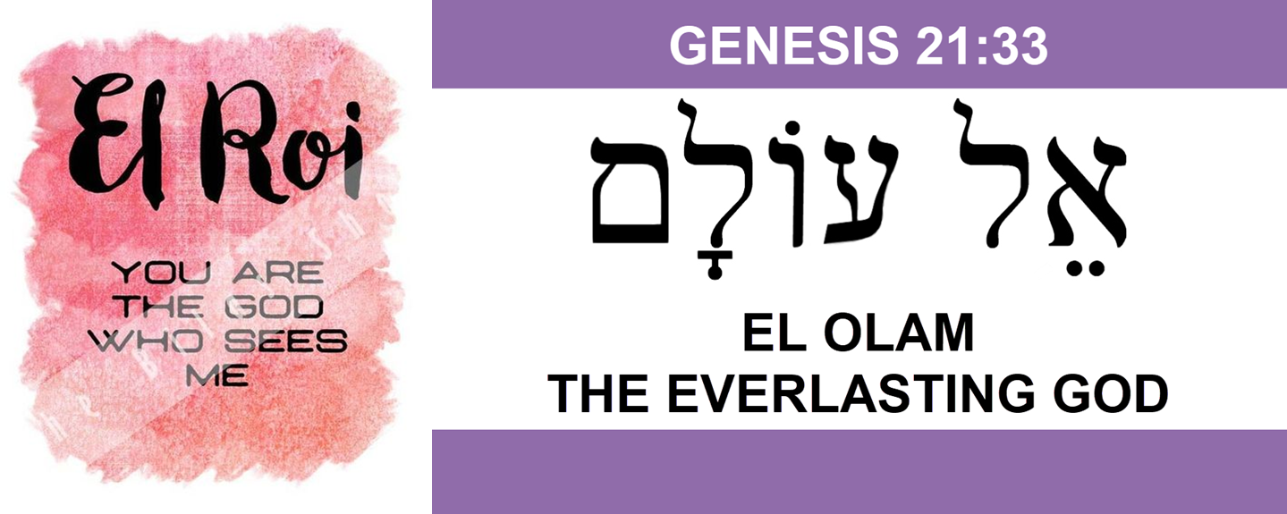

Slide 35
How Genesis 22 is About Jesus Christ
Typology | Genesis 22 | Jesus
Isaac’s age | Gen. 22:1 | Luke 3:23
Only Son | Gen. 22:2, 12, 16 | John 1:14
Place of execution | Gen. 22:2 | 2 Chron. 3:1
Donkey | Gen. 22:3 | Matt. 21:1-7
Third day | Genesis 22:4 | Matt. 16:21
Resurrection | Gen. 22:5 | 1 Cor. 15:20, 23

Slide 36
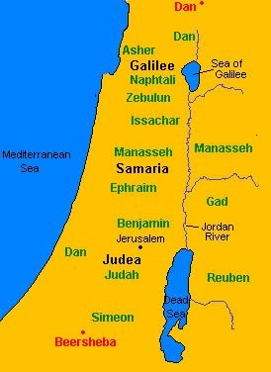

Slide 37
How Genesis 22 is About Jesus Christ
Typology | Genesis 22 | Jesus
Isaac’s carries the wood | Gen. 22:5 | Matt. 27:32
Father offers the Son | Gen. 22:6 | Matt. 27:46
Isaac’s volition | Gen. 22:6, 9 | John 10:17-18
Substitution | Genesis 22:8 | Isa. 53:3-6
Male sacrifice | Gen. 22:13 | John 1:29
Propitiation | Gen. 22:14 | Rom. 3:25

Slide 38
Genesis 22
Abraham Sacrifices Isaac
    Abraham tested (1-10)
    Substitutionary provision (11-14)
    Covenant reaffirmed (15-19)
    Rebekah’s lineage (20-24)

Slide 39
Genesis 22:15-19
Covenant Reaffirmed
    Call to Abraham (15)
    Basis (16)
    Provisions (17-18a)
    Basis restated (18b)
    Return to Beersheba (19)

Slide 40
Genesis 22:15-19
Covenant Reaffirmed
    Call to Abraham (15)
    Basis (16)
    Provisions (17-18a)
    Basis restated (18b)
    Return to Beersheba (19)

Slide 41
VI. 8 New Promises
Genesis 12:1-3
    Land (Gen. 12:1b)
    Great nation (Gen. 12:2a)
    Personal blessing (Gen. 12:2b)
    Great name (Gen. 12:2c)
    Blessing to others (Gen. 12:2d)
    Blessing to blessers (Gen. 12:3a)
    Cursing to cursers (Gen. 12:3b)
    Blessing to the world (Gen. 12:3c)

Slide 42
Dr. Arnold G. Fruchtenbaum
The Book of Genesis, 240
“This is the first of seven times that Abraham receives a direct revelation from God. In 12:1–3 is God’s initial call to Abram outside the Land of Canaan; in 12:7 is the first appearance to Abraham in the Land; in 13:14–17, Abraham encounters God after the separation of Lot; in 15:1–21, God signs and seals the Abrahamic Covenant; in 17:1–21, Abraham receives the token of the covenant; in 18:1–33, God speaks to him in conjunction with the destruction of Sodom; and in 22:1–2 and 22:11–18, God directs Abraham to offer Isaac.”

Slide 43
Genesis 22:15-19
Covenant Reaffirmed
    Call to Abraham (15)
    Basis (16)
    Provisions (17-18a)
    Basis restated (18b)
    Return to Beersheba (19)

Slide 44

Evidence of Abrahamic Covenant’s Unconditional Nature
ANE covenant ratification ceremony (Gen 15)
Lack of stated conditions for Israel’s obedience (Gen 15)
Covenant's eternality (Gen 17:7, 13, 19; Ps. 90:2)
Covenant's immutability (Heb 6:13-18; Mal. 3:6)
Trans-generational reaffirmation despite perpetual national disobedience (Jer 31:35-37)
Walvoord, The Millennial Kingdom, 149-52

Slide 45

J. Dwight Pentecost
Thy Kingdom Come, Page 66-67
“As before, God responded to the obedience of faith. He said to Abraham, ‘I swear by Myself, declares the Lord, that because you have done this and have not withheld your son, your only son, I will surely bless you and make your descendants as numerous as the stars in the sky and as the sand on the seashore. Your descendants will take possession of the cities of their enemies, and through your offspring all nations on earth will be blessed, because you have obeyed Me’ (Gen. 22:16–18).”

Slide 46
J. Dwight Pentecost
Thy Kingdom Come, Page 66-67
“Here again God promised Abraham that he would become the recipient of the covenant blessings. The covenant was not based on obedience, nor was the perpetuity of the covenant based on obedience—but rather the reception of covenant blessings was conditioned on obedience. Remember, an unconditional covenant may have conditional blessings. Thus, on the basis of faith that had produced obedience, Abraham would experience the blessings of the promises and the covenant.”

Slide 47
Six Parts of a Suzerain-Vassal Treaty in Deuteronomy
Preamble (1:1-5)
Prologue (1:6–4:40)
Covenant obligations (5–26)
Storage and reading instructions (27:2-3; 31:9, 24, 26)
Witnesses (32:1)
Blessings and curses (28)

Slide 48
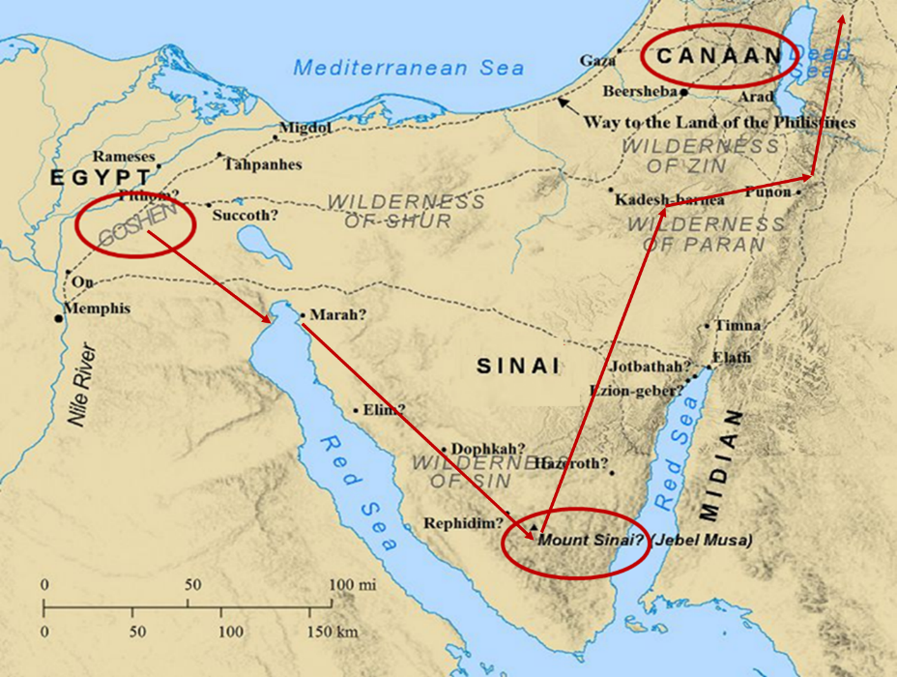

Slide 49
Genesis 22:15-19
Covenant Reaffirmed
    Call to Abraham (15)
    Basis (16)
    Provisions (17-18a)
    Basis restated (18b)
    Return to Beersheba (19)

Slide 50
VI. 8 New Promises
Genesis 12:1-3
    Land (Gen. 12:1b)
    Great nation (Gen. 12:2a)
    Personal blessing (Gen. 12:2b)
    Great name (Gen. 12:2c)
    Blessing to others (Gen. 12:2d)
    Blessing to blessers (Gen. 12:3a)
    Cursing to cursers (Gen. 12:3b)
    Blessing to the world (Gen. 12:3c)

Slide 51

Charles Ryrie
The Ryrie Study Bible, page 28
Genesis 22:16-18 (RSB:NASB1995U): Genesis 22:16-18. “your seed shall possess the gate of their enemies. This anticipates the conquest of Canaan under Joshua.”

Slide 52
New Promises
Genesis 12:1-3
    Land (Gen. 12:1b)
    Great nation (Gen. 12:2a)
    Personal blessing (Gen. 12:2b)
    Great name (Gen. 12:2c)
    Blessing to others (Gen. 12:2d)
    Blessing to blessers (Gen. 12:3a)
    Cursing to cursers (Gen. 12:3b)
    Blessing to the world (Gen. 12:3c)

Slide 53

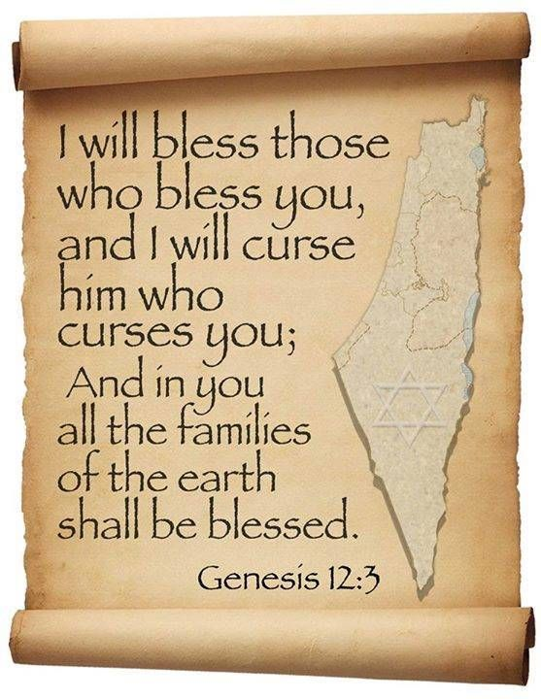
Genesis 12:3
“And I will bless those who bless you, And the one who curses you I will curse. And in you all the families of the earth will be blessed.”

Slide 54
Genesis 22:15-19
Covenant Reaffirmed
    Call to Abraham (15)
    Basis (16)
    Provisions (17-18a)
    Basis restated (18b)
    Return to Beersheba (19)

Slide 55
J. Dwight Pentecost
Thy Kingdom Come, Page 66-67
“As before, God responded to the obedience of faith. He said to Abraham, ‘I swear by Myself, declares the Lord, that because you have done this and have not withheld your son, your only son, I will surely bless you and make your descendants as numerous as the stars in the sky and as the sand on the seashore. Your descendants will take possession of the cities of their enemies, and through your offspring all nations on earth will be blessed, because you have obeyed Me’ (Gen. 22:16–18).”

Slide 56
J. Dwight Pentecost
Thy Kingdom Come, Page 66-67
“Here again God promised Abraham that he would become the recipient of the covenant blessings. The covenant was not based on obedience, nor was the perpetuity of the covenant based on obedience—but rather the reception of covenant blessings was conditioned on obedience. Remember, an unconditional covenant may have conditional blessings. Thus, on the basis of faith that had produced obedience, Abraham would experience the blessings of the promises and the covenant.”

Slide 57
Genesis 22:15-19
Covenant Reaffirmed
    Call to Abraham (15)
    Basis (16)
    Provisions (17-18a)
    Basis restated (18b)
    Return to Beersheba (19)

Slide 58
Covenant’s Results
Genesis 21:33-34
    Abraham plants (33a)
    Abraham worships (33b)
    Abraham sojourns (34)

Slide 60
Genesis 22
Abraham Sacrifices Isaac
    Abraham tested (1-10)
    Substitutionary provision (11-14)
    Covenant reaffirmed (15-19)
    Rebekah’s lineage (20-24)

Slide 61
Genesis 22:20-24
Rebekah’s Lineage
    Timing (20a)
    Nahor’s children (20b-24)
      From Milcah (20b-23)
      From Reumah (24)

Slide 62
Genesis 22:20-24
Rebekah’s Lineage
    Timing (20a)
    Nahor’s children (20b-24)
      From Milcah (20b-23)
      From Reumah (24)

Slide 63
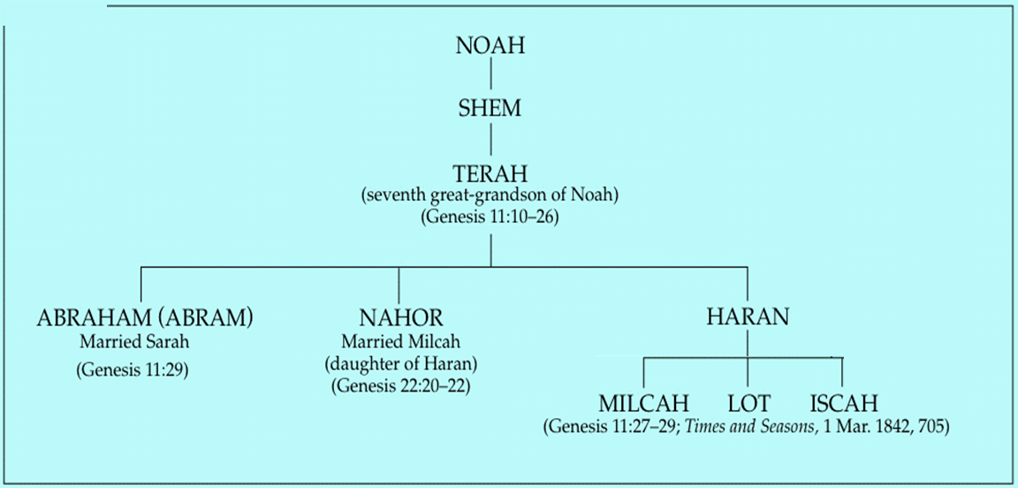

Slide 64
Genesis 22:20-24
Rebekah’s Lineage
    Timing (20a)
    Nahor’s children (20b-24)
      From Milcah (20b-23)
      From Reumah (24)

Slide 66
Genesis 22:20-24
Rebekah’s Lineage
    Timing (20a)
    Nahor’s children (20b-24)
      From Milcah (20b-23)
      From Reumah (24)

Slide 67

Nahor’s children through Milcah (Gen. 22:20b-23)
1. Uz (Job 1:1) | 5. Hazo
2. Buz | 6. Pildash
3. Aram | 7. Jidlaph
4. Chesed | 8. Bethuel (Gen. 24)

Slide 68
Genesis 22:20-24
Rebekah’s Lineage
    Timing (20a)
    Nahor’s children (20b-24)
      From Milcah (20b-23)
      From Reumah (24)

Slide 69
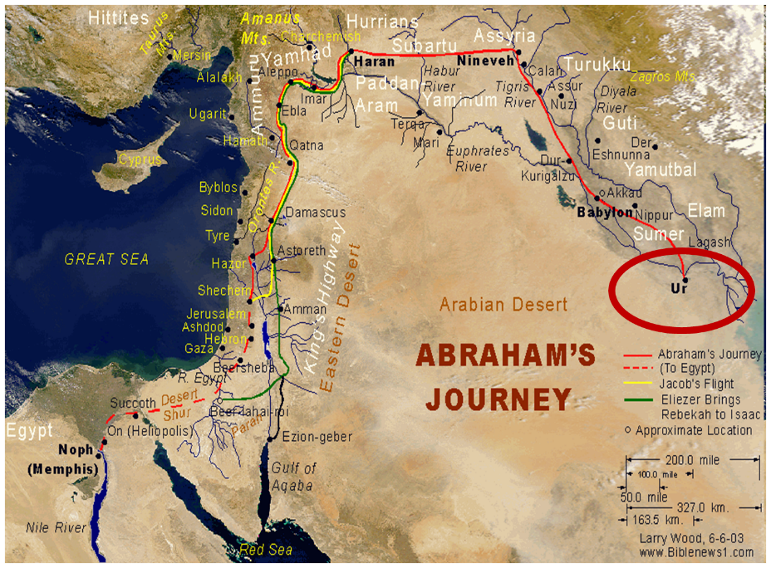

Slide 70
Nahor’s children through Reumah (Gen. 22:20b-23)
1. Tebah
2. Gaham
3. Tahash
4. Maacah

Slide 71
Conclusion

Slide 72
Genesis 12‒21
Abraham’s Early Journeys
Unconditional promises (Gen. 12:1-3) From Haran to Canaan (Gen. 12:4-5) In Canaan (Gen. 12:6-9) In Egypt (Gen. 12:10-20) Abram and Lot Separate (Gen. 13:1-13) Reaffirmation of Abram’s promises (Gen. 13:14-18) Abram Rescues Lot (14:1-24) Abrahamic Covenant (15:1-21) Hagar & Ishmael (16:1-16) | Circumcision (Gen. 17:1-27) Sodom & Gomorrah (Gen. 18‒19) Abraham & Abimelech (Gen. 20) Isaac’s birth (Gen. 21:1-7) Ishmael’s expulsion (21:8-21) Abraham & Abimelech’s covenant (21:22-34) Abraham sacrifices Isaac (22) Sarah’s death (23)

Slide 73
Genesis 22
Abraham Sacrifices Isaac
    Abraham tested (1-10)
    Substitutionary provision (11-14)
    Covenant reaffirmed (15-19)
    Rebekah’s lineage (20-24)

Slide 74
Genesis 12‒21
Abraham’s Early Journeys
Unconditional promises (Gen. 12:1-3) From Haran to Canaan (Gen. 12:4-5) In Canaan (Gen. 12:6-9) In Egypt (Gen. 12:10-20) Abram and Lot Separate (Gen. 13:1-13) Reaffirmation of Abram’s promises (Gen. 13:14-18) Abram Rescues Lot (14:1-24) Abrahamic Covenant (15:1-21) Hagar & Ishmael (16:1-16) | Circumcision (Gen. 17:1-27) Sodom & Gomorrah (Gen. 18‒19) Abraham & Abimelech (Gen. 20) Isaac’s birth (Gen. 21:1-7) Ishmael’s expulsion (21:8-21) Abraham & Abimelech’s covenant (21:22-34) Abraham sacrifices Isaac (22) Sarah’s death (23)

Slide 75
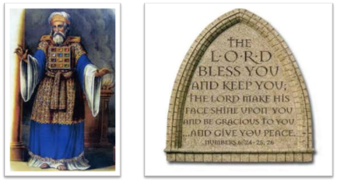
²⁴ The Lord bless you, and keep you; ²⁵ The Lord make His face shine on you, And be gracious to you; ²⁶ The Lord lift up His countenance on you, And give you peace.
Numbers 6:24–26 (NASB95)

