Slide 1

Ezekiel 36‒39
The Middle East Meltdown 2022
Dr. Andy Woods
Senior Pastor – Sugar Land Bible Church
President – Chafer Theological Seminary

Slide 2
Ezekiel 33‒48
Ezekiel recommissioned (33)
False shepherds removed (34)
Edom destroyed (35)
Israel’s restoration: physical & spiritual (36)
Israel’s restoration illustrated (37)
Means of restoration: Northern invasion (38)
Results of the Northern invasion: conversion (39)
Millennial Temple (40‒46)
Tribal land allotment (47‒48)

Slide 3

MAIL BAG
Hosea 5:15?
Theologians holding to two phase view?
Battle at the end of the Tribulation?
Imminency of the Rapture?
Gog-Magog (Ezek. 38‒39) on a feast day?

Slide 4
MAIL BAG
Hosea 5:15?
Theologians holding to two phase view?
Battle at the end of the Tribulation?
Imminency of the Rapture?
Gog-Magog (Ezek. 38‒39) on a feast day?

Slide 5


Genesis 12:3
“And I will bless those who bless you, And the one who curses you I will curse. And in you all the families of the earth will be blessed.”

Slide 6
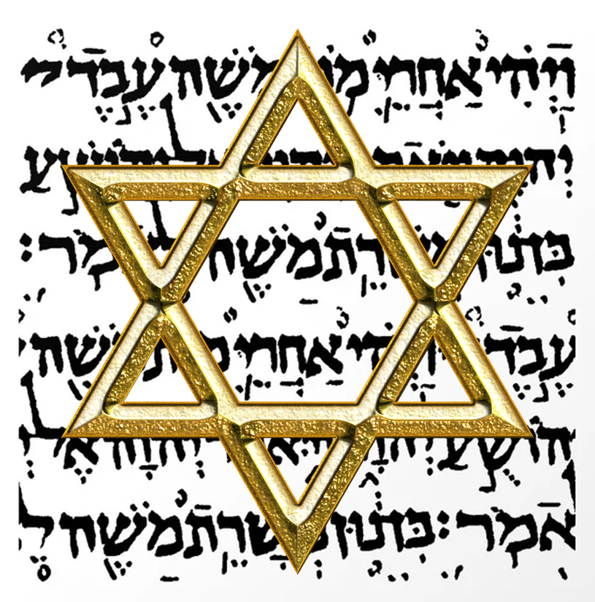
Israel’s Three Blessings to the World
(Gen 12:3b)
Scripture (Rom 3:2)
Savior (John 4:22)
Kingdom (Isa 2:2-3)

Slide 7
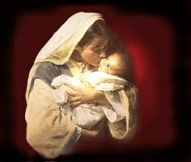
Satanic Attempts to Stop Messiah’s Birth
Cain & Abel (Gen. 4)
Sons of God (Gen. 6)
Pharaoh persecutes Israel (Exod. 1)
Joash protected from Athaliah (2 Chron. 22‒23)
Haman persecutes Israel (Esther)
Antiochus Epiphanés (Dan. 11:31)
Herod persecutes Christ (Matt 2; Rev 12:4)

Slide 8
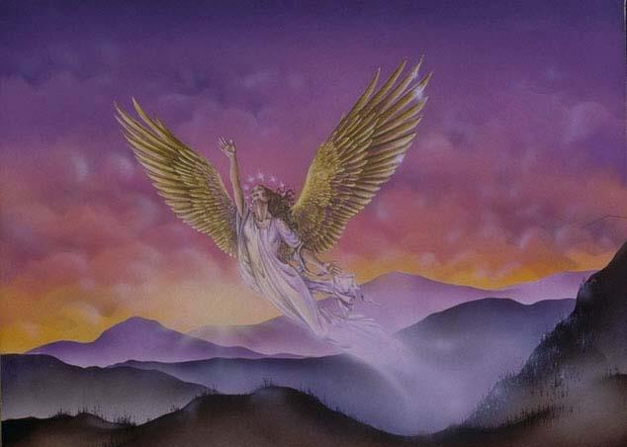
CONNECTING
REV 12 & ANTI-SEMITISM
DANIEL’S 70th WEEK (7 years)
Israel flees
3 ½ years
1260 days

Slide 9
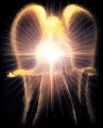

Satan’s Progressive Defeat
Initial eviction from heaven (Isa 14:12-15; Ezek 28:12-17)
Eden (Gen 3:15)
Pre-diluvian world (1 Pet 3:19-20)
Cross (John 12:31; 16:11; Col 2:15; Heb 2:14; 1 John 3:8)
Mid point of the Tribulation (Rev 12:9)
Beginning of millennium (Rev 20:2-3)
End of millennium (Rev 20:10)

Slide 10

Revelation 20:1-3
“Then I saw an angel coming down from heaven, holding the key of the abyss and a great chain in his hand. ² And he laid hold of the dragon, the serpent of old, who is the devil and Satan, and bound him for a thousand years; ³ and he threw him into the abyss, and shut it and sealed it over him, so that he would not deceive the nations any longer, until the thousand years were completed; after these things he must be released for a short time.”

Slide 11
Satan’s Progressive Defeat
Initial eviction from heaven (Isa 14:12-15; Ezek 28:12-17)
Eden (Gen 3:15)
Pre-diluvian world (1 Pet 3:19-20)
Cross (John 12:31; 16:11; Col 2:15; Heb 2:14; 1 John 3:8)
Mid point of the Tribulation (Rev 12:9)
Beginning of millennium (Rev 20:2-3)
End of millennium (Rev 20:10)

Slide 12

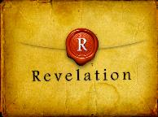
Revelation 20:10
“And the devil who deceived them was thrown into the lake of fire and brimstone, where the beast and the false prophet are also; and they will be tormented day and night forever and ever.”

Slide 13
Hosea 5:15
“I will go away and return to My place Until they acknowledge their guilt and seek My face; In their affliction they will earnestly seek Me.”

Slide 14
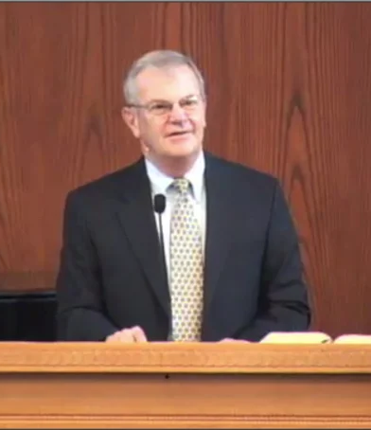
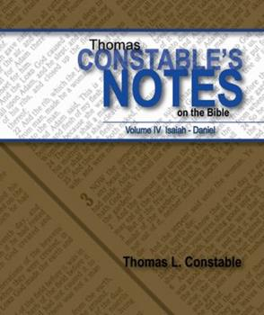
Thomas L. Constable
Constable’s online notes on Hosea, p. 55.
“The language would appear to reach into the Millennium, when the Israelites will indeed repent before God and seek His face (cf. 1:10-11; 2:14- 23).”
“Taken with Mt. 23:37-39, this passage gives in broad outline the course of Israel's future restoration to God.”

Slide 15

Christ’s Three Offices
Prophet – 1st Coming (Matt. 4:17)
Priest – Present Session (Heb. 4:15)
King – 2nd Coming (Isa. 9:6-7; Matt. 25:31)

Slide 16

Matthew 23:37-39
³⁷ “Jerusalem, Jerusalem, who kills the prophets and stones those who are sent to her! How often I wanted to gather [episynagō] your children together, the way a hen gathers [episynagō] her chicks under her wings, and you were unwilling. ³⁸ Behold, your house is being left to you desolate! ³⁹ For I say to you, from now on you will not see Me until you say, ‘Blessed is He who comes in the name of the Lord!’”

Slide 17
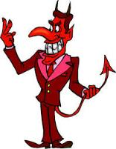
Names & Titles Demonstrating Satan’s
Post-Fall, Earthly Authority
(Job 1:7; 2:2; Luke 4:5-8; Rom. 8:19-22)
Prince of this world (John 12:31; 14:30; 16:11)
God of this age (2 Cor. 4:4)
Prince and power of the air (Eph. 2:2)
Who the believer wrestles with (Eph. 6:12)
Roaring lion (1 Pet. 5:8)
Whole world lies in his power (1 John 5:19)

Slide 18
MAIL BAG
Hosea 5:15?
Theologians holding to two phase view?
Battle at the end of the Tribulation?
Imminency of the Rapture?
Gog-Magog (Ezek. 38‒39) on a feast day?

Slide 19
When?
Beginning of the Millennium
End of the Millennium
End of the Tribulation
Before the Tribulation
First half of the Tribulation
Two phase view

Slide 20
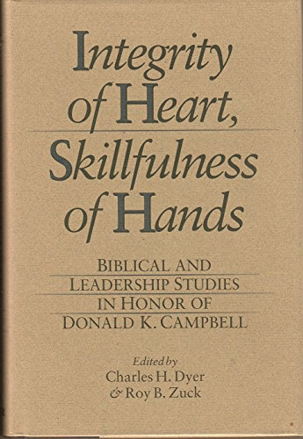

Slide 21
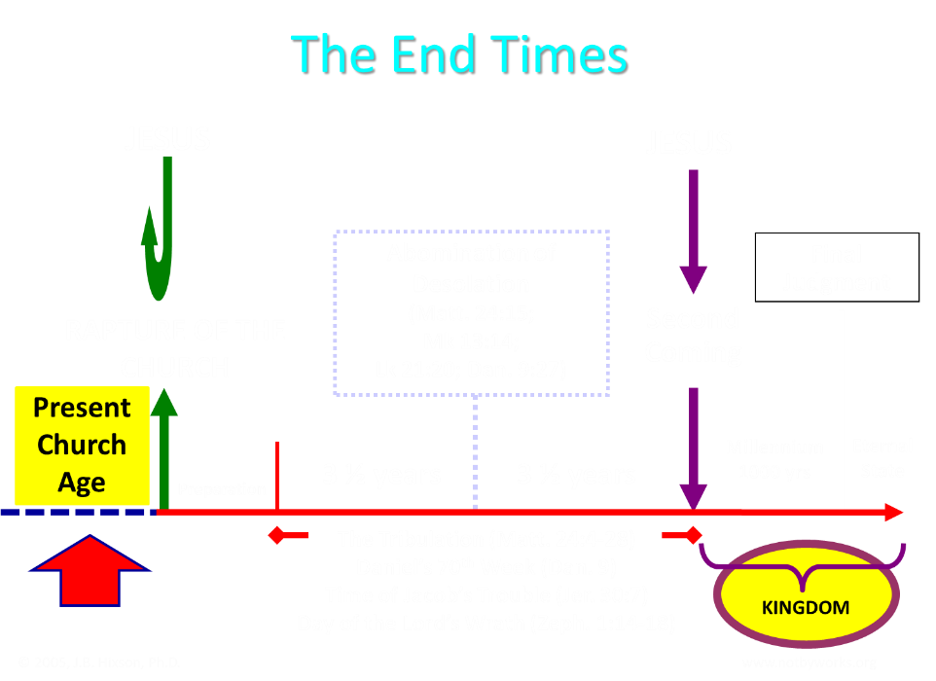

Slide 22

Pre-Daniel’s 70th Week Advocates
1. Tim LaHaye | 7. Mal Couch
2. Chuck Missler | 8. Joel Rosenberg
3. Thomas Ice | 9. Ron Rhodes
4. Randall Price | 10. Stanely Maughan
5. Zola Levitt | 11. David Cooper
6. Tom McCall | 12. Arnold Fruchtenbaum

Slide 23
What?
Divine annihilation of the coalition (38:19-22)
Birds and beasts feast on the carnage (39:4-5, 17-20)
Seven-month burying of the dead (39:11-12, 14-16)
Seven-year burning of weapons (39:9-10)
Israel’s salvation and restoration (39:22, 29)

Slide 24

Charles L. Feinberg
The Prophecy of Ezekiel: The Glory of the Lord, Paperback ed. (Chicago: Moody, 1969; reprint, Chicago: Moody, 1984), 230-31.
“Now there is presented the third emphasis of the greatness of the invasion and the subsequent slaughter at the hand of the Lord. Incidentally, the figure gives a clue as to the time setting for the entire passage. It is the same scene as that a Revelation 19, the great supper of God, and the chronology is clear. The events will transpire at the end of the great tribulation and just before the millennial reign of the Messiah of Israel.”

Slide 25


Jeremiah 30:7
“Alas! for that day is great, There is none like it; And it is the time of Jacob’s distress (Gen. 32:8; 35:10), But he will be saved from it.”

Slide 26

Ezekiel 36:24-28
“For I will take you from the nations, gather you from all the lands and bring you into your own land. ²⁵ Then I will sprinkle clean water on you, and you will be clean; I will cleanse you from all your filthiness and from all your idols. ²⁶ Moreover, I will give you a new heart and put a new spirit within you; and I will remove the heart of stone from your flesh and give you a heart of flesh. ²⁷ I will put My Spirit within you and cause you to walk in My statutes, and you will be careful to observe My ordinances. ²⁸ You will live in the land that I gave to your forefathers; so you will be My people, and I will be your God.”

Slide 27
Ezekiel 37:7-11
So I prophesied as I was commanded; and as I prophesied, there was a noise, and behold, a rattling; and the bones came together, bone to its bone. ⁸ And I looked, and behold, sinews were on them, and flesh grew and skin covered them; but there was no breath in them. ⁹ Then He said to me, “Prophesy to the breath, prophesy, son of man, and say to the breath, ‘Thus says the Lord God, “Come from the four winds, O breath, and breathe on these slain, that they come to life.”’” ¹⁰ So I prophesied as He . . .

Slide 28
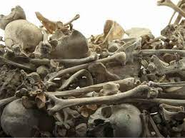
Ezekiel 37:7-11
. . . commanded me, and the breath came into them, and they came to life and stood on their feet, an exceedingly great army. ¹¹ Then He said to me, “Son of man, these bones are the whole house of Israel; behold, they say, ‘Our bones are dried up and our hope has perished. We are completely cut off’.”

Slide 29
MAIL BAG
Hosea 5:15?
Theologians holding to two phase view?
Battle at the end of the Tribulation?
Imminency of the Rapture?
Gog-Magog (Ezek. 38‒39) on a feast day?

Slide 30
Armageddon?
Ezek 38-39 |  | Armageddon
No battle (38:20-23) |  | Battle between armies and Lord (Rev. 19:19)
Invaders come from the far west and north (38:5) |  | All nations invade (Rev. 16:14; Zech. 12:3)
Enemies destroyed on Israel’s mountains (39:2-4) |  | Events take place in Jerusalem (Zech. 12:2; 14:2; and the Valley of Jehoshaphat (Joel 3:12)
Israel dwelling in safety (38:11) |  | Israel not dwelling in safety (Rev. 12:14-17)
No massive blood flow recorded |  | Massive flow of blood (Rev. 14:20)
Fire comes upon invaders (39:6) |  | Fire does not come upon invaders
Pentecost, Things to Come, 347-48

Slide 31


Slide 32
MAIL BAG
Hosea 5:15?
Theologians holding to two phase view?
Battle at the end of the Tribulation?
Imminency of the Rapture?
Gog-Magog (Ezek. 38‒39) on a feast day?

Slide 33

John 14:1–4
¹ “Do not let your heart be troubled; believe in God, believe also in Me. ² “In My Father’s house are many dwelling places; if it were not so, I would have told you; for I go to prepare a place for you. ³ “If I go and prepare a place for you, I will come again and receive you to Myself, that where I am, there you may be also. ⁴ “And you know the way where I am going.”

Slide 34
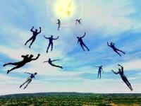
Imminent
(1 Cor 15:51; 1 Thess 4:15)
Imminency definition
James 5:8; 1 Thess 1:10; 1 Cor 1:7; Philip 3:20
We are to be looking for Jesus Christ and not the Antichrist!
Motivator (Holiness, Evangelism)
Feast of Trumpets?

Slide 35

1 Thessalonians 4:13-18
¹³ "But we do not want you to be uninformed, brethren, about those who are asleep, so that you will not grieve as do the rest who have no hope. ¹⁴ For if we believe that Jesus died and rose again, even so God will bring with Him those who have fallen asleep in Jesus. ¹⁵ For this we say to you by the word of the Lord, that we who are alive and remain until the coming of the Lord, will not precede those who . . .

Slide 36

1 Corinthians 15:51
“Behold, I tell you a mystery; we will not all sleep, but we will all be changed.”

Slide 37


Slide 38

Galatians 4:4
“But when the fullness of the time came, God sent forth His Son, born of a woman, born under the Law.”

Slide 39

Daniel 9:27
And he will make a firm covenant with the many for one week, but in the middle of the week he will put a stop to sacrifice and grain offering; and on the wing of abominations will come one who makes desolate, even until a complete destruction, one that is decreed, is poured out on the one who makes desolate.

Slide 40


Slide 41
MAIL BAG
Hosea 5:15?
Theologians holding to two phase view?
Battle at the end of the Tribulation?
Imminency of the Rapture?
Gog-Magog (Ezek. 38‒39) on a feast day?

Slide 42
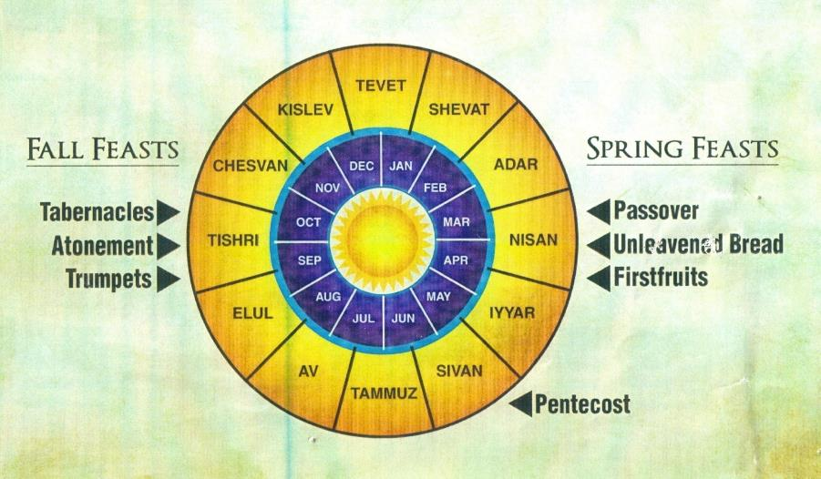

Slide 43


Slide 44


Slide 45
Levitical Feasts (Lev. 23)
Feast | Season | Purpose | Type
Passover | Spring | Redemption | 1 Cor. 5:7
Unleavened Bread | Spring | Separation | John 6:35
1st fruits | Spring | Praise | 1 Cor. 15:20
Pentecost | Spring | Praise | Acts 2:1-4
Trumpets | Fall | New Year | Matt. 24:31
Atonement | Fall | Lev 16 | Zech. 12:10
Booths | Fall | Wilderness provision | Zech. 14:16-18

Slide 46
What?
Divine annihilation of the coalition (38:19-22)
Birds and beasts feast on the carnage (39:4-5, 17-20)
Seven-month burying of the dead (39:11-12, 14-16)
Seven-year burning of weapons (39:9-10)
Israel’s salvation and restoration (39:22, 29)

Slide 47
Charles L. Feinberg
The Prophecy of Ezekiel: The Glory of the Lord, Paperback ed. (Chicago: Moody, 1969; reprint, Chicago: Moody, 1984), 231-32.
“Verses 25–29 teach that the complete return of Israel will occur after the defeat of Gog and his Confederates. Ezekiel summarized his prophecies of hope and restoration. When he stated that God will have mercy upon the whole house of Israel, he had in mind that all previous restorations were partial. Now a universal and final restoration will take place. It was God who allowed them to go into captivity; it is he who will see to it that they are regathered; indeed, it is he who will insure that not one is left out of the land...In conclusion, to summarize all the benefits promised, Ezekiel spoke of the outpouring of the Spirit upon the house of Israel (italics added).”

Slide 48

Zechariah 12:10
“I will pour out on the house of David and on the inhabitants of Jerusalem, the Spirit of grace and of supplication, so that they will look on Me whom they have pierced; and they will mourn for Him, as one mourns for an only son, and they will weep bitterly over Him like the bitter weeping over a firstborn.”

Slide 49
CONCLUSION

Slide 50
MAIL BAG
Hosea 5:15?
Theologians holding to two phase view?
Battle at the end of the Tribulation?
Imminency of the Rapture?
Gog-Magog (Ezek. 38‒39) on a feast day?

