Slide 1
Genesis 12‒50
Israel’s Birth & Preservation

Slide 2
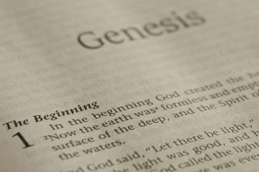
GENESIS STRUCTURE
Beginning of the Human race (Gen. 1‒11)
Beginning of the Hebrew race (Gen. 12‒50)

Slide 3
GENESIS STRUCTURE
Genesis 1-11 (four events)
Creation (1-2)
Fall (3-5)
Flood (6-9)
National dispersion (10-11)

Slide 4
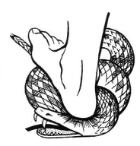
Genesis 3:15
“And I will put enmity Between you and the woman, And between your seed and her seed; He shall bruise you on the head, And you shall bruise him on the heel.”

Slide 5
GENESIS STRUCTURE
Beginning of the Human race (Gen. 1‒11)
Beginning of the Hebrew race (Gen. 12‒50)

Slide 6
GENESIS STRUCTURE
Genesis 12-50 (four people)
Abraham (12:1–25:11)
Isaac (25:12–26:35)
Jacob (27–36)
Joseph (37–50)

Slide 7
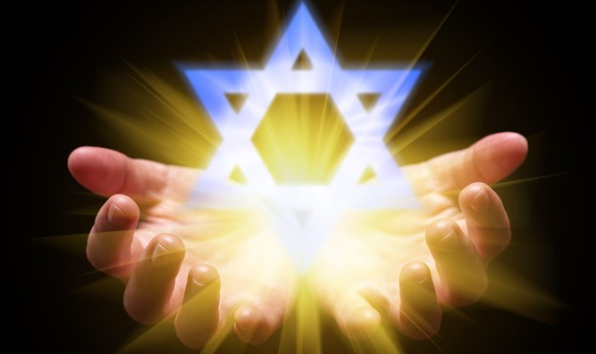
Isaiah 43:1
“But now, thus says the Lord, your Creator, O Jacob, And He who formed you, O Israel, 'Do not fear, for I have redeemed you; I have called you by name; you are Mine!'”

Slide 8
GENESIS STRUCTURE
Genesis 12-50 (four people)
Abraham (12:1–25:11)
Isaac (25:12–26:35)
Jacob (27–36)
Joseph (37–50)

Slide 9
Genesis 12‒21 Abraham’s Early Journeys
Unconditional promises (Gen. 12:1-3) From Haran to Canaan (Gen. 12:4-5) In Canaan (Gen. 12:6-9) In Egypt (Gen. 12:10-20) Abram and Lot Separate (Gen. 13:1-13) Reaffirmation of Abram’s promises (Gen. 13:14-18) Abram Rescues Lot (14:1-24) | Abrahamic Covenant (15:1-21) Hagar & Ishmael (16:1-16) Circumcision (Gen. 17:1-27) Sodom & Gomorrah (Gen. 18‒19) Abraham & Abimelech (Gen. 20) Isaac’s birth (Gen. 21:1-7) Ishmael’s expulsion (21:8-21) Abraham & Abimelech’s covenant (21:22-34)

Slide 10
Genesis 21:22-34 Abraham & Abimelech’s Covenant
Abimelech’s recognition (21:22)
Abimelech’s request (21:23)
Abraham’s response (21:24)
Abraham’s complaint (25)
Abimelech’s response (21:26)
Covenant entered (21:27-32)
Covenant’s results (21:33-34)

Slide 11
Genesis 21:22-34 Abraham & Abimelech’s Covenant
Abimelech’s recognition (21:22)
Abimelech’s request (21:23)
Abraham’s response (21:24)
Abraham’s complaint (25)
Abimelech’s response (21:26)
Covenant entered (21:27-32)
Covenant’s results (21:33-34)

Slide 12
Genesis 12‒21 Abraham’s Early Journeys
Unconditional promises (Gen. 12:1-3) From Haran to Canaan (Gen. 12:4-5) In Canaan (Gen. 12:6-9) In Egypt (Gen. 12:10-20) Abram and Lot Separate (Gen. 13:1-13) Reaffirmation of Abram’s promises (Gen. 13:14-18) Abram Rescues Lot (14:1-24) | Abrahamic Covenant (15:1-21) Hagar & Ishmael (16:1-16) Circumcision (Gen. 17:1-27) Sodom & Gomorrah (Gen. 18‒19) Abraham & Abimelech (Gen. 20) Isaac’s birth (Gen. 21:1-7) Ishmael’s expulsion (21:8-21) Abraham & Abimelech’s covenant (21:22-34)

Slide 13
Matt 5:13-14, 16
“You are the salt of the earth; but if the salt has become tasteless, how can it be made salty again? It is no longer good for anything, except to be thrown out and trampled under foot by men…You are the light of the world. A city set on a hill cannot be hidden…Let your light shine before men in such a way that they may see your good works, and glorify your Father who is in heaven.”

Slide 14
Genesis 21:22-34 Abraham & Abimelech’s Covenant
Abimelech’s recognition (21:22)
Abimelech’s request (21:23)
Abraham’s response (21:24)
Abraham’s complaint (25)
Abimelech’s response (21:26)
Covenant entered (21:27-32)
Covenant’s results (21:33-34)

Slide 15
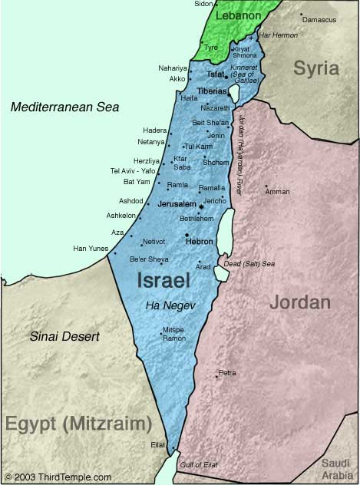
Negev

Slide 16
Genesis 12‒21 Abraham’s Early Journeys
Unconditional promises (Gen. 12:1-3) From Haran to Canaan (Gen. 12:4-5) In Canaan (Gen. 12:6-9) In Egypt (Gen. 12:10-20) Abram and Lot Separate (Gen. 13:1-13) Reaffirmation of Abram’s promises (Gen. 13:14-18) Abram Rescues Lot (14:1-24) | Abrahamic Covenant (15:1-21) Hagar & Ishmael (16:1-16) Circumcision (Gen. 17:1-27) Sodom & Gomorrah (Gen. 18‒19) Abraham & Abimelech (Gen. 20) Isaac’s birth (Gen. 21:1-7) Ishmael’s expulsion (21:8-21) Abraham & Abimelech’s covenant (21:22-34)

Slide 17
Evidence of Abrahamic Covenant’s Unconditional Nature
ANE covenant ratification ceremony (Gen 15)
Lack of stated conditions for Israel’s obedience (Gen 15)
Covenant's eternality (Gen 17:7, 13, 19; Ps. 90:2)
Covenant's immutability (Heb 6:13-18; Mal. 3:6)
Trans-generational reaffirmation despite perpetual national disobedience (Jer 31:35-37)
Walvoord, The Millennial Kingdom, 149-52

Slide 18
Dr. Arnold G. Fruchtenbaum
The Book of Genesis, 348
“The basis of the request was: but according to the kindness I have done unto you, you shall do unto me, and to the land wherein you have sojourned. What this shows is that Abraham had become a strong chieftain, a nomadic one, but a chieftain nonetheless, to be feared by the local city-kings of the city-states. They recognized that God was with Abraham, but Abraham had been deceptive once before. That was the paradox Abimelech faced: God was with Abraham, but Abraham was deceptive; it was this contradictory element that called for a binding treaty.”

Slide 19
Genesis 21:22-34 Abraham & Abimelech’s Covenant
Abimelech’s recognition (21:22)
Abimelech’s request (21:23)
Abraham’s response (21:24)
Abraham’s complaint (25)
Abimelech’s response (21:26)
Covenant entered (21:27-32)
Covenant’s results (21:33-34)

Slide 20
Genesis 21:22-34 Abraham & Abimelech’s Covenant
Abimelech’s recognition (21:22)
Abimelech’s request (21:23)
Abraham’s response (21:24)
Abraham’s complaint (25)
Abimelech’s response (21:26)
Covenant entered (21:27-32)
Covenant’s results (21:33-34)

Slide 21
Genesis 21:22-34 Abraham & Abimelech’s Covenant
Abimelech’s recognition (21:22)
Abimelech’s request (21:23)
Abraham’s response (21:24)
Abraham’s complaint (25)
Abimelech’s response (21:26)
Covenant entered (21:27-32)
Covenant’s results (21:33-34)

Slide 22
Genesis 21:22-34 Abraham & Abimelech’s Covenant
Abimelech’s recognition (21:22)
Abimelech’s request (21:23)
Abraham’s response (21:24)
Abraham’s complaint (25)
Abimelech’s response (21:26)
Covenant entered (21:27-32)
Covenant’s results (21:33-34)

Slide 24
Evidence of Abrahamic Covenant’s Unconditional Nature
ANE covenant ratification ceremony (Gen 15)
Lack of stated conditions for Israel’s obedience (Gen 15)
Covenant's eternality (Gen 17:7, 13, 19; Ps. 90:2)
Covenant's immutability (Heb 6:13-18; Mal. 3:6)
Trans-generational reaffirmation despite perpetual national disobedience (Jer 31:35-37)
Walvoord, The Millennial Kingdom, 149-52

Slide 25
Dr. Arnold G. Fruchtenbaum
The Book of Genesis, 349
“Verse 31 records the result: Wherefore he called that place Beer-sheba. In Hebrew, the name comprises two words: Be’er Sheva, literally meaning ‘the well of the seven.’ The figure seven comes from the seven lambs. The reason given is: because there they swore both of them. Not only does the word sheva mean ‘seven,’ but it also comes from the root shava, which means ‘to swear,’ because they swore an oath. Therefore, it carries a double meaning: ‘the well of the seven,’ because of the seven ewe lambs and ‘the well of the swearing’ because there they swore an oath.”

Slide 26
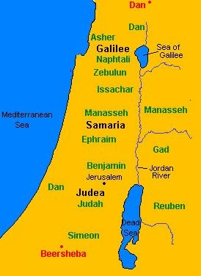

Slide 27
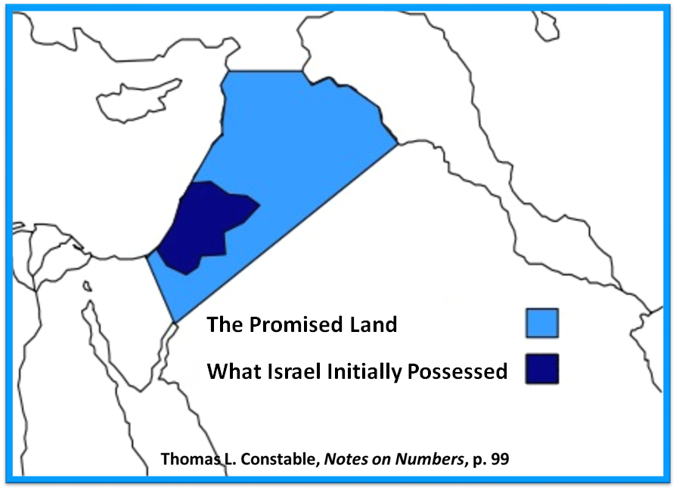

Slide 28
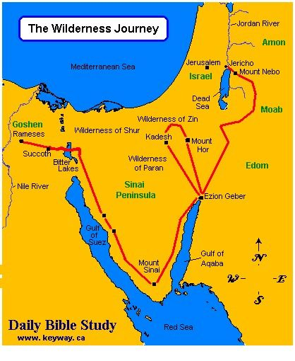

Slide 29
1 Peter 1:4-5
“⁴to obtain an inheritance which is imperishable, undefiled, and will not fade away, reserved in heaven for you, ⁵ who are protected by the power of God through faith for a salvation ready to be revealed in the last time.”

Slide 31
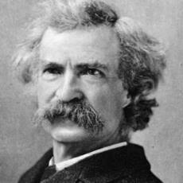
Mark Twain
The Innocents Abroad, Complete, 1st ed. (A Public Domain Book, 1869), 267, 285, 302. These quotes can be found in chapters 47, 49, 52.
“... A desolate country whose soil is rich enough, but is given over wholly to weeds… a silent mournful expanse…. a desolation is here that not even imagination can grace with the pomp of life and action…. we never saw a human being on the whole route…. there was hardly a tree or shrub anywhere. Even the olive tree and the cactus, those fast friends of a worthless soil, had almost deserted the country.”

Slide 32
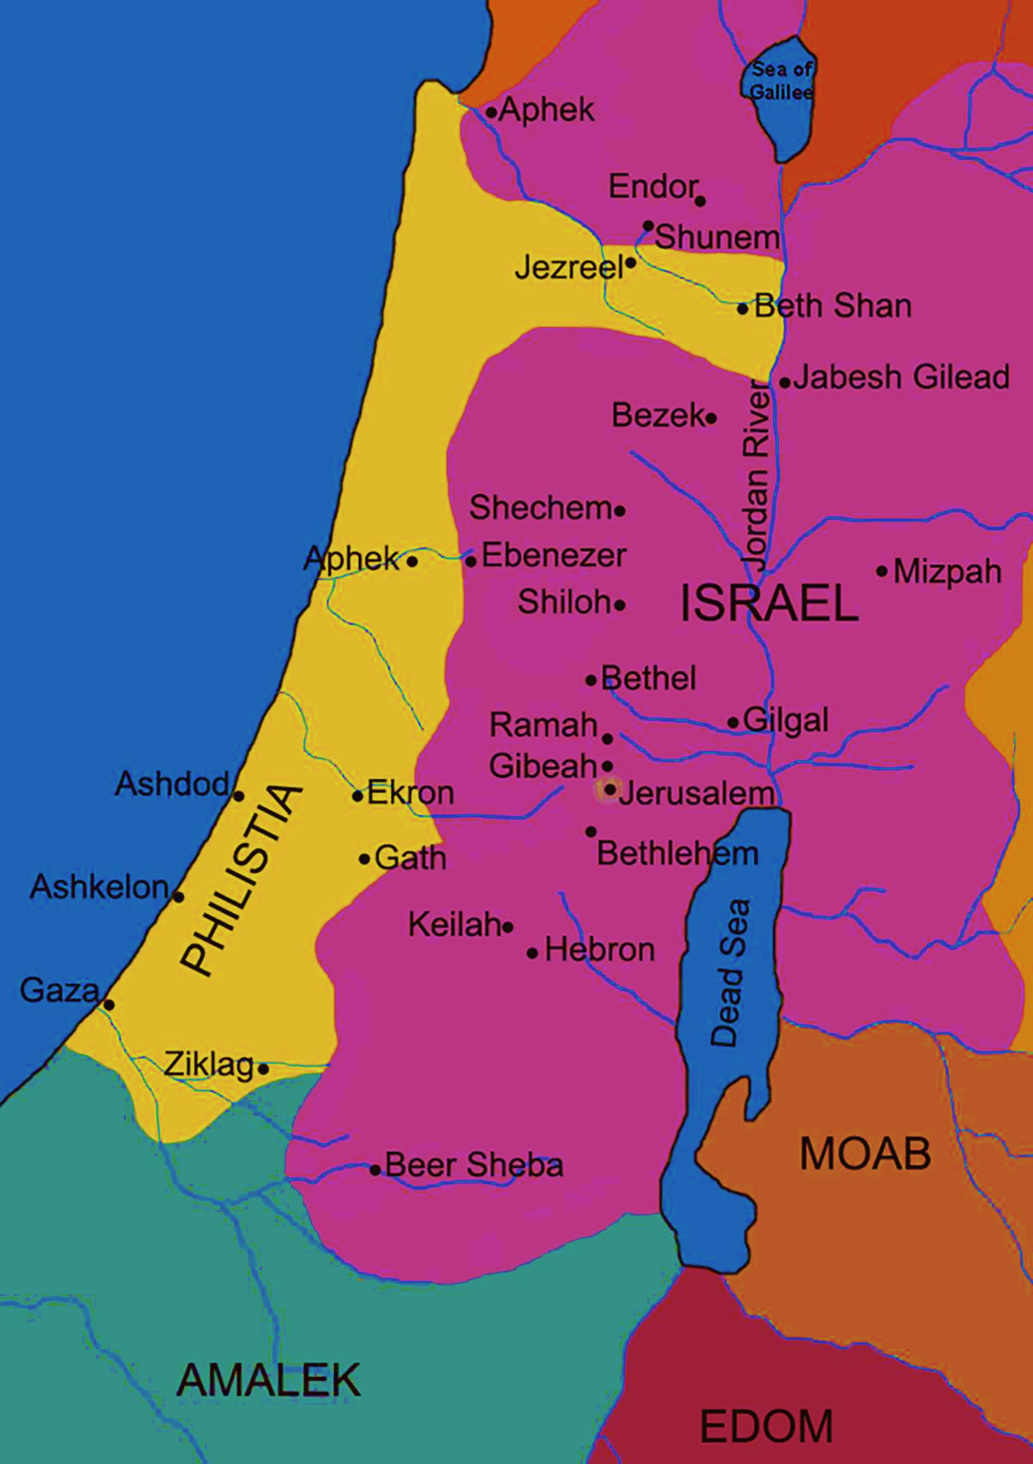

Slide 33
John 13:19; 14:29
“¹⁹ From now on I am telling you before it comes to pass, so that when it does occur, you may believe that I am He… ^{14:29} Now I have told you before it happens, so that when it happens, you may believe.”

Slide 34
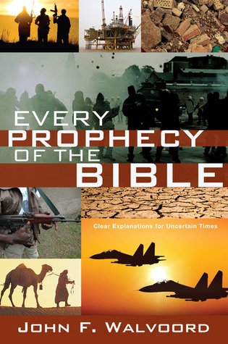

Slide 35
Dr. Arnold G. Fruchtenbaum
The Book of Genesis, 350
“Then came the departure: Abimelech and Phicol the captain of his host, and they returned into the land of the Philistines. Actually, there were no Philistines living in the area yet. Nevertheless, the title is given to these proleptically. It means that this is the area where later the Philistines indeed settled, and Gerar was part of the Philistine Plain. The Philistines arrived later, in the twelfth century b.c. These were their forerunners who now controlled the same territory the Philistines would control later on.”

Slide 36
Charles Ryrie
The Ryrie Study Bible, page 28
Genesis 21:32-33 (RSB:NASB1995U): Genesis 21:32-33. “It is alleged that the mention of the Philistines is an anachronism because they supposedly did not appear in Palestine until after 1190 b.c. However, there is evidence of expansion of Aegean trade during the period of Abraham, and the Philistines mentioned here likely were peaceful traders who settled on the SW coast of Palestine.”

Slide 37
Genesis 21:22-34 Abraham & Abimelech’s Covenant
Abimelech’s recognition (21:22)
Abimelech’s request (21:23)
Abraham’s response (21:24)
Abraham’s complaint (25)
Abimelech’s response (21:26)
Covenant entered (21:27-32)
Covenant’s results (21:33-34)

Slide 38
Covenant’s Results Genesis 21:33-34
Abraham plants (33a)
Abraham worships (33b)
Abraham sojourns (34)

Slide 39
Covenant’s Results Genesis 21:33-34
Abraham plants (33a)
Abraham worships (33b)
Abraham sojourns (34)

Slide 40
Covenant’s Results Genesis 21:33-34
Abraham plants (33a)
Abraham worships (33b)
Abraham sojourns (34)

Slide 41
Psalm 90:2
“Before the mountains were born Or You gave birth to the earth and the world, Even from everlasting (olam) to everlasting (olam), You are God.”

Slide 42
Charles Ryrie
The Ryrie Study Bible, page 28
Genesis 21:33 (RSB:NASB1995U): Genesis 21:33. “the Everlasting God. Heb., El Olam, from an original form meaning ‘the God of Eternity.’”

Slide 44
Covenant’s Results Genesis 21:33-34
Abraham plants (33a)
Abraham worships (33b)
Abraham sojourns (34)

Slide 45
Conclusion

Slide 46
Genesis 21:22-34 Abraham & Abimelech’s Covenant
Abimelech’s recognition (21:22)
Abimelech’s request (21:23)
Abraham’s response (21:24)
Abraham’s complaint (25)
Abimelech’s response (21:26)
Covenant entered (21:27-32)
Covenant’s results (21:33-34)

Slide 47
Genesis 12‒21 Abraham’s Early Journeys
Unconditional promises (Gen. 12:1-3) From Haran to Canaan (Gen. 12:4-5) In Canaan (Gen. 12:6-9) In Egypt (Gen. 12:10-20) Abram and Lot Separate (Gen. 13:1-13) Reaffirmation of Abram’s promises (Gen. 13:14-18) Abram Rescues Lot (14:1-24) Abrahamic Covenant (15:1-21) | Hagar & Ishmael (16:1-16) Circumcision (Gen. 17:1-27) Sodom & Gomorrah (Gen. 18‒19) Abraham & Abimelech (Gen. 20) Isaac’s birth (Gen. 21:1-7) Ishmael’s expulsion (21:8-21) Abraham & Abimelech’s covenant (21:22-34) Abraham sacrifices Isaac (22)

Slide 48
²⁴ The Lord bless you, and keep you; ²⁵ The Lord make His face shine on you, And be gracious to you; ²⁶ The Lord lift up His countenance on you, And give you peace.
Numbers 6:24–26 (NASB95)

