Slide 1

Ezekiel 36‒39
The Middle East Meltdown 2022
Dr. Andy Woods
Senior Pastor – Sugar Land Bible Church
President – Chafer Theological Seminary

Slide 2
Ezekiel 33‒48
Ezekiel recommissioned (33)
False shepherds removed (34)
Edom destroyed (35)
Israel’s restoration: physical & spiritual (36)
Israel’s restoration illustrated (37)
Means of restoration: Northern invasion (38)
Results of the Northern invasion: conversion (39)
Millennial Temple (40‒46)
Tribal land allotment (47‒48)

Slide 3

MAIL BAG
Resurrection during Millennium?
Weapons burning in the New Jerusalem?
Gog-Magog is symbolic?
Hosea 5:15?
Theologians holding to two phase view?
Battle at the end of the Tribulation?
Imminency of the Rapture?
Gog-Magog (Ezek. 38‒39) on a feast day?

Slide 4
MAIL BAG
Resurrection during Millennium?
Weapons burning in the New Jerusalem?
Gog-Magog is symbolic?
Hosea 5:15?
Theologians holding to two phase view?
Battle at the end of the Tribulation?
Imminency of the Rapture?
Gog-Magog (Ezek. 38‒39) on a feast day?

Slide 5
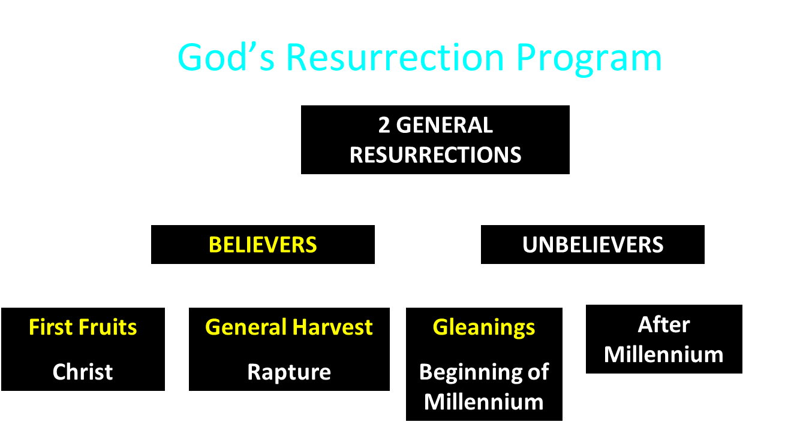

Slide 6

Daniel 12:1-2
“¹ Now at that time Michael, the great prince who stands guard over the sons of your people, will arise. And there will be a time of distress such as never occurred since there was a nation until that time; and at that time your people, everyone who is found written in the book, will be rescued. ² Many of those who sleep in the dust of the ground will awake, these to everlasting life, but the others to disgrace and everlasting contempt.”

Slide 7
Revelation 20:4-6
“⁴ Then I saw thrones, and they sat on them, and judgment was given to them. And I saw the souls of those who had been beheaded because of their testimony of Jesus and because of the word of God, and those who had not worshiped the beast or his image, and had not received the mark on their forehead and on their hand; and they came to life [zaō] and reigned with Christ for a thousand years. ⁵ The rest of the dead did not come to life [zaō] until the . . .

Slide 8
Revelation 20:4-6
. . . thousand years were completed. This is the first resurrection [anastasis]. ⁶ Blessed and holy is the one who has a part in the first resurrection [anastasis]; over these the second death has no power, but they will be priests of God and of Christ and will reign with Him for a thousand years.”

Slide 9


1 Corinthians 15:50-51
“⁵⁰ Now I say this, brethren, that flesh and blood cannot inherit the kingdom of God; nor does the perishable inherit the imperishable. ⁵¹ Behold, I tell you a mystery; we will not all sleep, but we will all be changed.”

Slide 10
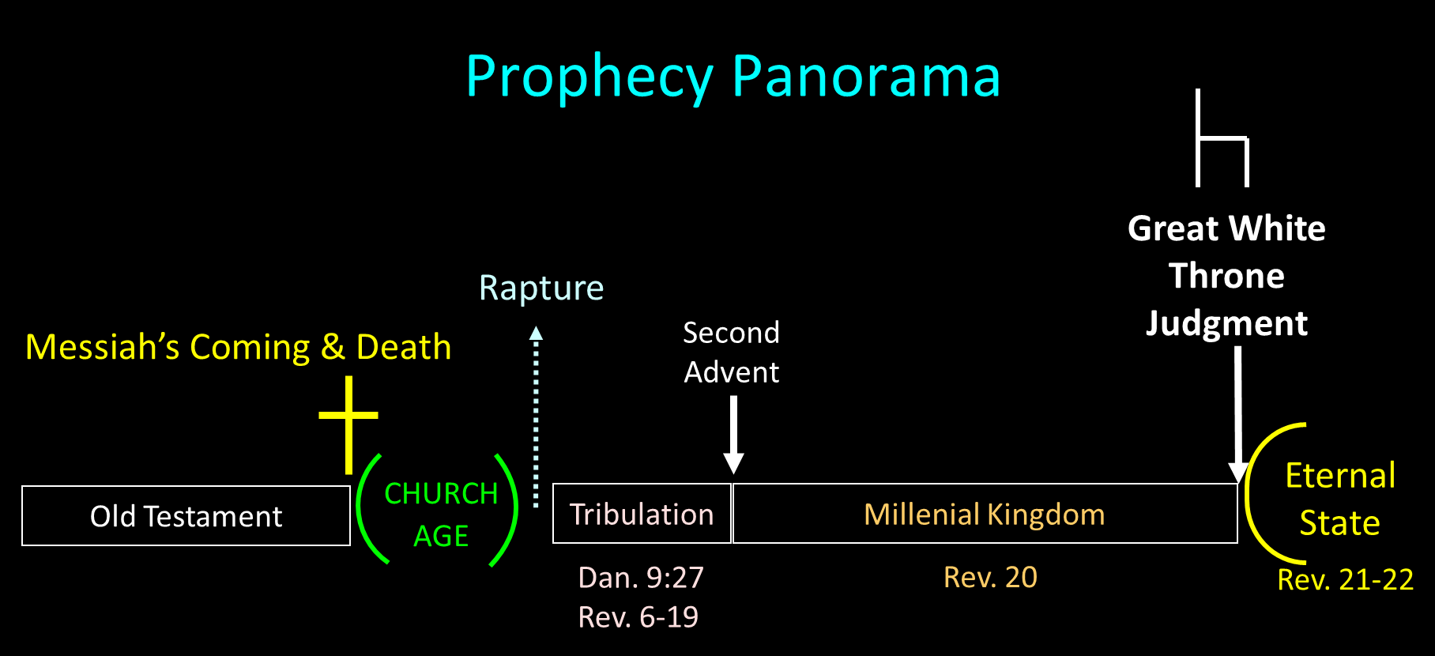

Slide 11
Millennium Rev.20 | Eternal State Rev.21-22
Sin restrained | Sin removed
Curse restrained | Curse removed
Death | No death
Mortals / resurrected | Resurrected only
Mortals Destinies undecided | All Destinies sealed
Renovation | Recreation
Temporary | Eternal
Transitional | Non-transitional
Dispensation | Not a dispensation

Slide 12
Millennium and Eternal State
 | Rev 20:1-10 | Rev 21–22
Time | 20:4 | 22:5
Luminaries | Isa 30:26 | 21:23; 22:5
Temple | Ezek 40–48 | 21:22
Death | Isa 65:20 | 21:4
Satanic activity | 20:7 | 20:10
Rebellion | 20:8-9 | 21:27

Slide 13

Deuteronomy 29:29
“The secret things belong to the Lord our God, but the things revealed belong to us and to our sons forever, that we may observe all the words of this law.”

Slide 14

2 Peter 1:3-4
“³ Seeing that His divine power has granted to us everything pertaining to life and godliness, through the true knowledge of Him who called us by His own glory and excellence. ⁴For by these He has granted to us His precious and magnificent promises, so that by them you may become partakers of the divine nature, having escaped the corruption that is in the world by lust.”

Slide 15
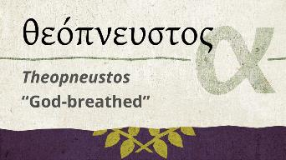
2 Timothy 3:16-17
“¹⁶ All Scripture is inspired by God and profitable for teaching, for reproof, for correction, for training in righteousness; ¹⁷ so that the man of God may be adequate, equipped for every good work.”
15

Slide 16
MAIL BAG
Resurrection during Millennium?
Weapons burning in the New Jerusalem?
Gog-Magog is symbolic?
Hosea 5:15?
Theologians holding to two phase view?
Battle at the end of the Tribulation?
Imminency of the Rapture?
Gog-Magog (Ezek. 38‒39) on a feast day?

Slide 17
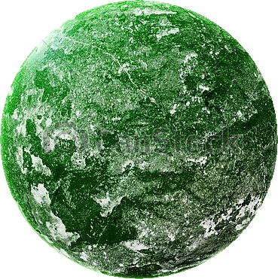
Jerusalem Descending
Notes:
The descending city is described as being like a stone called Jasper, only unlike the earthly stone, this one is clear as crystal. The ultimate state of heaven sounds more like a diamond, doesn’t it?

Slide 18

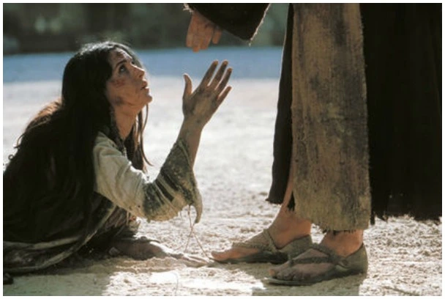
Revelation 21:4
“and He will wipe away every tear from their eyes; and there will no longer be any death; there will no longer be any mourning, or crying, or pain; the first things have passed away.”

Slide 19
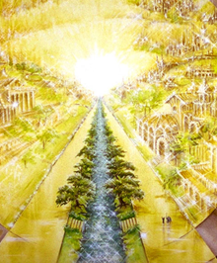
Eternal State is Future
No Satan (Rev 20:10)
No sea (Rev 21:1)
No death, crying, or pain (Rev 21:4)
No Sun (Rev 22:5)
No Moon (Rev 21:23)
No temple (Rev. 21:22)
No night (Rev 21:25)
No evil (Rev 21:27)
No curse (Rev 22:3)

Slide 21
Millennium Rev.20 | Eternal State Rev.21-22
Sin restrained | Sin removed
Curse restrained | Curse removed
Death | No death
Mortals / resurrected | Resurrected only
Mortals Destinies undecided | All Destinies sealed
Renovation | Recreation
Temporary | Eternal
Transitional | Non-transitional
Dispensation | Not a dispensation

Slide 22
Millennium and Eternal State
 | Rev 20:1-10 | Rev 21–22
Time | 20:4 | 22:5
Luminaries | Isa 30:26 | 21:23; 22:5
Temple | Ezek 40–48 | 21:22
Death | Isa 65:20 | 21:4
Satanic activity | 20:7 | 20:10
Rebellion | 20:8-9 | 21:27

Slide 23
What?
Divine annihilation of the coalition (38:19-22)
Birds and beasts feast on the carnage (39:4-5, 17-20)
Seven-month burying of the dead (39:11-12, 14-16)
Seven-year burning of weapons (39:9-10)
Israel’s salvation and restoration (39:22, 29)

Slide 24
When?
Beginning of the Millennium
End of the Millennium
End of the Tribulation
Before the Tribulation
First half of the Tribulation
Two phase view

Slide 25

25

Slide 26
MAIL BAG
Resurrection during Millennium?
Weapons burning in the New Jerusalem?
Gog-Magog is symbolic?
Hosea 5:15?
Theologians holding to two phase view?
Battle at the end of the Tribulation?
Imminency of the Rapture?
Gog-Magog (Ezek. 38‒39) on a feast day?

Slide 27
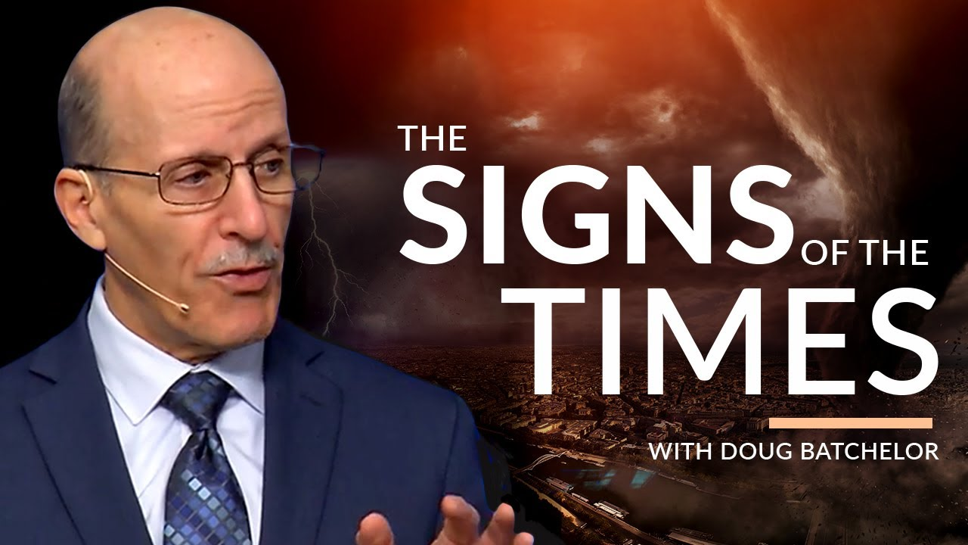

Slide 28


Slide 29

Ancient Names From Ezekiel 38:1-9
Magog (Central Asia), Rosh (Russia), Meshec (Turkey), Tubal (Turkey), Persia (Iran), Put (Libya), Cush (Sudan), Gomer (Turkey), | Togarmah (Turkey) Sheba (Saudi Arabia) Dedan (Saudi Arabia or Yemen) Tarshish (Spain) Merchants of Tarshish (Conglomeration of Western powers including Europe) Israel

Slide 30
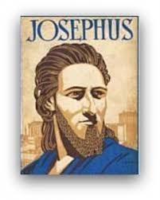
Josephus
Josephus, Antiquities, 1.6.1.
"Magog founded those that from him were named Magogites, but who are by the Greeks called Scythians."

Slide 31
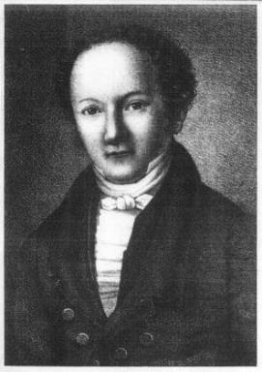
Wilhelm Gesenius
Gesenius' Hebrew and Chaldee Lexicon (Samuel Bagster and Sons, 1847; reprint, Grand Rapids: Baker, 1987), 752.
"pr. n. of a northern nation, mentioned with Tubal and Meshech; undoubtedly the Russians, who are mentioned by the Byzantine writers of the tenth century, under the name the Ros, dwelling to the north of Taurus . . .as dwelling on the river Rha (Wolga)."

Slide 32
Clyde Billington
Clyde E. Billington Jr., “The Rosh People in History and Prophecy (Part Two)” Michigan Theological Journal 3 (1992): 59, 61.
“Historical, ethnological, and archaeological evidence all favor the conclusion that the Rosh people of Ezekiel 38–39 were the ancestors of the Rus/Ros people of Europe and Asia. . . . Those Rosh people who lived to the north of the Black Sea in ancient and medieval times were called the Rus/Ros/Rox/Aorsi from very early times. . . . The Rosh people of the area north of the Black Sea formed the people known today as the Russians.”

Slide 33
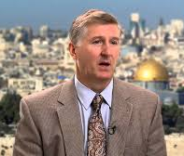
Is Rosh Russia?
The End, Page 296
“First, linguistically and historically, there is substantial evidence that in Ezekiel’s day there was a group of people known variously as Rash, Reshu, or Ros who lived in what today is southern Russia. Egyptian inscriptions as early as 2600 BC identify a place called Rosh (Rash). A later Egyptian inscription from about 1500 BC refers to a land called Reshu that was located to the north of Egypt. Other ancient documents include a place named Rosh or its equivalent in various languages.”

Slide 34
Is Rosh Russia?
The End, Page 296
“The word appears three times in the Septuagint (LXX), ten times in Sargon’s inscriptions, once in Ashurbanipal’s cylinder, once in Sennacherib’s annals, and five times in Ugaritic tablets. While the word has a variety of forms and spellings, it is clear that the same people are in view. Rosh was apparently a well-known place in Ezekiel’s day.”

Slide 35
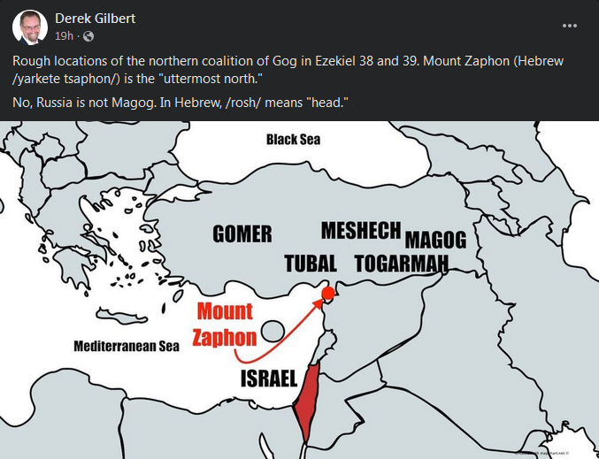

Slide 36

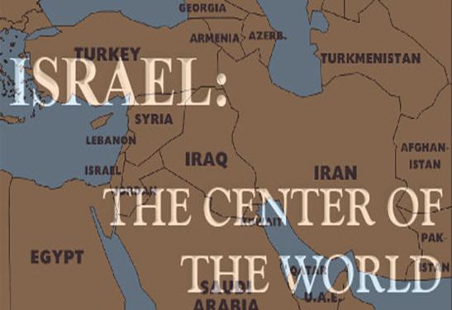
Ezekiel 38:2 (KJV)
“Son of man, set thy face against Gog, the land of Magog, the chief prince of Meshech and Tubal, and prophesy against him.”

Slide 37
Ezekiel 38:2 (NASB/NASB95)
“Son of man, set your face toward Gog of the land of Magog, the prince of Rosh, Meshech and Tubal, and prophesy against him.”

Slide 38
Wilhelm Gesenius
Gesenius' Hebrew and Chaldee Lexicon (Samuel Bagster and Sons, 1847; reprint, Grand Rapids: Baker, 1987), 752.
"pr. n. of a northern nation, mentioned with Tubal and Meshech; undoubtedly the Russians, who are mentioned by the Byzantine writers of the tenth century, under the name the Ros, dwelling to the north of Taurus . . .as dwelling on the river Rha (Wolga)."

Slide 39
Is Rosh Russia?
The End, Page 295
“The weight of evidence favors translating Rosh in Ezekiel 38–39 as a proper name. Five arguments support this view. First, the eminent Hebrew scholars C. F. Keil and Wilhelm Gesenius both hold that a proper noun is the better translation of Rosh in Ezekiel 38:2-3 and 39:1, referring to a specific geographical location. Second, the Greek translation of the Old Testament, the Septuagint, translates Rosh as the proper name Ros. This translation is especially significant since the Septuagint was translated only three centuries after Ezekiel was written—obviously much closer to the original than any modern translation.”

Slide 40
Is Rosh Russia?
The End, Page 295
“The modern translations of Rosh as an adjective can be traced to the Latin Vulgate of Jerome. Third, in their articles on Rosh, many Bible dictionaries and encyclopedias (New Bible Dictionary, Wycliffe Bible Dictionary, and International Standard Bible Encyclopedia) support taking it as a proper name in Ezekiel 38. Fourth, Rosh is mentioned the first time in Ezekiel 38:2 and then repeated in Ezekiel 38:3 and 39:1. If Rosh were simply a title, it would be dropped in these two places, because when titles are repeated in Hebrew, they are generally abbreviated.”

Slide 41
Is Rosh Russia?
The End, Page 295
“Fifth, the most impressive evidence in favor of taking Rosh as a proper name is simply that this translation in this context is the most natural. G. A. Cooke translates Ezekiel 38:2, ‘the chief of Rosh, Meshech and Tubal.’ He calls this ‘the most natural way of rendering the Hebrew.’ The compelling evidence of biblical scholarship indicates that Rosh be understood as a proper name—the name of a specific geographic area.”

Slide 42
Josephus
Josephus, Antiquities, 1.6.1.
"..and the Mosocheni were founded by Mosoch; now they are Cappadocians."

Slide 43

Herodotus, Histories, 3:93-94 (450 B.C.)
“The twelfth, the Bactrians as far as the land of the Aegli; these paid three hundred and sixty. The thirteenth, the Pactyic country and Armenia and the lands adjoining as far as the Euxine sea; these paid four hundred…The Moschi, Tibareni, Macrones, Mossynoeci, and Mares, the nineteenth province, were ordered to pay three hundred. The Indians made up the twentieth province. These are more in number than any nation of which we know, and they paid a greater tribute than any other province, namely three hundred and sixty talents of gold dust.”

Slide 44


Statue
&
Stone

Slide 45
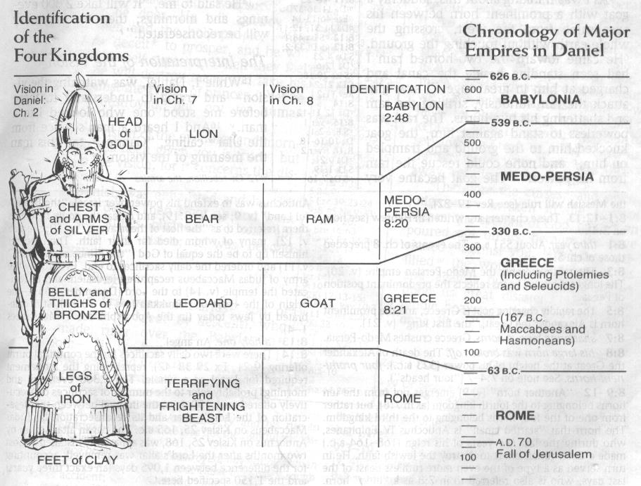

Slide 46
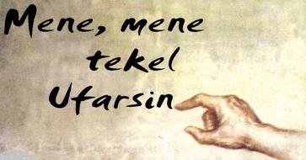
Daniel Interprets the Writing (5:24-28)

Slide 47
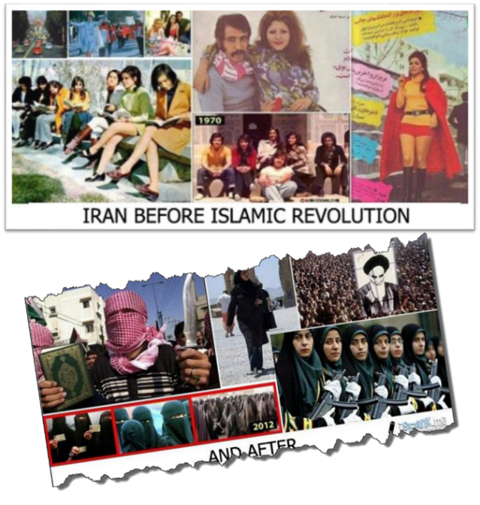

Slide 48
Josephus
Josephus, Antiquities, 1.6.2.
"Phut also was the founder of Libya, and called the inhabitants Phutites, from himself: there is also a river in the country of Moors which bears that name; whence it is that we may see the greatest part of the Grecian historiographers mention that river and the adjoining country by the apellation of Phut: but the name it has now has been by change given it from one of the sons of Mesraim, who was called Lybyos."

Slide 49
Josephus
Josephus, Antiquities, 1.6.2.
"For of the four sons of Ham, time has not at all hurt the name of Cush; for the Ethiopians, over whom he reigned, are even at this day, both by themselves and by all men in Asia, called Cushites."

Slide 50
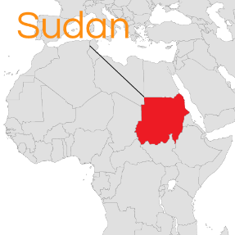
Cush = Sudan
Philip C. Johnson, “Cush,” in Wycliffe Bible Encyclopedia, ed. Howard F. Vos, Charles F. Pfeiffer, John Rea (Chicago: Moody, 1975), p. 1.411.
"The designation, Ethiopia, is misleading for it did not refer to the modern state of Ethiopia. . .Cush. . .bordered Egypt on the South,. . .or modern Sudan."

Slide 51
Josephus
Josephus, Antiquities, 1.6.1.
"For Gomer founded those whom the Greeks now call Galatians, [Galls,] but were then called Gomerites.”

Slide 52
Josephus
Josephus, Antiquities, 1.6.1.
"...Thrugramma the Thrugrammeans, who, as the Greeks resolved, were named Phrygians.”

Slide 53
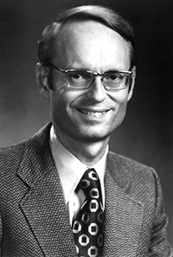
Tarshish = Spain
Ryrie Study Bible, p. 1,421.
The Ryrie Study Bible indicates that Tarshish “is located in the S of Spain near Gibraltar, 2,500 mi. (4,000 km) W of Palestine [or Israel] and the opposite direction from Nineveh.”

Slide 54

Revelation 20:7-9
“⁷ When the thousand years are completed, Satan will be released from his prison, ⁸ and will come out to deceive the nations which are in the four corners of the earth, Gog and Magog, to gather them together for the war; the number of them is like the sand of the seashore. ⁹ And they came up on the broad plain of the earth and surrounded the camp of the saints and the beloved city, and fire came down from heaven and devoured them.

Slide 56
Millennial Fulfillment?
EZEK. 38-39 | REV. 20:7-9
Northern invasion | All nation invade
Nations identified | Nations unidentified
Invasion leads to Millennium (Ezek 40-48) | Invasion comes at end of Millennium
Invasion leads to Millennium (Ezek 40-48) | Invasion leads to Eternal State (Rev 21-22)
7 months necessary to dispose of the dead (39:12) | Dead disposed of instantaneously (20:9)
Satan not bound prior to invasion | Satan bound prior to invasion (Rev 20:2)
Pentecost, Things To Come, 349-50

Slide 57
David J. MacLeod
David J. MacLeod, “The Fifth ‘Last Thing’: The Release of Satan and Man’s Final Rebellion (Rev. 20: 7–10),” Bibliotheca Sacra 157, no. 626 (April 2000): p. 209.
“How can Gog and Magog refer to a battle in Revelation 19 before the millennium and this battle at the end of the millennium? The most likely explanation is that Antichrist is Gog and will be defeated at the Second Coming. During the millennium his defeat will become a legend among the nations, something like Napoleon’s defeat at Waterloo. Then at the end of the millennial kingdom the Gog and Magog ‘legend’ is applied to a new historical situation (20:8), with Satan leading the new ‘Gog and Magog.’ Satan will meet his ‘Waterloo’—his ‘Gog and Magog.’”

Slide 58
MAIL BAG
Resurrection during Millennium?
Weapons burning in the New Jerusalem?
Gog-Magog is symbolic?
Hosea 5:15?
Theologians holding to two phase view?
Battle at the end of the Tribulation?
Imminency of the Rapture?
Gog-Magog (Ezek. 38‒39) on a feast day?

Slide 59
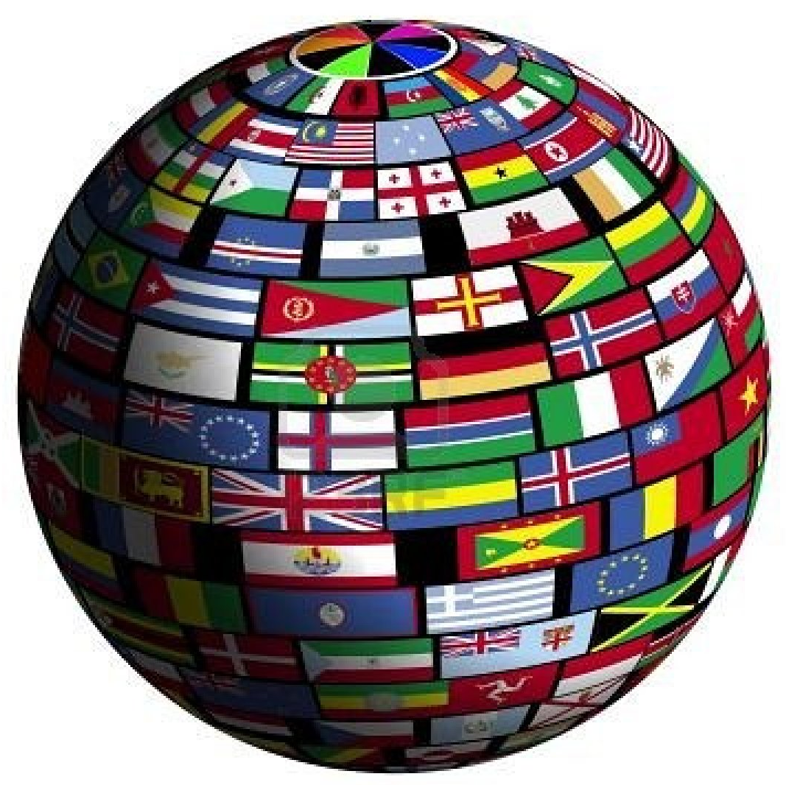
Genesis 12:3
“And I will bless those who bless you, And the one who curses you I will curse. And in you all the families of the earth will be blessed.”

Slide 60
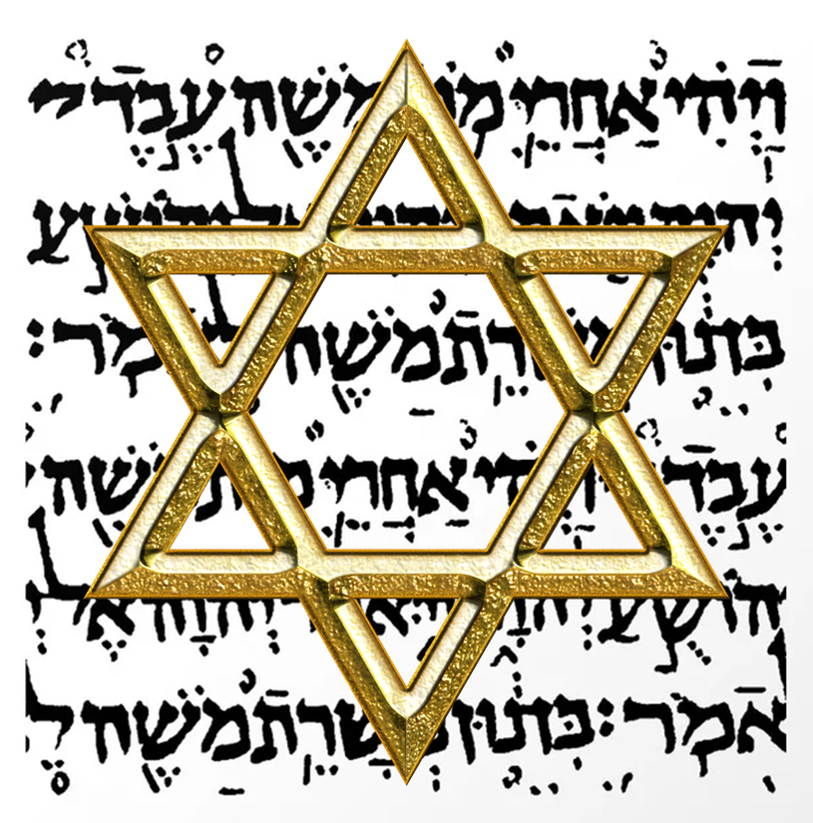
Israel’s Three Blessings to the World
(Gen 12:3b)
Scripture (Rom 3:2)
Savior (John 4:22)
Kingdom (Isa 2:2-3)

Slide 61
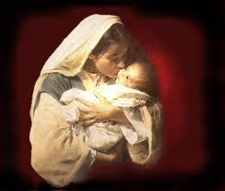
Satanic Attempts to Stop Messiah’s Birth
Cain & Abel (Gen. 4)
Sons of God (Gen. 6)
Pharaoh persecutes Israel (Exod. 1)
Joash protected from Athaliah (2 Chron. 22‒23)
Haman persecutes Israel (Esther)
Antiochus Epiphanés (Dan. 11:31)
Herod persecutes Christ (Matt 2; Rev 12:4)

Slide 62
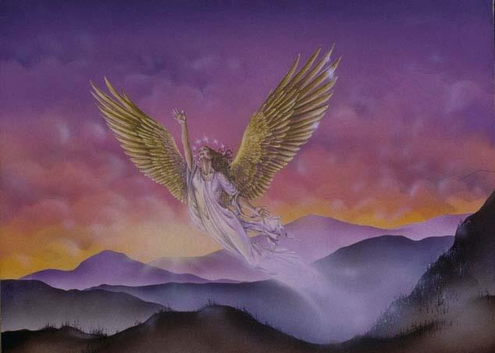
CONNECTING
REV 12 & ANTI-SEMITISM
DANIEL’S 70th WEEK (7 years)
Israel flees
3 ½ years
1260 days

Slide 63
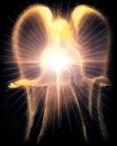

Satan’s Progressive Defeat
Initial eviction from heaven (Isa 14:12-15; Ezek 28:12-17)
Eden (Gen 3:15)
Pre-diluvian world (1 Pet 3:19-20)
Cross (John 12:31; 16:11; Col 2:15; Heb 2:14; 1 John 3:8)
Mid point of the Tribulation (Rev 12:9)
Beginning of millennium (Rev 20:2-3)
End of millennium (Rev 20:10)

Slide 64

Revelation 20:1-3
“Then I saw an angel coming down from heaven, holding the key of the abyss and a great chain in his hand. ² And he laid hold of the dragon, the serpent of old, who is the devil and Satan, and bound him for a thousand years; ³ and he threw him into the abyss, and shut it and sealed it over him, so that he would not deceive the nations any longer, until the thousand years were completed; after these things he must be released for a short time.”

Slide 65
Satan’s Progressive Defeat
Initial eviction from heaven (Isa 14:12-15; Ezek 28:12-17)
Eden (Gen 3:15)
Pre-diluvian world (1 Pet 3:19-20)
Cross (John 12:31; 16:11; Col 2:15; Heb 2:14; 1 John 3:8)
Mid point of the Tribulation (Rev 12:9)
Beginning of millennium (Rev 20:2-3)
End of millennium (Rev 20:10)

Slide 66
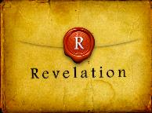
Revelation 20:10
“And the devil who deceived them was thrown into the lake of fire and brimstone, where the beast and the false prophet are also; and they will be tormented day and night forever and ever.”

Slide 67
Hosea 5:15
“I will go away and return to My place Until they acknowledge their guilt and seek My face; In their affliction they will earnestly seek Me.”

Slide 68
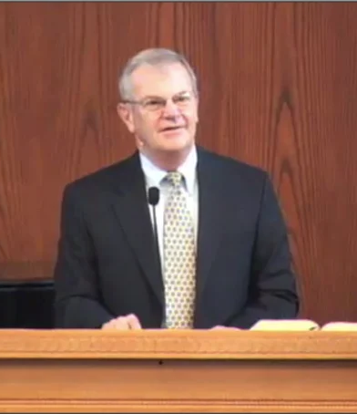
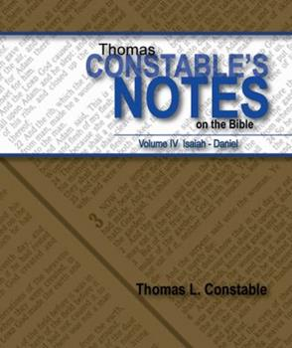
Thomas L. Constable
Constable’s online notes on Hosea, p. 55.
“The language would appear to reach into the Millennium, when the Israelites will indeed repent before God and seek His face (cf. 1:10-11; 2:14- 23).”
“Taken with Mt. 23:37-39, this passage gives in broad outline the course of Israel's future restoration to God.”

Slide 69

Christ’s Three Offices
Prophet – 1st Coming (Matt. 4:17)
Priest – Present Session (Heb. 4:15)
King – 2nd Coming (Isa. 9:6-7; Matt. 25:31)

Slide 70

Matthew 23:37-39
³⁷ “Jerusalem, Jerusalem, who kills the prophets and stones those who are sent to her! How often I wanted to gather [episynagō] your children together, the way a hen gathers [episynagō] her chicks under her wings, and you were unwilling. ³⁸ Behold, your house is being left to you desolate! ³⁹ For I say to you, from now on you will not see Me until you say, ‘Blessed is He who comes in the name of the Lord!’”

Slide 71
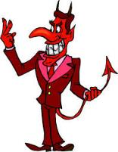
Names & Titles Demonstrating Satan’s
Post-Fall, Earthly Authority
(Job 1:7; 2:2; Luke 4:5-8; Rom. 8:19-22)
Prince of this world (John 12:31; 14:30; 16:11)
God of this age (2 Cor. 4:4)
Prince and power of the air (Eph. 2:2)
Who the believer wrestles with (Eph. 6:12)
Roaring lion (1 Pet. 5:8)
Whole world lies in his power (1 John 5:19)

Slide 72
MAIL BAG
Resurrection during Millennium?
Weapons burning in the New Jerusalem?
Gog-Magog is symbolic?
Hosea 5:15?
Theologians holding to two phase view?
Battle at the end of the Tribulation?
Imminency of the Rapture?
Gog-Magog (Ezek. 38‒39) on a feast day?

Slide 73
When?
Beginning of the Millennium
End of the Millennium
End of the Tribulation
Before the Tribulation
First half of the Tribulation
Two phase view

Slide 74
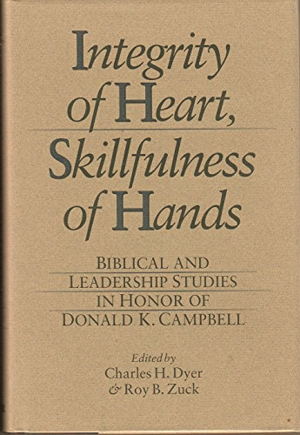

Slide 75
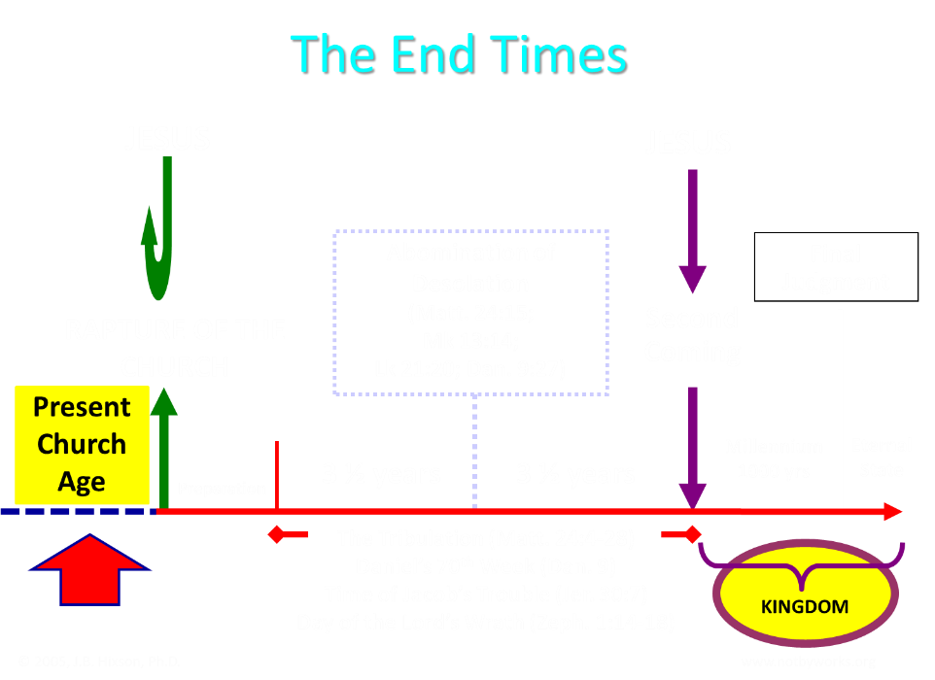

Slide 76

Pre-Daniel’s 70th Week Advocates
1. Tim LaHaye | 7. Mal Couch
2. Chuck Missler | 8. Joel Rosenberg
3. Thomas Ice | 9. Ron Rhodes
4. Randall Price | 10. Stanely Maughan
5. Zola Levitt | 11. David Cooper
6. Tom McCall | 12. Arnold Fruchtenbaum

Slide 77
What?
Divine annihilation of the coalition (38:19-22)
Birds and beasts feast on the carnage (39:4-5, 17-20)
Seven-month burying of the dead (39:11-12, 14-16)
Seven-year burning of weapons (39:9-10)
Israel’s salvation and restoration (39:22, 29)

Slide 78

Charles L. Feinberg
The Prophecy of Ezekiel: The Glory of the Lord, Paperback ed. (Chicago: Moody, 1969; reprint, Chicago: Moody, 1984), 230-31.
“Now there is presented the third emphasis of the greatness of the invasion and the subsequent slaughter at the hand of the Lord. Incidentally, the figure gives a clue as to the time setting for the entire passage. It is the same scene as that a Revelation 19, the great supper of God, and the chronology is clear. The events will transpire at the end of the great tribulation and just before the millennial reign of the Messiah of Israel.”

Slide 79


Jeremiah 30:7
“Alas! for that day is great, There is none like it; And it is the time of Jacob’s distress (Gen. 32:8; 35:10), But he will be saved from it.”

Slide 80
Ezekiel 36:24-28
“For I will take you from the nations, gather you from all the lands and bring you into your own land. ²⁵ Then I will sprinkle clean water on you, and you will be clean; I will cleanse you from all your filthiness and from all your idols. ²⁶ Moreover, I will give you a new heart and put a new spirit within you; and I will remove the heart of stone from your flesh and give you a heart of flesh. ²⁷ I will put My Spirit within you and cause you to walk in My statutes, and you will be careful to observe My ordinances. ²⁸ You will live in the land that I gave to your forefathers; so you will be My people, and I will be your God.”

Slide 81
Ezekiel 37:7-11
So I prophesied as I was commanded; and as I prophesied, there was a noise, and behold, a rattling; and the bones came together, bone to its bone. ⁸ And I looked, and behold, sinews were on them, and flesh grew and skin covered them; but there was no breath in them. ⁹ Then He said to me, “Prophesy to the breath, prophesy, son of man, and say to the breath, ‘Thus says the Lord God, “Come from the four winds, O breath, and breathe on these slain, that they come to life.”’” ¹⁰ So I prophesied as He . . .

Slide 82
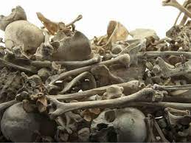
Ezekiel 37:7-11
. . . commanded me, and the breath came into them, and they came to life and stood on their feet, an exceedingly great army. ¹¹ Then He said to me, “Son of man, these bones are the whole house of Israel; behold, they say, ‘Our bones are dried up and our hope has perished. We are completely cut off’.”

Slide 83
MAIL BAG
Resurrection during Millennium?
Weapons burning in the New Jerusalem?
Gog-Magog is symbolic?
Hosea 5:15?
Theologians holding to two phase view?
Battle at the end of the Tribulation?
Imminency of the Rapture?
Gog-Magog (Ezek. 38‒39) on a feast day?

Slide 84
Armageddon?
Ezek 38-39 |  | Armageddon
No battle (38:20-23) |  | Battle between armies and Lord (Rev. 19:19)
Invaders come from the far west and north (38:5) |  | All nations invade (Rev. 16:14; Zech. 12:3)
Enemies destroyed on Israel’s mountains (39:2-4) |  | Events take place in Jerusalem (Zech. 12:2; 14:2; and the Valley of Jehoshaphat (Joel 3:12)
Israel dwelling in safety (38:11) |  | Israel not dwelling in safety (Rev. 12:14-17)
No massive blood flow recorded |  | Massive flow of blood (Rev. 14:20)
Fire comes upon invaders (39:6) |  | Fire does not come upon invaders
Pentecost, Things to Come, 347-48

Slide 86
MAIL BAG
Resurrection during Millennium?
Weapons burning in the New Jerusalem?
Gog-Magog is symbolic?
Hosea 5:15?
Theologians holding to two phase view?
Battle at the end of the Tribulation?
Imminency of the Rapture?
Gog-Magog (Ezek. 38‒39) on a feast day?

Slide 87

John 14:1–4
¹ “Do not let your heart be troubled; believe in God, believe also in Me. ² “In My Father’s house are many dwelling places; if it were not so, I would have told you; for I go to prepare a place for you. ³ “If I go and prepare a place for you, I will come again and receive you to Myself, that where I am, there you may be also. ⁴ “And you know the way where I am going.”

Slide 88
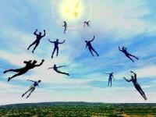
Imminent
(1 Cor 15:51; 1 Thess 4:15)
Imminency definition
James 5:8; 1 Thess 1:10; 1 Cor 1:7; Philip 3:20
We are to be looking for Jesus Christ and not the Antichrist!
Motivator (Holiness, Evangelism)
Feast of Trumpets?

Slide 89
1 Thessalonians 4:13-18
¹³ "But we do not want you to be uninformed, brethren, about those who are asleep, so that you will not grieve as do the rest who have no hope. ¹⁴ For if we believe that Jesus died and rose again, even so God will bring with Him those who have fallen asleep in Jesus. ¹⁵ For this we say to you by the word of the Lord, that we who are alive and remain until the coming of the Lord, will not precede those who . . .

Slide 90

1 Corinthians 15:51
“Behold, I tell you a mystery; we will not all sleep, but we will all be changed.”

Slide 91


Slide 92

Galatians 4:4
“But when the fullness of the time came, God sent forth His Son, born of a woman, born under the Law.”

Slide 93

Daniel 9:27
And he will make a firm covenant with the many for one week, but in the middle of the week he will put a stop to sacrifice and grain offering; and on the wing of abominations will come one who makes desolate, even until a complete destruction, one that is decreed, is poured out on the one who makes desolate.

Slide 94


Slide 95
MAIL BAG
Resurrection during Millennium?
Weapons burning in the New Jerusalem?
Gog-Magog is symbolic?
Hosea 5:15?
Theologians holding to two phase view?
Battle at the end of the Tribulation?
Imminency of the Rapture?
Gog-Magog (Ezek. 38‒39) on a feast day?

Slide 96
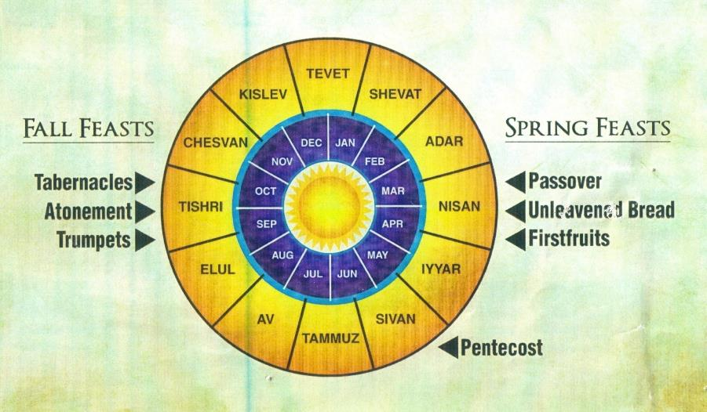

Slide 97


Slide 98
Levitical Feasts (Lev. 23)
Feast | Season | Purpose | Type
Passover | Spring | Redemption | 1 Cor. 5:7
Unleavened Bread | Spring | Separation | John 6:35
1st fruits | Spring | Praise | 1 Cor. 15:20
Pentecost | Spring | Praise | Acts 2:1-4
Trumpets | Fall | New Year | Matt. 24:31
Atonement | Fall | Lev 16 | Zech. 12:10
Booths | Fall | Wilderness provision | Zech. 14:16-18

Slide 99
What?
Divine annihilation of the coalition (38:19-22)
Birds and beasts feast on the carnage (39:4-5, 17-20)
Seven-month burying of the dead (39:11-12, 14-16)
Seven-year burning of weapons (39:9-10)
Israel’s salvation and restoration (39:22, 29)

Slide 100
Zechariah 12:10
“I will pour out on the house of David and on the inhabitants of Jerusalem, the Spirit of grace and of supplication, so that they will look on Me whom they have pierced; and they will mourn for Him, as one mourns for an only son, and they will weep bitterly over Him like the bitter weeping over a firstborn.”

Slide 101
CONCLUSION

Slide 102
MAIL BAG
Resurrection during Millennium?
Weapons burning in the New Jerusalem?
Gog-Magog is symbolic?
Hosea 5:15?
Theologians holding to two phase view?
Battle at the end of the Tribulation?
Imminency of the Rapture?
Gog-Magog (Ezek. 38‒39) on a feast day?

