Slide 1
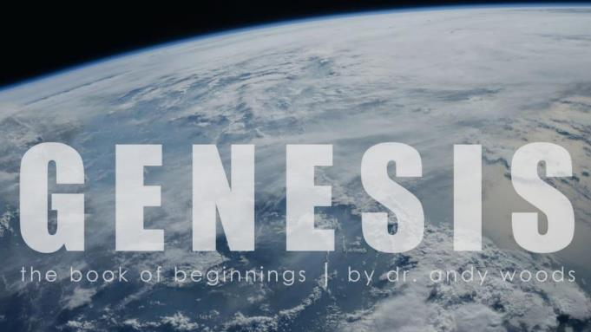
Genesis 12‒50
Israel’s Birth & Preservation

Slide 2
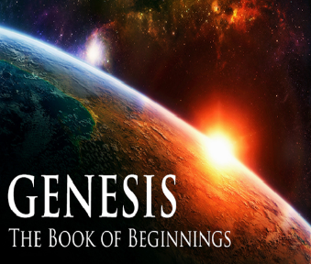
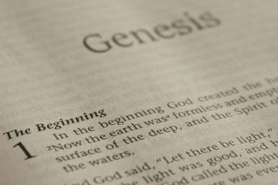
GENESIS STRUCTURE
Beginning of the Human race (Gen. 1‒11)
Beginning of the Hebrew race (Gen. 12‒50)

Slide 3
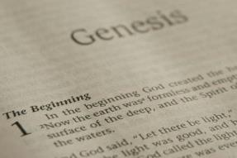
GENESIS STRUCTURE
Genesis 1-11 (four events)
Creation (1-2)
Fall (3-5)
Flood (6-9)
National dispersion (10-11)

Slide 4
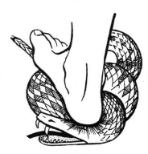
Genesis 3:15
“And I will put enmity Between you and the woman, And between your seed and her seed; He shall bruise you on the head, And you shall bruise him on the heel.”

Slide 5
GENESIS STRUCTURE
Beginning of the Human race (Gen. 1‒11)
Beginning of the Hebrew race (Gen. 12‒50)

Slide 6
GENESIS STRUCTURE
Genesis 12-50 (four people)
Abraham (12:1–25:11)
Isaac (25:12–26:35)
Jacob (27–36)
Joseph (37–50)

Slide 7
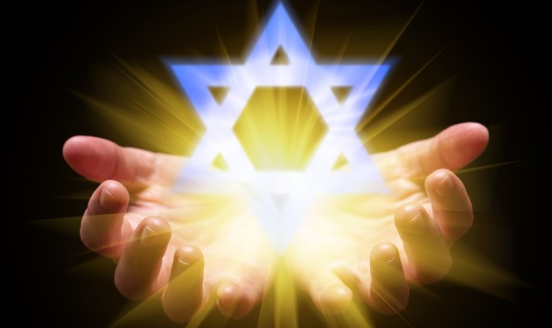
Isaiah 43:1
“But now, thus says the Lord, your Creator, O Jacob, And He who formed you, O Israel, 'Do not fear, for I have redeemed you; I have called you by name; you are Mine!'”

Slide 8
GENESIS STRUCTURE
Genesis 12-50 (four people)
Abraham (12:1–25:11)
Isaac (25:12–26:35)
Jacob (27–36)
Joseph (37–50)

Slide 9
Genesis 12‒21 Abraham’s Early Journeys
Unconditional promises (Gen. 12:1-3) From Haran to Canaan (Gen. 12:4-5) In Canaan (Gen. 12:6-9) In Egypt (Gen. 12:10-20) Abram and Lot Separate (Gen. 13:1-13) Reaffirmation of Abram’s promises (Gen. 13:14-18) Abram Rescues Lot (14:1-24) | Abrahamic Covenant (15:1-21) Hagar & Ishmael (16:1-16) Circumcision (Gen. 17:1-27) Sodom & Gomorrah (Gen. 18‒19) Abraham & Abimelech (Gen. 20) Isaac’s birth (Gen. 21:1-7) Ishmael’s expulsion (21:8-21)

Slide 10
Genesis 21:8-21 Ishmael’s Expulsion
Isaac’s weaning (8)
Ishmael’s mocking (9)
Sarah’s demand (10)
Abraham’s grief (11)
God comforts Abraham (12-13)
Expulsion (14)
Hagar’s anguish (15-16)
God’s comfort (17-18)
God’s provision (19)
Ishmael’s development (20)
Ishmael's marriage (21)

Slide 11
Genesis 21:8-21 Ishmael’s Expulsion
Isaac’s weaning (8)
Ishmael’s mocking (9)
Sarah’s demand (10)
Abraham’s grief (11)
God comforts Abraham (12-13)
Expulsion (14)
Hagar’s anguish (15-16)
God’s comfort (17-18)
God’s provision (19)
Ishmael’s development (20)
Ishmael's marriage (21)

Slide 12
Genesis 12‒21 Abraham’s Early Journeys
Unconditional promises (Gen. 12:1-3) From Haran to Canaan (Gen. 12:4-5) In Canaan (Gen. 12:6-9) In Egypt (Gen. 12:10-20) Abram and Lot Separate (Gen. 13:1-13) Reaffirmation of Abram’s promises (Gen. 13:14-18) Abram Rescues Lot (14:1-24) | Abrahamic Covenant (15:1-21) Hagar & Ishmael (16:1-16) Circumcision (Gen. 17:1-27) Sodom & Gomorrah (Gen. 18‒19) Abraham & Abimelech (Gen. 20) Isaac’s birth (Gen. 21:1-7) Ishmael’s expulsion (21:8-21)

Slide 13
Genesis 21:8-21 Ishmael’s Expulsion
Isaac’s weaning (8)
Ishmael’s mocking (9)
Sarah’s demand (10)
Abraham’s grief (11)
God comforts Abraham (12-13)
Expulsion (14)
Hagar’s anguish (15-16)
God’s comfort (17-18)
God’s provision (19)
Ishmael’s development (20)
Ishmael's marriage (21)

Slide 14
VI. 8 New Promises Genesis 12:1-3
Land (Gen. 12:1b)
Great nation (Gen. 12:2a)
Personal blessing (Gen. 12:2b)
Great name (Gen. 12:2c)
Blessing to others (Gen. 12:2d)
Blessing to blessers (Gen. 12:3a)
Cursing to cursers (Gen. 12:3b)
Blessing to the world (Gen. 12:3c)

Slide 15
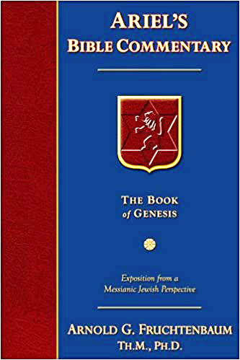
Dr. Arnold G. Fruchtenbaum
The Book of Genesis, 240
“This is the first of seven times that Abraham receives a direct revelation from God. In 12:1–3 is God’s initial call to Abram outside the Land of Canaan; in 12:7 is the first appearance to Abraham in the Land; in 13:14–17, Abraham encounters God after the separation of Lot; in 15:1–21, God signs and seals the Abrahamic Covenant; in 17:1–21, Abraham receives the token of the covenant; in 18:1–33, God speaks to him in conjunction with the destruction of Sodom; and in 22:1–2 and 22:11–18, God directs Abraham to offer Isaac.”

Slide 16
Abimelech & God Genesis 21:12-13
Concerning Isaac (12)
Concerning Ishmael (13)

Slide 17
Abimelech & God Genesis 21:12-13
Concerning Isaac (12)
Concerning Ishmael (13)

Slide 18
Dr. Arnold G. Fruchtenbaum
The Book of Genesis, 345
“Then came the divine instruction: In all that Sarah said unto you, hearken unto her voice. This is the only time a husband is told by God to harken to or to obey his wife.”

Slide 19
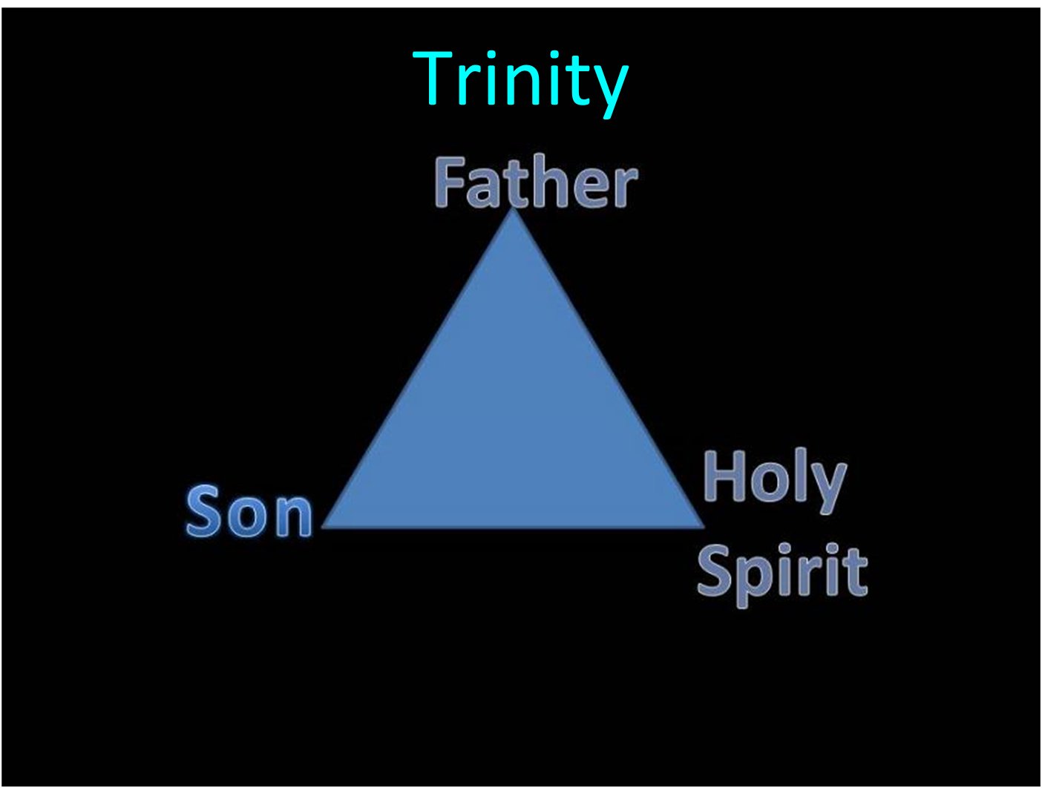

Slide 20
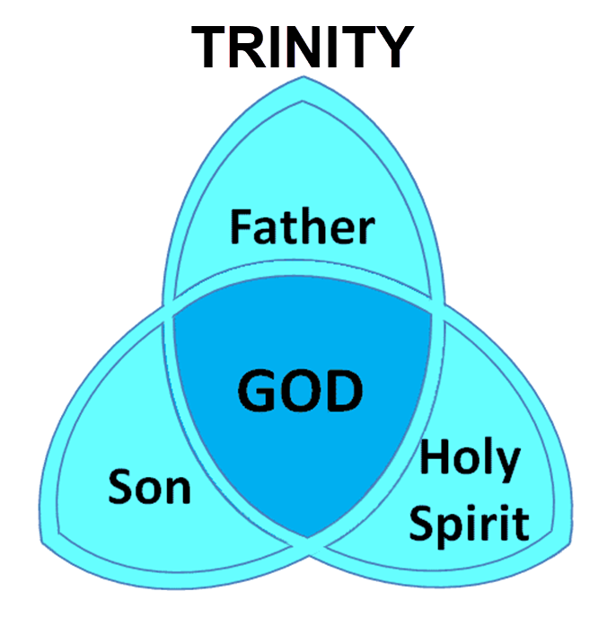

Slide 21
Genesis 1:26-28
²⁶ Then God said, “Let Us make man in Our image, according to Our likeness; and let them rule over the fish of the sea and over the birds of the sky and over the cattle and over all the earth, and over every creeping thing that creeps on the earth.” ²⁷ God created man in His own image, in the image of God He created him; male and female He created them. ²⁸ God blessed them; and God said to them, “Be fruitful and multiply, and fill the earth, and subdue it; and rule over the fish of the sea and over the birds of the sky and over every living thing that moves on the earth.”

Slide 22
Abimelech & God Genesis 21:12-13
Concerning Isaac (12)
Concerning Ishmael (13)

Slide 23
VI. 8 New Promises Genesis 12:1-3
Land (Gen. 12:1b)
Great nation (Gen. 12:2a)
Personal blessing (Gen. 12:2b)
Great name (Gen. 12:2c)
Blessing to others (Gen. 12:2d)
Blessing to blessers (Gen. 12:3a)
Cursing to cursers (Gen. 12:3b)
Blessing to the world (Gen. 12:3c)

Slide 24
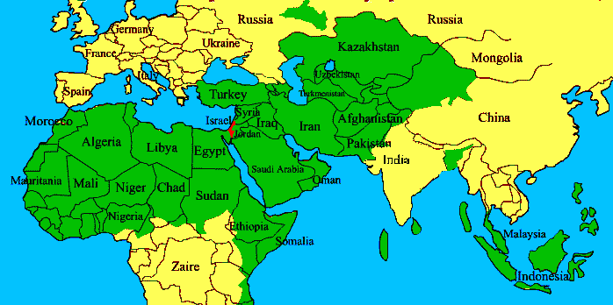
ISRAEL

Slide 25
Genesis 21:8-21 Ishmael’s Expulsion
Isaac’s weaning (8)
Ishmael’s mocking (9)
Sarah’s demand (10)
Abraham’s grief (11)
God comforts Abraham (12-13)
Expulsion (14)
Hagar’s anguish (15-16)
God’s comfort (17-18)
God’s provision (19)
Ishmael’s development (20)
Ishmael's marriage (21)

Slide 26
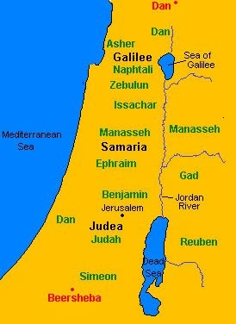

Slide 27
Genesis 21:8-21 Ishmael’s Expulsion
Isaac’s weaning (8)
Ishmael’s mocking (9)
Sarah’s demand (10)
Abraham’s grief (11)
God comforts Abraham (12-13)
Expulsion (14)
Hagar’s anguish (15-16)
God’s comfort (17-18)
God’s provision (19)
Ishmael’s development (20)
Ishmael's marriage (21)

Slide 28
Genesis 21:8-21 Ishmael’s Expulsion
Isaac’s weaning (8)
Ishmael’s mocking (9)
Sarah’s demand (10)
Abraham’s grief (11)
God comforts Abraham (12-13)
Expulsion (14)
Hagar’s anguish (15-16)
God’s comfort (17-18)
God’s provision (19)
Ishmael’s development (20)
Ishmael's marriage (21)

Slide 29
ISRAEL

Slide 30
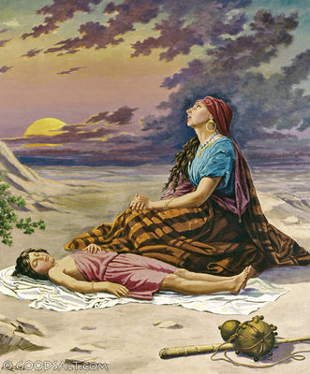
Charles Ryrie
The Ryrie Study Bible, page 27
Genesis 21:18 (RSB:NASB1995U): Genesis 21:18. “This promise assured Hagar that Ishmael would survive.”

Slide 31
Genesis 21:8-21 Ishmael’s Expulsion
Isaac’s weaning (8)
Ishmael’s mocking (9)
Sarah’s demand (10)
Abraham’s grief (11)
God comforts Abraham (12-13)
Expulsion (14)
Hagar’s anguish (15-16)
God’s comfort (17-18)
God’s provision (19)
Ishmael’s development (20)
Ishmael's marriage (21)

Slide 32
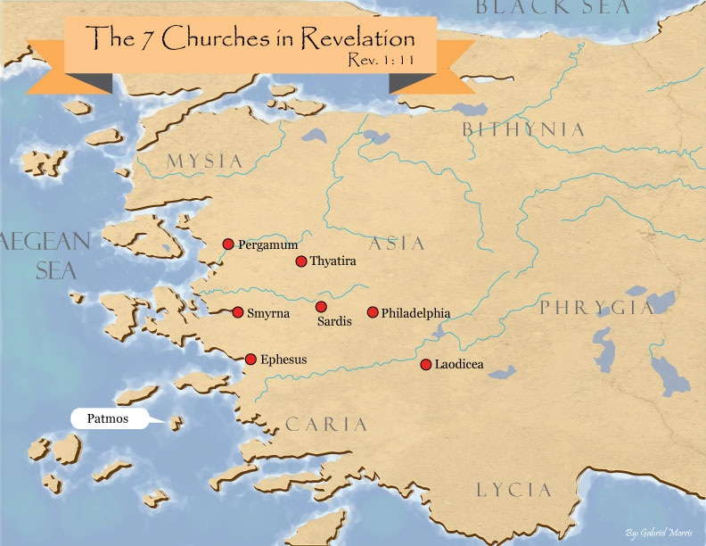

Slide 33
God’s Provision
Exodus 16
1 Kings 17:2-6
Psalm 37:25
Matthew 6:25-34
Philippians 4:19

Slide 34
Genesis 21:8-21 Ishmael’s Expulsion
Isaac’s weaning (8)
Ishmael’s mocking (9)
Sarah’s demand (10)
Abraham’s grief (11)
God comforts Abraham (12-13)
Expulsion (14)
Hagar’s anguish (15-16)
God’s comfort (17-18)
God’s provision (19)
Ishmael’s development (20)
Ishmael's marriage (21)

Slide 35
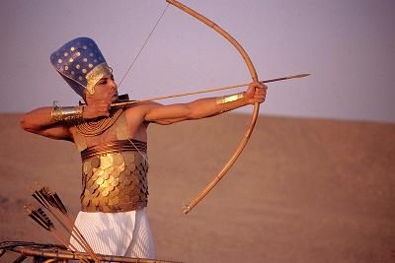
Dr. Arnold G. Fruchtenbaum
The Book of Genesis, 346
“He now became a hunter. In the context of Genesis, this is not a positive but a negative, as already indicated with Nimrod; for he, too, was a mighty hunter before the Lord.”

Slide 36
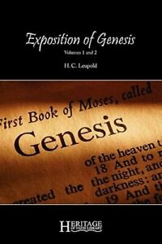
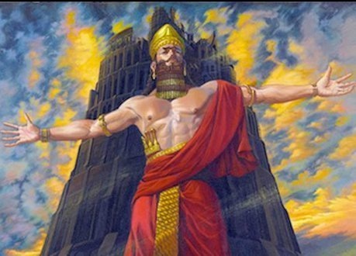
H. C. Leupold
H.C. Leupold, Exposition of Genesis, 1:366.
“For the meaning of the verb form nimrodh, without a doubt, is ‘let us revolt’.”

Slide 37
Genesis 21:8-21 Ishmael’s Expulsion
Isaac’s weaning (8)
Ishmael’s mocking (9)
Sarah’s demand (10)
Abraham’s grief (11)
God comforts Abraham (12-13)
Expulsion (14)
Hagar’s anguish (15-16)
God’s comfort (17-18)
God’s provision (19)
Ishmael’s development (20)
Ishmael's marriage (21)

Slide 38
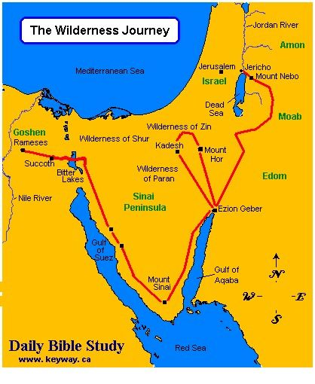

Slide 39
Dr. Arnold G. Fruchtenbaum
The Book of Genesis, 347
“The wife for Ishmael was the same nationality as the mother. The ancient Egyptians were Hamitic. As is known from Egyptian archeology, the Hamitic Egyptians were quite anti-Semitic, which would add to the antagonism that was already there.”

Slide 40
ISRAEL

Slide 41
Conclusion

Slide 42
Genesis 21:8-21 Ishmael’s Expulsion
Isaac’s weaning (8)
Ishmael’s mocking (9)
Sarah’s demand (10)
Abraham’s grief (11)
God comforts Abraham (12-13)
Expulsion (14)
Hagar’s anguish (15-16)
God’s comfort (17-18)
God’s provision (19)
Ishmael’s development (20)
Ishmael's marriage (21)

Slide 43
Genesis 12‒21 Abraham’s Early Journeys
Unconditional promises (Gen. 12:1-3) From Haran to Canaan (Gen. 12:4-5) In Canaan (Gen. 12:6-9) In Egypt (Gen. 12:10-20) Abram and Lot Separate (Gen. 13:1-13) Reaffirmation of Abram’s promises (Gen. 13:14-18) Abram Rescues Lot (14:1-24) | Abrahamic Covenant (15:1-21) Hagar & Ishmael (16:1-16) Circumcision (Gen. 17:1-27) Sodom & Gomorrah (Gen. 18‒19) Abraham & Abimelech (Gen. 20) Isaac’s birth (Gen. 21:1-7) Ishmael’s expulsion (21:8-21) Abraham & Abimelech’s covenant (21:22-34)

Slide 44
²⁴ The Lord bless you, and keep you; ²⁵ The Lord make His face shine on you, And be gracious to you; ²⁶ The Lord lift up His countenance on you, And give you peace.
Numbers 6:24–26 (NASB95)

