Slide 1

Ezekiel 36‒39
The Middle East Meltdown 2022
Dr. Andy Woods
Senior Pastor – Sugar Land Bible Church
President – Chafer Theological Seminary

Slide 2
Ezekiel 33‒48
Ezekiel recommissioned (33)
False shepherds removed (34)
Edom destroyed (35)
Israel’s restoration: physical & spiritual (36)
Israel’s restoration illustrated (37)
Means of restoration: Northern invasion (38)
Results of the Northern invasion: conversion (39)
Millennial Temple (40‒46)
Tribal land allotment (47‒48)

Slide 3

MAIL BAG
Is Gog killed in battle?
Second seal judgment?
Coincides with Rapture?
Armageddon?
Resurrection during Millennium?
Israel and the Antichrist?

Slide 4
MAIL BAG
Is Gog killed in battle?
Second seal judgment?
Coincides with Rapture?
Armageddon?
Resurrection during Millennium?
Israel and the Antichrist?

Slide 5
MAIL BAG
Is Gog killed in battle?
Second seal judgment?
Coincides with Rapture?
Armageddon?
Resurrection during Millennium?
Israel and the Antichrist?

Slide 6

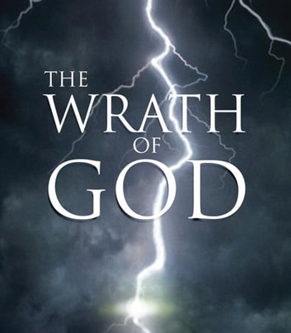
Ezekiel 38:18-19
“¹⁸ It will come about on that day, when Gog comes against the land of Israel,” declares the Lord God, “that My fury will mount up in My anger. ¹⁹ In My zeal and in My blazing wrath I declare that on that day there will surely be a great earthquake in the land of Israel.”

Slide 7


Slide 8

1st Six Seals (Revelation 6)
SEAL 1 – 6:1-2 – Advent of antichrist
SEAL 2 – 6:3-4 – War
SEAL 3 – 6:5-6 – Famine
SEAL 4 – 6:7-8 – Death
SEAL 5 – 6:9-11 – Martyrdoms
SEAL 6 – 6:12-17 – Cosmic disturbances

Slide 9

Ezekiel 38:8, 11
“⁸ After many days you will be summoned; in the latter years you will come into the land that is restored from the sword, whose inhabitants have been gathered from many nations to the mountains of Israel which had been a continual waste; but its people were brought out from the nations, and they are living securely [batach], all of them….¹¹ and you will say, ‘I will go up against the land of unwalled villages. I will go against those who are at rest [shacat], that live securely [batach], all of them living without walls and having no bars or gates.”

Slide 10
Ezekiel 38‒39
Invasion planned (38:1-13)
Invasion executed (38:14-16)
Invasion defeated (38:17‒39:20)
Invasion’s results (39:21-29)

Slide 11
MAIL BAG
Is Gog killed in battle?
Second seal judgment?
Coincides with Rapture?
Armageddon?
Resurrection during Millennium?
Israel and the Antichrist?

Slide 12

Promised Exemption from Divine Wrath
The promise (1 Thess 1:10; 5:9; Rom 5:9; 8:1; Rev 3:10)
Tribulation = divine wrath/anger (Rev 6:16-17; 11:18; 14:10; 15:1, 7; 16:1, 19; 19:15)

Slide 13
Ezekiel 38:18-19
“¹⁸ It will come about on that day, when Gog comes against the land of Israel,” declares the Lord God, “that My fury will mount up in My anger. ¹⁹ In My zeal and in My blazing wrath I declare that on that day there will surely be a great earthquake in the land of Israel.”

Slide 14


Slide 15
Ezekiel 38:8, 11
“⁸ After many days you will be summoned; in the latter years you will come into the land that is restored from the sword, whose inhabitants have been gathered from many nations to the mountains of Israel which had been a continual waste; but its people were brought out from the nations, and they are living securely [batach], all of them….¹¹ and you will say, ‘I will go up against the land of unwalled villages. I will go against those who are at rest [shacat], that live securely [batach], all of them living without walls and having no bars or gates.”

Slide 16

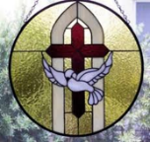
2 Thessalonians 2:6-7
⁶And you know what restrains [katechon; neuter] him now, so that in his time he will be revealed. ⁷For the mystery of lawlessness is already at work; only he who now restrains [katechōn; masculine] will do so until he is taken out of the way.

Slide 17

3 Reasons Why the Restrainer is the Holy Spirit
(2 Thessalonians 2:6-7)
The Holy Spirit is omnipotent
The Holy Spirit view handles well the switch in gender from the neuter (vs. 6) to the masculine (vs. 7)
The Holy Spirit is active in the world (Gen. 6:3; John 16:7-11)

Slide 18
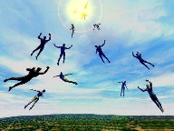
Restrainer Must First be Removed
Restrainer holds back the Antichrist (2 Thess 2:6-7)
Restrainer = the omnipotent Holy Spirit (2 Thess 2:9)
Holy Spirit permanently indwells all Christians (John 14:16; Rom 8:9)
Spirit indwelt Christians must first be removed prior to the Antichrist's advent

Slide 19
MAIL BAG
Is Gog killed in battle?
Second seal judgment?
Coincides with Rapture?
Armageddon?
Resurrection during Millennium?
Israel and the Antichrist?

Slide 21
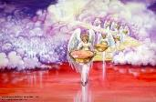
Seven Bowls
(Revelation 16)
1st Bowl (16:1-2) – Boils
2nd Bowl (16:3) – Sea becomes blood
3rd Bowl (16:4-7) – Freshwater destroyed
4th Bowl (16:8-9) – Sun scorches man
5th Bowl (16:10-11) – Darkness
6th Bowl (16:12-16) – Euphrates dried
7th Bowl (16:17-21) – Greatest earthquake

Slide 22
Literal Geography in Revelation
Asia | 1:4 | Philadelphia | 3:7
Patmos | 1:9 | Laodicea | 3:14
Ephesus | 2:1 | Euphrates | 9:14;16:12
Smyrna | 2:8 | Jerusalem | 11:8
Pergamum | 2:12 | Armageddon | 16:16
Thyatira | 2:18 | Jerusalem | 20:9
Sardis | 3:1 | New Jerusalem | 21:2

Slide 23
Armageddon?
Ezek 38-39 | Armageddon
No battle (38:20-23) | Battle between armies and Lord (Rev. 19:19)
Invaders come from the far west and north (38:5) | All nations invade (Rev. 16:14; Zech. 12:3)
Enemies destroyed on Israel’s mountains (39:2-4) | Events take place in Jerusalem (Zech. 12:2; 14:2; and the Valley of Jehoshaphat (Joel 3:12)
Israel dwelling in safety (38:11) | Israel not dwelling in safety (Rev. 12:14-17)
No massive blood flow recorded | Massive flow of blood (Rev. 14:20)
Fire comes upon invaders (39:6) | Fire does not come upon invaders
Pentecost, Things to Come, 347-48

Slide 24
When?
Beginning of the Millennium
End of the Millennium
End of the Tribulation
Before the Tribulation
First half of the Tribulation
Two phase view

Slide 25
MAIL BAG
Is Gog killed in battle?
Second seal judgment?
Coincides with Rapture?
Armageddon?
Resurrection during Millennium?
Israel and the Antichrist?

Slide 26
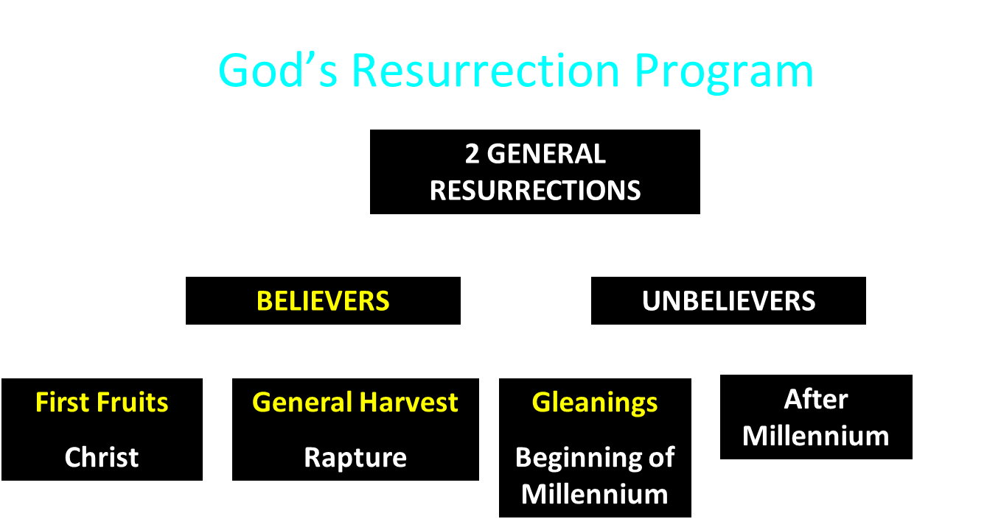

Slide 27

Daniel 12:1-2
“¹ Now at that time Michael, the great prince who stands guard over the sons of your people, will arise. And there will be a time of distress such as never occurred since there was a nation until that time; and at that time your people, everyone who is found written in the book, will be rescued. ² Many of those who sleep in the dust of the ground will awake, these to everlasting life, but the others to disgrace and everlasting contempt.”

Slide 28
Revelation 20:4-6
“⁴ Then I saw thrones, and they sat on them, and judgment was given to them. And I saw the souls of those who had been beheaded because of their testimony of Jesus and because of the word of God, and those who had not worshiped the beast or his image, and had not received the mark on their forehead and on their hand; and they came to life [zaō] and reigned with Christ for a thousand years. ⁵ The rest of the dead did not come to life [zaō] until the . . .

Slide 29
Revelation 20:4-6
. . . thousand years were completed. This is the first resurrection [anastasis]. ⁶ Blessed and holy is the one who has a part in the first resurrection [anastasis]; over these the second death has no power, but they will be priests of God and of Christ and will reign with Him for a thousand years.”

Slide 30


1 Corinthians 15:50-51
“⁵⁰ Now I say this, brethren, that flesh and blood cannot inherit the kingdom of God; nor does the perishable inherit the imperishable. ⁵¹ Behold, I tell you a mystery; we will not all sleep, but we will all be changed.”

Slide 31
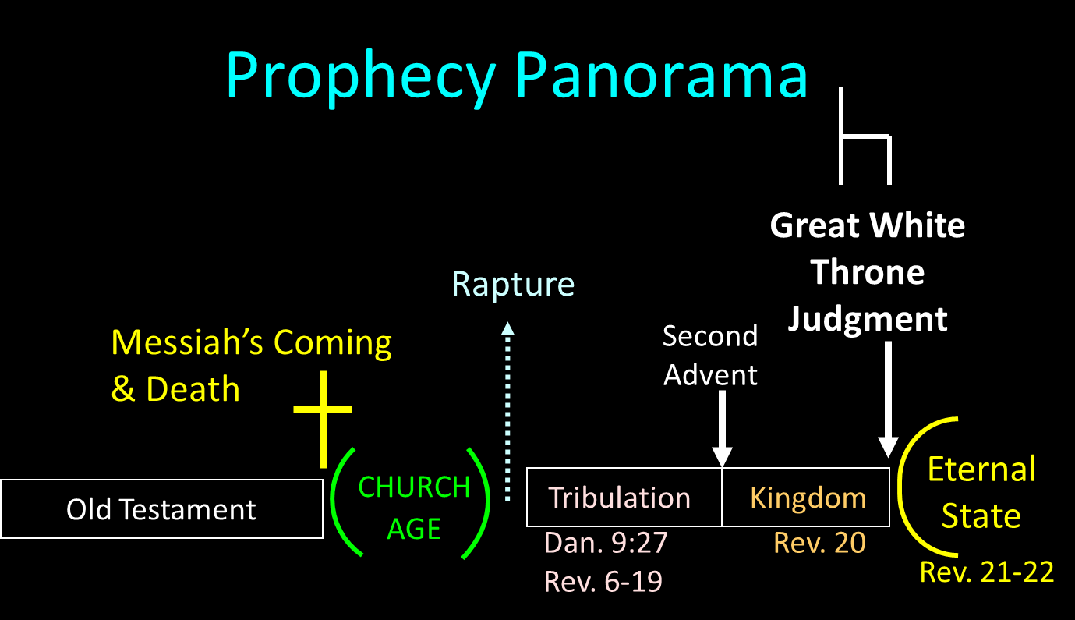

Slide 32
Millennium Rev.20 | Eternal State Rev.21-22
Sin restrained | Sin removed
Curse restrained | Curse removed
Death | No death
Mortals / resurrected | Resurrected only
Mortals Destinies undecided | All Destinies sealed
Renovation | Recreation
Temporary | Eternal
Transitional | Non-transitional
Dispensation | Not a dispensation

Slide 33
Millennium and Eternal State
 | Rev 20:1-10 | Rev 21–22
Time | 20:4 | 22:5
Luminaries | Isa 30:26 | 21:23; 22:5
Temple | Ezek 40–48 | 21:22
Death | Isa 65:20 | 21:4
Satanic activity | 20:7 | 20:10
Rebellion | 20:8-9 | 21:27

Slide 34

Deuteronomy 29:29
“The secret things belong to the Lord our God, but the things revealed belong to us and to our sons forever, that we may observe all the words of this law.”

Slide 35
MAIL BAG
Is Gog killed in battle?
Second seal judgment?
Coincides with Rapture?
Armageddon?
Resurrection during Millennium?
Israel and the Antichrist?

Slide 36

Daniel 9:27
And he will make a firm covenant with the many for one week, but in the middle of the week he will put a stop to sacrifice and grain offering; and on the wing of abominations will come one who makes desolate, even until a complete destruction, one that is decreed, is poured out on the one who makes desolate.

Slide 38

Isaiah 28:15, 18
“¹⁵ Because you have said, ‘We have made a covenant with death, And with Sheol we have made a pact. The overwhelming scourge will not reach us when it passes by, For we have made falsehood our refuge and we have concealed ourselves with deception.’… ¹⁸ Your covenant with death will be canceled, And your pact with Sheol will not stand; When the overwhelming scourge passes through, Then you become its trampling place.”

Slide 39
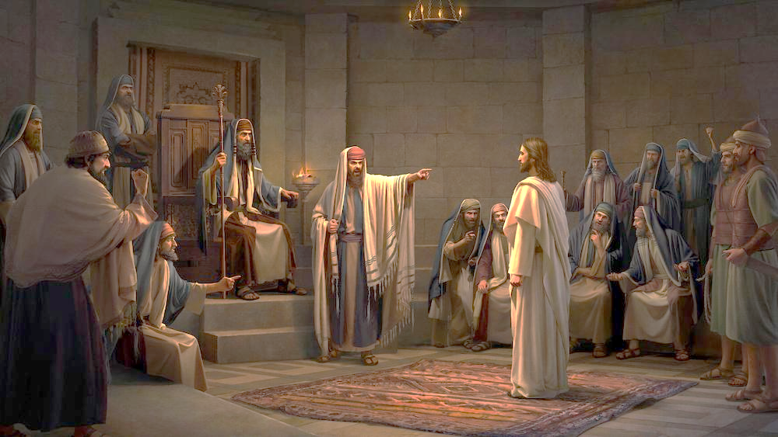
John 5:43
“I have come in My Father’s name, and you do not receive Me; if another comes in his own name, you will receive him.”

Slide 40

HANUKKAH
The Maccabean revolt
December 25th 164 BC, the temple is liberated and rededicated
1 & 2 Maccabees
The miracle of the lamp oil
Hanukkah “Feast of Dedication” (festival of lights).
Christmas / Jewish Holiday
John 10:22-24

Slide 41
Levitical Feasts (Lev. 23)
Feast | Season | Purpose | Type
Passover | Spring | Redemption | 1 Cor. 5:7
Unleavened Bread | Spring | Separation | John 6:35
1st fruits | Spring | Praise | 1 Cor. 15:20
Pentecost | Spring | Praise | Acts 2:1-4
Trumpets | Fall | New Year | Matt. 24:31
Atonement | Fall | Lev 16 | Zech. 12:10
Booths | Fall | Wilderness provision | Zech. 14:16-18

Slide 42
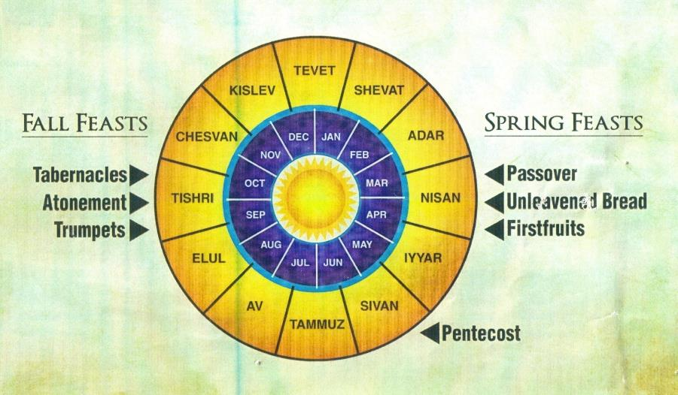

Slide 43


Slide 44
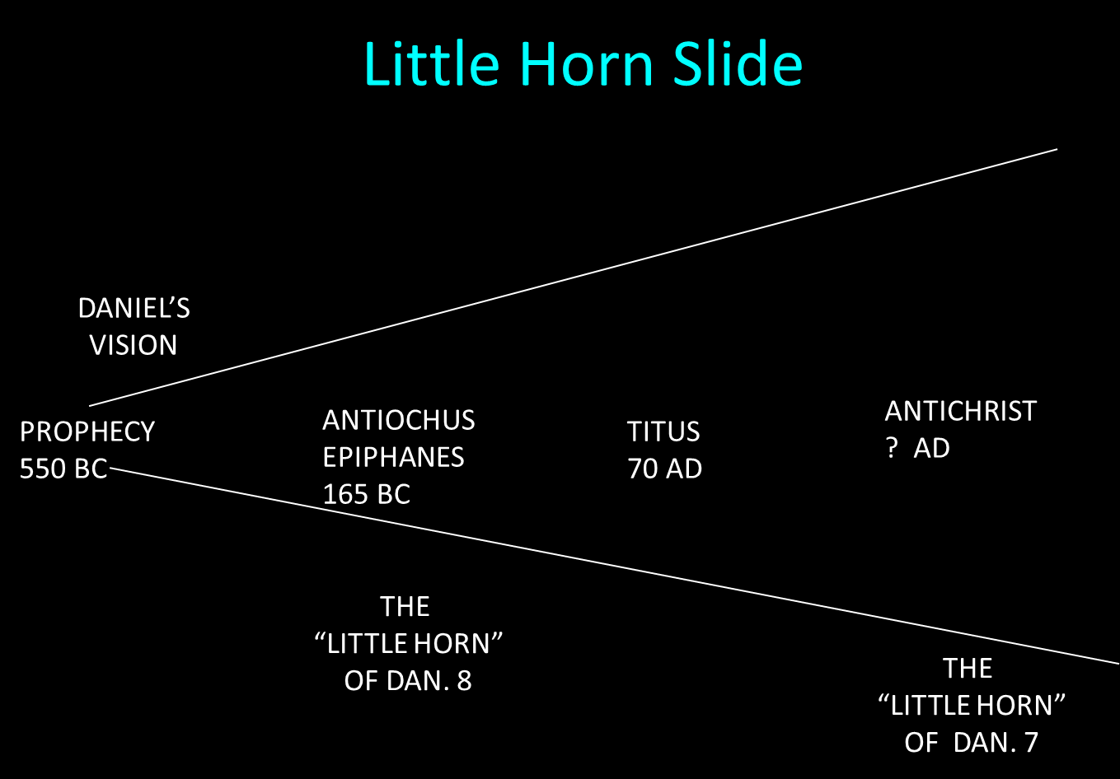

Slide 45

Zechariah 12:10
“I will pour out on the house of David and on the inhabitants of Jerusalem, the Spirit of grace and of supplication, so that they will look on Me whom they have pierced; and they will mourn for Him, as one mourns for an only son, and they will weep bitterly over Him like the bitter weeping over a firstborn.”

Slide 46
Romans 11:25-26
“²⁵ For I do not want you, brethren, to be uninformed of this mystery—so that you will not be wise in your own estimation—that a partial hardening has happened to Israel until the fullness of the Gentiles has come in; ²⁶ and so all Israel will be saved; just as it is written, ‘The Deliverer will come from Zion, He will remove ungodliness from Jacob.’”

Slide 47
CONCLUSION

Slide 48
MAIL BAG
Is Gog killed in battle?
Second seal judgment?
Coincides with Rapture?
Armageddon?
Resurrection during Millennium?
Israel and the Antichrist?

