Slide 1
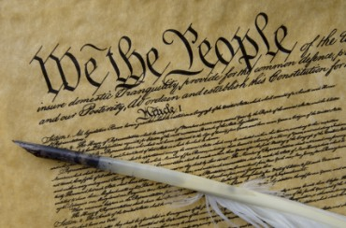

Seven Principles That Made America Great
Dr. Andy Woods
Senior Pastor – Sugar Land Bible Church
President – Chafer Theological Seminary

Slide 2



Slide 3

God Blesses His Truth
Proverbs 14:34
“Righteousness exalts a nation, but sin is a reproach to any people.”
Ps 33:12
“Blessed is the nation whose God is the Lord.”

Slide 4

Founders’ Sources
34% Bible
8.3% Baron Montesquieu
7.9% William Blackstone
2.9% John Locke
Donald S. Lutz, The Origins of American Constitutionalism (Baton Rouge, LA: Louisiana State University Press, 1988), 141.

Slide 5

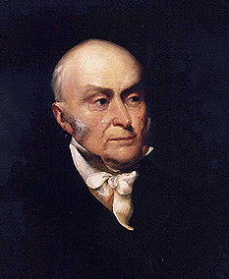
John Quincy Adams
“The birth-day of the nation is indissolubly linked with the birth-day of the Saviour [and] forms a leading event in the progress of the gospel dispensation… the Declaration of Independence first organized the social compact on the foundation of the Redeemer’s mission upon the earth [and] laid the corner stone of human government upon the first precepts of Christianity.”
John Quincy Adams, An Oration Delivered before the Inhabitants of the Town of Newburyport at Their Request on the Sixty-First Anniversary of the Declaration of Independence (Newburyport: Whipple, 1837), 5-6.

Slide 6


God Blesses His Truth
Amos 7:7-8
⁷ Thus He showed me, and behold, the Lord was standing by a vertical wall with a plumb line in His hand. ⁸ The LORD said to me, “What do you see, Amos?” And I said, “A plumb line.” Then the Lord said, “Behold I am about to put a plumb line In the midst of My people Israel. I will spare them no longer.”

Slide 7

So What? Points of Application!
Repent (Rev 2:5)
“Therefore, remember from where you have fallen, and repent and do the deeds you did at first; or else I am coming to you and will remove your lampstand out of its place—unless you repent.”

Slide 8

Seven Principles that Made America Great
Sanctity of Life Principle (Gen. 1:27)
Recognition of Human Depravity Principle (Gen. 8:21)
Non-New World Order Principle (Gen. 11:6)
Economic Justice Principle (Gen. 3:19)
Heterosexual Monogamy Principle (Gen. 2:24)
Cooperation with Christianity Principle (Prov. 14:34)
Pro-Israel Principle (Gen. 12:3)

Slide 9
Seven Principles that Made America Great
Sanctity of Life Principle (Gen. 1:27)
Recognition of Human Depravity Principle (Gen. 8:21)
Non-New World Order Principle (Gen. 11:6)
Economic Justice Principle (Gen. 3:19)
Heterosexual Monogamy Principle (Gen. 2:24)
Cooperation with Christianity Principle (Prov. 14:34)
Pro-Israel Principle (Gen. 12:3)

Slide 10

Genesis 1:27
God created man in His own image, in the image of God He created him; male and female He created them.

Slide 11


Genesis 9:6
“Whoever sheds man’s blood, By man his blood shall be shed, For in the image of God He made man.”

Slide 12
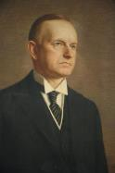
Calvin Coolidge
Calvin Coolidge stated July 5, 1926: "The principles...which went into the Declaration of Independence...are found in...the sermons...of the early colonial clergy...They justified freedom by the text that we are all created in the Divine image."
Calvin Coolidge, May 15, 1926, College of William and Mary, Williamsburg, Virginia, http.americanminute.com/index.php?date=05-15

Slide 13
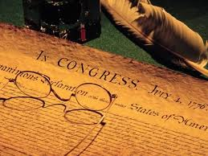
Declaration of Independence
“the Laws of Nature and of Nature’s God,”
“we hold these truths to be self evident, that all men are created equal,”
“they are endowed by their Creator with certain unalienable Rights,”
“appealing to the Supreme Judge of the world for the rectitude of our intentions,”
“with firm reliance on the protection of Divine Providence.”
Church of the Holy Trinity v. U.S., 143 U.S. 457, 467-68 (1892)

Slide 14
Declaration of Independence
Declaration of Independence, In Congress, July 4, 1776, The unanimous Declaration of the thirteen united States of America
“We hold these truths to be self-evident, that all men are created equal, that they are endowed by their Creator with certain unalienable Rights, that among these are Life, Liberty and the pursuit of Happiness.”
“That TO SECURE THESE RIGHTS, Governments are instituted among Men, deriving their just powers from the consent of the governed,”
“That whenever any Form of Government becomes destructive of these ends, it is the Right of the People to alter or to abolish it, and to institute new Government…”

Slide 15
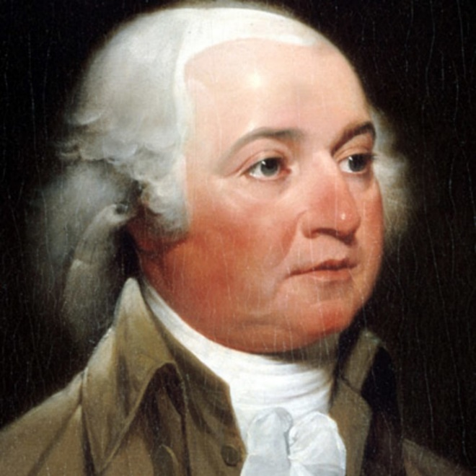
John Adams
John Adams - America's second President "Rights [are] antecedent to all earthly government; Rights...cannot be repealed or restrained by human laws; Rights [are] derived from the great Legislature of the universe."
John Adams, The Works of John Adams, Second President of the United States, ed. Charles Francis Adams, 10 vols. (Boston: Little, Brown, 1856), 3:449.

Slide 16
First Amendment
“Congress shall make no law respecting an establishment of religion, or prohibiting the free exercise there of.”
16

Slide 17
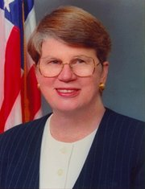
Speech by Attorney General Janet Reno, Newark, New Jersey, May 5, 1995. Quoted in James Bovard, “Waco Must Get a Hearing,” Wall Street Journal, May 15, 1995.
Former Attorney General Janet Reno
“You are part of a government that has given its people more freedom…than any other government in the history of the world.”

Slide 18
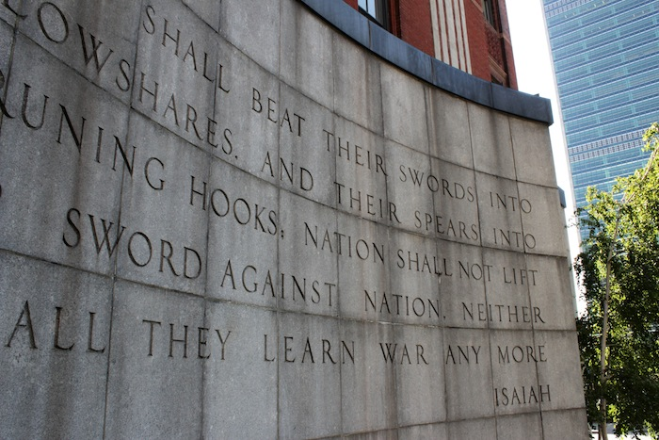

Slide 19
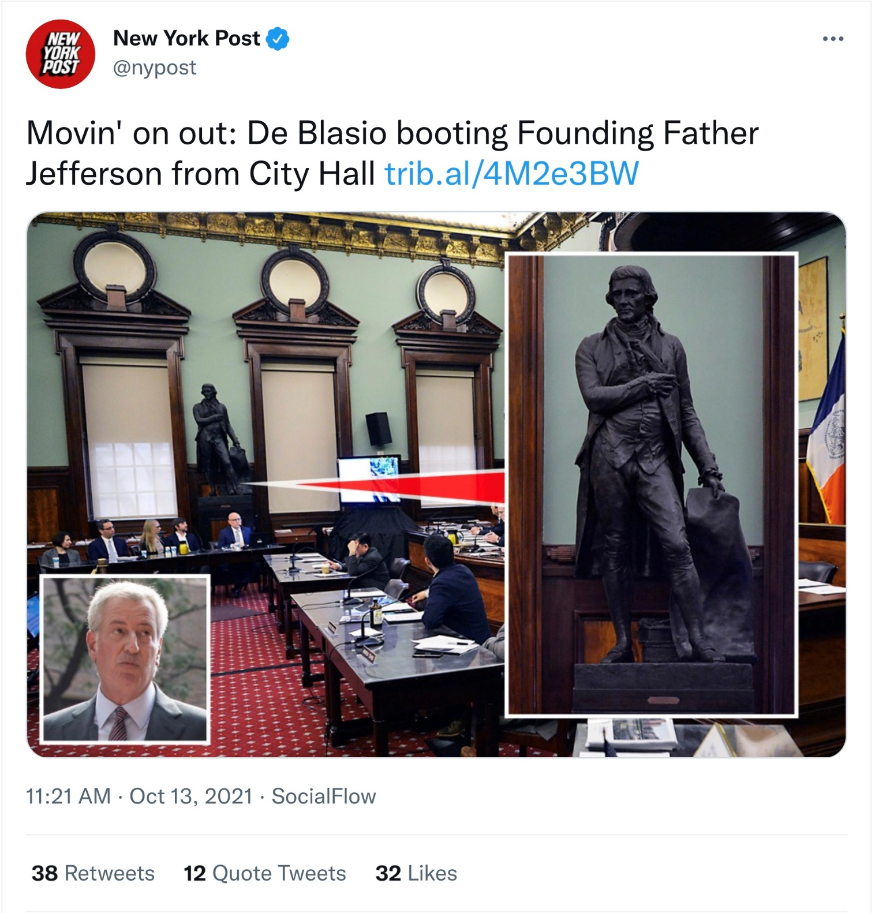

Slide 20
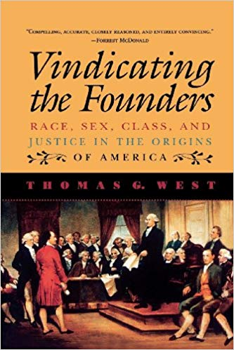
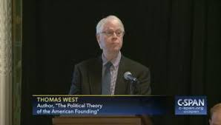

Slide 21
Seven Principles that Made America Great
Sanctity of Life Principle (Gen. 1:27)
Recognition of Human Depravity Principle (Gen. 8:21)
Non-New World Order Principle (Gen. 11:6)
Economic Justice Principle (Gen. 3:19)
Heterosexual Monogamy Principle (Gen. 2:24)
Cooperation with Christianity Principle (Prov. 14:34)
Pro-Israel Principle (Gen. 12:3)

Slide 22

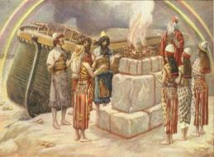
Genesis 8:21
The Lord smelled the soothing aroma; and the Lord said to Himself, “I will never again curse the ground on account of man, for the intent of man’s heart is evil from his youth; and I will never again destroy every living thing, as I have done. [emphasis mine].

Slide 23


Jeremiah 17:9
“The heart is more deceitful than all else And is desperately sick; Who can understand it?.”

Slide 24

Romans 3:23
“for all have sinned and fall short of the glory of God.”

Slide 25
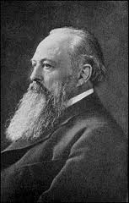
Lord Acton
“ALL POWER TENDS TO CORRUPT AND ABSOLUTE POWER CORRUPTS ABSOLUTELY.”

Slide 26
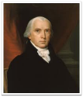
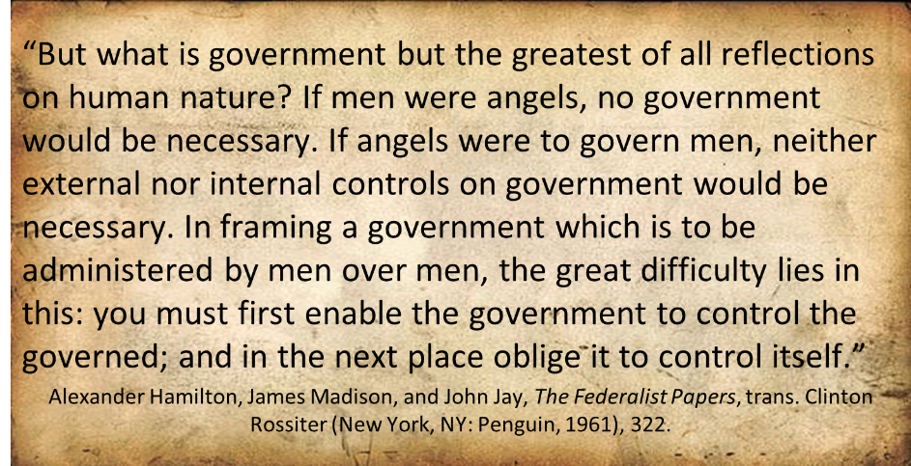
Federalist # 51

Slide 27
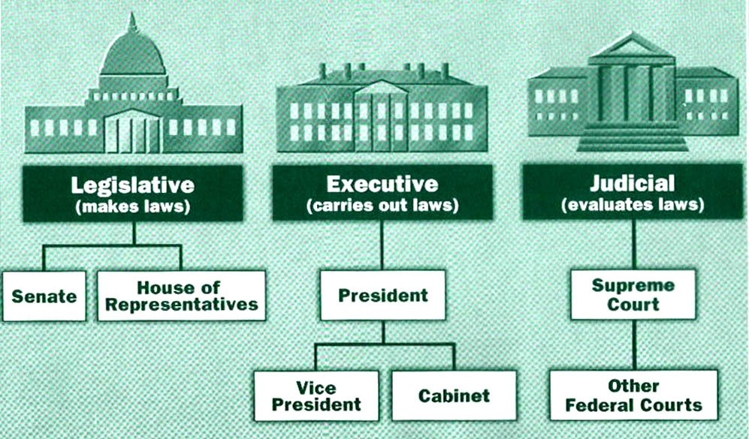

Slide 28

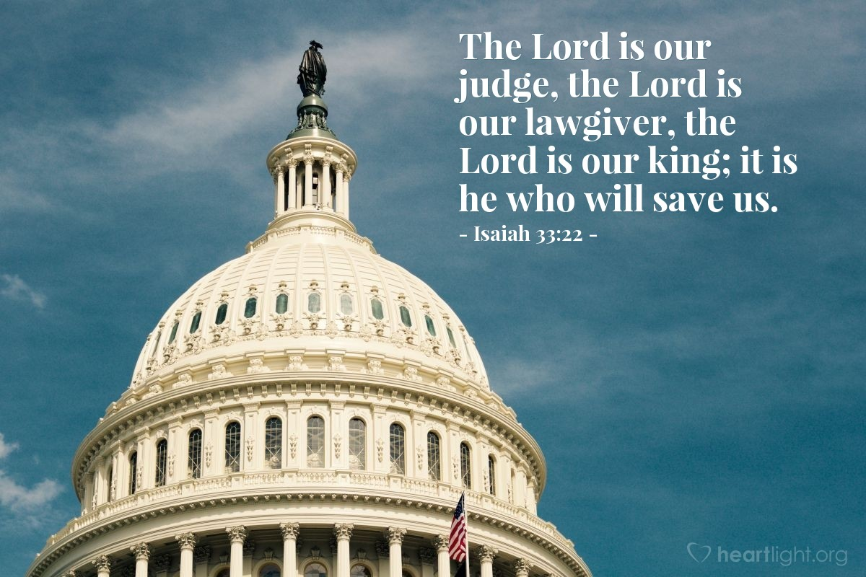
Isaiah 33:22
“For the LORD is our judge, The LORD is our lawgiver, The LORD is our king.”

Slide 29
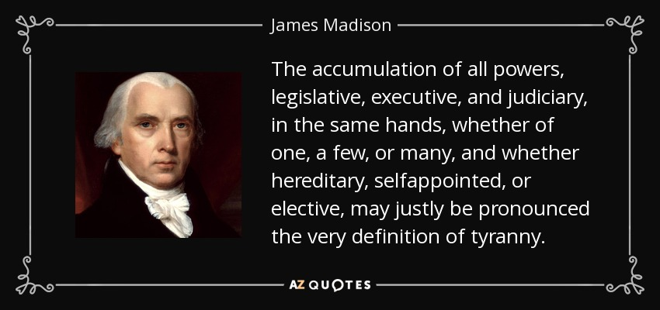
James Madison
Federalist No. 47 (January 30, 1788)
29

Slide 30
Tenth Amendment
“The powers not delegated to the United States by the Constitution nor prohibited by it to the States are reserved to the States respectively or to the people.”

Slide 31
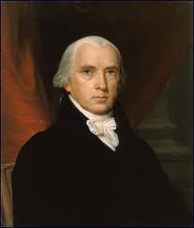
Federalist # 45
“The powers delegated by the proposed Constitution to the federal government, are few and defined. Those which are to remain in the State governments are numerous and indefinite.”
Alexander Hamilton, James Madison, and John Jay, The Federalist Papers, trans. Clinton Rossiter (New York, NY: Penguin, 1961), 292.

Slide 32
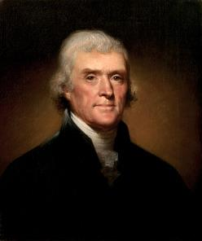
Thomas Jefferson
Kentucky Resolutions of 1798: "...in questions of power then, let no more be heard of confidence in man, but bind him down from mischief by the chains of the constitution..." (from draft)
Papers of Thomas Jefferson 30:529-556

Slide 33
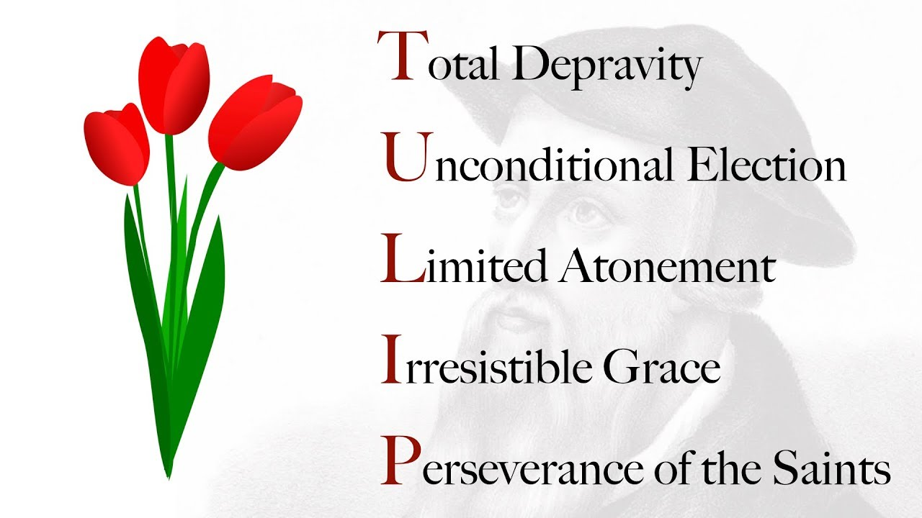

Slide 34
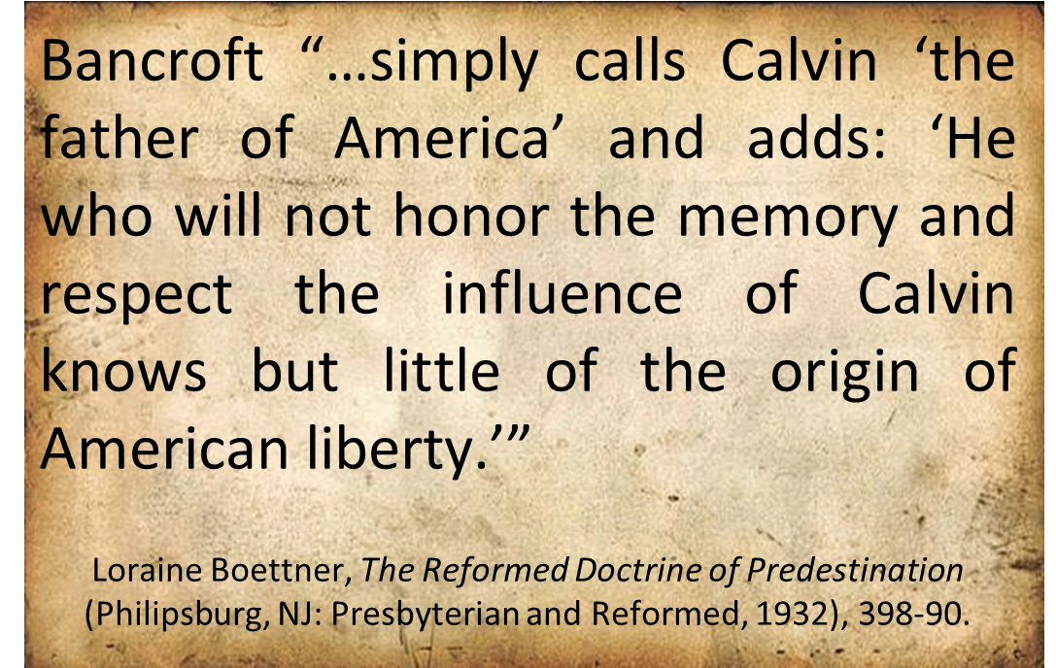
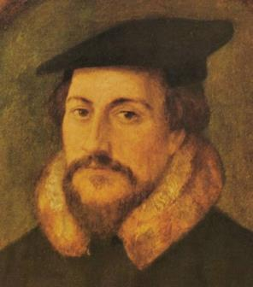
John Calvin

Slide 35
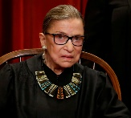
An Outdated Document?
On February 2012, US SCOTUS Justice Ruth Bader Ginsburg appeared on Egypt's Al-Hayat TV following the overthrowing Hosni Murbarak. While advising the Egyptian people on the formation of a new Egyptian constitution, she observed: “You should certainly be aided by all the constitution-writing that has gone on since the end of World War II. I would not look to the US constitution, if I were drafting a constitution in the year 2012. I might look at the constitution of South Africa. That was a deliberate attempt to have a fundamental instrument of . . .
http://www.realclearpolitics.com/video/2012/02/03/ruth_bader_ginsburg_to_egypt_dont_use_us_constitution_as_a_model.html.

Slide 36
An Outdated Document?
“…government that embraced basic human rights, had an independent judiciary... It really is, I think, a great piece of work that was done. Much more recent than the US Constitution - Canada has a Charter of Rights and Freedoms. It dates from 1982. You would almost certainly look at the European Convention on Human Rights. Yes, why not take advantage of what there is elsewhere in the world? I am a very strong believer in listening and learning from others (italics added).”
http://www.realclearpolitics.com/video/2012/02/03/ruth_bader_ginsburg_to_egypt_dont_use_us_constitution_as_a_model.html.

Slide 37
Seven Principles that Made America Great
Sanctity of Life Principle (Gen. 1:27)
Recognition of Human Depravity Principle (Gen. 8:21)
Non-New World Order Principle (Gen. 11:6)
Economic Justice Principle (Gen. 3:19)
Heterosexual Monogamy Principle (Gen. 2:24)
Cooperation with Christianity Principle (Prov. 14:34)
Pro-Israel Principle (Gen. 12:3)

Slide 38


Genesis 11:6
The Lord said, “Behold, they are one people, and they all have the same language. And this is what they began to do, and now nothing which they purpose to do will be impossible for them.”

Slide 39
God’s Doctrine of Nations
Since Babel | Deut. 32:8; Acts 17:26
Millennium | Isaiah 2:4; 66:18; Zech. 14:16-18; Rev. 12:5; 20:3
Eternal State | Rev. 21:24, 26

Slide 40

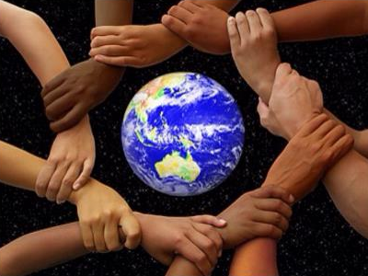
Deuteronomy 32:8
“When the Most High gave the nations their inheritance, When He separated the sons of man, He set the boundaries of the peoples According to the number of the sons of Israel.”

Slide 41
Acts 17:26
and He made from one man every nation of mankind to live on all the face of the earth, having determined their appointed times and the boundaries of their habitation, (Italics added)

Slide 42
The Divine Institutions
Conscience (Gen. 3:22)
Marriage and family (Gen. 1:26-28; 2:18-25)
Labor (Gen. 2:15; 3:19)
Government (Gen. 9:6)
Nationalism (Gen. 11:1-9)

Slide 43
The Divine Institutions
Conscience (Gen. 3:22)
Marriage and family (Gen. 1:26-28; 2:18-25)
Labor (Gen. 2:15; 3:19)
Government (Gen. 9:6)
Nationalism (Gen. 11:1-9)

Slide 44
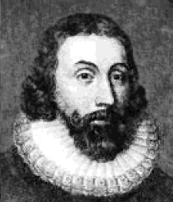
John Winthrop
“For we must consider that we shall be as a City set upon a Hill; the eyes of all people are upon us; so that if we shall deal falsely with our God in this work we have undertaken and so cause him to withdraw his present help from us, we shall be a story and a by-word through the world.”
John Winthrop, “A Model of Christian Charity,” Winthrop Papers, 2:292-95.

Slide 45

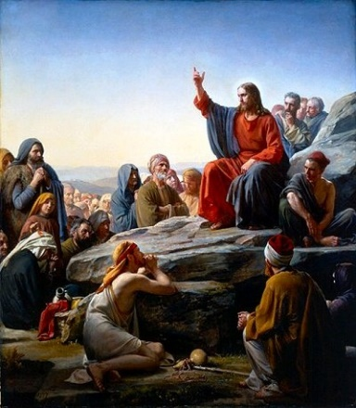
Matt 5:13, 16
“You are the light of the world. A city set on a hill cannot be hidden…Let your light shine before men in such a way that they may see your good works, and glorify your Father who is in heaven.”

Slide 46
John Winthrop
“It will be a service to the Church of great consequence to carry the Gospel into those parts of the world, to help on the coming of the fullness of the Gentiles, & to raise a Bulwark against the kingdom of Anti-Christ which the Jesuits labor to rear up in those parts.”
R.C. Winthrop, Life and Letters of John Winthrop (Boston: Ticknor and Fick's, 1864), Vol. 1, pp. 309-311.

Slide 47
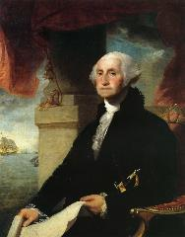
George Washington’s Farwell Address of 1790
"It is our true policy to steer clear of permanent alliances with any portion of the foreign world."
George Washington, “Washington’s Farewell Address,” online: www.wikapedia.org, accessed 7 May 2010, 1.

Slide 48
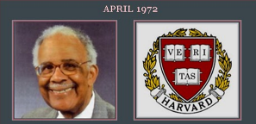
Humanist Proselytizing
“Every child in America entering school at the age of five is mentally ill because he comes to school with certain allegiances to our founding fathers, toward our elected officials, toward his parents, toward a belief in a supernatural being, and toward the sovereignty of this nation as a separate entity. It's up to you as teachers to make all these sick children well by creating the international child of the future.”
Chester M. Pierce, Harvard psychiatrist, speaking as an expert in public education at the 1973 International Education Seminar.

Slide 49
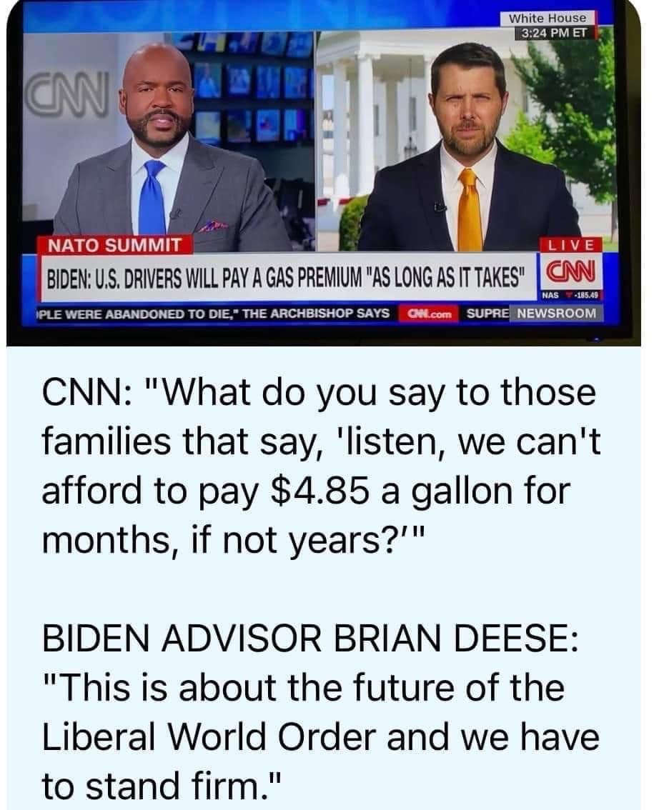

Slide 50

Sine Qua Non of Nationhood
Common language
Common culture
Common currency
Enforceable national borders

Slide 51

Open Borders
“In a private, paid speech to a Brazilian bank on May 16, 2013, Hillary Clinton said: ‘My dream is a hemispheric common market, with open trade and open borders, some time in the future with energy that is as green and sustainable as we can get it, powering growth and opportunity for every person in the hemisphere.’ This secret speech was released as part of the Podesta emails obtained by Wikileaks.”
http://www.breitbart.com/live/third-presidential-debate-fact-check-livewire/fact-check-yes-hillary-clinton-wants-open-borders/

Slide 52


Slide 53


Slide 54
Seven Principles that Made America Great
Sanctity of Life Principle (Gen. 1:27)
Recognition of Human Depravity Principle (Gen. 8:21)
Non-New World Order Principle (Gen. 11:6)
Economic Justice Principle (Gen. 3:19)
Heterosexual Monogamy Principle (Gen. 2:24)
Cooperation with Christianity Principle (Prov. 14:34)
Pro-Israel Principle (Gen. 12:3)

Slide 55

Genesis 3:19
“By the sweat of your face You will eat bread, Till you return to the ground, Because from it you were taken; For you are dust, And to dust you shall return.”

Slide 56
The Divine Institutions
Conscience (Gen. 3:22)
Marriage and family (Gen. 1:26-28; 2:18-25)
Labor (Gen. 2:15; 3:19)
Government (Gen. 9:6)
Nationalism (Gen. 11:1-9)

Slide 57
Seven Principles that Made America Great
Sanctity of Life Principle (Gen. 1:27)
Recognition of Human Depravity Principle (Gen. 8:21)
Non-New World Order Principle (Gen. 11:6)
Economic Justice Principle (Gen. 3:19)
Heterosexual Monogamy Principle (Gen. 2:24)
Cooperation with Christianity Principle (Prov. 14:34)
Pro-Israel Principle (Gen. 12:3)

Slide 58


Genesis 1:27
“God created man in His own image, in the image of God He created him; male and female He created them.”
Genesis 2:24
“For this reason a man shall leave his father and his mother, and be joined to his wife; and they shall become one flesh.”

Slide 59
The Divine Institutions
Conscience (Gen. 3:22)
Marriage and family (Gen. 1:26-28; 2:18-25)
Labor (Gen. 2:15; 3:19)
Government (Gen. 9:6)
Nationalism (Gen. 11:1-9)

Slide 60
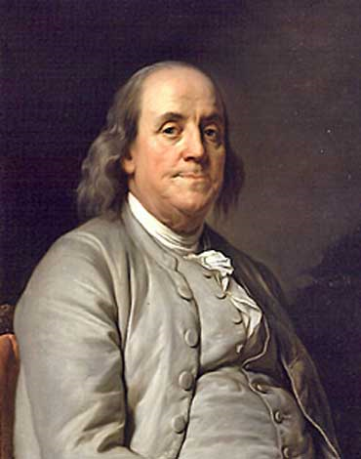
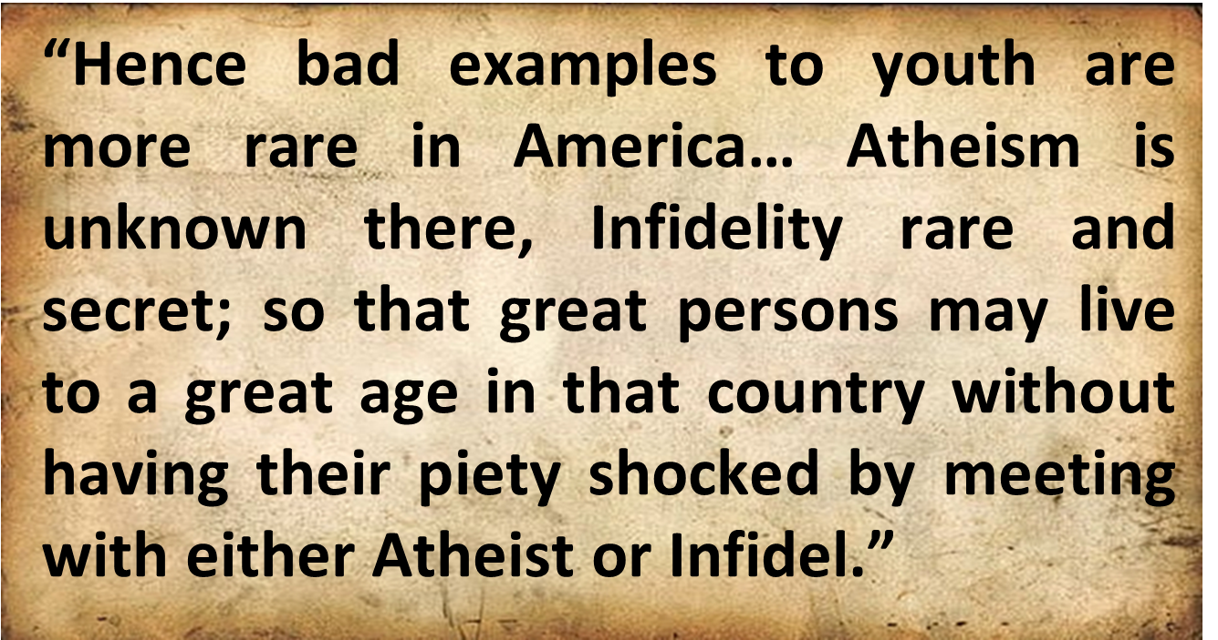
Benjamin Franklin
Benjamin Franklin, “Advice on Coming to America,” America in Person, ed. George D. Youstra, 109.

Slide 61
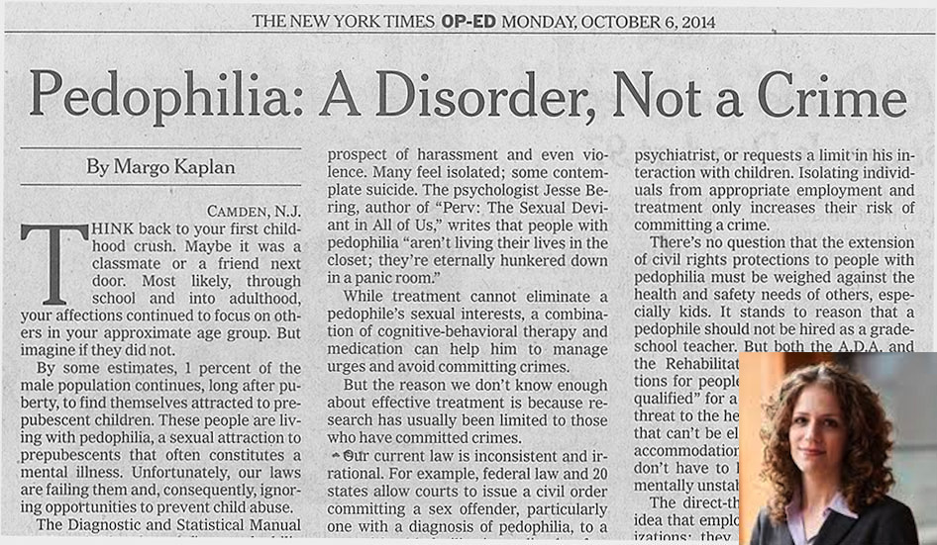

Slide 62
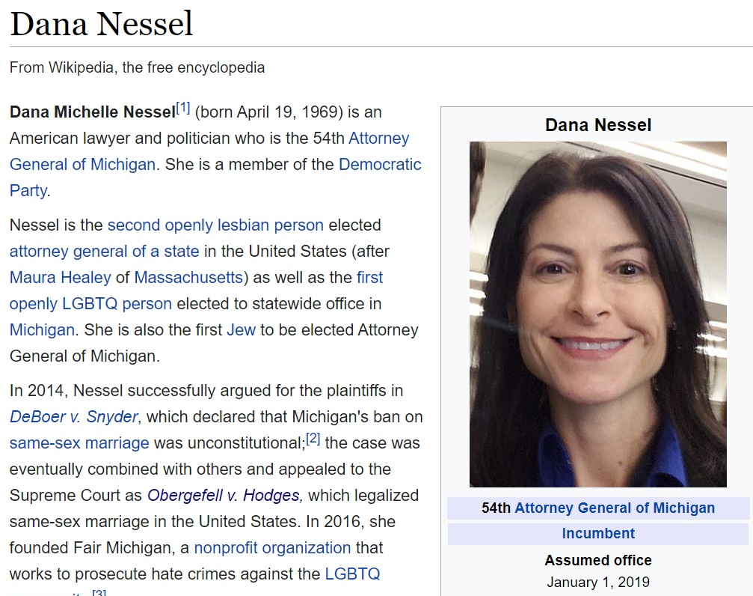

Slide 63
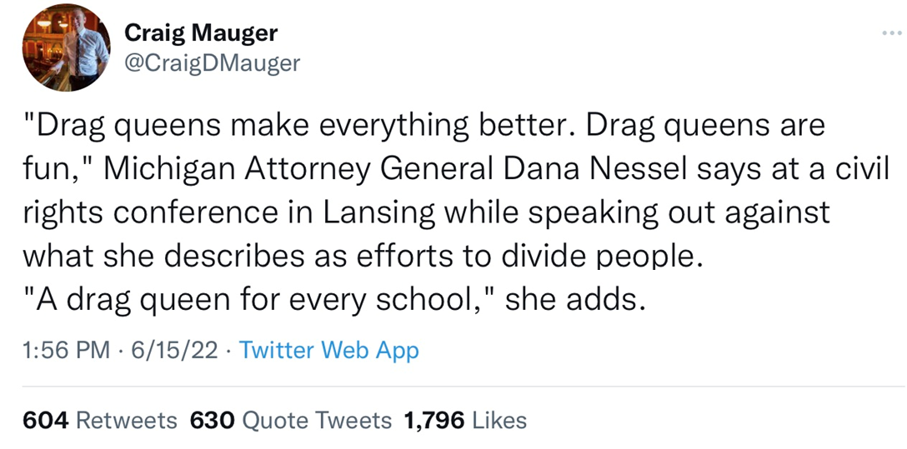

Slide 64
Seven Principles that Made America Great
Sanctity of Life Principle (Gen. 1:27)
Recognition of Human Depravity Principle (Gen. 8:21)
Non-New World Order Principle (Gen. 11:6)
Economic Justice Principle (Gen. 3:19)
Heterosexual Monogamy Principle (Gen. 2:24)
Cooperation with Christianity Principle (Prov. 14:34)
Pro-Israel Principle (Gen. 12:3)

Slide 65
Thomas Jefferson
"My views ... are the result of a life of inquiry and reflection, and very different from the anti-Christian system imputed to me by those who know nothing of my opinions. To the corruptions of Christianity, I am, indeed, opposed; but not to the genuine precepts of Jesus Himself. I am a Christian in the only sense in which He wished any one to be; sincerely attached to his doctrines in preference to all others...His system of morals...if filled up in the style and spirit of the rich fragments He left us, would be the most perfect and sublime that has ever been taught by man...His moral doctrines...were more pure and . . .
On April 21, 1803, Jefferson wrote to Dr. Benjamin Rush, also a signer of the Declaration

Slide 66
Thomas Jefferson
...perfect than those of the most correct of the philosophers...gathering all into one family under the bonds of love, charity, peace, common wants and common aids. A development of this head will evince the peculiar superiority of the system of Jesus over all others. The precepts of philosophy, and of the Hebrew code, laid hold of actions only. He pushed his scrutinies into the heart of man; erected his tribunal in the region of his thoughts, and purified the waters at the fountain head.”
On April 21, 1803, Jefferson wrote to Dr. Benjamin Rush, also a signer of the Declaration

Slide 67

Matthew 5:21-22
“²¹ “You have heard that the ancients were told, ‘You shall not commit murder’ and ‘Whoever commits murder shall be liable to the court.’ ²² But I say to you that everyone who is angry with his brother shall be guilty before the court; and whoever says to his brother, ‘You good-for-nothing,’ shall be guilty before the supreme court; and whoever says, ‘You fool,’ shall be guilty enough to go into the fiery hell.”

Slide 68
Matthew 5:27-28
“²⁷ You have heard that it was said, ‘You shall not commit adultery’; ²⁸ but I say to you that everyone who looks at a woman with lust for her has already committed adultery with her in his heart.”

Slide 69
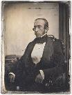
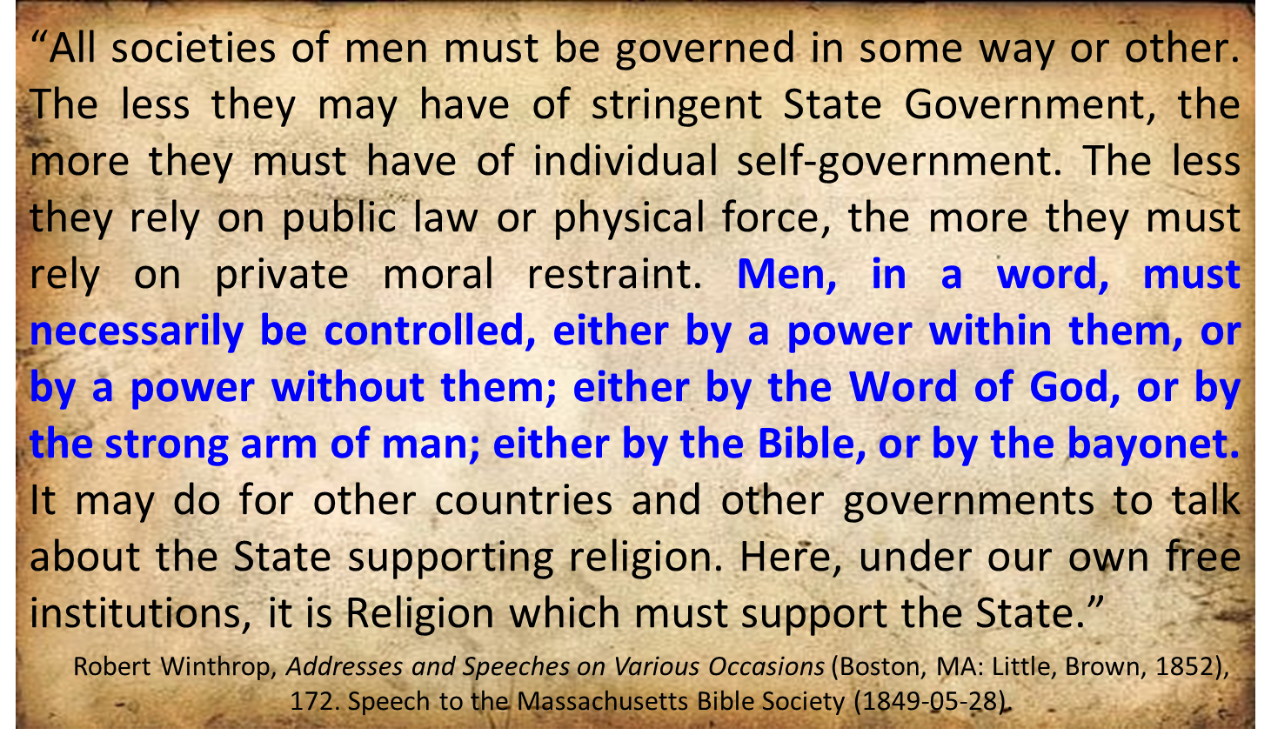
Robert Charles Winthrop

Slide 70
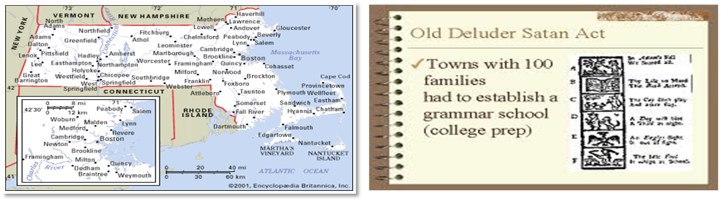
Old Satan Deluder Law: 1642 Massachusetts
“It being one chief project of that old deluder, Satan, to keep men from the knowledge of the Scriptures, as in former time…It is therefore ordered…that after the Lord hath increased the settlement…they shall…appoint one within their town, to teach all such children to read…they shall set up a grammar school to instruct youths…”
Church of the Holy Trinity v. U.S., 143 U.S. 457, 467 (1892)

Slide 71
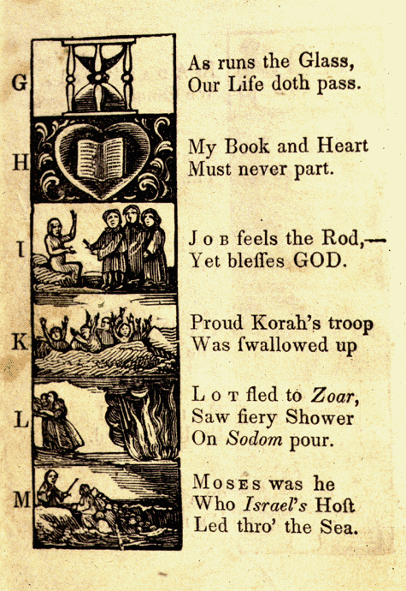
New England Primer
A: “In Adam’s fall we sinned all.”
C: Christ crucify’d for sinners dy’d.”
D: “The deluge drown’d the earth around.”
J: Job feels the rod, yet blesses God
N: “Noah did view the old world & new.”
Z: “Zaccheus he did climb the tree our Lord to see.”
New England Primer, 1737

Slide 72

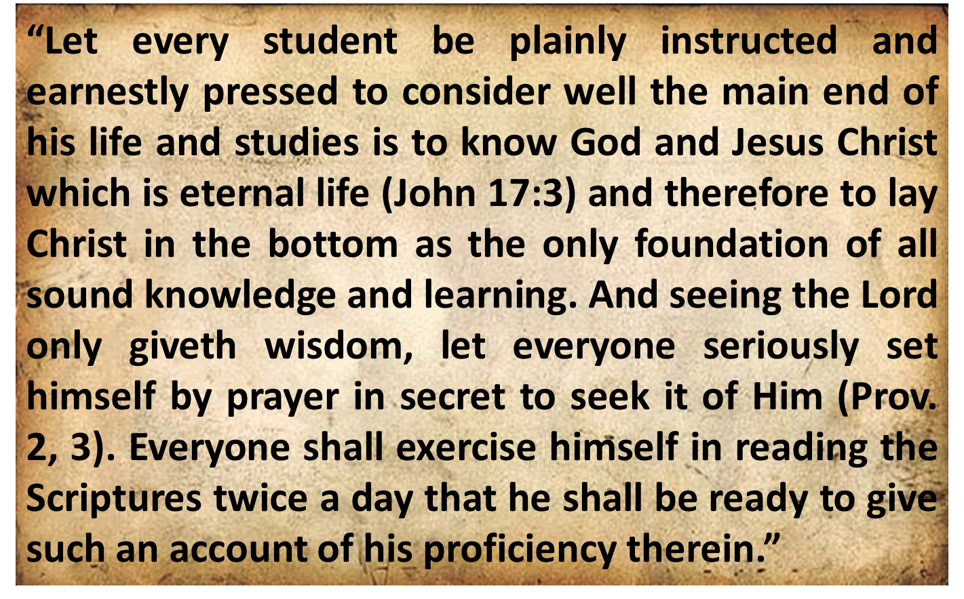
Harvard University
Rules of Harvard in 1636; quoted in David Barton, Original Intent, 81

Slide 73
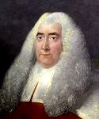
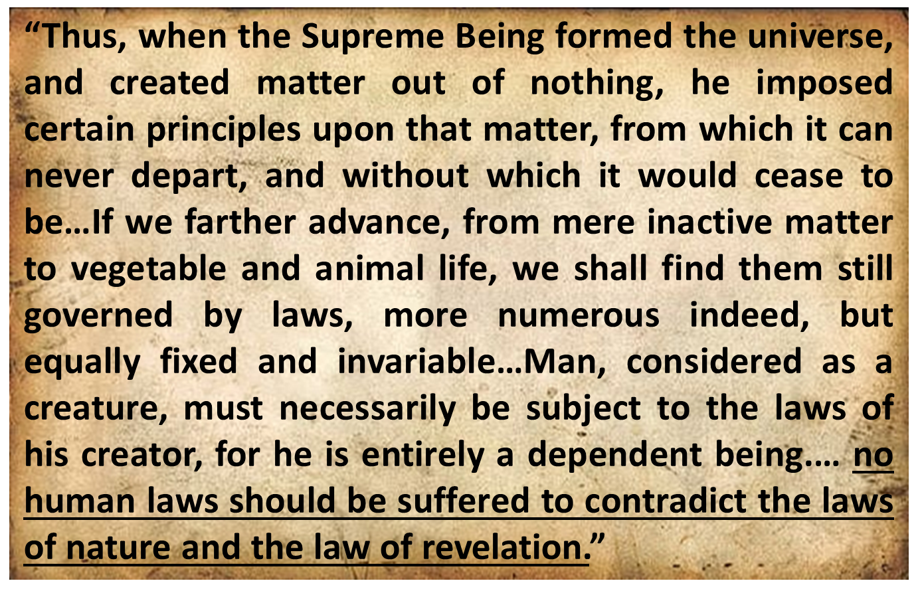
Sir William Blackstone
Sir William Blackstone, Commentaries on the Laws of New England, 5 vols.
(Philadelphia: Robert Bell Union Library, 1771; reprint, NY: Layston, 1967), 1:38-39, 42.

Slide 74
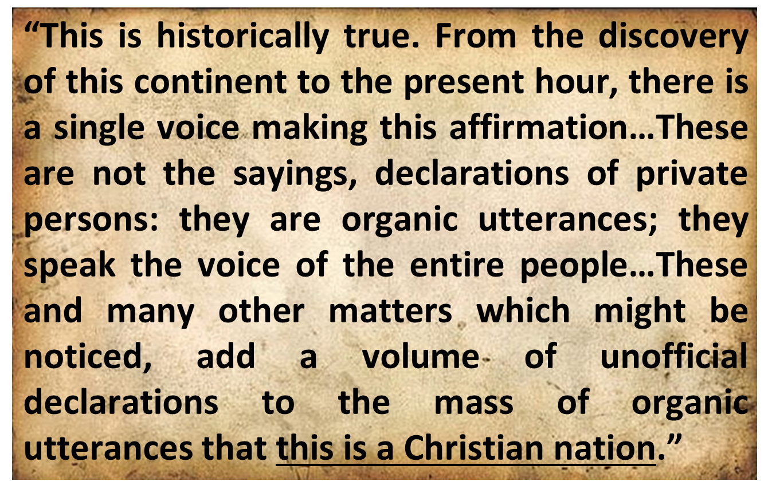
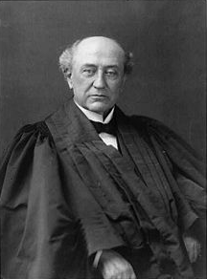
America is a “Christian Nation”
Church of the Holy Trinity v. U.S., 143 U.S. 457, 465, 470-71 (1892)

Slide 75

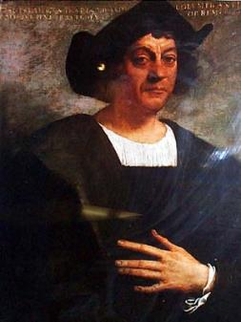
Christopher Columbus
“Our Lord opened to my understanding (I could sense his hand upon me) so it became clear to me that the voyage was feasible…All those who heard of my enterprise rejected it with laughter, scoffing at me...Who doubts this illumination was from the Holy Spirit? I attest that He, with marvelous rays of light, consoled me with the holy and sacred Scriptures...”

Slide 76
Christopher Columbus
...“they inflame me with a sense of great urgency…No one should be afraid to take on any enterprise in the name of the Savior if it is right and if the purpose is purely for His holy service...And I say that the sign that convinces me that our Lord is hastening the end of the world is the preaching of the Gospel in so many distant lands.”
Columbus, Book of Prophecies, trans. Kay Brigham, 178-79, 182-83.

Slide 77
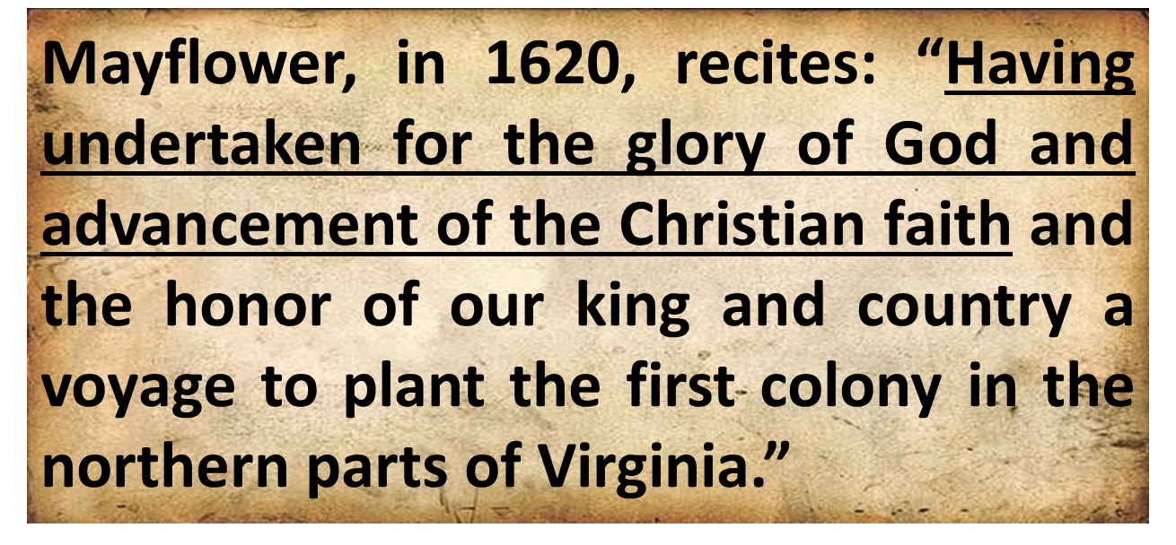
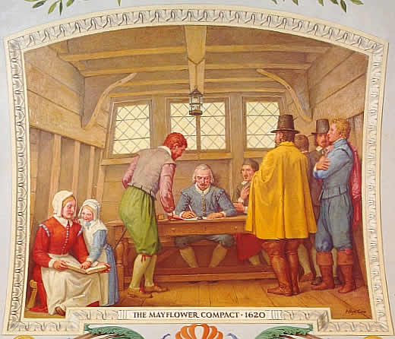
Mayflower Compact (1620)
David Brewer, United States A Christian Nation, 14

Slide 78

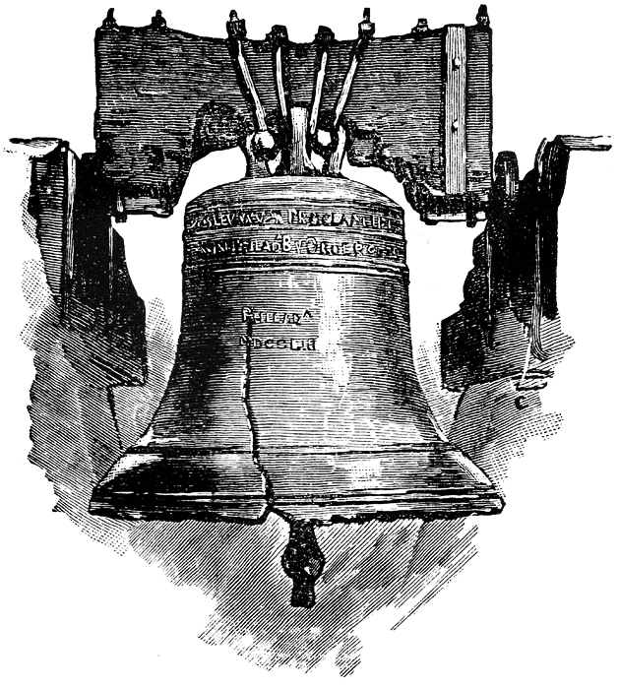
Leviticus 25:10 (NKJV)
And you shall consecrate the fiftieth year, and proclaim liberty throughout all the land to all its inhabitants. It shall be a Jubilee for you; and each of you shall return to his possession, and each of you shall return to his family.
78

Slide 79
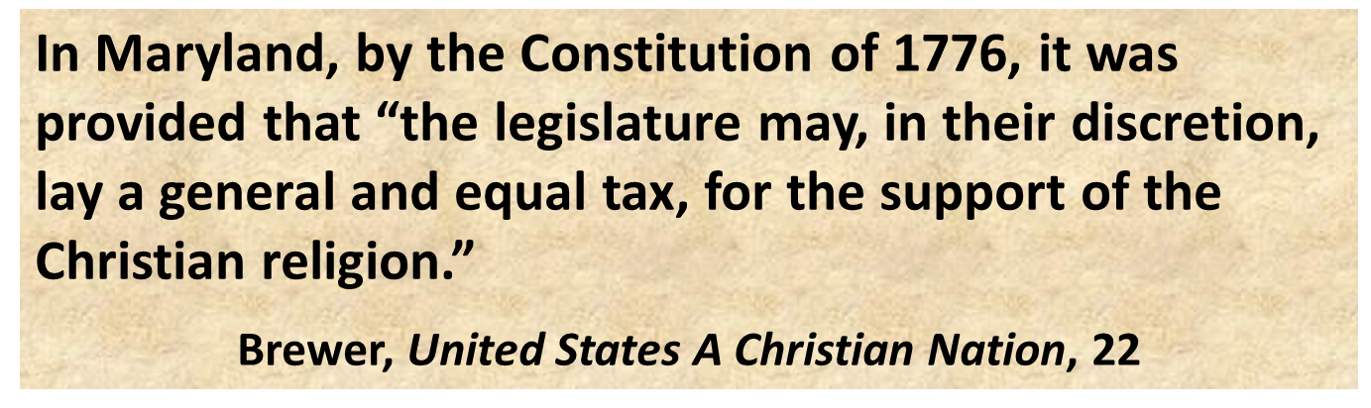
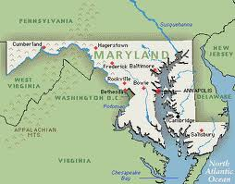
Maryland Constitution (1776)

Slide 80

Chief Justice Warren Burger
Lynch v. Donnelly, 465 U.S. 668, 673-74 (1984).
"A significant example of the contemporaneous understanding of that Clause is found in the events of the first week of the First Session of the First Congress in 1789. In the very week that Congress approved the Establishment Clause as part of the Bill of Rights for submission to the states, it enacted legislation providing for paid Chaplains for the House and Senate... It is clear that neither the 17 draftsmen of the Constitution who were Members of the First Congress, nor the Congress of 1789, saw any establishment problem in the employment of congressional Chaplains to offer daily prayers in the Congress, a practice that has continued for nearly two centuries. It would be difficult to identify a more striking example of the accommodation of religious belief intended by the Framers."

Slide 81
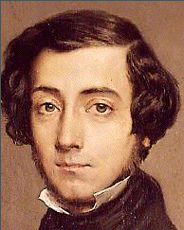

Alexis de Tocqueville

Slide 82

Scripture and Psychological Damage
“But if portions of the New Testament were read without explanation, they could be, and in his specific experience with children Dr. Grayzel observed, had been, psychologically harmful to the child and had caused a divisive force within the social media of the school.”
School District of Abington Township v. Schempp, 374 U.S. 203, 209 (1963).

Slide 83


Slide 84
Seven Principles that Made America Great
Sanctity of Life Principle (Gen. 1:27)
Recognition of Human Depravity Principle (Gen. 8:21)
Non-New World Order Principle (Gen. 11:6)
Economic Justice Principle (Gen. 3:19)
Heterosexual Monogamy Principle (Gen. 2:24)
Cooperation with Christianity Principle (Prov. 14:34)
Pro-Israel Principle (Gen. 12:3)

Slide 85

ISRAEL

Slide 86


Genesis 12:3
“And I will bless those who bless you, And the one who curses you I will curse. And in you all the families of the earth will be blessed.”

Slide 87
Genesis 12:3
“And I will bless those who bless you, And the one who curses you I will curse. And in you all the families of the earth will be blessed.”

Slide 88

Israel’s Three Blessings to the World
(Gen 12:3b)
Scripture (Rom 3:2)
Savior (John 4:22)
Kingdom (Isa 2:2-3)

Slide 89


Slide 90
Genesis 12:3
“And I will bless those who bless you, And the one who curses you I will curse. And in you all the families of the earth will be blessed.”

Slide 91


Statue
&
Stone

Slide 92


Slide 93
Genesis 12:3
“And I will bless those who bless you, And the one who curses you I will curse. And in you all the families of the earth will be blessed.”

Slide 94
Letter to the Hebrew Congregation of Newport, Rhode Island, August 18, 1790
"I rejoice in the opportunity of assuring you, that I shall always retain a grateful remembrance of the cordial welcome I experienced in my visit to Newport...the Government of the United States, which gives to bigotry no sanction, to persecution no assistance...May the Children of the Stock of Abraham, who dwell in this land, continue to merit and enjoy the good will of the other Inhabitants; while every one shall sit in safety under his own vine and fig tree, and there shall be none to make him afraid."

Slide 95


Slide 96


Slide 97


Slide 98
Conclusion

Slide 99
Seven Principles that Made America Great
Sanctity of Life Principle (Gen. 1:27)
Recognition of Human Depravity Principle (Gen. 8:21)
Non-New World Order Principle (Gen. 11:6)
Economic Justice Principle (Gen. 3:19)
Heterosexual Monogamy Principle (Gen. 2:24)
Cooperation with Christianity Principle (Prov. 14:34)
Pro-Israel Principle (Gen. 12:3)

Slide 100

²⁴ The Lord bless you, and keep you; ²⁵ The Lord make His face shine on you, And be gracious to you; ²⁶ The Lord lift up His countenance on you, And give you peace.
Numbers 6:24–26 (NASB95)

