Slide 1

Ezekiel 36‒39
The Middle East Meltdown 2022
Dr. Andy Woods
Senior Pastor – Sugar Land Bible Church
President – Chafer Theological Seminary

Slide 2

SLBC Position Statements # 1
SANCTITY OF LIFE – We believe that the fetus, from the moment of conception, is a person (Psalm 139:13-18). We also believe that all persons are created in the image of God regardless of age, health, function and/or condition of dependency.

Slide 3
Ezekiel 33‒48
Ezekiel recommissioned (33)
False shepherds removed (34)
Edom destroyed (35)
Israel’s restoration: physical & spiritual (36)
Israel’s restoration illustrated (37)
Means of restoration: Northern invasion (38)
Results of the Northern invasion: conversion (39)
Millennial Temple (40‒46)
Tribal land allotment (47‒48)

Slide 4

MAIL BAG
Timing of the birds of prey?
Is Gog killed in battle?
Second seal judgment?
Coincides with Rapture?
Armageddon?
Resurrection during Millennium?
Israel and the Antichrist?

Slide 5
MAIL BAG
Timing of the birds of prey?
Is Gog killed in battle?
Second seal judgment?
Coincides with Rapture?
Armageddon?
Resurrection during Millennium?
Israel and the Antichrist?

Slide 6
What?
Divine annihilation of the coalition (38:19-22)
Birds and beasts feast on the carnage (39:4-5, 17-20)
Seven-month burying of the dead (39:11-12, 14-16)
Seven-year burning of weapons (39:9-10)
Israel’s salvation and restoration (39:22, 29)

Slide 7

Charles L. Feinberg
The Prophecy of Ezekiel: The Glory of the Lord, Paperback ed. (Chicago: Moody, 1969; reprint, Chicago: Moody, 1984), 230-31.
“Now there is presented the third emphasis of the greatness of the invasion and the subsequent slaughter at the hand of the Lord. Incidentally, the figure gives a clue as to the time setting for the entire passage. It is the same scene as that a Revelation 19, the great supper of God, and the chronology is clear. The events will transpire at the end of the great tribulation and just before the millennial reign of the Messiah of Israel.”

Slide 8
What?
Divine annihilation of the coalition (38:19-22)
Birds and beasts feast on the carnage (39:4-5, 17-20)
Seven-month burying of the dead (39:11-12, 14-16)
Seven-year burning of weapons (39:9-10)
Israel’s salvation and restoration (39:22, 29)

Slide 9

Matthew 23:37-39
³⁷ “Jerusalem, Jerusalem, who kills the prophets and stones those who are sent to her! How often I wanted to gather [episynagō] your children together, the way a hen gathers [episynagō] her chicks under her wings, and you were unwilling. ³⁸ Behold, your house is being left to you desolate! ³⁹ For I say to you, from now on you will not see Me until you say, ‘Blessed is He who comes in the name of the Lord!’”

Slide 10


Slide 11


Slide 12
MAIL BAG
Timing of the birds of prey?
Is Gog killed in battle?
Second seal judgment?
Coincides with Rapture?
Armageddon?
Resurrection during Millennium?
Israel and the Antichrist?

Slide 13
MAIL BAG
Timing of the birds of prey?
Is Gog killed in battle?
Second seal judgment?
Coincides with Rapture?
Armageddon?
Resurrection during Millennium?
Israel and the Antichrist?

Slide 15

1st Six Seals (Revelation 6)
SEAL 1 – 6:1-2 – Advent of antichrist
SEAL 2 – 6:3-4 – War
SEAL 3 – 6:5-6 – Famine
SEAL 4 – 6:7-8 – Death
SEAL 5 – 6:9-11 – Martyrdoms
SEAL 6 – 6:12-17 – Cosmic disturbances

Slide 16

Ezekiel 38:8, 11
“⁸ After many days you will be summoned; in the latter years you will come into the land that is restored from the sword, whose inhabitants have been gathered from many nations to the mountains of Israel which had been a continual waste; but its people were brought out from the nations, and they are living securely [batach], all of them….¹¹ and you will say, ‘I will go up against the land of unwalled villages. I will go against those who are at rest [shacat], that live securely [batach], all of them living without walls and having no bars or gates.”

Slide 17
Ezekiel 38‒39
Invasion planned (38:1-13)
Invasion executed (38:14-16)
Invasion defeated (38:17‒39:20)
Invasion’s results (39:21-29)

Slide 18
MAIL BAG
Timing of the birds of prey?
Is Gog killed in battle?
Second seal judgment?
Coincides with Rapture?
Armageddon?
Resurrection during Millennium?
Israel and the Antichrist?

Slide 19

Promised Exemption from Divine Wrath
The promise (1 Thess 1:10; 5:9; Rom 5:9; 8:1; Rev 3:10)
Tribulation = divine wrath/anger (Rev 6:16-17; 11:18; 14:10; 15:1, 7; 16:1, 19; 19:15)

Slide 20

Ezekiel 38:18-19
“¹⁸ It will come about on that day, when Gog comes against the land of Israel,” declares the Lord God, “that My fury will mount up in My anger. ¹⁹ In My zeal and in My blazing wrath I declare that on that day there will surely be a great earthquake in the land of Israel.”

Slide 22
Ezekiel 38:8, 11
“⁸ After many days you will be summoned; in the latter years you will come into the land that is restored from the sword, whose inhabitants have been gathered from many nations to the mountains of Israel which had been a continual waste; but its people were brought out from the nations, and they are living securely [batach], all of them….¹¹ and you will say, ‘I will go up against the land of unwalled villages. I will go against those who are at rest [shacat], that live securely [batach], all of them living without walls and having no bars or gates.”

Slide 23


2 Thessalonians 2:6-7
⁶And you know what restrains [katechon; neuter] him now, so that in his time he will be revealed. ⁷For the mystery of lawlessness is already at work; only he who now restrains [katechōn; masculine] will do so until he is taken out of the way.

Slide 24
MAIL BAG
Timing of the birds of prey?
Is Gog killed in battle?
Second seal judgment?
Coincides with Rapture?
Armageddon?
Resurrection during Millennium?
Israel and the Antichrist?

Slide 26
Armageddon?
Ezek 38-39 | Armageddon
No battle (38:20-23) | Battle between armies and Lord (Rev. 19:19)
Invaders come from the far west and north (38:5) | All nations invade (Rev. 16:14; Zech. 12:3)
Enemies destroyed on Israel’s mountains (39:2-4) | Events take place in Jerusalem (Zech. 12:2; 14:2; and the Valley of Jehoshaphat (Joel 3:12)
Israel dwelling in safety (38:11) | Israel not dwelling in safety (Rev. 12:14-17)
No massive blood flow recorded | Massive flow of blood (Rev. 14:20)
Fire comes upon invaders (39:6) | Fire does not come upon invaders
Pentecost, Things to Come, 347-48

Slide 27
MAIL BAG
Timing of the birds of prey?
Is Gog killed in battle?
Second seal judgment?
Coincides with Rapture?
Armageddon?
Resurrection during Millennium?
Israel and the Antichrist?

Slide 28
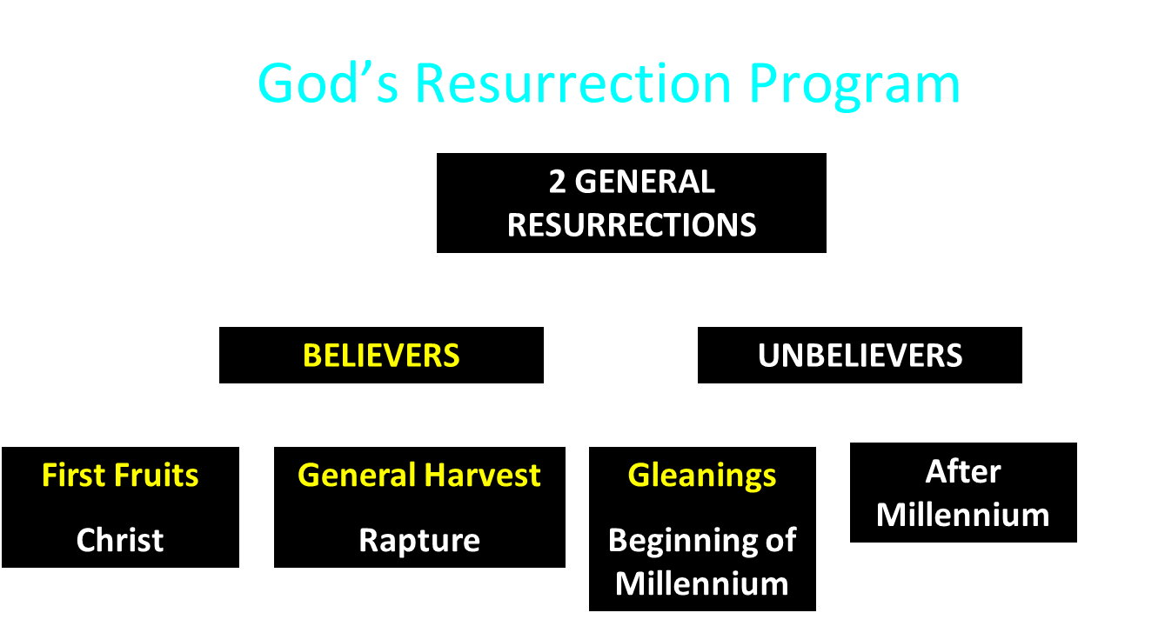

Slide 29

Daniel 12:1-2
“¹ Now at that time Michael, the great prince who stands guard over the sons of your people, will arise. And there will be a time of distress such as never occurred since there was a nation until that time; and at that time your people, everyone who is found written in the book, will be rescued. ² Many of those who sleep in the dust of the ground will awake, these to everlasting life, but the others to disgrace and everlasting contempt.”

Slide 30
Revelation 20:4-6
“⁴ Then I saw thrones, and they sat on them, and judgment was given to them. And I saw the souls of those who had been beheaded because of their testimony of Jesus and because of the word of God, and those who had not worshiped the beast or his image, and had not received the mark on their forehead and on their hand; and they came to life [zaō] and reigned with Christ for a thousand years. ⁵ The rest of the dead did not come to life [zaō] until the . . .

Slide 31
Revelation 20:4-6
. . . thousand years were completed. This is the first resurrection [anastasis]. ⁶ Blessed and holy is the one who has a part in the first resurrection [anastasis]; over these the second death has no power, but they will be priests of God and of Christ and will reign with Him for a thousand years.”

Slide 32

1 Corinthians 15:50-51
“⁵⁰ Now I say this, brethren, that flesh and blood cannot inherit the kingdom of God; nor does the perishable inherit the imperishable. ⁵¹ Behold, I tell you a mystery; we will not all sleep, but we will all be changed.”

Slide 33
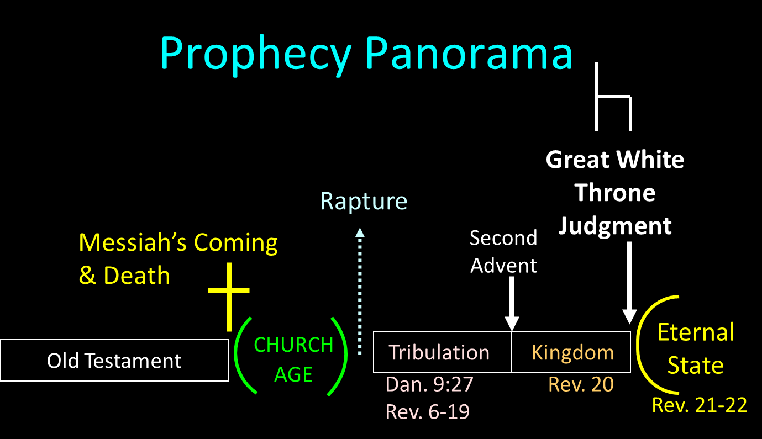

Slide 34
Millennium Rev.20 | Eternal State Rev.21-22
Sin restrained | Sin removed
Curse restrained | Curse removed
Death | No death
Mortals / resurrected | Resurrected only
Mortals Destinies undecided | All Destinies sealed
Renovation | Recreation
Temporary | Eternal
Transitional | Non-transitional
Dispensation | Not a dispensation

Slide 35
Millennium and Eternal State
 | Rev 20:1-10 | Rev 21–22
Time | 20:4 | 22:5
Luminaries | Isa 30:26 | 21:23; 22:5
Temple | Ezek 40–48 | 21:22
Death | Isa 65:20 | 21:4
Satanic activity | 20:7 | 20:10
Rebellion | 20:8-9 | 21:27

Slide 36
MAIL BAG
Timing of the birds of prey?
Is Gog killed in battle?
Second seal judgment?
Coincides with Rapture?
Armageddon?
Resurrection during Millennium?
Israel and the Antichrist?

Slide 37

Daniel 9:27
And he will make a firm covenant with the many for one week, but in the middle of the week he will put a stop to sacrifice and grain offering; and on the wing of abominations will come one who makes desolate, even until a complete destruction, one that is decreed, is poured out on the one who makes desolate.

Slide 39

Isaiah 28:15, 18
“¹⁵ Because you have said, ‘We have made a covenant with death, And with Sheol we have made a pact. The overwhelming scourge will not reach us when it passes by, For we have made falsehood our refuge and we have concealed ourselves with deception.’… ¹⁸ Your covenant with death will be canceled, And your pact with Sheol will not stand; When the overwhelming scourge passes through, Then you become its trampling place.”

Slide 40


Slide 41
Zechariah 12:10
“I will pour out on the house of David and on the inhabitants of Jerusalem, the Spirit of grace and of supplication, so that they will look on Me whom they have pierced; and they will mourn for Him, as one mourns for an only son, and they will weep bitterly over Him like the bitter weeping over a firstborn.”

Slide 42
CONCLUSION

Slide 43
MAIL BAG
Timing of the birds of prey?
Is Gog killed in battle?
Second seal judgment?
Coincides with Rapture?
Armageddon?
Resurrection during Millennium?
Israel and the Antichrist?

