Slide 1
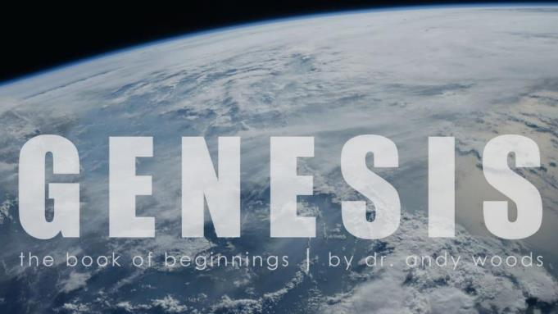
Genesis 12‒50
Israel’s Birth & Preservation

Slide 2
SLBC Position Statements # 1
SANCTITY OF LIFE – We believe that the fetus, from the moment of conception, is a person (Psalm 139:13-18). We also believe that all persons are created in the image of God regardless of age, health, function and/or condition of dependency.

Slide 3
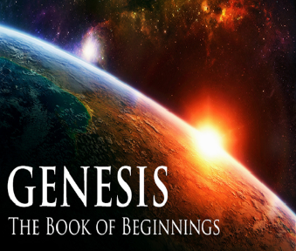
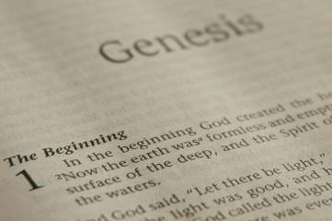
GENESIS STRUCTURE
Beginning of the Human race (Gen. 1‒11)
Beginning of the Hebrew race (Gen. 12‒50)

Slide 4
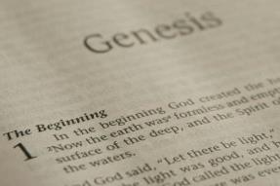
GENESIS STRUCTURE
Genesis 1-11 (four events)
Creation (1-2)
Fall (3-5)
Flood (6-9)
National dispersion (10-11)

Slide 5
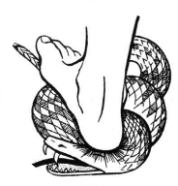
Genesis 3:15
“And I will put enmity Between you and the woman, And between your seed and her seed; He shall bruise you on the head, And you shall bruise him on the heel.”

Slide 6
GENESIS STRUCTURE
Beginning of the Human race (Gen. 1‒11)
Beginning of the Hebrew race (Gen. 12‒50)

Slide 7
GENESIS STRUCTURE
Genesis 12-50 (four people)
Abraham (12:1–25:11)
Isaac (25:12–26:35)
Jacob (27–36)
Joseph (37–50)

Slide 8
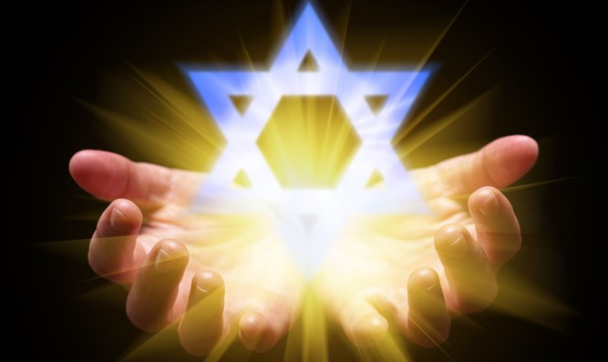
Isaiah 43:1
“But now, thus says the Lord, your Creator, O Jacob, And He who formed you, O Israel, 'Do not fear, for I have redeemed you; I have called you by name; you are Mine!'”

Slide 9
GENESIS STRUCTURE
Genesis 12-50 (four people)
Abraham (12:1–25:11)
Isaac (25:12–26:35)
Jacob (27–36)
Joseph (37–50)

Slide 10
Genesis 12‒21 Abraham’s Early Journeys
Unconditional promises (Gen. 12:1-3) From Haran to Canaan (Gen. 12:4-5) In Canaan (Gen. 12:6-9) In Egypt (Gen. 12:10-20) Abram and Lot Separate (Gen. 13:1-13) Reaffirmation of Abram’s promises (Gen. 13:14-18) Abram Rescues Lot (14:1-24) | Abrahamic Covenant (15:1-21) Hagar & Ishmael (16:1-16) Circumcision (Gen. 17:1-27) Sodom & Gomorrah (Gen. 18‒19) Abraham & Abimelech (Gen. 20) Isaac’s birth (Gen. 21:1-7) Ishmael’s expulsion (21:8-21)

Slide 11
Genesis 21:8-21 Ishmael’s Expulsion
Isaac’s weaning (8)
Ishmael’s mocking (9)
Sarah’s demand (10)
Abraham’s grief (11)
God comforts Abraham (12-13)
Expulsion (14)
Hagar’s anguish (15-16)
God’s comfort (17-18)
God’s provision (19)
Ishmael’s development (20)
Ishmael's marriage (21)

Slide 12
Genesis 21:8-21 Ishmael’s Expulsion
Isaac’s weaning (8)
Ishmael’s mocking (9)
Sarah’s demand (10)
Abraham’s grief (11)
God comforts Abraham (12-13)
Expulsion (14)
Hagar’s anguish (15-16)
God’s comfort (17-18)
God’s provision (19)
Ishmael’s development (20)
Ishmael's marriage (21)

Slide 13
Genesis 21:8-21 Ishmael’s Expulsion
Isaac’s weaning (8)
Ishmael’s mocking (9)
Sarah’s demand (10)
Abraham’s grief (11)
God comforts Abraham (12-13)
Expulsion (14)
Hagar’s anguish (15-16)
God’s comfort (17-18)
God’s provision (19)
Ishmael’s development (20)
Ishmael's marriage (21)

Slide 14
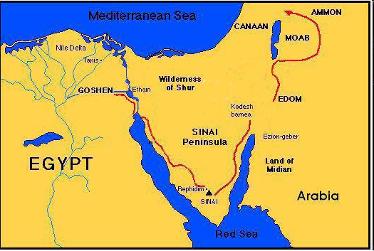

Slide 15
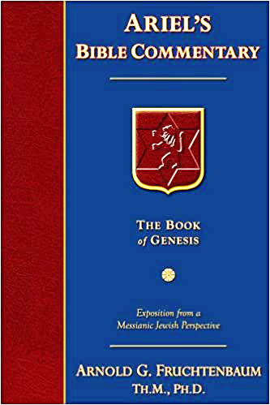
Dr. Arnold G. Fruchtenbaum
The Book of Genesis, 341
“What she saw him doing was mocking. The Hebrew word for Isaac and the Hebrew word for mocking is the same root, but appears here as a piel intensive. Here again there is a play upon words with Isaac’s name but this time in a negative sense. Ishmael took Isaac’s name and its meaning and reduced it to mockery; he was ‘isaacing’ Isaac. Nor was Ishmael just a young child. He was seventeen to twenty years old, and he was mocking someone who was between three and five years old.”

Slide 16
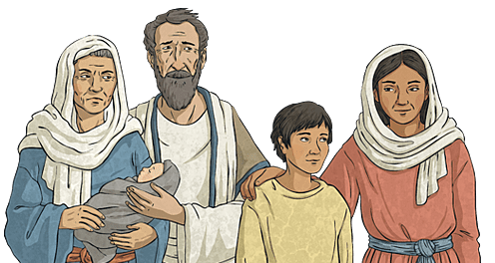
Charles Ryrie
The Ryrie Study Bible, page 27
Genesis 21:9 (RSB:NASB1995U): Genesis 21:9. “From the same Hebrew root as Isaac, though in an intensive form. The word is also used in 19:14 and 39:14–17. In Isaac, Ishmael saw all his hopes for an inheritance shattered.”

Slide 17
Genesis 21:8-21 Ishmael’s Expulsion
Isaac’s weaning (8)
Ishmael’s mocking (9)
Sarah’s demand (10)
Abraham’s grief (11)
God comforts Abraham (12-13)
Expulsion (14)
Hagar’s anguish (15-16)
God’s comfort (17-18)
God’s provision (19)
Ishmael’s development (20)
Ishmael's marriage (21)

Slide 18
Dr. Arnold G. Fruchtenbaum
The Book of Genesis, 343
“The reason was: for the son of this handmaid shall not be the heir with my son, even with Isaac; Isaac was to be the heir, and Ishmael was to be disinherited. This again fits with the Nuzi Tablets and the Code of Hammurabi, in which the son of the wife has precedence over the son of a handmaid, even if the son of the wife was born later. The father was forbidden, however, to expel the son of the handmaid if the son of the wife had been born. Ishmael was to be disinherited, but he was not to be dishonored. Hence, God’s intervention would have to come into play for the expulsion to occur.”

Slide 19
Galatians 4:24–25
²⁴ This is allegorically speaking, for these women are two covenants: one proceeding from Mount Sinai bearing children who are to be slaves; she is Hagar. ²⁵ Now this Hagar is Mount Sinai in Arabia and corresponds to the present Jerusalem, for she is in slavery with her children.

Slide 20
Genesis 21:8-21 Ishmael’s Expulsion
Isaac’s weaning (8)
Ishmael’s mocking (9)
Sarah’s demand (10)
Abraham’s grief (11)
God comforts Abraham (12-13)
Expulsion (14)
Hagar’s anguish (15-16)
God’s comfort (17-18)
God’s provision (19)
Ishmael’s development (20)
Ishmael's marriage (21)

Slide 21
Genesis 12‒21 Abraham’s Early Journeys
Unconditional promises (Gen. 12:1-3) From Haran to Canaan (Gen. 12:4-5) In Canaan (Gen. 12:6-9) In Egypt (Gen. 12:10-20) Abram and Lot Separate (Gen. 13:1-13) Reaffirmation of Abram’s promises (Gen. 13:14-18) Abram Rescues Lot (14:1-24) | Abrahamic Covenant (15:1-21) Hagar & Ishmael (16:1-16) Circumcision (Gen. 17:1-27) Sodom & Gomorrah (Gen. 18‒19) Abraham & Abimelech (Gen. 20) Isaac’s birth (Gen. 21:1-7) Ishmael’s expulsion (21:8-21)

Slide 22
Genesis 21:8-21 Ishmael’s Expulsion
Isaac’s weaning (8)
Ishmael’s mocking (9)
Sarah’s demand (10)
Abraham’s grief (11)
God comforts Abraham (12-13)
Expulsion (14)
Hagar’s anguish (15-16)
God’s comfort (17-18)
God’s provision (19)
Ishmael’s development (20)
Ishmael's marriage (21)

Slide 23
VI. 8 New Promises Genesis 12:1-3
Land (Gen. 12:1b)
Great nation (Gen. 12:2a)
Personal blessing (Gen. 12:2b)
Great name (Gen. 12:2c)
Blessing to others (Gen. 12:2d)
Blessing to blessers (Gen. 12:3a)
Cursing to cursers (Gen. 12:3b)
Blessing to the world (Gen. 12:3c)

Slide 24
Dr. Arnold G. Fruchtenbaum
The Book of Genesis, 240
“This is the first of seven times that Abraham receives a direct revelation from God. In 12:1–3 is God’s initial call to Abram outside the Land of Canaan; in 12:7 is the first appearance to Abraham in the Land; in 13:14–17, Abraham encounters God after the separation of Lot; in 15:1–21, God signs and seals the Abrahamic Covenant; in 17:1–21, Abraham receives the token of the covenant; in 18:1–33, God speaks to him in conjunction with the destruction of Sodom; and in 22:1–2 and 22:11–18, God directs Abraham to offer Isaac.”

Slide 25
Abimelech & God Genesis 21:12-13
Concerning Isaac (12)
Concerning Ishmael (13)

Slide 26
Abimelech & God Genesis 21:12-13
Concerning Isaac (12)
Concerning Ishmael (13)

Slide 27
Abimelech & God Genesis 21:12-13
Concerning Isaac (12)
Concerning Ishmael (13)

Slide 28
VI. 8 New Promises Genesis 12:1-3
Land (Gen. 12:1b)
Great nation (Gen. 12:2a)
Personal blessing (Gen. 12:2b)
Great name (Gen. 12:2c)
Blessing to others (Gen. 12:2d)
Blessing to blessers (Gen. 12:3a)
Cursing to cursers (Gen. 12:3b)
Blessing to the world (Gen. 12:3c)

Slide 29
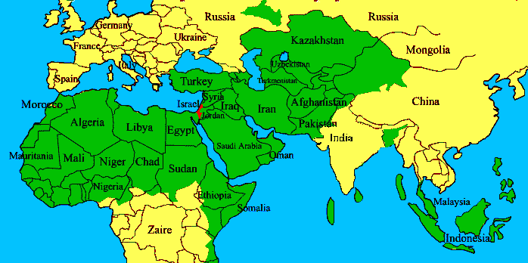
ISRAEL

Slide 30
Genesis 21:8-21 Ishmael’s Expulsion
Isaac’s weaning (8)
Ishmael’s mocking (9)
Sarah’s demand (10)
Abraham’s grief (11)
God comforts Abraham (12-13)
Expulsion (14)
Hagar’s anguish (15-16)
God’s comfort (17-18)
God’s provision (19)
Ishmael’s development (20)
Ishmael's marriage (21)

Slide 31
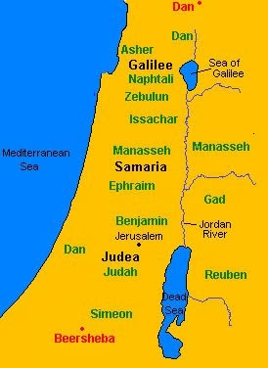

Slide 32
Genesis 21:8-21 Ishmael’s Expulsion
Isaac’s weaning (8)
Ishmael’s mocking (9)
Sarah’s demand (10)
Abraham’s grief (11)
God comforts Abraham (12-13)
Expulsion (14)
Hagar’s anguish (15-16)
God’s comfort (17-18)
God’s provision (19)
Ishmael’s development (20)
Ishmael's marriage (21)

Slide 33
Genesis 21:8-21 Ishmael’s Expulsion
Isaac’s weaning (8)
Ishmael’s mocking (9)
Sarah’s demand (10)
Abraham’s grief (11)
God comforts Abraham (12-13)
Expulsion (14)
Hagar’s anguish (15-16)
God’s comfort (17-18)
God’s provision (19)
Ishmael’s development (20)
Ishmael's marriage (21)

Slide 34
VI. 8 New Promises Genesis 12:1-3
Land (Gen. 12:1b)
Great nation (Gen. 12:2a)
Personal blessing (Gen. 12:2b)
Great name (Gen. 12:2c)
Blessing to others (Gen. 12:2d)
Blessing to blessers (Gen. 12:3a)
Cursing to cursers (Gen. 12:3b)
Blessing to the world (Gen. 12:3c)

Slide 35
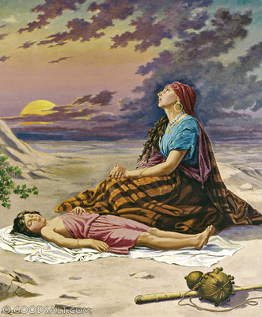
Charles Ryrie
The Ryrie Study Bible, page 27
Genesis 21:18 (RSB:NASB1995U): Genesis 21:18. “This promise assured Hagar that Ishmael would survive.”

Slide 36
Genesis 21:8-21 Ishmael’s Expulsion
Isaac’s weaning (8)
Ishmael’s mocking (9)
Sarah’s demand (10)
Abraham’s grief (11)
God comforts Abraham (12-13)
Expulsion (14)
Hagar’s anguish (15-16)
God’s comfort (17-18)
God’s provision (19)
Ishmael’s development (20)
Ishmael's marriage (21)

Slide 37
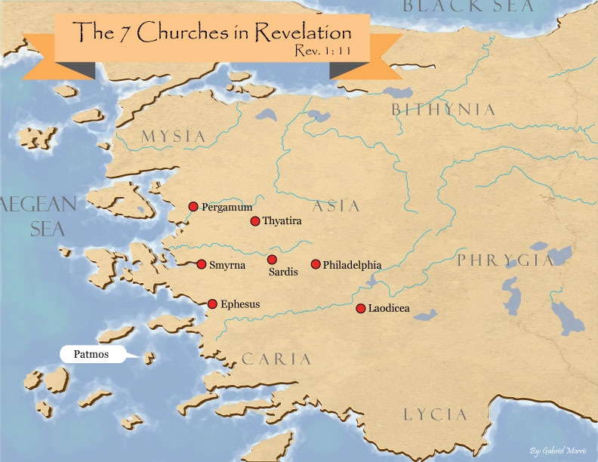

Slide 38
God’s Provision
Exodus 16
1 Kings 17:2-6
Psalm 37:25
Matthew 6:25-34
Philippians 4:19

Slide 39
Genesis 21:8-21 Ishmael’s Expulsion
Isaac’s weaning (8)
Ishmael’s mocking (9)
Sarah’s demand (10)
Abraham’s grief (11)
God comforts Abraham (12-13)
Expulsion (14)
Hagar’s anguish (15-16)
God’s comfort (17-18)
God’s provision (19)
Ishmael’s development (20)
Ishmael's marriage (21)

Slide 40
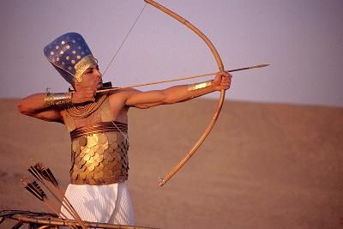
Dr. Arnold G. Fruchtenbaum
The Book of Genesis, 346
“He now became a hunter. In the context of Genesis, this is not a positive but a negative, as already indicated with Nimrod; for he, too, was a mighty hunter before the Lord.”

Slide 41
Genesis 21:8-21 Ishmael’s Expulsion
Isaac’s weaning (8)
Ishmael’s mocking (9)
Sarah’s demand (10)
Abraham’s grief (11)
God comforts Abraham (12-13)
Expulsion (14)
Hagar’s anguish (15-16)
God’s comfort (17-18)
God’s provision (19)
Ishmael’s development (20)
Ishmael's marriage (21)

Slide 42
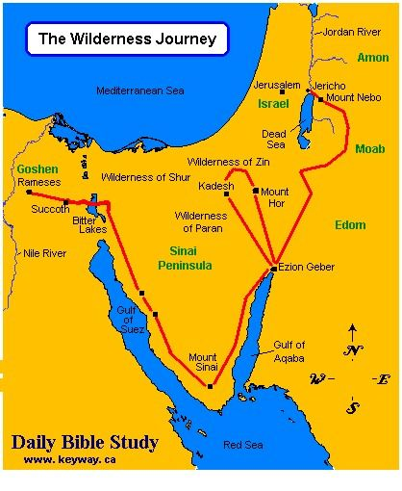

Slide 43
Dr. Arnold G. Fruchtenbaum
The Book of Genesis, 347
“The wife for Ishmael was the same nationality as the mother. The ancient Egyptians were Hamitic. As is known from Egyptian archeology, the Hamitic Egyptians were quite anti-Semitic, which would add to the antagonism that was already there.”

Slide 44
ISRAEL

Slide 45
Conclusion

Slide 46
Genesis 21:8-21 Ishmael’s Expulsion
Isaac’s weaning (8)
Ishmael’s mocking (9)
Sarah’s demand (10)
Abraham’s grief (11)
God comforts Abraham (12-13)
Expulsion (14)
Hagar’s anguish (15-16)
God’s comfort (17-18)
God’s provision (19)
Ishmael’s development (20)
Ishmael's marriage (21)

Slide 47
Genesis 12‒21 Abraham’s Early Journeys
Unconditional promises (Gen. 12:1-3) From Haran to Canaan (Gen. 12:4-5) In Canaan (Gen. 12:6-9) In Egypt (Gen. 12:10-20) Abram and Lot Separate (Gen. 13:1-13) Reaffirmation of Abram’s promises (Gen. 13:14-18) Abram Rescues Lot (14:1-24) | Abrahamic Covenant (15:1-21) Hagar & Ishmael (16:1-16) Circumcision (Gen. 17:1-27) Sodom & Gomorrah (Gen. 18‒19) Abraham & Abimelech (Gen. 20) Isaac’s birth (Gen. 21:1-7) Ishmael’s expulsion (21:8-21) Abraham & Abimelech’s covenant (21:22-34)

Slide 48
²⁴ The Lord bless you, and keep you; ²⁵ The Lord make His face shine on you, And be gracious to you; ²⁶ The Lord lift up His countenance on you, And give you peace.
Numbers 6:24–26 (NASB95)

