Slide 1

Ezekiel 36‒39
The Middle East Meltdown 2022
Dr. Andy Woods
Senior Pastor – Sugar Land Bible Church
President – Chafer Theological Seminary

Slide 2
Ezekiel 33‒48
Ezekiel recommissioned (33)
False shepherds removed (34)
Edom destroyed (35)
Israel’s restoration: physical & spiritual (36)
Israel’s restoration illustrated (37)
Means of restoration: Northern invasion (38)
Results of the Northern invasion: conversion (39)
Millennial Temple (40‒46)
Tribal land allotment (47‒48)

Slide 3

MAIL BAG
Timeline?
Matthew 27:52-53?
Stage setting events?
Timing of the birds of prey?
Is Gog killed in battle?
Second seal judgment?
Coincides with Rapture?

Slide 4
MAIL BAG
Timeline?
Matthew 27:52-53?
Stage setting events?
Timing of the birds of prey?
Is Gog killed in battle?
Second seal judgment?
Coincides with Rapture?

Slide 5


Slide 6


Slide 7
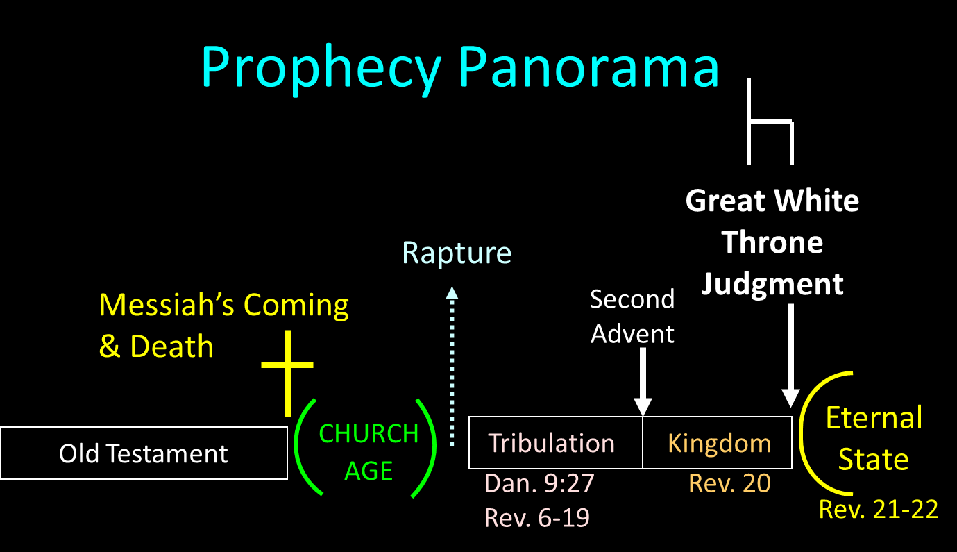

Slide 8
MAIL BAG
Timeline?
Matthew 27:52-53?
Stage setting events?
Timing of the birds of prey?
Is Gog killed in battle?
Second seal judgment?
Coincides with Rapture?

Slide 9
MAIL BAG
Timeline?
Matthew 27:52-53?
Stage setting events?
Timing of the birds of prey?
Is Gog killed in battle?
Second seal judgment?
Coincides with Rapture?

Slide 10


Slide 11
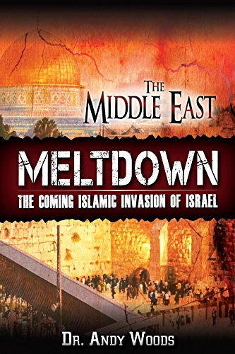

Slide 12


Ezekiel 38:12
“to capture spoil and to seize plunder, to turn your hand against the waste places which are now inhabited, and against the people who are gathered from the nations, who have acquired cattle and goods, who live at the center of the world.”

Slide 13
Ezekiel 38:13
“Sheba and Dedan and the merchants of Tarshish with all its villages will say to you, ‘Have you come to capture spoil? Have you assembled your company to seize plunder, to carry away silver and gold, to take away cattle and goods, to capture great spoil?’”

Slide 14
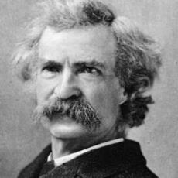
Mark Twain
The Innocents Abroad, Complete, 1st ed. (A Public Domain Book, 1869), 267, 285, 302. These quotes can be found in chapters 47, 49, 52.
“... A desolate country whose soil is rich enough, but is given over wholly to weeds… a silent mournful expanse…. a desolation is here that not even imagination can grace with the pomp of life and action…. we never saw a human being on the whole route…. there was hardly a tree or shrub anywhere. Even the olive tree and the cactus, those fast friends of a worthless soil, had almost deserted the country.”

Slide 15
Why?
COUNTRY | GROSS DOMESTIC PRODUCT
ISRAEL | $123 BILLION
Egypt | $81 billion
Syria | $26 billion
Lebanon | $21 billion
Jordan | $12 billion
Source: CIA World Fact Book, 2005

Slide 16
Why?
COUNTRY | GROSS DOMESTIC PRODUCT (in U.S. $)
ISRAEL | $467 BILLION
Egypt | $396 billion
Jordan | $45 billion
Lebanon | $19 billion
Syria (no data after 2010) | $60 billion (est. 2010)
Source: I.M.F., 2021

Slide 17


Slide 18
Ezekiel 38:13
“Sheba and Dedan and the merchants of Tarshish with all its villages will say to you, ‘Have you come to capture spoil? Have you assembled your company to seize plunder, to carry away silver and gold, to take away cattle and goods, to capture great spoil?’”

Slide 19
Ancient Names From Ezekiel 38:1-9
Magog (Central Asia) Rosh (Russia) Meshec (Turkey) Tubal (Turkey) Persia (Iran) Put (Libya) Cush (Sudan) Gomer (Turkey) | Togarmah (Turkey) Sheba (Saudi Arabia) Dedan (Saudi Arabia or Yemen) Tarshish (Spain) Merchants of Tarshish (Conglomeration of Western powers including Europe) Israel

Slide 20
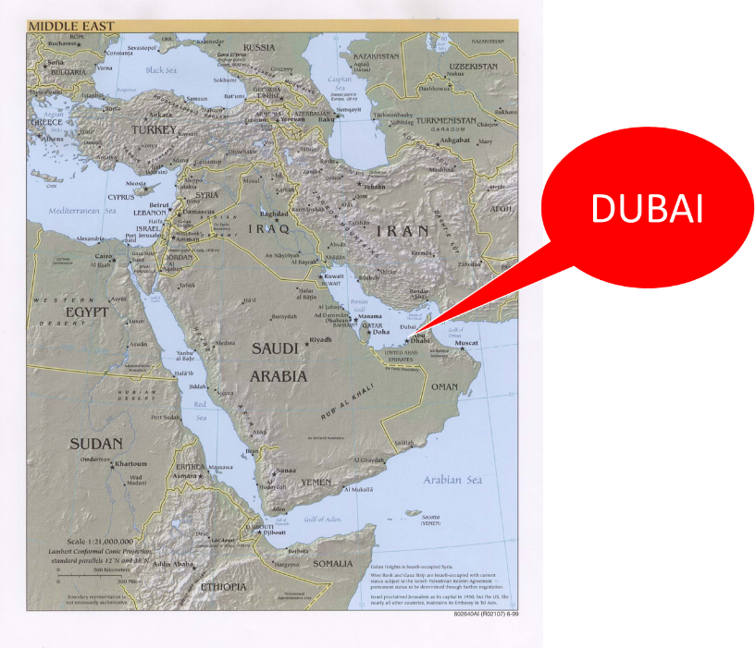

Slide 21
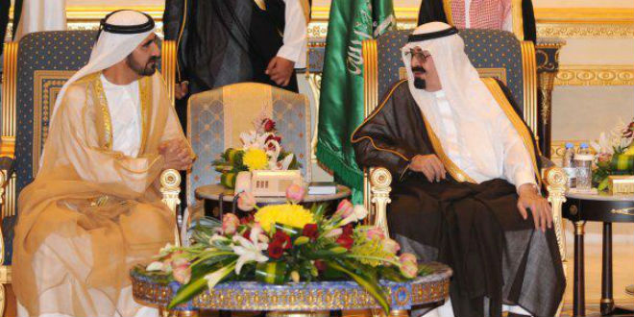
“SAUDI PRINCE: ‘I’LL SIDE WITH ISRAEL’ AGAINST PALESTINIAN UPRISING, [AND] IRAN.”
https://www.breakingisraelnews.com/52468/saudi-prince-ill-side-with-israel-against-palestinian-uprising-middle-east/#bco8FQkRWpkSLkuq.97

Slide 22

TIMES OF INDIA
online: http://tass.com/politics/932980. December 01, 2017 , accessed 12 December 2017.
“Saudi Arabia intercepts second Yemen missile in a month. Saudi Arabia on Thursday intercepted and destroyed a ballistic missile fired from war-torn Yemen, state media reported, the second such attack this month claimed by Iran-backed Huthi rebels.”

Slide 23
Ezekiel 38:13
“Sheba and Dedan and the merchants of Tarshish with all its villages will say to you, ‘Have you come to capture spoil? Have you assembled your company to seize plunder, to carry away silver and gold, to take away cattle and goods, to capture great spoil?’”

Slide 24

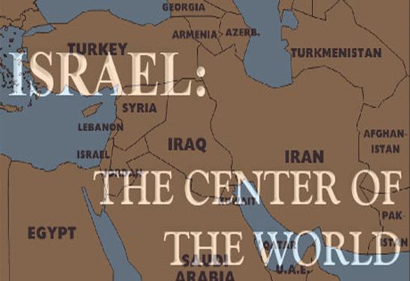
Charles L. Feinberg
The Prophecy of Ezekiel: The Glory of the Lord, Paperback ed. (Chicago: Moody, 1969; reprint, Chicago: Moody, 1984), 223.
“The young lions of Tarshish are taken to mean either the strong leaders and princes or greedy rulers of these commercial communities.”

Slide 25
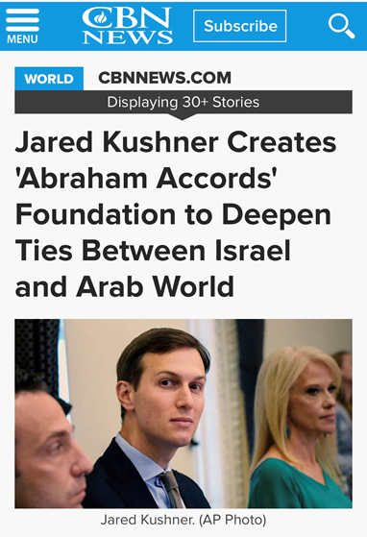

Slide 26
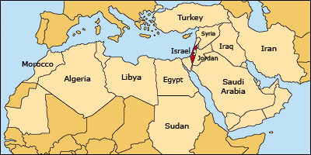

Slide 27
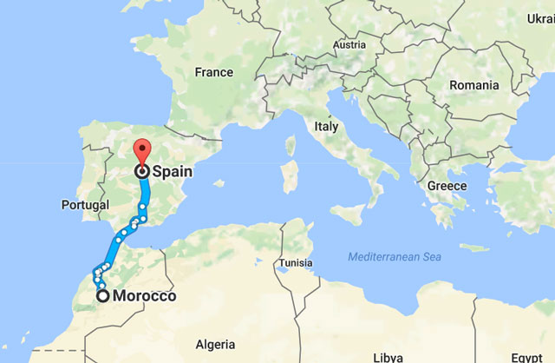

Slide 29
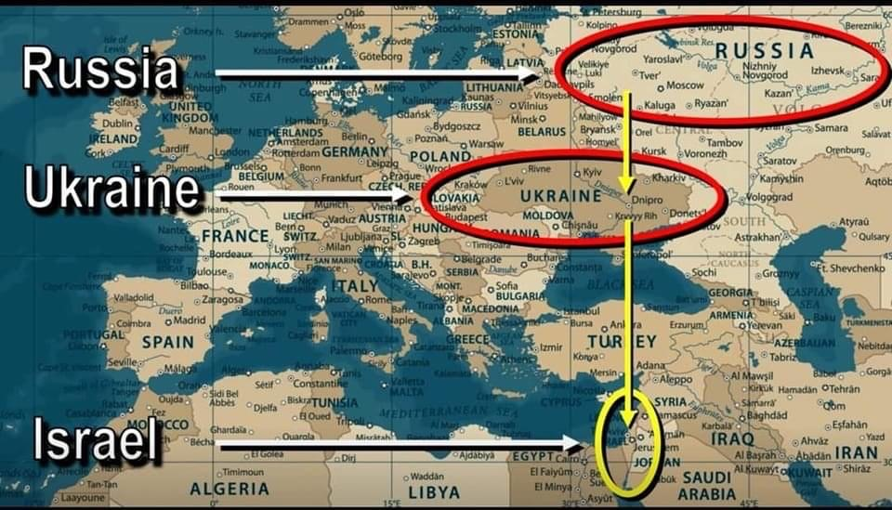

Slide 30
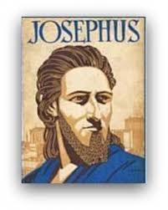
Josephus
Josephus, Antiquities, 1.6.1.
"Magog founded those that from him were named Magogites, but who are by the Greeks called Scythians."

Slide 32
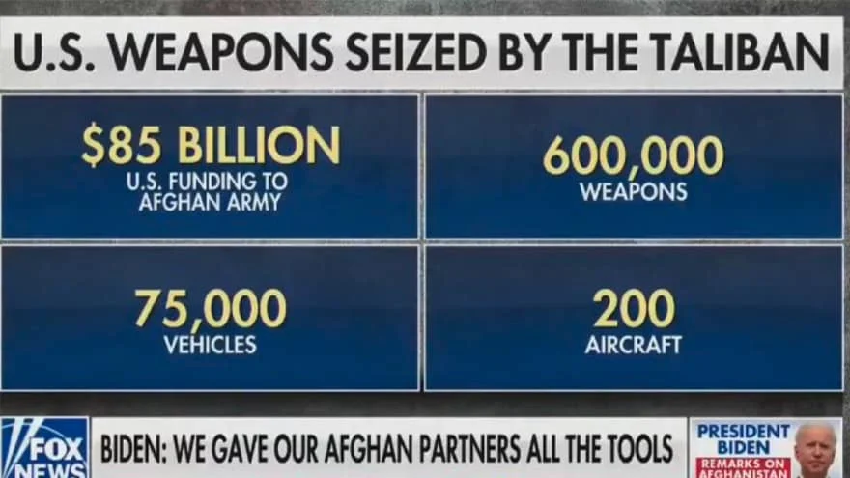

Slide 33
MAIL BAG
Timeline?
Matthew 27:52-53?
Stage setting events?
Timing of the birds of prey?
Is Gog killed in battle?
Second seal judgment?
Coincides with Rapture?

Slide 34
What?
Divine annihilation of the coalition (38:19-22)
Birds and beasts feast on the carnage (39:4-5, 17-20)
Seven-month burying of the dead (39:11-12, 14-16)
Seven-year burning of weapons (39:9-10)
Israel’s salvation and restoration (39:22, 29)

Slide 35
Charles L. Feinberg
The Prophecy of Ezekiel: The Glory of the Lord, Paperback ed. (Chicago: Moody, 1969; reprint, Chicago: Moody, 1984), 230-31.
“Now there is presented the third emphasis of the greatness of the invasion and the subsequent slaughter at the hand of the Lord. Incidentally, the figure gives a clue as to the time setting for the entire passage. It is the same scene as that a Revelation 19, the great supper of God, and the chronology is clear. The events will transpire at the end of the great tribulation and just before the millennial reign of the Messiah of Israel.”

Slide 36
What?
Divine annihilation of the coalition (38:19-22)
Birds and beasts feast on the carnage (39:4-5, 17-20)
Seven-month burying of the dead (39:11-12, 14-16)
Seven-year burning of weapons (39:9-10)
Israel’s salvation and restoration (39:22, 29)

Slide 37

Matthew 23:37-39
³⁷ “Jerusalem, Jerusalem, who kills the prophets and stones those who are sent to her! How often I wanted to gather [episynagō] your children together, the way a hen gathers [episynagō] her chicks under her wings, and you were unwilling. ³⁸ Behold, your house is being left to you desolate! ³⁹ For I say to you, from now on you will not see Me until you say, ‘Blessed is He who comes in the name of the Lord!’”

Slide 40
MAIL BAG
Timeline?
Matthew 27:52-53?
Stage setting events?
Timing of the birds of prey?
Is Gog killed in battle?
Second seal judgment?
Coincides with Rapture?

Slide 41
MAIL BAG
Timeline?
Matthew 27:52-53?
Stage setting events?
Timing of the birds of prey?
Is Gog killed in battle?
Second seal judgment?
Coincides with Rapture?

Slide 43

1st Six Seals (Revelation 6)
SEAL 1 – 6:1-2 – Advent of antichrist
SEAL 2 – 6:3-4 – War
SEAL 3 – 6:5-6 – Famine
SEAL 4 – 6:7-8 – Death
SEAL 5 – 6:9-11 – Martyrdoms
SEAL 6 – 6:12-17 – Cosmic disturbances

Slide 44

Ezekiel 38:8, 11
“⁸ After many days you will be summoned; in the latter years you will come into the land that is restored from the sword, whose inhabitants have been gathered from many nations to the mountains of Israel which had been a continual waste; but its people were brought out from the nations, and they are living securely [batach], all of them….¹¹ and you will say, ‘I will go up against the land of unwalled villages. I will go against those who are at rest [shacat], that live securely [batach], all of them living without walls and having no bars or gates.”

Slide 45
Ezekiel 38‒39
Invasion planned (38:1-13)
Invasion executed (38:14-16)
Invasion defeated (38:17‒39:20)
Invasion’s results (39:21-29)

Slide 46
MAIL BAG
Timeline?
Matthew 27:52-53?
Stage setting events?
Timing of the birds of prey?
Is Gog killed in battle?
Second seal judgment?
Coincides with Rapture?

Slide 47

Promised Exemption from Divine Wrath
The promise (1 Thess 1:10; 5:9; Rom 5:9; 8:1; Rev 3:10)
Tribulation = divine wrath/anger (Rev 6:16-17; 11:18; 14:10; 15:1, 7; 16:1, 19; 19:15)

Slide 48

Ezekiel 38:18-19
“¹⁸ It will come about on that day, when Gog comes against the land of Israel,” declares the Lord God, “that My fury will mount up in My anger. ¹⁹ In My zeal and in My blazing wrath I declare that on that day there will surely be a great earthquake in the land of Israel.”

Slide 49
CONCLUSION

Slide 50
MAIL BAG
Timeline?
Matthew 27:52-53?
Stage setting events?
Timing of the birds of prey?
Is Gog killed in battle?
Second seal judgment?
Coincides with Rapture?

