Slide 1
Genesis 12‒50
Israel’s Birth & Preservation

Slide 2
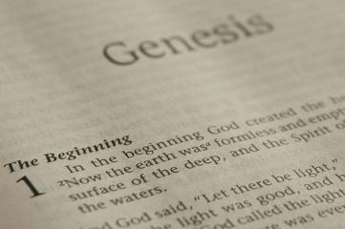
GENESIS STRUCTURE
Beginning of the Human race (Gen. 1‒11)
Beginning of the Hebrew race (Gen. 12‒50)

Slide 3
GENESIS STRUCTURE
Genesis 1-11 (four events)
Creation (1-2)
Fall (3-5)
Flood (6-9)
National dispersion (10-11)

Slide 4
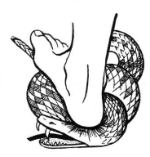
Genesis 3:15
“And I will put enmity Between you and the woman, And between your seed and her seed; He shall bruise you on the head, And you shall bruise him on the heel.”

Slide 5
GENESIS STRUCTURE
Beginning of the Human race (Gen. 1‒11)
Beginning of the Hebrew race (Gen. 12‒50)

Slide 6
GENESIS STRUCTURE
Genesis 12-50 (four people)
Abraham (12:1–25:11)
Isaac (25:12–26:35)
Jacob (27–36)
Joseph (37–50)

Slide 7
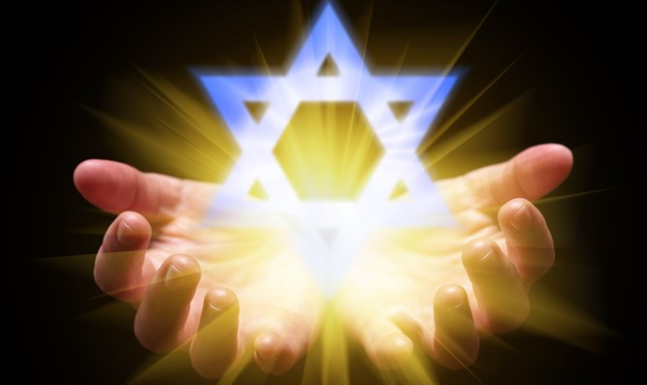
Isaiah 43:1
“But now, thus says the Lord, your Creator, O Jacob, And He who formed you, O Israel, 'Do not fear, for I have redeemed you; I have called you by name; you are Mine!'”

Slide 8
GENESIS STRUCTURE
Genesis 12-50 (four people)
Abraham (12:1–25:11)
Isaac (25:12–26:35)
Jacob (27–36)
Joseph (37–50)

Slide 9
Genesis 12‒21 Abraham’s Early Journeys
Unconditional promises (Gen. 12:1-3) From Haran to Canaan (Gen. 12:4-5) In Canaan (Gen. 12:6-9) In Egypt (Gen. 12:10-20) Abram and Lot Separate (Gen. 13:1-13) Reaffirmation of Abram’s promises (Gen. 13:14-18) Abram Rescues Lot (14:1-24) | Abrahamic Covenant (15:1-21) Hagar & Ishmael (16:1-16) Circumcision (Gen. 17:1-27) Sodom & Gomorrah (Gen. 18‒19) Abraham & Abimelech (Gen. 20) Isaac’s birth (Gen. 21:1-7)

Slide 10
Genesis 21:1-7 Isaac’s Birth
Promise fulfilled (21:1-2)
Name: Isaac (21:3)
Circumcision (21:4)
Abraham’s age (21:5)
Sarah’s laughter (21:6-7)

Slide 11
Genesis 21:1-7 Isaac’s Birth
Promise fulfilled (21:1-2)
Name: Isaac (21:3)
Circumcision (21:4)
Abraham’s age (21:5)
Sarah’s laughter (21:6-7)

Slide 12
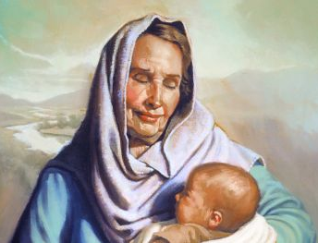
Dr. Arnold G. Fruchtenbaum
The Book of Genesis, 340
“He that opened the wombs of the House of Abimelech now opened the womb of Sarah.”

Slide 13
Dr. Arnold G. Fruchtenbaum
The Book of Genesis, 340
“Three times it is stated in these verses that God had said or God had spoken, emphasizing the fulfillment of His Word.”

Slide 14
John 13:19; 14:29
“¹⁹ From now on I am telling you before it comes to pass, so that when it does occur, you may believe that I am He… ^{14:29} Now I have told you before it happens, so that when it happens, you may believe.”

Slide 15
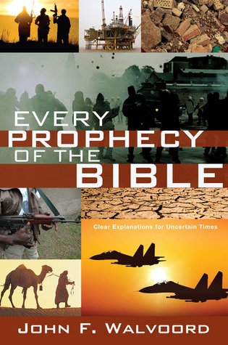

Slide 16
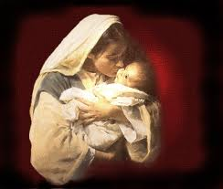
Galatians 4:4
“But when the fullness of the time came, God sent forth His Son, born of a woman, born under the Law.”

Slide 17
Genesis 21:1-7 Isaac’s Birth
Promise fulfilled (21:1-2)
Name: Isaac (21:3)
Circumcision (21:4)
Abraham’s age (21:5)
Sarah’s laughter (21:6-7)

Slide 18
Genesis 21:1-7 Isaac’s Birth
Promise fulfilled (21:1-2)
Name: Isaac (21:3)
Circumcision (21:4)
Abraham’s age (21:5)
Sarah’s laughter (21:6-7)

Slide 19
Genesis 12‒21 Abraham’s Early Journeys
Unconditional promises (Gen. 12:1-3) From Haran to Canaan (Gen. 12:4-5) In Canaan (Gen. 12:6-9) In Egypt (Gen. 12:10-20) Abram and Lot Separate (Gen. 13:1-13) Reaffirmation of Abram’s promises (Gen. 13:14-18) Abram Rescues Lot (14:1-24) | Abrahamic Covenant (15:1-21) Hagar & Ishmael (16:1-16) Circumcision (Gen. 17:1-27) Sodom & Gomorrah (Gen. 18‒19) Abraham & Abimelech (Gen. 20) Isaac’s birth (Gen. 21:1-7)

Slide 20
Dr. Arnold G. Fruchtenbaum
The Book of Genesis, 341
“Genesis 21:4 deals with the circumcision of Isaac: And Abraham circumcised his son Isaac. The timing was: when he was eight days old, as God had commanded him. Now the token of the covenant was being applied on the day that it was commanded, and Isaac is the first one recorded to be circumcised on the eighth day, since all those circumcised in chapter 17 were beyond the age of eight days.”

Slide 21
Genesis 21:1-7 Isaac’s Birth
Promise fulfilled (21:1-2)
Name: Isaac (21:3)
Circumcision (21:4)
Abraham’s age (21:5)
Sarah’s laughter (21:6-7)

Slide 22
Dr. Arnold G. Fruchtenbaum
The Book of Genesis, 341
“Genesis 21:5 specified the age of Abraham: Abraham was a hundred years old, when his son Isaac was born unto him. It was a twenty-five year wait before the promise of God was fulfilled; the promises of God are not always immediate, but they are always sure.”

Slide 23
2 Peter 3:9
“The Lord is not slow about His promise, as some count slowness, but is patient toward you, not wishing for any to perish but for all to come to repentance.”

Slide 24
Genesis 21:1-7 Isaac’s Birth
Promise fulfilled (21:1-2)
Name: Isaac (21:3)
Circumcision (21:4)
Abraham’s age (21:5)
Sarah’s laughter (21:6-7)

Slide 25
Charles Ryrie
The Ryrie Study Bible, page 27
Genesis 21:7 (RSB:NASB1995U): Genesis 21:7. “Sarah’s body was rejuvenated not only to bear a child but also to nurse him.”

Slide 26
Ezekiel 37:7-11
So I prophesied as I was commanded; and as I prophesied, there was a noise, and behold, a rattling; and the bones came together, bone to its bone. ⁸ And I looked, and behold, sinews were on them, and flesh grew and skin covered them; but there was no breath in them. ⁹ Then He said to me, “Prophesy to the breath, prophesy, son of man, and say to the breath, ‘Thus says the Lord God, “Come from the four winds, O breath, and breathe on these slain, that they come to life.”’” ¹⁰ So I prophesied as He . . .

Slide 27
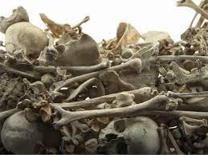
Ezekiel 37:7-11
. . . commanded me, and the breath came into them, and they came to life and stood on their feet, an exceedingly great army. ¹¹ Then He said to me, “Son of man, these bones are the whole house of Israel; behold, they say, ‘Our bones are dried up and our hope has perished. We are completely cut off’.”

Slide 28
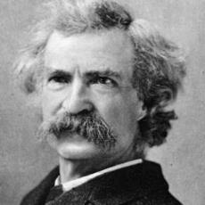
Mark Twain
The Innocents Abroad, Complete, 1st ed. (A Public Domain Book, 1869), 267, 285, 302. These quotes can be found in chapters 47, 49, 52.
“... A desolate country whose soil is rich enough, but is given over wholly to weeds… a silent mournful expanse…. a desolation is here that not even imagination can grace with the pomp of life and action…. we never saw a human being on the whole route…. there was hardly a tree or shrub anywhere. Even the olive tree and the cactus, those fast friends of a worthless soil, had almost deserted the country.”

Slide 29
Why?
COUNTRY | GROSS DOMESTIC PRODUCT
ISRAEL | $123 BILLION
Egypt | $81 billion
Syria | $26 billion
Lebanon | $21 billion
Jordan | $12 billion
Source: CIA World Fact Book, 2005

Slide 30
Why?
COUNTRY | GROSS DOMESTIC PRODUCT (in U.S. $)
ISRAEL | $467 BILLION
Egypt | $396 billion
Jordan | $45 billion
Lebanon | $19 billion
Syria (no data after 2010) | $60 billion (est. 2010)
Source: I.M.F., 2021

Slide 31
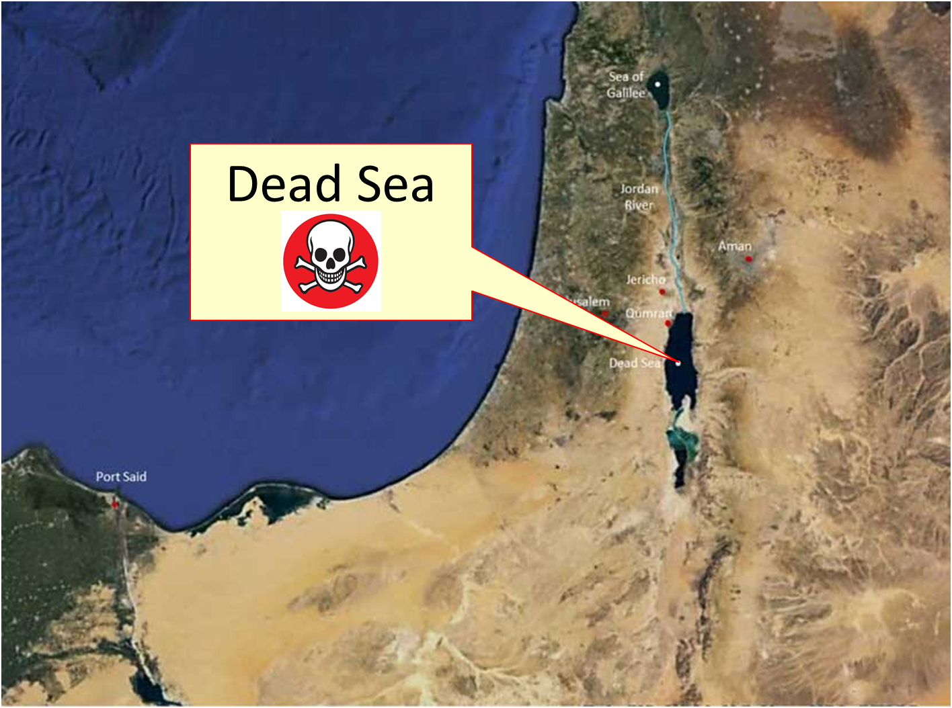

Slide 32
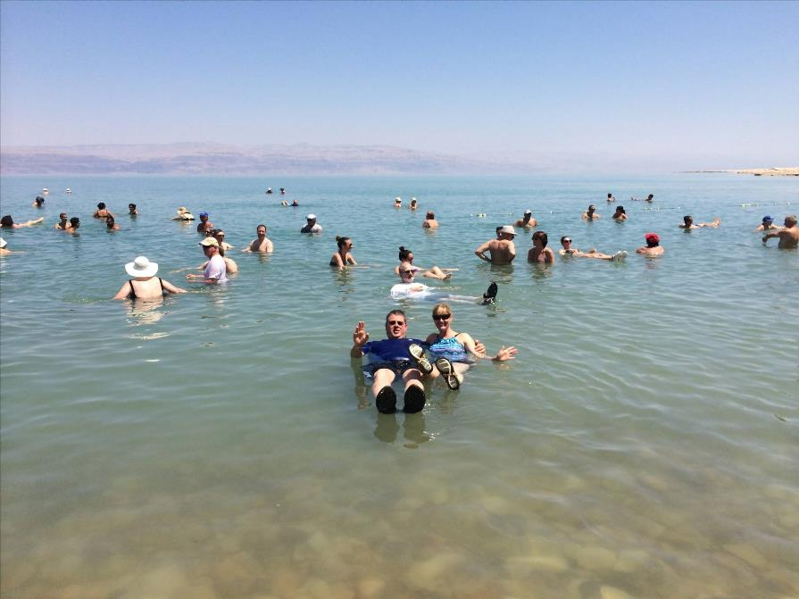

Slide 33
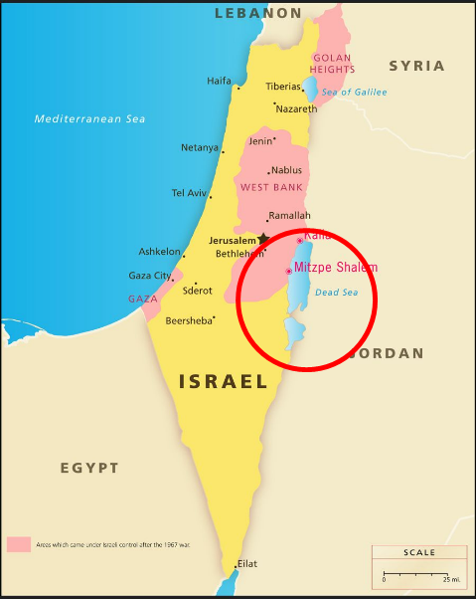
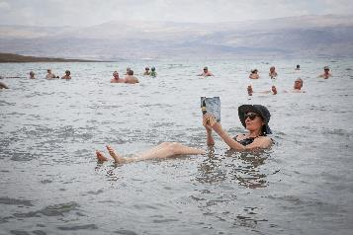
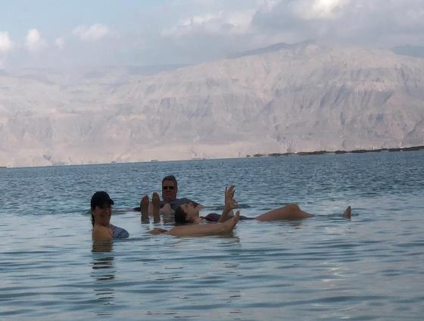
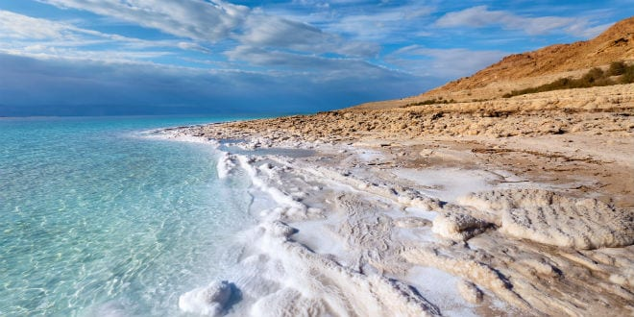
DEAD SEA

Slide 35
Conclusion

Slide 36
Genesis 21:1-7 Isaac’s Birth
Promise fulfilled (21:1-2)
Name: Isaac (21:3)
Circumcision (21:4)
Abraham’s age (21:5)
Sarah’s laughter (21:6-7)

Slide 37
Genesis 12‒21 Abraham’s Early Journeys
Unconditional promises (Gen. 12:1-3) From Haran to Canaan (Gen. 12:4-5) In Canaan (Gen. 12:6-9) In Egypt (Gen. 12:10-20) Abram and Lot Separate (Gen. 13:1-13) Reaffirmation of Abram’s promises (Gen. 13:14-18) Abram Rescues Lot (14:1-24) | Abrahamic Covenant (15:1-21) Hagar & Ishmael (16:1-16) Circumcision (Gen. 17:1-27) Sodom & Gomorrah (Gen. 18‒19) Abraham & Abimelech (Gen. 20) Isaac’s birth (Gen. 21:1-7) Ishmael’s expulsion (21:8-21)

Slide 38
²⁴ The Lord bless you, and keep you; ²⁵ The Lord make His face shine on you, And be gracious to you; ²⁶ The Lord lift up His countenance on you, And give you peace.
Numbers 6:24–26 (NASB95)

