Slide 1
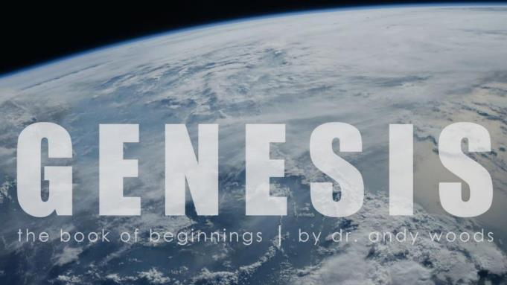
Genesis 12‒50
Israel’s Birth & Preservation

Slide 2
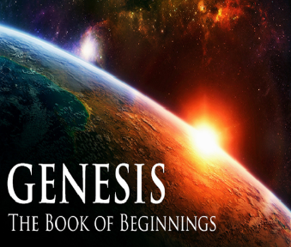
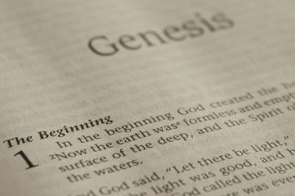
GENESIS STRUCTURE
Beginning of the Human race (Gen. 1‒11)
Beginning of the Hebrew race (Gen. 12‒50)

Slide 3
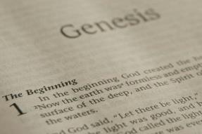
GENESIS STRUCTURE
Genesis 1-11 (four events)
Creation (1-2)
Fall (3-5)
Flood (6-9)
National dispersion (10-11)

Slide 4
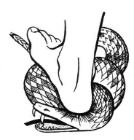
Genesis 3:15
“And I will put enmity Between you and the woman, And between your seed and her seed; He shall bruise you on the head, And you shall bruise him on the heel.”

Slide 5
GENESIS STRUCTURE
Beginning of the Human race (Gen. 1‒11)
Beginning of the Hebrew race (Gen. 12‒50)

Slide 6
GENESIS STRUCTURE
Genesis 12-50 (four people)
Abraham (12:1–25:11)
Isaac (25:12–26:35)
Jacob (27–36)
Joseph (37–50)

Slide 7
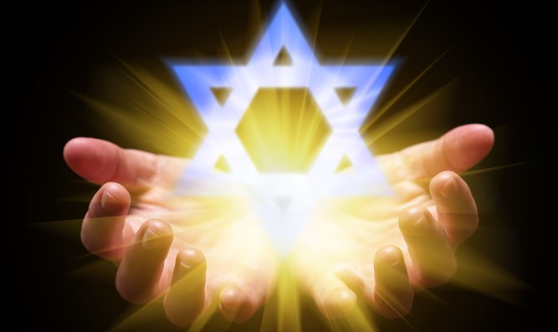
Isaiah 43:1
“But now, thus says the Lord, your Creator, O Jacob, And He who formed you, O Israel, 'Do not fear, for I have redeemed you; I have called you by name; you are Mine!'”

Slide 8
GENESIS STRUCTURE
Genesis 12-50 (four people)
Abraham (12:1–25:11)
Isaac (25:12–26:35)
Jacob (27–36)
Joseph (37–50)

Slide 9
Genesis 12‒20 Abraham’s Early Journeys
Unconditional promises (Gen. 12:1-3) From Haran to Canaan (Gen. 12:4-5) In Canaan (Gen. 12:6-9) In Egypt (Gen. 12:10-20) Abram and Lot Separate (Gen. 13:1-13) Reaffirmation of Abram’s promises (Gen. 13:14-18) Abram Rescues Lot (14:1-24) | Abrahamic Covenant (15:1-21) Hagar & Ishmael (16:1-16) Circumcision (Gen. 17:1-27) Sodom & Gomorrah (Gen. 18‒19) Abraham & Abimelech (Gen. 20)

Slide 10
Genesis 20 Abraham & Abimelech
Background (20:1-2)
Abimelech & God (20:3-8)
Abimelech & Abraham (20:9-15)
Abimelech & Sarah (16)
Removal of the curse (17-18)

Slide 11
Genesis 20 Abraham & Abimelech
Background (20:1-2)
Abimelech & God (20:3-8)
Abimelech & Abraham (20:9-15)
Abimelech & Sarah (16)
Removal of the curse (17-18)

Slide 12
Background Genesis 20:1-2
Abraham’s movement (1)
Abraham endangers the seed (2)

Slide 13
Genesis 20 Abraham & Abimelech
Background (20:1-2)
Abimelech & God (20:3-8)
Abimelech & Abraham (20:9-15)
Abimelech & Sarah (16)
Removal of the curse (17-18)

Slide 14
Abimelech & God Genesis 20:3-8
God’s warning (3)
Abimelech’s defense (4-5)
God’s response (6-7)
Abimelech’s report (8)

Slide 15
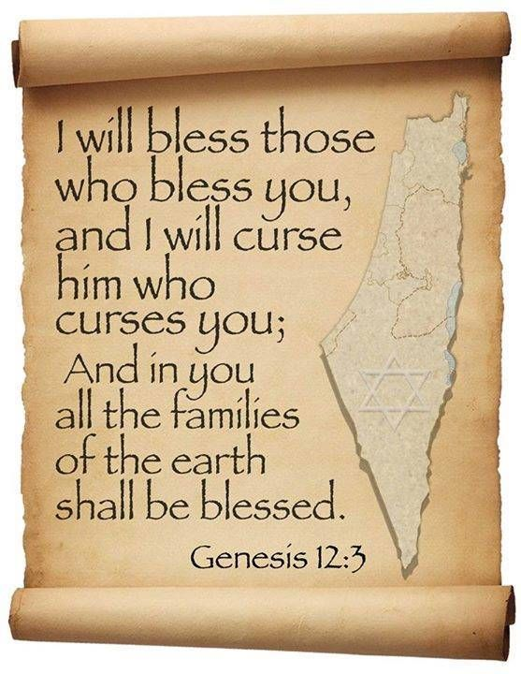
Genesis 12:3
“And I will bless those who bless you, And the one who curses you I will curse. And in you all the families of the earth will be blessed.”

Slide 16
Evidence of Abrahamic Covenant’s Unconditional Nature
ANE covenant ratification ceremony (Gen 15)
Lack of stated conditions for Israel’s obedience (Gen 15)
Covenant's eternality (Gen 17:7, 13, 19; Ps. 90:2)
Covenant's immutability (Heb 6:13-18; Mal. 3:6)
Trans-generational reaffirmation despite perpetual national disobedience (Jer 31:35-37)
Walvoord, The Millennial Kingdom, 149-52

Slide 17
Genesis 20 Abraham & Abimelech
Background (20:1-2)
Abimelech & God (20:3-8)
Abimelech & Abraham (20:9-15)
Abimelech & Sarah (16)
Removal of the curse (17-18)

Slide 18
Abimelech & Abraham Genesis 20:9-15
Abimelech’s questions & charges (9-10)
Abraham’s justification (11-13)
Abimelech’s response (14-15)

Slide 19
Abimelech & Abraham Genesis 20:9-15
Abimelech’s questions & charges (9-10)
Abraham’s justification (11-13)
Abimelech’s response (14-15)

Slide 20
Abimelech & Abraham Genesis 20:9-15
Abimelech’s questions & charges (9-10)
Abraham’s justification (11-13)
Abimelech’s response (14-15)

Slide 21
Abraham’s Justification Genesis 20:11-13
Fear (11)
Fabrication (12)
Policy (13)

Slide 22
Abimelech & Abraham Genesis 20:9-15
Abimelech’s questions & charges (9-10)
Abraham’s justification (11-13)
Abimelech’s response (14-15)

Slide 23
Abimelech’s Response Genesis 20:14-15
Gifts (14a)
Sarah (14b)
Offer (15)

Slide 24
Abimelech’s Response Genesis 20:14-15
Gifts (14a)
Sarah (14b)
Offer (15)

Slide 25
Evidence of Abrahamic Covenant’s Unconditional Nature
ANE covenant ratification ceremony (Gen 15)
Lack of stated conditions for Israel’s obedience (Gen 15)
Covenant's eternality (Gen 17:7, 13, 19; Ps. 90:2)
Covenant's immutability (Heb 6:13-18; Mal. 3:6)
Trans-generational reaffirmation despite perpetual national disobedience (Jer 31:35-37)
Walvoord, The Millennial Kingdom, 149-52

Slide 26
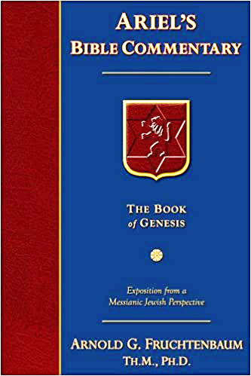
Dr. Arnold G. Fruchtenbaum
The Book of Genesis, 3338
“Abimelech’s action is in keeping with Middle Assyrian Law (15th-12th century b.c.): ‘If in the case of a seignior’s [man’s] wife, one not her father, nor her brother, nor her son, but another person, has caused her to take to the road, but he did not know that she was a seignior’s [man’s] wife, he shall (so) swear and he shall also pay two talents of lead to the woman’s husband.’”

Slide 27
Abimelech’s Response Genesis 20:14-15
Gifts (14a)
Sarah (14b)
Offer (15)

Slide 28
Genesis 3:15
“And I will put enmity Between you and the woman, And between your seed and her seed; He shall bruise you on the head, And you shall bruise him on the heel.”

Slide 29
Abimelech’s Response Genesis 20:14-15
Gifts (14a)
Sarah (14b)
Offer (15)

Slide 30
VI. 8 New Promises Genesis 12:1-3
Land (Gen. 12:1b)
Great nation (Gen. 12:2a)
Personal blessing (Gen. 12:2b)
Great name (Gen. 12:2c)
Blessing to others (Gen. 12:2d)
Blessing to blessers (Gen. 12:3a)
Cursing to cursers (Gen. 12:3b)
Blessing to the world (Gen. 12:3c)

Slide 32
Henry Clarence Thiessen
Lectures in Systematic Theology, rev. ed. (Grand Rapids: Eerdmans, 1979), 191.
“The Scriptures speak of human nature as totally depraved. However, the doctrine of ‘total depravity’ is easily misunderstood and misinterpreted. From the negative standpoint, it is important to know both what it does not mean and what it does mean. This does not mean that every sinner is devoid of all qualities pleasing to men; that he commits, or is prone to every form of sin; or that he is bitterly opposed to God as it is possible for him to be. Jesus recognized the existence of pleasing qualities in some individuals (Mark 10:21); He said that the scribes and Pharisees did some things God demanded (Matt. 23:23); Paul asserted that some Gentiles ‘do instinctively the things of the law’ (Rom. 2:14); God told Abraham that the iniquity of the Amorites would grow worse (Gen. 15:16); and Paul says that ‘evil men and imposters will proceed from bad to worse’ (2 Tim. 3:13).”

Slide 33
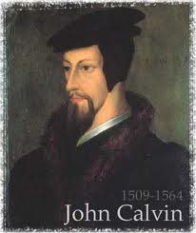
Total Depravity
What total depravity is not:
Man is as evil as he can possibly be & indulges every possible sin
Man is incapable of doing good things
Gen. 3:22
Matt. 7:11
Acts 10:1-2
Rom. 2:14-15

Slide 34
Total Depravity
What total depravity is:
Every area of man’s being is touched by sin
Intellect (Prov. 3:5-6; 14:12; 2 Cor. 4:4; Rom. 3:11a)
Conscience (1 Tim 4:2)
Will (Rom 1:28; 3:11b)
Deeds (Rom. 3:12)
Speech (Rom. 3:13-14)
Feet (Rom. 3:15)

Slide 35
Total Depravity
What total depravity is:
Every area of man’s being is touched by sin (cont’d)
Heart (Mark 7:21; Eph 4:18)
Body (Gen 3:19; Rom. 8:23)
Total being (Rom 1:18–3:20)
Man is incapable of earning merit favor from God (Isa 64:6; Eph. 2:8-9)

Slide 36
Genesis 20 Abraham & Abimelech
Background (20:1-2)
Abimelech & God (20:3-8)
Abimelech & Abraham (20:9-15)
Abimelech & Sarah (16)
Removal of the curse (17-18)

Slide 37
VI. 8 New Promises Genesis 12:1-3
Land (Gen. 12:1b)
Great nation (Gen. 12:2a)
Personal blessing (Gen. 12:2b)
Great name (Gen. 12:2c)
Blessing to others (Gen. 12:2d)
Blessing to blessers (Gen. 12:3a)
Cursing to cursers (Gen. 12:3b)
Blessing to the world (Gen. 12:3c)

Slide 38
Genesis 20 Abraham & Abimelech
Background (20:1-2)
Abimelech & God (20:3-8)
Abimelech & Abraham (20:9-15)
Abimelech & Sarah (16)
Removal of the curse (17-18)

Slide 39
Abimelech & Abraham Genesis 20:17-18
Abraham’s prayer (17a)
Result (17b)
Curse (18)

Slide 40
Abimelech & Abraham Genesis 20:17-18
Abraham’s prayer (17a)
Result (17b)
Curse (18)

Slide 41
Evidence of Abrahamic Covenant’s Unconditional Nature
ANE covenant ratification ceremony (Gen 15)
Lack of stated conditions for Israel’s obedience (Gen 15)
Covenant's eternality (Gen 17:7, 13, 19; Ps. 90:2)
Covenant's immutability (Heb 6:13-18; Mal. 3:6)
Trans-generational reaffirmation despite perpetual national disobedience (Jer 31:35-37)
Walvoord, The Millennial Kingdom, 149-52

Slide 42
Abimelech & Abraham Genesis 20:17-18
Abraham’s prayer (17a)
Result (17b)
Curse (18)

Slide 43
2 Timothy 2:11-13
“It is a trustworthy statement: For if we died with Him, we will also live with Him; ¹² If we endure, we will also reign with Him; If we deny Him, He also will deny us; ¹³ If we are faithless, He remains faithful, for He cannot deny Himself.”

Slide 44
Abimelech & Abraham Genesis 20:17-18
Abraham’s prayer (17a)
Result (17b)
Curse (18)

Slide 45
VI. 8 New Promises Genesis 12:1-3
Land (Gen. 12:1b)
Great nation (Gen. 12:2a)
Personal blessing (Gen. 12:2b)
Great name (Gen. 12:2c)
Blessing to others (Gen. 12:2d)
Blessing to blessers (Gen. 12:3a)
Cursing to cursers (Gen. 12:3b)
Blessing to the world (Gen. 12:3c)

Slide 46
Genesis 12:3
“And I will bless those who bless you, And the one who curses you I will curse. And in you all the families of the earth will be blessed.”

Slide 47
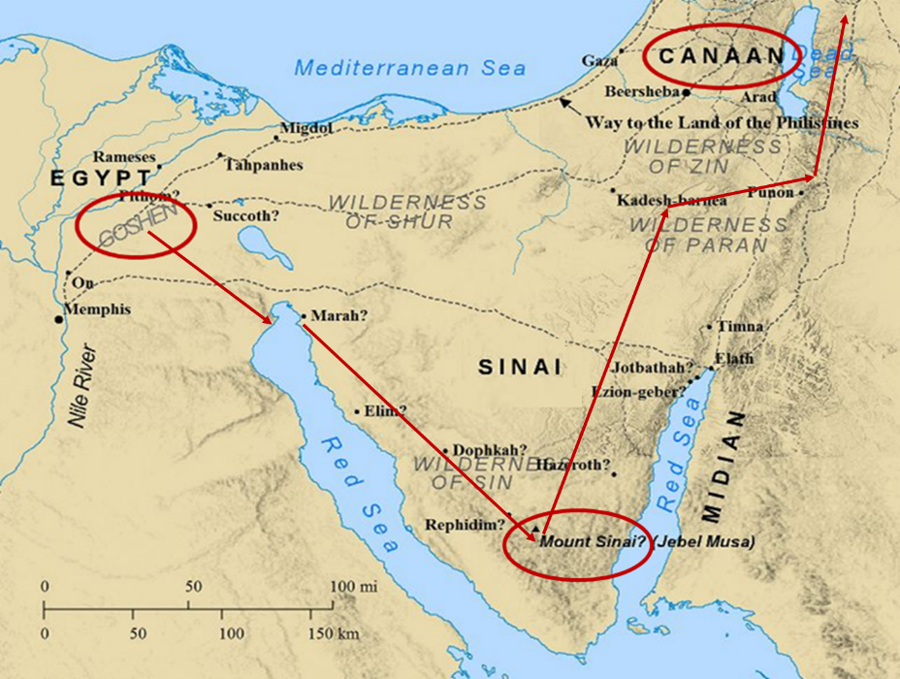

Slide 48
Dr. Arnold G. Fruchtenbaum
The Book of Genesis, 339-40
“Finally, in 20:18, the actual curse is revealed: For Jehovah had fast closed up all the wombs of the house of Abimelech, because of Sarah, Abraham’s wife. Here again is an example of the outworking of the Abrahamic Covenant and the curse-for-curse-in-kind principle. Abimelech’s action would have resulted in Isaac not being born, and so the specific curse against Abraham was the danger of extinction of Abraham’s line and the promised nation by keeping birth from occurring.”

Slide 49
Dr. Arnold G. Fruchtenbaum
The Book of Genesis, 339-40
“If Isaac would not be born, the Jewish nation would then die out with the death of Abraham. If God had not reversed the curse on Abimelech, he would have been faced with the real danger of extinction because of the inability of the women in his household to give birth to children. When Abimelech restored Sarah to Abraham, the future of Abimelech’s nation is restored by God.”

Slide 50
Conclusion

Slide 51
Genesis 20 Abraham & Abimelech
Background (20:1-2)
Abimelech & God (20:3-8)
Abimelech & Abraham (20:9-15)
Abimelech & Sarah (16)
Removal of the curse (17-18)

Slide 52
Genesis 12‒21 Abraham’s Early Journeys
Unconditional promises (Gen. 12:1-3) From Haran to Canaan (Gen. 12:4-5) In Canaan (Gen. 12:6-9) In Egypt (Gen. 12:10-20) Abram and Lot Separate (Gen. 13:1-13) Reaffirmation of Abram’s promises (Gen. 13:14-18) Abram Rescues Lot (14:1-24) | Abrahamic Covenant (15:1-21) Hagar & Ishmael (16:1-16) Circumcision (Gen. 17:1-27) Sodom & Gomorrah (Gen. 18‒19) Abraham & Abimelech (Gen. 20) Isaac’s birth (Gen. 21)

Slide 53
²⁴ The Lord bless you, and keep you; ²⁵ The Lord make His face shine on you, And be gracious to you; ²⁶ The Lord lift up His countenance on you, And give you peace.
Numbers 6:24–26 (NASB95)

