Slide 1
Genesis 12‒50
Israel’s Birth & Preservation

Slide 2
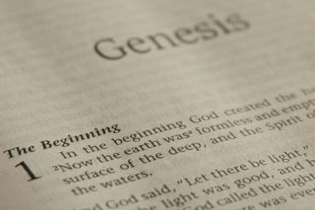
GENESIS STRUCTURE
Beginning of the Human race (Gen. 1‒11)
Beginning of the Hebrew race (Gen. 12‒50)

Slide 3
GENESIS STRUCTURE
Genesis 1-11 (four events)
Creation (1-2)
Fall (3-5)
Flood (6-9)
National dispersion (10-11)

Slide 4
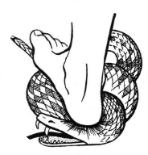
Genesis 3:15
“And I will put enmity Between you and the woman, And between your seed and her seed; He shall bruise you on the head, And you shall bruise him on the heel.”

Slide 5
GENESIS STRUCTURE
Beginning of the Human race (Gen. 1‒11)
Beginning of the Hebrew race (Gen. 12‒50)

Slide 6
GENESIS STRUCTURE
Genesis 12-50 (four people)
Abraham (12:1–25:11)
Isaac (25:12–26:35)
Jacob (27–36)
Joseph (37–50)

Slide 7
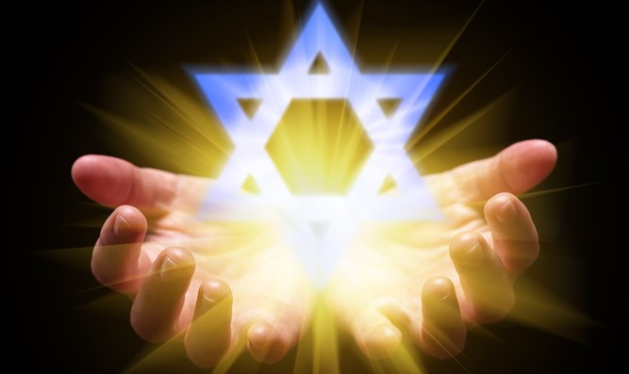
Isaiah 43:1
“But now, thus says the Lord, your Creator, O Jacob, And He who formed you, O Israel, 'Do not fear, for I have redeemed you; I have called you by name; you are Mine!'”

Slide 8
GENESIS STRUCTURE
Genesis 12-50 (four people)
Abraham (12:1–25:11)
Isaac (25:12–26:35)
Jacob (27–36)
Joseph (37–50)

Slide 9
Genesis 12‒20 Abram’s Early Journeys
Unconditional promises (Gen. 12:1-3)
From Haran to Canaan (Gen. 12:4-5)
In Canaan (Gen. 12:6-9)
In Egypt (Gen. 12:10-20)
Abram and Lot Separate (Gen. 13:1-13)
Reaffirmation of Abram’s promises (Gen. 13:14-18)
Abram Rescues Lot (14:1-24)
Abrahamic Covenant (15:1-21)
Hagar & Ishmael (16:1-16)
Circumcision (Gen. 17:1-27)
Sodom & Gomorrah (Gen. 18‒19)
Abraham & Abimelech (Gen. 20)

Slide 10
Genesis 20 Abraham & Abimelech
Background (20:1-2)
Abimelech & God (20:3-8)
Abimelech & Abraham (20:9-15)
Abimelech & Sarah (16)
Removal of the curse (17-18)

Slide 11
Genesis 20 Abraham & Abimelech
Background (20:1-2)
Abimelech & God (20:3-8)
Abimelech & Abraham (20:9-15)
Abimelech & Sarah (16)
Removal of the curse (17-18)

Slide 12
Background Genesis 20:1-2
Abraham’s movement (1)
Abraham endangers the seed (2)

Slide 13
Background Genesis 20:1-2
Abraham’s movement (1)
Abraham endangers the seed (2)

Slide 14
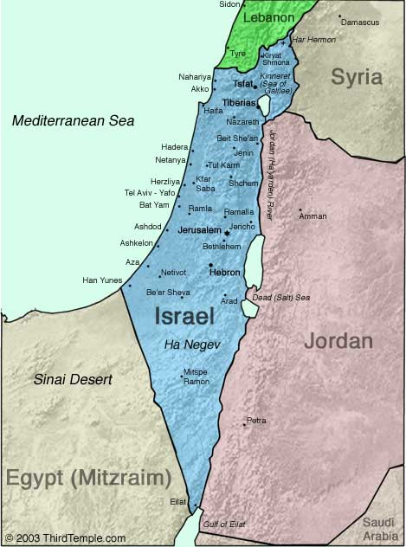
Negev

Slide 16
Background Genesis 20:1-2
Abraham’s movement (1)
Abraham endangers the seed (2)

Slide 18
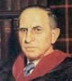
John Murray
Redemption Accomplished and Applied, (Grand Rapids, MI: Eerdmans Publishing Co. 2015 edition), p. 152, 154-55, 165. pp. 152, 154-55, 165
“The crucial test of true faith is endurance to the end, abiding in Christ, and continuance in the Word…He cannot abandon himself to sin; he cannot come under the domination of sin; he cannot be guilty of certain kinds of unfaithfulness…Let us appreciate the doctrine of the perseverance of the saints and recognize that we may entertain the faith of our security in Christ only as we persevere in faith and holiness to the end...The perseverance of the saints reminds us very forcefully that only those who persevere to the end are truly saints.”

Slide 19
1 Peter 1:5
“⁴to obtain an inheritance which is imperishable, undefiled, and will not fade away, reserved in heaven for you, ⁵ who are protected by the power of God through faith for a salvation ready to be revealed in the last time.”

Slide 20
Genesis 20 Abraham & Abimelech
Background (20:1-2)
Abimelech & God (20:3-8)
Abimelech & Abraham (20:9-15)
Abimelech & Sarah (16)
Removal of the curse (17-18)

Slide 21
Abimelech & God Genesis 20:3-8
God’s warning (3)
Abimelech’s defense (4-5)
God’s response (6-7)
Abimelech’s report (8)

Slide 22
Abimelech & God Genesis 20:3-8
God’s warning (3)
Abimelech’s defense (4-5)
God’s response (6-7)
Abimelech’s report (8)

Slide 23
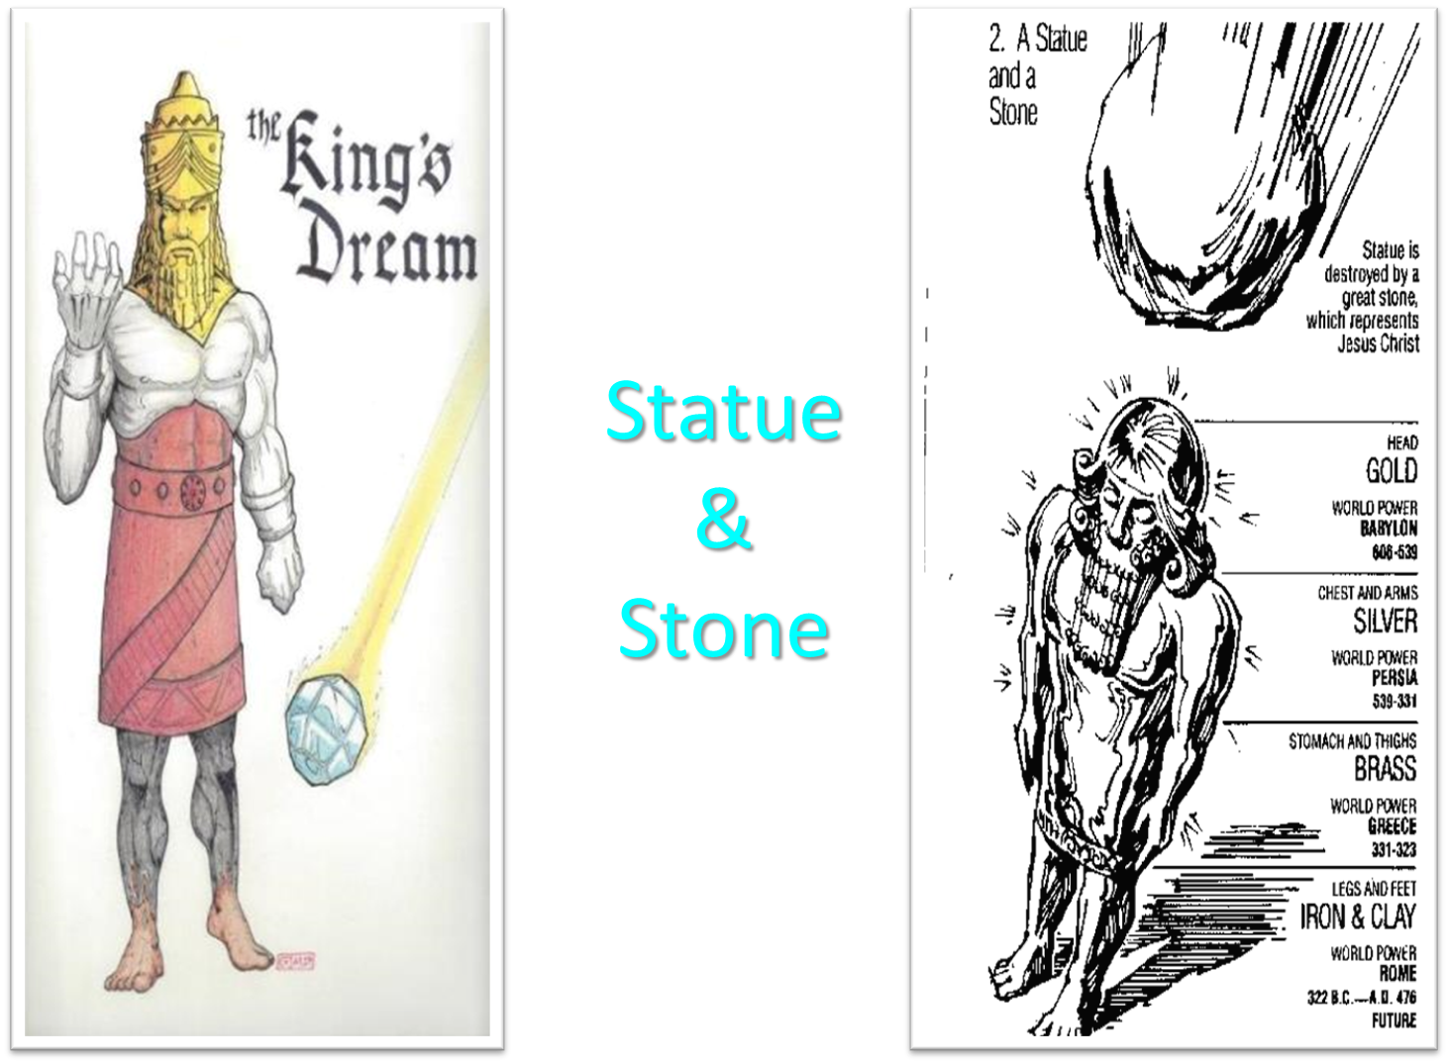

Slide 24
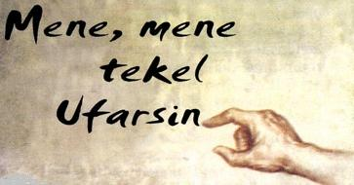
Daniel Interprets the Writing (5:24-28)

Slide 25
Dr. Arnold G. Fruchtenbaum
The Book of Genesis, 334-35
“In Genesis and elsewhere, God more than once appeared to pagans by means of a dream. In Genesis, Abimelech is the first of five pagans to receive a divine revelation of things by a dream, and all were warnings. The other four were Laban (31:24), the butler and the baker (40:5), and Pharaoh (41:1).”

Slide 26
VI. 8 New Promises Genesis 12:1-3
Land (Gen. 12:1b)
Great nation (Gen. 12:2a)
Personal blessing (Gen. 12:2b)
Great name (Gen. 12:2c)
Blessing to others (Gen. 12:2d)
Blessing to blessers (Gen. 12:3a)
Cursing to cursers (Gen. 12:3b)
Blessing to the world (Gen. 12:3c)

Slide 27
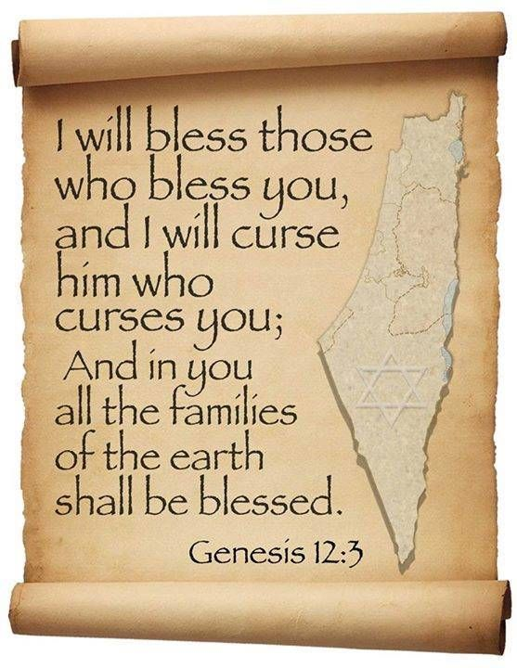
Genesis 12:3
“And I will bless those who bless you, And the one who curses you I will curse. And in you all the families of the earth will be blessed.”

Slide 28
Evidence of Abrahamic Covenant’s Unconditional Nature
ANE covenant ratification ceremony (Gen 15)
Lack of stated conditions for Israel’s obedience (Gen 15)
Covenant's eternality (Gen 17:7, 13, 19; Ps. 90:2)
Covenant's immutability (Heb 6:13-18; Mal. 3:6)
Trans-generational reaffirmation despite perpetual national disobedience (Jer 31:35-37)
Walvoord, The Millennial Kingdom, 149-52

Slide 29
2 Timothy 2:11-13
“It is a trustworthy statement: For if we died with Him, we will also live with Him; ¹² If we endure, we will also reign with Him; If we deny Him, He also will deny us; ¹³ If we are faithless, He remains faithful, for He cannot deny Himself.”

Slide 30
Abimelech & God Genesis 20:3-8
God’s warning (3)
Abimelech’s defense (4-5)
God’s response (6-7)
Abimelech’s report (8)

Slide 31
Abimelech & God Genesis 20:3-8
God’s warning (3)
Abimelech’s defense (4-5)
God’s response (6-7)
Abimelech’s report (8)

Slide 32
God’s Response Genesis 20:6-7
God’s acknowledgement (6)
God’s instructions (7)
Positive (7a)
Negative (7b)

Slide 33
God’s Response Genesis 20:6-7
God’s acknowledgement (6)
God’s instructions (7)
Positive (7a)
Negative (7b)

Slide 35
God’s Response Genesis 20:6-7
God’s acknowledgement (6)
God’s instructions (7)
Positive (7a)
Negative (7b)

Slide 36
God’s Response Genesis 20:6-7
God’s acknowledgement (6)
God’s instructions (7)
Positive (7a)
Negative (7b)

Slide 37
God’s Response Genesis 20:6-7
God’s acknowledgement (6)
God’s instructions (7)
Positive (7a)
Negative (7b)

Slide 38
VI. 8 New Promises Genesis 12:1-3
Land (Gen. 12:1b)
Great nation (Gen. 12:2a)
Personal blessing (Gen. 12:2b)
Great name (Gen. 12:2c)
Blessing to others (Gen. 12:2d)
Blessing to blessers (Gen. 12:3a)
Cursing to cursers (Gen. 12:3b)
Blessing to the world (Gen. 12:3c)

Slide 39
Genesis 12:3
“And I will bless those who bless you, And the one who curses you I will curse. And in you all the families of the earth will be blessed.”

Slide 40
Abimelech & God Genesis 20:3-8
God’s warning (3)
Abimelech’s defense (4-5)
God’s response (6-7)
Abimelech’s report (8)

Slide 41
Genesis 12:3
“And I will bless those who bless you, And the one who curses you I will curse. And in you all the families of the earth will be blessed.”

Slide 42
Genesis 20 Abraham & Abimelech
Background (20:1-2)
Abimelech & God (20:3-8)
Abimelech & Abraham (20:9-15)
Abimelech & Sarah (16)
Removal of the curse (17-18)

Slide 43
Abimelech & Abraham Genesis 20:9-15
Abimelech’s questions & charges (9-10)
Abraham’s justification (11-13)
Abimelech’s response (14-15)

Slide 44
Abimelech & Abraham Genesis 20:9-15
Abimelech’s questions & charges (9-10)
Abraham’s justification (11-13)
Abimelech’s response (14-15)

Slide 45
Dr. Arnold G. Fruchtenbaum
The Book of Genesis, 337
“The irony here is that a pagan king condemned a patriarch for his sin.”

Slide 46
Abimelech & Abraham Genesis 20:9-15
Abimelech’s questions & charges (9-10)
Abraham’s justification (11-13)
Abimelech’s response (14-15)

Slide 47
Abraham’s Justification Genesis 20:11-13
Fear (11)
Fabrication (12)
Policy (13)

Slide 48
Abraham’s Justification Genesis 20:11-13
Fear (11)
Fabrication (12)
Policy (13)

Slide 49
Abraham’s Justification Genesis 20:11-13
Fear (11)
Fabrication (12)
Policy (13)

Slide 51
Dr. Arnold G. Fruchtenbaum
The Book of Genesis, 337
“Then in verse 12, he explained his relationship with Sarah: And moreover she is indeed my sister, the daughter of my father, but not the daughter of my mother; and she became my wife. Therefore, Sarah was Abraham’s wife, but she was also his half-sister, having the same father, but a different mother. This was later forbidden by the Law of Moses (Lev. 18:9, 18:11, 20:17; Deut. 27:22; Ezek. 22:11), but this law was not in force in Abraham’s day.”

Slide 52
Abraham’s Justification Genesis 20:11-13
Fear (11)
Fabrication (12)
Policy (13)

Slide 53
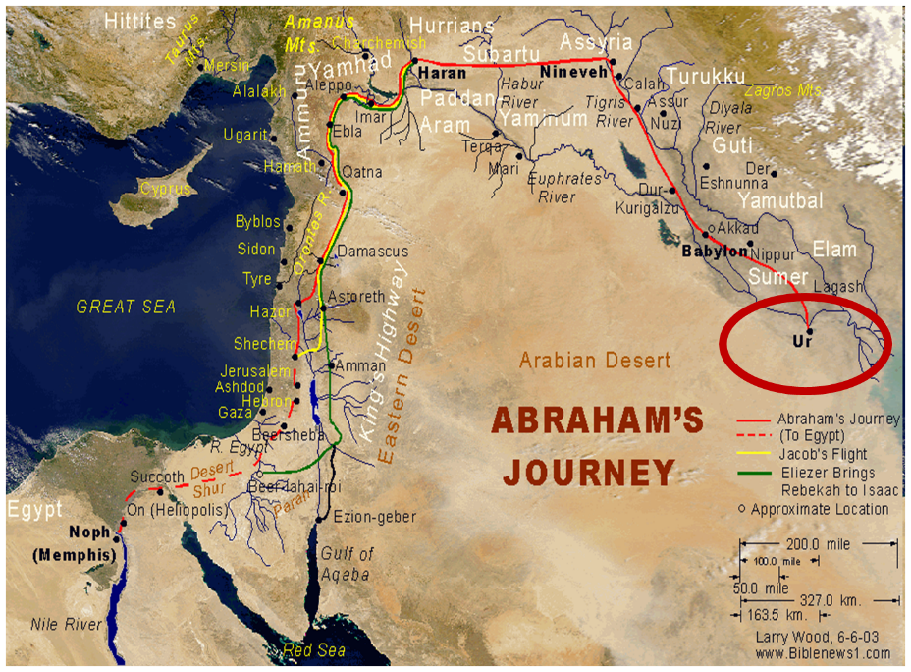

Slide 54
Abimelech & Abraham Genesis 20:9-15
Abimelech’s questions & charges (9-10)
Abraham’s justification (11-13)
Abimelech’s response (14-15)

Slide 55
Abimelech’s Response Genesis 20:14-15
Gifts (14a)
Sarah (14b)
Offer (15)

Slide 56
Abimelech’s Response Genesis 20:14-15
Gifts (14a)
Sarah (14b)
Offer (15)

Slide 57
Evidence of Abrahamic Covenant’s Unconditional Nature
ANE covenant ratification ceremony (Gen 15)
Lack of stated conditions for Israel’s obedience (Gen 15)
Covenant's eternality (Gen 17:7, 13, 19; Ps. 90:2)
Covenant's immutability (Heb 6:13-18; Mal. 3:6)
Trans-generational reaffirmation despite perpetual national disobedience (Jer 31:35-37)
Walvoord, The Millennial Kingdom, 149-52

Slide 58
Dr. Arnold G. Fruchtenbaum
The Book of Genesis, 3338
“Abimelech’s action is in keeping with Middle Assyrian Law (15th-12th century b.c.): ‘If in the case of a seignior’s [man’s] wife, one not her father, nor her brother, nor her son, but another person, has caused her to take to the road, but he did not know that she was a seignior’s [man’s] wife, he shall (so) swear and he shall also pay two talents of lead to the woman’s husband.’”

Slide 59
Abimelech’s Response Genesis 20:14-15
Gifts (14a)
Sarah (14b)
Offer (15)

Slide 60
Abimelech’s Response Genesis 20:14-15
Gifts (14a)
Sarah (14b)
Offer (15)

Slide 61
VI. 8 New Promises Genesis 12:1-3
Land (Gen. 12:1b)
Great nation (Gen. 12:2a)
Personal blessing (Gen. 12:2b)
Great name (Gen. 12:2c)
Blessing to others (Gen. 12:2d)
Blessing to blessers (Gen. 12:3a)
Cursing to cursers (Gen. 12:3b)
Blessing to the world (Gen. 12:3c)

Slide 63
Henry Clarence Thiessen
Lectures in Systematic Theology, rev. ed. (Grand Rapids: Eerdmans, 1979), 191.
“The Scriptures speak of human nature as totally depraved. However, the doctrine of ‘total depravity’ is easily misunderstood and misinterpreted. From the negative standpoint, it is important to know both what it does not mean and what it does mean. This does not mean that every sinner is devoid of all qualities pleasing to men; that he commits, or is prone to every form of sin; or that he is bitterly opposed to God as it is possible for him to be. Jesus recognized the existence of pleasing qualities in some individuals (Mark 10:21); He said that the scribes and Pharisees did some things God demanded (Matt. 23:23); Paul asserted that some Gentiles ‘do instinctively the things of the law’ (Rom. 2:14); God told Abraham that the iniquity of the Amorites would grow worse (Gen. 15:16); and Paul says that ‘evil men and imposters will proceed from bad to worse’ (2 Tim. 3:13).”

Slide 64
Genesis 20 Abraham & Abimelech
Background (20:1-2)
Abimelech & God (20:3-8)
Abimelech & Abraham (20:9-15)
Abimelech & Sarah (16)
Removal of the curse (17-18)

Slide 65
VI. 8 New Promises Genesis 12:1-3
Land (Gen. 12:1b)
Great nation (Gen. 12:2a)
Personal blessing (Gen. 12:2b)
Great name (Gen. 12:2c)
Blessing to others (Gen. 12:2d)
Blessing to blessers (Gen. 12:3a)
Cursing to cursers (Gen. 12:3b)
Blessing to the world (Gen. 12:3c)

Slide 66
Genesis 20 Abraham & Abimelech
Background (20:1-2)
Abimelech & God (20:3-8)
Abimelech & Abraham (20:9-15)
Abimelech & Sarah (16)
Removal of the curse (17-18)

Slide 67
Abimelech & Abraham Genesis 20:17-18
Abraham’s prayer (17a)
Result (17b)
Curse (18)

Slide 68
Abimelech & Abraham Genesis 20:17-18
Abraham’s prayer (17a)
Result (17b)
Curse (18)

Slide 69
Evidence of Abrahamic Covenant’s Unconditional Nature
ANE covenant ratification ceremony (Gen 15)
Lack of stated conditions for Israel’s obedience (Gen 15)
Covenant's eternality (Gen 17:7, 13, 19; Ps. 90:2)
Covenant's immutability (Heb 6:13-18; Mal. 3:6)
Trans-generational reaffirmation despite perpetual national disobedience (Jer 31:35-37)
Walvoord, The Millennial Kingdom, 149-52

Slide 70
Abimelech & Abraham Genesis 20:17-18
Abraham’s prayer (17a)
Result (17b)
Curse (18)

Slide 71
2 Timothy 2:11-13
“It is a trustworthy statement: For if we died with Him, we will also live with Him; ¹² If we endure, we will also reign with Him; If we deny Him, He also will deny us; ¹³ If we are faithless, He remains faithful, for He cannot deny Himself.”

Slide 72
Abimelech & Abraham Genesis 20:17-18
Abraham’s prayer (17a)
Result (17b)
Curse (18)

Slide 73
VI. 8 New Promises Genesis 12:1-3
Land (Gen. 12:1b)
Great nation (Gen. 12:2a)
Personal blessing (Gen. 12:2b)
Great name (Gen. 12:2c)
Blessing to others (Gen. 12:2d)
Blessing to blessers (Gen. 12:3a)
Cursing to cursers (Gen. 12:3b)
Blessing to the world (Gen. 12:3c)

Slide 74
Genesis 12:3
“And I will bless those who bless you, And the one who curses you I will curse. And in you all the families of the earth will be blessed.”

Slide 76
Dr. Arnold G. Fruchtenbaum
The Book of Genesis, 339-40
“Finally, in 20:18, the actual curse is revealed: For Jehovah had fast closed up all the wombs of the house of Abimelech, because of Sarah, Abraham’s wife. Here again is an example of the outworking of the Abrahamic Covenant and the curse-for-curse-in-kind principle. Abimelech’s action would have resulted in Isaac not being born, and so the specific curse against Abraham was the danger of extinction of Abraham’s line and the promised nation by keeping birth from occurring.”

Slide 77
Dr. Arnold G. Fruchtenbaum
The Book of Genesis, 339-40
“If Isaac would not be born, the Jewish nation would then die out with the death of Abraham. If God had not reversed the curse on Abimelech, he would have been faced with the real danger of extinction because of the inability of the women in his household to give birth to children. When Abimelech restored Sarah to Abraham, the future of Abimelech’s nation is restored by God.”

Slide 78
Conclusion

Slide 79
Genesis 20 Abraham & Abimelech
Background (20:1-2)
Abimelech & God (20:3-8)
Abimelech & Abraham (20:9-15)
Abimelech & Sarah (16)
Removal of the curse (17-18)

Slide 80
Genesis 12‒20 Abram’s Early Journeys
Unconditional promises (Gen. 12:1-3)
From Haran to Canaan (Gen. 12:4-5)
In Canaan (Gen. 12:6-9)
In Egypt (Gen. 12:10-20)
Abram and Lot Separate (Gen. 13:1-13)
Reaffirmation of Abram’s promises (Gen. 13:14-18)
Abram Rescues Lot (14:1-24)
Abrahamic Covenant (15:1-21)
Hagar & Ishmael (16:1-16)
Circumcision (Gen. 17:1-27)
Sodom & Gomorrah (Gen. 18‒19)
Abraham & Abimelech (Gen. 20)
Isaac’s birth (Gen. 21)

Slide 81
²⁴ The Lord bless you, and keep you; ²⁵ The Lord make His face shine on you, And be gracious to you; ²⁶ The Lord lift up His countenance on you, And give you peace.
Numbers 6:24–26 (NASB95)

