Slide 1
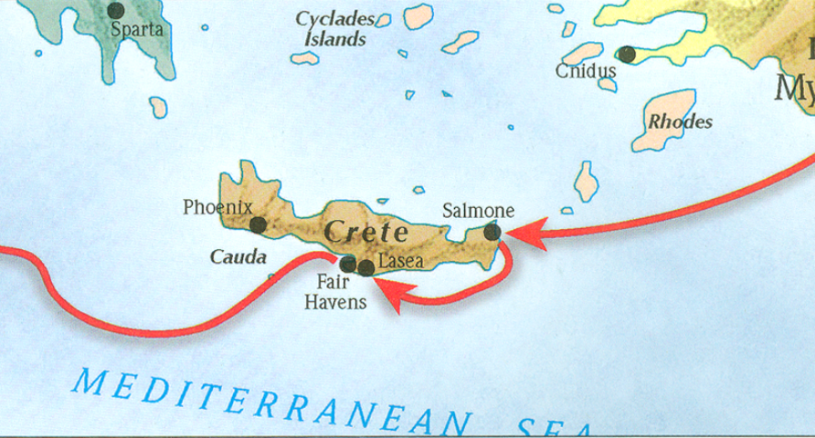
The book of Titus
Worthy of the Gospel

Slide 2
The Book of Titus
“The Role of Grace?” Part II
Titus 2:11-15

Slide 3
The Book of Titus
“Our Responsibilities?”
Titus 3:1-8

Slide 4
Titus 1:5
“For this reason I left you in Crete, that you would set in order what remains and appoint elders in every city as I directed you…”

Slide 5
Titus 1:13
“This testimony is true. For this reason reprove them severely so that they may be sound in the faith…”
Titus 2:1
But as for you, speak the things which are fitting for sound doctrine.

Slide 6
Titus 2:2-10
Older men are to be temperate, dignified, sensible, sound in faith, in love, in perseverance. Older women likewise are to be reverent in their behavior, not malicious gossips nor enslaved to much wine, teaching what is good, so that they may encourage the young women to love their husbands, to love their children, to be sensible, pure, workers at home, kind, being subject to their own husbands, so that the word of God will not be dishonored. Likewise urge the young men to be sensible; in all things show yourself to be an example of good deeds, with purity in doctrine, dignified, sound in speech which is beyond reproach, so that the opponent will be put to shame, having nothing bad to say about us. Urge bondslaves to be subject to their own masters in everything, to be well-pleasing, not argumentative, not pilfering, but showing all good faith so that they will adorn the doctrine of God our Savior in every respect.

Slide 7
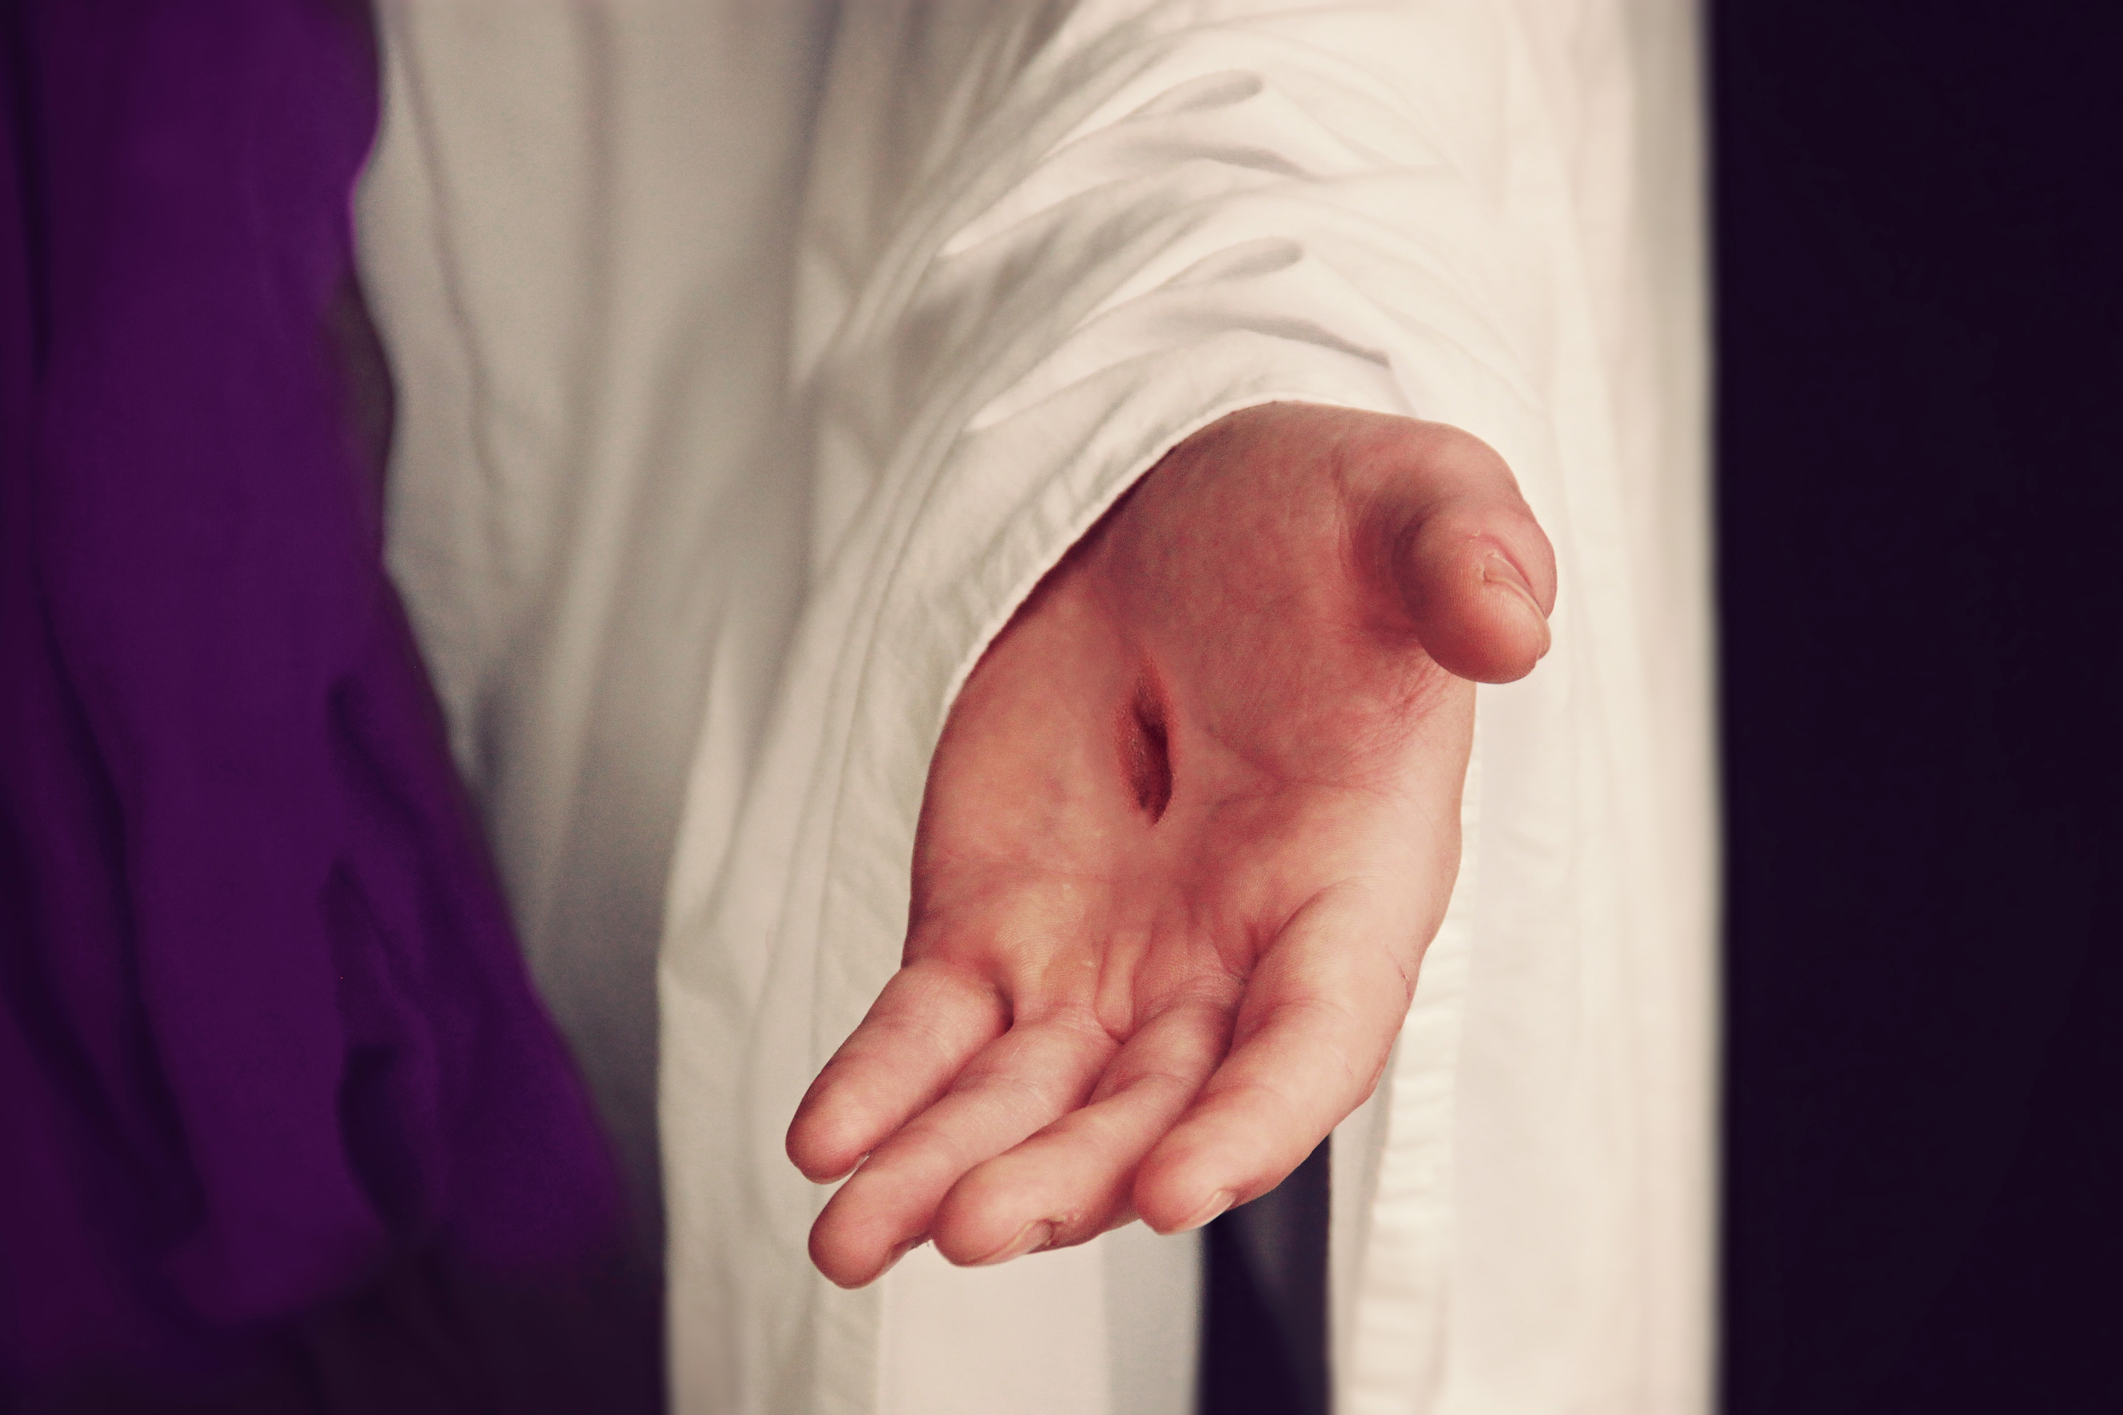
Titus 2:11
“For the grace of God has appeared, bringing salvation to all men..”

Slide 8
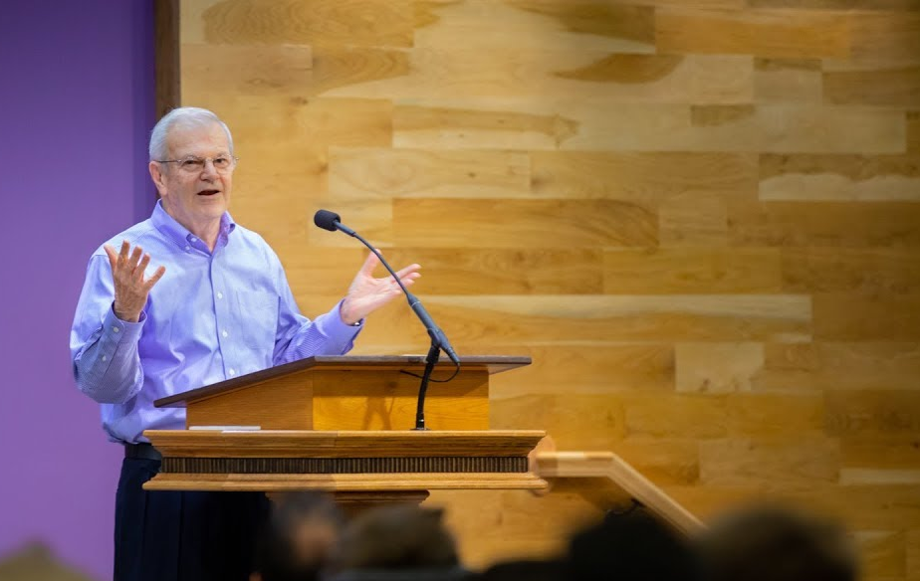
“Usually ‘grace’ refers to the principle by which God operates. Yet it also describes the sphere in which the believer lives, as here (cf. 5:2), as ‘the Law’ describes the old realm. ‘Under grace’ is not, however, a condition in which we are free from any responsibility (cf. Matt. 11:28-30; Titus 2:11-12), as Paul proceeded to clarify in verses 15-23.”
Thomas Constable, Notes on Romans – Romans 6:14, www.planobiblechapel.org.

Slide 9
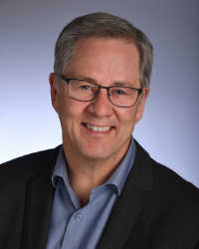
Titus 2:11
“Χάρις, ‘grace,’ is a one-word summary of god’s saving act in Christ, given freely to sinners who believe (cf. 1 Tim 1:2).”
William D. Mounce, Pastoral Epistles, vol. 46, Word Biblical Commentary (Dallas: Word, Incorporated, 2000), 422.

Slide 10
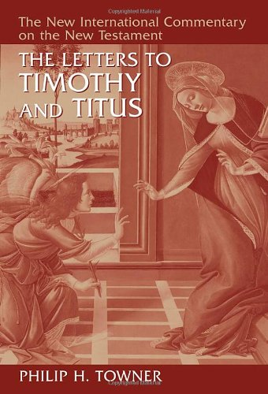
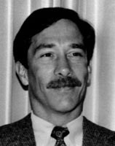
Titus 2:11
“The grace of God that offers salvation” is a roundabout way of referring to the contents of the gospel message. We know from the verb “appeared” that “grace” here means the saving act itself as that which gave full expression to “the grace of God.”
Philip H. Towner, The Letters to Timothy and Titus, The New International Commentary on the New Testament (Grand Rapids, MI: Wm. B. Eerdmans Publishing Co., 2006), 745.

Slide 11
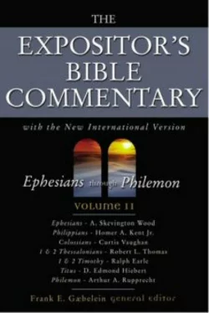
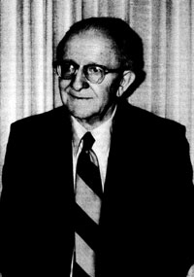
Titus 2:11
“The entire program of redemption is rooted in “the grace of God,” his free favor and spontaneous action toward needy sinners to deliver and transform them. In the Greek, “has appeared” stands emphatically at the beginning, stressing the manifestation of grace as a historical reality. The reference is to Christ’s entire earthly life—his birth, life, death, and resurrection.
D. Edmond Hiebert, “Titus,” in The Expositor’s Bible Commentary: Ephesians through Philemon, ed. Frank E. Gaebelein, vol. 11 (Grand Rapids, MI: Zondervan Publishing House, 1981), 439.

Slide 12
Outline of Titus
Salutation (1:1-5a)
Assignor (1:1-3)
Assignee (1:4)
Assignment (1:5)
Assignment Explained (1:5-3:11)
Appoint Elders (1:5b-16)
Addressing Doctrinal Issues (2:1-3:11)
Conclusion (3:12-15)
Requests (3:12-14)
Greetings (3:15a-b)
Benediction (3:15c)
Outline adapted from Titus Argument, Article by Andy Woods, 2007.

Slide 13
b. Addressing Doctrinal Issues (Titus 2:1-3:11)
2) The Role of Grace (2:11-15)
Supplied by God to all men (2:11)
Stimulates godly living (2:12)
Secures hope (2:13)
Substituted by Christ (2:14)
Stirred up by Titus
Outline adapted from Titus Argument, Article by Andy Woods, 2007.

Slide 14
b. Addressing Doctrinal Issues (Titus 2:1-3:11)
Our Responsibilities? (3:1-8)
To civil authorities – 3.1
To the world in general – 3.2
Reasons for our behavior – 3.3-8
Outline adapted from Titus Argument, Article by Andy Woods, 2007.

Slide 15
Titus 2:5; 2:9
2:5 …to be sensible, pure, workers at home, kind, being subject to their own husbands, so that the word of God will not be dishonored.
2:9 …Urge bondslaves to be subject to their own masters in everything, to be well-pleasing, not argumentative,

Slide 16
Romans 13:1-5
Every person is to be in subjection to the governing authorities. For there is no authority except from God, and those which exist are established by God. Therefore whoever resists authority has opposed the ordinance of God; and they who have opposed will receive condemnation upon themselves. For rulers are not a cause of fear for good behavior, but for evil. Do you want to have no fear of authority? Do what is good and you will have praise from the same; for it is a minister of God to you for good. But if you do what is evil, be afraid; for it does not bear the sword for nothing; for it is a minister of God, an avenger who brings wrath on the one who practices evil. Therefore it is necessary to be in subjection, not only because of wrath, but also for conscience’ sake.

Slide 17
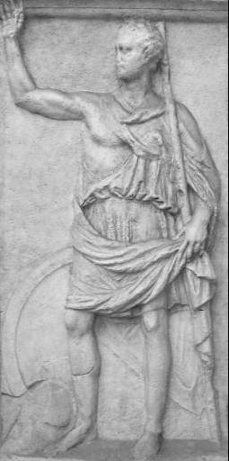
The laws allow them to possess as much land as they can get with no limitation whatever. Money is so highly valued among them, that its possession is not only thought to be necessary but in the highest degree creditable. And in fact greed and avarice are so native to the soil in Crete, that they are the only people in the world among whom no stigma attaches to any sort of gain whatever… you could find no habits prevailing in private life more steeped in treachery than those in Crete, and no public policy more inequitable. Holding, then, the Cretan constitution to be neither like the Spartan, nor worthy of choice or imitation, I reject it from the comparison which I have institute.
Polybius, Histories (Medford, MA: Macmillan, 1889), 497.

Slide 18
1 Peter 2:13-17
13 Submit yourselves for the Lord’s sake to every human institution, whether to a king as the one in authority, 14 or to governors as sent by him for the punishment of evildoers and the praise of those who do right. 15 For such is the will of God that by doing right you may silence the ignorance of foolish men. 16 Act as free men, and do not use your freedom as a covering for evil, but use it as bondslaves of God. 17 Honor all people, love the brotherhood, fear God, honor the king.

Slide 19
1 Peter 2:18-20
18 Servants, be submissive to your masters with all respect, not only to those who are good and gentle, but also to those who are unreasonable. 19 For this finds favor, if for the sake of conscience toward God a person bears up under sorrows when suffering unjustly. 20 For what credit is there if, when you sin and are harshly treated, you endure it with patience? But if when you do what is right and suffer for it you patiently endure it, this finds favor with God.

Slide 20
b. Addressing Doctrinal Issues (Titus 2:1-3:11)
Our Responsibilities? (3:1-8)
To civil authorities – 3.1
To the world in general – 3.2
Reasons for our behavior – 3.3-8
Outline adapted from Titus Argument, Article by Andy Woods, 2007.

Slide 21
Titus 3:3
For we also once were foolish ourselves, disobedient, deceived, enslaved to various lusts and pleasures, spending our life in malice and envy, hateful, hating one another.

Slide 22
Titus 3:4
But when the kindness of God our Savior and His love for mankind appeared,

Slide 23
Titus 2:11
“Χάρις, ‘grace,’ is a one-word summary of god’s saving act in Christ, given freely to sinners who believe (cf. 1 Tim 1:2).”
William D. Mounce, Pastoral Epistles, vol. 46, Word Biblical Commentary (Dallas: Word, Incorporated, 2000), 422.

Slide 24
Regeneration
Παλιγγενεσία
What is it? Impartation of new spiritual life to the one who believes
Why is it necessary? Because you were dead in trespasses. (Ephesians 2:1-2; Genesis 2:16-17)
Key passages: John 3:5-7; Titus 3:5
“Regeneration” also found in Matthew 19:28
Order of events: 1) Faith 2) Regeneration

Slide 25
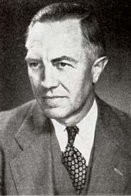
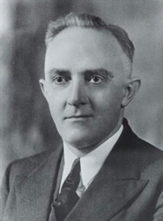
On Regeneration
“A man is not saved because he believes in Christ; he believes in Christ because he is saved.”
Lorainne Boettner, Predestination (Grand Rapids: Eerdmans, 1936), 101.
“A man is not regenerated because he has first believed in Christ, but he believes in Christ because he has been regenerated.”
Arthur W. Pink, The Holy Spirit (Grand Rapids: Baker, 1978), 55.

Slide 26
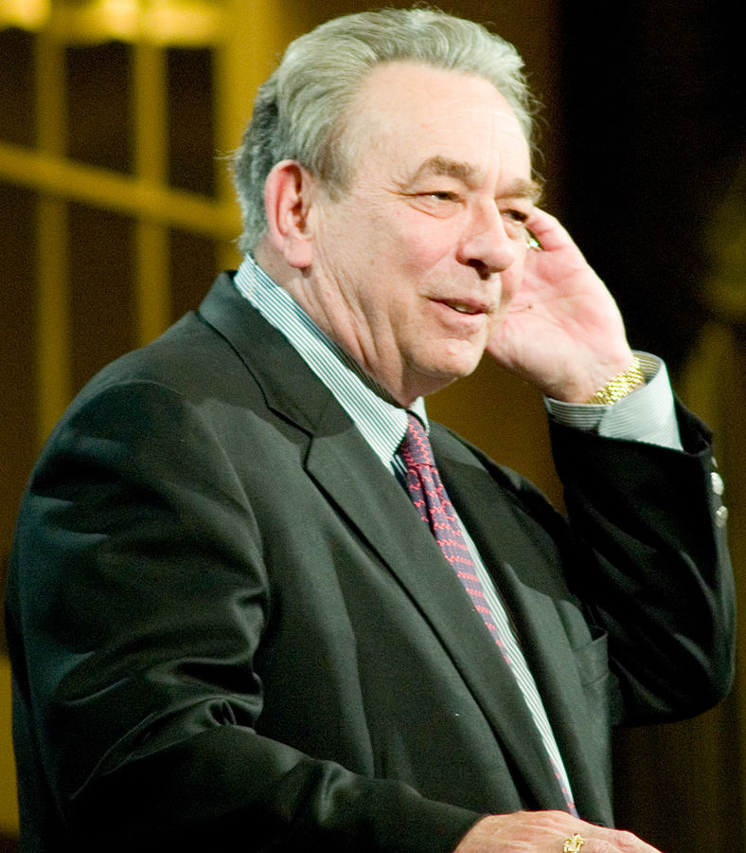
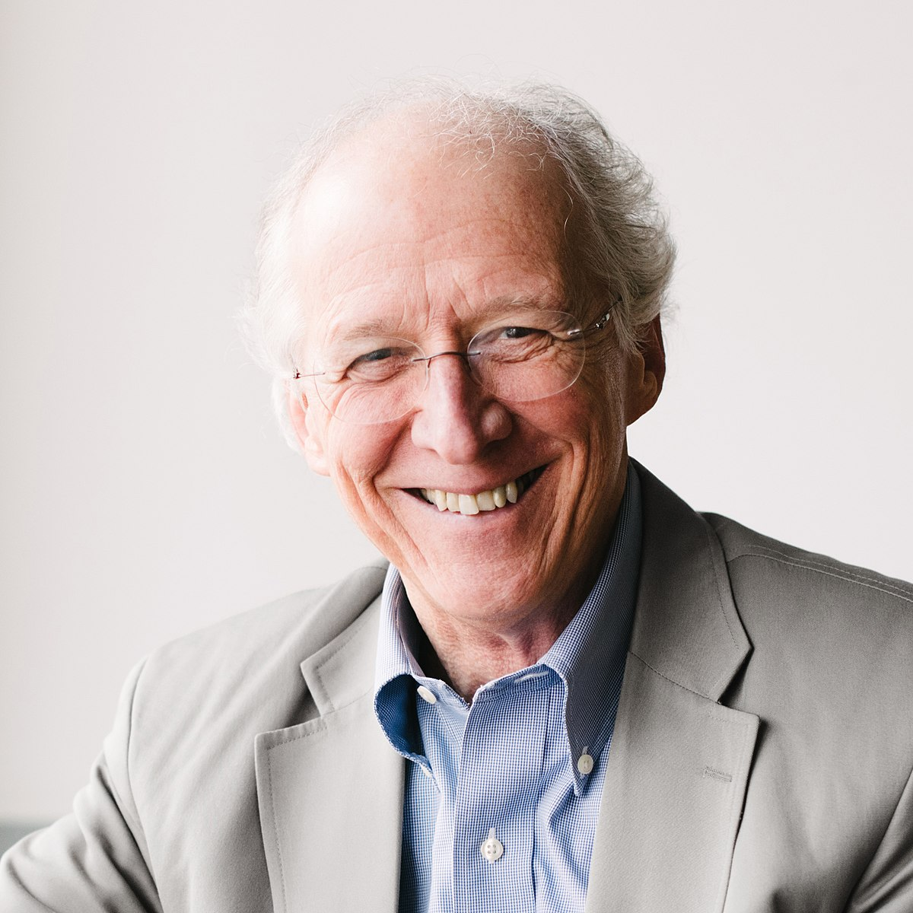
On Regeneration
“We do not believe in order to be born again; we are born again that we may believe.”
R. C. Sproul, Chosen By God (Carol Stream, IL: Tyndale House, 1986), 73.
“Faith is the evidence of the new birth, not the cause of it.”
John Piper, Desiring God (Sisters, OR: Multnomah, 2003), 63.

Slide 27
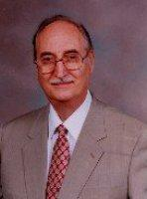
On Regeneration
“. . . regeneration is the necessary precondition and efficient cause of faith in Jesus Christ.”
Robert Reymond, New Systematic Theology of the Christian Faith (Nashville: Thomas Nelson, 1998), 708.
“…the revived [regenerated] heart repents and trusts Christ in saving faith as the only source of justification.”
ESV Study Bible, 2531.

Slide 28
On Ephesians 2:5
“Dead men do not cooperate with grace. Unless regeneration takes place first, there is no possibility of faith.”
R. C. Sproul, The Mystery of the Holy Spirit (Carol Stream, IL: Tyndale House, 1994), 105.

Slide 29
John 2:13
13 “…who were born, not of blood nor of the will of the flesh nor of the will of man, but of God.”

Slide 30
John 2:12-13
12 “But as many as received Him, to them He gave the right to become children of God, even to those who believe in His name,
13 who were born, not of blood nor of the will of the flesh nor of the will of man, but of God.”

Slide 31
Faith preceding Regeneration
Genesis 15:6 – “Then he believed in the Lord; and He reckoned it to him as righteousness.”
John 3:16 - “For God so loved the world, that He gave His only begotten Son, that whoever believes in Him shall not perish, but have eternal life.
Acts 16:30-31 – “They said, ‘Believe in the Lord Jesus, and you will be saved, you and your household.’”

Slide 32
Faith preceding Regeneration
John 5:24 - “Truly, truly, I say to you, he who hears My word, and believes Him who sent Me, has eternal life…”
John 20:30-31 - Therefore many other signs Jesus also performed in the presence of the disciples, which are not written in this book; but these have been written so that you may believe that Jesus is the Christ, the Son of God; and that believing you may have life in His name.

Slide 33
CONCLUSION

Slide 34
Jude 24-25
Now to Him who is able to keep you from stumbling, and to make you stand in the presence of His glory blameless with great joy, to the only God our Savior, through Jesus Christ our Lord, be glory, majesty, dominion and authority, before all time and now and forever. Amen.

Slide 35
The book of Titus
Worthy of the Gospel

