Slide 1
Genesis 12‒50
Israel’s Birth & Preservation

Slide 2
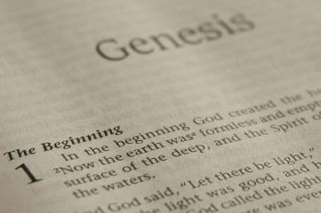
GENESIS STRUCTURE
Beginning of the Human race (Gen. 1‒11)
Beginning of the Hebrew race (Gen. 12‒50)

Slide 3
GENESIS STRUCTURE
Genesis 1-11 (four events)
Creation (1-2)
Fall (3-5)
Flood (6-9)
National dispersion (10-11)

Slide 4
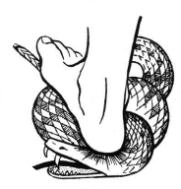
Genesis 3:15
“And I will put enmity Between you and the woman, And between your seed and her seed; He shall bruise you on the head, And you shall bruise him on the heel.”

Slide 5
GENESIS STRUCTURE
Beginning of the Human race (Gen. 1‒11)
Beginning of the Hebrew race (Gen. 12‒50)

Slide 6
GENESIS STRUCTURE
Genesis 12-50 (four people)
Abraham (12:1–25:11)
Isaac (25:12–26:35)
Jacob (27–36)
Joseph (37–50)

Slide 7
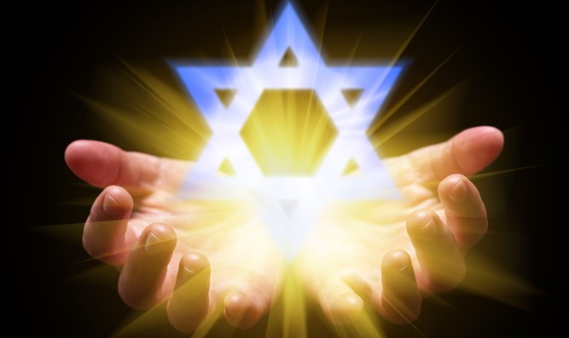
Isaiah 43:1
“But now, thus says the Lord, your Creator, O Jacob, And He who formed you, O Israel, 'Do not fear, for I have redeemed you; I have called you by name; you are Mine!'”

Slide 8
GENESIS STRUCTURE
Genesis 12-50 (four people)
Abraham (12:1–25:11)
Isaac (25:12–26:35)
Jacob (27–36)
Joseph (37–50)

Slide 9
Genesis 12‒19 Abram’s Early Journeys
Unconditional promises (Gen. 12:1-3)
From Haran to Canaan (Gen. 12:4-5)
In Canaan (Gen. 12:6-9)
In Egypt (Gen. 12:10-20)
Abram and Lot Separate (Gen. 13:1-13)
Reaffirmation of Abram’s promises (Gen. 13:14-18)
Abram Rescues Lot (14:1-24)
Abrahamic Covenant (15:1-21)
Hagar & Ishmael (16:1-16)
Circumcision (Gen. 17:1-27)
Sodom & Gomorrah (Gen. 18‒19)

Slide 10
Genesis 18‒19 Sodom & Gomorrah
Visitation (18:1-15)
Prediction (18:16-33)
Destruction (19:1-38)

Slide 11
Genesis 18‒19 Sodom & Gomorrah
Visitation (18:1-15)
Prediction (18:16-33)
Destruction (19:1-38)

Slide 12
Visitation Genesis 18:1-15
Hosting (1-8)
Promise of Isaac (9-15)

Slide 13
Genesis 18‒19 Sodom & Gomorrah
Visitation (18:1-15)
Prediction (18:16-33)
Destruction (19:1-38)

Slide 14
Prediction Genesis 18:16-33
Prophecy (16-21)
Intercession (22-33)

Slide 15
Genesis 18‒19 Sodom & Gomorrah
Visitation (18:1-15)
Prediction (18:16-33)
Destruction (19:1-38)

Slide 16
Destruction Genesis 19:1-38
Angels in Sodom (1-11)
Lot’s rescue (12-22)
Destruction (23-29)
Lot’s incest (30-38)

Slide 17
Destruction Genesis 19:1-38
Angels in Sodom (1-11)
Lot’s rescue (12-22)
Destruction (23-29)
Lot’s incest (30-38)

Slide 18
Angels in Sodom Genesis 19:1-11
Angelic arrival (1)
Lot’s invitation (2-3)
Mob’s attack (4-5)
Lot’s refusal & counter-offer (6-8)
Mob’s response (9)
Angelic response (10-11)

Slide 19
Destruction Genesis 19:1-38
Angels in Sodom (1-11)
Lot’s rescue (12-22)
Destruction (23-29)
Lot’s incest (30-38)

Slide 20
Lot’s Rescue Genesis 19:12-22
Angelic prediction (12-13)
Lot’s announcement (14)
Angelic exhortation (15)
Angelic enforcement (16)
Angelic instructions (17)
Lot’s request (18-20)
Angelic response (21-22)

Slide 21
Destruction Genesis 19:1-38
Angels in Sodom (1-11)
Lot’s rescue (12-22)
Destruction (23-29)
Lot’s incest (30-38)

Slide 22
Sodom’s Destruction Genesis 19:23-29
Timing (23)
Overthrow (24-25)
Lot’s loss (26)
Abraham’s response (27-28)
Summary (29)

Slide 23
Destruction Genesis 19:1-38
Angels in Sodom (1-11)
Lot’s rescue (12-22)
Destruction (23-29)
Lot’s incest (30-38)

Slide 24
Lot’s Incest Genesis 19:30-38
Lot’s departure (30)
Daughters’ plan (31-32)
1st born’s execution (33)
2nd born’s execution (34-35)
Result (36)
Moabites born (37)
Ammonites born (38)

Slide 25
Lot’s Incest Genesis 19:30-38
Lot’s departure (30)
Daughters’ plan (31-32)
1st born’s execution (33)
2nd born’s execution (34-35)
Result (36)
Moabites born (37)
Ammonites born (38)

Slide 26
Genesis 19:22
“Hurry, escape there, for I cannot do anything until you arrive there.” Therefore the name of the town was called Zoar.”

Slide 27
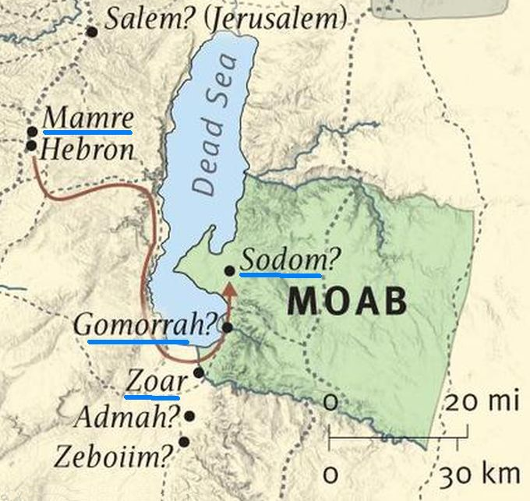

Slide 28
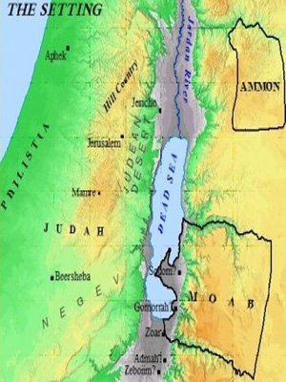

Slide 30
Dr. Arnold G. Fruchtenbaum
The Book of Genesis, 318
“Abraham stopped at ten, because he assumed that would be sufficient because of the size of Lot’s family, since Lot’s total household at this point did number ten: Lot; Lot’s wife; Lot’s two sons (19:12); his two married daughters (19:14); and his two sons-in-laws (19:14); and finally, his two single virgin daughters (19:8).”

Slide 31
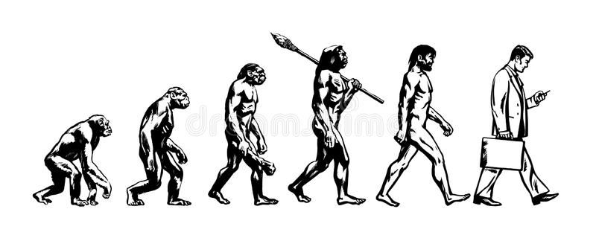

Slide 32
Lot’s Incest Genesis 19:30-38
Lot’s departure (30)
Daughters’ plan (31-32)
1st born’s execution (33)
2nd born’s execution (34-35)
Result (36)
Moabites born (37)
Ammonites born (38)

Slide 33
Daughter’s Plan Genesis 19:31-32
Problem (31)
Solution (32)

Slide 34
Daughter’s Plan Genesis 19:31-32
Problem (31)
Solution (32)

Slide 35
Dr. Arnold G. Fruchtenbaum
The Book of Genesis, 330
“In verse 31b, she expressed the problem: Our father is old, meaning his time is running out for him to be able to produce sons. Furthermore: There is not a man in the earth to come in unto us after the manner of all the earth. Sometimes this phrase has been misinterpreted to mean that they thought that everybody in the world was destroyed and there were no men left, but that is simply not true. They did, after all, spend some time in Zoar, and so they knew there were males available.”

Slide 36
Dr. Arnold G. Fruchtenbaum
The Book of Genesis, 330
“Therefore, they were not saying that there were no men left alive anywhere in the world to whom they could be joined in marriage. Rather, the issue was that no men would be willing to marry them, since their survival of such destruction implied that they were somewhat bad luck. Twice now, Sodom suffered a calamity, and both times Lot and his family were involved. Furthermore, the married parts of the family were also killed.”

Slide 37
Daughter’s Plan Genesis 19:31-32
Problem (31)
Solution (32)

Slide 38
Dr. Arnold G. Fruchtenbaum
The Book of Genesis, 330-31
“Therefore, in verse 32, the older daughter came up with a solution: Let us make our father drink wine. The Hebrew word means, ‘Let us make our father drunk.’ She does not merely want him to drink wine, but she wants him to become drunk. Then: We will lie with him. There is a play upon the words in the Hebrew text again. To make drunk is nashke; to lie with him is nishkavah. “Let us make him nashke and then we will nishkavah.”

Slide 40
Lot’s Incest Genesis 19:30-38
Lot’s departure (30)
Daughters’ plan (31-32)
1st born’s execution (33)
2nd born’s execution (34-35)
Result (36)
Moabites born (37)
Ammonites born (38)

Slide 41
Lot’s Incest Genesis 19:30-38
Lot’s departure (30)
Daughters’ plan (31-32)
1st born’s execution (33)
2nd born’s execution (34-35)
Result (36)
Moabites born (37)
Ammonites born (38)

Slide 42
Lot’s Incest Genesis 19:30-38
Lot’s departure (30)
Daughters’ plan (31-32)
1st born’s execution (33)
2nd born’s execution (34-35)
Result (36)
Moabites born (37)
Ammonites born (38)

Slide 43
Luke 19:41-44
^{41 “}When He approached Jerusalem, He saw the city and wept over it, ⁴² saying, “If you had known in this day, even you, the things which make for peace! But now they have been hidden from your eyes. ⁴³ For the days will come upon you when your enemies will throw up a barricade against you, and surround you and hem you in on . . .

Slide 44
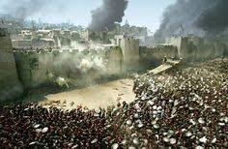
Luke 19:41-44
. . . every side, ⁴⁴ and they will level you to the ground and your children within you, and they will not leave in you one stone upon another, because you did not recognize the time of your visitation.”

Slide 45
Lot’s Incest Genesis 19:30-38
Lot’s departure (30)
Daughters’ plan (31-32)
1st born’s execution (33)
2nd born’s execution (34-35)
Result (36)
Moabites born (37)
Ammonites born (38)

Slide 49
Lot’s Incest Genesis 19:30-38
Lot’s departure (30)
Daughters’ plan (31-32)
1st born’s execution (33)
2nd born’s execution (34-35)
Result (36)
Moabites born (37)
Ammonites born (38)

Slide 53
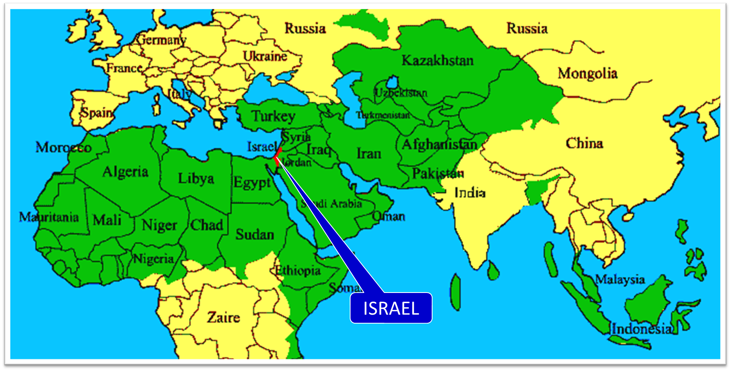

Slide 54
Concluding Thoughts Lot and Sodom & Gomorrah
Perseverance of the Saints?
Lot disappears
Sodom in the Kingdom
A sin worse than Sodom?

Slide 55
Concluding Thoughts Lot and Sodom & Gomorrah
Perseverance of the Saints?
Lot disappears
Sodom in the Kingdom
A sin worse than Sodom?

Slide 56
2 Peter 2:7-9
“⁷ and if He rescued righteous Lot, oppressed by the sensual conduct of unprincipled men ⁸ (for by what he saw and heard that righteous man, while living among them, felt his righteous soul tormented day after day by their lawless deeds), ⁹ then the Lord knows how to rescue the godly from temptation, and to keep the unrighteous under punishment for the day of judgment.”

Slide 57
John 10:27-29
“²⁷ My sheep hear My voice, and I know them, and they follow Me; ²⁸ and I give eternal life to them, and they will never perish [ou mē; aiōnia]; and no one will snatch them out of My hand. ²⁹ My Father, who has given them to Me, is greater than all; and no one is able to snatch them out of the Father’s hand.”

Slide 59
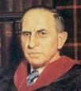
John Murray
Redemption Accomplished and Applied, (Grand Rapids, MI: Eerdmans Publishing Co. 2015 edition), p. 152, 154-55, 165. pp. 152, 154-55, 165
“The crucial test of true faith is endurance to the end, abiding in Christ, and continuance in the Word…He cannot abandon himself to sin; he cannot come under the domination of sin; he cannot be guilty of certain kinds of unfaithfulness…Let us appreciate the doctrine of the perseverance of the saints and recognize that we may entertain the faith of our security in Christ only as we persevere in faith and holiness to the end...The perseverance of the saints reminds us very forcefully that only those who persevere to the end are truly saints.”

Slide 60
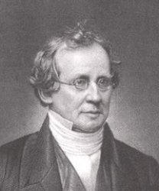
Charles Hodge
A Commentary on the Epistle to the Romans (Grand Rapids, MI: Eerdman’s Publishing, 1983 edition), p. 292.
Calvinist theologian Charles Hodge (1797-1878), in referring to evidence of being elected, said: “The only evidence of election is effectual calling, that is, the production of holiness. And the only evidence of the genuineness of this call and the certainty of our perseverance, is a patient continuance in well doing.”

Slide 61
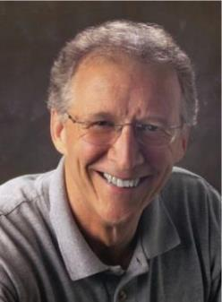
John Piper
John Piper & Pastoral Staff, TULIP: What We Believe about the Five Points of Calvinism: Position Paper
of the Pastoral Staff (Desiring God Ministries, 1997), 25, cited in Dave Hunt, What Love is This?, 379.
“No Christian can be sure that he is a true believer. Hence, there is an ongoing need to be dedicated to the Lord and to deny ourselves so that we might make it.”

Slide 62
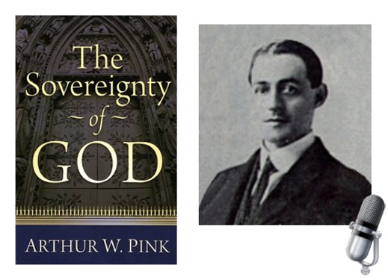
A. W. Pink
Practical Christianity, p. 16.
“Readers, if there is a reserve in your obedience, you are on your way to hell.”

Slide 63
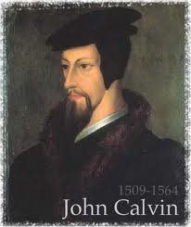
Examples of Old Testament Non-Persevering Saints
Noah (Gen. 9:20-23; Heb. 11:7)
Lot (Gen. 13; 19; 2 Pet. 2:7-8)
Moses (Num. 20:11-12; Deut. 32:5; Matt. 17:1-3; Heb. 11:23-29; Rev. 11:6)
Exodus’ generation (Num. 13‒14; Heb. 11:29)
Samson (Judges 13‒16; Heb. 11:32)
Saul (1 Sam. 28; 31)
Solomon (1 Kgs. 11:4, 9-10)

Slide 64
Examples of New Testament Non-Persevering Saints
Untrustworthy believers (John 2:23-25)
Non-confessing believers (John 12:42)
Ananias and Sapphira (Acts 5:1-11)
Simon the Sorcerer (Acts 8:13)
Immature believers at Corinth (1 Cor. 3:1-3)
Unrewarded believers at Corinth (1 Cor. 3:15)
Disciplined believers at Corinth (1 Cor. 11:27-32)
Demas (2 Tim. 4:10; Col. 4:14)
Immature believers in Hebrews (Heb. 5:11-14)
Seven churches in Asia Minor (Rev. 3:19)

Slide 65
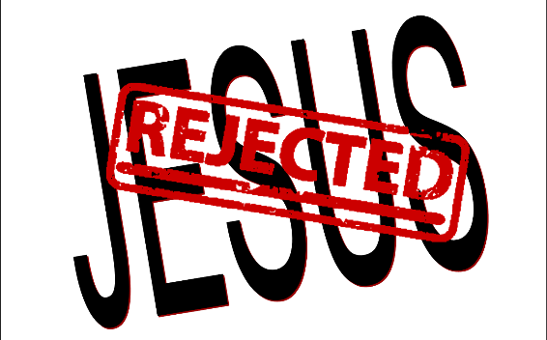
2 Timothy 2:11-13
“It is a trustworthy statement: For if we died with Him, we will also live with Him; ¹² If we endure, we will also reign with Him; If we deny Him, He also will deny us; ¹³ If we are faithless, He remains faithful, for He cannot deny Himself.”

Slide 66
1 Peter 1:5
“⁴to obtain an inheritance which is imperishable, undefiled, and will not fade away, reserved in heaven for you, ⁵ who are protected by the power of God through faith for a salvation ready to be revealed in the last time.”

Slide 67
Concluding Thoughts Lot and Sodom & Gomorrah
Perseverance of the Saints?
Lot disappears
Sodom in the Kingdom
A sin worse than Sodom?

Slide 68
Concluding Thoughts Lot and Sodom & Gomorrah
Perseverance of the Saints?
Lot disappears
Sodom in the Kingdom
A sin worse than Sodom?

Slide 69
Concluding Thoughts Lot and Sodom & Gomorrah
Perseverance of the Saints?
Lot disappears
Sodom in the Kingdom
A sin worse than Sodom?

Slide 70
Dr. Arnold G. Fruchtenbaum
The Book of Genesis, 332
“The first reference is Matthew 11:23–24, where Jesus declared that it would be more tolerable for Sodom in the day of judgment than for Capernaum. Although homosexuality is a very grievous sin, an even more grievous sin is having been confronted with spiritual truth, especially concerning the Messiahship of Jesus, and rejecting it. Since so many miracles of Jesus were performed in Capernaum and the people living there rejected Him anyway, it will be more tolerable for Sodom in the Day of Judgment than for Capernaum.”

Slide 71
Conclusion

Slide 72
Destruction Genesis 19:1-38
Angels in Sodom (1-11)
Lot’s rescue (12-22)
Destruction (23-29)
Lot’s incest (30-38)

Slide 73
Lot’s Incest Genesis 19:30-38
Lot’s departure (30)
Daughters’ plan (31-32)
1st born’s execution (33)
2nd born’s execution (34-35)
Result (36)
Moabites born (37)
Ammonites born (38)

Slide 74
Genesis 12‒20 Abram’s Early Journeys
Unconditional promises (Gen. 12:1-3)
From Haran to Canaan (Gen. 12:4-5)
In Canaan (Gen. 12:6-9)
In Egypt (Gen. 12:10-20)
Abram and Lot Separate (Gen. 13:1-13)
Reaffirmation of Abram’s promises (Gen. 13:14-18)
Abram Rescues Lot (14:1-24)
Abrahamic Covenant (15:1-21)
Hagar & Ishmael (16:1-16)
Circumcision (Gen. 17:1-27)
Sodom & Gomorrah (Gen. 18‒19)
Abimelech (Gen. 20)

Slide 75
²⁴ The Lord bless you, and keep you; ²⁵ The Lord make His face shine on you, And be gracious to you; ²⁶ The Lord lift up His countenance on you, And give you peace.
Numbers 6:24–26 (NASB95)

