Slide 1
The Miracle of
ISRAEL

Slide 4
HisChannel.com/JeffKinley

Slide 5
The Miracle of
ISRAEL

Slide 6
Israel’s Scattering Prophesied
“If you are not careful to observe all the words of this law which are written in this book, to fear this honored and awesome name, [b]the Lord your God, 59 then the Lord will bring extraordinary plagues on you and [c]your descendants, even severe and lasting plagues, and miserable and chronic sicknesses. 60 He will bring back on you all the diseases of Egypt of which you were afraid, and they will cling to you. 61 Also every sickness and every plague which, not written in the book of this law, the Lord will bring on you until you are destroyed. 62 Then you shall be left few in number, whereas you were as numerous as the stars of heaven, because you did not [e]obey the Lord your God. 63 It shall come about that as the Lord delighted over you to prosper you, and multiply you, so the Lord will delight over you to make you perish and destroy you; and you will be torn from the land where you are entering to possess it. 64 Moreover, the Lord will scatter you among all peoples, from one end of the earth to the other end of the earth; and there you shall serve other gods, wood and stone, which you or your fathers have not known.
- Deuteronomy 28:58-64

Slide 7
Israel’s Persecution Prophesied
Among those nations you shall find no rest, and there will be no resting place for the sole of your foot; but there the Lord will give you a trembling heart, failing of eyes, and despair of soul. ⁶⁶ So your life shall hang in doubt before you; and you will be in dread night and day, and shall have no assurance of your life. ⁶⁷ In the morning you shall say, ‘Would that it were evening!’ And at evening you shall say, ‘Would that it were morning!’ because of the dread of your heart which you dread, and for the sight of your eyes which you will see.
Deuteronomy 28:65-67

Slide 8
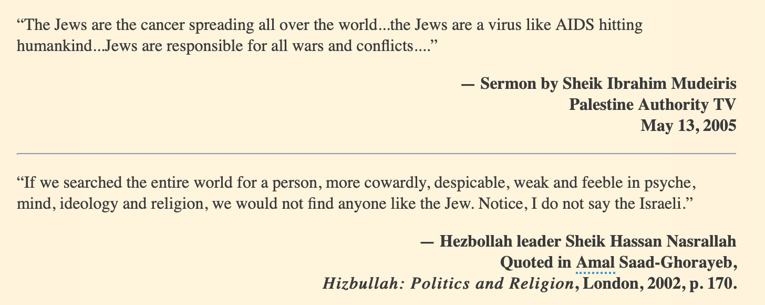

Slide 10
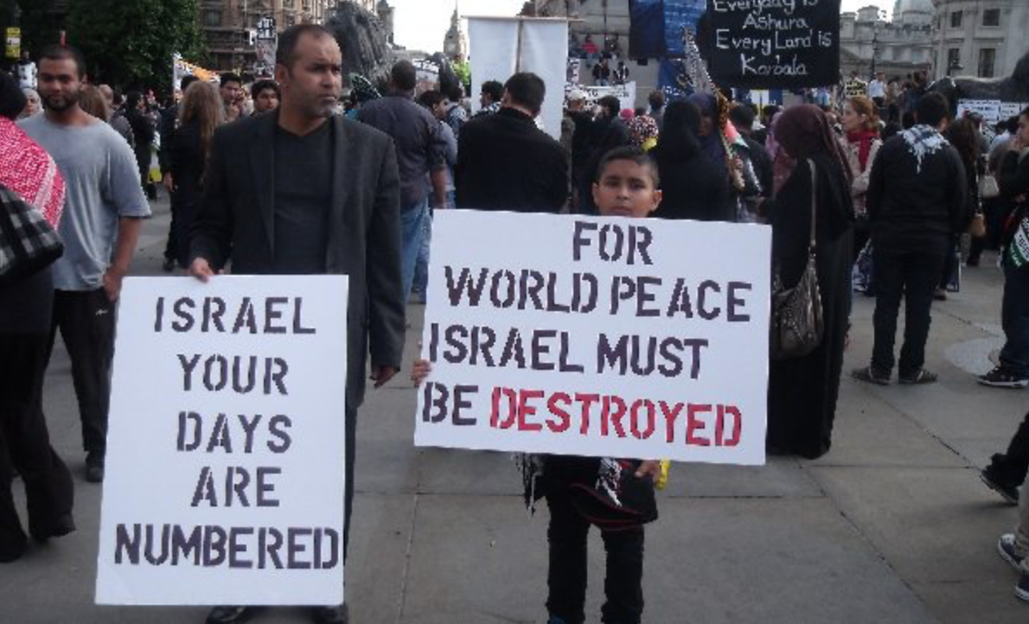
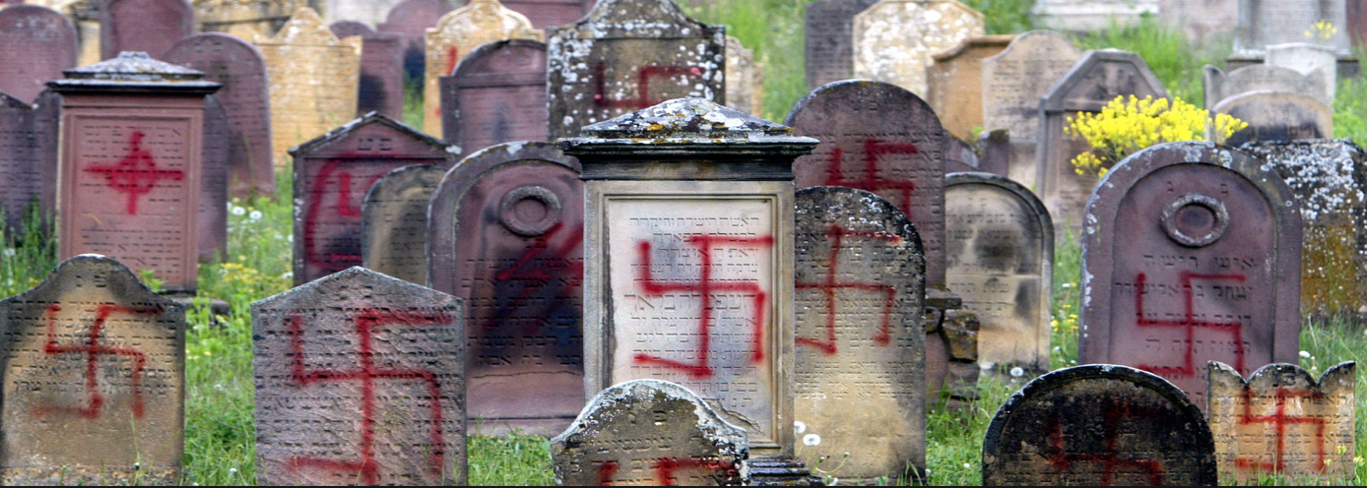

Slide 11
Desolation of Israel’s Land Prophesied
Now the generation to come, your sons who rise up after you and the foreigner who comes from a distant land, when they see the plagues of the land and the diseases with which the Lord has afflicted it, will say, 23 ‘All its land is brimstone and salt, a burning waste, unsown and unproductive, and no grass grows in it, like the overthrow of Sodom and Gomorrah, Admah and Zeboiim, which the Lord overthrew in His anger and in His wrath.’ 24 All the nations will say, ‘Why has the Lord done thus to this land? Why this great outburst of anger?’ 25 Then men will say, ‘Because they forsook the covenant of the Lord, the God of their fathers, which He made with them when He brought them out of the land of Egypt.
Deuteronomy 29:22-25

Slide 12
Jewish Preservation Prophesied
Thus says the Lord, Who gives the sun for light by day And the fixed order of the moon and the stars for light by night, Who stirs up the sea so that its waves roar; The Lord of hosts is His name: “If this fixed order departs From before Me,” declares the Lord, “Then the offspring of Israel also will cease From being a nation before Me forever.”
Jeremiah 31:35-36

Slide 13
“The mightiest counterpart to the _____ is represented by the Jew. In hardly any people in the world is the instinct of self-preservation developed more strongly than in the so-called 'chosen.' Of this, the mere fact of the survival of this race may be considered the best proof. Where is the people which in the last two thousand years has been exposed to so slight changes of inner disposition, character, etc., as the Jewish people? What people, finally, has gone through greater upheavals than this one-and nevertheless issued from the mightiest catastrophes of mankind unchanged? What an infinitely tough will to live and preserve the species speaks from these facts!”

Slide 14
“The mightiest counterpart to the Aryan is represented by the Jew. In hardly any people in the world is the instinct of self-preservation developed more strongly than in the so-called 'chosen.' Of this, the mere fact of the survival of this race may be considered the best proof. Where is the people which in the last two thousand years has been exposed to so slight changes of inner disposition, character, etc., as the Jewish people? What people, finally, has gone through greater upheavals than this one-and nevertheless issued from the mightiest catastrophes of mankind unchanged? What an infinitely tough will to live and preserve the species speaks from these facts!”
Adolf Hitler - Mein Kampf (Chapter XI - Nation and Race)

Slide 15
Regathering of Israel Prophesied
"I will bring them out from the peoples and gather them from the countries and bring them to their own land; and I will feed them on the mountains of Israel, by the streams, and in all the inhabited places of the land. - Ezekiel 34:13
For behold, days are coming,’ declares the Lord, ‘when I will restore the fortunes of My people Israel and Judah.’ The Lord says, ‘I will also bring them back to the land that I gave to their forefathers and they shall possess it. - Jeremiah 30:3
Fear not, for I am with you;
I will bring your offspring from the east,
and from the west I will gather you.
I will say to the north, Give up,
and to the south, Do not withhold;
bring my sons from afar
and my daughters from the end of the earth
- Isaiah 43:5-6

Slide 16
Rebuilding of Jewish Temple Prophesied
Daniel 9:27; Matthew 24:15; 2 Thessalonians 2:3-4; Revelation 11:1-2
The future “Abomination of Desolation” cannot take place unless a third Temple is built.

Slide 17
What is Our Response to the Miracle of Israel?
If Israel exists, then God exists. Atheism is dying.
God’s Word is trustworthy, reliable, and true.
God is sovereign over history (Job 42:2; Dan 2:45)
God is the ultimate Promise-Keeper (Gen 12:3; Eek 26-37)
Strong evidence future prophecies will be fulfilled.
It’s the clearest indication that we are in the season of
the Lord’s return (Eek 37:12; Hebrews 10:25)

Slide 18
OUR GOD IS THE GOD OF MIRACLES
OUR GOD IS THE GOD OF ISRAEL
OUR GOD IS THE GOD OF SALVATION
WHO IS LIKE OUR GOD?!

Slide 19
The Miracle of
ISRAEL

