Slide 1
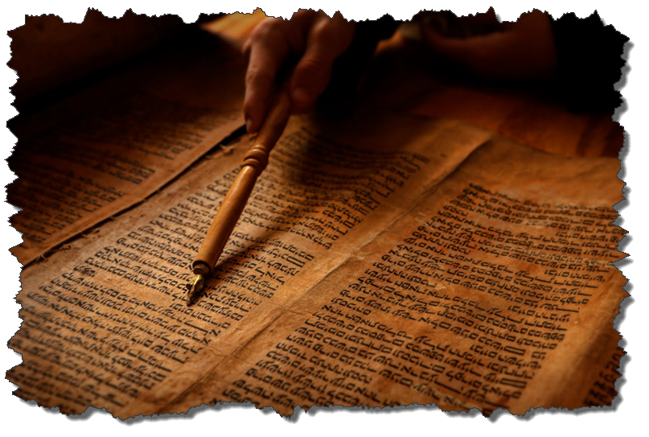
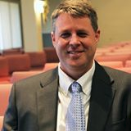
ISRAEL and
THE COVENANTS
Dr. Andy Woods
Senior Pastor – Sugar Land Bible Church
President – Chafer Theological Seminary

Slide 2
ISRAEL & THE COVENANTS
The Need
The Nation
The Covenant
The Sub-Covenants
The Future
The Hope
The Attitude
Notes:
Outline

Slide 3
ISRAEL & THE COVENANTS
The Need
The Nation
The Covenant
The Sub-Covenants
The Future
The Hope
The Attitude
Notes:
Outline

Slide 4


Genesis 3:15
“And I will put enmity Between you and the woman, And between your seed and her seed; He shall bruise you on the head, And you shall bruise him on the heel.”

Slide 5

Genesis 11:7-9
⁷ “Come, let Us go down and there confuse their language, so that they will not understand one another’s speech.” ⁸ So the Lord scattered them abroad from there over the face of the whole earth; and they stopped building the city. ⁹ Therefore its name was called Babel, because there the Lord confused the language of the whole earth; and from there the Lord scattered them abroad over the face of the whole earth.

Slide 6
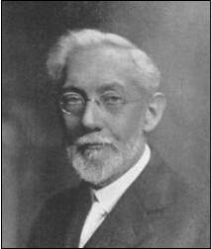
Larkin, The Book of Revelation, 151.
“The river Euphrates, on which the city of Babylon was built, was one of the four branches into which the river that flowed through the Garden of Eden was divided, and Satan doubtless chose the site of Babylon as his headquarters from which to sally forth to tempt Adam and Eve. It was doubtless here that the Antediluvian apostasy had its source that ended in the flood. To this centre the ‘forces of Evil’ gravitated after the Flood, and ‘Babel’ was the result. This was the origin of the nations, but the nations were not scattered abroad over the earth until Satan had implanted in them the ‘Virus’ of a doctrine that has been the source of every false religion the world has ever known.”

Slide 7
Spread of the Mother-Child Cult
 | MOTHER | CHILD
Assyria | Ishtar | Tammuz
Phoenicia | Astarte | Baal
Egypt | Isis | Osirus/Horus
Greece | Aphrodite | Eros
Rome | Venus | Cupid
Asia | Cybele | Desius
India | Isi | Aswara
Roman Catholicism | Mary | Jesus
Alexander Hislop, Two Babylons

Slide 8
ISRAEL & THE COVENANTS
The Need
The Nation
The Covenant
The Sub-Covenants
The Future
The Hope
The Attitude
Notes:
Outline

Slide 9


Slide 10


Isaiah 43:1
“But now, thus says the Lord, your Creator, O Jacob, And He who formed you, O Israel, 'Do not fear, for I have redeemed you; I have called you by name; you are Mine!'”

Slide 11


Genesis 12:3
“And I will bless those who bless you, And the one who curses you I will curse. And in you all the families of the earth will be blessed.”

Slide 12
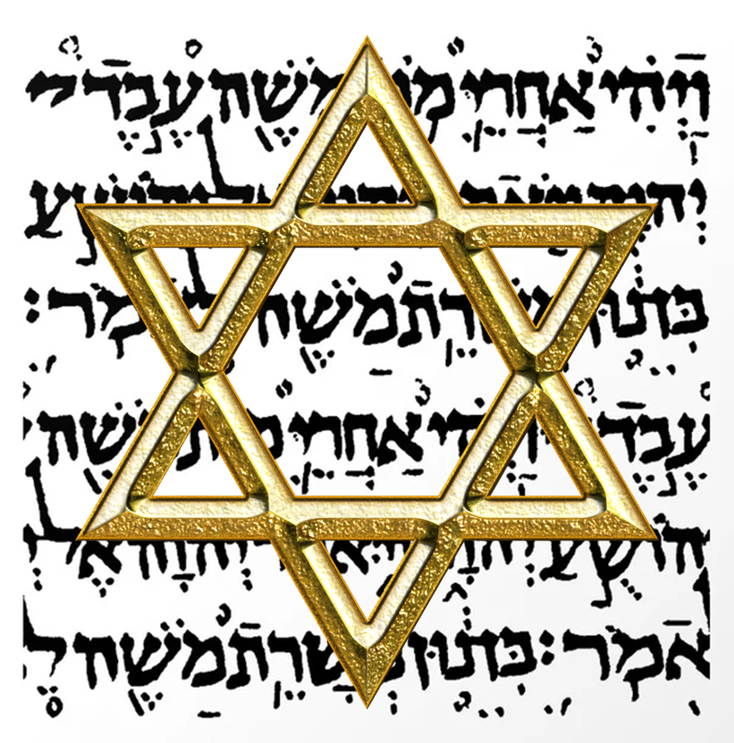
Israel’s Three Blessings to the World
(Gen 12:3b)
Scripture (Rom 3:2)
Savior (John 4:22)
Kingdom (Isa 2:2-3)

Slide 13
ISRAEL & THE COVENANTS
The Need
The Nation
The Covenant
The Sub-Covenants
The Future
The Hope
The Attitude
Notes:
Outline

Slide 14
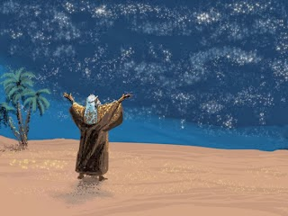
Genesis 15:18
“On that day the Lord made a covenant with Abram, saying, ‘To your descendants I have given this land, From the river of Egypt as far as the great river, the river Euphrates:”

Slide 15
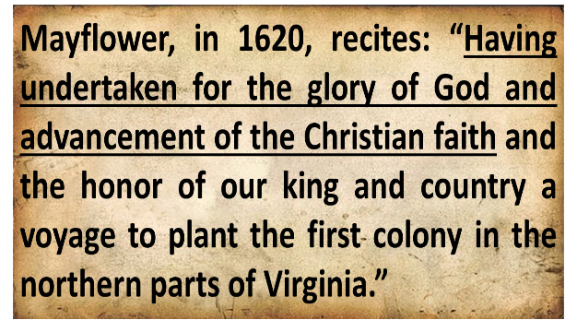
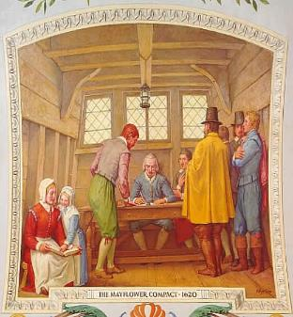
Mayflower Compact (1620)
David Brewer, United States A Christian Nation, 14

Slide 16
Dr. William F. Albright
W. F. Albright, Yahweh and the Gods of Canaan: A Historical Analysis of Two Contrasting Faiths (Garden City, NY: Doubleday, 1968), 106-08.
“‘Contracts and treaties were common everywhere, but only the Hebrews, so far as we know, made covenants with their gods or God. Being prevailing caravaneers and so ethno-political intruders in the West, the early Hebrews were in constant need of contractual and treaty protection.’ Of course, we biblicists would insist that it was God that made the contracts with men, not the other way around.”
Charles C. Clough, "Social-Political Implications of the New Covenant," in An Introduction to the New Covenant, ed. Christopher Cone (Hurst, TX: Tyndale Seminary Press, 2013), 277, fn. 13.

Slide 17


Slide 18
ISRAEL & THE COVENANTS
The Need
The Nation
The Covenant
The Sub-Covenants
The Future
The Hope
The Attitude
Notes:
Outline

Slide 19


Slide 20

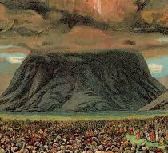
Deuteronomy 29:1
“These are the words of the covenant which the Lord commanded Moses to make with the sons of Israel in the land of Moab, besides the covenant which He had made with them at Horeb.”

Slide 21
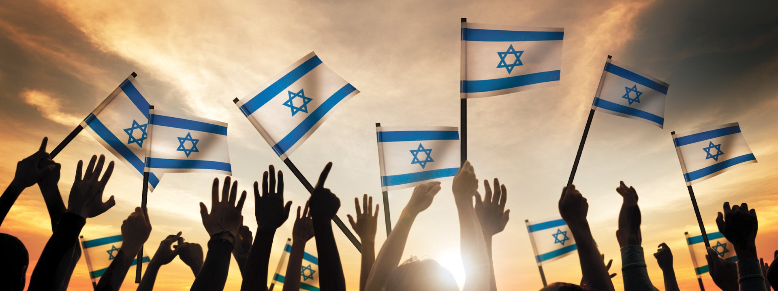
Deuteronomy 30:3
“Then the Lord your God will restore you from captivity, and have compassion on you, and will gather you again from all the peoples where the Lord your God has scattered you.”

Slide 22

2 Samuel 7:12-16
“¹² When your days are complete and you lie down with your fathers, I will raise up your descendant after you, who will come forth from you, and I will establish his kingdom. ¹³ He shall build a house for My name, and I will establish the throne of his kingdom forever. ¹⁴ I will be a father to him and he will be a son to Me; when he commits iniquity, I will correct him with the rod of men. . .

Slide 23
2 Samuel 7:12-16
. . . and the strokes of the sons of men, 15 but My lovingkindness shall not depart from him, as I took it away from Saul, whom I removed from before you. ¹⁶ Your house and your kingdom shall endure before Me forever; your throne shall be established forever.” ¹⁷ In accordance with all these words and all this vision, so Nathan spoke to David.”

Slide 24
Jeremiah 31:31-34
“³¹ Behold, days are coming,” declares the Lord, “when I will make a new covenant with the house of Israel and with the house of Judah, ³² not like the covenant which I made with their fathers in the day I took them by the hand to bring them out of the land of Egypt, My covenant which they broke, although I was a husband to them,” declares the Lord. ³³ “But this is the covenant which I will make with the house of Israel after those days,” declares the Lord, . . .

Slide 25
Jeremiah 31:31-34
...“I will put My law within them and on their heart I will write it; and I will be their God, and they shall be My people. ³⁴ They will not teach again, each man his neighbor and each man his brother, saying, ‘Know the Lord,’ for they will all know Me, from the least of them to the greatest of them,” declares the Lord, “for I will forgive their iniquity, and their sin I will remember no more.”

Slide 26
ISRAEL & THE COVENANTS
The Need
The Nation
The Covenant
The Sub-Covenants
The Future
The Hope
The Attitude
Notes:
Outline

Slide 27

Ezekiel 36:22
“Therefore, say to the house of Israel, ‘This is what the Lord God says: ‘It is not for your sake, house of Israel, that I am about to act, but for My holy name, which you have profaned among the nations where you went.’”

Slide 28


Slide 29

Jeremiah 31:35-37
³⁵ Thus says the Lord, Who gives the sun for light by day And the fixed order of the moon and the stars for light by night, Who stirs up the sea so that its waves roar; The Lord of hosts is His name: ³⁶ “If this fixed order departs From before Me,” declares the Lord, “Then the offspring of Israel also will cease From being a nation before Me forever.” ³⁷ Thus says the Lord, “If the heavens above . . .

Slide 30
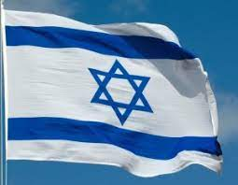
Jeremiah 31:35-37
. . . can be measured And the foundations of the earth searched out below, Then I will also cast off all the offspring of Israel For all that they have done,” declares the Lord.

Slide 31
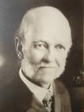
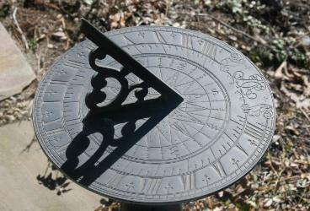
William E. Blackstone
Jesus Is Coming: God's Hope for a Restless World (New York: F.H. Revell, 1908; reprint, Grand Rapids: Kregel, 1989), 238.
“Israel is God's sun dial. If anyone desires to know our place in God’s chronology, our position in the great march of events, look at Israel.”

Slide 32
ISRAEL & THE COVENANTS
The Need
The Nation
The Covenant
The Sub-Covenants
The Future
The Hope
The Attitude
Notes:
Outline

Slide 33
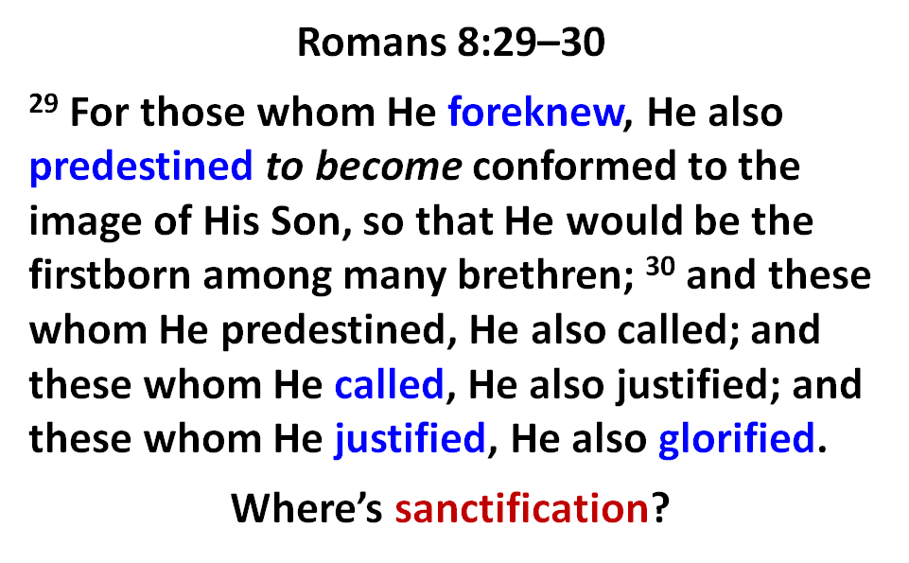

Slide 34
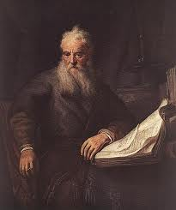
Romans Outline
Salutation (1:1-17)
Sin (1:18–3:20)
Salvation (3:21–5:21)
Sanctification (6–8)
Sovereignty (9–11)
Service (12:1–15:13)
Summation (15:14–16:27)

Slide 35
Romans Outline
Salutation (1:1-17)
Sin (1:18–3:20)
Salvation (3:21–5:21)
Sanctification (6–8)
Sovereignty (9–11)
Service (12:1–15:13)
Summation (15:14–16:27)

Slide 36


Slide 37
V. Sovereignty (Rom 9–11)
Israel in the past: elected (Rom 9)
Israel in the present: rejected (Rom 10)
Israel in the future: accepted (Rom 11)

Slide 38
Romans 11:25-26
“²⁵ For I do not want you, brethren, to be uninformed of this mystery—so that you will not be wise in your own estimation—that a partial hardening has happened to Israel until the fullness of the Gentiles has come in; ²⁶ and so all Israel will be saved; just as it is written, ‘The Deliverer will come from Zion, He will remove ungodliness from Jacob.’”

Slide 39
Romans Outline
Salutation (1:1-17)
Sin (1:18–3:20)
Salvation (3:21–5:21)
Sanctification (6–8)
Sovereignty (9–11)
Service (12:1–15:13)
Summation (15:14–16:27)

Slide 40


Romans 12:1
¹ Therefore I urge you, brethren, by the mercies of God, to present your bodies a living and holy sacrifice, acceptable to God, which is your spiritual service of worship.

Slide 41
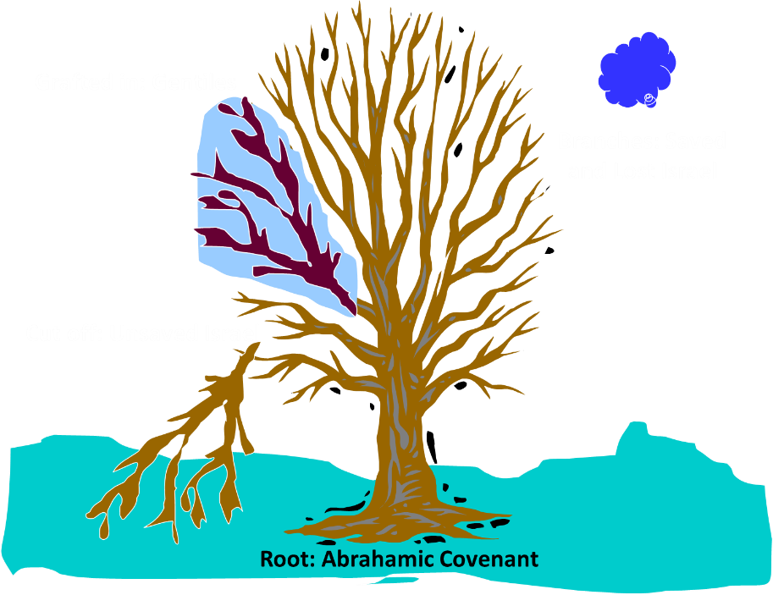
Notes:
41

Slide 42
Romans 11:13, 17-21
“¹³ But I am speaking to you who are Gentiles. Inasmuch then as I am an apostle of Gentiles, I magnify my ministry… ¹⁷ But if some of the branches were broken off, and you, being a wild olive, were grafted in among them and became partaker with them of the rich root of the olive tree, ¹⁸ do not be arrogant toward the branches; but if you are arrogant, remember that it is not you who . . .

Slide 43
Romans 11:13, 17-21
…supports the root, but the root supports you. ¹⁹ You will say then, “Branches were broken off so that I might be grafted in.” ²⁰ Quite right, they were broken off for their unbelief, but you stand by your faith. Do not be conceited, but fear; ²¹ for if God did not spare the natural branches, He will not spare you, either.”

Slide 44
ISRAEL & THE COVENANTS
The Need
The Nation
The Covenant
The Sub-Covenants
The Future
The Hope
The Attitude
Notes:
Outline

Slide 45

Romans 11:13, 17-21
“¹³ But I am speaking to you who are Gentiles. Inasmuch then as I am an apostle of Gentiles, I magnify my ministry…¹⁷ But if some of the branches were broken off, and you, being a wild olive, were grafted in among them and became partaker with them of the rich root of the olive tree, ¹⁸ do not be arrogant toward the branches; but if you are arrogant, remember that it is not you who . . .

Slide 46
Romans 11:13, 17-21
. . supports the root, but the root supports you. ¹⁹ You will say then, “Branches were broken off so that I might be grafted in.” ²⁰ Quite right, they were broken off for their unbelief, but you stand by your faith. Do not be conceited, but fear; ²¹ for if God did not spare the natural branches, He will not spare you, either.”

Slide 47


Slide 48
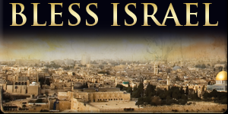
Romans 11:28-29
“²⁸ From the standpoint of the gospel they are enemies for your sake, but from the standpoint of God’s choice they are beloved for the sake of the fathers; ²⁹ for the gifts and the calling of God are irrevocable.”

Slide 49
Romans 15:27
“Yes, they were pleased to do so, and they are indebted to them. For if the Gentiles have shared in their spiritual things, they are indebted to minister to them also in material things.”

Slide 50

Tony Campolo
Tony Campolo, cited in Paul R. Wilkinson, Israel Betrayed: Volume 2: The Rise of Christian Palestinianism (San Antonio, TX: Ariel, 2018), 140.
“…a little nation that has survived primarily because of the wealth and the war materials supplied by the U.S. government.”

Slide 51
Conclusion

Slide 52
ISRAEL & THE COVENANTS
The Need
The Nation
The Covenant
The Sub-Covenants
The Future
The Hope
The Attitude
Notes:
Outline

