Slide 1
ANTI-SEMITISM
FROM “NEVER AGAIN”
OLIVIER MELNICK
CHOSEN
PEOPLE
MINISTRIES
TO “OVER AGAIN!”

Slide 2
4 REASONS TO STUDY ANTI-SEMITISM
1. Anti-Semitism focuses on the destruction of the people of the Book, the Jewish people.
2. Anti-Semitism is strongly connected to Replacement Theology.
3. Anti-Semitism is an inseparable part of the fabric of Jewish history. It must be studied if we want to understand the Jewish people.
4. Anti-Semitism CAN be used in outreach to Jewish people.

Slide 3
DEFINING
ANTI-SEMITISM
“Anti-Semitism is the satanic and irrational hatred of the Jewish people characterized by destructive thoughts, words, or actions against them.”

Slide 4
A CONTEMPORARY CHALLENGE:
The Road to Auschwitz was built by hate
but paved with indifference. Ian Kershaw
The Road to another Holocaust is being rebuilt by hate but paved with political correctness and apathy. Olivier Melnick
Anti-Semitism builds an unlikely bridge and creates unexpected bonds between us and the rest of the Jewish community.

Slide 5
A genuine follower of Yeshua cannot hate the Jews.
ANTI-SEMITISM
IS NOT BIBLICAL
Psalm 83:3-5 They make shrewd plans against Your people, And conspire together against Your treasured ones. They have said,“Come, and let us wipe them out as a nation,That the name of Israel be remembered no more.” For they have conspired together with one mind; Against You they make a covenant.

Slide 6
A genuine follower of Yeshua cannot hate the Jews.
ANTI-SEMITISM
IS NOT BIBLICAL
Romans 11:11 I say then, they did not stumble so as to fall, did they? May it never be! But by their transgression salvation has come to the Gentiles, to make them jealous.

Slide 7
MODERN ANTI-SEMITISM
DIDN’T HAPPEN IN A VACUUM
YOU MUST KNOW WHAT YOU BRING TO THE TABLE!

Slide 8
• CLASSICAL ANTI-SEMITISM • THEOLOGICAL ANTI-JUDAISM • RACIAL ANTI-SEMITISM FROM THE BIBLICAL ACCOUNT TO THE HOLOCAUST • MODERN ANTI-SEMITISM • NEW ANTI-SEMITISM • END-TIMES ANTI-SEMITISM POST-HOLOCAUST TO TODAY
THE MORPHING OF ANTI-SEMITISM

Slide 9
• Theological anti-Judaism paved the way for racial Anti-Semitism. • The Exegetical deviation of some of the early Church Fathers was a catalyst. • Anti-Semitism progressively grew, widening the chasm between the Church and the Jews and starting the “Us and Them!” syndrome.
CLASSICAL
ANTI-SEMITISM
FROM THE BIBLICAL ACCOUNT TO THE HOLOCAUST

Slide 10
The Church Fathers • Ignatius Bishop of Antioch (c. AD 35 – c.108) • Origen of Alexandria (AD 185-254) • John Chrysostom (AD 344-407) • Augustine (AD 354-430) • Jerome (AD 347-420)
CLASSICAL
ANTI-SEMITISM
FROM THE BIBLICAL ACCOUNT TO THE HOLOCAUST

Slide 11
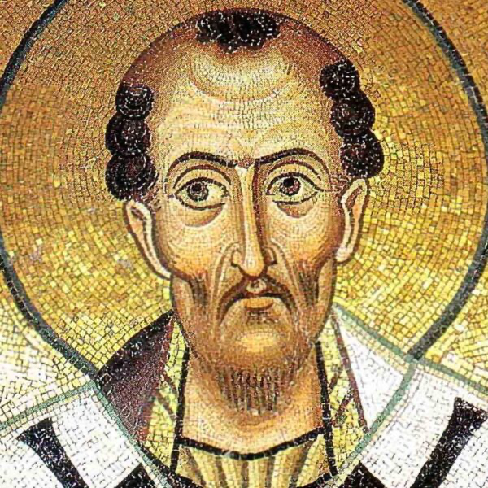
John Chrysostom (AD 344-407) “The synagogue is worse than a brothel…it is the den of scoundrels and the repair of wild beasts…the temple of demons devoted to idolatrous cults…the refuge of brigands and debauchees, and the cavern of devils. It is a criminal assembly of Jews…a place of meeting for the assassins of Christ… a house worse than a drinking shop…a den of thieves, a house of ill fame, a dwelling of iniquity, the refuge of devils, a gulf and an abyss of perdition.… I would say the same things about their souls… As for me, I hate the synagogue…I hate the Jews for the same reason.… men who are lustful, rapacious, greedy, perfidious bandits…inveterate murderers, destroyers, men possessed by the devil,… they have surpassed the ferocity of wild beasts, for they murder their offspring and immolate them to the devil.” Adversus Judaeos (Against the Jews)
CLASSICAL
ANTI-SEMITISM
FROM THE BIBLICAL ACCOUNT TO THE HOLOCAUST

Slide 12
The Church Fathers: • Jerome (AD 347-420) A deviation of one degree seems insignificant and yet, 1º between New York and Los Angeles will result in a 50 miles deviation off course. The Church’s exegetical deviation took many far away from biblical truth, leading to diatribes and eventually the death of millions.
CLASSICAL
ANTI-SEMITISM
FROM THE BIBLICAL ACCOUNT TO THE HOLOCAUST

Slide 13
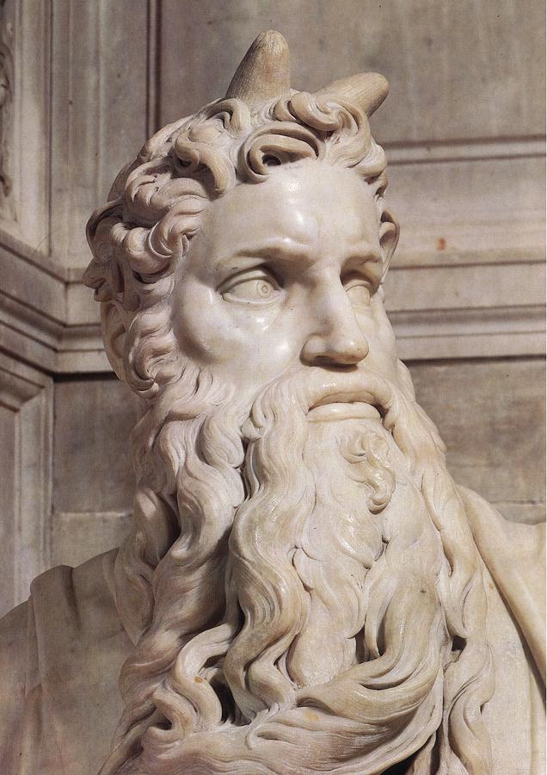
CLASSICAL
ANTI-SEMITISM
FROM THE BIBLICAL ACCOUNT TO THE HOLOCAUST
Context is critical!
In his monumental 4th Century work “The Vulgate” Jerome translated the Bible in Latin. He mistakenly translated the word קָרַן “karan” from the Hebrew “keren” that can mean “ray of light” or “horn” into horn.
Michelangelo’s “Moses” commissioned in 1505 by the Pope, ended up with
horns on Moses’ forehead.

Slide 14
CLASSICAL
ANTI-SEMITISM
FROM THE BIBLICAL ACCOUNT TO THE HOLOCAUST
Context is critical!
Exodus 34:29 It came about when Moses was coming down from Mount Sinai (and the two tablets of the testimony were in Moses’ hand as he was coming down from the mountain), that Moses did not know that the skin of his face shone because of his speaking with Him.

Slide 15
CLASSICAL
ANTI-SEMITISM
FROM THE BIBLICAL ACCOUNT TO THE HOLOCAUST
Exodus 34:34-35 But whenever Moses went in before the Lord to speak with Him, he would take off the veil until he came out; and whenever he came out and spoke to the sons of Israel what he had been commanded, the sons of Israel would see the face of Moses, that the skin of Moses’ face shone. So Moses would replace the veil over his face until he went in to speak with Him.

Slide 16
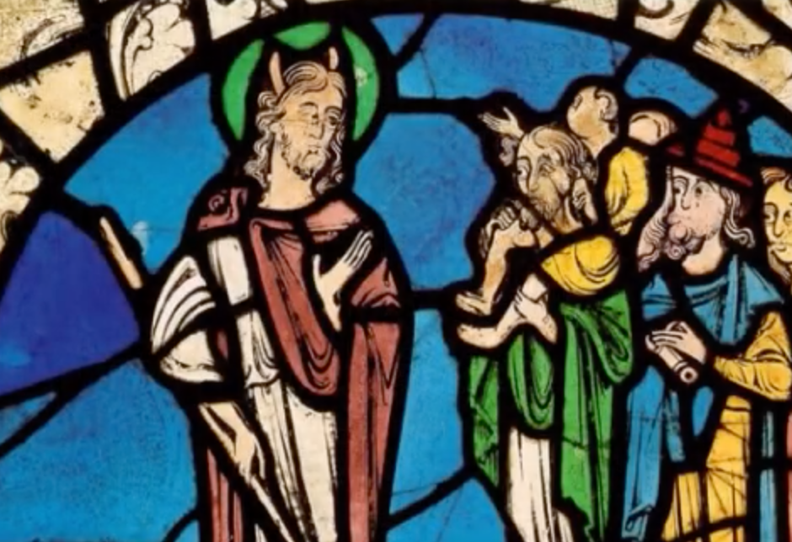
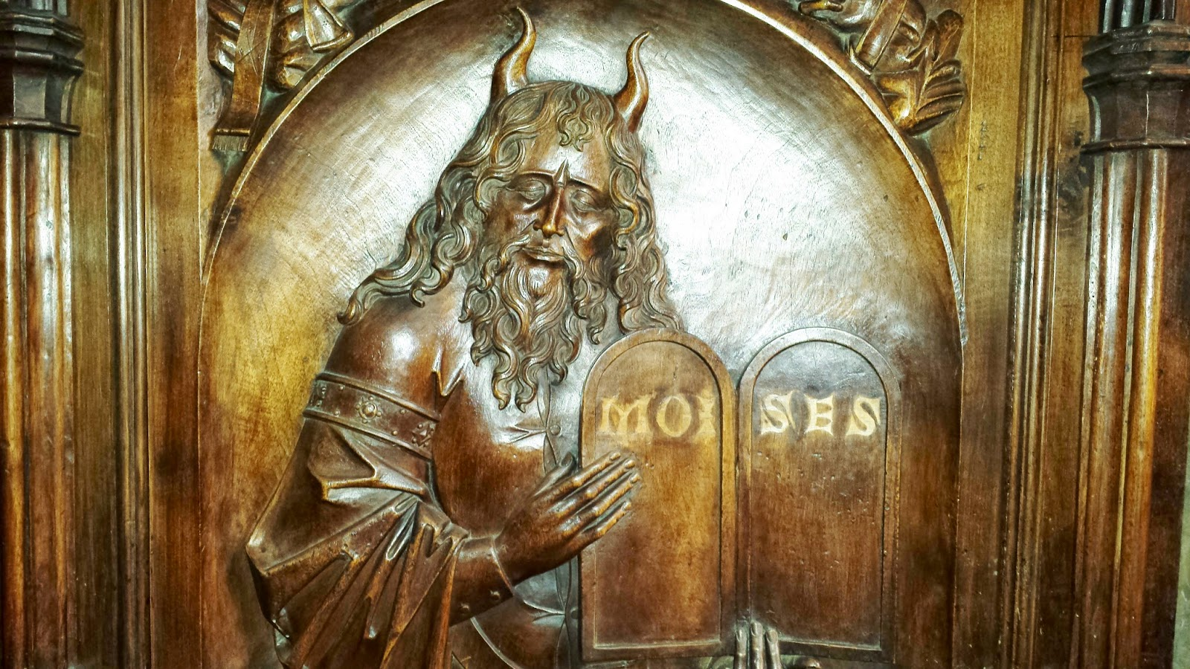
CLASSICAL
ANTI-SEMITISM
FROM THE BIBLICAL ACCOUNT TO THE HOLOCAUST

Slide 17
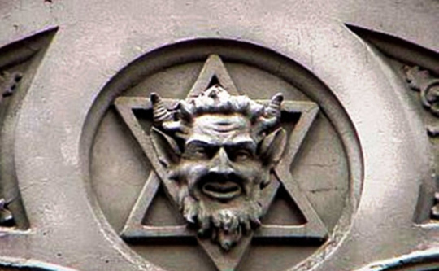
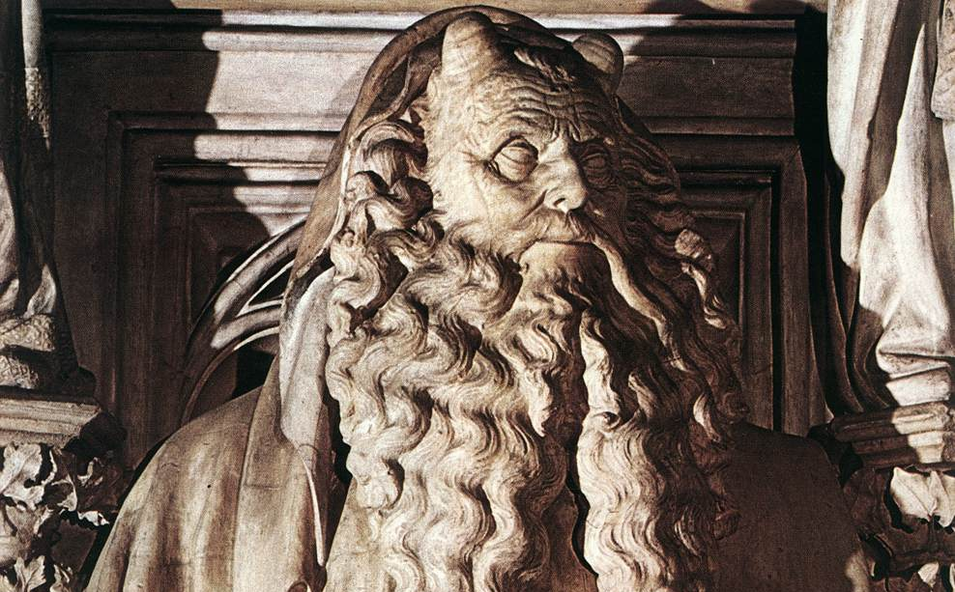
CLASSICAL
ANTI-SEMITISM
The deviation creates an increasingly more negative image.

Slide 18
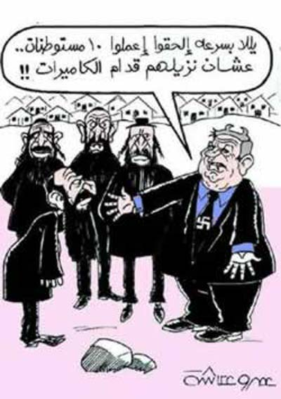
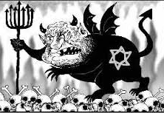
CLASSICAL
ANTI-SEMITISM
FROM THE BIBLICAL ACCOUNT TO THE HOLOCAUST

Slide 19
CLASSICAL
ANTI-SEMITISM
FROM THE BIBLICAL ACCOUNT TO THE HOLOCAUST
What’s in a name?
MURDERERS (Origen)
CHRIST KILLERS (St Hyppolitus) POSSESSED BY THE DEVIL (Chrysostom)
DEGENERATE(Chrysostom)
CURSED BY GOD (Hilary of Poitiers)
DEMONS (Gregory of Nyssa)
REJECTED AND CONDEMNED (Martin Luther)

Slide 20
CLASSICAL
ANTI-SEMITISM
FROM THE BIBLICAL ACCOUNT TO THE HOLOCAUST
VERMIN (Hitler)
SUB-HUMANS (Hitler)
(Today’s enemies)
OCCUPIERS COLONIZERS
APARTHEID PEOPLE
BLOOD SUCKERS
HUMAN RIGHTS VIOLATORS
MURDERERS OF PALESTINIANS
NEW NAZIS OF THE MIDDLE EAST

Slide 21
CLASSICAL
ANTI-SEMITISM
FROM THE BIBLICAL ACCOUNT TO THE HOLOCAUST
What’s does the Bible have to say?
The apple of God’s eye (Zechariah 2:8)
Daughter of Zion (Zephaniah 3:14)
God’s chosen people (1 Kings 3:8)
A treasured possession (Deuteronomy 7:6)
A holy people (Deuteronomy 7:6)
God’s hidden ones (Psalm 83:3) A great nation (Genesis 12:2) Beloved (Romans 11:28)

Slide 22
CLASSICAL
ANTI-SEMITISM
FROM THE BIBLICAL ACCOUNT TO THE HOLOCAUST
• The Middle Ages (c. A.D. 500-1500)
• THE THEODISIAN CODE – AD 438
• THE JUSTINIAN CODE – AD 529
• THE START OF A JEWISH/CHRISTIAN POLARIZATION
• FORCED BAPTISMS AND FORCED
CONVERSIONS

Slide 23
CLASSICAL
ANTI-SEMITISM
FROM THE BIBLICAL ACCOUNT TO THE HOLOCAUST
• The Crusades (A.D. 1096-1291)
• 1096: The Crusaders marched throughout Europe raping Jewish women, looting Jewish villages and killing Jewish men claiming that “God wills it!”
• 1099: Led by Godfrey de Bouillon they enter Jerusalem and set its synagogue ablaze with 1000 Jewish people inside, as they marched around it singing “Christ, We Adore Thee! Thee are our light, our direction, our love”.

Slide 24
CLASSICAL
ANTI-SEMITISM
FROM THE BIBLICAL ACCOUNT TO THE HOLOCAUST
Money Lending (1200s – 1300s)
• Christians were allowed to borrow money ONLY from Jews who were becoming increasingly limited in what they could own or do as a business. Leaders of Europe started taxing the Jewish moneylenders on their profit. Taxes kept increasing, Jewish lenders had to increase their interest rates. The process eventually gave birth to the myth of the “greedy Jew.”

Slide 25
CLASSICAL
ANTI-SEMITISM
FROM THE BIBLICAL ACCOUNT TO THE HOLOCAUST
The Ritual Murder Libel (1141 forward)
• First case was recorded in Norwich, England in 1141. The dead body of a boy was found on Good Friday. The testimony of a monk was the only record of the event.
• Re-emerged in Poland in the 18th century
• 19th century in France, Germany & Russia
• New York in 1928.
• Nazi propaganda during WWII
• Birmingham, Alabama in 1962.
Anti-Semites are still propagating it around the world and especially in the Middle East.

Slide 26
CLASSICAL
ANTI-SEMITISM
FROM THE BIBLICAL ACCOUNT TO THE HOLOCAUST
The Badge of Shame (1215)
• After the 4th Lateran Council in 1215, Jews had to start wearing a badge known as “La rouelle” on their garments. It
became known as “the badge of shame” and later became the yellow star used during the Holocaust.
• The reason given was the prevention
of sexual relation and/or marriage
between Jews and Christians.

Slide 27
CLASSICAL
ANTI-SEMITISM
FROM THE BIBLICAL ACCOUNT TO THE HOLOCAUST
Host Desecration (1215)
• Also during the 4th Lateran Council, Pope
Innocent III made the doctrine of transubstantiation an official part of the Catholic Church.
• Jews became accused of desecrating communion wafers by piercing them. The blood of Yeshua would pour again as they reenacted the crucifixion for which they had originally been found guilty.
• As a result, about 100,000 Jews from over 140 different European communities were massacred.

Slide 28
CLASSICAL
ANTI-SEMITISM
FROM THE BIBLICAL ACCOUNT TO THE HOLOCAUST
The Jews as “Christ Killers”
• The Bible claims that Yeshua gave His own life so
that He could take it back. If anything we all share in the guilt.
John 10:17-18 For this reason the Father loves Me, because I lay down My life so that I may take it again.
18 No one has taken it away from Me, but I lay it down on My own initiative. I have authority to lay it down, and I have authority to take it up again.This
commandment I received from My Father.”

Slide 29
CLASSICAL
ANTI-SEMITISM
FROM THE BIBLICAL ACCOUNT TO THE HOLOCAUST
Yeshua described and predicted the conspiracy against Him.
Mark 10:33-34 “Behold, we are going up to Jerusalem, and the Son of Man will be delivered to the chief priests and the scribes; and they will condemn Him to death and will hand Him over to the Gentiles. They will mock Him and spit on Him, and scourge Him and kill Him, and three days later He will rise again.”

Slide 30
CLASSICAL
ANTI-SEMITISM
FROM THE BIBLICAL ACCOUNT TO THE HOLOCAUST
The Poisoning of the Wells of Europe
• The “ Black Death” or “Black Plague” was the most
devastating pandemic in the history of mankind from
1347 to 1350, it was responsible for the death of tens of millions of people worldwide.
• Fewer Jewish people died from it, and thus the Jewish people were accused of poisoning the wells of Europe.

Slide 31
CLASSICAL
ANTI-SEMITISM
FROM THE BIBLICAL ACCOUNT TO THE HOLOCAUST
The Poisoning of the Wells of Europe
• In reality, communal isolation, kosher laws and liturgical hand washing were responsible for fewer Jewish casualties.

Slide 32
CLASSICAL
ANTI-SEMITISM
FROM THE BIBLICAL ACCOUNT TO THE HOLOCAUST
• The Spanish Inquisition
• The first Ghetto (Italy)
• Luther and the Reformation
By the end of the 15th century, the Jew has become an undesirable agent of Satan. The terms “Jewish” and “diabolical” are now synonymous. To Jews, the symbol of the cross, so dear to Christians, has become such an offense and became known as “the symbol of disaster.” Medieval anti-Semitism left a mark
that the 21st century is still trying to erase.

Slide 33
CLASSICAL
ANTI-SEMITISM
FROM THE BIBLICAL ACCOUNT TO THE HOLOCAUST
• The Pale of Settlement (1791-1917)
• A geographical area where Jewish people could live within the Russian Empire, similar to a large ghetto (about 1,000,000 square miles).
• The Eastern European Pogroms (1800s)
• Government sponsored riots against the Jewish People. The first one on record was in Odessa in 1821. They started after the establishment of the Pale and often as a result of the Jews refusal to convert to Eastern Christian Orthodoxy.

Slide 34
CLASSICAL
ANTI-SEMITISM
FROM THE BIBLICAL ACCOUNT TO THE HOLOCAUST
• The Holocaust (1933-1945)
• A systematic, willful attempt at exterminating all of European Jewry.
• Legislation (1933-1938): The Nuremberg Laws
• Criminalization of Jewishness (1938-1939): Kristallnacht
• Isolation (1939-1941): Ghettos
• Annihilation (1941-1945): Death Camps
The Holocaust was the culmination of 2000 years
Of anti-Semitism.

Slide 35
CLASSICAL
ANTI-SEMITISM
FROM THE BIBLICAL ACCOUNT TO THE HOLOCAUST
OUT OF THE ASHES OF THE HOLOCAUST, A NEW JEWISH MOTTO WAS BORN:
NEVER AGAIN!

