Slide 1
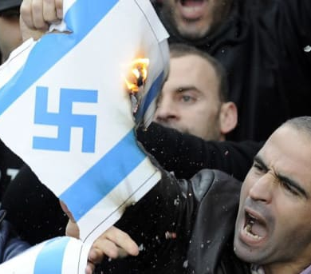
ANTI-SEMITISM
FROM “NEVER AGAIN”
OLIVIER MELNICK
CHOSEN
PEOPLE
MINISTRIES
TO “OVER AGAIN!”

Slide 2
MODERN
ANTI-SEMITISM
FROM THE HOLOCAUST TO THE TODAY
The Postmodern Era (c.1945 -today):
Modern Anti-Semitism has a lot in common with Classical Anti-Semitism as far as the goal is concerned. It was, is, and always will be the complete destruction of the Jewish people just because they are Jewish.
By the mid-50s, a new Anti-Semitism was forming, or possibly classical Anti-Semitism was re-packaged and morphed into a socially acceptable ideology.
Now, It has new boundaries, a new methodology, and an expanded source.

Slide 3
MODERN
ANTI-SEMITISM
FROM THE HOLOCAUST TO THE TODAY
The Boundaries Are
Different
• The boundaries of
classical Anti-Semitism
were European for the
most part. The cancer of
Jewish hatred was a localized cancer spreading
as far as the European
train network system.

Slide 4
MODERN
ANTI-SEMITISM
FROM THE HOLOCAUST TO THE TODAY
The Boundaries Are Different
• The new boundaries extend to the whole world. The cancer has metastasized.
• With the advent of satellite communications, the Internet and the social networks, modern Anti-Semitism now reaches to the four corners of the world and the growth of its grip is rapid and exponential.
• Outside of Eretz Yisrael, there is really no safe place for Jewish people anymore.

Slide 5
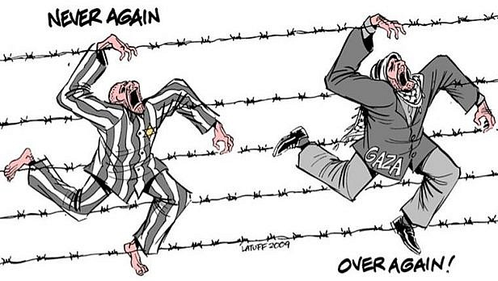
MODERN
ANTI-SEMITISM
FROM THE HOLOCAUST TO THE TODAY
The Methodology is different
• A role reversal: The new methodology has turned the victims into perpetrators and the
perpetrators into victims.
• Jews are painted as
the “New Nazis of the
Middle East.”

Slide 6
MODERN
ANTI-SEMITISM
FROM THE HOLOCAUST TO THE TODAY
The Methodology is different
• First, only the Jewish people were targeted.
Now Israel is also in the crosshair of modern Anti-Semitism. Additionally, any political move made in Israel might have global repercussions on Jewish communities anywhere on the planet.
Today, Jews have become known as: OCCUPIERS • COLONIZERS APARTHEID PEOPLE • BLOOD SUCKERS • HUMAN RIGHTS VIOLATORS • MURDERERS • NEW NAZIS OF THE MIDDLE EAST

Slide 7
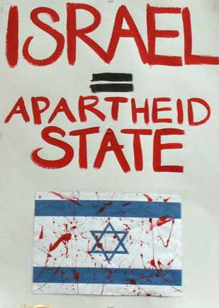
MODERN
ANTI-SEMITISM
FROM THE HOLOCAUST TO THE TODAY
ANTI-SEMITISM
HAS BEEN
RENAMED
ANTI-ISRAELISM
OR ANTI-ZIONISM

Slide 8
MODERN
ANTI-SEMITISM
FROM THE HOLOCAUST TO THE TODAY
The Source has expanded
• The source of Anti-Semitism has always been the same; it is Satan who loves what God hates and hates what god loves.
• Satan also knows that when Israel calls upon Yeshua at the end of the Tribulation, his career of hatred is over, and he is in no hurry to relocate for retirement.

Slide 9
MODERN
ANTI-SEMITISM
FROM THE HOLOCAUST TO THE TODAY
Zechariah 12:10 I will pour out on the house of David and on the inhabitants of Jerusalem, the Spirit of grace and of supplication, so that they will look on Me whom they have pierced; and they will mourn for Him, as one mourns for an only son, and they will weep bitterly over Him like the bitter weeping over a firstborn.
Romans 11:26 and so all Israel will be saved; just as it is written, “The Deliverer will come from Zion, He will remove ungodliness from Jacob.”

Slide 10
MODERN
ANTI-SEMITISM
FROM THE HOLOCAUST TO THE TODAY
Revelation 20:1-3,10
1Then I saw an angel coming down from heaven, having the key to the bottomless pit and a great chain in his hand. 2 He laid hold of the dragon, that serpent of old, who is the Devil and Satan, and bound him for a thousand years;3 and he cast him into the bottomless pit, and shut him up, and set a seal on him, so that he should deceive the nations no more till the thousand years were finished. But after these things he must be released for a little while.
10 And the devil who deceived them was thrown into the lake of fire and brimstone, where the beast and the false prophet are also; and they will be tormented day and night forever and ever.

Slide 11
MODERN
ANTI-SEMITISM
FROM THE HOLOCAUST TO THE TODAY
SATAN’S AGENDA:
• He knows he cannot change God’s program or hinder it, but he’ll try to postpone it.
• Since Israel is involved in the Second Coming of Messiah, Satan is committed to postponing the Jewish people from saying “Baruch Haba Bashem Adonai”
(Blessed is he who comes in the name of the Lord.)
WHAT BETTER WAY TO POSTPONE HIS DEMISE THAN TO CREATE ANTISEMITISM TO PUSH THE JEWISH PEOPLE AWAY FROM GOD, YESHUA AND CHRISTIANITY?

Slide 12
MODERN
ANTI-SEMITISM
FROM THE HOLOCAUST TO THE TODAY
SATAN TRIES EVERYTHING
TO ACCOMPLISH TWO GOALS
TURN THE JEWS AGAINST YESHUA
To stop them from calling on Him
2. TURN THE WORLD AGAINST THE JEWS
To kill them all in case plan A fails

Slide 13
MODERN
ANTI-SEMITISM
FROM THE HOLOCAUST TO THE TODAY
Matthew 23:37-39
³⁷ “Jerusalem, Jerusalem, who kills the prophets and stones those who are sent to her! How often I wanted to gather your children together, the way a hen gathers her chicks under her wings, and you were unwilling. ³⁸ Behold, your house is being left to you desolate! ³⁹ For I say to you, from now on you will not see Me until you say, ‘Blessed is He who comes in the name of the Lord!’”

Slide 14
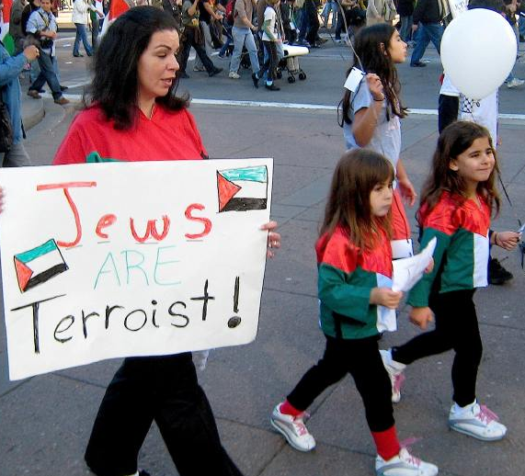
MODERN
ANTI-SEMITISM
FROM THE HOLOCAUST TO THE TODAY
SATAN IS SUB-CONTRACTING HIS HATRED
ACROSS THE WIDEST SPECTRUM EVER:
• Liberalism and Secular Anti-Israelism
According to the liberal world- view, Anti-Semitism is not even on the agenda, as it has become acceptable to be anti-Israel. It is claimed that you can be anti-
Israel in the name of world peace,
all without being anti-Semitic.

Slide 15
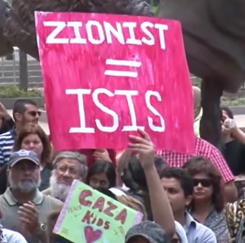
MODERN
ANTI-SEMITISM
FROM THE HOLOCAUST TO THE TODAY
• Liberal Campus Antifada
One-sided pro-Palestinian agenda gets heavily promoted by groups like Students for Justice in Palestine (SJP), Jewish Voice for Peace (JVP) or the various Muslim Student Associations (MSA),with connection to the Muslim Brotherhood.
• The Muslim Brotherhood’s motto is: “God is our objective. The Prophet is our leader. The Qur'an is our law. Jihad is our way. Dying in the way of God is our highest hope. God is greater!”

Slide 16
MODERN
ANTI-SEMITISM
FROM THE HOLOCAUST TO THE TODAY
• Columbia University, New York
• 9 Universities in California
• Ohio University
• University of New Orleans
• University of Michigan
• Loyola University, Chicago
• Northeastern University, Boston
• University of Washington
• University of Maryland
• New York University
• University of New Mexico
• York University, Toronto
• University of Minnesota
• A presence on over 200 campuses in America…
and growing!

Slide 17
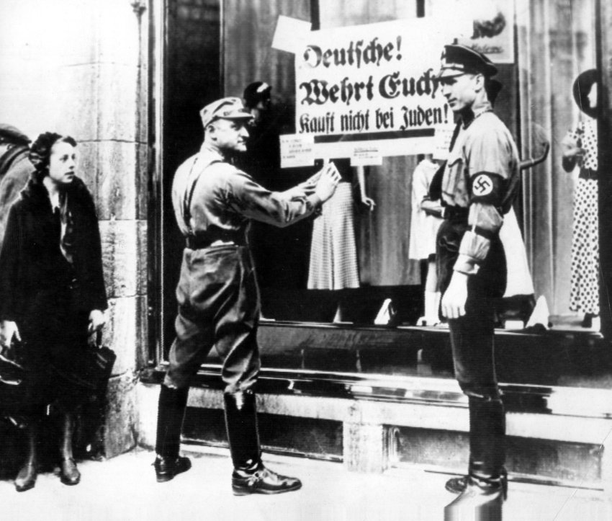
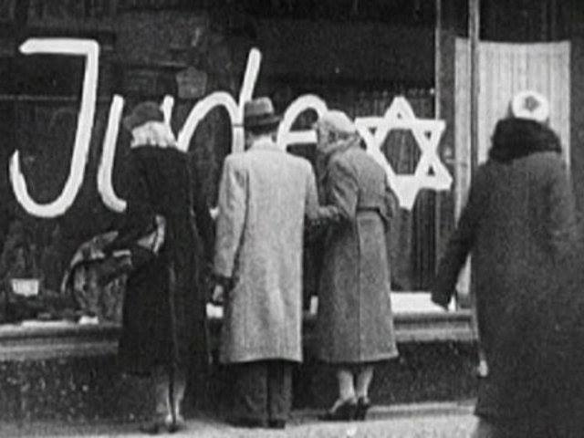
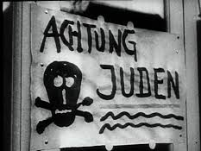
MODERN
ANTISEMITISM
FROM THE HOLOCAUST TO THE TODAY
• Boycott, Divestment and Sanctions Movement
Boycotting Jewish businesses isn’t a new thing.
Kristallnacht, November 9-10, 1938

Slide 18
MODERN
ANTI-SEMITISM
FROM THE HOLOCAUST TO THE TODAY
• Boycott, Divestment and Sanctions Movement
Boycott was officially reborn in 2005 as the modern BDS movement from the work of Mahmoud Abbas and Omar Barghouti. More specifically, the BDS movement became a thing during the anti-racism Durban Conference in 2001.
• Lack of consistency in BDS is hypocritical at best.
• BDS exists beyond the University campuses.
• Boycott of Israel can be academic, cultural, political, economic and artistic.

Slide 19
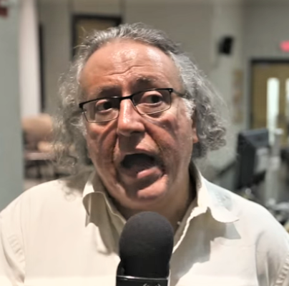
MODERN
ANTI-SEMITISM
FROM THE HOLOCAUST TO THE TODAY
“The real aim of BDS is to bring down the State of Israel.” As’ad AbuKalil, Professor of Political Science, University of California, Stanislaus.

Slide 20
MODERN
ANTI-SEMITISM
FROM THE HOLOCAUST TO THE TODAY
• Replacement Theology & Christian Palestinianism
• Replacement Theology continues it pervasive intrusion into biblical Christianity.
• Christian Palestinianism takes Replacement Theology to a new level.
• It is Replacement Theology on steroids.
1 Corinthians 10:32 Give no offense either to Jews or to Greeks or to the church of God.

Slide 21
MODERN
ANTI-SEMITISM
FROM THE HOLOCAUST TO THE TODAY
“Christian Palestinianism is an inverted mirror image of Christian Zionism. All the basic elements of a Christian Zionist eschatology are reversed, so that the Bible is seen to be Christian, not Jewish, the land of the Bible is Palestine not Israel, the son of God is a Palestinian not a Jew, the Holocaust is resented not remembered, 1948 is a catastrophe not a miracle, the Jewish people are illegal occupiers not rightful owners, and biblical prophecy is a moral manifesto and not a signpost to the Second Coming.” Dr. Paul Wilkinson “For Zion Sake”
• Replacement Theology, Christian Palestinianism and Anti-Semitism are tightly connected

Slide 22
MODERN
ANTI-SEMITISM
FROM THE HOLOCAUST TO THE TODAY
United Nations General Assembly: Resolutions
2019:18 against Israel/7 against the rest of the world
2020:17 against Israel/6 against the rest of the world
2021:14 against Israel/5 against the rest of the world
THE BIAS IS OBVIOUS AND FACTS ARE IGNORED!

Slide 23
MODERN
ANTI-SEMITISM
FROM THE HOLOCAUST TO THE TODAY
UNESCO (United Nations Educational Scientific and
Cultural Organization)
• Recognized the State of Palestine as a full member
(2011)
• Declared that the Temple Mount is a Muslim site known
as al-Haram al-Sharif (2016 and 2018)
• Declared that Jerusalem has no right to be the Jewish
Capital (2017)

Slide 24
MODERN
ANTI-SEMITISM
FROM THE HOLOCAUST TO THE TODAY
Amnesty International 2021 Report
ISRAEL AND OCCUPIED PALESTINIAN TERRITORIES 2021
“Armed conflict between Israel and Palestinian armed groups in the Gaza Strip in May entailed apparent war crimes and possible crimes against humanity. Disproportionate and reckless strikes by Israeli forces killed 242 Palestinians in Gaza. Unlawful attacks by Israel included targeted strikes on medical facilities and personnel.

Slide 25
MODERN
ANTI-SEMITISM
FROM THE HOLOCAUST TO THE TODAY
Israel maintained its illegal blockade on the Gaza Strip, inflicting collective punishment on residents and exacerbating the humanitarian crisis there, and Palestinians’ freedom of movement was arbitrarily restricted in the West Bank. Israeli authorities subjected Palestinians to forced evictions, arbitrary detention, torture and other ill-treatment, all committed with almost total impunity.

Slide 26
MODERN
ANTI-SEMITISM
FROM THE HOLOCAUST TO THE TODAY
Israel’s discriminatory system of governing Palestinians in Israel and the Occupied Palestinian Territories (OPT) constituted apartheid, a crime under international law. The Ministry of Defense labelled six Palestinian civil society organizations as “terrorist” in October. Conscientious objectors to military service were imprisoned. Divorce and other personal status laws governed by religious courts continued to discriminate against women, and domestic violence rose during the Covid-19 pandemic. The authorities denied asylum seekers access to a fair and prompt refugee status determination process, and to economic support. While Israel transferred 5,000 Covid-19 doses to the Palestinian authorities, it sent thousands of doses to diplomatic allies.”

Slide 27
MODERN
ANTI-SEMITISM
FROM THE HOLOCAUST TO THE TODAY
LIBERALS
HOLLYWOOD
CHRISTIAN PALESTINISTS
CAMPUS INTIFADA
ISRAEL AND THE
JEWISH PEOPLE
IRRATIONAL
RADICAL ISLAM
EVANGELICALS
BDS PROPONENTS
EUROPEAN UNION
UNITED NATIONS

Slide 28
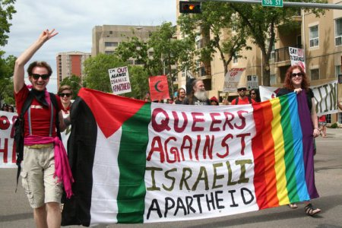
MODERN
ANTI-SEMITISM
FROM THE HOLOCAUST TO THE TODAY
• Liberal Christians, atheists and radical Muslims are groups that are always on the two extremes of the ideological spectrum, except when it comes to Israel and the Jews.

Slide 29
END-TIMES
ANTI-SEMITISM
FROM 2012
TO THE TODAY
END-TIMES ANTISEMITISM
• End-times Anti-Semitism blends classic Anti-Semitism and the new Anti-Semitism.
• 2012 “L’affaire Merah” – 7 dead including a rabbi and 3 young students at a school in Toulouse, France.
• End-Times Anti-Semitism is killing Jews again!
SATAN’S MACHINE OF HATRED AGAINST THE JEWS IS MOVING FULL STEAM FORWARD

Slide 30
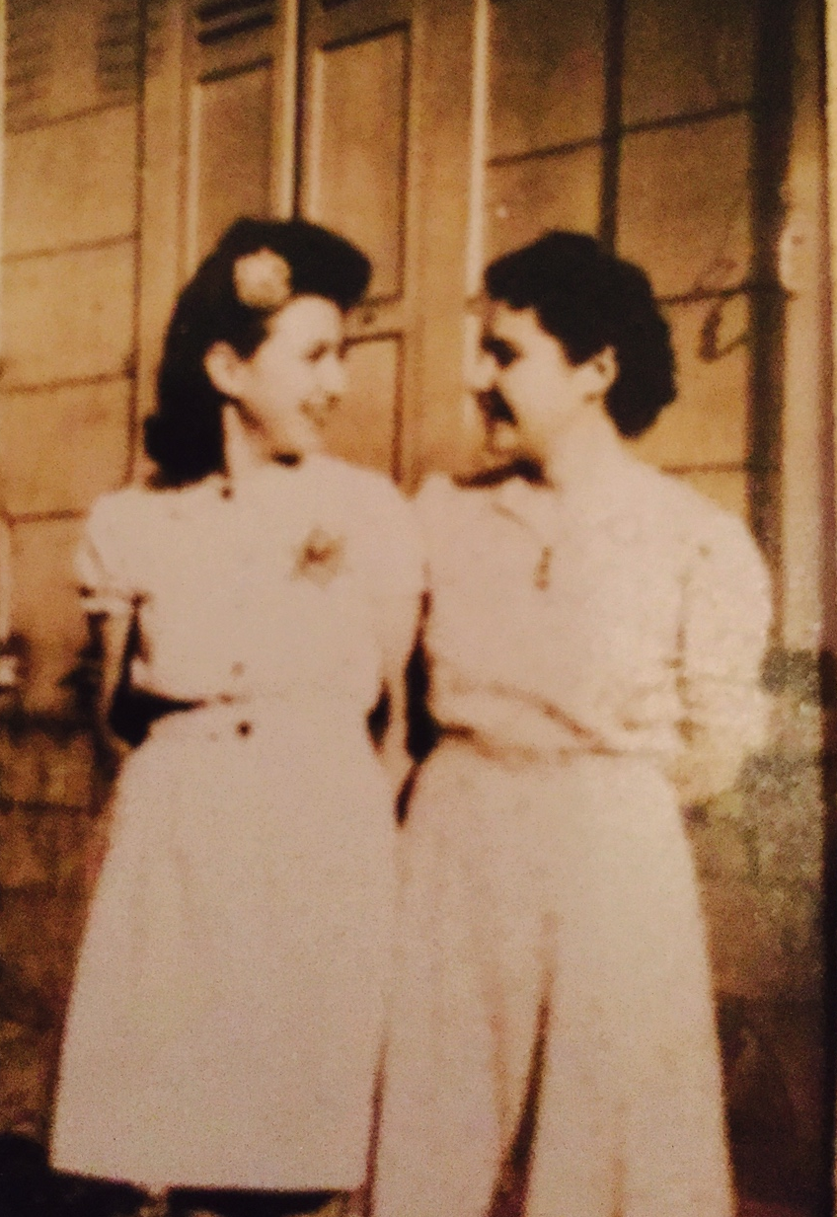
END-TIMES
ANTI-SEMITISM
FROM THE 2012
TO THE TODAY
Only 77 Years
had passed
between these
2 photos!

Slide 31
END-TIMES
ANTI-SEMITISM
FROM THE 2012
TO THE TODAY
Paris January 9, 2015
4 killed at the HyperCacher Supermarket

Slide 32
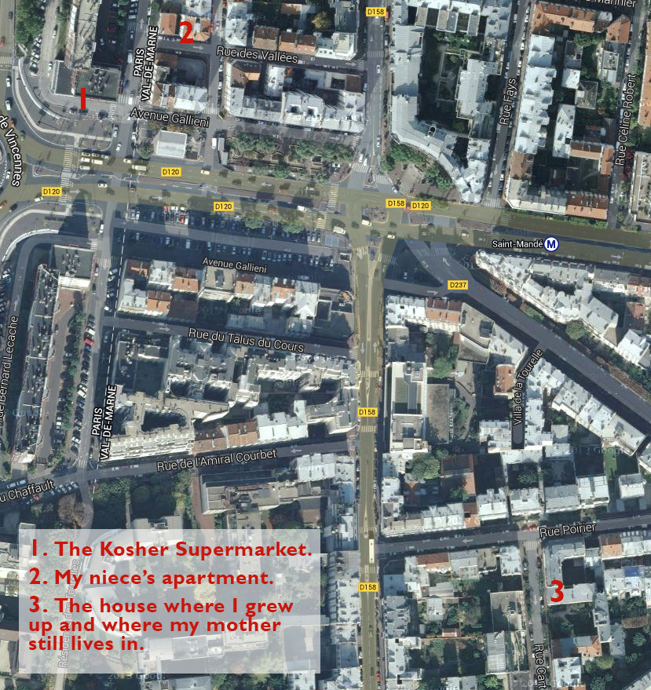
END-TIMES
ANTI-SEMITISM
FROM THE 2012
TO THE TODAY
2
1
“Olivier,
are they coming
back
for us?”
3

Slide 33
END-TIMES ANTI-SEMITISM:
A Believer’s Response
1. Education
Know the players
Know the agenda
Know the ultimate goal
2. Share your knowledge
With your children
With your students
With your congregations

Slide 34
END-TIMES ANTI-SEMITISM:
A Believer’s Response
3. Support Israel
Attend events in your area
Attend events on Campuses
Visit Israel
4. Speak up
Confront revisionism with facts and with the Bible whenever possible
Stay away from character assassination

Slide 35
END-TIMES ANTI-SEMITISM:
A Believer’s Response
5. Fight BDS
Buy Israeli products
Defend Israel with the truth
Sustain Israel in prayer

Slide 36
END-TIMES ANTI-SEMITISM:
A Believer’s Response
Remember who we fight
Ephesians 6:12 For our struggle is not against flesh and blood, but against the rulers, against the powers, against the world forces of this darkness, against the spiritual forces of wickedness in the heavenly places.

Slide 37
END-TIMES ANTI-SEMITISM:
A Believer’s Response
Remember who we also pray for
Matthew 5:44
“But I say to you, love your enemies and pray for those who persecute you.”

Slide 38
END-TIMES ANTI-SEMITISM:
A Believer’s Response
Remember who we serve
Jeremiah 31:35-37
Thus says the Lord, Who gives the sun for light by day And the fixed order of the moon and the stars for light by night, Who stirs up the sea so that its waves roar; The Lord of hosts
is His name:“If this fixed order departs From before Me,” declares the Lord, “Then the offspring of Israel also will
cease From being a nation before Me forever.”

Slide 39
ISRAEL’S HOPE
Zechariah 8:23 Thus says the Lord of hosts, “In those days ten men from all the nations will grasp the garment of a Jew, saying,‘Let us go with you, for we have heard that God is with you.’”

Slide 40
ANTI-SEMITISM
FROM “NEVER AGAIN”
TO “OVER AGAIN!”
Olivier@chosenpeople.com
www.newantisemitism.com

