Slide 1
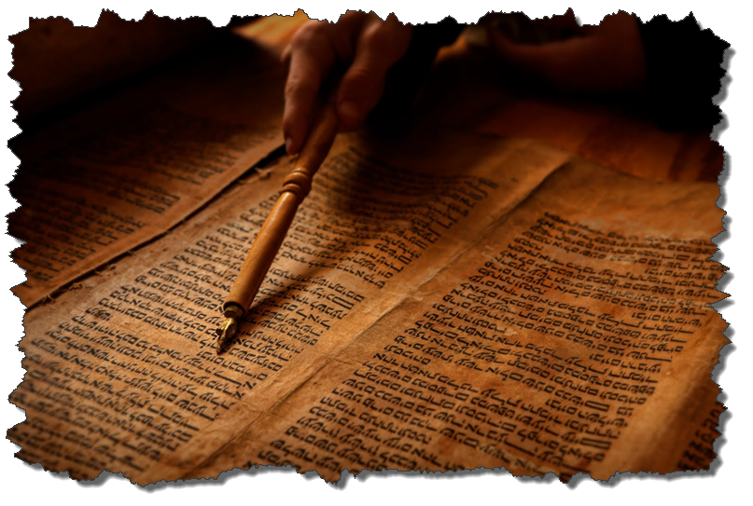
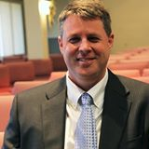
ISRAEL and
THE KINGDOM
Dr. Andy Woods
Senior Pastor – Sugar Land Bible Church
President – Chafer Theological Seminary

Slide 2

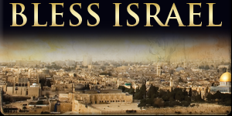
Romans 11:15
“For if their rejection is the reconciliation of the world, what will their acceptance be but life from the dead?”

Slide 3


2 Peter 1:19
“So we have the prophetic word made more sure, to which you do well to pay attention as to a lamp shining in a dark place, until the day dawns and the morning star arises in your hearts.”

Slide 4

OT PROPHETS DESCRIBE THE KINGDOM
Established by God (Dan. 2:44)
Eternal (Dan. 7:27)
Christ’s direct rule (Zech. 9:9-10)
Earthly (Zech. 14:9)
Land promises realized (Gen. 15:18-21)
Israel’s preeminence (Isa. 49:22-23)
Millennial Temple (Ezek. 40‒46)

Slide 5
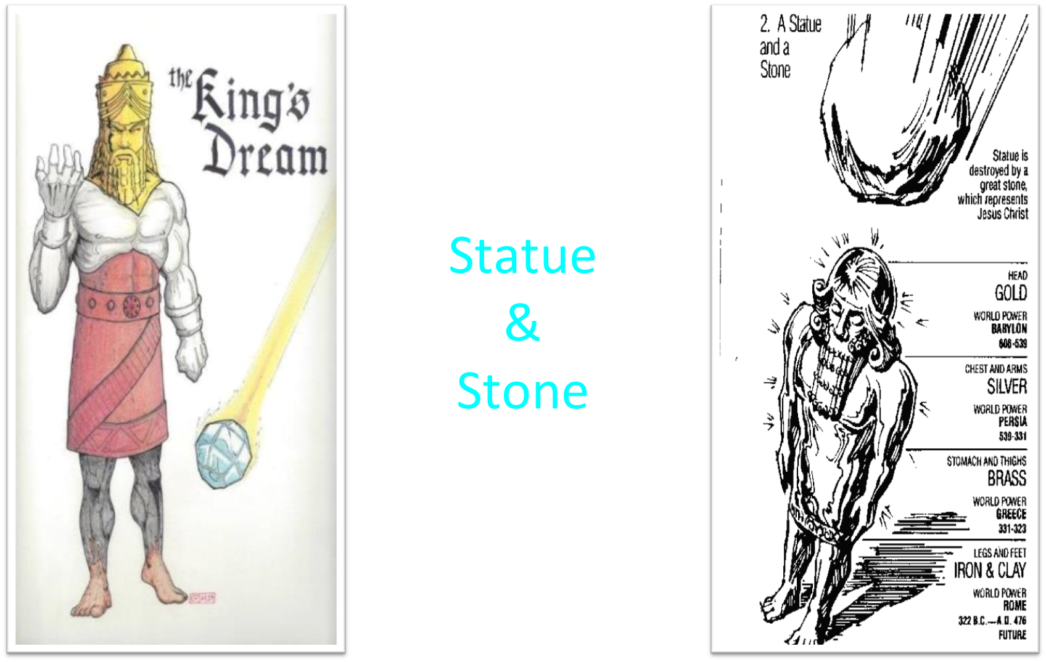

Slide 6
OT PROPHETS DESCRIBE THE KINGDOM
Established by God (Dan. 2:44)
Eternal (Dan. 7:27)
Christ’s direct rule (Zech. 9:9-10)
Earthly (Zech. 14:9)
Land promises realized (Gen. 15:18-21)
Israel’s preeminence (Isa. 49:22-23)
Millennial Temple (Ezek. 40‒46)

Slide 7
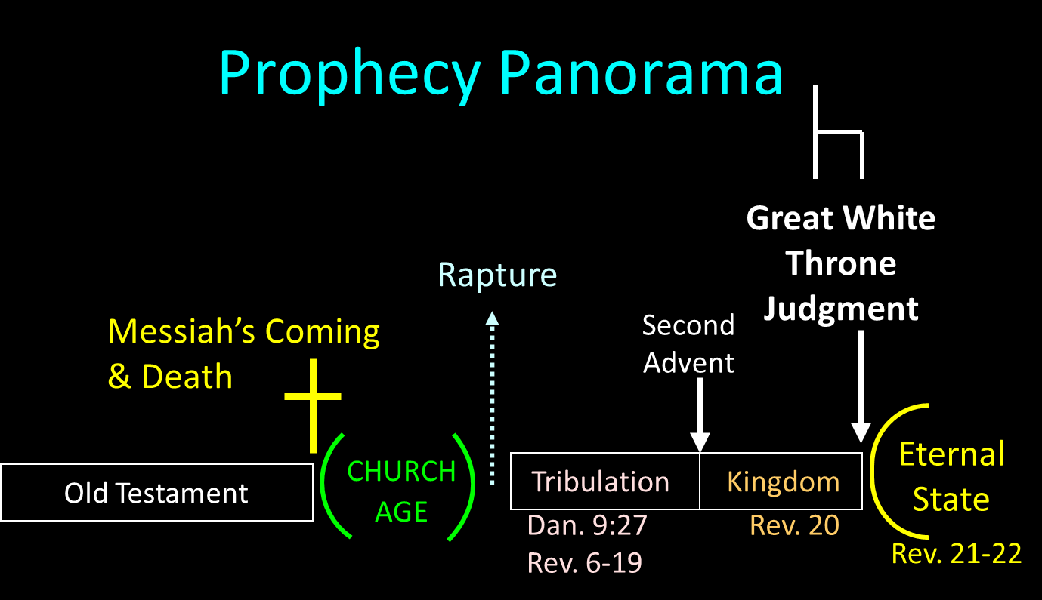

Slide 8
OT PROPHETS DESCRIBE THE KINGDOM
Established by God (Dan. 2:44)
Eternal (Dan. 7:27)
Christ’s direct rule (Zech. 9:9-10)
Earthly (Zech. 14:9)
Land promises realized (Gen. 15:18-21)
Israel’s preeminence (Isa. 49:22-23)
Millennial Temple (Ezek. 40‒46)

Slide 9
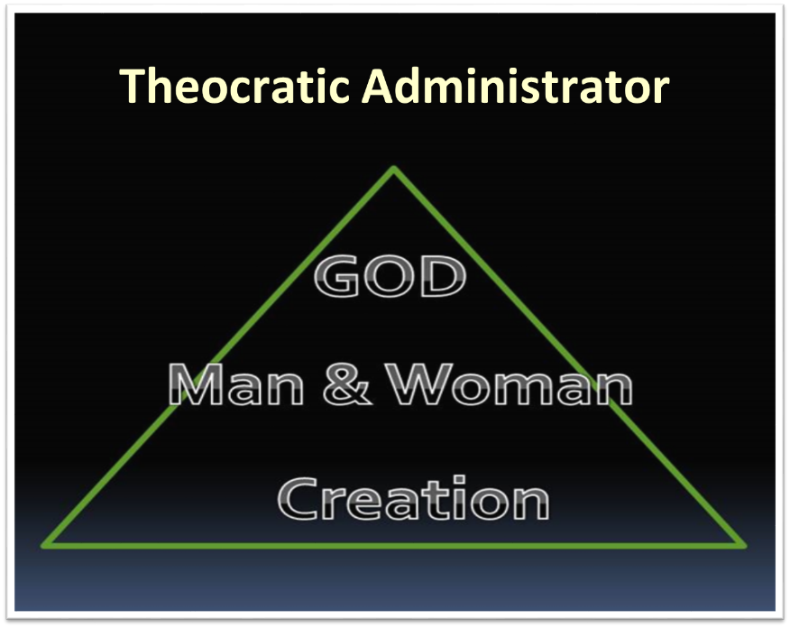

Slide 10
OT PROPHETS DESCRIBE THE KINGDOM
Established by God (Dan. 2:44)
Eternal (Dan. 7:27)
Christ’s direct rule (Zech. 9:9-10)
Earthly (Zech. 14:9)
Land promises realized (Gen. 15:18-21)
Israel’s preeminence (Isa. 49:22-23)
Millennial Temple (Ezek. 40‒46)

Slide 11
OT PROPHETS DESCRIBE THE KINGDOM
Established by God (Dan. 2:44)
Eternal (Dan. 7:27)
Christ’s direct rule (Zech. 9:9-10)
Earthly (Zech. 14:9)
Land promises realized (Gen. 15:18-21)
Israel’s preeminence (Isa. 49:22-23)
Millennial Temple (Ezek. 40‒46)

Slide 12
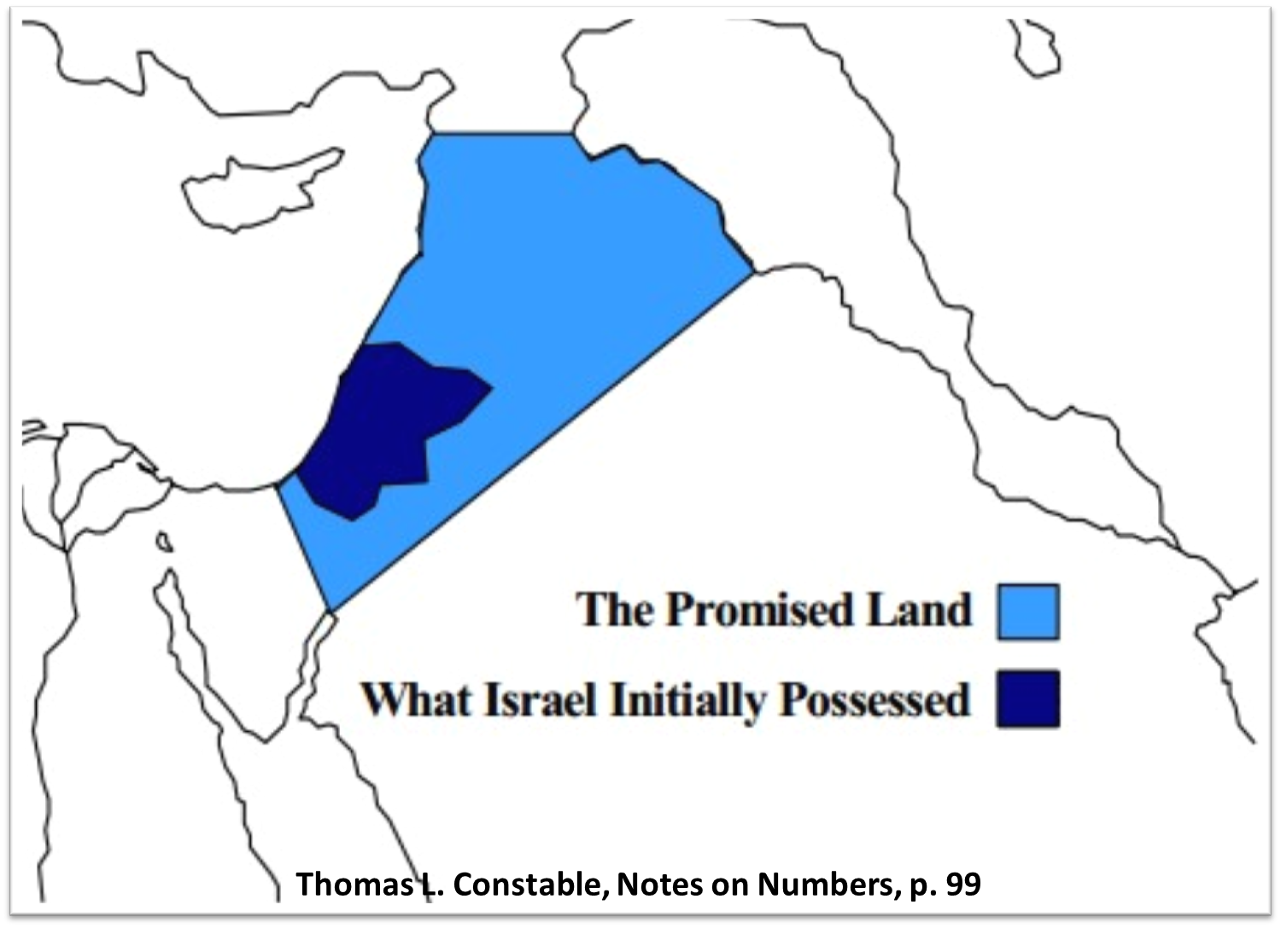

Slide 13
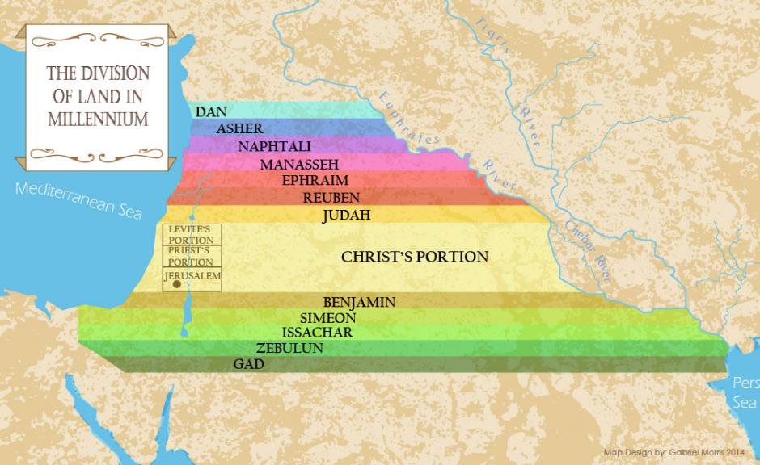

Slide 14
OT PROPHETS DESCRIBE THE KINGDOM
Established by God (Dan. 2:44)
Eternal (Dan. 7:27)
Christ’s direct rule (Zech. 9:9-10)
Earthly (Zech. 14:9)
Land promises realized (Gen. 15:18-21)
Israel’s preeminence (Isa. 49:22-23)
Millennial Temple (Ezek. 40‒46)

Slide 15

Isaiah 2:1-4
¹ “The word which Isaiah the son of Amoz saw concerning Judah and Jerusalem.² Now it will come about that In the last days The mountain of the house of the Lord Will be established as the chief of the mountains, And will be raised above the hills; And all the nations will stream to it.³ And many peoples will come and say, “Come, let us go up to the mountain of the Lord, To the house of the God of Jacob; . . .

Slide 16

Isaiah 2:1-4
. . .That He may teach us concerning His ways And that we may walk in His paths.” For the law will go forth from Zion And the word of the Lord from Jerusalem.⁴ And He will judge between the nations, And will render decisions for many peoples; And they will hammer their swords into plowshares and their spears into pruning hooks. Nation will not lift up sword against nation, And never again will they learn war.”

Slide 17
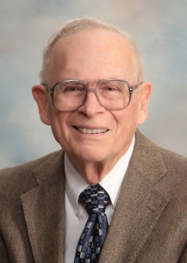
Robert Thomas
Four Views on the Book of Revelation, page 207.
“At the end of the Millennium that city will be Satan’s prime objective with his rebel army, because Israel will be a leader among the nations.”

Slide 18
OT PROPHETS DESCRIBE THE KINGDOM
Established by God (Dan. 2:44)
Eternal (Dan. 7:27)
Christ’s direct rule (Zech. 9:9-10)
Earthly (Zech. 14:9)
Land promises realized (Gen. 15:18-21)
Israel’s preeminence (Isa. 49:22-23)
Millennial Temple (Ezek. 40‒46)

Slide 19


Slide 20


Slide 21
DIFFERENCES BETWEEN THE MILLENNIUM & ETERNAL STATE
MILLENNIUM (REV. 20:1-10) | ETERNAL STATE (REV. 21‒22)
Present earth (Gen. 13:17) | New Earth (Rev. 21:1)
Waters (Gen. 15:18-21) | No sea (Rev. 21:1)
Rebellion (Zech. 14:16-18) | No rebellion (Rev. 21:4)
Tribal land (Ezek. 47:13-23) | Tribal city gates (Rev. 21:12)
Sin exists (Ezek 45:22) | No sin (Rev. 21:4)
Temple (Ezek. 40‒46) | No temple (Rev. 21:22)
Rod of iron (Ps. 2:6-8) | No rod needed (Rev. 21:8)
Death (Isa. 65:20) | No death (Rev. 21:4)
Sun exists (Isa. 30:26) | No sun (Rev. 21:23; 22:5)

Slide 22
DIFFERENCES BETWEEN THE MILLENNIUM & ETERNAL STATE
MILLENNIUM (REV. 20:1-10) | ETERNAL STATE (REV. 21‒22)
Present earth (Gen. 13:17) | New Earth (Rev. 21:1)
Waters (Gen. 15:18-21) | No sea (Rev. 21:1)
Rebellion (Zech. 14:16-18) | No rebellion (Rev. 21:4)
Tribal land (Ezek. 47:13-23) | Tribal city gates (Rev. 21:12)
Sin exists (Ezek 45:22) | No sin (Rev. 21:4)
Temple (Ezek. 40‒46) | No temple (Rev. 21:22)
Rod of iron (Ps. 2:6-8) | No rod needed (Rev. 21:8)
Death (Isa. 65:20) | No death (Rev. 21:4)
Sun exists (Isa. 30:26) | No sun (Rev. 21:23; 22:5)

Slide 23
OT PROPHETS DESCRIBE THE KINGDOM
Millennial David (Jer. 30:9)
Righteousness (Isa. 9:6-7)
Curse curtailed (Isa. 65:20, 22)
Peace (Isa. 2:4)
Prosperity (Amos 9:13-14; Isa 65:22)
Topographical changes (Ezek. 47:1-12)
Immediate answers to prayer (Isa. 65:24)

Slide 24

Jeremiah 30:9
“But they shall serve the Lord their God and David their king, whom I will raise up for them.”

Slide 25
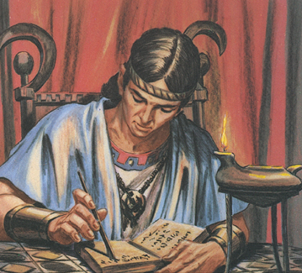
The Millennial David
Root of Jesse
Branch of David
Son of David
Seed of David

Slide 26
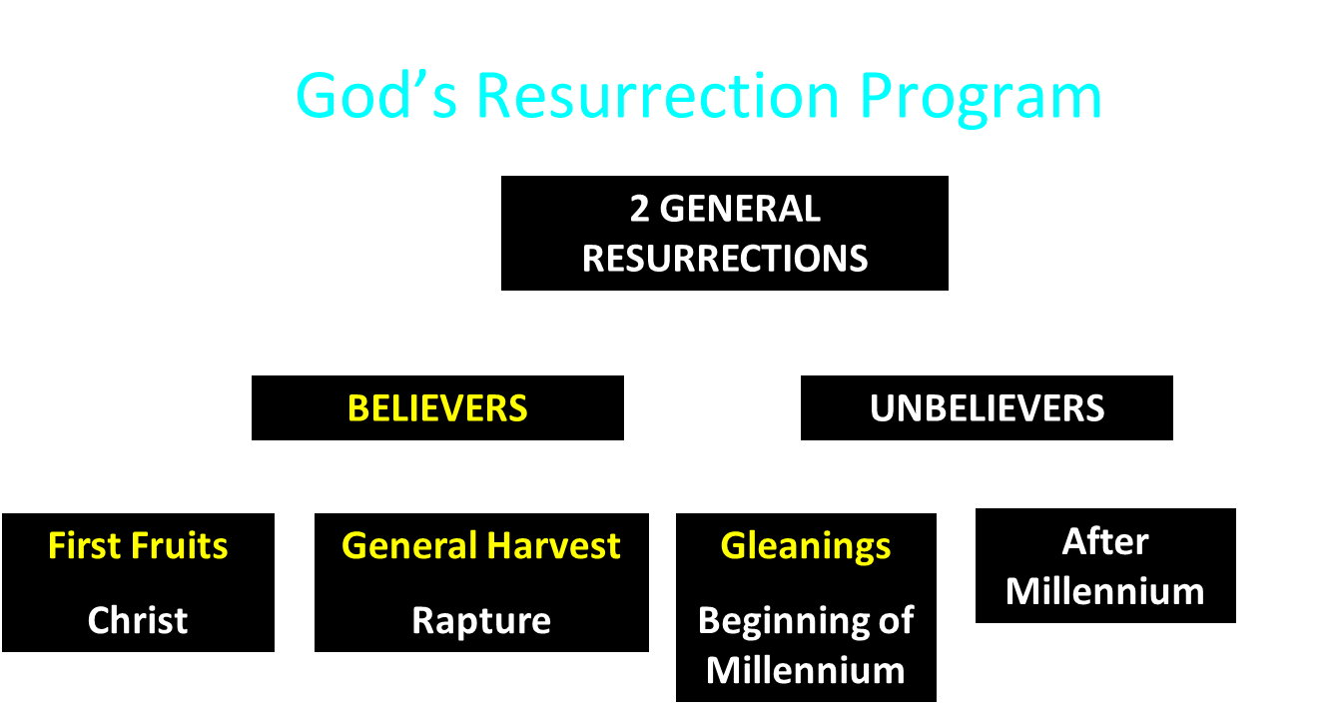

Slide 27
OT PROPHETS DESCRIBE THE KINGDOM
Millennial David (Jer. 30:9)
Righteousness (Isa. 9:6-7)
Curse curtailed (Isa. 65:20, 22)
Peace (Isa. 2:4)
Prosperity (Amos 9:13-14; Isa 65:22)
Topographical changes (Ezek. 47:1-12)
Immediate answers to prayer (Isa. 65:24)

Slide 28
Isaiah 9:6-7
⁶ For a child will be born to us, a son will be given to us; And the government will rest on His shoulders; And His name will be called Wonderful Counselor, Mighty God, Eternal Father, Prince of Peace.⁷ There will be no end to the increase of His government or of peace, On the throne of David and over his kingdom, To establish it and to uphold it with justice and righteousness From then on and forevermore. The zeal of the Lord of hosts will accomplish this.

Slide 29

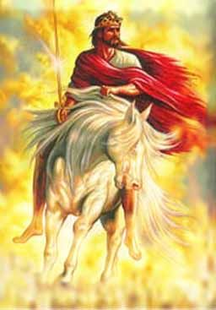
9. Righteousness (Isa. 9:6-7)
Knowledge of the Lord (Isa. 11:9)
Christ ruling with a rod of iron (Ps. 2:6-9)

Slide 30
9. Righteousness (Isa. 9:6-7)
Knowledge of the Lord (Isa. 11:9)
Christ ruling with a rod of iron (Ps. 2:6-9)

Slide 31
Isaiah 11:6-9
⁶ “And the wolf will dwell with the lamb, And the leopard will lie down with the young goat, And the calf and the young lion and the fatling together; And a little boy will lead them.⁷ Also the cow and the bear will graze, Their young will lie down together, And the lion will eat straw like the ox. ⁸ The nursing child will play by the hole of the cobra, And the weaned child will put his hand on the viper’s den. ⁹ They will not hurt or destroy in all My holy mountain, For the earth will be full of the knowledge of the Lord As the waters cover the sea.”

Slide 32
9. Righteousness (Isa. 9:6-7)
Knowledge of the Lord (Isa. 11:9)
Christ ruling with a rod of iron (Ps. 2:6-9)

Slide 33

Isaiah 2:3b-4
³...God of Jacob; That He may teach us concerning His ways And that we may walk in His paths.” For the law will go forth from Zion And the word of the Lord from Jerusalem.⁴ And He will judge between the nations, And will render decisions for many peoples; And they will hammer their swords into plowshares and their spears into pruning hooks. Nation will not lift up sword against nation, And never again will they learn war.”

Slide 34
OT PROPHETS DESCRIBE THE KINGDOM
Millennial David (Jer. 30:9)
Righteousness (Isa. 9:6-7)
Curse curtailed (Isa. 65:20, 22)
Peace (Isa. 2:4)
Prosperity (Amos 9:13-14; Isa 65:22)
Topographical changes (Ezek. 47:1-12)
Immediate answers to prayer (Isa. 65:24)

Slide 35
Romans 8:19-22
¹⁹ For the anxious longing of the creation waits eagerly for the revealing of the sons of God. ²⁰ For the creation was subjected to futility, not willingly, but because of Him who subjected it, in hope ²¹ that the creation itself also will be set free from its slavery to corruption into the freedom of the glory of the children of God. ²² For we know that the whole creation groans and suffers the pains of childbirth together until now.

Slide 36
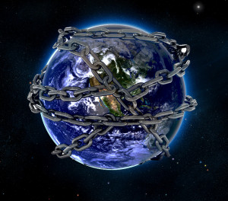

Slide 37
Isaiah 11:6-9
⁶ “And the wolf will dwell with the lamb, And the leopard will lie down with the young goat, And the calf and the young lion and the fatling together; And a little boy will lead them.⁷ Also the cow and the bear will graze, Their young will lie down together, And the lion will eat straw like the ox. ⁸ The nursing child will play by the hole of the cobra, And the weaned child will put his hand on the viper’s den. ⁹ They will not hurt or destroy in all My holy mountain, For the earth will be full of the knowledge of the Lord As the waters cover the sea.”

Slide 38
Isaiah 65:17-25
¹⁷ “For behold, I create new heavens and a new earth; And the former things will not be remembered or come to mind.¹⁸ “But be glad and rejoice forever in what I create; For behold, I create Jerusalem for rejoicing And her people for gladness.¹⁹ “I will also rejoice in Jerusalem and be glad in My people; And there will no longer be heard in her The voice of weeping and the sound of crying.²⁰ “No longer will there be in it an infant who lives but a few days, Or an old man who does not live out his days; For the youth will die at the age of one hundred And the one who does not . . .

Slide 39
Isaiah 65:17-25
...reach the age of one hundred Will be thought accursed.²¹ “They will build houses and inhabit them; They will also plant vineyards and eat their fruit.²² “They will not build and another inhabit, They will not plant and another eat; For as the lifetime of a tree, so will be the days of My people, And My chosen ones will wear out the work of their hands.²³ “They will not labor in vain, Or bear children for calamity; For they are the offspring of those blessed by the Lord, And their descendants…

Slide 40
DIFFERENCES BETWEEN THE MILLENNIUM & ETERNAL STATE
MILLENNIUM (REV. 20:1-10) | ETERNAL STATE (REV. 21‒22)
Present earth (Gen. 13:17) | New Earth (Rev. 21:1)
Waters (Gen. 15:18-21) | No sea (Rev. 21:1)
Rebellion (Zech. 14:16-18) | No rebellion (Rev. 21:4)
Tribal land (Ezek. 47:13-23) | Tribal city gates (Rev. 21:12)
Sin exists (Ezek 45:22) | No sin (Rev. 21:4)
Temple (Ezek. 40‒46) | No temple (Rev. 21:22)
Rod of iron (Ps. 2:6-8) | No rod needed (Rev. 21:8)
Death (Isa. 65:20) | No death (Rev. 21:4)
Sun exists (Isa. 30:26) | No sun (Rev. 21:23; 22:5)

Slide 41

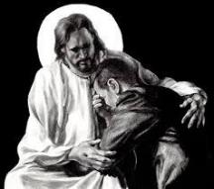
Revelation 21:4
“and He will wipe away every tear from their eyes; and there will no longer be any death; there will no longer be any mourning, or crying, or pain; the first things have passed away.”

Slide 42
OT PROPHETS DESCRIBE THE KINGDOM
Millennial David (Jer. 30:9)
Righteousness (Isa. 9:6-7)
Curse curtailed (Isa. 65:20, 22)
Peace (Isa. 2:4)
Prosperity (Amos 9:13-14; Isa 65:22)
Topographical changes (Ezek. 47:1-12)
Immediate answers to prayer (Isa. 65:24)

Slide 43
Isaiah 2:3b-4
³...God of Jacob; That He may teach us concerning His ways And that we may walk in His paths.” For the law will go forth from Zion And the word of the Lord from Jerusalem.⁴ And He will judge between the nations, And will render decisions for many peoples; And they will hammer their swords into plowshares and their spears into pruning hooks. Nation will not lift up sword against nation, And never again will they learn war.”

Slide 44
Isaiah 11:6-9
⁶ “And the wolf will dwell with the lamb, And the leopard will lie down with the young goat, And the calf and the young lion and the fatling together; And a little boy will lead them.⁷ Also the cow and the bear will graze, Their young will lie down together, And the lion will eat straw like the ox. ⁸ The nursing child will play by the hole of the cobra, And the weaned child will put his hand on the viper’s den. ⁹ They will not hurt or destroy in all My holy mountain, For the earth will be full of the knowledge of the Lord As the waters cover the sea.”

Slide 45
Isaiah 65:17-25
…with them.²⁴ It will also come to pass that before they call, I will answer; and while they are still speaking, I will hear. ²⁵ The wolf and the lamb will graze together, and the lion will eat straw like the ox; and dust will be the serpent’s food. They will do no evil or harm in all My holy mountain,” says the Lord.

Slide 46
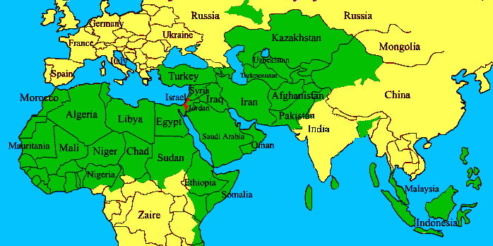
ISRAEL

Slide 47
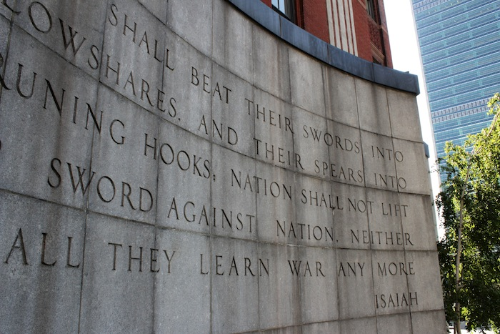

Slide 48
OT PROPHETS DESCRIBE THE KINGDOM
Millennial David (Jer. 30:9)
Righteousness (Isa. 9:6-7)
Curse curtailed (Isa. 65:20, 22)
Peace (Isa. 2:4)
Prosperity (Amos 9:13-14; Isa 65:22)
Topographical changes (Ezek. 47:1-12)
Immediate answers to prayer (Isa. 65:24)

Slide 49

Isaiah 65:21–22
²¹ “They will build houses and inhabit them; They will also plant vineyards and eat their fruit. ²² “They will not build and another inhabit, They will not plant and another eat; For as the lifetime of a tree, so will be the days of My people, And My chosen ones will wear out the work of their hands.

Slide 50
Amos 9:13
¹³ “Behold, days are coming,” declares the Lord, “When the plowman will overtake the reaper And the treader of grapes him who sows seed; When the mountains will drip sweet wine And all the hills will be dissolved.”

Slide 51
OT PROPHETS DESCRIBE THE KINGDOM
Millennial David (Jer. 30:9)
Righteousness (Isa. 9:6-7)
Curse curtailed (Isa. 65:20, 22)
Peace (Isa. 2:4)
Prosperity (Amos 9:13-14; Isa 65:22)
Topographical changes (Ezek. 47:1-12)
Immediate answers to prayer (Isa. 65:24)

Slide 52
13. Topographical Changes (Ezek. 47:1-12)
Abundant rainfall (Ezek. 34:26-27)
Water in the desert (Isa. 35:6-7)
Life to the Dead Sea (Ezek. 47:1-12)
Sun seven times brighter (Isa. 30:26)
Physical healing (Isa. 35:5-6)

Slide 53
13. Topographical Changes (Ezek. 47:1-12)
Abundant rainfall (Ezek. 34:26-27)
Water in the desert (Isa. 35:6-7)
Life to the Dead Sea (Ezek. 47:1-12)
Sun seven times brighter (Isa. 30:26)
Physical healing (Isa. 35:5-6)

Slide 54
13. Topographical Changes (Ezek. 47:1-12)
Abundant rainfall (Ezek. 34:26-27)
Water in the desert (Isa. 35:6-7)
Life to the Dead Sea (Ezek. 47:1-12)
Sun seven times brighter (Isa. 30:26)
Physical healing (Isa. 35:5-6)

Slide 55
13. Topographical Changes (Ezek. 47:1-12)
Abundant rainfall (Ezek. 34:26-27)
Water in the desert (Isa. 35:6-7)
Life to the Dead Sea (Ezek. 47:1-12)
Sun seven times brighter (Isa. 30:26)
Physical healing (Isa. 35:5-6)

Slide 56
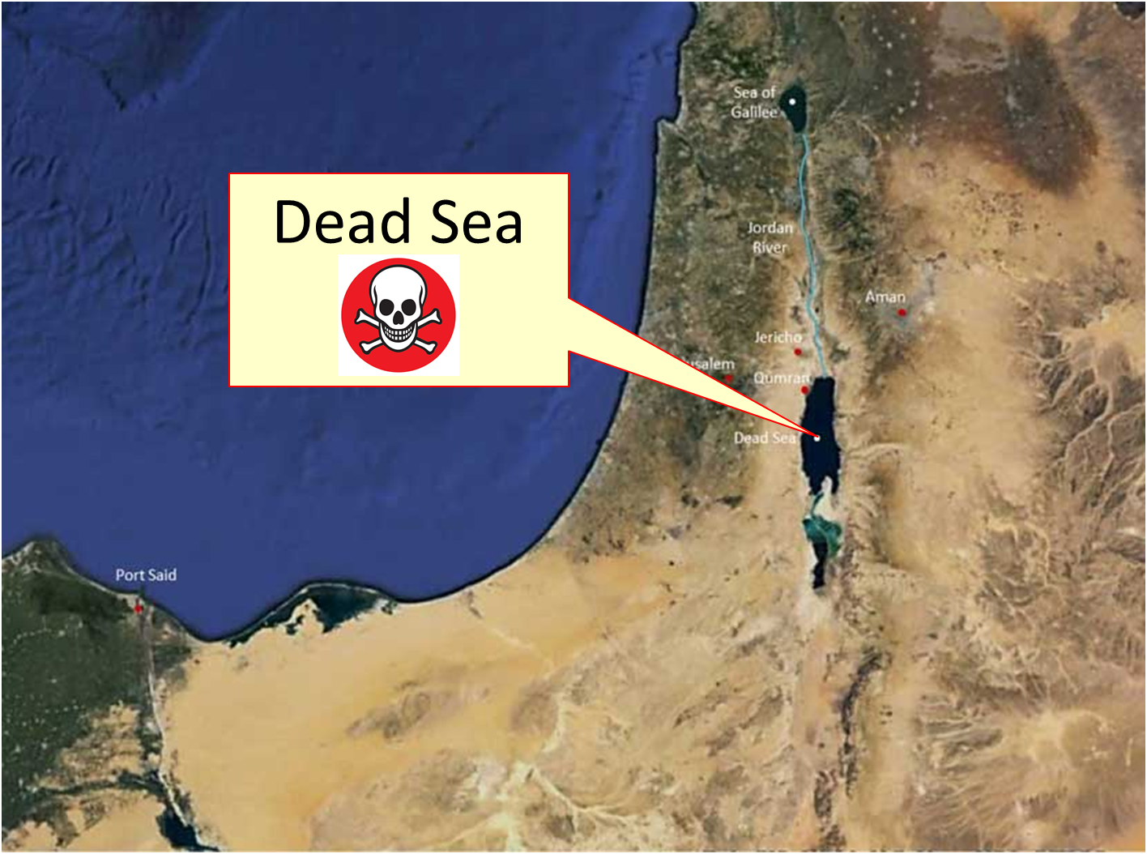

Slide 57
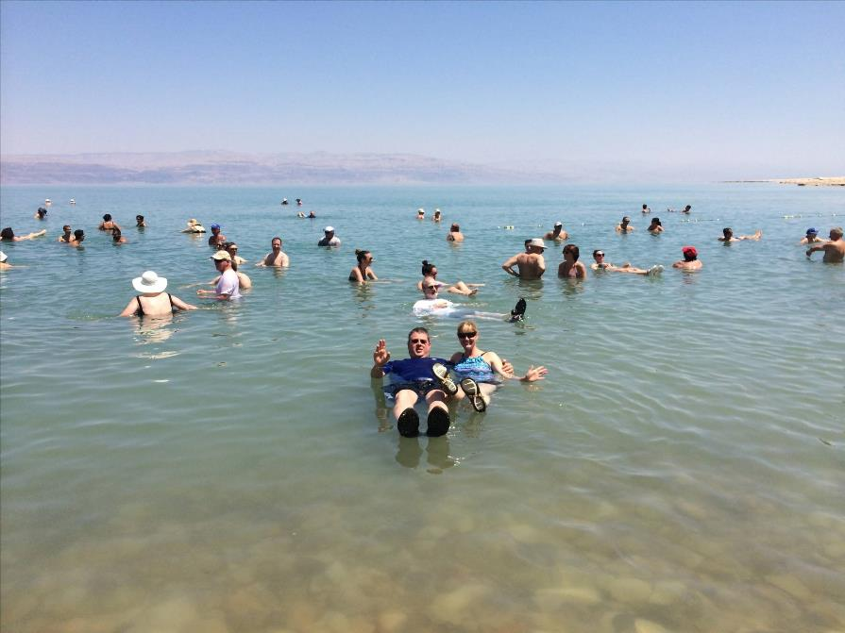

Slide 58
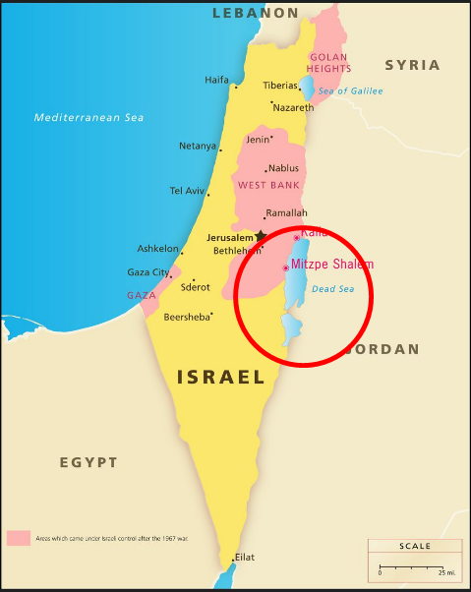
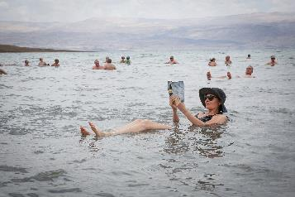
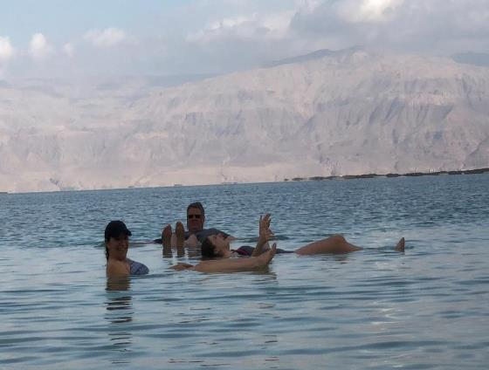
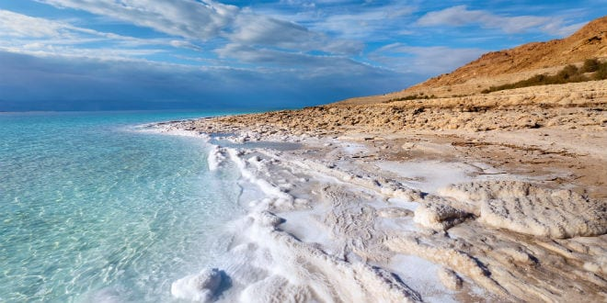
DEAD SEA

Slide 59
13. Topographical Changes (Ezek. 47:1-12)
Abundant rainfall (Ezek. 34:26-27)
Water in the desert (Isa. 35:6-7)
Life to the Dead Sea (Ezek. 47:1-12)
Sun seven times brighter (Isa. 30:26)
Physical healing (Isa. 35:5-6)

Slide 60
13. Topographical Changes (Ezek. 47:1-12)
Abundant rainfall (Ezek. 34:26-27)
Water in the desert (Isa. 35:6-7)
Life to the Dead Sea (Ezek. 47:1-12)
Sun seven times brighter (Isa. 30:26)
Physical healing (Isa. 35:5-6)

Slide 61
Isaiah 35:5-6
“⁵ Then the eyes of the blind will be opened And the ears of the deaf will be unstopped. ⁶ Then the lame will leap like a deer, And the tongue of the mute will shout for joy. For waters will break forth in the wilderness And streams in the Arabah.”

Slide 62
OT PROPHETS DESCRIBE THE KINGDOM
Millennial David (Jer. 30:9)
Righteousness (Isa. 9:6-7)
Curse curtailed (Isa. 65:20, 22)
Peace (Isa. 2:4)
Prosperity (Amos 9:13-14; Isa 65:22)
Topographical changes (Ezek. 47:1-12)
Immediate answers to prayer (Isa. 65:24)

Slide 63
Isaiah 65:17-25
…with them.²⁴ It will also come to pass that before they call, I will answer; and while they are still speaking, I will hear. ²⁵ The wolf and the lamb will graze together, and the lion will eat straw like the ox; and dust will be the serpent’s food. They will do no evil or harm in all My holy mountain,” says the Lord.

Slide 64
Conclusion

Slide 65
OT PROPHETS DESCRIBE THE KINGDOM
Established by God (Dan. 2:44)
Eternal (Dan. 7:27)
Christ’s direct rule (Zech. 9:9-10)
Earthly (Zech. 14:9)
Land promises realized (Gen. 15:18-21)
Israel’s preeminence (Isa. 49:22-23)
Millennial Temple (Ezek. 40‒46)

Slide 66
OT PROPHETS DESCRIBE THE KINGDOM
Millennial David (Jer. 30:9)
Righteousness (Isa. 9:6-7)
Curse curtailed (Isa. 65:20, 22)
Peace (Isa. 2:4)
Prosperity (Amos 9:13-14; Isa 65:22)
Topographical changes (Ezek. 47:1-12)
Immediate answers to prayer (Isa. 65:24)

