Slide 1
Chosen People Ministries
THE NEW RIGHTEOUS
AMONG THE NATIONS
Olivier Melnick

Slide 2
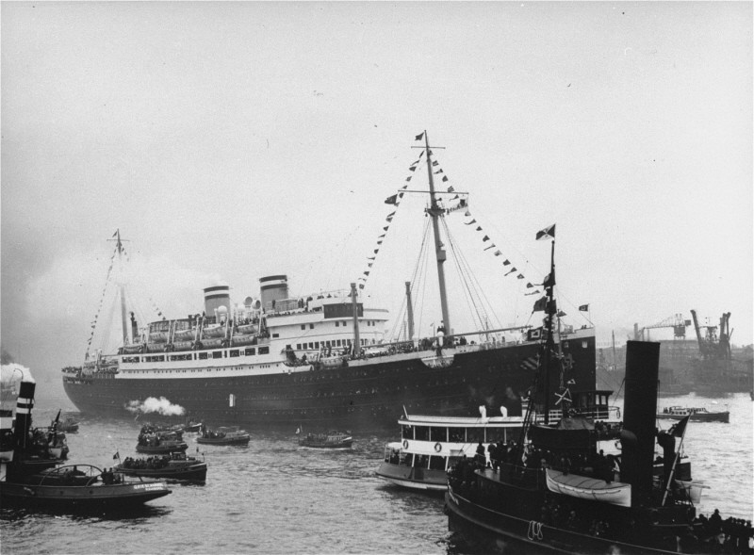
INTRODUCTION
THE VOYAGE OF THE ST. LOUIS (937 Passengers)
• May 13, 1939: The St. Louis ship leaves Hamburg, Germany.
• May 27, 1939: The St. Louis arrives in Cuba and passengers are denied entry.
• May 28, 1939: The St. Louis arrives in the USA and passengers are denied entry.

Slide 3
INTRODUCTION
THE VOYAGE OF THE ST. LOUIS (937 Passengers)
• The St. Louis ship was forced to return to Europe with its passengers who were taken by Great Britain, the Netherlands, Belgium and France.
• Almost a third of the original passengers died in the Holocaust.

Slide 4
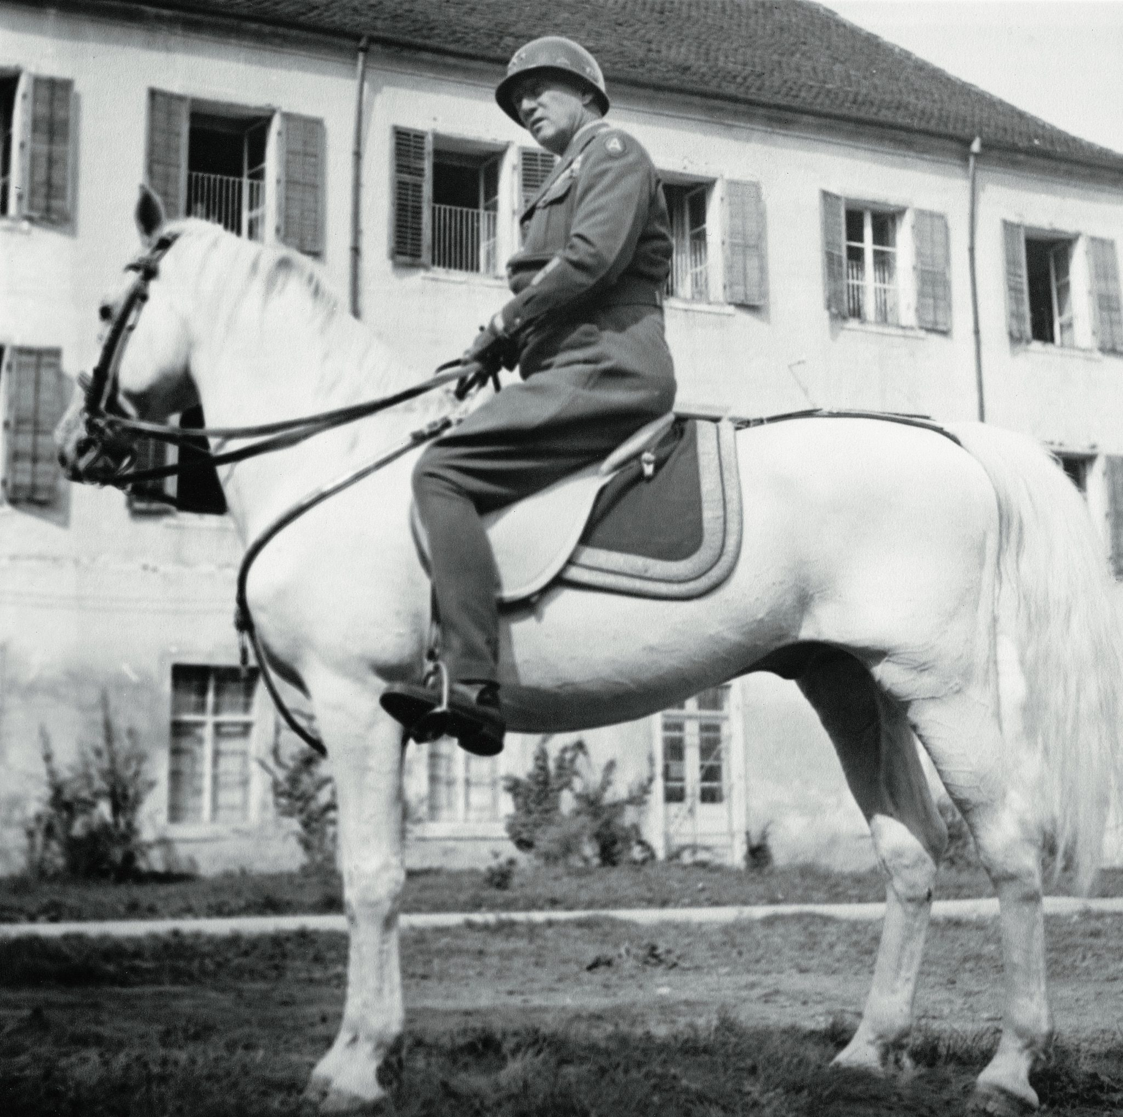
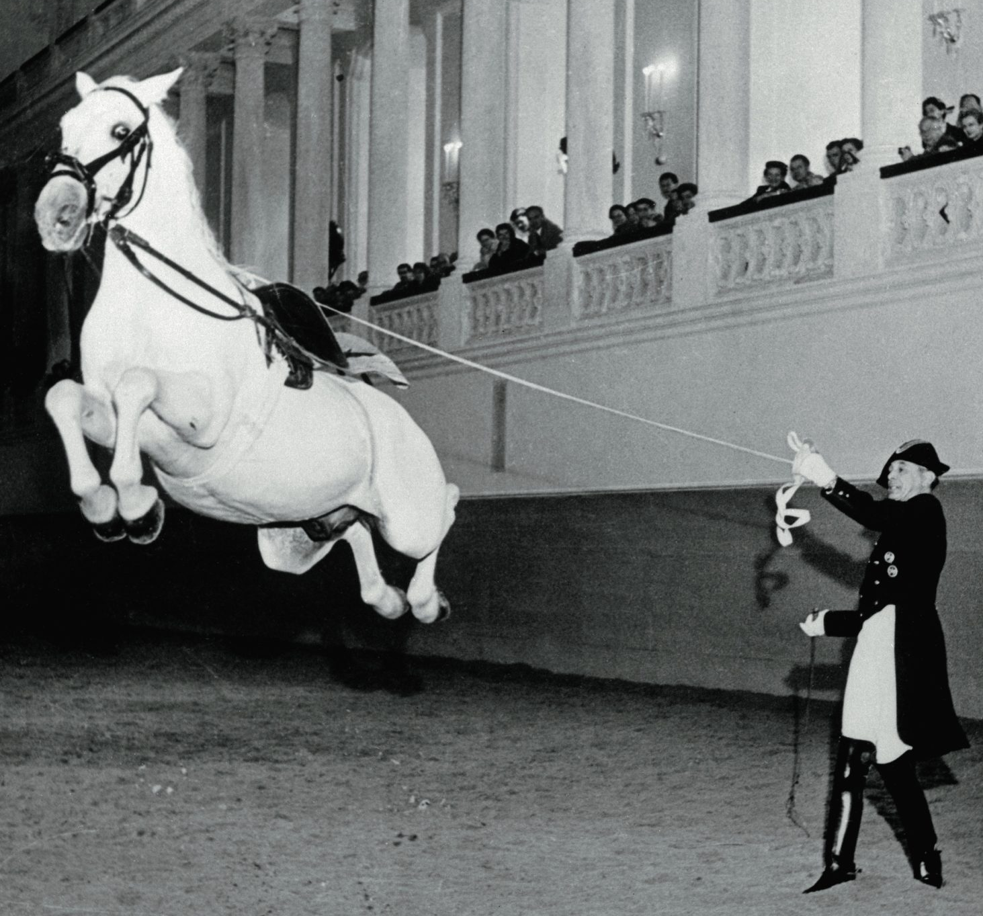
INTRODUCTION
THE RESCUE OF THE LIPIZZANER HORSES
• A 450-year old tradition : The Lipizzaner Horses Spanish Riding School of Vienna.
• The rare stallions were at risk of being killed by 1944.
• A rescue team led by General Patton was sent to save them.

Slide 5
INTRODUCTION
• All throughout 1944, various Jewish organizations begged the USA to bomb the death camps or at least the railroads leading to them. NOTHING HAPPENED!
• The US War Dept responded that this would constitute, "a diversion of considerable air support essential to the success of our forces now engaged in decisive operations elsewhere.”

Slide 6
INTRODUCTION
• At the same time, German factories were bombed within less than 5 miles of Auschwitz, yet the camp was left untouched.
• The allies didn’t want tens of thousands of Jewish refugees, but a few dozens horses were worth the effort!
The horses were saved and
the Jews were left to die in the camps!

Slide 7
INTRODUCTION
• Past – Yad Vashem
• Future – The Time of Jacob’s Trouble
• Present – Not a bystander

Slide 8
INTRODUCTION
Premillennial, Pretribulational order:
• Rapture
• Tribulation (Time of Jacob’s Trouble)
• Second Coming
• Millennial Kingdom
• Eternal Order

Slide 9
INTRODUCTION
• The Time of Jacob’s Trouble
Joel 2:1-2 1 Blow a trumpet in Zion, And sound an alarm on My holy mountain! Let all the inhabitants of the land tremble, For the day of the LORD is coming; Surely it is near, A day of darkness and gloom, A day of clouds and thick darkness. As the dawn is spread over the mountains, So there is a great and mighty people; There has never been anything like it, Nor will there be again after it To the years of many generations.

Slide 10
INTRODUCTION
• The Time of Jacob’s Trouble
Jeremiah 30:7 Alas! for that day is great, There is none like it; And it is the time of Jacob’s distress, But he will be saved from it.
Daniel 12:1 “Now at that time Michael, the great prince who stands guard over the sons of your people, will arise. And there will be a time of distress such as never occurred since there was a nation until that time; and at that time your people, everyone who is found written in the book, will be rescued.”

Slide 11
INTRODUCTION
Three possible outcomes for Jewish people left behind:
Death without Messiah – Eternity in the Lake of Fire
(Revelation 19:20; 20:15)
Death as a Tribulation Martyrs - After trusting Messiah
(Revelation 7:9-17)
Survival through the Tribulation – Direct entrance into the millennial kingdom
(Matthew 25:31-40)

Slide 12
THE PAST
Defining the Righteous Among the Nations
• ger toshav or “resident alien”
• Hasid Umot Ha-Olam or “Pious people of the world”
Talmud (Sanhedrin 37a): “Whoever destroys a soul from Israel, the Scripture considers it as if he destroyed an entire world. And whoever saves a life from Israel, the Scripture considers it as if he saved an entire world.”

Slide 13
THE PAST
Luke 10:33-34: But a Samaritan, who was on a journey, came upon him; and when he saw him,
he felt compassion, 34 and came to him and bandaged up his wounds, pouring oil and wine on them; and he put him on his own beast, and brought him to an inn and took care of him.

Slide 14
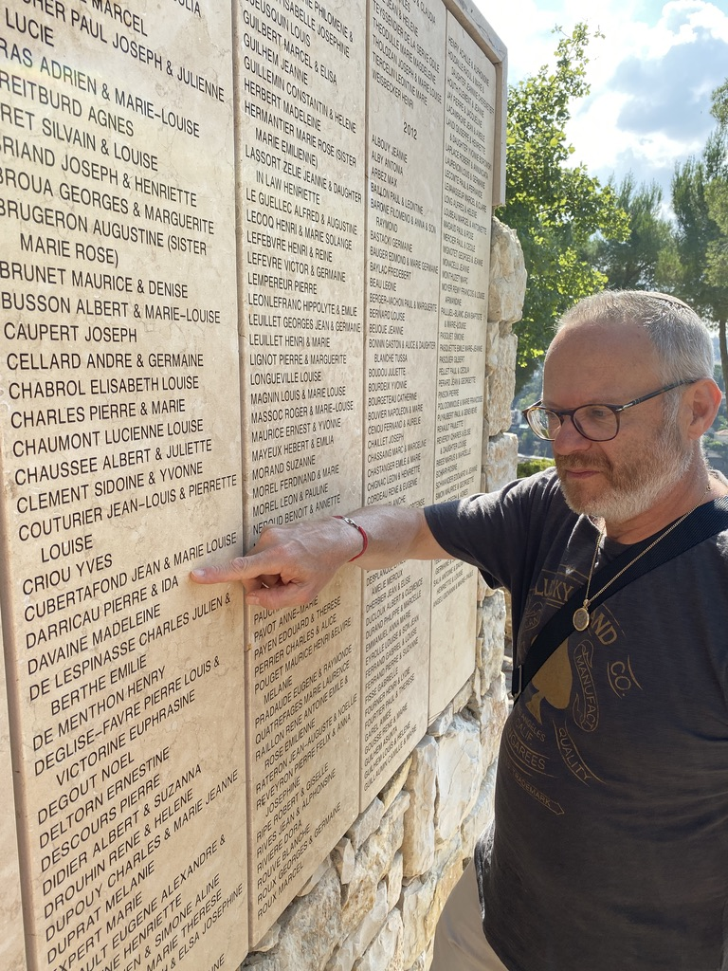
THE PAST
1963: Yad Vashem started to award the honorary title of
“Righteous Among the Nations.”
• Trees planted on the premises
• Names added to the
“Wall of Honor”

Slide 15
THE PAST
THE CRITERIAS FOR BEING
A RIGHTEOUS AMONG THE NATIONS:
Had to be a Gentile.
Had to be actively involved in helping Jews avoid deportation.
Had to risk their own freedom or lives to do so.
Couldn’t seek financial gain or conversion.

Slide 16
THE PAST
SOME FAMOUS RIGHTEOUS AMONG THE NATIONS:
• Raoul Wallenberg
• Corrie Ten Boom
• Oskar Schindler
• Henri & Magda Trocmé

Slide 17
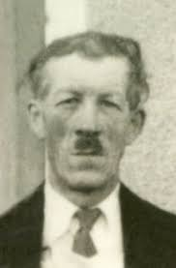
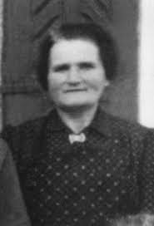
THE PAST
SOME
“NOT SO FAMOUS”
RIGHTEOUS AMONG
THE NATIONS:
• Pierre and Ida
Darricau

Slide 18
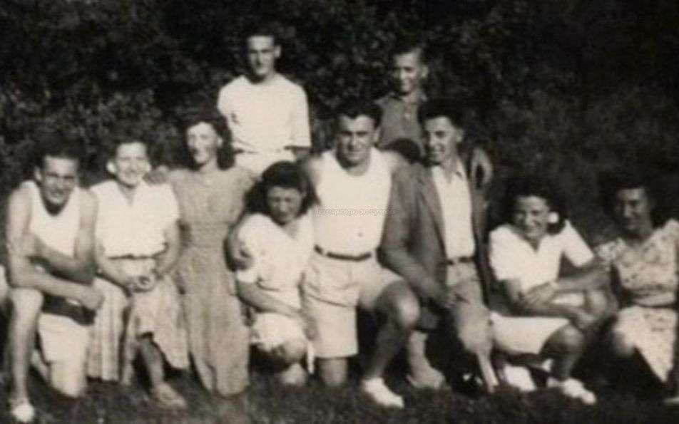
THE PAST
Pierre and Ida
Darricau rescued Evelyn Weinzveig from the Nazis and hid her on their farm in the Southwest of France (1942-45)

Slide 19
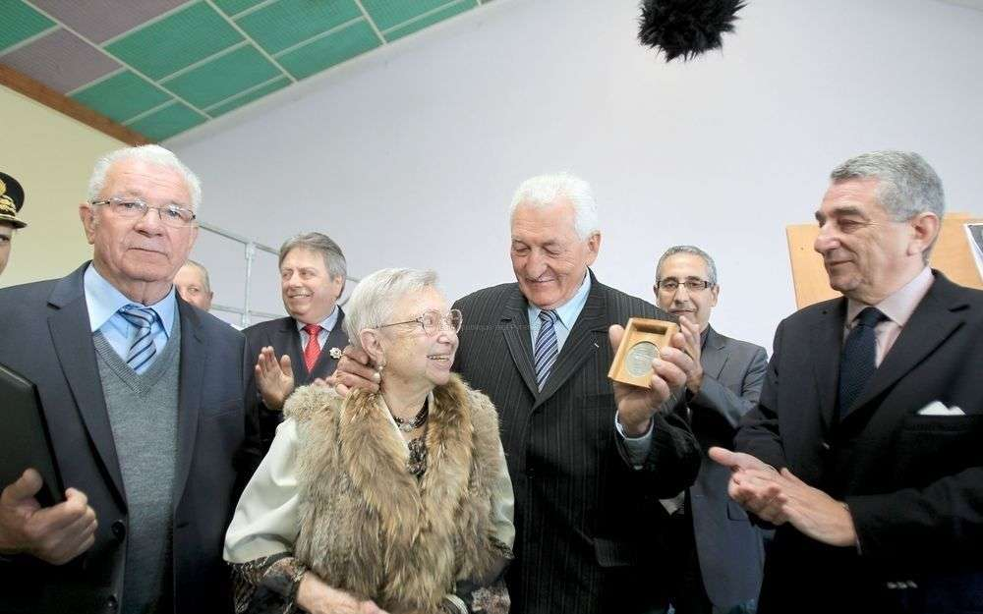
THE PAST
In 2013,Evelyn Weinzveig reunited with the Darricau’s two sons as they received the Yad Vashem medal on behalf of their deceased parents.

Slide 20
THE PAST
YAD VASHEM ESTABLISHED THAT THE RIGHTEOUS AMONG THE NATIONS HELPED IN SEVERAL WAYS:
• Provided shelter and food.
• Made or provided false papers.
• Moved Jewish people away from dangerous
Nazi-controlled areas.
• Saved Jewish children who had lost their parents
in the camps.

Slide 21
THE PAST
• As of January 1, 2021, Yad Vashem had recognized 27,921 Righteous Among the Nations around the world accounting for about 10,000 rescuing stories.
• Over 22,000 of these individuals come from five countries: Poland, The Netherlands, France, Ukraine and Belgium.

Slide 22
THE FUTURE
The “New” Righteous Among the Nations
• Are a group of Gentiles coming in the future.
• Will be identified by Yeshua upon His Second Coming after the Tribulation.
• Are spoken of in the Olivet Discourse
(Matthew 25:31-46)
• Are never called “Righteous Among the Nations”
in the Bible.

Slide 23
THE FUTURE
The ROLE of the New Righteous Among the Nations
The Timeframe – Matthew 25:31 – A judgment
“But when the Son of Man comes in His glory, and all the angels with Him, then He will sit on His glorious throne.

Slide 24
THE FUTURE
The ROLE of the New Righteous Among the Nations
The Separation – Matthew 25:32-33 – Goats and sheep
32 All the nations will be gathered before Him; and He will separate them from one another, as the shepherd separates the sheep from the goats; 33 and He will
put the sheep on His right, and the goats on the left.

Slide 25
THE FUTURE
The ROLE of the New Righteous Among the Nations
The Reward – Matthew 25:34 – Entrance into the Kingdom
34“Then the King will say to those on His right, ‘Come, you who are blessed of My Father, inherit the kingdom prepared for you from the foundation of the world.

Slide 26
THE FUTURE
The ROLE of the New Righteous Among the Nations
The Reason – Matthew 25:35-36 – Compassion
35 For I was hungry, and you gave Me something to eat; I was thirsty, and you gave Me something to drink; I was a stranger, and you invited Me in; 36 naked, and you clothed Me; I was sick, and you visited Me; I was in prison, and you came to Me.’

Slide 27
THE FUTURE
The ROLE of the New Righteous Among the Nations
The Reaction – Matthew 25:37-39 – Surprise
37 Then the righteous will answer Him, ‘Lord, when
did we see You hungry, and feed You, or thirsty, and give You something to drink? And when did we see
You a stranger, and invite You in, or naked, and clothe You? When did we see You sick, or in prison, and
come to You?’

Slide 28
THE FUTURE
The ROLE of the New Righteous Among the Nations
The Response – Matthew 25:40 – Yeshua’s brothers
40 The King will answer and say to them, ‘Truly I say
to you, to the extent that you did it to one of these brothers of Mine, even the least of them, you did
it to Me.’

Slide 29
THE FUTURE
The FATE of the accursed Gentiles
A Different Reward – Matthew 25:41-46 – Lake of Fire
41 “Then He will also say to those on His left, ‘Depart from Me, accursed ones, into the eternal fire which has been prepared for the devil and his angels; for I was hungry, and you gave Me nothing to eat; I was thirsty, and you gave Me nothing to drink;

Slide 30
THE FUTURE
43 I was a stranger, and you did not invite Me in; naked, and you did not clothe Me; sick, and in prison, and you did not visit Me.’ 44 Then they themselves also will answer, ‘Lord, when did we see You hungry, or thirsty, or a stranger, or naked, or sick, or in prison, and did not take care of You?’ 45 Then He will answer them, ‘Truly I say to you, to the extent that you did not do it to one of the least of these, you did not do it to Me.’ 46 These will go away into eternal punishment, but the righteous into eternal life.”

Slide 31
THE FUTURE
NOT SALVATION BY WORKS!
• Kingdom entry not because of performance.
• Performance as a result of salvation.
Genesis 5:6 Then he believed in the LORD; and He reckoned it
to him as righteousness.
Ephesians 2:8-9 For by grace you have been saved through
faith; and that not of yourselves, it is the gift of God;
not as a result of works, so that no one may boast.

Slide 32
THE PRESENT
The TIMING of the Rapture
The Imminency – Matthew 24:36 – Next on God’s timetable
36 But of that day and hour no one knows, not even the angels of heaven, nor the Son, but the Father alone.

Slide 33
THE PRESENT
The URGENCY prior to the Rapture
The Days of Noah – Matthew 24:37-38 – Unannounced
37 For the coming of the Son of Man will be just like the days
of Noah. 38 For as in those days before the flood they were
eating and drinking, marrying and giving in marriage, until
the day that Noah entered the ark,

Slide 34
THE PRESENT
The RETURN of antisemitism
• The whole world will turn on Israel (Zechariah 12:3)
• Antisemitism is on a continuum and is growing exponentially.
• Jews are being killed again.
• A transnational neo-pogrom (Melanie Philips)
• Satan is obsessed with eliminating the Jews.
• Satan knows that one day Israel will say “Baruch Haba Bashem Adonai” and that will put a stop to his agenda.

Slide 35
THE PRESENT
The TIME IS NOW!
• Evangelicals love and pray for Israel and their Jewish friends (Psalm 122:6)
• Prayer is our foundation, but it is time to build on it.
• Why not start helping Jewish people TODAY?
• Jewish people NEED to hear that we have their back.
• It is time to put our faith into action.

Slide 36
THE PRESENT
WE WILL NOT BE BYSTANDERS!
• Visit a synagogue, JCC or Jewish organization
and let them know you are not a bystander.
• Call Jewish officials and let them know you are not a bystander.
• Email Jewish officials and let them know you are not a
bystander.
• Reassure your Jewish friends that they can count on you.
JEWISH PEOPLE NEED TO KNOW THAT THEY CAN TRUST CHRISTIANS

Slide 37
FINAL WORDS
““We must take sides.
Neutrality helps the
oppressor, never the victim. Silence encourages the tormentor, never the tormented.”
ELIE WIESEL

Slide 38
FINAL WORDS
A bystander who does nothing always facilitates
the work of a perpetrator.

Slide 39
FINAL WORDS
I will not be
a bystander,
how about you?

