Slide 1
Israel and the Coming

Slide 2
Why Talk About Antichrist?
He’s in the Bible (real person)
100+ Passages of Scripture describing him
The Most Prominent end times figure besides jesus
36X in revelation called “The beast”
He is definitely Coming (1 Jn. 2:18; Rev. 13)
Spirit of Antichrist is Among us (1 Jn. 4:1-3)
He is likely alive today

Slide 3
What does “Anti” Christ mean?
anti = “against”, “in place of”
“See to it that no one misleads you. For many
will come in my name, saying, ‘I am the Christ,’
and will mislead many.
For false Christ’s and false prophets will arise and
will show great signs and wonders, so as to
mislead, if possible, even the elect.
Behold, I have told you in advance.”
- Jesus (Matthew 24:4-5, 24-25)

Slide 4
What do we know about Him?
He is known by many names in Scripture:
The little horn (Daniel 7:8)
The insolent king (Daniel 8:23)
The one who makes desolate (Daniel 9:27)
The man of lawlessness (2 Thess. 2:3)
The son of destruction (2 Thess. 2:3)
Antichrist (1 John 2:18, 22; 4;3; 2 John 1:7)
The beast coming up out of the sea (Rev. 13:1

Slide 5
What else does the Bible say?
An ambitious Politician (Daniel 9:27; Rev. 17:11-12)
A Military Demagogue (Daniel 11:38-39, 40-44; Rev. 6:2, 13:2, 4)
A Master orator (Daniel 7:8, 11; 11:36; Rev. 13:5)
Charming, cunning and deceptive (2 Thess. 2:4, 10-12; Jn 8:44)
Arrogant, lawless, blaspheming (Daniel 11:36; 2 Thess. 2:7-8)
Harbors an Ancient Hatred for Jews (Gen. 3:15; Rev. 6:9; 11:7;
12:7-9, 12-17; 13:7,15;17:6)

Slide 6
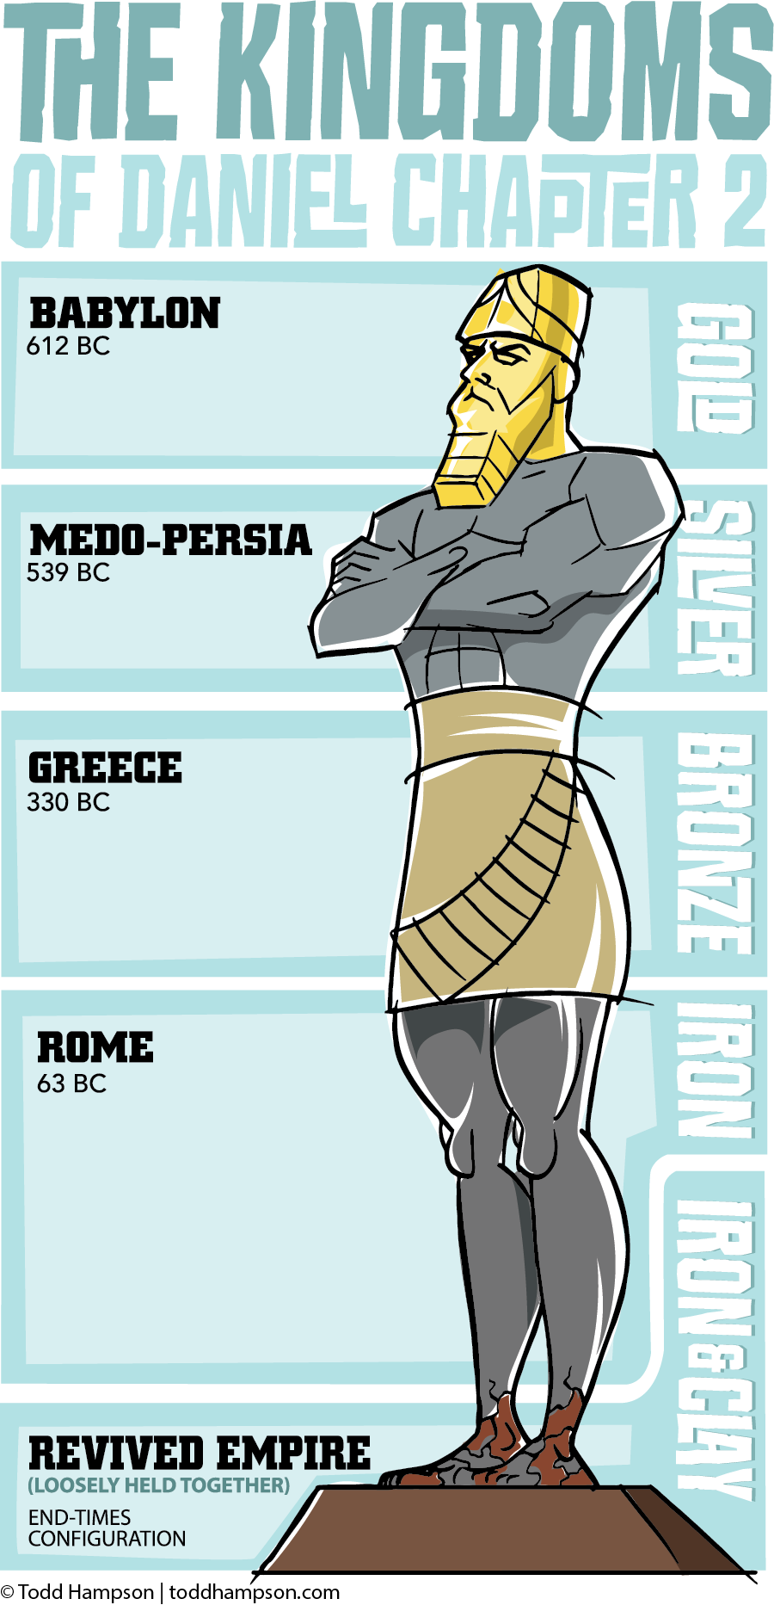
He will lead a 10-nation
kingdom, a “Revived
Roman Empire”
Political
Economic
religious
Revelation 13:1-2
Daniel 2:42
Daniel 7:24

Slide 7
His Relationship to Israel in the Last Days
The Covenant of Peace
(Daniel 9:27)
Lulls Israel into complacency
Will likely facilitate Temple Construction
Is a source of security (Ez. 38:8, 11)
Further Establishes AC as a global leader

Slide 8
His Relationship to Israel in the Last Days
The Betrayal
(Daniel 9:27; 11: 45; 12:1; Matt 24:21; 2 Thess 2:3-5)
Why the abomination?
Jealously and the messiah complex.
Antichrist’s return from the dead.
Satanic hatred of God.
Inaugurates Satan’s “Last Stand”

Slide 9
His Relationship to Israel in the Last Days
The Last Days Holocaust
(Matt 24:15-23; Rev. 12:12-17)
The Final Redemption
(Matthew 23:39; Zechariah 12:10; Rev. 19)

Slide 10
So What Is the Bottom Line?
The Time of Jacob’s Trouble is Coming
(Jeremiah 30:7)
Two-Thirds of the Jews Will Perish
(Zechariah 13:8)
The Remnant Jews Will All Be Saved
(Romans 11:25-26)
Antichrist Will Be Defeated
(Revelation 19:20)

Slide 11
Jesus Conquers
Israel is Redeemed
God is Vindicated

Slide 12
As last days believers,
we are not told to look for Antichrist.
Instead, we are exhorted to look for,
and long for, THE Christ!

