Slide 1


Zechariah
God Remembers!

Slide 2

Structure
Introductory call to repentance (1:1-6)
Eight-night visions (1:7–6:15)
Question and answers about fasting (7–8)
Two burdens (9–14)

Slide 3
Structure
Introductory call to repentance (1:1-6)
Eight-night visions (1:7–6:15)
Question and answers about fasting (7–8)
Two burdens (9–14)

Slide 4
ZECHARIAH’S EIGHT NIGHT VISIONS
Vision | Reference | Meaning
The Red-horse Rider among the Myrtles | 1:7-17 | God’s anger against the nations & blessing on restored Israel.
The Four Horns & the Four Craftsmen | 1:18-21 | God’s judgment on the nations that afflict Israel.
The Surveyor with a Measuring Line | Chapter 2 | God’s future blessing on restored Israel.
The Cleansing & Crowning of Joshua the Hight Priest. | Chapter 3 | Israel’s future cleansing from sin & reinstatement as a priestly nation.
The Golden Lampstand & the Two Olive Trees | Chapter 4 | Israel as the light to the nations under Messiah, the King-Priest.
The Flying Scroll | 5:1-4 | The severity & totality of divine judgment on individual Israelites.
The Woman in the Ephah | 5:5-11 | The removal of national Israel’s sin of rebellion against God.
The Four Chariots | 6:1-8 | Divine judgment on Gentile nations.

Slide 5
II. Eight Night Visions
(1:7‒6:15)
  Riders & horses among the myrtle trees (1:7-17)
  Four horns & four craftsmen (1:18-21)
  Man with the measuring line (2)
  Cleansing of the High Priest Joshua (3)
  Lampstand & olive tree (4)
  Flying scroll (5:1-4)
  Woman in the basket (5:5-11)
  Four chariots (6:1-8)
  Conclusion: crowning of Joshua (6:9-15)

Slide 6
Structure
Introductory call to repentance (1:1-6)
Eight-night visions (1:7–6:15)
Question and answers about fasting (7–8)
Two burdens (9–14)

Slide 7
III. Questions & Answers Concerning Fasting
(7‒8)
  Question (7:1-3)
  Four divine answers (7:4‒8:23)
    Condemnation of empty ritualism (7:4-7)
    Condemnation of past covenant failure (7:8-14)
    Prediction of Jerusalem’s restoration (8:1-17)
    Prediction of future blessing (8:18-23)

Slide 8
Structure
Introductory call to repentance (1:1-6)
Eight-night visions (1:7–6:15)
Question and answers about fasting (7–8)
Two burdens (9–14)

Slide 9
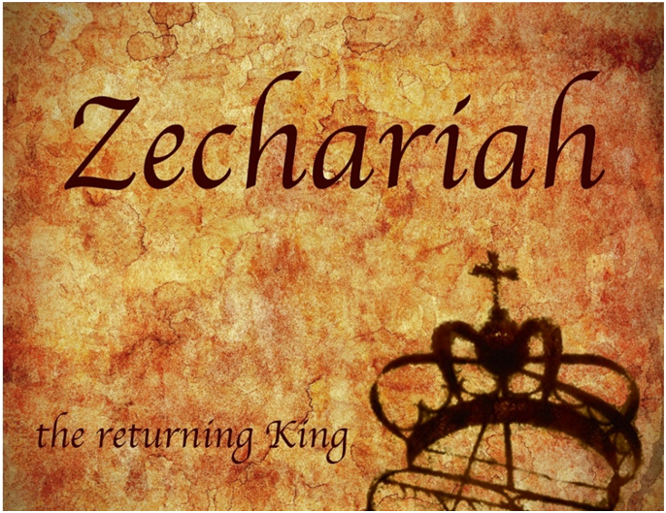
IV. Two Burdens
(9‒14)
  Israel’s postponed deliverance due to her rejection of her Messiah (9‒11)
  Israel’s future deliverance due to her acceptance of her Messiah (12‒14)

Slide 10
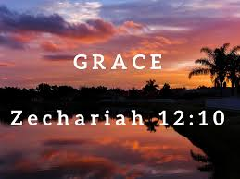
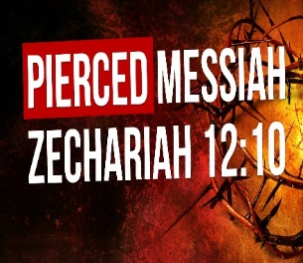
Zechariah 12
(Israel’s Physical & Spiritual Salvation)
Israel’s physical deliverance (12:1-9)
  The nations that will attack Israel (1-3)
  The God who will protect Israel (4-9)
Israel’s spiritual deliverance (12:10-14)
  God’s Spirit: the cause of revival (10a)
  Israel’s remorse: the result of revival (11-14)

Slide 11
Zechariah 12
(Israel’s Physical & Spiritual Salvation)
Israel’s physical deliverance (12:1-9)
  The nations that will attack Israel (1-3)
  The God who will protect Israel (4-9)
Israel’s spiritual deliverance (12:10-14)
  God’s Spirit: the cause of revival (10a)
  Israel’s remorse: the result of revival (11-14)

Slide 12
Zechariah 12
(Israel’s Physical & Spiritual Salvation)
Israel’s physical deliverance (12:1-9)
  The nations who will attack Israel (1-3)
  The God who will protect Israel (4-9)
Israel’s spiritual deliverance (12:10-14)
  God’s Spirit: the cause of revival (10a)
  Israel’s remorse: the result of revival (11-14)

Slide 13
Zechariah 12
(Israel’s Physical & Spiritual Salvation)
Israel’s physical deliverance (12:1-9)
  The nations that will attack Israel (1-3)
  The God who will protect Israel (4-9)
Israel’s spiritual deliverance (12:10-14)
  God’s Spirit: the cause of revival (10a)
  Israel’s remorse: the result of revival (11-14)

Slide 14
Zechariah 12
(Israel’s Physical & Spiritual Salvation)
Israel’s physical deliverance (12:1-9)
  The nations that will attack Israel (1-3)
  The God who will protect Israel (4-9)
Israel’s spiritual deliverance (12:10-14)
  God’s Spirit: the cause of revival (10a)
  Israel’s remorse: the result of revival (11-14)

Slide 15
Zechariah 12
(Israel’s Physical & Spiritual Salvation)
Israel’s physical deliverance (12:1-9)
  The nations that will attack Israel (1-3)
  The God who will protect Israel (4-9)
Israel’s spiritual deliverance (12:10-14)
  God’s Spirit: the cause of revival (10a)
  Israel’s remorse: the result of revival (11-14)

Slide 16

Ezekiel 36:24-28
“For I will take you from the nations, gather you from all the lands and bring you into your own land. ²⁵ Then I will sprinkle clean water on you, and you will be clean; I will cleanse you from all your filthiness and from all your idols. ²⁶ Moreover, I will give you a new heart and put a new spirit within you; and I will remove the heart of stone from your flesh and give you a heart of flesh. ²⁷ I will put My Spirit within you and cause you to walk in My statutes, and you will be careful to observe My ordinances. ²⁸ You will live in the land that I gave to your forefathers; so you will be My people, and I will be your God.”

Slide 17
Ezekiel 37:7-11
So I prophesied as I was commanded; and as I prophesied, there was a noise, and behold, a rattling; and the bones came together, bone to its bone. ⁸ And I looked, and behold, sinews were on them, and flesh grew and skin covered them; but there was no breath in them. ⁹ Then He said to me, “Prophesy to the breath, prophesy, son of man, and say to the breath, ‘Thus says the Lord God, “Come from the four winds, O breath, and breathe on these slain, that they come to life.”’” ¹⁰ So I prophesied as He . . .

Slide 18
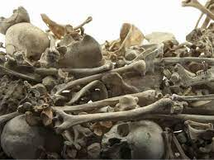
Ezekiel 37:7-11
. . . commanded me, and the breath came into them, and they came to life and stood on their feet, an exceedingly great army. ¹¹ Then He said to me, “Son of man, these bones are the whole house of Israel; behold, they say, ‘Our bones are dried up and our hope has perished. We are completely cut off’.”

Slide 19
Israel’s Two Regatherings
THE PRESENT (FIRST) REGATHERING | THE PERMANENT (SECOND) REGATHERING
Return to part of the land | Return to all the land
Return in unbelief | Return in faith
Restored to the land only | Restored to the land and the Lord
Sets the stage for Tribulation (discipline) | Sets the stage for Millennium (blessing)
Adapted from: Price, Jerusalem In Prophecy, 219

Slide 20

John 16:7-11
“⁷ But I tell you the truth, it is to your advantage that I go away; for if I do not go away, the Helper will not come to you; but if I go, I will send Him to you. ⁸ And He, when He comes, will convict the world concerning sin and righteousness and judgment; ⁹ concerning sin, because they do not believe in Me; ¹⁰ and concerning righteousness, because I go to the Father and you no longer see Me; ¹¹ and concerning judgment, because the ruler of this world has been judged.”

Slide 21
OT Prophecies About Christ
Prophecy | Scripture | Years in Advance
Manner of Birth | Isaiah 7:14 | 700 years
Place of Birth | Micah 5:2 | 700 years
Nationality | Numbers 24:17 | 1400 years
Tribe | Genesis 49:10 | 1800 years
Time of and Response to His Messiahship | Dan. 9:25-26 | 600 years

Slide 22
OT Prophecies About Christ
Prophecy | Scripture | Years in Advance
Crucified Between Thieves | Isaiah 53:9 | 700 years
Pierced | Isaiah 53:5 | 700 years
No Broken Bones | Psalm 22:17 | 1000 years
Gamble for His Clothing | Psalm 22:18 | 1000 years
Buried in Rich Man’s Tomb | Isaiah 53:9 | 700 years
Notes:
109 prophecies…
Peter Stoner – SCIENCE SPEAKS, An Evaluation of Certain Christian Evidences
To fulfill just 8 prophecies =1 X 10 to the twenty-eighth power!
Can we visualize this with an illustration? Suppose we took an atheistic professor, blindfolded him and covered the state of Texas two feet deep with silver dollars. Then we put a check on one of those silver dollars and mixed them up. The odds of one person fulfilling just these eight prophecies would be the same as this atheistic professor selecting the silver dollar upon which we have placed a check, in his first try.
https://www.bereanpublishers.com/the-odds-of-eight-messianic-prophecies-coming-true/

Slide 23
Zechariah 12
(Israel’s Physical & Spiritual Salvation)
Israel’s physical deliverance (12:1-9)
  The nations that will attack Israel (1-3)
  The God who will protect Israel (4-9)
Israel’s spiritual deliverance (12:10-14)
  God’s Spirit: the cause of revival (10a)
  Israel’s remorse: the result of revival (11-14)

Slide 24

Lewis Sperry Chafer, vol. 7, Systematic Theology
(Grand Rapids, MI: Kregel Publications, 1993), 265-66.
Belief-God’s One Condition for Justification
“…because upwards of 150 passages of Scripture condition salvation upon believing only (cf. John 3:16; Acts 16:31).”

Slide 25
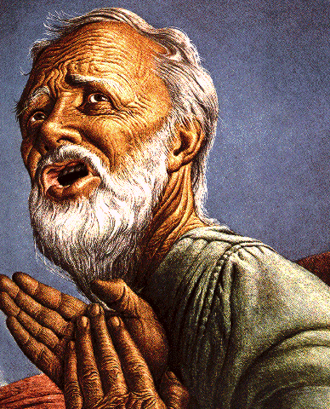
Belief – God’s One Condition for Justification
Gen 15:6
Then he believed in the LORD; and He reckoned it to him as righteousness.
John 3:16
For God so loved the world, that He gave His only begotten Son, that whoever believes in Him shall not perish, but have eternal life.
Acts 16:30-31
"Sirs, what must I do to be saved?" They said, "Believe in the Lord Jesus, and you will be saved..."

Slide 26

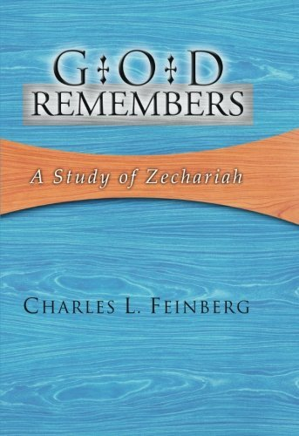
Charles L. Feinberg
God Remembers: A Study of Zechariah (Wheaton: Van Kampen, 1950, p. 223.
“The mourning of Hadadrimmon...in the valley of Megiddo was on the occasion of the slaying of the godly King Josiah by Pharaoh-Necho of Egypt...[2 Chronicles 35:22-27]. The Chronicles passage reveals how great was the lamentation over the king. And rightly so, for ‘this was the greatest sorrow, which had fallen on Judah. Josiah was the last hope of it’s declining kingdom…In Josiah’s death the last gleam of the sunset of Judah faded into night.’”

Slide 27

Zechariah 12:12-13
“¹² The land will mourn, every family by itself; the family of the house of David by itself and their wives by themselves; the family of the house of Nathan by itself and their wives by themselves; ¹³ the family of the house of Levi by itself and their wives by themselves; the family of the Shimeites by itself and their wives by themselves.”

Slide 28
Zechariah 12:12-13
“¹² The land will mourn, every family by itself; the family of the house of David by itself and their wives by themselves; the family of the house of Nathan by itself and their wives by themselves; ¹³ the family of the house of Levi by itself and their wives by themselves; the family of the Shimeites by itself and their wives by themselves.”

Slide 29
Zechariah 12:12-13
“¹² The land will mourn, every family by itself; the family of the house of David by itself and their wives by themselves; the family of the house of Nathan by itself and their wives by themselves; ¹³ the family of the house of Levi by itself and their wives by themselves; the family of the Shimeites by itself and their wives by themselves.”

Slide 30
Zechariah 12:12-13
“¹² The land will mourn, every family by itself; the family of the house of David by itself and their wives by themselves; the family of the house of Nathan by itself and their wives by themselves; ¹³ the family of the house of Levi by itself and their wives by themselves; the family of the Shimeites by itself and their wives by themselves.”

Slide 31
Zechariah 12:12-13
“¹² The land will mourn, every family by itself; the family of the house of David by itself and their wives by themselves; the family of the house of Nathan by itself and their wives by themselves; ¹³ the family of the house of Levi by itself and their wives by themselves; the family of the Shimeites by itself and their wives by themselves.”

Slide 32
Zechariah 12:12-13
“¹² The land will mourn, every family by itself; the family of the house of David by itself and their wives by themselves; the family of the house of Nathan by itself and their wives by themselves; ¹³ the family of the house of Levi by itself and their wives by themselves; the family of the Shimeites by itself and their wives by themselves.”

Slide 33
Zechariah 12:12-13
“¹² The land will mourn, every family by itself; the family of the house of David by itself and their wives by themselves; the family of the house of Nathan by itself and their wives by themselves; ¹³ the family of the house of Levi by itself and their wives by themselves; the family of the Shimeites by itself and their wives by themselves.”

Slide 34
Zechariah 12:12-13
“¹² The land will mourn, every family by itself; the family of the house of David by itself and their wives by themselves; the family of the house of Nathan by itself and their wives by themselves; ¹³ the family of the house of Levi by itself and their wives by themselves; the family of the Shimeites by itself and their wives by themselves.”

Slide 35

Romans 11:25-26
“²⁵ For I do not want you, brethren, to be uninformed of this mystery—so that you will not be wise in your own estimation—that a partial hardening has happened to Israel until the fullness of the Gentiles has come in; ²⁶ and so all Israel will be saved; just as it is written, ‘The Deliverer will come from Zion, He will remove ungodliness from Jacob.’”

Slide 36
The Coming Universal Israeli National Revival
(Zechariah 12:12-13)
David ‒ kings (13a)
Nathan ‒ prophets (13b)
Levi ‒ priests (14a)
Shimeites ‒ ordinary Levites (Num. 3:21)-citizens (14b)

Slide 37
Zechariah 13:8-9
⁸“It will come about in all the land,” Declares the Lord, “That two parts in it will be cut off and perish; But the third will be left in it. ⁹“And I will bring the third part through the fire, Refine them as silver is refined, And test them as gold is tested. They will call on My name, And I will answer them; I will say, ‘They are My people,’ And they will say, ‘The Lord is my God.’ ”

Slide 38


Jeremiah 30:7
“Alas! for that day is great, There is none like it; And it is the time of Jacob’s distress (Gen. 32:8; 35:10), But he will be saved from it.”

Slide 39
Conclusion

Slide 40
Zechariah 12
(Israel’s Physical & Spiritual Salvation)
Israel’s physical deliverance (12:1-9)
  The nations that will attack Israel (1-3)
  The God who will protect Israel (4-9)
Israel’s spiritual deliverance (12:10-14)
  God’s Spirit: the cause of revival (10a)
  Israel’s remorse: the result of revival (11-14)

