Slide 1

Ezekiel 36‒39
The Middle East Meltdown 2022
Dr. Andy Woods
Senior Pastor – Sugar Land Bible Church
President – Chafer Theological Seminary

Slide 2
Ezekiel 33‒48
Ezekiel recommissioned (33)
False shepherds removed (34)
Edom destroyed (35)
Israel’s restoration: physical & spiritual (36)
Israel’s restoration illustrated (37)
Means of restoration: Northern invasion (38)
Results of the Northern invasion: conversion (39)
Millennial Temple (40‒46)
Tribal land allotment (47‒48)

Slide 3
Ezekiel 36
Israel to prosper again (1-15)
Israel’s sins inhibiting prosperity (16-21)
Israel to be restored: physically & spiritually (22-38)

Slide 4
Ezekiel 33‒48
Ezekiel recommissioned (33)
False shepherds removed (34)
Edom destroyed (35)
Israel’s restoration: physical & spiritual (36)
Israel’s restoration illustrated (37)
Means of restoration: Northern invasion (38)
Results of the Northern invasion: conversion (39)
Millennial Temple (40‒46)
Tribal land allotment (47‒48)

Slide 5
Ezekiel 37
Vision: Valley of the Dry Bones (1-14)
  Vision (1-10)
  Interpretation (11-14)
Sign: Two Sticks (15-28)
  Sign (15-17)
  Interpretation (18-28)

Slide 6
Ezekiel 33‒48
Ezekiel recommissioned (33)
False shepherds removed (34)
Edom destroyed (35)
Israel’s restoration: physical & spiritual (36)
Israel’s restoration illustrated (37)
Means of restoration: Northern invasion (38)
Results of the Northern invasion: conversion (39)
Millennial Temple (40‒46)
Tribal land allotment (47‒48)

Slide 7
Ezekiel 38‒39
Invasion planned (38:1-13)
Invasion executed (38:14-16)
Invasion defeated (38:17‒39:20)
Invasion’s results (39:21-29)

Slide 8
Ezekiel 38‒39
Invasion planned (38:1-13)
Invasion executed (38:14-16)
Invasion defeated (38:17‒39:20)
Invasion’s results (39:21-29)

Slide 9
I. Invasion Planned (Ezekiel 38:1-13)
  God’s intention (1-9)
  Gog’s intention (10-13)

Slide 10


Slide 11

Ancient Names From Ezekiel 38:1-9
Magog (Central Asia), Rosh (Russia), Meshec (Turkey), Tubal (Turkey), Persia (Iran), Put (Libya), Cush (Sudan), Gomer (Turkey), | Togarmah (Turkey) Sheba (Saudi Arabia) Dedan (Saudi Arabia or Yemen) Tarshish (Spain) Merchants of Tarshish (Conglomeration of Western powers including Europe) Israel

Slide 12
Ezekiel 38‒39
Invasion planned (38:1-13)
Invasion executed (38:14-16)
Invasion defeated (38:17‒39:20)
Invasion’s results (39:21-29)

Slide 13
Ezekiel 38‒39
Invasion planned (38:1-13)
Invasion executed (38:14-16)
Invasion defeated (38:17‒39:20)
Invasion’s results (39:21-29)

Slide 14
III. Invasion Defeated (Ezekiel 38:17‒39:20)
  Armies destroyed (38:17‒39:8)
  Weapons burned (39:9-10)
  Soldiers buried (39:11-16)
  Soldiers eaten (39:17-20)

Slide 15
III. Invasion Defeated (Ezekiel 38:17‒39:20)
  Armies destroyed (38:17‒39:8)
  Weapons burned (39:9-10)
  Soldiers buried (39:11-16)
  Soldiers eaten (39:17-20)

Slide 16
Ezekiel 33‒48
Ezekiel recommissioned (33)
False shepherds removed (34)
Edom destroyed (35)
Israel’s restoration: physical & spiritual (36)
Israel’s restoration illustrated (37)
Means of restoration: Northern invasion (38)
Results of the Northern invasion: conversion (39)
Millennial Temple (40‒46)
Tribal land allotment (47‒48)

Slide 17

Charles L. Feinberg
The Prophecy of Ezekiel: The Glory of the Lord, Paperback ed. (Chicago: Moody, 1969; reprint, Chicago: Moody, 1984), 219.
“Notice that twice it is stated (38:17; 39:8) that former prophets foretold this invasion (Ps. 2:1-3; Isaiah 29:1-8; Joel 2:20; 3:9-21; Zech. 12:1 ff; 14:2-3).”

Slide 18
III. Invasion Defeated (Ezekiel 38:17‒39:20)
  Armies destroyed (38:17‒39:8)
  Weapons burned (39:9-10)
  Soldiers buried (39:11-16)
  Soldiers eaten (39:17-20)

Slide 19


Genesis 12:3
“And I will bless those who bless you, And the one who curses you I will curse. And in you all the families of the earth will be blessed.”

Slide 20
What?
Divine annihilation of the coalition (38:19-22)
Birds and beasts feast on the carnage (39:4-5, 17-20)
Seven-month burying of the dead (39:11-12, 14-16)
Seven-year burning of weapons (39:9-10)
Israel’s salvation and restoration (39:22, 29)

Slide 21
When?
Beginning of the Millennium
End of the Millennium
End of the Tribulation
Before the Tribulation
First half of the Tribulation
Two phase view

Slide 22
When?
Beginning of the Millennium
End of the Millennium
End of the Tribulation
Before the Tribulation
First half of the Tribulation
Two phase view

Slide 23


Dr. Arnold G. Fruchtenbaum
Footsteps of the Messiah, 120
“Furthermore, this view fails to solve the problem of the seven months (burial) and seven years (weapons burning), since both would have to continue into the Millennium to be accomplished. Again, this is inconsistent with other revelation regarding the Kingdom, which starts out with a thoroughly cleansed earth.”

Slide 24


Slide 25
Millennium Rev.20 | Eternal State Rev.21-22
Sin restrained | Sin removed
Curse restrained | Curse removed
Death | No death
Mortals / resurrected | Resurrected only
Mortals Destinies undecided | All Destinies sealed
Renovation | Recreation
Temporary | Eternal
Transitional | Non-transitional

Slide 26
Millennium and Eternal State
 | Rev 20:1-10 | Rev 21–22
Time | 20:4 | 22:5
Luminaries | Isa 30:26 | 21:23; 22:5
Temple | Ezek 40–48 | 21:22
Death | Isa 65:20 | 21:4
Satanic activity | 20:7 | 20:10
Rebellion | 20:8-9 | 21:27

Slide 27

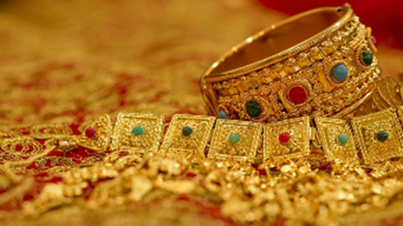
Ezekiel 38:12
“to capture spoil and to seize plunder, to turn your hand against the waste places which are now inhabited, and against the people who are gathered from the nations, who have acquired cattle and goods, who live at the center of the world.”

Slide 28
Ezekiel 38:13
“Sheba and Dedan and the merchants of Tarshish with all its villages will say to you, ‘Have you come to capture spoil? Have you assembled your company to seize plunder, to carry away silver and gold, to take away cattle and goods, to capture great spoil?’”

Slide 29
III. Invasion Defeated (Ezekiel 38:17‒39:20)
  Armies destroyed (38:17‒39:8)
  Weapons burned (39:9-10)
  Soldiers buried (39:11-16)
  Soldiers eaten (39:17-20)

Slide 30
Genesis 12:3
“And I will bless those who bless you, And the one who curses you I will curse. And in you all the families of the earth will be blessed.”

Slide 31
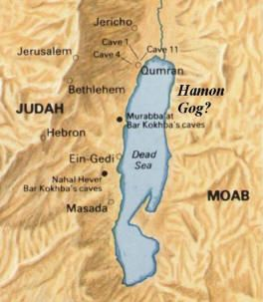

Slide 32
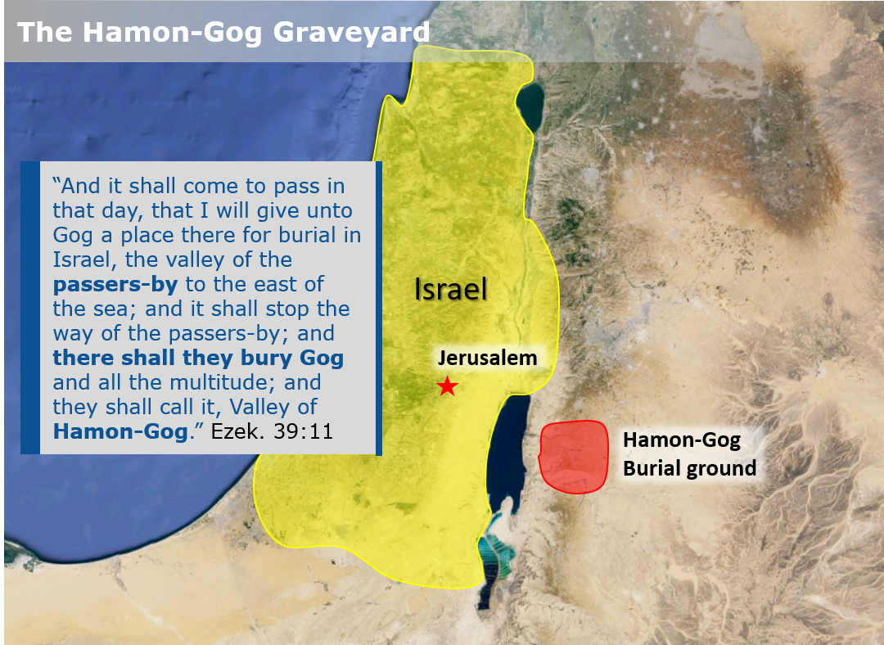

Slide 33
What?
Divine annihilation of the coalition (38:19-22)
Birds and beasts feast on the carnage (39:4-5, 17-20)
Seven-month burying of the dead (39:11-12, 14-16)
Seven-year burning of weapons (39:9-10)
Israel’s salvation and restoration (39:22, 29)

Slide 34


Slide 35

Daniel 12:11-12
“¹¹ From the time that the regular sacrifice is abolished and the abomination of desolation is set up, there will be 1,290 days. ¹² How blessed is he who keeps waiting and attains to the 1,335 days!”
35

Slide 36
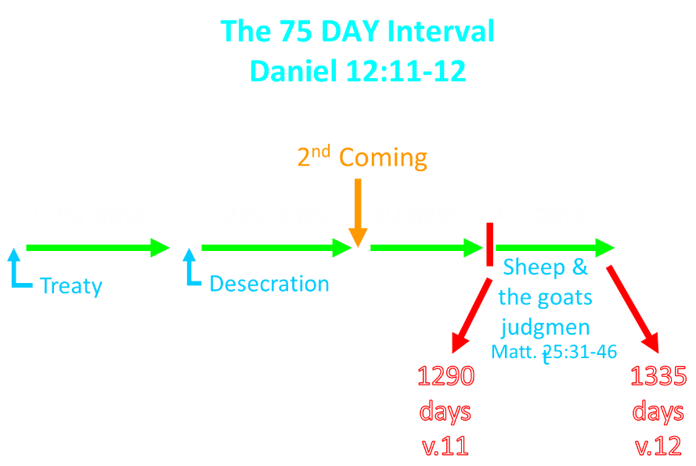

Slide 37

Dr. Arnold Fruchtenbaum
Footsteps of the Messiah, 355.
“The Millennium will not begin the day immediately following the last day of the Great Tribulation because there will be a seventy-five day interval. During this time between the Great Tribulation and the start of the Messianic Age, a number of events will occur. The existence of this interval is demonstrated in Daniel 12:11-12.”

Slide 38
The 75 DAY Interval
Daniel 12:11-12
The Beast cast into the Lake of Fire (Rev. 19:20)
The False Prophet cast into the Lake of Fire (Rev. 19:20)
The binding of Satan (Rev. 20:1-3)
The Judgment of the Jews (Ezek. 20:33-44)
The Judgment of the Gentiles (Matt. 25:31-46)
Resurrection of OT saints (Dan. 12:2) & Tribulation martyrs (Rev. 20:4-5)
Rewarding of OT saints & Tribulation martyrs (Dan. 12:3)
Fruchtenbaum, Footsteps of the Messiah, 356-66

Slide 39
Dispensational Theology is a System of Theology
Traditional-normative dispensational theology is a system that embodies three essential, fundamental concepts called the sine qua non (lit. “without which is not”):
The consistent use of a plain, normal, literal, grammatical-historical method of interpretation;
Which reveals that the Church is distinct from Israel;
God’s overall purpose is to bring glory to Himself (Eph. 1:6, 12, 14).
Dr. Charles Ryrie, Dispensationalism, pp. 38-41

Slide 40
Doxological Purpose
God’s ultimate purpose for the ages is to glorify Himself. Scripture is not human-centered, as though salvation were the principle point, but God-centered, because His glory is at the center.
The glory of God is the primary principle that unifies all dispensations, the program of salvation being just one of the means by which God glorifies Himself. Each successive revelation of God’s plan for the ages, as well as His dealing with the elect, non-elect, angels, and nations all manifest His glory.
Dictionary of Premillennial Theology, Charles Ryrie, p. 94

Slide 41
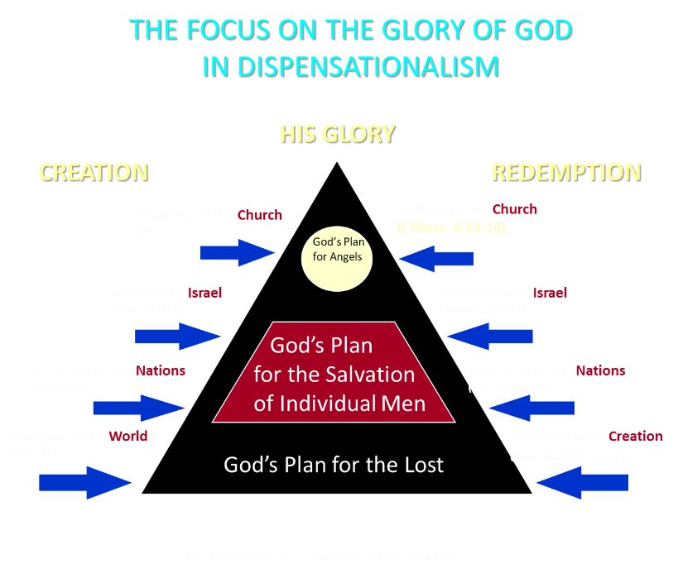

Slide 42
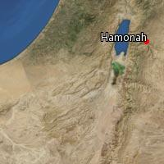

Slide 43
CONCLUSION

Slide 44
III. Invasion Defeated (Ezekiel 38:17‒39:20)
  Armies destroyed (38:17‒39:8)
  Weapons burned (39:9-10)
  Soldiers buried (39:11-16)
  Soldiers eaten (39:17-20)

