Slide 1
Genesis 12‒50
Israel’s Birth & Preservation

Slide 2
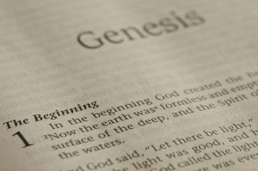
GENESIS STRUCTURE
Beginning of the Human race (Gen. 1‒11)
Beginning of the Hebrew race (Gen. 12‒50)

Slide 3
GENESIS STRUCTURE
Genesis 1-11 (four events)
Creation (1-2)
Fall (3-5)
Flood (6-9)
National dispersion (10-11)

Slide 4
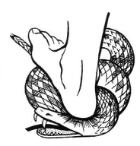
Genesis 3:15
“And I will put enmity Between you and the woman, And between your seed and her seed; He shall bruise you on the head, And you shall bruise him on the heel.”

Slide 5
GENESIS STRUCTURE
Beginning of the Human race (Gen. 1‒11)
Beginning of the Hebrew race (Gen. 12‒50)

Slide 6
GENESIS STRUCTURE
Genesis 12-50 (four people)
Abraham (12:1–25:11)
Isaac (25:12–26:35)
Jacob (27–36)
Joseph (37–50)

Slide 7
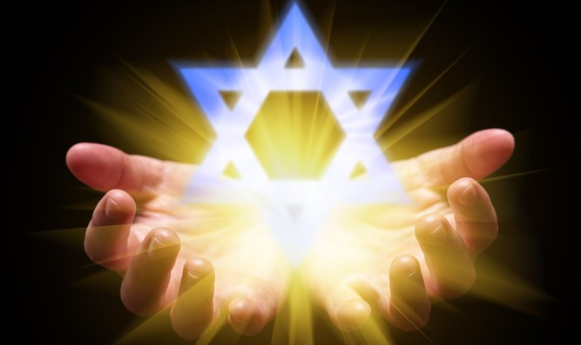
Isaiah 43:1
“But now, thus says the Lord, your Creator, O Jacob, And He who formed you, O Israel, 'Do not fear, for I have redeemed you; I have called you by name; you are Mine!'”

Slide 8
GENESIS STRUCTURE
Genesis 12-50 (four people)
Abraham (12:1–25:11)
Isaac (25:12–26:35)
Jacob (27–36)
Joseph (37–50)

Slide 9
Genesis 12‒19 Abram’s Early Journeys
Unconditional promises (Gen. 12:1-3)
From Haran to Canaan (Gen. 12:4-5)
In Canaan (Gen. 12:6-9)
In Egypt (Gen. 12:10-20)
Abram and Lot Separate (Gen. 13:1-13)
Reaffirmation of Abram’s promises (Gen. 13:14-18)
Abram Rescues Lot (14:1-24)
Abrahamic Covenant (15:1-21)
Hagar & Ishmael (16:1-16)
Circumcision (Gen. 17:1-27)
Sodom & Gomorrah (Gen. 18‒19)

Slide 10
Genesis 18‒19 Sodom & Gomorrah
Visitation (18:1-15)
Prediction (18:16-33)
Destruction (19:1-38)

Slide 11
Genesis 18‒19 Sodom & Gomorrah
Visitation (18:1-15)
Prediction (18:16-33)
Destruction (19:1-38)

Slide 12
Visitation Genesis 18:1-15
Hosting (1-8)
Promise of Isaac (9-15)

Slide 13
Genesis 18‒19 Sodom & Gomorrah
Visitation (18:1-15)
Prediction (18:16-33)
Destruction (19:1-38)

Slide 14
Prediction Genesis 18:16-33
Prophecy (16-21)
Intercession (22-33)

Slide 15
Genesis 18‒19 Sodom & Gomorrah
Visitation (18:1-15)
Prediction (18:16-33)
Destruction (19:1-38)

Slide 16
Destruction Genesis 19:1-38
Angels in Sodom (1-11)
Lot’s rescue (12-22)
Destruction (23-29)
Lot’s incest (30-38)

Slide 17
Destruction Genesis 19:1-38
Angels in Sodom (1-11)
Lot’s rescue (12-22)
Destruction (23-29)
Lot’s incest (30-38)

Slide 18
Angels in Sodom Genesis 19:1-11
Angelic arrival (1)
Lot’s invitation (2-3)
Mob’s attack (4-5)
Lot’s refusal & counter-offer (6-8)
Mob’s response (9)
Angelic response (10-11)

Slide 19
Destruction Genesis 19:1-38
Angels in Sodom (1-11)
Lot’s rescue (12-22)
Destruction (23-29)
Lot’s incest (30-38)

Slide 20
Lot’s Rescue Genesis 19:12-22
Angelic prediction (12-13)
Lot’s announcement (14)
Angelic exhortation (15)
Angelic enforcement (16)
Angelic instructions (17)
Lot’s request (18-20)
Angelic response (21-22)

Slide 21
Destruction Genesis 19:1-38
Angels in Sodom (1-11)
Lot’s rescue (12-22)
Destruction (23-29)
Lot’s incest (30-38)

Slide 22
Sodom’s Destruction Genesis 19:23-29
Timing (23)
Overthrow (24-25)
Lot’s loss (26)
Abraham’s response (27-28)
Summary (29)

Slide 23
Sodom’s Destruction Genesis 19:23-29
Timing (23)
Overthrow (24-25)
Lot’s loss (26)
Abraham’s response (27-28)
Summary (29)

Slide 24
Genesis 18‒19 Sodom & Gomorrah
Visitation (18:1-15)
Prediction (18:16-33)
Destruction (19:1-38)

Slide 25
2 Peter 3:9
“The Lord is not slow about His promise, as some count slowness, but is patient toward you, not wishing for any to perish but for all to come to repentance.”

Slide 26
Sodom’s Destruction Genesis 19:23-29
Timing (23)
Overthrow (24-25)
Lot’s loss (26)
Abraham’s response (27-28)
Summary (29)

Slide 27
Sodom’s Overthrow Genesis 19:24-25
Means (24)
Result (25)

Slide 28
Sodom’s Overthrow Genesis 19:24-25
Means (24)
Result (25)

Slide 29
Charles Ryrie
The Ryrie Study Bible
“Genesis 19:24 (RSB:NASB1995U): 19:24 brimstone and fire. Deposits of sulfur (brimstone) and asphalt (cf. 14:10) have been found in this area. Possibly an earthquake occurred, and lightning ignited the gases that were released, causing a rain of fire and smoke.”

Slide 30
Dr. Arnold G. Fruchtenbaum
The Book of Genesis, 327
“There are two Jehovahs in this passage: a Jehovah on earth and Jehovah in heaven, showing a plurality in the Godhead. The first Jehovah, on the earth, rained judgment from the second Jehovah, in heaven. Even the ancient rabbis recognized that there seem to be two Jehovahs, and they had to find a way around it. Some rabbis identified the first Jehovah as Gabriel and the second Jehovah as God. Other rabbis tried to simplify it further by claiming it represented God in His heavenly court.”

Slide 31
Genesis 1:26-28
²⁶ Then God said, “Let Us make man in Our image, according to Our likeness; and let them rule over the fish of the sea and over the birds of the sky and over the cattle and over all the earth, and over every creeping thing that creeps on the earth.” ²⁷ God created man in His own image, in the image of God He created him; male and female He created them. ²⁸ God blessed them; and God said to them, “Be fruitful and multiply, and fill the earth, and subdue it; and rule over the fish of the sea and over the birds of the sky and over every living thing that moves on the earth.”

Slide 32
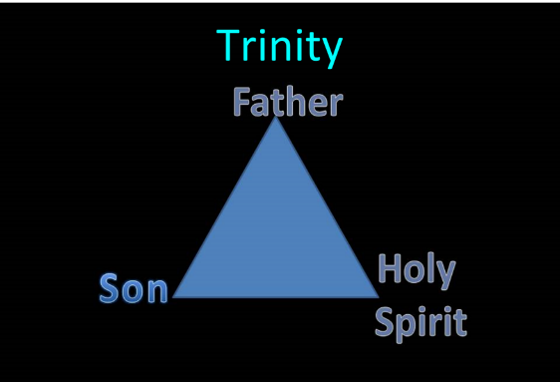
TRINITARIANISM IN GENESIS
Gen 1:26
Gen 3:22
Gen 11:7
Isa 6:8

Slide 33
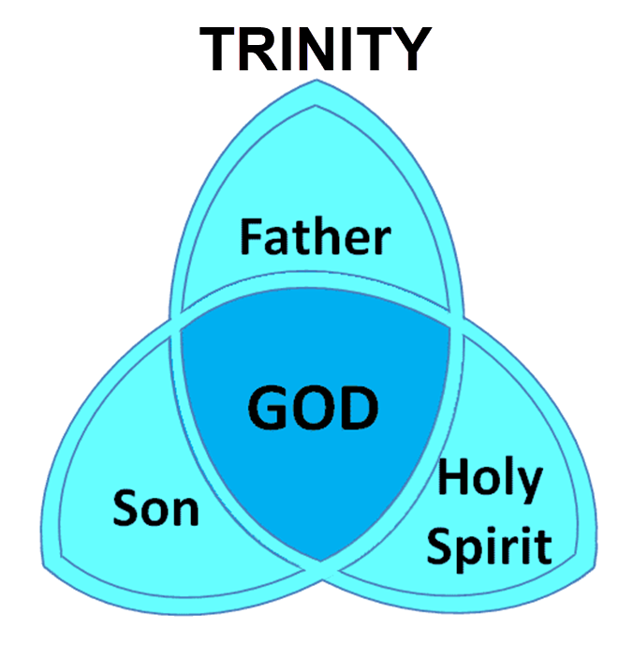

Slide 34
Genesis as the Seed-Plot of the Bible
“…Genesis gives us a synoptic preface to the entire Bible. It is the seed-plot of the Bible. The germ or beginning of all truth is within this wonderful book. Genesis is the foundation upon which the entire revelation rests; the root out of which the rest grows. Truths found here are developed in successive ages.”
Herbert Lockyer, The Gospel in the Pentateuch (Chicago: The Bible Institute Colportage Association, 1939), 25.

Slide 35
Dominoes in a Row

Slide 36
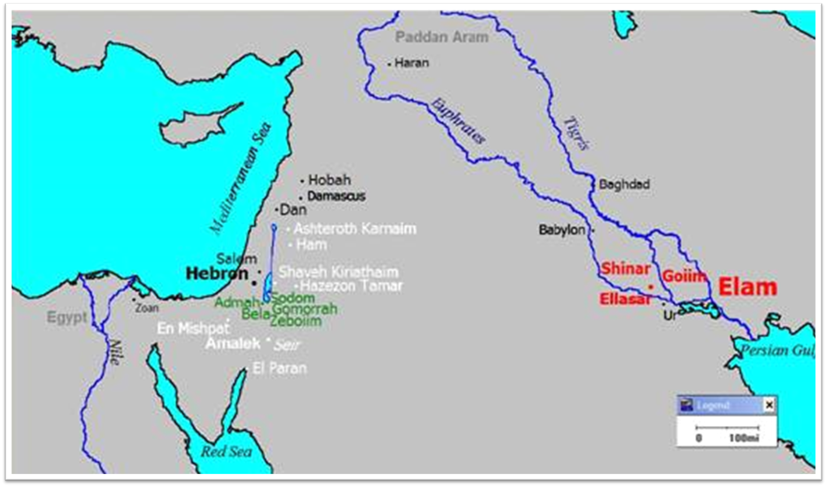

Slide 37
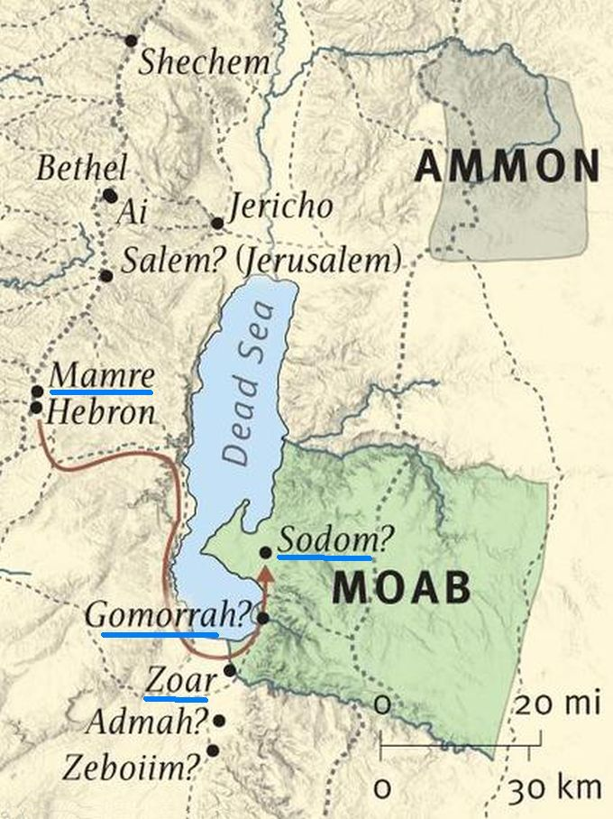

Slide 38
Sodom’s Overthrow Genesis 19:24-25
Means (24)
Result (25)

Slide 39
Dr. Arnold G. Fruchtenbaum
The Book of Genesis, 328
“In addition, indeed, the term ‘overthrow’ became a technical term for the destruction of the cities of Sodom and Gomorrah. In the New Testament, there developed Greek technical terms for the Flood and for the overthrow of Sodom and Gomorrah, and both terms are found in II Peter 2:4–9. The technical term for the Flood is kataklusmos, the origin of the English word ‘cataclysm.’ The technical term for the overthrow of Sodom and Gomorrah is katastrophei, the origin of the English word ‘catastrophe.’”

Slide 42
Genesis 3:17-19a
¹⁷ Then to Adam He said, “Because you have listened to the voice of your wife, and have eaten from the tree about which I commanded you, saying, ‘You shall not eat from it’; Cursed is the ground because of you; In toil you will eat of it All the days of your life. ¹⁸ “Both thorns and thistles it shall grow for you; And you will eat the plants of the field; ¹⁹ By the sweat of your face You will eat bread...”

Slide 43
Romans 8:19-22
¹⁹ For the anxious longing of the creation waits eagerly for the revealing of the sons of God. ²⁰ For the creation was subjected to futility, not willingly, but because of Him who subjected it, in hope ²¹ that the creation itself also will be set free from its slavery to corruption into the freedom of the glory of the children of God. ²² For we know that the whole creation groans and suffers the pains of childbirth together until now.

Slide 44
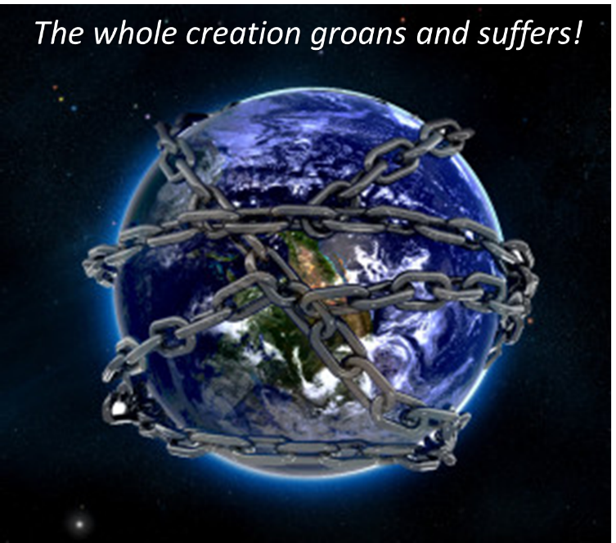

Slide 45
Sodom’s Destruction Genesis 19:23-29
Timing (23)
Overthrow (24-25)
Lot’s loss (26)
Abraham’s response (27-28)
Summary (29)

Slide 46
Angelic Enforcement Genesis 19:17
Location (17a)
Instructions (17b)
Escape (17b-e)
Do not look back (17c)
Get out of the valley (17d)
Flee to the Mountain (17e)
Reason (17f)

Slide 47
Charles Ryrie
The Ryrie Study Bible
“Genesis 19:26 (RSB:NASB1995U): 19:26 Lot’s wife, who was trailing behind him with her heart still in Sodom, looked back, died, and possibly was enveloped by blowing salt, which formed a ‘pillar’ around her body. This event was used by Jesus as a warning to others not to look back (Luke 17:21–33).”

Slide 48
1 Corinthians 3:15
“If any man’s work is burned up, he will suffer loss; but he himself will be saved, yet so as through fire.”

Slide 49
Scripture’s Five Crowns (Rev 4:10: 3:11; 2 John 8)
SCRIPTURE | CROWN | PURPOSE
1 Cor. 9:24-27 | INCORRUPTIBLE | Gaining mastery over the flesh
1 Thess. 2:19-20 | REJOICING | Soul winning
Jas. 1:12; Rev. 2:10 | LIFE | Enduring trials
1 Pet. 5:2-4 | GLORY | Shepherding God’s people
2 Tim. 4:8 | RIGHTEOUSNESS | Longing for His appearing

Slide 50
Romans 12:2
“And do not be conformed to this world, but be transformed by the renewing of your mind, so that you may prove what the will of God is, that which is good and acceptable and perfect.”

Slide 51
Colossians 2:8
“See to it that there is no one who takes you captive through philosophy and empty deception in accordance with human tradition, in accordance with the elementary principles of the world, rather than in accordance with Christ.”

Slide 52
2 Peter 2:7-9
“⁷ and if He rescued righteous Lot, oppressed by the sensual conduct of unprincipled men ⁸ (for by what he saw and heard that righteous man, while living among them, felt his righteous soul tormented day after day by their lawless deeds), ⁹ then the Lord knows how to rescue the godly from temptation, and to keep the unrighteous under punishment for the day of judgment.”

Slide 53
John 10:27-29
“²⁷ My sheep hear My voice, and I know them, and they follow Me; ²⁸ and I give eternal life to them, and they will never perish [ou mē; aiōnia]; and no one will snatch them out of My hand. ²⁹ My Father, who has given them to Me, is greater than all; and no one is able to snatch them out of the Father’s hand.”

Slide 54
YIELDING TO THE OLD (SIN) NATURE
BELIEVER’S CONSEQUENCES | PASSAGE(S)
Lack of power | (Gal 5:16; 1 Thess. 5:19)
Grieving the Holy Spirit | (Eph 4:30-32)
Loss of joy | (Ps. 51:4, 12; Gal. 5:22-23)
Loss of spiritual sight | (2 Pet. 1:8-10; Luke 15:18-19)
Lack of growth | (1 Pet. 2:1-2)
Carnality | (1 Cor 3:1-3)
Unfruitfulness | (John 15:5, 8)
Lack of purpose | (Eccles. 1:2-3, 8; Mark 8:35)
Lack of stability | (Gal. 3:3; 2 Tim. 2:18; 2 Pet. 3:17)

Slide 55
YIELDING TO THE OLD (SIN) NATURE
BELIEVER’S CONSEQUENCES | PASSAGE(S)
Conviction | (2 Pet 2:7-8; Ps 32:1-5)
Divine discipline | (Heb. 12:5-11; Rev. 3:19)
Premature death | (Acts 5:1-11; 1 Cor 11:30; 1 John 5:16; Rev 2:22-23)
Loss of reward | (1 Cor. 3:15; 9:27; 2 John 8; Rev 3:11)
Loss of fellowship | (1 John 1:9)
Excommunication | (1 Cor 5:4-5; Matt 18:15-17)
Temporal consequences | (Gal 6:7-8)
Unanswered prayer | (Ps 66:18; 1 Pet 3:7)
Loss of testimony | (Gen 19:14)
Loss of leadership privileges | (1 Tim 3:1-13; 2 Sam. 12)

Slide 56
Sodom’s Destruction Genesis 19:23-29
Timing (23)
Overthrow (24-25)
Lot’s loss (26)
Abraham’s response (27-28)
Summary (29)

Slide 57
Abraham’s Response Genesis 19:27-28
What Abraham did (27)
What Abraham saw (28)

Slide 58
Abraham’s Response Genesis 19:27-28
What Abraham did (27)
What Abraham saw (28)

Slide 59
Abraham’s Response Genesis 19:27-28
What Abraham did (27)
What Abraham saw (28)

Slide 60
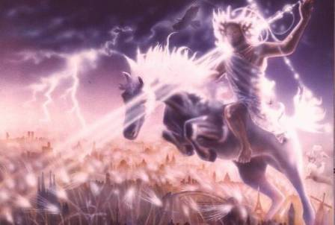
Isaiah 13-14
Day of the Lord (13:6-9)
Cosmic disturbances (13:10-13)
Global judgment (13:11-12)
Sodom and Gomorrah (13:19)
Complete and final desolation (13:20-22)
Universal peace and rest (14:5-8)
Israel’s regeneration (14:1-4)
Henry Morris, Revelation Record, 348.

Slide 61
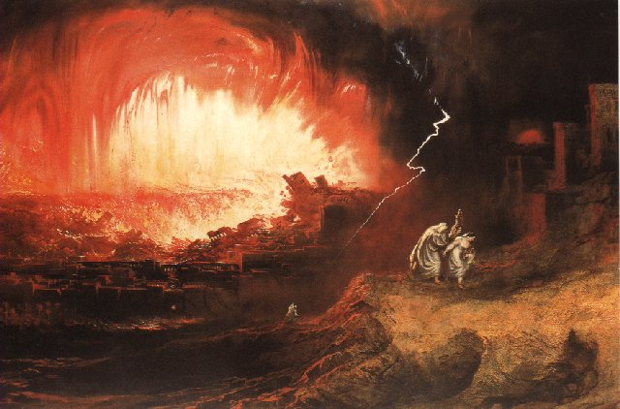
Jeremiah 50-51
Sudden destruction (51:8)
Complete destruction (50:3, 13, 26, 39-40; 51:29, 43, 62)
No reuse of building materials (51:26)
Believers flee (50:8; 51:6, 45)
Israel’s regeneration (50:2, 4-5, 20; 51:50)
Dyer, "The Identity of Babylon in Revelation 17–18 (Part 2)," 443-49.

Slide 62
Charles Ryrie
The Ryrie Study Bible
“Genesis 19:29 (RSB:NASB1995U): 19:29 The overthrow of Sodom and Gomorrah is used as a warning on several occasions in both the OT (Deut. 29:23; Isa. 1:9–10; Jer. 49:18; Amos 4:11) and NT (Matt. 10:15; 11:23–24; Rom. 9:29; 2 Peter 2:6; Jude 7; Rev. 11:8).”

Slide 63
Dominoes in a Row

Slide 64
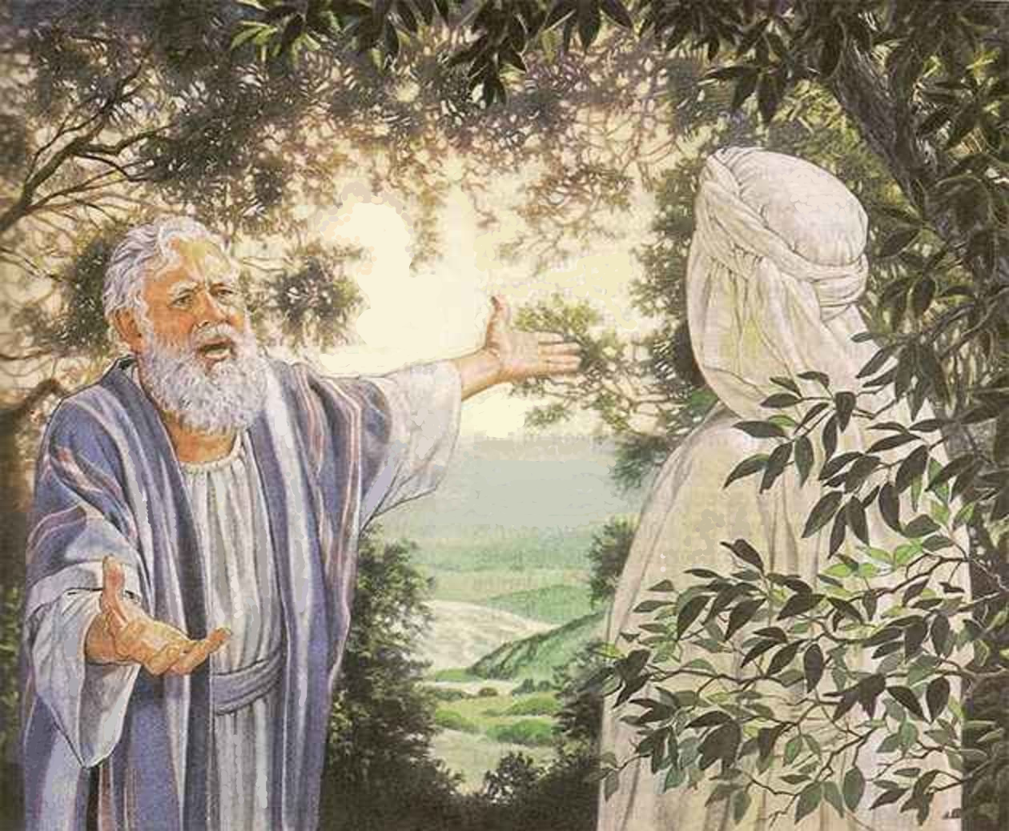
Intercession Genesis 18:24-32
Fifty (24-26)
Forty-five (27-28)
Forty (29)
Thirty (30)
Twenty (31)
Ten (32)

Slide 65
Sodom’s Destruction Genesis 19:23-29
Timing (23)
Overthrow (24-25)
Lot’s loss (26)
Abraham’s response (27-28)
Summary (29)

Slide 66
Summary Genesis 19:29
God’s action (29a)
God’s remembrance (29b)

Slide 67
Summary Genesis 19:29
God’s action (29a)
God’s remembrance (29b)

Slide 70
John 13:19; 14:29
“¹⁹ From now on I am telling you before it comes to pass, so that when it does occur, you may believe that I am He… ^{14:29} Now I have told you before it happens, so that when it happens, you may believe.”

Slide 72
Summary Genesis 19:29
God’s action (29a)
God’s remembrance (29b)

Slide 73
Dr. Arnold G. Fruchtenbaum
The Book of Genesis, 175
“The word remember does not mean remember in the sense that God temporarily forgot about the ark and its inhabitants; rather it means remembering in the sense of movement toward the object. For example, in Genesis 19:29, God remembered Abraham with a view to saving Lot; in Exodus 2:24, God remembered his covenant with the Patriarchs with a view to rescuing Israel; in Jeremiah 2:2, God remembered Israel with a view toward her restoration; in Jeremiah 31:20, God remembered Ephraim with a view toward extending mercy to him; and in Luke 1:54–55, God remembered Israel with a view toward sending the Messiah to Israel. Furthermore, the sense was that of God remembering a covenant; although in . . .

Slide 74
Dr. Arnold G. Fruchtenbaum
The Book of Genesis, 175, 328
. . . in this case the covenant itself had not yet been made. He said earlier in chapter 6, that He would establish His covenant with Noah. Furthermore, in 7:4 God remembered that the rain would only last forty days. All these usages fit into the word ‘remember.’ . . .God’s action is described: God remembered Abraham. Once again, the word ‘remember’ does not mean that God forgot; rather it means remember in the sense of taking action on behalf of. Therefore, God remembered Abraham; He remembered the Abrahamic Covenant; He remembered Abraham’s real concern was Lot.”

Slide 75
Dr. Arnold G. Fruchtenbaum
The Book of Genesis, 318
“Sometimes God will not respond positively to specific prayer requests, but He will respond to the desire behind those prayer requests.”

Slide 76
Conclusion

Slide 77
Destruction Genesis 19:1-38
Angels in Sodom (1-11)
Lot’s rescue (12-22)
Destruction (23-29)
Lot’s incest (30-38)

Slide 78
Sodom’s Destruction Genesis 19:23-29
Timing (23)
Overthrow (24-25)
Lot’s loss (26)
Abraham’s response (27-28)
Summary (29)

Slide 79
Destruction Genesis 19:1-38
Angels in Sodom (1-11)
Lot’s rescue (12-22)
Destruction (23-29)
Lot’s incest (30-38)

Slide 80
²⁴ The Lord bless you, and keep you; ²⁵ The Lord make His face shine on you, And be gracious to you; ²⁶ The Lord lift up His countenance on you, And give you peace.
Numbers 6:24–26 (NASB95)

