Slide 1
Genesis 12‒50
Israel’s Birth & Preservation

Slide 2
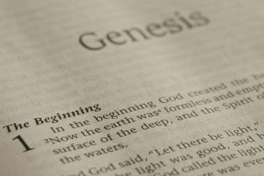
GENESIS STRUCTURE
Beginning of the Human race (Gen. 1‒11)
Beginning of the Hebrew race (Gen. 12‒50)

Slide 3
GENESIS STRUCTURE
Genesis 1-11 (four events)
Creation (1-2)
Fall (3-5)
Flood (6-9)
National dispersion (10-11)

Slide 4
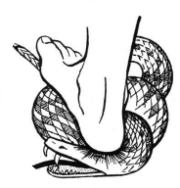
Genesis 3:15
“And I will put enmity Between you and the woman, And between your seed and her seed; He shall bruise you on the head, And you shall bruise him on the heel.”

Slide 5
GENESIS STRUCTURE
Beginning of the Human race (Gen. 1‒11)
Beginning of the Hebrew race (Gen. 12‒50)

Slide 6
GENESIS STRUCTURE
Genesis 12-50 (four people)
Abraham (12:1–25:11)
Isaac (25:12–26:35)
Jacob (27–36)
Joseph (37–50)

Slide 7
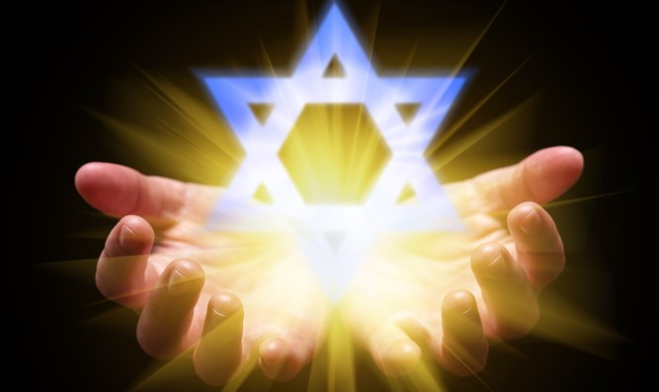
Isaiah 43:1
“But now, thus says the Lord, your Creator, O Jacob, And He who formed you, O Israel, 'Do not fear, for I have redeemed you; I have called you by name; you are Mine!'”

Slide 8
GENESIS STRUCTURE
Genesis 12-50 (four people)
Abraham (12:1–25:11)
Isaac (25:12–26:35)
Jacob (27–36)
Joseph (37–50)

Slide 9
Genesis 12‒19 Abram’s Early Journeys
Unconditional promises (Gen. 12:1-3)
From Haran to Canaan (Gen. 12:4-5)
In Canaan (Gen. 12:6-9)
In Egypt (Gen. 12:10-20)
Abram and Lot Separate (Gen. 13:1-13)
Reaffirmation of Abram’s promises (Gen. 13:14-18)
Abram Rescues Lot (14:1-24)
Abrahamic Covenant (15:1-21)
Hagar & Ishmael (16:1-16)
Circumcision (Gen. 17:1-27)
Sodom & Gomorrah (Gen. 18‒19)

Slide 10
Genesis 18‒19 Sodom & Gomorrah
Visitation (18:1-15)
Prediction (18:16-33)
Destruction (19:1-38)

Slide 11
Genesis 18‒19 Sodom & Gomorrah
Visitation (18:1-15)
Prediction (18:16-33)
Destruction (19:1-38)

Slide 12
Visitation Genesis 18:1-15
Hosting (1-8)
Promise of Isaac (9-15)

Slide 13
Genesis 18‒19 Sodom & Gomorrah
Visitation (18:1-15)
Prediction (18:16-33)
Destruction (19:1-38)

Slide 14
Prediction Genesis 18:16-33
Prophecy (16-21)
Intercession (22-33)

Slide 15
Genesis 18‒19 Sodom & Gomorrah
Visitation (18:1-15)
Prediction (18:16-33)
Destruction (19:1-38)

Slide 16
Destruction Genesis 19:1-38
Angels in Sodom (1-11)
Lot’s rescue (12-22)
Destruction (23-29)
Lot’s incest (30-38)

Slide 17
Destruction Genesis 19:1-38
Angels in Sodom (1-11)
Lot’s rescue (12-22)
Destruction (23-29)
Lot’s incest (30-38)

Slide 18
Angels in Sodom Genesis 19:1-11
Angelic arrival (1)
Lot’s invitation (2-3)
Mob’s attack (4-5)
Lot’s refusal & counter-offer (6-8)
Mob’s response (9)
Angelic response (10-11)

Slide 19
Destruction Genesis 19:1-38
Angels in Sodom (1-11)
Lot’s rescue (12-22)
Destruction (23-29)
Lot’s incest (30-38)

Slide 20
Lot’s Rescue Genesis 19:12-22
Angelic prediction (12-13)
Lot’s announcement (14)
Angelic exhortation (15)
Angelic enforcement (16)
Angelic instructions (17)
Lot’s request (18-20)
Angelic response (21-22)

Slide 21
Lot’s Rescue Genesis 19:12-22
Angelic prediction (12-13)
Lot’s announcement (14)
Angelic exhortation (15)
Angelic enforcement (16)
Angelic instructions (17)
Lot’s request (18-20)
Angelic response (21-22)

Slide 22
Angelic Prediction Genesis 19:12-13
Exhortation (12)
Reason (13)

Slide 23
Angelic Prediction Genesis 19:12-13
Exhortation (12)
Reason (13)

Slide 24
Dr. Arnold G. Fruchtenbaum
The Book of Genesis, 318
“Abraham stopped at ten, because he assumed that would be sufficient because of the size of Lot’s family, since Lot’s total household at this point did number ten: Lot; Lot’s wife; Lot’s two sons (19:12); his two married daughters (19:14); and his two sons-in-laws (19:14); and finally, his two single virgin daughters (19:8).”

Slide 25
Angelic Prediction Genesis 19:12-13
Exhortation (12)
Reason (13)

Slide 27
John 13:19; 14:29
“¹⁹ From now on I am telling you before it comes to pass, so that when it does occur, you may believe that I am He… ^{14:29} Now I have told you before it happens, so that when it happens, you may believe.”

Slide 29
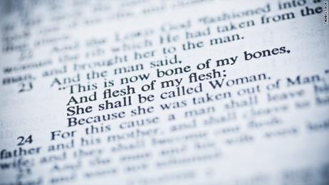
THE BIBLE AND HOMOSEXUALITY
Creation (Gen. 1‒2)
Sodom and Gomorrah (Gen. 18‒19)
The Mosaic Law (Lev. 18; 20)
Jesus Christ (Matt. 19; John 2)
The Apostle Paul (Rom. 1; 1 Cor. 6; 1 Tim. 1)

Slide 30
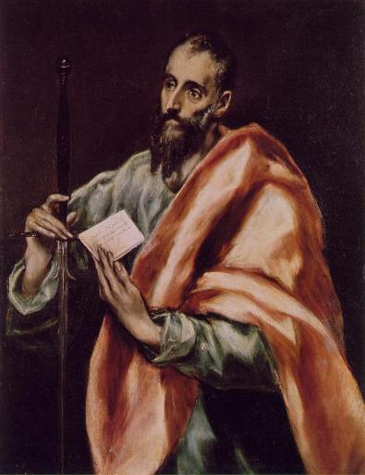
The Apostle Paul
Pro-Heterosexuality
1 Cor. 7:2-5
Eph. 5:22-33
1 Tim. 3:2, 12
Anti-Homosexuality
1 Cor. 6:9-11
Rom. 1:26-27
1 Tim. 1:9-10

Slide 31
Lot’s Rescue Genesis 19:12-22
Angelic prediction (12-13)
Lot’s announcement (14)
Angelic exhortation (15)
Angelic enforcement (16)
Angelic instructions (17)
Lot’s request (18-20)
Angelic response (21-22)

Slide 32
2 Peter 2:7-9
“⁷ and if He rescued righteous Lot, oppressed by the sensual conduct of unprincipled men ⁸ (for by what he saw and heard that righteous man, while living among them, felt his righteous soul tormented day after day by their lawless deeds), ⁹ then the Lord knows how to rescue the godly from temptation, and to keep the unrighteous under punishment for the day of judgment.”

Slide 33
John 10:27-29
“My sheep hear My voice, and I know them, and they follow Me; ²⁸ and I give eternal life to them, and they will never perish [ou mē; aiōnia]; and no one will snatch them out of My hand. ²⁹ My Father, who has given them to Me, is greater than all; and no one is able to snatch them out of the Father’s hand.” (NASB)

Slide 34
YIELDING TO THE OLD (SIN) NATURE
BELIEVER’S CONSEQUENCES | PASSAGE(S)
Lack of power | (Gal 5:16; 1 Thess. 5:19)
Grieving the Holy Spirit | (Eph 4:30-32)
Loss of joy | (Ps. 51:4, 12; Gal. 5:22-23)
Loss of spiritual sight | (2 Pet. 1:8-10; Luke 15:18-19)
Lack of growth | (1 Pet. 2:1-2)
Carnality | (1 Cor 3:1-3)
Unfruitfulness | (John 15:5, 8)
Lack of purpose | (Eccles. 1:2-3, 8; Mark 8:35)
Lack of stability | (Gal. 3:3; 2 Tim. 2:18; 2 Pet. 3:17)

Slide 35
YIELDING TO THE OLD (SIN) NATURE
BELIEVER’S CONSEQUENCES | PASSAGE(S)
Conviction | (2 Pet 2:7-8; Ps 32:1-5)
Divine discipline | (Heb. 12:5-11; Rev. 3:19)
Premature death | (Acts 5:1-11; 1 Cor 11:30; 1 John 5:16; Rev 2:22-23)
Loss of reward | (1 Cor. 3:15; 9:27; 2 John 8; Rev 3:11)
Loss of fellowship | (1 John 1:9)
Excommunication | (1 Cor 5:4-5; Matt 18:15-17)
Temporal consequences | (Gal 6:7-8)
Unanswered prayer | (Ps 66:18; 1 Pet 3:7)
Loss of testimony | (Gen 19:14)
Loss of leadership privileges | (1 Tim 3:1-13; 2 Sam. 12)

Slide 36
Lot’s Rescue Genesis 19:12-22
Angelic prediction (12-13)
Lot’s announcement (14)
Angelic exhortation (15)
Angelic enforcement (16)
Angelic instructions (17)
Lot’s request (18-20)
Angelic response (21-22)

Slide 37
Lot’s Rescue Genesis 19:12-22
Angelic prediction (12-13)
Lot’s announcement (14)
Angelic exhortation (15)
Angelic enforcement (16)
Angelic instructions (17)
Lot’s request (18-20)
Angelic response (21-22)

Slide 38
Romans 12:2
“And do not be conformed to this world, but be transformed by the renewing of your mind, so that you may prove what the will of God is, that which is good and acceptable and perfect.”

Slide 39
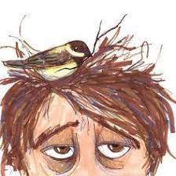
Colossians 2:8
“See to it that there is no one who takes you captive through philosophy and empty deception in accordance with human tradition, in accordance with the elementary principles of the world, rather than in accordance with Christ.”

Slide 40
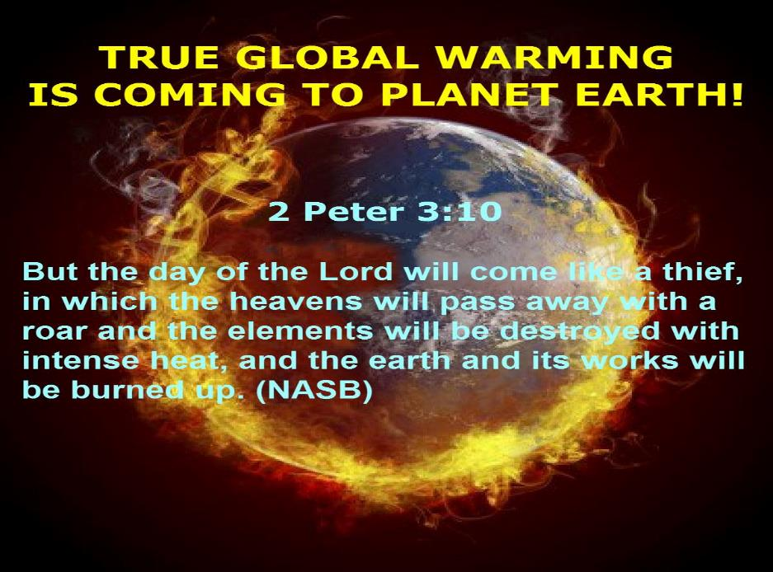

Slide 41
Ante-Nicene Fathers: “Heavenly and Eschatological" Interpretation of John 14:1-4
“Interestingly, references to John 14:1-3 virtually disappear when perusing the writings of the Nicene and Post-Nicene fathers. This is a bit surprising, given the abundance of material in these later writers when compared with the Ante-Nicenes. I would assume that with the rise of Augustinian amillennialism and its optimistic interpretation regarding the present arrival of the Kingdom of God, the kind of hope held out in John 14:1-3 ceased to hold relevance.”
George Gunn, “John 14:1-3: The Father's House: Are We There Yet?,” 30, n. 24.

Slide 42
Scripture’s Five Crowns (Rev 4:10: 3:11; 2 John 8)
SCRIPTURE | CROWN | PURPOSE
1 Cor. 9:24-27 | INCORRUPTIBLE | Gaining mastery over the flesh
1 Thess. 2:19-20 | REJOICING | Soul winning
Jas. 1:12; Rev. 2:10 | LIFE | Enduring trials
1 Pet. 5:2-4 | GLORY | Shepherding God’s people
2 Tim. 4:8 | RIGHTEOUSNESS | Longing for His appearing

Slide 43
Genesis 6:1-4
“¹ Now it came about, when men began to multiply on the face of the land, and daughters were born to them, ² that the sons of God saw that the daughters of men were beautiful; and they took wives for themselves, whomever they chose. ³ Then the Lord said, ‘My Spirit shall not strive with man forever, because he also is flesh; nevertheless his days shall be one hundred and twenty years.’ ⁴ The Nephilim were on the earth in those days, and also afterward, when the . . .

Slide 44
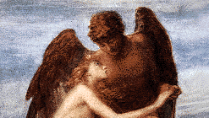
Genesis 6:1-4
. . . sons of God came in to the daughters of men, and they bore children to them. Those were the mighty men who were of old, men of renown.”

Slide 45
Genesis 15:13, 16
“¹³ Then God said to Abram, ‘Know for certain that your descendants will be strangers in a land that is not theirs, where they will be enslaved and oppressed for four hundred years…¹⁶ Then in the fourth generation they will return here, for the wrongdoing of the Amorite is not yet complete.’”

Slide 46
Distinctions Between 144,000 & Multitude
144,000 | MULTITUDE
Revelation 7:1-8 | Revelation 7:9-17
Numbered | Innumerable
Jews | All nations
Sealed | Slain
Sealed before the Tribulation | Converted out of the Tribulation
Hitchcock and Ice, The Truth Behind Left Behind, 77

Slide 47
Lot’s Rescue Genesis 19:12-22
Angelic prediction (12-13)
Lot’s announcement (14)
Angelic exhortation (15)
Angelic enforcement (16)
Angelic instructions (17)
Lot’s request (18-20)
Angelic response (21-22)

Slide 48
Angelic Enforcement Genesis 19:17
Location (17a)
Instructions (17b)
Escape (17b-e)
Do not look back (17c)
Get out of the valley (17d)
Flee to the Mountain (17e)
Reason (17f)

Slide 49
Angelic Enforcement Genesis 19:17
Location (17a)
Instructions (17b)
Escape (17b-e)
Do not look back (17c)
Get out of the valley (17d)
Flee to the Mountain (17e)
Reason (17f)

Slide 50
Angelic Enforcement Genesis 19:17
Location (17a)
Instructions (17b)
Escape (17b-e)
Do not look back (17c)
Get out of the valley (17d)
Flee to the Mountain (17e)
Reason (17f)

Slide 51
Angelic Enforcement Genesis 19:17
Location (17a)
Instructions (17b)
Escape (17b-e)
Do not look back (17c)
Get out of the valley (17d)
Flee to the Mountain (17e)
Reason (17f)

Slide 52
“TIME-TEXTS” IN REVELATION R.C. Sproul, The Last Days According to Jesus, p.139
SHORTLY, QUICKLY “TACOS”
1:1 | …Things which must shortly take place
2:16 | Repent, or else I will come to you quickly.
3:11 | Behold, I come quickly!
22:6 | …Which must shortly take place.
22:7 | Behold, I come quickly!
22:12 | Behold, I am coming quickly!
22:20 | Surely, I am coming quickly!
NEAR, AT HAND “ENGYS”
1:3 | The time is near.
22:10 | The time is at hand.
ABOUT TO, ON THE POINT OF “MELLŌ”
1:19 | Write…the things that are about to take place.
3:10 | …the hour of trial…is about to come upon the whole world.

Slide 53
Angelic Enforcement Genesis 19:17
Location (17a)
Instructions (17b)
Escape (17b-e)
Do not look back (17c)
Get out of the valley (17d)
Flee to the Mountain (17e)
Reason (17f)

Slide 54
Angelic Enforcement Genesis 19:17
Location (17a)
Instructions (17b)
Escape (17b-e)
Do not look back (17c)
Get out of the valley (17d)
Flee to the Mountain (17e)
Reason (17f)

Slide 55
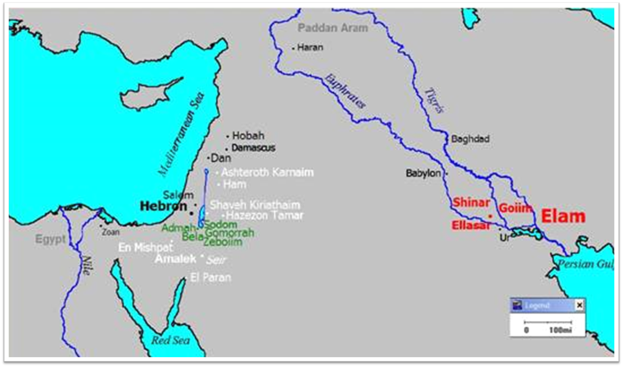

Slide 56
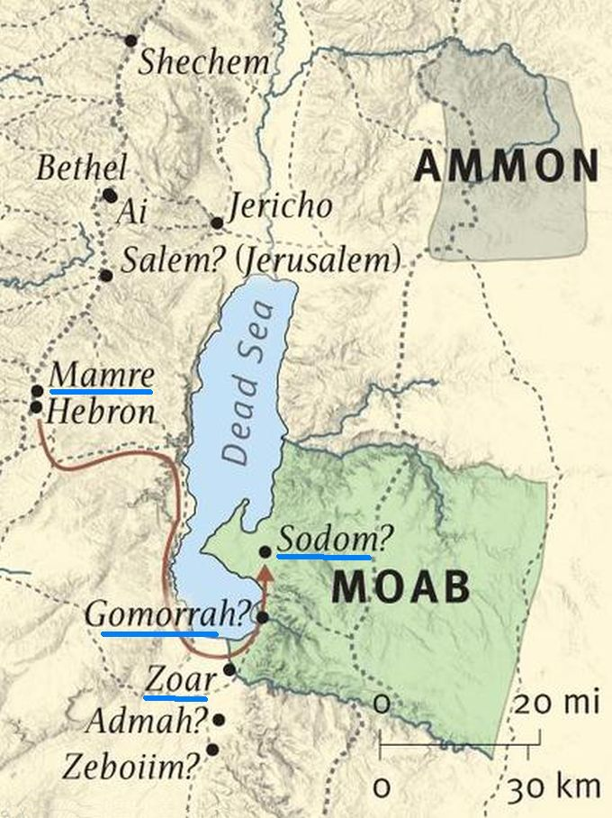

Slide 57
Angelic Enforcement Genesis 19:17
Location (17a)
Instructions (17b)
Escape (17b-e)
Do not look back (17c)
Get out of the valley (17d)
Flee to the Mountain (17e)
Reason (17f)

Slide 58
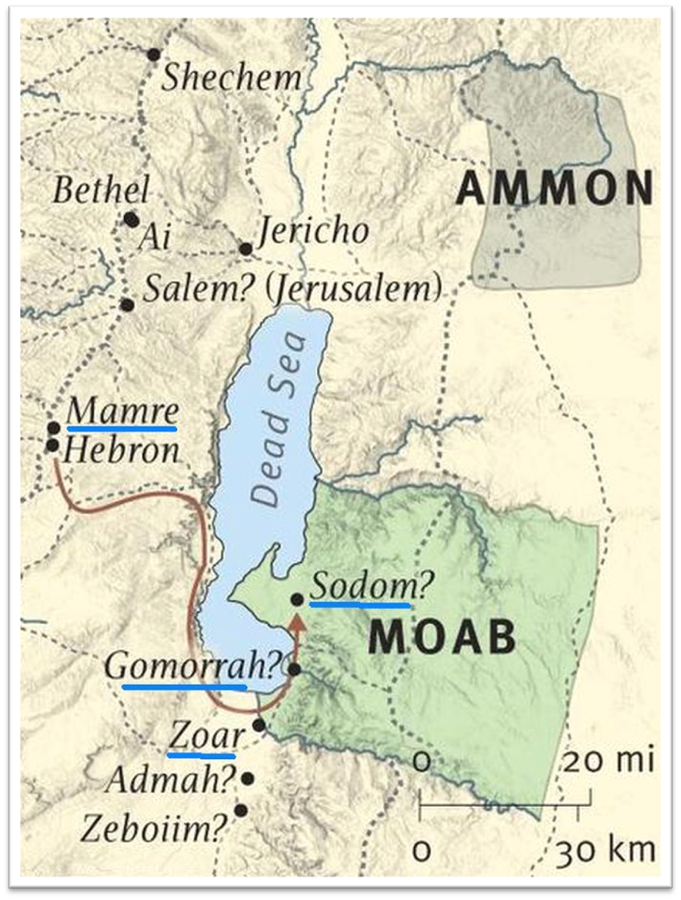
Dr. Arnold G. Fruchtenbaum
The Book of Genesis, 325
“They are to escape to the mountain, which will serve as the area of safety. The definite article the used with mountain probably refers to the mountains of the Trans-Jordan where the descendants settled.”

Slide 59
Matthew 24:15-16, 20
“¹⁵ Therefore when you see the abomination of desolation which was spoken of through Daniel the prophet, standing in the holy place (let the reader understand) ¹⁶ then those who are in Judea must flee to the mountains…²⁰ But pray that your flight will not be in the winter, or on a Sabbath.”

Slide 60
Angelic Enforcement Genesis 19:17
Location (17a)
Instructions (17b)
Escape (17b-e)
Do not look back (17c)
Get out of the valley (17d)
Flee to the Mountain (17e)
Reason (17f)

Slide 61
Lot’s Rescue Genesis 19:12-22
Angelic prediction (12-13)
Lot’s announcement (14)
Angelic exhortation (15)
Angelic enforcement (16)
Angelic instructions (17)
Lot’s request (18-20)
Angelic response (21-22)

Slide 62
Angelic Enforcement Genesis 19:18-20
Protest (18)
Basis (19)
God’s compassion (19a)
Lot’s inability (19b)
Request (20)

Slide 63
Angelic Enforcement Genesis 19:18-20
Protest (18)
Basis (19)
God’s compassion (19a)
Lot’s inability (19b)
Request (20)

Slide 64
Angelic Enforcement Genesis 19:18-20
Protest (18)
Basis (19)
God’s compassion (19a)
Lot’s inability (19b)
Request (20)

Slide 65
Angelic Enforcement Genesis 19:18-20
Protest (18)
Basis (19)
God’s compassion (19a)
Lot’s inability (19b)
Request (20)

Slide 66
Angelic Enforcement Genesis 19:18-20
Protest (18)
Basis (19)
God’s compassion (19a)
Lot’s inability (19b)
Request (20)

Slide 67
Angelic Enforcement Genesis 19:18-20
Protest (18)
Basis (19)
God’s compassion (19a)
Lot’s inability (19b)
Request (20)

Slide 68
Dr. Arnold G. Fruchtenbaum
The Book of Genesis, 326
“Then came the request in verse 20: Behold now, this city is near to flee unto, and it is a little one. Oh let me escape thither (is it not a little one?). Lot emphasized a little one twice. In other words, this town was so little compared to the other four that perhaps God could leave this one alone and let Lot flee to that one so that [Lot’s] soul shall live.”

Slide 69
Lot’s Rescue Genesis 19:12-22
Angelic prediction (12-13)
Lot’s announcement (14)
Angelic exhortation (15)
Angelic enforcement (16)
Angelic instructions (17)
Lot’s request (18-20)
Angelic response (21-22)

Slide 70
Angelic Response Genesis 19:21-22
Request granted (21)
New instructions (22)

Slide 71
Angelic Response Genesis 19:21-22
Request granted (21)
New instructions (22)

Slide 72
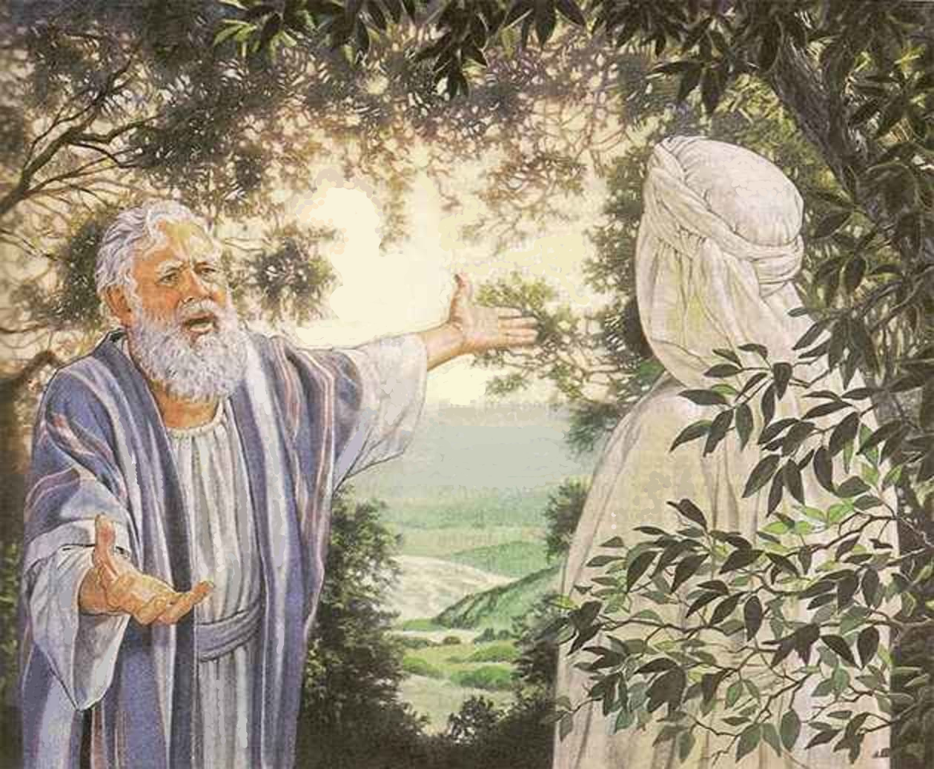
Intercession Genesis 18:24-32
Fifty (24-26)
Forty-five (27-28)
Forty (29)
Thirty (30)
Twenty (31)
Ten (32)

Slide 73
Angelic Response Genesis 19:21-22
Request granted (21)
New instructions (22)

Slide 74
Genesis 19:22
“Hurry, escape there, for I cannot do anything until you arrive there.” Therefore the name of the town was called Zoar.”

Slide 75
Luke 17:28-30
“²⁸ It was the same as happened in the days of Lot: they were eating, they were drinking, they were buying, they were selling, they were planting, and they were building; ²⁹ but on the day that Lot left Sodom, it rained fire and brimstone from heaven and destroyed them all. ³⁰ It will be just the same on the day that the Son of Man is revealed.”

Slide 76
Matthew 24:36-39
³⁶ “But of that day and hour no one knows, not even the angels of heaven, nor the Son, but the Father alone. ³⁷ For the coming of the Son of Man will be just like the days of Noah. ³⁸ For as in those days before the flood they were eating and drinking, marrying and giving in marriage, until the day that Noah entered the ark, ³⁹ and they did not understand until the flood came and took them all away; so will the coming of the Son of Man be.”

Slide 77
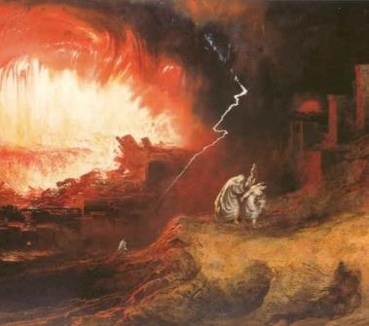
Symbolic Parallels
Luke 17:26-30
Enoch taken before the flood (Gen 5:24)
Noah protected before the flood (Gen 7:6-7)
Lot taken before judgment upon Sodom (2 Pet 2:7; Gen 19:22)

Slide 78
Genesis 19:22
“Hurry, escape there, for I cannot do anything until you arrive there.” Therefore the name of the town was called Zoar.”

Slide 79
Dr. Arnold G. Fruchtenbaum
The Book of Genesis, 326
“Therefore the name of the city was called Zoar. It was at this point that the town’s name became Zoar. In the Hebrew text, there is a play upon words. The Hebrew word for little used here is the word meitzar, and Zoar in Hebrew is tzoar. The original name of the city was Bela (14:2, 8). Thus, Zoar became the only city of the five cities of the Plain to survive the overthrow, and only because of Lot’s intercession for Zoar.”

Slide 80
Conclusion

Slide 81
Lot’s Rescue Genesis 19:12-22
Angelic prediction (12-13)
Lot’s announcement (14)
Angelic exhortation (15)
Angelic enforcement (16)
Angelic instructions (17)
Lot’s request (18-20)
Angelic response (21-22)

Slide 82
Destruction Genesis 19:1-38
Angels in Sodom (1-11)
Lot’s rescue (12-22)
Destruction (23-29)
Lot’s incest (30-38)

Slide 83
“The Lord bless you and keep you; the Lord make his face shine on you and be gracious to you; the Lord turn his face toward you and give you peace.” (NIV)

