Slide 1
Genesis 12‒50
Israel’s Birth & Preservation

Slide 2
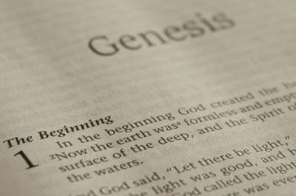
GENESIS STRUCTURE
Beginning of the Human race (Gen. 1‒11)
Beginning of the Hebrew race (Gen. 12‒50)

Slide 3
GENESIS STRUCTURE
Genesis 1-11 (four events)
Creation (1-2)
Fall (3-5)
Flood (6-9)
National dispersion (10-11)

Slide 4
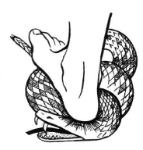
Genesis 3:15
“And I will put enmity Between you and the woman, And between your seed and her seed; He shall bruise you on the head, And you shall bruise him on the heel.”

Slide 5
GENESIS STRUCTURE
Beginning of the Human race (Gen. 1‒11)
Beginning of the Hebrew race (Gen. 12‒50)

Slide 6
GENESIS STRUCTURE
Genesis 12-50 (four people)
Abraham (12:1–25:11)
Isaac (25:12–26:35)
Jacob (27–36)
Joseph (37–50)

Slide 7
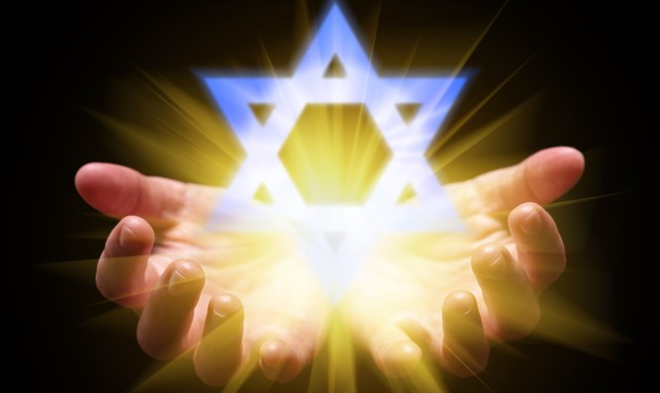
Isaiah 43:1
“But now, thus says the Lord, your Creator, O Jacob, And He who formed you, O Israel, 'Do not fear, for I have redeemed you; I have called you by name; you are Mine!'”

Slide 8
GENESIS STRUCTURE
Genesis 12-50 (four people)
Abraham (12:1–25:11)
Isaac (25:12–26:35)
Jacob (27–36)
Joseph (37–50)

Slide 9
Genesis 12‒19 Abram’s Early Journeys
Unconditional promises (Gen. 12:1-3)
From Haran to Canaan (Gen. 12:4-5)
In Canaan (Gen. 12:6-9)
In Egypt (Gen. 12:10-20)
Abram and Lot Separate (Gen. 13:1-13)
Reaffirmation of Abram’s promises (Gen. 13:14-18)
Abram Rescues Lot (14:1-24)
Abrahamic Covenant (15:1-21)
Hagar & Ishmael (16:1-16)
Circumcision (Gen. 17:1-27)
Sodom & Gomorrah (Gen. 18‒19)

Slide 10
Genesis 18‒19 Sodom & Gomorrah
Visitation (18:1-15)
Prediction (18:16-33)
Destruction (19:1-38)

Slide 11
Genesis 18‒19 Sodom & Gomorrah
Visitation (18:1-15)
Prediction (18:16-33)
Destruction (19:1-38)

Slide 12
Visitation Genesis 18:1-15
Hosting (1-8)
Promise of Isaac (9-15)

Slide 13
Genesis 18‒19 Sodom & Gomorrah
Visitation (18:1-15)
Prediction (18:16-33)
Destruction (19:1-38)

Slide 14
Prediction Genesis 18:16-33
Prophecy (16-21)
Intercession (22-33)

Slide 15
Genesis 18‒19 Sodom & Gomorrah
Visitation (18:1-15)
Prediction (18:16-33)
Destruction (19:1-38)

Slide 16
Destruction Genesis 19:1-38
Angels in Sodom (1-11)
Lot’s rescue (12-22)
Destruction (23-29)
Lot’s incest (30-38)

Slide 17
Destruction Genesis 19:1-38
Angels in Sodom (1-11)
Lot’s rescue (12-22)
Destruction (23-29)
Lot’s incest (30-38)

Slide 18
Angels in Sodom Genesis 19:1-11
Angelic arrival (1)
Lot’s invitation (2-3)
Mob’s attack (4-5)
Lot’s refusal & counter-offer (6-8)
Mob’s response (9)
Angelic response (10-11)

Slide 19
Angels in Sodom Genesis 19:1-11
Angelic arrival (1)
Lot’s invitation (2-3)
Mob’s attack (4-5)
Lot’s refusal & counter-offer (6-8)
Mob’s response (9)
Angelic response (10-11)

Slide 20
Dr. Arnold G. Fruchtenbaum
The Book of Genesis, 320
“The verse then reveals Lot’s position: Lot sat in the gate of Sodom. This marks the final stage of Lot’s progression from living in a tent outside the city as a nomad (13:12), to living in a house in Sodom (14:12), to sitting at the gate of Sodom, which shows a position of authority. He had become one of the elders of the city, a position of authority and prominence; he became a magistrate. This may have been due to the fact that the inhabitants of Sodom knew the reason they were rescued by Abraham earlier was because of Lot, and that may have explained how Lot was able to advance so quickly when normally that would not have been the case.”

Slide 21
Romans 12:2
“And do not be conformed to this world, but be transformed by the renewing of your mind, so that you may prove what the will of God is, that which is good and acceptable and perfect.”

Slide 22
Colossians 2:8
“See to it that there is no one who takes you captive through philosophy and empty deception in accordance with human tradition, in accordance with the elementary principles of the world, rather than in accordance with Christ.”

Slide 23
Visitation Genesis 18:1-15
Hosting (1-8)
Promise of Isaac (9-15)

Slide 24
Angels in Sodom Genesis 19:1-11
Angelic arrival (1)
Lot’s invitation (2-3)
Mob’s attack (4-5)
Lot’s refusal & counter-offer (6-8)
Mob’s response (9)
Angelic response (10-11)

Slide 26
Levitical Feasts (Leviticus 23)
Feast | Season | Purpose | Type
Passover | Spring | Redemption | 1 Cor 5:7
Unleavened Bread | Spring | Separation | John 6:35
1st fruits | Spring | Praise | 1 Cor 15:20
Pentecost | Spring | Praise | Acts 2:1-4
Trumpets | Fall | New Year | Matt 24:31
Atonement | Fall | Lev 16 | Zech 12:10
Booths | Fall | Wilderness provision | Zech 14:16-18

Slide 27
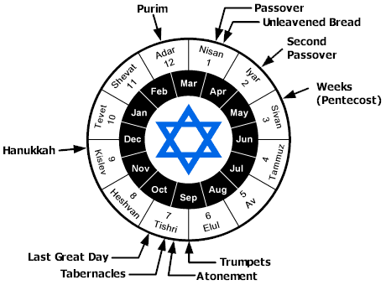

Slide 28
Genesis 6:1-4
“¹ Now it came about, when men began to multiply on the face of the land, and daughters were born to them, ² that the sons of God saw that the daughters of men were beautiful; and they took wives for themselves, whomever they chose. ³ Then the Lord said, ‘My Spirit shall not strive with man forever, because he also is flesh; nevertheless his days shall be one hundred and twenty years.’ ⁴ The Nephilim were on the earth in those days, and also afterward, when the . . .

Slide 29
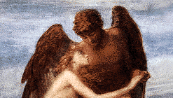
Genesis 6:1-4
. . . sons of God came in to the daughters of men, and they bore children to them. Those were the mighty men who were of old, men of renown.”

Slide 30
DOES NOT REFER TO ANGELS | DOES REFER TO ANGELS
Millard Erickson | John MacArthur
J. Sidlow Baxter | Henry Morris
Warren Wiersbe | Arnold Fruchtenbaum
Paul Enns | Robert Lightner
Gleason Archer | D. Edmond Hiebert
John Sailhammer | James Boice
Wayne Grudem | Robert Morey
Meredith Kline | M. R. DeHann
Leupold | Charles Ryrie
Williamson, unpublished paper, DTS

Slide 31
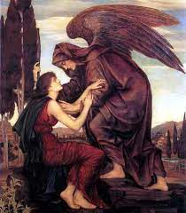
Objections to the Angel View
Angels do not marry? (Matt. 22:30)
Angels are spirits (Heb. 1:14)

Slide 33
Angels in Sodom Genesis 19:1-11
Angelic arrival (1)
Lot’s invitation (2-3)
Mob’s attack (4-5)
Lot’s refusal & counter-offer (6-8)
Mob’s response (9)
Angelic response (10-11)

Slide 34
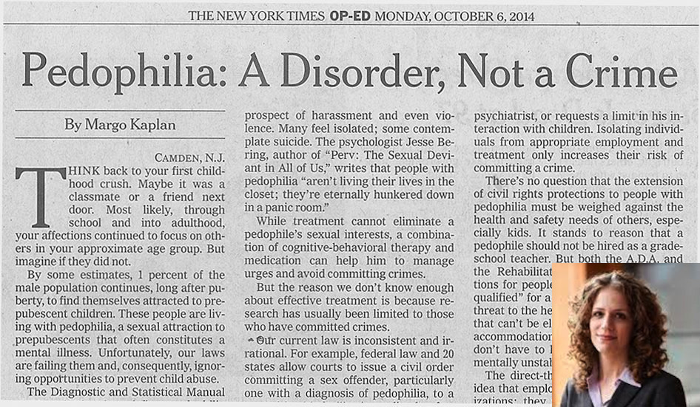

Slide 35
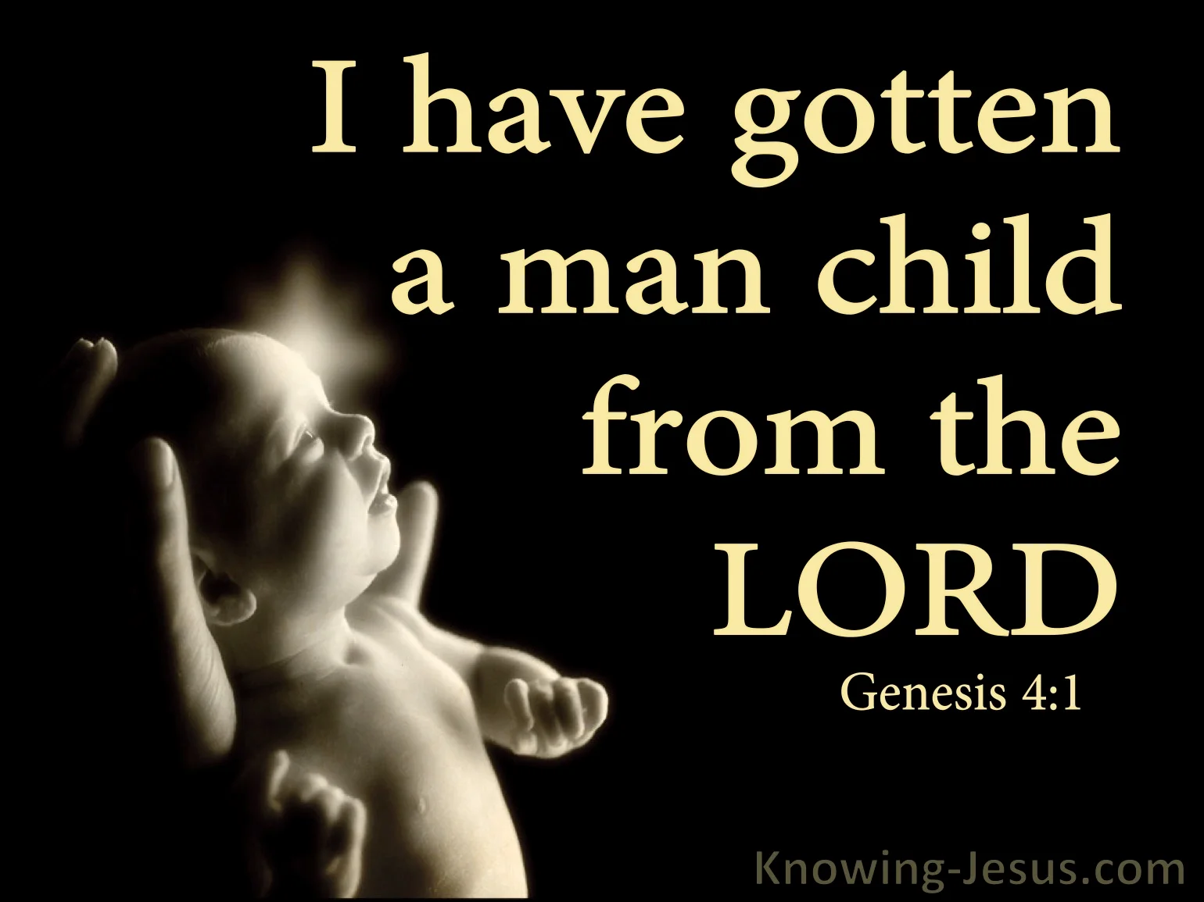
Genesis 4:1
“Now the man had relations with his wife Eve, and she conceived and gave birth to Cain, and she said, ‘I have gotten a manchild with the help of the Lord.’”

Slide 36
Angels in Sodom Genesis 19:1-11
Angelic arrival (1)
Lot’s invitation (2-3)
Mob’s attack (4-5)
Lot’s refusal & counter-offer (6-8)
Mob’s response (9)
Angelic response (10-11)

Slide 37
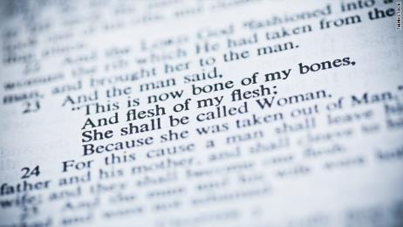
THE BIBLE AND HOMOSEXUALITY
Creation (Gen. 1‒2)
Sodom and Gomorrah (Gen. 18‒19)
The Mosaic Law (Lev. 18; 20)
Jesus Christ (Matt. 19; John 2)
The Apostle Paul (Rom. 1; 1 Cor. 6; 1 Tim. 1)

Slide 38
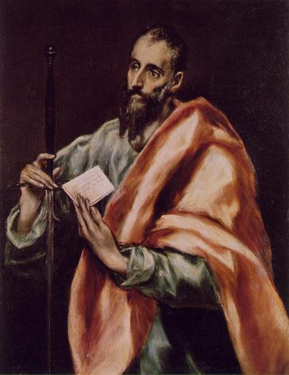
The Apostle Paul
Pro-Heterosexuality
1 Cor. 7:2-5
Eph. 5:22-33
1 Tim. 3:2, 12
Anti-Homosexuality
1 Cor. 6:9-11
Rom. 1:26-27
1 Tim. 1:9-10

Slide 39
2 Peter 2:7-9
“⁷ and if He rescued righteous Lot, oppressed by the sensual conduct of unprincipled men ⁸ (for by what he saw and heard that righteous man, while living among them, felt his righteous soul tormented day after day by their lawless deeds), ⁹ then the Lord knows how to rescue the godly from temptation, and to keep the unrighteous under punishment for the day of judgment.”

Slide 40
2 Peter 2:7-9
“⁷ and if He rescued righteous Lot, oppressed by the sensual conduct of unprincipled men ⁸ (for by what he saw and heard that righteous man, while living among them, felt his righteous soul tormented day after day by their lawless deeds), ⁹ then the Lord knows how to rescue the godly from temptation, and to keep the unrighteous under punishment for the day of judgment.”

Slide 41
1 Corinthians 3:1-3 (NKJV)
¹ And I, brethren, could not speak to you as to spiritual people but as to carnal, as to babes in Christ. ² I fed you with milk and not with solid food; for until now you were not able to receive it, and even now you are still not able; ³ for you are still carnal. For where there are envy, strife, and divisions among you, are you not carnal and behaving like mere men?

Slide 42
Notes:
Ray Steadman – “1st Californians”
Unbelievers vs Categories of Believers
Unbelievers – ψυχικός psuchikós; Natural, pertaining to the natural as distinguished from the spiritual
Spiritual Believers – πνευματικός pneumatikós; of persons who are spiritual, enlightened by the Holy Spirit
Infant Believers – σάρκινος sárkinos; with propensities of the flesh unto sin; νήπιος nḗpios; an infant, child, baby without any definite limitation of age. (This relates to immaturity and lack of instruction)
Carnal Believers – σαρκικός sarkikós; tendency to satisfy the flesh, implying sinfulness, sinful propensity, carnal (This relates to disobedience and open rebellion)

Slide 43
1 Corinthians 3:15
“If any man’s work is burned up, he will suffer loss; but he himself will be saved, yet so as through fire.”

Slide 44
Angels in Sodom Genesis 19:1-11
Angelic arrival (1)
Lot’s invitation (2-3)
Mob’s attack (4-5)
Lot’s refusal & counter-offer (6-8)
Mob’s response (9)
Angelic response (10-11)

Slide 46
Luke 17:28-30
“²⁸ It was the same as happened in the days of Lot: they were eating, they were drinking, they were buying, they were selling, they were planting, and they were building; ²⁹ but on the day that Lot left Sodom, it rained fire and brimstone from heaven and destroyed them all. ³⁰ It will be just the same on the day that the Son of Man is revealed.”

Slide 47
Angels in Sodom Genesis 19:1-11
Angelic arrival (1)
Lot’s invitation (2-3)
Mob’s attack (4-5)
Lot’s refusal & counter-offer (6-8)
Mob’s response (9)
Angelic response (10-11)

Slide 48
Genesis 19:22
“Hurry, escape there, for I cannot do anything until you arrive there.” Therefore the name of the town was called Zoar.”

Slide 49
Dr. Arnold G. Fruchtenbaum
The Book of Genesis, 323
“Then in 19:11 came the angels’ judgment of blindness: And they smote the men that were at the door of the house with blindness, both small and great. The Hebrew word for blindness here is not the normal word that is used. Outside this verse, this word for blindness is found only once elsewhere, in II Kings 6:18, which is also in the context of angels. This word refers to a partial blindness with mental bewilderment; that is, mental confusion resulting from distorted vision.”

Slide 50
Romans 1:21-22
“²¹ For even though they knew God, they did not honor Him as God or give thanks, but they became futile in their reasonings, and their senseless hearts were darkened. ²² Claiming to be wise, they became fools.”

Slide 51
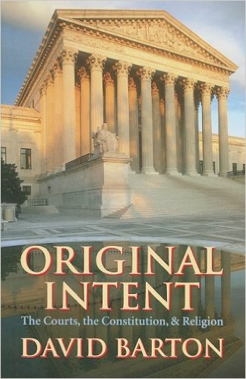
David Barton, Original Intent, p. 245

Slide 52
Dr. Arnold G. Fruchtenbaum
The Book of Genesis, 323
“The result was: so that they wearied themselves to find the door. They were so insistent upon their wickedness, so intent on homosexual abuse, that even after being struck with blindness they still tried to get through the door until they simply got too tired to continue.”

Slide 54
Conclusion

Slide 55
Genesis 18‒19 Sodom & Gomorrah
Visitation (18:1-15)
Prediction (18:16-33)
Destruction (19:1-38)

Slide 56
Destruction Genesis 19:1-38
Angels in Sodom (1-11)
Lot’s rescue (12-22)
Destruction (23-29)
Lot’s incest (30-38)

Slide 57
Angels in Sodom Genesis 19:1-11
Angelic arrival (1)
Lot’s invitation (2-3)
Mob’s attack (4-5)
Lot’s refusal & counter-offer (6-8)
Mob’s response (9)
Angelic response (10-11)

Slide 58
Destruction Genesis 19:1-38
Angels in Sodom (1-11)
Lot’s rescue (12-22)
Destruction (23-29)
Lot’s incest (30-38)

Slide 59
“The Lord bless you and keep you; the Lord make his face shine on you and be gracious to you; the Lord turn his face toward you and give you peace.” (NIV)

