Slide 1

Ezekiel 36‒39
The Middle East Meltdown 2022
Dr. Andy Woods
Senior Pastor – Sugar Land Bible Church
President – Chafer Theological Seminary

Slide 2
Ezekiel 33‒48
Ezekiel recommissioned (33)
False shepherds removed (34)
Edom destroyed (35)
Israel’s restoration: physical & spiritual (36)
Israel’s restoration illustrated (37)
Means of restoration: Northern invasion (38)
Results of the Northern invasion: conversion (39)
Millennial Temple (40‒46)
Tribal land allotment (47‒48)

Slide 3
Ezekiel 36
Israel to prosper again (1-15)
Israel’s sins inhibiting prosperity (16-21)
Israel to be restored: physically & spiritually (22-38)

Slide 4
Ezekiel 33‒48
Ezekiel recommissioned (33)
False shepherds removed (34)
Edom destroyed (35)
Israel’s restoration: physical & spiritual (36)
Israel’s restoration illustrated (37)
Means of restoration: Northern invasion (38)
Results of the Northern invasion: conversion (39)
Millennial Temple (40‒46)
Tribal land allotment (47‒48)

Slide 5
Ezekiel 37
Vision: Valley of the Dry Bones (1-14)
  Vision (1-10)
  Interpretation (11-14)
Sign: Two Sticks (15-28)
  Sign (15-17)
  Interpretation (18-28)

Slide 6
Ezekiel 33‒48
Ezekiel recommissioned (33)
False shepherds removed (34)
Edom destroyed (35)
Israel’s restoration: physical & spiritual (36)
Israel’s restoration illustrated (37)
Means of restoration: Northern invasion (38)
Results of the Northern invasion: conversion (39)
Millennial Temple (40‒46)
Tribal land allotment (47‒48)

Slide 7
Ezekiel 38‒39
Invasion planned (38:1-13)
Invasion executed (38:14-16)
Invasion defeated (38:17‒39:20)
Invasion’s results (39:21-29)

Slide 8
Ezekiel 38‒39
Invasion planned (38:1-13)
Invasion executed (38:14-16)
Invasion defeated (38:17‒39:20)
Invasion’s results (39:21-29)

Slide 9
I. Invasion Planned (Ezekiel 38:1-13)
  God’s intention (1-9)
  Gog’s intention (10-13)

Slide 10


Slide 11

Ancient Names From Ezekiel 38:1-9
Magog (Central Asia), Rosh (Russia), Meshec (Turkey), Tubal (Turkey), Persia (Iran), Put (Libya), Cush (Sudan), Gomer (Turkey), | Togarmah (Turkey) Sheba (Saudi Arabia) Dedan (Saudi Arabia or Yemen) Tarshish (Spain) Merchants of Tarshish (Conglomeration of Western powers including Europe) Israel

Slide 12
Ezekiel 38‒39
Invasion planned (38:1-13)
Invasion executed (38:14-16)
Invasion defeated (38:17‒39:20)
Invasion’s results (39:21-29)

Slide 13
Ezekiel 38‒39
Invasion planned (38:1-13)
Invasion executed (38:14-16)
Invasion defeated (38:17‒39:20)
Invasion’s results (39:21-29)

Slide 14
III. Invasion Defeated (Ezekiel 38:17‒39:20)
  Armies destroyed (38:17‒39:8)
  Weapons burned (39:9-10)
  Soldiers buried (39:11-16)
  Soldiers eaten (39:17-20)

Slide 15
III. Invasion Defeated (Ezekiel 38:17‒39:20)
  Armies destroyed (38:17‒39:8)
  Weapons burned (39:9-10)
  Soldiers buried (39:11-16)
  Soldiers eaten (39:17-20)

Slide 16

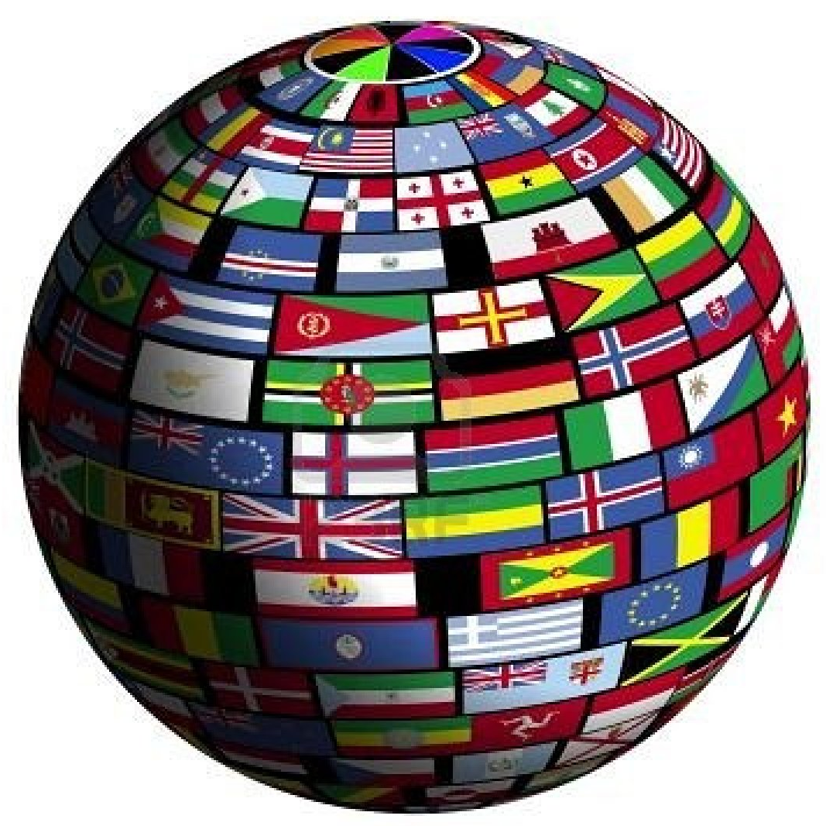
Genesis 12:3
“And I will bless those who bless you, And the one who curses you I will curse. And in you all the families of the earth will be blessed.”

Slide 17

Charles L. Feinberg
The Prophecy of Ezekiel: The Glory of the Lord, Paperback ed. (Chicago: Moody, 1969; reprint, Chicago: Moody, 1984), 223, 228.
“Through the centuries Israel has time and again been the prey of one nation after another. Yet in every case the visitation of God in wrath has been unmistakable upon the ones involved. But the nations have not fully learned their lesson as far as hatred of Israel is concerned and will try yet once more. Satan will urge them on yet again to their doom so that all may see that God curses those who curse Abraham’s seed. Let us be among those seeking their good and their blessing…It will be seen that the serious and fatal weakness of the enemies of Israel will be their reliance on numbers, and their confidence that Israel‘s weaknesses means their strength and ultimate victory. They fail, as always, to take God into account.”

Slide 18
Charles L. Feinberg
The Prophecy of Ezekiel: The Glory of the Lord, Paperback ed. (Chicago: Moody, 1969; reprint, Chicago: Moody, 1984), 219.
“Notice that twice it is stated (38:17; 39:8) that former prophets foretold this invasion (Ps. 2:1-3; Isaiah 29:1-8; Joel 2:20; 3:9-21; Zech. 12:1 ff; 14:2-3).”

Slide 19

Ezekiel 38:18-19
“¹⁸ It will come about on that day, when Gog comes against the land of Israel,” declares the Lord God, “that My fury will mount up in My anger. ¹⁹ In My zeal and in My blazing wrath I declare that on that day there will surely be a great earthquake in the land of Israel.”

Slide 20

Ezekiel 38:18-19
“¹⁸ It will come about on that day, when Gog comes against the land of Israel,” declares the Lord God, “that My fury will mount up in My anger. ¹⁹ In My zeal and in My blazing wrath I declare that on that day there will surely be a great earthquake in the land of Israel.”

Slide 21


Slide 22
6 Timing Clues
Restoration section (33-48)
Latter times (38:8a)
Last days (38:16)
After Israel’s regathering in unbelief but before her final restoration (38:8b; 39:22, 29)
During God’s wrath (Ezek. 38:18-19)
While Israel is living securely and peacefully (38:8c, 11)

Slide 23

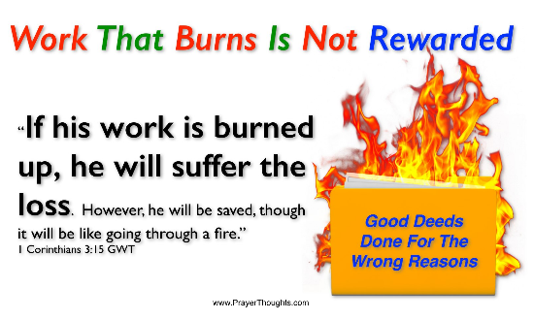
Genesis 19:22
“Hurry, escape there, for I cannot do anything until you arrive there.” Therefore, the name of the town was called Zoar.”

Slide 24

Ezekiel 38:18-19
“¹⁸ It will come about on that day, when Gog comes against the land of Israel,” declares the Lord God, “that My fury will mount up in My anger. ¹⁹ In My zeal and in My blazing wrath I declare that on that day there will surely be a great earthquake in the land of Israel.”

Slide 25
After tremors, experts warn a huge quake is the greatest threat facing Israel
“Scientists say thousands could die because Israel, which sits on a major fault line, has ignored warnings to strengthen homes and schools. After a series of minor tremors rattled northern Israel over the last two weeks, experts warned that the country is negligently unprepared for a major earthquake that would likely kill thousands of people, including many children. ‘The threat of an earthquake, is in my eyes, the greatest threat facing the state of Israel,’ geologist Ariel Heimann told Hadashot news on Friday. ‘It is definitely a greater threat than the Qassam [rockets] fired from Gaza, and it is a far greater danger than the Iranian threat.’ Israel sits on the Syrian-African rift, a tear in the earth’s crust . . .

Slide 26
After tremors, experts warn a huge quake is the greatest threat facing Israel
…running the length of the border separating Israel and Jordan, and is part of the Great Rift Valley, which extends from northern Syria to Mozambique. ‘If, God forbid, we have an earthquake like this, it will leave thousands dead and hundreds of thousands of people will have to leave their homes. Houses will be destroyed, there will be massive economic damage that will set the country back dozens of years,’ Heimann warned.”
Times of Israel Staff: https://www.timesofisrael.com/after-tremors-experts-warn-a-huge-quake-is-the-greatest-threat-facing-israel/ 14 July 2018.

Slide 28
What?
Divine annihilation of the coalition (38:19-22)
Birds and beasts feast on the carnage (39:4-5, 17-20)
Seven-month burying of the dead (39:11-12, 14-16)
Seven-year burning of weapons (39:9-10)
Israel’s salvation and restoration (39:22, 29)

Slide 29
What?
Divine annihilation of the coalition (38:19-22)
Birds and beasts feast on the carnage (39:4-5, 17-20)
Seven-month burying of the dead (39:11-12, 14-16)
Seven-year burning of weapons (39:9-10)
Israel’s salvation and restoration (39:22, 29)

Slide 30
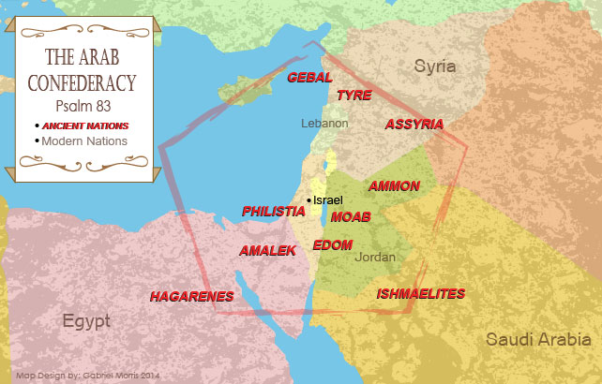

Slide 31
Ezekiel 39:2, 4
“² and I will turn you around, drive you on, take you up from the remotest parts of the north and bring you against the mountains of Israel…⁴ You will fall on the mountains of Israel, you and all your troops and the peoples who are with you; I will give you as food to every kind of predatory bird and beast of the field.”

Slide 32
Dispensational Theology is a System of Theology
Traditional-normative dispensational theology is a system that embodies three essential, fundamental concepts called the sine qua non (lit. “without which is not”):
The consistent use of a plain, normal, literal, grammatical-historical method of interpretation;
Which reveals that the Church is distinct from Israel;
God’s overall purpose is to bring glory to Himself (Eph. 1:6, 12, 14).
Dr. Charles Ryrie, Dispensationalism, pp. 38-41

Slide 33
Doxological Purpose
God’s ultimate purpose for the ages is to glorify Himself. Scripture is not human-centered, as though salvation were the principle point, but God-centered, because His glory is at the center.
The glory of God is the primary principle that unifies all dispensations, the program of salvation being just one of the means by which God glorifies Himself. Each successive revelation of God’s plan for the ages, as well as His dealing with the elect, non-elect, angels, and nations all manifest His glory.
Dictionary of Premillennial Theology, Charles Ryrie, p. 94

Slide 34
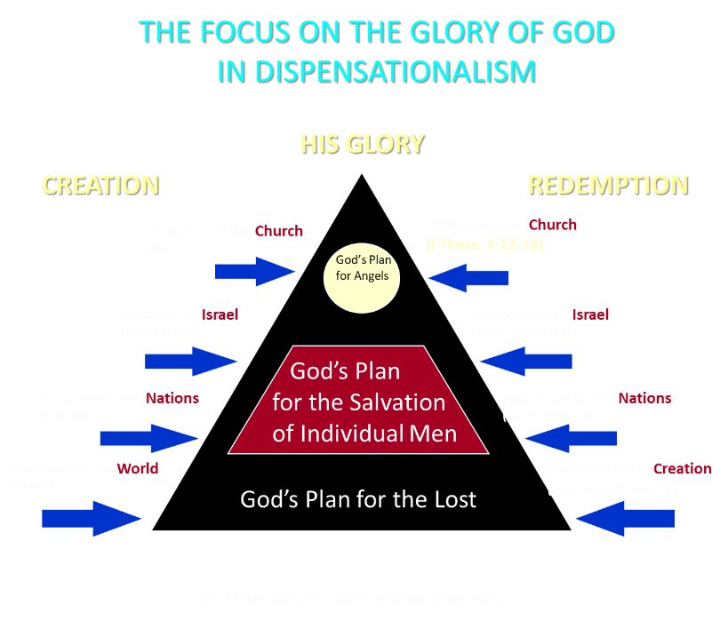

Slide 35
Ezekiel 33‒48
Ezekiel recommissioned (33)
False shepherds removed (34)
Edom destroyed (35)
Israel’s restoration: physical & spiritual (36)
Israel’s restoration illustrated (37)
Means of restoration: Northern invasion (38)
Results of the Northern invasion: conversion (39)
Millennial Temple (40‒46)
Tribal land allotment (47‒48)

Slide 37
Ancient Names From Ezekiel 38:1-9
Magog (Central Asia) Rosh (Russia) Meshec (Turkey) Tubal (Turkey) Persia (Iran) Put (Libya) Cush (Sudan) Gomer (Turkey) | Togarmah (Turkey) Sheba (Saudi Arabia) Dedan (Saudi Arabia or Yemen) Tarshish (Spain) Merchants of Tarshish (Conglomeration of Western powers including Europe) Israel

Slide 38
Ezekiel 39:2, 4
“² and I will turn you around, drive you on, take you up from the remotest parts of the north and bring you against the mountains of Israel…⁴You will fall on the mountains of Israel, you and all your troops and the peoples who are with you; I will give you as food to every kind of predatory bird and beast of the field.”

Slide 39
Ezekiel 39:2, 4
“² and I will turn you around, drive you on, take you up from the remotest parts of the north and bring you against the mountains of Israel…⁴You will fall on the mountains of Israel, you and all your troops and the peoples who are with you; I will give you as food to every kind of predatory bird and beast of the field.”

Slide 41
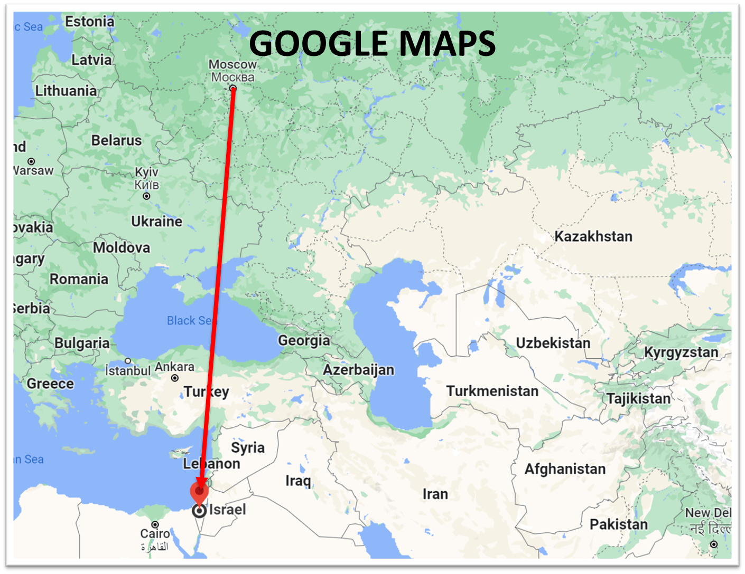

Slide 42
Ezekiel 39:2, 4
“² and I will turn you around, drive you on, take you up from the remotest parts of the north and bring you against the mountains of Israel…⁴You will fall on the mountains of Israel, you and all your troops and the peoples who are with you; I will give you as food to every kind of predatory bird and beast of the field.”

Slide 43
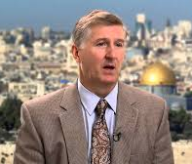
Mountains of Israel?
Mark Hitchcock, The Amazing Claims of Bible Prophecy: What You Need to Know in These Uncertain Times (Harvest House: Eugene, OR, 2010), 211.
“According to Ezekiel 39:2, 4, Israel must possess the ‘mountains of Israel’ when this invasion occurs...The famous Six Day war in Israel in 1967 helped set the stage for this to be fulfilled. Before the Six Day War, all the mountains of Israel, with the exception of a small strip of west Jerusalem, were in the hands of the Jordanian Arabs. Only since 1967 have the mountains of Israel been in Israel, thus setting the stage for the fulfillment of this prophecy.”

Slide 44


Dr. Arnold G. Fruchtenbaum
THE MODERN STATE OF ISRAEL IN BIBLE PROPHECY
Paper presented to the PTSG on 12-7-21, pps. 18-19
“But where in the Land of Israel will the invading armies be destroyed? The exact location is revealed in Ezekiel 39:2 and 4a: ‘and I will turn you about, and will lead you on, and will cause you to come up from the uttermost parts of the north; and I will bring you upon the mountains of Israel…you shall fall upon the mountains of Israel.’ The phrase ‘the mountains of Israel’ refers to the central mountain range that makes up the backbone of the country. In the Hebrew Scriptures, these mountains were known as the Hill Country of Ephraim and the Hill Country of Judah. Some of the famous biblical cities that lie within these mountains include Dothan, Shechem, Samaria, Shiloh, Bethel, Ai, Ramah, Bethlehem, Hebron, Debir, and most importantly, Jerusalem, which seems to be the target of the invading army. However, from 1948 until the Six-Day War in 1967, these mountains were not in Israel, but in Jordan.”

Slide 45
Dr. Arnold G. Fruchtenbaum
THE MODERN STATE OF ISRAEL IN BIBLE PROPHECY
Paper presented to the PTSG on 12-7-21, pps. 18-19
“They are now referred to politically as the West Bank. In 1948, Jordanian forces took over these mountains and annexed them as part of Jordan. All Israel had was a small corridor leading west to Jerusalem. The border between Israel and Jordan ran down the foot of these mountains, then cut into the mountains, dividing Jerusalem in two, and then went out again and continued along the foot of these mountains. Israel had maybe five percent or less of the mountains, while the rest belonged to Jordan. Only since 1967 have the mountains of Israel been in Israel. Besides the Temple compound falling into Jewish hands, another by-product of the Six-Day War was that these mountains also fell under Israeli sovereignty. Therefore, not only could this prophecy not have been fulfilled before 1948, but it could also not have been fulfilled before 1967.”

Slide 46
Dr. Arnold G. Fruchtenbaum
THE MODERN STATE OF ISRAEL IN BIBLE PROPHECY
Paper presented to the PTSG on 12-7-21, pps. 18-19
“The mountains of Israel (the West Bank) are yet to have a very important and relevant role in Bible prophecy. As for the present State of Israel, they became part of Israel in 1967. This is yet another way the modern Jewish State fits within Bible prophecy.”

Slide 47
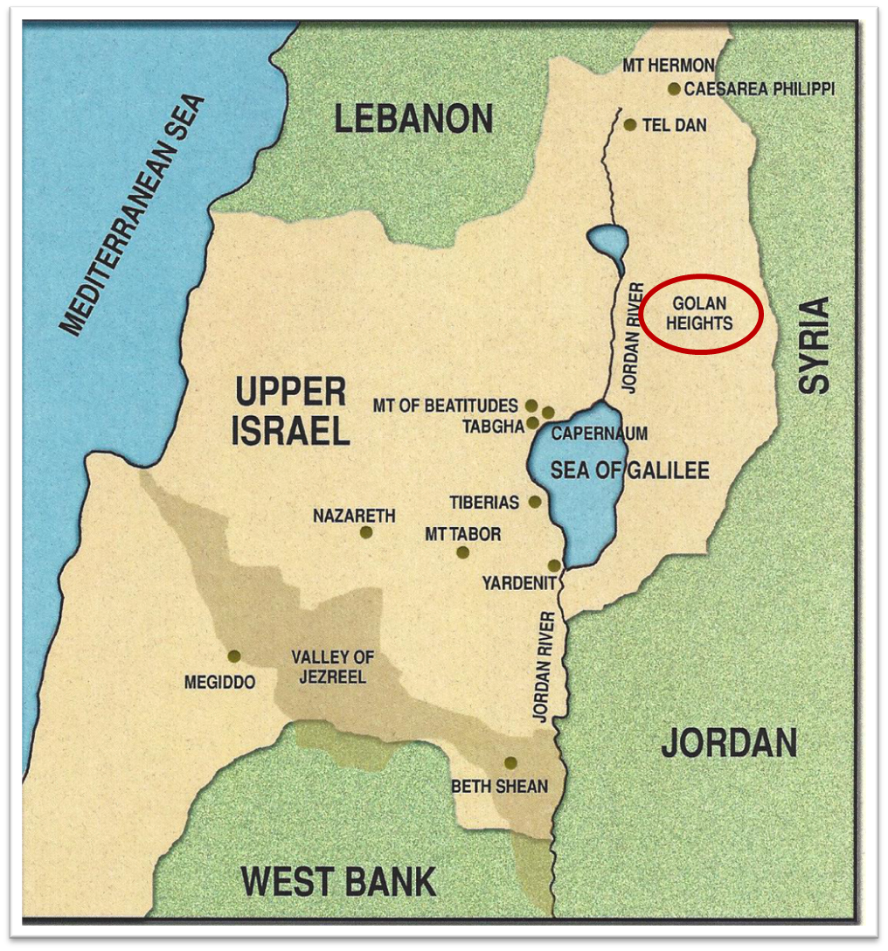

Slide 48
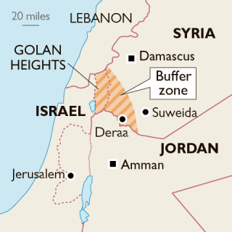

Slide 49
Ezekiel 39:2, 4
“² and I will turn you around, drive you on, take you up from the remotest parts of the north and bring you against the mountains of Israel…⁴You will fall on the mountains of Israel, you and all your troops and the peoples who are with you; I will give you as food to every kind of predatory bird and beast of the field.”

Slide 50

Ezekiel 38:12
“to capture spoil and to seize plunder, to turn your hand against the waste places which are now inhabited, and against the people who are gathered from the nations, who have acquired cattle and goods, who live at the center of the world.”

Slide 51
Ezekiel 38:13
“Sheba and Dedan and the merchants of Tarshish with all its villages will say to you, ‘Have you come to capture spoil? Have you assembled your company to seize plunder, to carry away silver and gold, to take away cattle and goods, to capture great spoil?’”

Slide 52
Ezekiel 39:2, 4
“² and I will turn you around, drive you on, take you up from the remotest parts of the north and bring you against the mountains of Israel…⁴You will fall on the mountains of Israel, you and all your troops and the peoples who are with you; I will give you as food to every kind of predatory bird and beast of the field.”

Slide 54
What?
Divine annihilation of the coalition (38:19-22)
Birds and beasts feast on the carnage (39:4-5, 17-20)
Seven-month burying of the dead (39:11-12, 14-16)
Seven-year burning of weapons (39:9-10)
Israel’s salvation and restoration (39:22, 29)

Slide 55
Charles L. Feinberg
The Prophecy of Ezekiel: The Glory of the Lord, Paperback ed. (Chicago: Moody, 1969; reprint, Chicago: Moody, 1984), 228.
“Though the judgment on the enemies will occur in Israel, the catastrophe will extend far beyond to the ends of the earth to accomplish the purpose of God. Once more the Lord will relate His purpose in Israel to that for all the world. It is the concept of concentric circles where that which is accomplished at the very center reaches out irresistibly to the farthest confines of the circumference. God is the Lord of the nations. His true character will appear in its proper light as both righteous and mighty. Such emphasis is made of this thought throughout the book of Ezekiel because this is the design of God in all history, and there is no more important concept in all the universe.”

Slide 56
CONCLUSION

Slide 57
III. Invasion Defeated (Ezekiel 38:17‒39:20)
  Armies destroyed (38:17‒39:8)
  Weapons burned (39:9-10)
  Soldiers buried (39:11-16)
  Soldiers eaten (39:17-20)

