Slide 1

Ezekiel 36‒39
The Middle East Meltdown 2022
Dr. Andy Woods
Senior Pastor – Sugar Land Bible Church
President – Chafer Theological Seminary

Slide 2
Ezekiel 33‒48
Ezekiel recommissioned (33)
False shepherds removed (34)
Edom destroyed (35)
Israel’s restoration: physical & spiritual (36)
Israel’s restoration illustrated (37)
Means of restoration: Northern invasion (38)
Results of the Northern invasion: conversion (39)
Millennial Temple (40‒46)
Tribal land allotment (47‒48)

Slide 3
Ezekiel 36
Israel to prosper again (1-15)
Israel’s sins inhibiting prosperity (16-21)
Israel to be restored: physically & spiritually (22-38)

Slide 4
Ezekiel 33‒48
Ezekiel recommissioned (33)
False shepherds removed (34)
Edom destroyed (35)
Israel’s restoration: physical & spiritual (36)
Israel’s restoration illustrated (37)
Means of restoration: Northern invasion (38)
Results of the Northern invasion: conversion (39)
Millennial Temple (40‒46)
Tribal land allotment (47‒48)

Slide 5
Ezekiel 37
Vision: Valley of the Dry Bones (1-14)
  Vision (1-10)
  Interpretation (11-14)
Sign: Two Sticks (15-28)
  Sign (15-17)
  Interpretation (18-28)

Slide 6
Ezekiel 33‒48
Ezekiel recommissioned (33)
False shepherds removed (34)
Edom destroyed (35)
Israel’s restoration: physical & spiritual (36)
Israel’s restoration illustrated (37)
Means of restoration: Northern invasion (38)
Results of the Northern invasion: conversion (39)
Millennial Temple (40‒46)
Tribal land allotment (47‒48)

Slide 7
Ezekiel 38‒39
Invasion planned (38:1-13)
Invasion executed (38:14-16)
Invasion defeated (38:17‒39:20)
Invasion’s results (39:21-29)

Slide 8
Ezekiel 38‒39
Invasion planned (38:1-13)
Invasion executed (38:14-16)
Invasion defeated (38:17‒39:20)
Invasion’s results (39:21-29)

Slide 9
I. Invasion Planned (Ezekiel 38:1-13)
  God’s intention (1-9)
  Gog’s intention (10-13)

Slide 10
I. Invasion Planned (Ezekiel 38:1-13)
  God’s intention (1-9)
  Gog’s intention (10-13)

Slide 11


Slide 12

Ancient Names From Ezekiel 38:1-9
Magog (Central Asia), Rosh (Russia), Meshec (Turkey), Tubal (Turkey), Persia (Iran), Put (Libya), Cush (Sudan), Gomer (Turkey), | Togarmah (Turkey) Sheba (Saudi Arabia) Dedan (Saudi Arabia or Yemen) Tarshish (Spain) Merchants of Tarshish (Conglomeration of Western powers including Europe) Israel

Slide 13
I. Invasion Planned (Ezekiel 38:1-13)
  God’s intention (1-9)
  Gog’s intention (10-13)

Slide 14

Ezekiel 38:13
“Sheba and Dedan and the merchants of Tarshish with all its villages will say to you, ‘Have you come to capture spoil? Have you assembled your company to seize plunder, to carry away silver and gold, to take away cattle and goods, to capture great spoil?’”

Slide 15
Ancient Names From Ezekiel 38:1-9
Magog (Central Asia) Rosh (Russia) Meshec (Turkey) Tubal (Turkey) Persia (Iran) Put (Libya) Cush (Sudan) Gomer (Turkey) | Togarmah (Turkey) Sheba (Saudi Arabia) Dedan (Saudi Arabia or Yemen) Tarshish (Spain) Merchants of Tarshish (Conglomeration of Western powers including Europe) Israel

Slide 16
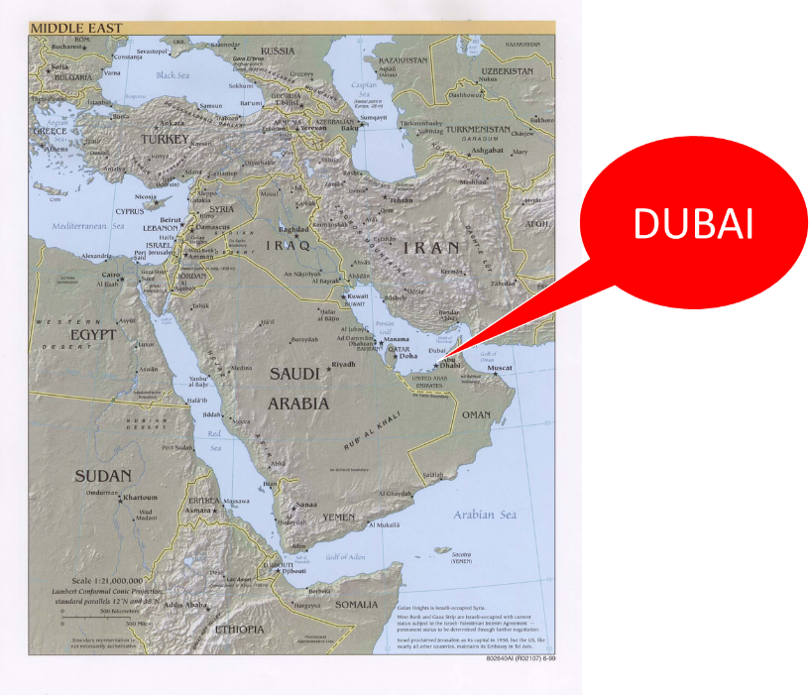

Slide 17
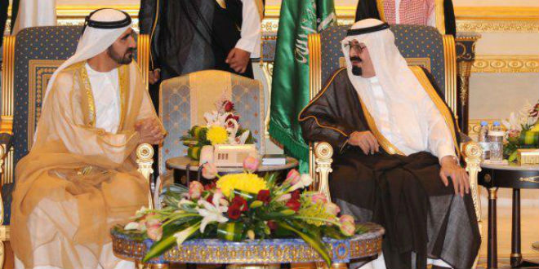
“SAUDI PRINCE: ‘I’LL SIDE WITH ISRAEL’ AGAINST PALESTINIAN UPRISING, [AND] IRAN.”
https://www.breakingisraelnews.com/52468/saudi-prince-ill-side-with-israel-against-palestinian-uprising-middle-east/#bco8FQkRWpkSLkuq.97

Slide 18

TIMES OF INDIA
online: http://tass.com/politics/932980. December 01, 2017 , accessed 12 December 2017.
“Saudi Arabia intercepts second Yemen missile in a month. Saudi Arabia on Thursday intercepted and destroyed a ballistic missile fired from war-torn Yemen, state media reported, the second such attack this month claimed by Iran-backed Huthi rebels.”

Slide 19
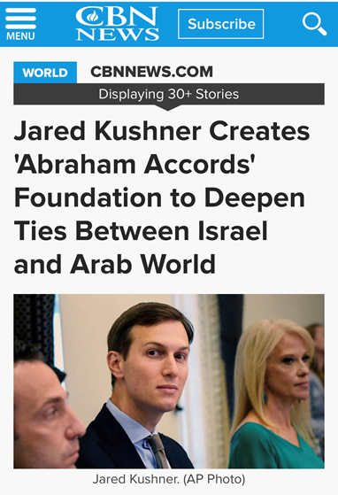

Slide 20
Ezekiel 38:13
“Sheba and Dedan and the merchants of Tarshish with all its villages will say to you, ‘Have you come to capture spoil? Have you assembled your company to seize plunder, to carry away silver and gold, to take away cattle and goods, to capture great spoil?’”

Slide 21
Ancient Names From Ezekiel 38:1-9
Magog (Central Asia) Rosh (Russia) Meshec (Turkey) Tubal (Turkey) Persia (Iran) Put (Libya) Cush (Sudan) Gomer (Turkey) | Togarmah (Turkey) Sheba (Saudi Arabia) Dedan (Saudi Arabia or Yemen) Tarshish (Spain) Merchants of Tarshish (Conglomeration of Western powers including Europe) Israel

Slide 22
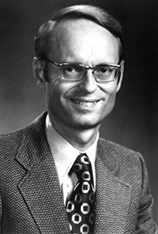
Tarshish = Spain
Ryrie Study Bible, p. 1,421.
The Ryrie Study Bible indicates that Tarshish “is located in the S of Spain near Gibraltar, 2,500 mi. (4,000 km) W of Palestine [or Israel] and the opposite direction from Nineveh.”

Slide 23
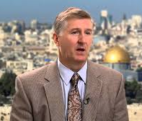
Young Lions = Western Nations
Mark Hitchcock, After the Empire: Bible Prophecy in Light of the Fall of the Soviet Union (Wheaton, Il: Tyndale, 1994), p. 101.
“Young lions are often used in the Scripture to refer to energetic rulers. Therefore, the young lions who verbally oppose Gog’s invasion are strong military and political leaders who act with Tarshish...It was in the farthest west regions of the known world, in Spain. As we know, Spain is in modern Europe. Tarshish, or modern Spain, could be used by Ezekiel to represent all of the western nations whom Saudi Arabia will join with in denouncing this invasion.”

Slide 24
Ezekiel 38:13
“Sheba and Dedan and the merchants of Tarshish with all its villages will say to you, ‘Have you come to capture spoil? Have you assembled your company to seize plunder, to carry away silver and gold, to take away cattle and goods, to capture great spoil?’”

Slide 25

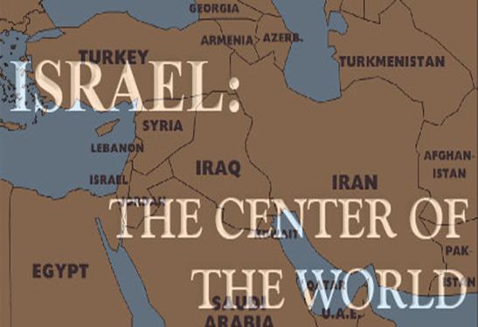
Charles L. Feinberg
The Prophecy of Ezekiel: The Glory of the Lord, Paperback ed. (Chicago: Moody, 1969; reprint, Chicago: Moody, 1984), 223.
“The young lions of Tarshish are taken to mean either the strong leaders and princes or greedy rulers of these commercial communities.”

Slide 27
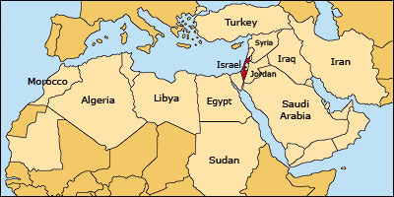

Slide 28
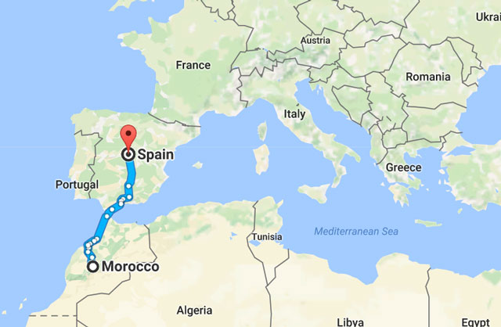

Slide 29
Ezekiel 38:13
“Sheba and Dedan and the merchants of Tarshish with all its villages will say to you, ‘Have you come to capture spoil? Have you assembled your company to seize plunder, to carry away silver and gold, to take away cattle and goods, to capture great spoil?’”

Slide 30

Ezekiel 38:12
“to capture spoil and to seize plunder, to turn your hand against the waste places which are now inhabited, and against the people who are gathered from the nations, who have acquired cattle and goods, who live at the center of the world.”

Slide 31
Ezekiel 38‒39
Invasion planned (38:1-13)
Invasion executed (38:14-16)
Invasion defeated (38:17‒39:20)
Invasion’s results (39:21-29)

Slide 32

Ezekiel 38:8, 11
“⁸ After many days you will be summoned; in the latter years you will come into the land that is restored from the sword, whose inhabitants have been gathered from many nations to the mountains of Israel which had been a continual waste; but its people were brought out from the nations, and they are living securely [batach], all of them….¹¹ and you will say, ‘I will go up against the land of unwalled villages. I will go against those who are at rest [shacat], that live securely [batach], all of them living without walls and having no bars or gates.”

Slide 33

Isaiah 28:15, 18
“¹⁵ Because you have said, “We have made a covenant with death, And with Sheol we have made a pact. The overwhelming scourge will not reach us when it passes by, For we have made falsehood our refuge and we have concealed ourselves with deception.”… ¹⁸ Your covenant with death will be canceled, And your pact with Sheol will not stand; When the overwhelming scourge passes through, Then you become its trampling place.”

Slide 34

Daniel 9:27
And he will make a firm covenant with the many for one week, but in the middle of the week he will put a stop to sacrifice and grain offering; and on the wing of abominations will come one who makes desolate, even until a complete destruction, one that is decreed, is poured out on the one who makes desolate.

Slide 35


Slide 36


Slide 37
6 Timing Clues
Restoration section (33-48)
Latter times (38:8a)
Last days (38:16)
After Israel’s regathering in unbelief but before her final restoration (38:8b; 39:22, 29)
During God’s wrath (Ezek. 38:18-19)
While Israel is living securely and peacefully (38:8c, 11)

Slide 39
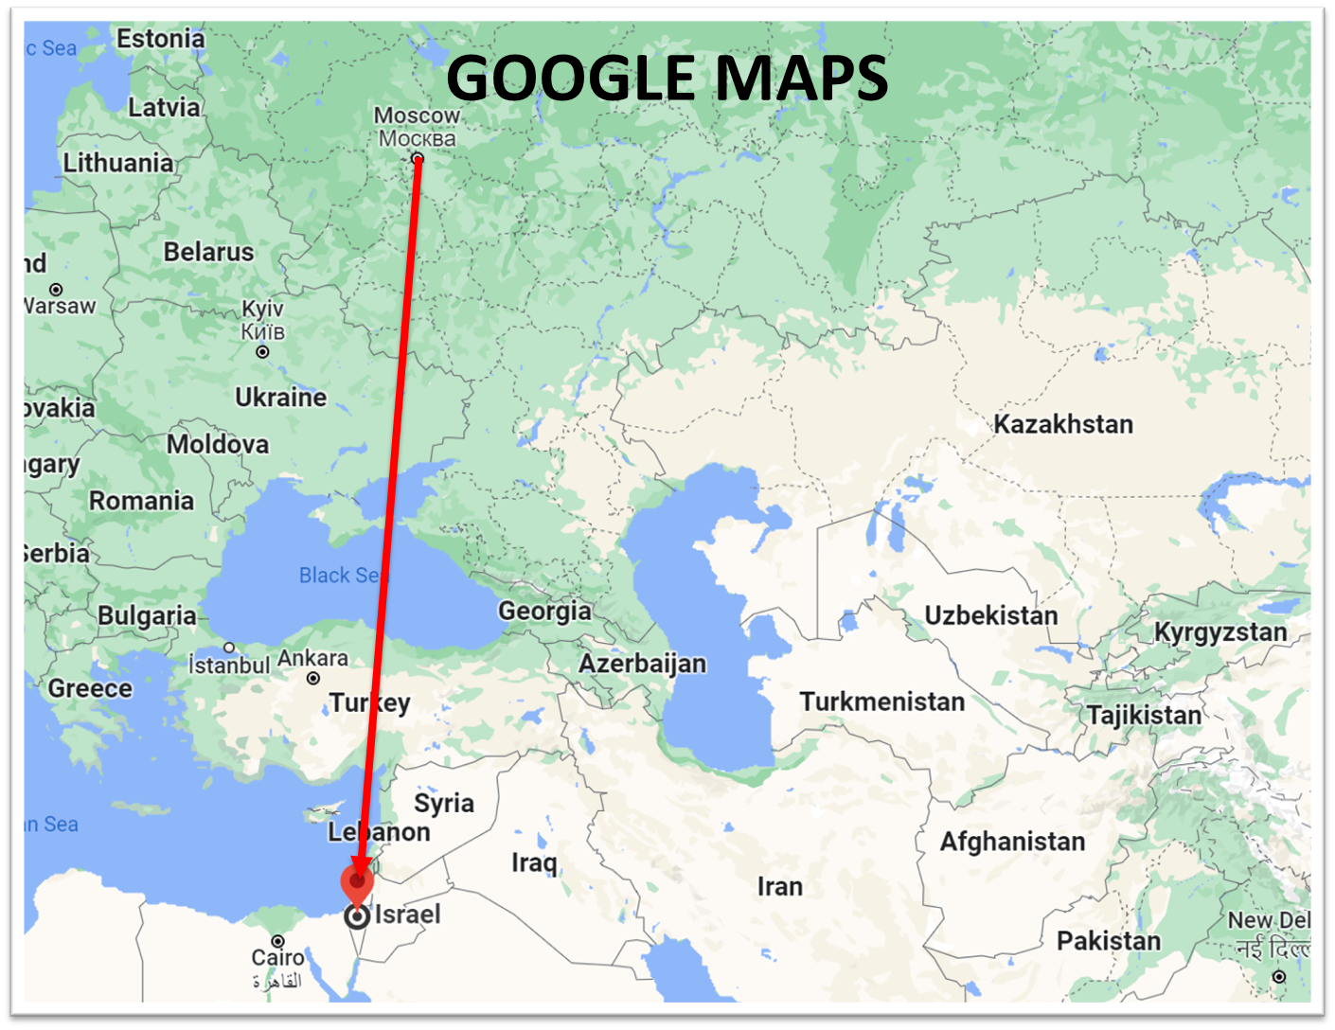

Slide 40
Ezekiel 39:2, 4
“² and I will turn you around, drive you on, take you up from the remotest parts of the north and bring you against the mountains of Israel…⁴ You will fall on the mountains of Israel, you and all your troops and the peoples who are with you; I will give you as food to every kind of predatory bird and beast of the field.”

Slide 41
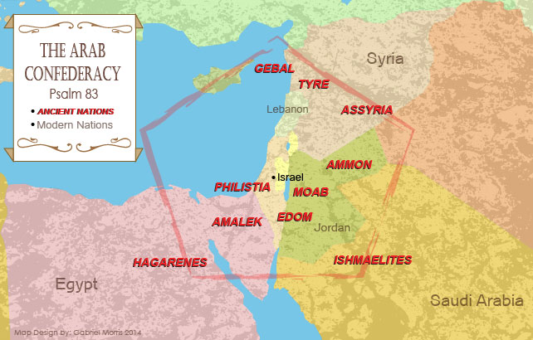

Slide 42
Ezekiel 39:2, 4
“² and I will turn you around, drive you on, take you up from the remotest parts of the north and bring you against the mountains of Israel…⁴ You will fall on the mountains of Israel, you and all your troops and the peoples who are with you; I will give you as food to every kind of predatory bird and beast of the field.”

Slide 43
Charles L. Feinberg
The Prophecy of Ezekiel: The Glory of the Lord, Paperback ed. (Chicago: Moody, 1969; reprint, Chicago: Moody, 1984), 224.
“Do not fail to notice ‘my people’ in verses 14 and 16, and ‘my land’ in verse 16. The godless nations have had little idea how involved God is in all the concerns His people and His land. This has been true throughout their national existence but will be all the more evident when God finally decides to intervene decisively into the affairs of men in the consummation of the prophetic program for the earth.”

Slide 44
6 Timing Clues
Restoration section (33-48)
Latter times (38:8a)
Last days (38:16)
After Israel’s regathering in unbelief but before her final restoration (38:8b; 39:22, 29)
During God’s wrath (Ezek. 38:18-19)
While Israel is living securely and peacefully (38:8c, 11)

Slide 45
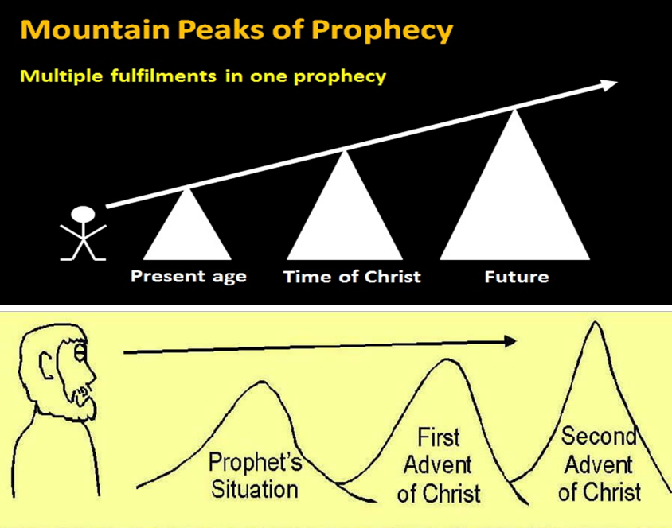

Slide 46
Ezekiel 38‒39
Invasion planned (38:1-13)
Invasion executed (38:14-16)
Invasion defeated (38:17‒39:20)
Invasion’s results (39:21-29)

Slide 47
III. Invasion Defeated (Ezekiel 38:17‒39:20)
  Armies destroyed (38:17‒39:8)
  Weapons burned (39:9-10)
  Soldiers buried (39:11-16)
  Soldiers eaten (39:17-20)

Slide 48
III. Invasion Defeated (Ezekiel 38:17‒39:20)
  Armies destroyed (38:17‒39:8)
  Weapons burned (39:9-10)
  Soldiers buried (39:11-16)
  Soldiers eaten (39:17-20)

Slide 49

Genesis 12:3
“And I will bless those who bless you, And the one who curses you I will curse. And in you all the families of the earth will be blessed.”

Slide 50
Charles L. Feinberg
The Prophecy of Ezekiel: The Glory of the Lord, Paperback ed. (Chicago: Moody, 1969; reprint, Chicago: Moody, 1984), 223, 228.
“Through the centuries Israel has time and again been the prey of one nation after another. Yet in every case the visitation of God in wrath has been unmistakable upon the ones involved. But the nations have not fully learned their lesson as far as hatred of Israel is concerned and will try yet once more. Satan will urge them on yet again to their doom so that all may see that God curses those who curse Abraham’s seed. Let us be among those seeking their good and their blessing…It will be seen that the serious and fatal weakness of the enemies of Israel will be their reliance on numbers, and their confidence that Israel‘s weaknesses means their strength and ultimate victory. They fail, as always, to take God into account.”

Slide 51
Charles L. Feinberg
The Prophecy of Ezekiel: The Glory of the Lord, Paperback ed. (Chicago: Moody, 1969; reprint, Chicago: Moody, 1984), 219.
“Notice that twice it is stated (38:17; 39:8) that former prophets foretold this invasion (Ps. 2:1-3; Isaiah 29:1-8; Joel 2:20; 3:9-21; Zech. 12:1 ff; 14:2-3).”

Slide 52
Ezekiel 38:18-19
“¹⁸ It will come about on that day, when Gog comes against the land of Israel,” declares the Lord God, “that My fury will mount up in My anger. ¹⁹ In My zeal and in My blazing wrath I declare that on that day there will surely be a great earthquake in the land of Israel.”

Slide 53

Ezekiel 38:18-19
“¹⁸ It will come about on that day, when Gog comes against the land of Israel,” declares the Lord God, “that My fury will mount up in My anger. ¹⁹ In My zeal and in My blazing wrath I declare that on that day there will surely be a great earthquake in the land of Israel.”

Slide 55
6 Timing Clues
Restoration section (33-48)
Latter times (38:8a)
Last days (38:16)
After Israel’s regathering in unbelief but before her final restoration (38:8b; 39:22, 29)
During God’s wrath (Ezek. 38:18-19)
While Israel is living securely and peacefully (38:8c, 11)

Slide 56

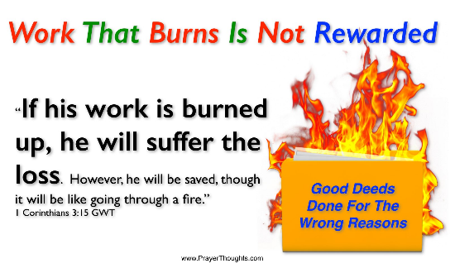
Genesis 19:22
“Hurry, escape there, for I cannot do anything until you arrive there.” Therefore, the name of the town was called Zoar.”

Slide 57

Ezekiel 38:18-19
“¹⁸ It will come about on that day, when Gog comes against the land of Israel,” declares the Lord God, “that My fury will mount up in My anger. ¹⁹ In My zeal and in My blazing wrath I declare that on that day there will surely be a great earthquake in the land of Israel.”

Slide 58
After tremors, experts warn a huge quake is the greatest threat facing Israel
“Scientists say thousands could die because Israel, which sits on a major fault line, has ignored warnings to strengthen homes and schools. After a series of minor tremors rattled northern Israel over the last two weeks, experts warned that the country is negligently unprepared for a major earthquake that would likely kill thousands of people, including many children. ‘The threat of an earthquake, is in my eyes, the greatest threat facing the state of Israel,’ geologist Ariel Heimann told Hadashot news on Friday. ‘It is definitely a greater threat than the Qassam [rockets] fired from Gaza, and it is a far greater danger than the Iranian threat.’ Israel sits on the Syrian-African rift, a tear in the earth’s crust . . .

Slide 59
After tremors, experts warn a huge quake is the greatest threat facing Israel
…running the length of the border separating Israel and Jordan, and is part of the Great Rift Valley, which extends from northern Syria to Mozambique. ‘If, God forbid, we have an earthquake like this, it will leave thousands dead and hundreds of thousands of people will have to leave their homes. Houses will be destroyed, there will be massive economic damage that will set the country back dozens of years,’ Heimann warned.”
Times of Israel Staff: https://www.timesofisrael.com/after-tremors-experts-warn-a-huge-quake-is-the-greatest-threat-facing-israel/ 14 July 2018.

Slide 61
What?
Divine annihilation of the coalition (38:19-22)
Birds and beasts feast on the carnage (39:4-5, 17-20)
Seven-month burying of the dead (39:11-12, 14-16)
Seven-year burning of weapons (39:9-10)
Israel’s salvation and restoration (39:22, 29)

Slide 62
What?
Divine annihilation of the coalition (38:19-22)
Birds and beasts feast on the carnage (39:4-5, 17-20)
Seven-month burying of the dead (39:11-12, 14-16)
Seven-year burning of weapons (39:9-10)
Israel’s salvation and restoration (39:22, 29)

Slide 64
Ezekiel 39:2, 4
“² and I will turn you around, drive you on, take you up from the remotest parts of the north and bring you against the mountains of Israel…⁴ You will fall on the mountains of Israel, you and all your troops and the peoples who are with you; I will give you as food to every kind of predatory bird and beast of the field.”

Slide 65
Dispensational Theology is a System of Theology
Traditional-normative dispensational theology is a system that embodies three essential, fundamental concepts called the sine qua non (lit. “without which is not”):
The consistent use of a plain, normal, literal, grammatical-historical method of interpretation;
Which reveals that the Church is distinct from Israel;
God’s overall purpose is to bring glory to Himself (Eph. 1:6, 12, 14).
Dr. Charles Ryrie, Dispensationalism, pp. 38-41

Slide 66
Doxological Purpose
God’s ultimate purpose for the ages is to glorify Himself. Scripture is not human-centered, as though salvation were the principle point, but God-centered, because His glory is at the center.
The glory of God is the primary principle that unifies all dispensations, the program of salvation being just one of the means by which God glorifies Himself. Each successive revelation of God’s plan for the ages, as well as His dealing with the elect, non-elect, angels, and nations all manifest His glory.
Dictionary of Premillennial Theology, Charles Ryrie, p. 94

Slide 67
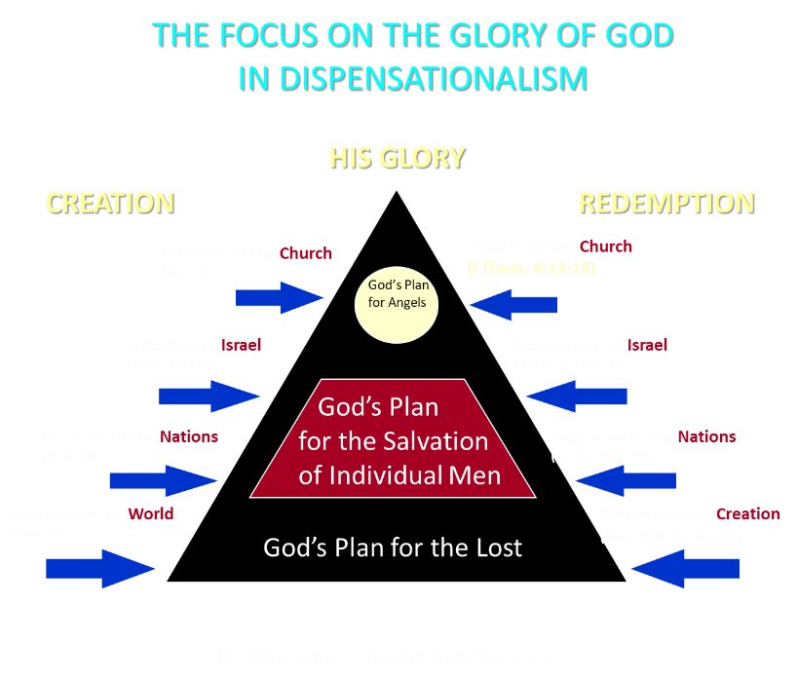

Slide 68
CONCLUSION

Slide 69
Ezekiel 33‒48
Ezekiel recommissioned (33)
False shepherds removed (34)
Edom destroyed (35)
Israel’s restoration: physical & spiritual (36)
Israel’s restoration illustrated (37)
Means of restoration: Northern invasion (38)
Results of the Northern invasion: conversion (39)
Millennial Temple (40‒46)
Tribal land allotment (47‒48)

