Slide 1
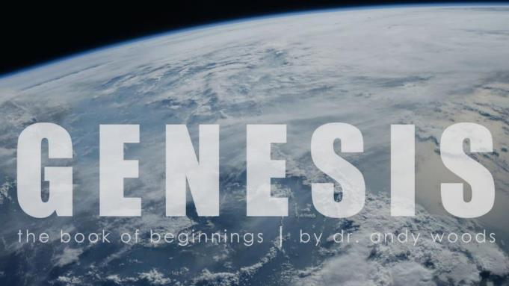
Genesis 12‒50
Israel’s Birth & Preservation

Slide 2
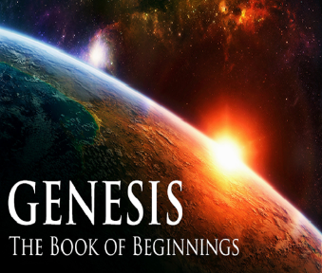
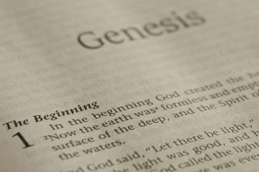
GENESIS STRUCTURE
Beginning of the Human race (Gen. 1‒11)
Beginning of the Hebrew race (Gen. 12‒50)

Slide 3
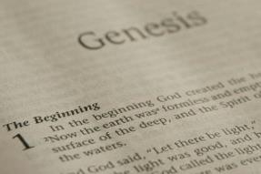
GENESIS STRUCTURE
Genesis 1-11 (four events)
Creation (1-2)
Fall (3-5)
Flood (6-9)
National dispersion (10-11)

Slide 4
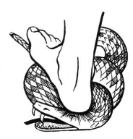
Genesis 3:15
“And I will put enmity Between you and the woman, And between your seed and her seed; He shall bruise you on the head, And you shall bruise him on the heel.”

Slide 5
GENESIS STRUCTURE
Beginning of the Human race (Gen. 1‒11)
Beginning of the Hebrew race (Gen. 12‒50)

Slide 6
GENESIS STRUCTURE
Genesis 12-50 (four people)
Abraham (12:1–25:11)
Isaac (25:12–26:35)
Jacob (27–36)
Joseph (37–50)

Slide 7
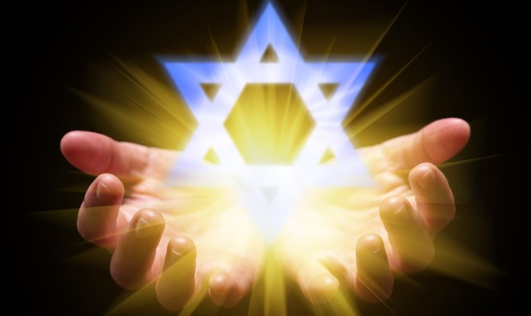
Isaiah 43:1
“But now, thus says the Lord, your Creator, O Jacob, And He who formed you, O Israel, 'Do not fear, for I have redeemed you; I have called you by name; you are Mine!'”

Slide 8
GENESIS STRUCTURE
Genesis 12-50 (four people)
Abraham (12:1–25:11)
Isaac (25:12–26:35)
Jacob (27–36)
Joseph (37–50)

Slide 9
Genesis 12‒19 Abram’s Early Journeys
Unconditional promises (Gen. 12:1-3)
From Haran to Canaan (Gen. 12:4-5)
In Canaan (Gen. 12:6-9)
In Egypt (Gen. 12:10-20)
Abram and Lot Separate (Gen. 13:1-13)
Reaffirmation of Abram’s promises (Gen. 13:14-18)
Abram Rescues Lot (14:1-24)
Abrahamic Covenant (15:1-21)
Hagar & Ishmael (16:1-16)
Circumcision (Gen. 17:1-27)
Sodom & Gomorrah (Gen. 18‒19)

Slide 10
Genesis 18‒19 Sodom & Gomorrah
Visitation (18:1-15)
Prediction (18:16-33)
Destruction (19:1-38)

Slide 11
Genesis 18‒19 Sodom & Gomorrah
Visitation (18:1-15)
Prediction (18:16-33)
Destruction (19:1-38)

Slide 12
Visitation Genesis 18:1-15
Hosting (1-8)
Promise of Isaac (9-15)

Slide 13
Genesis 18‒19 Sodom & Gomorrah
Visitation (18:1-15)
Prediction (18:16-33)
Destruction (19:1-38)

Slide 14
Prediction Genesis 18:16-33
Prophecy (16-21)
Intercession (22-33)

Slide 15
Prediction Genesis 18:16-33
Prophecy (16-21)
Intercession (22-33)

Slide 16
Prophecy Genesis 18:16-21
Departure (16)
Reasons for disclosure (17-19)
Reasons for Coming Destruction (20-21)

Slide 17
Prediction Genesis 18:16-33
Prophecy (16-21)
Intercession (22-33)

Slide 18
Intercession Genesis 18:22-33
Circumstances (22)
Communion (23)
Intercession (24-32)
Conclusion (33)

Slide 19
Intercession Genesis 18:22-33
Circumstances (22)
Communion (23)
Intercession (24-32)
Conclusion (33)

Slide 20
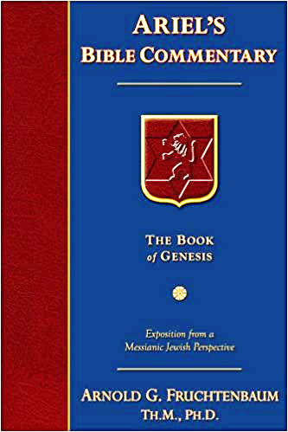
Dr. Arnold G. Fruchtenbaum
The Book of Genesis, 316-17
“Verse 22 gives the circumstance, beginning with the two angels: And the men turned from thence, meaning from God and Abraham, and went toward Sodom. As for the third member: but Abraham stood yet before Jehovah. God’s visible form stayed behind, and Abraham was standing before God’s visible manifestation in human form.”

Slide 21
Intercession Genesis 18:22-33
Circumstances (22)
Communion (23)
Intercession (24-32)
Conclusion (33)

Slide 22
Dr. Arnold G. Fruchtenbaum
The Book of Genesis, 317
“In verse 23, Abraham began by drawing near to God: And Abraham drew near, and said. Drawing near often has the concept of worship. Abraham was already standing near God but now took on a posture of worship.”

Slide 23
Intercession Genesis 18:22-33
Circumstances (22)
Communion (23)
Intercession (24-32)
Conclusion (33)

Slide 24
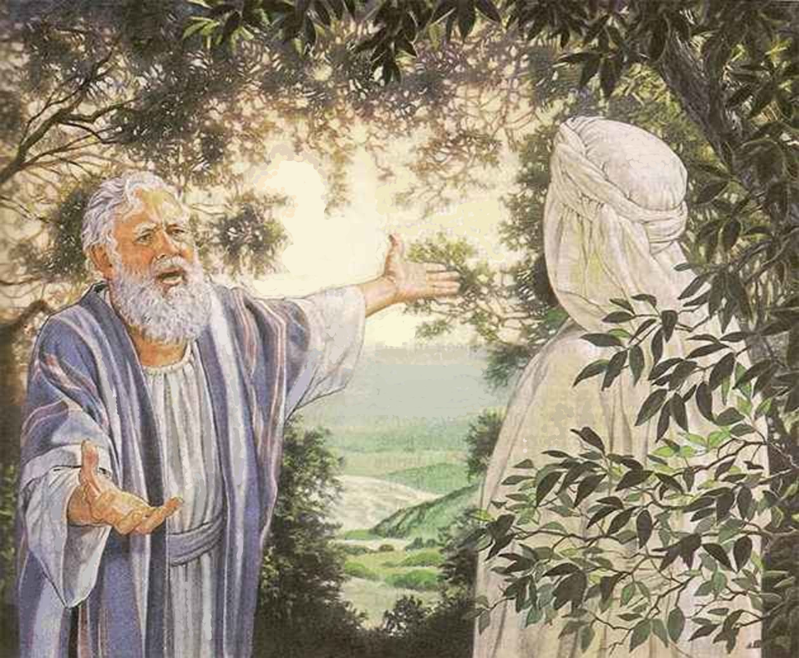
Intercession Genesis 18:24-32
Fifty (24-26)
Forty-five (27-28)
Forty (29)
Thirty (30)
Twenty (31)
Ten (32)

Slide 25
Intercession Genesis 18:24-32
Fifty (24-26)
Forty-five (27-28)
Forty (29)
Thirty (30)
Twenty (31)
Ten (32)

Slide 26
Intercession Genesis 18:24-32
Fifty (24-26)
Forty-five (27-28)
Forty (29)
Thirty (30)
Twenty (31)
Ten (32)

Slide 27
Dr. Arnold G. Fruchtenbaum
The Book of Genesis, 317
“The basis of the plea is in verse 27: Abraham answered and said, Behold now, I have taken upon me to speak unto the Lord, who am but dust and ashes. In Hebrew, dust and ashes is a play upon words, because they sound almost the same: aphar and epher.”

Slide 28
Intercession Genesis 18:24-32
Fifty (24-26)
Forty-five (27-28)
Forty (29)
Thirty (30)
Twenty (31)
Ten (32)

Slide 29
Intercession Genesis 18:24-32
Fifty (24-26)
Forty-five (27-28)
Forty (29)
Thirty (30)
Twenty (31)
Ten (32)

Slide 30
Intercession Genesis 18:24-32
Fifty (24-26)
Forty-five (27-28)
Forty (29)
Thirty (30)
Twenty (31)
Ten (32)

Slide 31
Intercession Genesis 18:24-32
Fifty (24-26)
Forty-five (27-28)
Forty (29)
Thirty (30)
Twenty (31)
Ten (32)

Slide 32
Dr. Arnold G. Fruchtenbaum
The Book of Genesis, 318
“Abraham stopped at ten, because he assumed that would be sufficient because of the size of Lot’s family, since Lot’s total household at this point did number ten: Lot; Lot’s wife; Lot’s two sons (19:12); his two married daughters (19:14); and his two sons-in-laws (19:14); and finally, his two single virgin daughters (19:8).”

Slide 33
Intercession Genesis 18:22-33
Circumstances (22)
Communion (23)
Intercession (24-32)
Conclusion (33)

Slide 34
Concluding Thoughts Prayer
Power (Jas. 5:16b)
Specificity
Boldness (Heb. 4:15)
Humility (Gen. 18:27)
Persistence (Matt. 7:7-11; Luke 18:1-8)

Slide 35
Concluding Thoughts God’s Nature & Answers
God’s grace
God’s answers

Slide 36
Concluding Thoughts God’s Nature & Answers
God’s grace
God’s answers

Slide 37
Genesis 6:1-3
“¹ Now it came about, when men began to multiply on the face of the land, and daughters were born to them, ² that the sons of God saw that the daughters of men were beautiful; and they took wives for themselves, whomever they chose. ³ Then the Lord said, “My Spirit shall not strive with man forever, because he also is flesh; nevertheless his days shall be one hundred and twenty years.”

Slide 38
Genesis 15:13, 16
“¹³ Then God said to Abram, ‘Know for certain that your descendants will be strangers in a land that is not theirs, where they will be enslaved and oppressed for four hundred years…¹⁶ Then in the fourth generation they will return here, for the wrongdoing of the Amorite is not yet complete.’”

Slide 39
2 Peter 3:9
“The Lord is not slow about His promise, as some count slowness, but is patient toward you, not wishing for any to perish but for all to come to repentance.”

Slide 40
Concluding Thoughts God’s Nature & Answers
God’s grace
God’s answers

Slide 41
Dr. Arnold G. Fruchtenbaum
The Book of Genesis, 318
“Sometimes God will not respond positively to specific prayer requests, but He will respond to the desire behind those prayer requests.”

Slide 42
Conclusion

Slide 43
Intercession Genesis 18:22-33
Circumstances (22)
Communion (23)
Intercession (24-32)
Conclusion (33)

Slide 44
Genesis 18‒19 Sodom & Gomorrah
Visitation (18:1-15)
Prediction (18:16-33)
Destruction (19:1-38)

Slide 45
Destruction Genesis 19:1-38
Angels in Sodom (1-11)
Lot’s rescue (12-22)
Destruction (23-29)
Lot’s incest (30-38)

Slide 46
“The Lord bless you and keep you; the Lord make his face shine on you and be gracious to you; the Lord turn his face toward you and give you peace.” (NIV)

