Slide 1

Ezekiel 36‒39
The Middle East Meltdown 2022
Dr. Andy Woods
Senior Pastor – Sugar Land Bible Church
President – Chafer Theological Seminary

Slide 2
Ezekiel 33‒48
Ezekiel recommissioned (33)
False shepherds removed (34)
Edom destroyed (35)
Israel’s restoration: physical & spiritual (36)
Israel’s restoration illustrated (37)
Means of restoration: Northern invasion (38)
Results of the Northern invasion: conversion (39)
Millennial Temple (40‒46)
Tribal land allotment (47‒48)

Slide 3
Ezekiel 36
Israel to prosper again (1-15)
Israel’s sins inhibiting prosperity (16-21)
Israel to be restored: physically & spiritually (22-38)

Slide 4
Ezekiel 33‒48
Ezekiel recommissioned (33)
False shepherds removed (34)
Edom destroyed (35)
Israel’s restoration: physical & spiritual (36)
Israel’s restoration illustrated (37)
Means of restoration: Northern invasion (38)
Results of the Northern invasion: conversion (39)
Millennial Temple (40‒46)
Tribal land allotment (47‒48)

Slide 5
Ezekiel 37
Vision: Valley of the Dry Bones (1-14)
  Vision (1-10)
  Interpretation (11-14)
Sign: Two Sticks (15-28)
  Sign (15-17)
  Interpretation (18-28)

Slide 6
Ezekiel 33‒48
Ezekiel recommissioned (33)
False shepherds removed (34)
Edom destroyed (35)
Israel’s restoration: physical & spiritual (36)
Israel’s restoration illustrated (37)
Means of restoration: Northern invasion (38)
Results of the Northern invasion: conversion (39)
Millennial Temple (40‒46)
Tribal land allotment (47‒48)

Slide 7
Ezekiel 38‒39
Invasion planned (38:1-13)
Invasion executed (38:14-16)
Invasion defeated (38:17‒39:20)
Invasion’s results (39:21-29)

Slide 8
Ezekiel 38‒39
Invasion planned (38:1-13)
Invasion executed (38:14-16)
Invasion defeated (38:17‒39:20)
Invasion’s results (39:21-29)

Slide 9
I. Invasion Planned (Ezekiel 38:1-13)
  God’s intention (1-9)
  Gog’s intention (10-13)

Slide 10
I. Invasion Planned (Ezekiel 38:1-13)
  God’s intention (1-9)
  Gog’s intention (10-13)

Slide 11


Slide 12

Ancient Names From Ezekiel 38:1-9
Magog (Central Asia), Rosh (Russia), Meshec (Turkey), Tubal (Turkey), Persia (Iran), Put (Libya), Cush (Sudan), Gomer (Turkey), | Togarmah (Turkey) Sheba (Saudi Arabia) Dedan (Saudi Arabia or Yemen) Tarshish (Spain) Merchants of Tarshish (Conglomeration of Western powers including Europe) Israel

Slide 13

Ezekiel 38:8
“After many days you will be summoned; in the latter years you will come into the land that is restored from the sword, whose inhabitants have been gathered from many nations to the mountains of Israel which had been a continual waste; but its people were brought out from the nations, and they are living securely, all of them.”

Slide 14
Ezekiel 38:8
“After many days you will be summoned; in the latter years you will come into the land that is restored from the sword, whose inhabitants have been gathered from many nations to the mountains of Israel which had been a continual waste; but its people were brought out from the nations, and they are living securely, all of them.”

Slide 15
6 Timing Clues
Restoration section (33-48)
Latter times (38:8a)
Last days (38:16)
After Israel’s regathering in unbelief but before her final restoration (38:8b; 39:22, 29)
During God’s wrath (Ezek. 38:18-19)
While Israel is living securely and peacefully (38:8c, 11)

Slide 16
6 Timing Clues
Restoration section (33-48)
Latter times (38:8a)
Last days (38:16)
After Israel’s regathering in unbelief but before her final restoration (38:8b; 39:22, 29)
During God’s wrath (Ezek. 38:18-19)
While Israel is living securely and peacefully (38:8c, 11)

Slide 17
Ezekiel 38:8
“After many days you will be summoned; in the latter years you will come into the land that is restored from the sword, whose inhabitants have been gathered from many nations to the mountains of Israel which had been a continual waste; but its people were brought out from the nations, and they are living securely, all of them.”

Slide 18


Slide 19
Six Parts of a Suzerain-Vassal Treaty in Deuteronomy
Preamble (1:1-5)
Prologue (1:6–4:40)
Covenant obligations (5–26)
Storage and reading instructions (27:2-3; 31:9, 24, 26)
Witnesses (32:1)
Blessings and curses (28)

Slide 20
Deuteronomy 28:49-50
⁴⁹ “The Lord will bring a nation against you from far away, from the end of the earth, as the eagle swoops down; a nation whose language you will not understand, ⁵⁰ a nation with a defiant attitude, who will have no respect for the old, nor show favor to the young.”

Slide 21
Israel's Judgments
Division of the kingdom in 931 B.C. (1 Kgs. 12)
Assyrian judgment in 722 B.C. (2 Kgs. 17)
Babylonian captivity in 586 B.C. (2 Kgs. 25)
Rome Diaspora in A.D. 70 (Luke 19:41-44)

Slide 22
Ezekiel 38:8
“After many days you will be summoned; in the latter years you will come into the land that is restored from the sword, whose inhabitants have been gathered from many nations to the mountains of Israel which had been a continual waste; but its people were brought out from the nations, and they are living securely, all of them.”

Slide 23


Slide 24
Quran Surah (or chapter) 24:55
“Allah has promised those who have believed among you and done righteous deeds that He will surely grant them succession [Caliphate] upon the earth just as He granted it to those before them and that He will surely establish for them [therein] their religion which He has preferred for them and that He will surely substitute for them, after their fear, security, [for] they worship Me, not associating anything with Me. But whoever disbelieves after that - then those are the defiantly disobedient.”

Slide 25
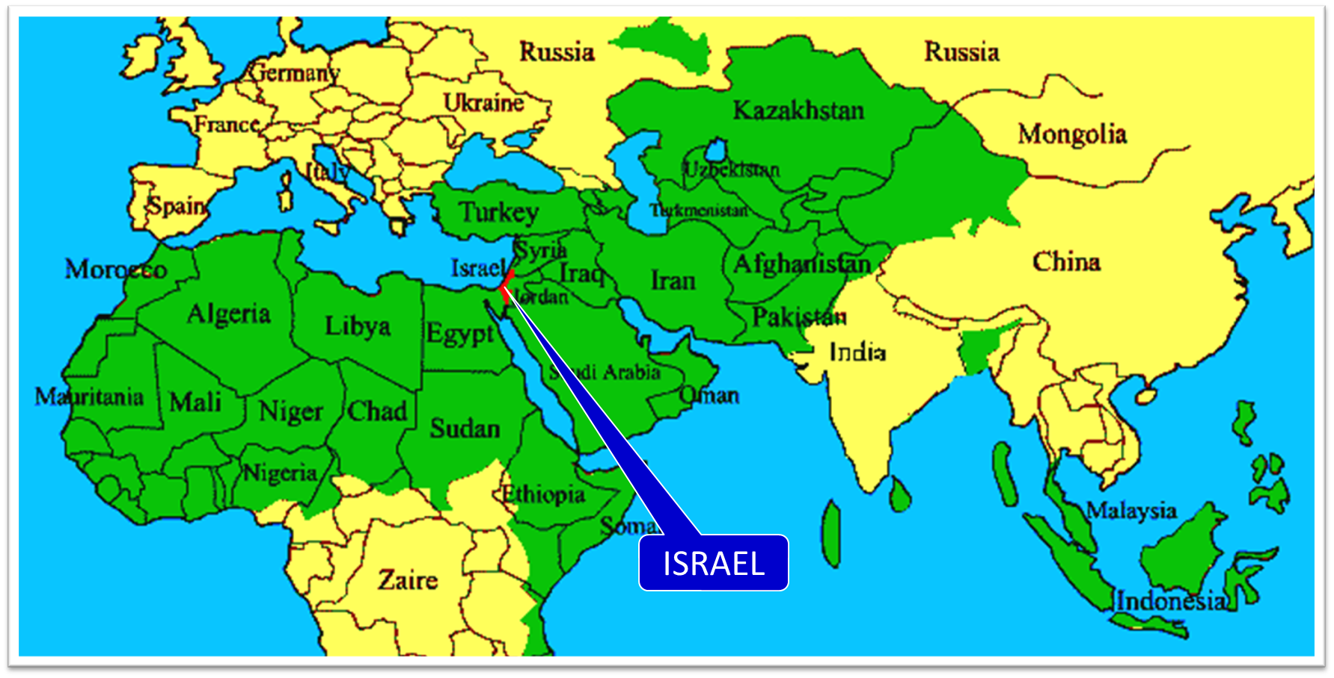

Slide 26
Ezekiel 38:8
“After many days you will be summoned; in the latter years you will come into the land that is restored from the sword, whose inhabitants have been gathered from many nations to the mountains of Israel which had been a continual waste; but its people were brought out from the nations, and they are living securely, all of them.”

Slide 27
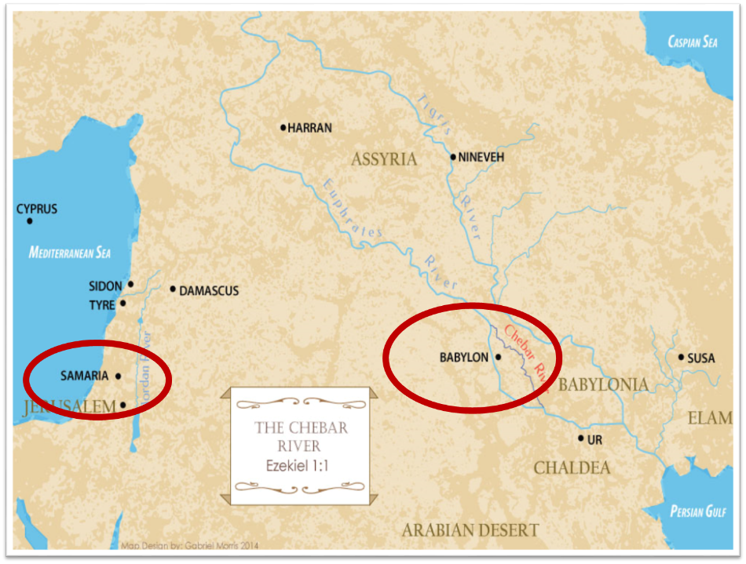

Slide 28
Ezekiel 38:8
“After many days you will be summoned; in the latter years you will come into the land that is restored from the sword, whose inhabitants have been gathered from many nations to the mountains of Israel which had been a continual waste; but its people were brought out from the nations, and they are living securely, all of them.”

Slide 29

Ezekiel 39:2, 4
“² and I will turn you around, drive you on, take you up from the remotest parts of the north and bring you against the mountains of Israel…⁴You will fall on the mountains of Israel, you and all your troops and the peoples who are with you; I will give you as food to every kind of predatory bird and beast of the field.”

Slide 30
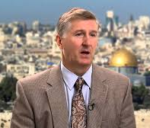
Mountains of Israel?
Mark Hitchcock, The Amazing Claims of Bible Prophecy: What You Need to Know in These Uncertain Times (Harvest House: Eugene, OR, 2010), 211.
“According to Ezekiel 39:2, 4, Israel must possess the ‘mountains of Israel’ when this invasion occurs...The famous Six Day war in Israel in 1967 helped set the stage for this to be fulfilled. Before the Six Day War, all the mountains of Israel, with the exception of a small strip of west Jerusalem, were in the hands of the Jordanian Arabs. Only since 1967 have the mountains of Israel been in Israel, thus setting the stage for the fulfillment of this prophecy.”

Slide 31


Dr. Arnold G. Fruchtenbaum
THE MODERN STATE OF ISRAEL IN BIBLE PROPHECY
Paper presented to the PTSG on 12-7-21, pps. 18-19
“But where in the Land of Israel will the invading armies be destroyed? The exact location is revealed in Ezekiel 39:2 and 4a: ‘and I will turn you about, and will lead you on, and will cause you to come up from the uttermost parts of the north; and I will bring you upon the mountains of Israel…you shall fall upon the mountains of Israel.’ The phrase ‘the mountains of Israel’ refers to the central mountain range that makes up the backbone of the country. In the Hebrew Scriptures, these mountains were known as the Hill Country of Ephraim and the Hill Country of Judah. Some of the famous biblical cities that lie within these . . .

Slide 32
Dr. Arnold G. Fruchtenbaum
THE MODERN STATE OF ISRAEL IN BIBLE PROPHECY
Paper presented to the PTSG on 12-7-21, pps. 18-19
...mountains include Dothan, Shechem, Samaria, Shiloh, Bethel, Ai, Ramah, Bethlehem, Hebron, Debir, and most importantly, Jerusalem, which seems to be the target of the invading army. However, from 1948 until the Six-Day War in 1967, these mountains were not in Israel, but in Jordan. They are now referred to politically as the West Bank. In 1948, Jordanian forces took over these mountains and annexed them as part of Jordan. All Israel had was a small corridor leading west to Jerusalem. The border between Israel and Jordan ran down the foot of these mountains, then cut into the mountains, dividing Jerusalem in…

Slide 33
Dr. Arnold G. Fruchtenbaum
THE MODERN STATE OF ISRAEL IN BIBLE PROPHECY
Paper presented to the PTSG on 12-7-21, pps. 18-19
…two, and then went out again and continued along the foot of these mountains. Israel had maybe five percent or less of the mountains, while the rest belonged to Jordan. Only since 1967 have the mountains of Israel been in Israel. Besides the Temple compound falling into Jewish hands, another by-product of the Six-Day War was that these mountains also fell under Israeli sovereignty. Therefore, not only could this prophecy not have been fulfilled before 1948, but it could also not have been fulfilled before 1967.”“The mountains of Israel (the West Bank) are yet to have a very important and relevant role in Bible . . .

Slide 34
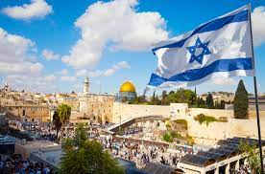
Dr. Arnold G. Fruchtenbaum
THE MODERN STATE OF ISRAEL IN BIBLE PROPHECY
Paper presented to the PTSG on 12-7-21, pps. 18-19
. . .prophecy. As for the present State of Israel, they became part of Israel in 1967. This is yet another way the modern Jewish State fits within Bible prophecy.”

Slide 35
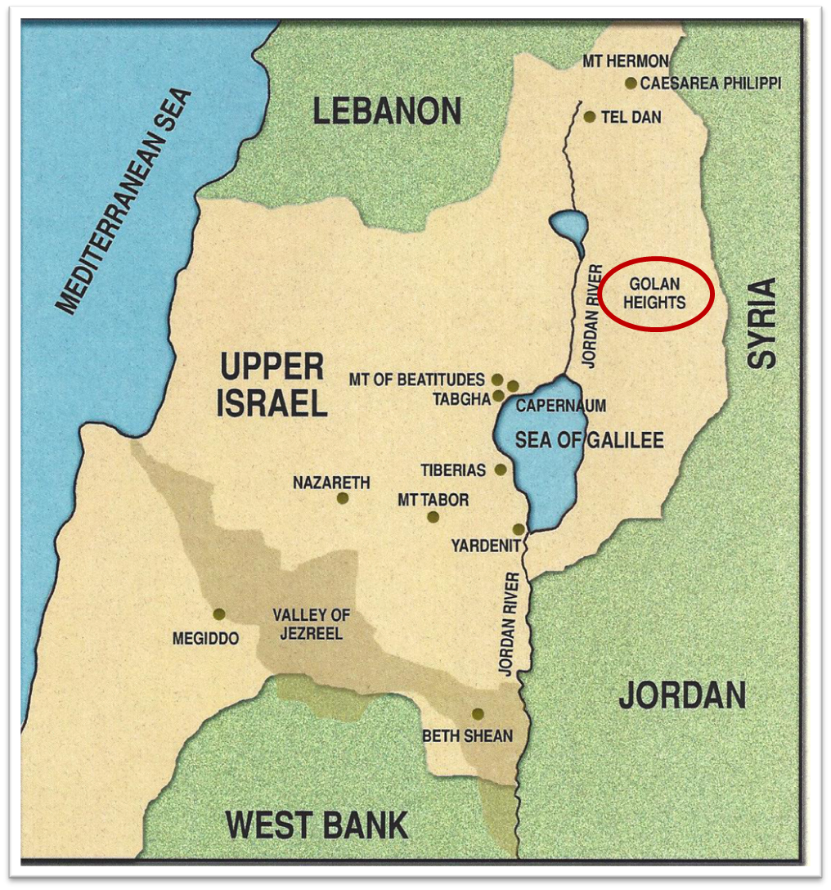

Slide 36
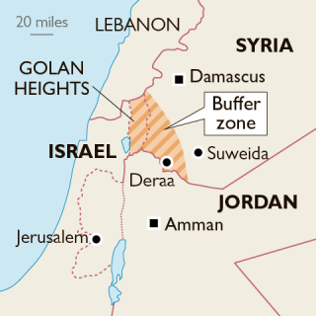

Slide 37
Ezekiel 38:8
“After many days you will be summoned; in the latter years you will come into the land that is restored from the sword, whose inhabitants have been gathered from many nations to the mountains of Israel which had been a continual waste; but its people were brought out from the nations, and they are living securely, all of them.”

Slide 38
Leviticus 26:43
“For the land will be abandoned by them, and will make up for its sabbaths while it is made desolate without them. They, meanwhile, will be making amends for their iniquity, because they rejected My ordinances and their soul abhorred My statutes.”

Slide 39
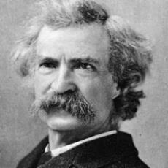
Mark Twain
The Innocents Abroad, Complete, 1st ed. (A Public Domain Book, 1869), 267, 285, 302. These quotes can be found in chapters 47, 49, 52.
“... A desolate country whose soil is rich enough, but is given over wholly to weeds… a silent mournful expanse…. a desolation is here that not even imagination can grace with the pomp of life and action…. we never saw a human being on the whole route…. there was hardly a tree or shrub anywhere. Even the olive tree and the cactus, those fast friends of a worthless soil, had almost deserted the country.”

Slide 40
Ezekiel 38:8
“After many days you will be summoned; in the latter years you will come into the land that is restored from the sword, whose inhabitants have been gathered from many nations to the mountains of Israel which had been a continual waste; but its people were brought out from the nations, and they are living securely, all of them.”

Slide 41

Daniel 9:27
And he will make a firm covenant with the many for one week, but in the middle of the week he will put a stop to sacrifice and grain offering; and on the wing of abominations will come one who makes desolate, even until a complete destruction, one that is decreed, is poured out on the one who makes desolate.

Slide 42


Slide 43


Slide 44

Isaiah 28:15, 18
“¹⁵ Because you have said, “We have made a covenant with death, And with Sheol we have made a pact. The overwhelming scourge will not reach us when it passes by, For we have made falsehood our refuge and we have concealed ourselves with deception.”… ¹⁸ Your covenant with death will be canceled, And your pact with Sheol will not stand; When the overwhelming scourge passes through, Then you become its trampling place.”

Slide 45
6 Timing Clues
Restoration section (33-48)
Latter times (38:8a)
Last days (38:16)
After Israel’s regathering in unbelief but before her final restoration (38:8b; 39:22, 29)
During God’s wrath (Ezek. 38:18-19)
While Israel is living securely and peacefully (38:8c, 11)

Slide 46
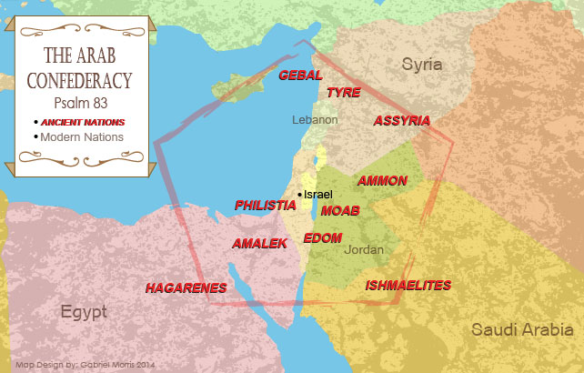

Slide 47
Ezekiel 39:2, 4
“² and I will turn you around, drive you on, take you up from the remotest parts of the north and bring you against the mountains of Israel…⁴You will fall on the mountains of Israel, you and all your troops and the peoples who are with you; I will give you as food to every kind of predatory bird and beast of the field.”

Slide 48
I. Invasion Planned (Ezekiel 38:1-13)
  God’s intention (1-9)
  Gog’s intention (10-13)

Slide 49

Genesis 12:3
“And I will bless those who bless you, And the one who curses you I will curse. And in you all the families of the earth will be blessed.”

Slide 50
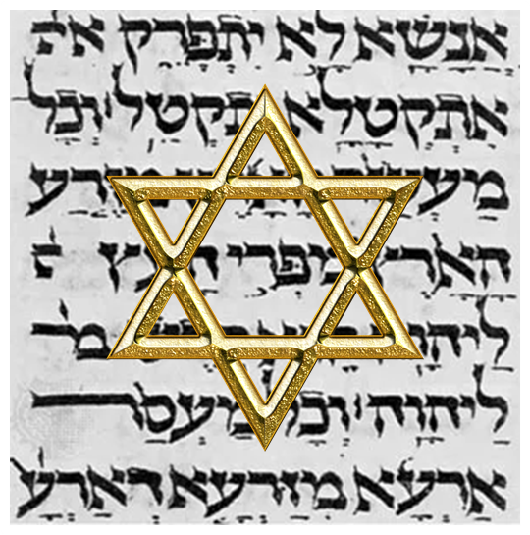
Israel’s Three Blessings to the World
(Gen 12:3b)
Scripture (Rom 3:2)
Savior (John 4:22)
Kingdom (Isa 2:2-3)

Slide 51
Ezekiel 38:8, 11
“⁸ After many days you will be summoned; in the latter years you will come into the land that is restored from the sword, whose inhabitants have been gathered from many nations to the mountains of Israel which had been a continual waste; but its people were brought out from the nations, and they are living securely [batach], all of them….¹¹ and you will say, ‘I will go up against the land of unwalled villages. I will go against those who are at rest [shacat], that live securely [batach], all of them living without walls and having no bars or gates.”

Slide 52
Isaiah 28:15, 18
“¹⁵ Because you have said, “We have made a covenant with death, And with Sheol we have made a pact. The overwhelming scourge will not reach us when it passes by, For we have made falsehood our refuge and we have concealed ourselves with deception.”… ¹⁸ Your covenant with death will be canceled, And your pact with Sheol will not stand; When the overwhelming scourge passes through, Then you become its trampling place.”

Slide 53
Daniel 9:27
And he will make a firm covenant with the many for one week, but in the middle of the week he will put a stop to sacrifice and grain offering; and on the wing of abominations will come one who makes desolate, even until a complete destruction, one that is decreed, is poured out on the one who makes desolate.

Slide 56
6 Timing Clues
Restoration section (33-48)
Latter times (38:8a)
Last days (38:16)
After Israel’s regathering in unbelief but before her final restoration (38:8b; 39:22, 29)
During God’s wrath (Ezek. 38:18-19)
While Israel is living securely and peacefully (38:8c, 11)

Slide 57

Ezekiel 38:12
“to capture spoil and to seize plunder, to turn your hand against the waste places which are now inhabited, and against the people who are gathered from the nations, who have acquired cattle and goods, who live at the center of the world.”

Slide 58
Ezekiel 38:12
“to capture spoil and to seize plunder, to turn your hand against the waste places which are now inhabited, and against the people who are gathered from the nations, who have acquired cattle and goods, who live at the center of the world.”

Slide 59

Deuteronomy 33:24
“Of Asher he said, ‘More blessed than sons is Asher; May he be favored by his brothers, And may he dip his foot in oil.’”

Slide 60
Mark Twain
The Innocents Abroad, Complete, 1st ed. (A Public Domain Book, 1869), 267, 285, 302. These quotes can be found in chapters 47, 49, 52.
“... A desolate country whose soil is rich enough, but is given over wholly to weeds… a silent mournful expanse…. a desolation is here that not even imagination can grace with the pomp of life and action…. we never saw a human being on the whole route…. there was hardly a tree or shrub anywhere. Even the olive tree and the cactus, those fast friends of a worthless soil, had almost deserted the country.”

Slide 61

Charles L. Feinberg
The Prophecy of Ezekiel: The Glory of the Lord, Paperback ed. (Chicago: Moody, 1969; reprint, Chicago: Moody, 1984), 222-23.
“What is it that will allow for the coalition of nations to descend upon and invade the Holy Land?…The plan will be devised because of one important feature of Israel’s occupation of their ancestral home: their wealth…How much we hear today on all sides of national security, social security and financial security. Men’s minds are occupied with plans for security. Thus, the enemy will see the opportunity of the day to invade, overrun with ease and come off with a handsome prize, for the returned people will have come with much wealth (cf. Isa. 60:5–9). . . .

Slide 62
Charles L. Feinberg
The Prophecy of Ezekiel: The Glory of the Lord, Paperback ed. (Chicago: Moody, 1969; reprint, Chicago: Moody, 1984), 222-23.
. . .The enemy, greedy of Israel‘s wealth, will embark on a campaign quest for gain. It is now common knowledge that the deposits of mineral wealth in the Dead Sea are the greatest in the world. The envious eyes of the foe will not be denied longer; the hour when Israel lives without fear of attack and will be considered the most auspicious for the invasion and plunder.”

Slide 63
Why?
COUNTRY | GROSS DOMESTIC PRODUCT
ISRAEL | $123 BILLION
Egypt | $81 billion
Syria | $26 billion
Lebanon | $21 billion
Jordan | $12 billion
Source: CIA World Fact Book, 2005

Slide 64
Why?
COUNTRY | GROSS DOMESTIC PRODUCT (in U.S. $)
ISRAEL | $467 BILLION
Egypt | $396 billion
Jordan | $45 billion
Lebanon | $19 billion
Syria (no data after 2010) | $60 billion (est. 2010)
Source: I.M.F., 2021

Slide 65
THE ROTHSCHILD’S PALESTINE, ALL ROADS LEAD TO JERUSALEM
http://www.matterofprinciple.net/ 011/11/rothschilds-palestine.html (accessed December 15, 2011). Although there is a wide variation of estimates, many different sources estimate the mineral wealth of the Dead Sea in the trillions of dollars.
“The value of the minerals of the Dead Sea is estimated at five trillion dollars. This estimate appears to be optimistic but it is supported in part by the report of the Crown Agents of the British Colonies entitled ‘Production of Minerals From the Waters of the Dead Sea’.... This official report estimates the minerals, except oil, in 1925 as follows: Magnesium Chloride, 22,000 tons, value 600 billion dollars; Potassium Chloride, 20,000 tons, value 75 billion dollars; other minerals valued at 1,200 billion dollars; or a total of about three trillion dollars, exclusive of oil.”

Slide 66
Todd Strandberg
“Could Israel Become a Major Oil Exporter,” online: www.bibleprophecy.com, accessed 26 May 2015.
In the summer of 2010, "...huge deposits of natural gas were found along Israel's northern coastline…Israel is actually sitting on top of a vast amount of oil. According to Harold Vinegar, the former chief scientist of Royal Dutch Shell, the Shefla Basin holds the world’s second-largest shale deposits outside the United States, from which around 250 billion barrels of oil–about the same as Saudi Arabia’s proven reserves...Estimates of global deposits range from 2.8 trillion to 3.3 trillion barrels of recoverable oil...The technology curb has now reached the point where shale is becoming an exploitable resource...the Shefla shale is in a hospitable location. It also contains oil of the light, sweet variety that is easy to refine into gasoline or other common end products. Most of all, the Jews have proven themselves to be very talented at exploiting resources. If they can't make shale oil work, I doubt any nation can.”

Slide 67
OIL DISCOVERY IN ISRAEL?
Globes Correspondent, “Huge Oil Discovery on Golan Heights,” online: http://www.globes.co.il/en/article-huge-oil-discovery-on-golan-heights-1001071698, accessed 09 October 2015.
“Israel consumes 270,000 barrels of oil per day. Although the existence of the oil in the ground is a fact, the critical phase now is to check how easily it can be extracted and whether it involves high production costs. In a period of very low oil prices, extraction will have to be relatively cheap to make exploitation of the field profitable. Just as Israel's offshore Mediterranean gas discoveries have created an entire energy industry, so the Golan oil find could also generate a new industry around it. But while the gas has been found dozens of kilometers from Israel, the Golan find is much closer...Bartov said, "There is enormous excitement. It's a fantastic feeling. We came here thinking maybe yes or maybe no and now things are really happening.”

Slide 68
OIL DISCOVERY IN ISRAEL?
Globes Correspondent, “Huge Oil Discovery on Golan Heights,” online: http://www.globes.co.il/en/article-huge-oil-discovery-on-golan-heights-1001071698, accessed 09 October 2015.
“After more than a year of round-the-clock drilling, large amounts of oil have been found on the Golan Heights. Estimates are that the amount of oil discovered will make Israel self sufficient for very many years to come. Afek Oil and Gas chief geologist Dr. Yuval Bartov told Channel 2 News, "We are talking about a strata which is 350 meters thick and what is important is the thickness and the porosity. On average in the world strata are 20-30 meters thick, so this is ten times as large as that, so we are talking about significant quantities. The important thing is to know the oil is in the rock and that's what we now know." Three drillings have so far taken place in the southern Golan Heights which have found large reserves of oil. Potential production is dramatic - billions of barrels, which will easily provide all Israel's oil needs...”

Slide 69

Matthew Kreiger
Jerusalem Post, cited in David Jeremiah, What in the World Is Going On? 10 Prophetic Clues You Cannot Afford to Ignore (Nashville: Nelson, 2008), 175.
“Despite a population of only slightly more than 7 million people...Israel is now home to more than 7,200 millionaires...Of the 500 wealthiest people in the world, six are now Israeli, and all told, Israel's rich had assets in 2007 of more than $35 billion dollars... Israel's GDP is almost double that of any other Middle Eastern country.”

Slide 70
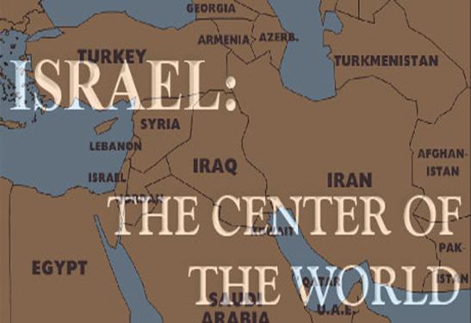
Ezekiel 38:12
“to capture spoil and to seize plunder, to turn your hand against the waste places which are now inhabited, and against the people who are gathered from the nations, who have acquired cattle and goods, who live at the center of the world.”

Slide 71
Ezekiel 5:5
“Thus says the Lord God, ‘This is Jerusalem; I have set her at the center of the nations, with lands around her.'”

Slide 72
Charles L. Feinberg
The Prophecy of Ezekiel: The Glory of the Lord, Paperback ed. (Chicago: Moody, 1969; reprint, Chicago: Moody, 1984), 223.
“An interesting phrase is employed to define the place where God’s people will be dwelling. It is called the middle (literally, the navel) of the earth as explained in 5:5. The land of Israel is in the center of the earth as far as God’s purposes for the world are concerned (cf. Deut. 32:8). Rabbinic literature states: ‘As the navel is set in the center of the human body, so the land of Israel is the navel of the world…Situated in the center of the world, in Jerusalem in the center of the land of Israel, and the sanctuary in the center of Jerusalem, and the holy place in the center of the sanctuary, and the ark in the center of the holy place, and the foundation stone before the holy place, because from it the world was founded.’ Midrash, Tanachma, Qedoshim.”

Slide 73
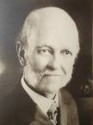
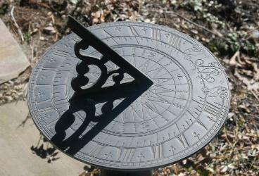
William E. Blackstone
Jesus Is Coming: God's Hope for a Restless World (New York: F.H. Revell, 1908; reprint, Grand Rapids: Kregel, 1989), 238.
“Israel is God's sun dial. If anyone desires to know our place in God’s chronology, our position in the great march of events, look at Israel.”

Slide 74
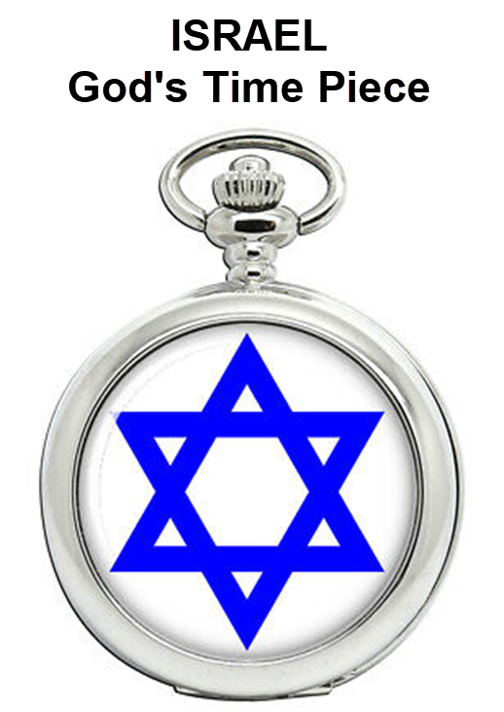

Slide 75
Ezekiel 38:13
“Sheba and Dedan and the merchants of Tarshish with all its villages will say to you, ‘Have you come to capture spoil? Have you assembled your company to seize plunder, to carry away silver and gold, to take away cattle and goods, to capture great spoil?’”

Slide 76
Ezekiel 38:13
“Sheba and Dedan and the merchants of Tarshish with all its villages will say to you, ‘Have you come to capture spoil? Have you assembled your company to seize plunder, to carry away silver and gold, to take away cattle and goods, to capture great spoil?’”

Slide 77
Ancient Names From Ezekiel 38:1-9
Magog (Central Asia) Rosh (Russia) Meshec (Turkey) Tubal (Turkey) Persia (Iran) Put (Libya) Cush (Sudan) Gomer (Turkey) | Togarmah (Turkey) Sheba (Saudi Arabia) Dedan (Saudi Arabia or Yemen) Tarshish (Spain) Merchants of Tarshish (Conglomeration of Western powers including Europe) Israel

Slide 78
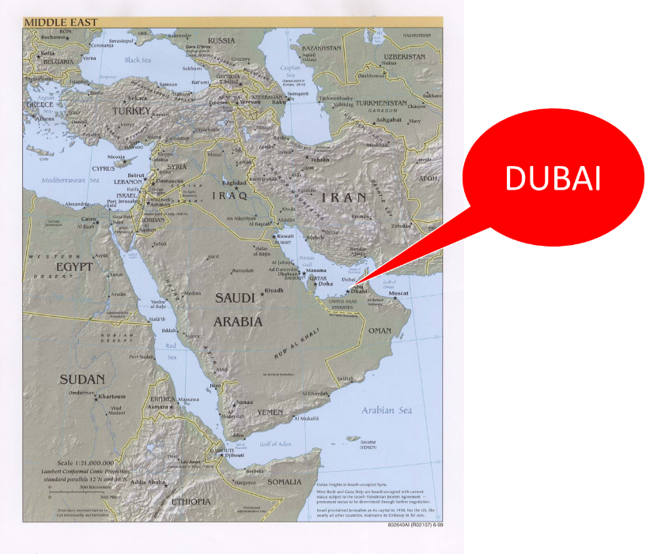

Slide 79
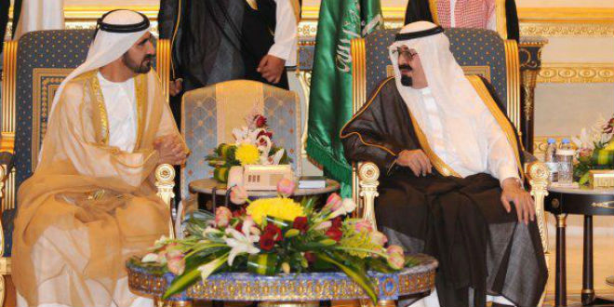
“SAUDI PRINCE: ‘I’LL SIDE WITH ISRAEL’ AGAINST PALESTINIAN UPRISING, [AND] IRAN.”
https://www.breakingisraelnews.com/52468/saudi-prince-ill-side-with-israel-against-palestinian-uprising-middle-east/#bco8FQkRWpkSLkuq.97

Slide 80

TIMES OF INDIA
online: http://tass.com/politics/932980. December 01, 2017 , accessed 12 December 2017.
“Saudi Arabia intercepts second Yemen missile in a month. Saudi Arabia on Thursday intercepted and destroyed a ballistic missile fired from war-torn Yemen, state media reported, the second such attack this month claimed by Iran-backed Huthi rebels.”

Slide 81
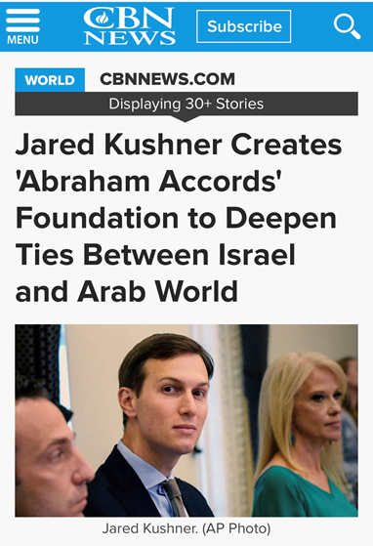

Slide 82
Ezekiel 38:13
“Sheba and Dedan and the merchants of Tarshish with all its villages will say to you, ‘Have you come to capture spoil? Have you assembled your company to seize plunder, to carry away silver and gold, to take away cattle and goods, to capture great spoil?’”

Slide 83
Ancient Names From Ezekiel 38:1-9
Magog (Central Asia) Rosh (Russia) Meshec (Turkey) Tubal (Turkey) Persia (Iran) Put (Libya) Cush (Sudan) Gomer (Turkey) | Togarmah (Turkey) Sheba (Saudi Arabia) Dedan (Saudi Arabia or Yemen) Tarshish (Spain) Merchants of Tarshish (Conglomeration of Western powers including Europe) Israel

Slide 84
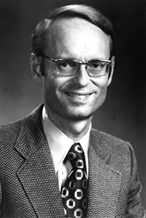
Tarshish = Spain
Ryrie Study Bible, p. 1,421.
The Ryrie Study Bible indicates that Tarshish “is located in the S of Spain near Gibraltar, 2,500 mi. (4,000 km) W of Palestine [or Israel] and the opposite direction from Nineveh.”

Slide 85
Young Lions = Western Nations
Mark Hitchcock, After the Empire: Bible Prophecy in Light of the Fall of the Soviet Union (Wheaton, Il: Tyndale, 1994), p. 101.
“Young lions are often used in the Scripture to refer to energetic rulers. Therefore, the young lions who verbally oppose Gog’s invasion are strong military and political leaders who act with Tarshish...It was in the farthest west regions of the known world, in Spain. As we know, Spain is in modern Europe. Tarshish, or modern Spain, could be used by Ezekiel to represent all of the western nations whom Saudi Arabia will join with in denouncing this invasion.”

Slide 86
Ezekiel 38:13
“Sheba and Dedan and the merchants of Tarshish with all its villages will say to you, ‘Have you come to capture spoil? Have you assembled your company to seize plunder, to carry away silver and gold, to take away cattle and goods, to capture great spoil?’”

Slide 87
Charles L. Feinberg
The Prophecy of Ezekiel: The Glory of the Lord, Paperback ed. (Chicago: Moody, 1969; reprint, Chicago: Moody, 1984), 223.
“The young lions of Tarshish are taken to mean either the strong leaders and princes or greedy rulers of these commercial communities.”

Slide 88
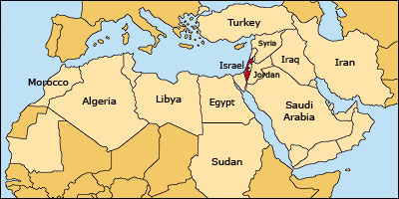

Slide 89
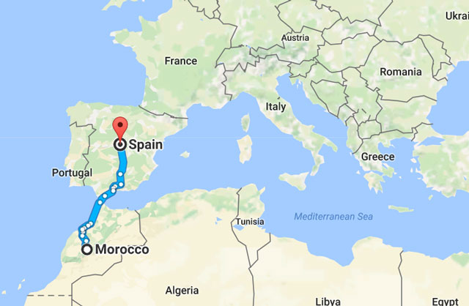

Slide 90
Ezekiel 38:13
“Sheba and Dedan and the merchants of Tarshish with all its villages will say to you, ‘Have you come to capture spoil? Have you assembled your company to seize plunder, to carry away silver and gold, to take away cattle and goods, to capture great spoil?’”

Slide 91
CONCLUSION

Slide 92
Ezekiel 38‒39
Invasion planned (38:1-13)
Invasion executed (38:14-16)
Invasion defeated (38:17‒39:20)
Invasion’s results (39:21-29)

Slide 93
I. Invasion Planned (Ezekiel 38:1-13)
  God’s intention (1-9)
  Gog’s intention (10-13)

