Slide 1
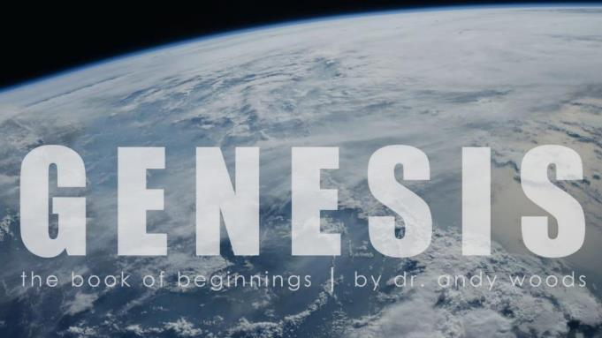
Genesis 12‒50
Israel’s Birth & Preservation

Slide 2
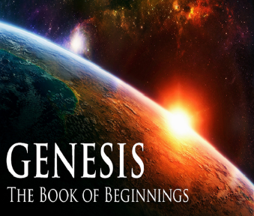
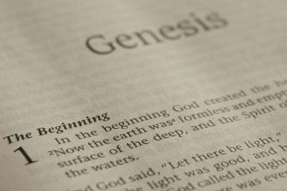
GENESIS STRUCTURE
Beginning of the Human race (Gen. 1‒11)
Beginning of the Hebrew race (Gen. 12‒50)

Slide 3
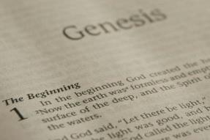
GENESIS STRUCTURE
Genesis 1-11 (four events)
Creation (1-2)
Fall (3-5)
Flood (6-9)
National dispersion (10-11)

Slide 4
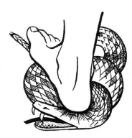
Genesis 3:15
“And I will put enmity Between you and the woman, And between your seed and her seed; He shall bruise you on the head, And you shall bruise him on the heel.”

Slide 5
GENESIS STRUCTURE
Beginning of the Human race (Gen. 1‒11)
Beginning of the Hebrew race (Gen. 12‒50)

Slide 6
GENESIS STRUCTURE
Genesis 12-50 (four people)
Abraham (12:1–25:11)
Isaac (25:12–26:35)
Jacob (27–36)
Joseph (37–50)

Slide 7
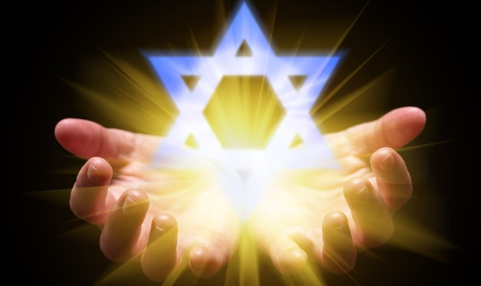
Isaiah 43:1
“But now, thus says the Lord, your Creator, O Jacob, And He who formed you, O Israel, 'Do not fear, for I have redeemed you; I have called you by name; you are Mine!'”

Slide 8
GENESIS STRUCTURE
Genesis 12-50 (four people)
Abraham (12:1–25:11)
Isaac (25:12–26:35)
Jacob (27–36)
Joseph (37–50)

Slide 9
Genesis 12‒19 Abram’s Early Journeys
Unconditional promises (Gen. 12:1-3)
From Haran to Canaan (Gen. 12:4-5)
In Canaan (Gen. 12:6-9)
In Egypt (Gen. 12:10-20)
Abram and Lot Separate (Gen. 13:1-13)
Reaffirmation of Abram’s promises (Gen. 13:14-18)
Abram Rescues Lot (14:1-24)
Abrahamic Covenant (15:1-21)
Hagar & Ishmael (16:1-16)
Circumcision (Gen. 17:1-27)
Sodom & Gomorrah (Gen. 18‒19)

Slide 10
Genesis 18‒19 Sodom & Gomorrah
Visitation (18:1-15)
Prediction (18:16-33)
Destruction (19:1-38)

Slide 11
Genesis 18‒19 Sodom & Gomorrah
Visitation (18:1-15)
Prediction (18:16-33)
Destruction (19:1-38)

Slide 12
Visitation Genesis 18:1-15
Hosting (1-8)
Promise of Isaac (9-15)

Slide 13
Visitation Genesis 18:1-15
Hosting (1-8)
Promise of Isaac (9-15)

Slide 14
Hosting Genesis 18:1-8
The appearance (1)
The invitation (2-5a)
The acceptance (5b)
The hospitality (6-8)

Slide 15
Visitation Genesis 18:1-15
Hosting (1-8)
Promise of Isaac (9-15)

Slide 16
Promise of Isaac Genesis 18:9-15
Focus on Sarah (9)
Promise (10a)
Sarah’s unbelief (10b-12)
Promise reaffirmed (13-14)
Sarah’s response (15a)
God’s response (15b)

Slide 17
Genesis 18‒19 Sodom & Gomorrah
Visitation (18:1-15)
Prediction (18:16-33)
Destruction (19:1-38)

Slide 18
Prediction Genesis 18:16-33
Prophecy (16-21)
Intercession (22-33)

Slide 19
Prediction Genesis 18:16-33
Prophecy (16-21)
Intercession (22-33)

Slide 20
Prophecy Genesis 18:16-21
Departure (16)
Reasons for disclosure (17-19)
Reasons for Coming Destruction (20-21)

Slide 21
Prophecy Genesis 18:16-21
Departure (16)
Reasons for disclosure (17-19)
Reasons for Coming Destruction (20-21)

Slide 22
Prophecy Genesis 18:16-21
Departure (16)
Reasons for disclosure (17-19)
Reasons for Coming Destruction (20-21)

Slide 23
Reasons for Disclosure Genesis 18:17-19
Question (17)
Reasons (18-19)
Abrahamic Covenant: Fulfillment (18a)
Channel of blessing (18b)
Intimacy with God (19a)
Transgenerational teaching (19b)
Abrahamic Covenant: reiterated (19c)

Slide 24
Reasons for Disclosure Genesis 18:17-19
Question (17)
Reasons (18-19)
Abrahamic Covenant: Fulfillment (18a)
Channel of blessing (18b)
Intimacy with God (19a)
Transgenerational teaching (19b)
Abrahamic Covenant: reiterated (19c)

Slide 25
“Mystery” Defined
“In the N.T, it [mystērion] denotes, not the mysterious (as with the Eng. word), but that which, being outside the range of unassisted natural apprehension, can be made known only by Divine revelation, and is made known in a manner and at a time appointed by God, and to those who are illumined by His Spirit.
W. E. Vine, Merrill F. Unger, and William White, Vine's Complete Expository Dictionary of the Old and New Testament Words (Nashville: Nelson, 1996), 424.

Slide 26
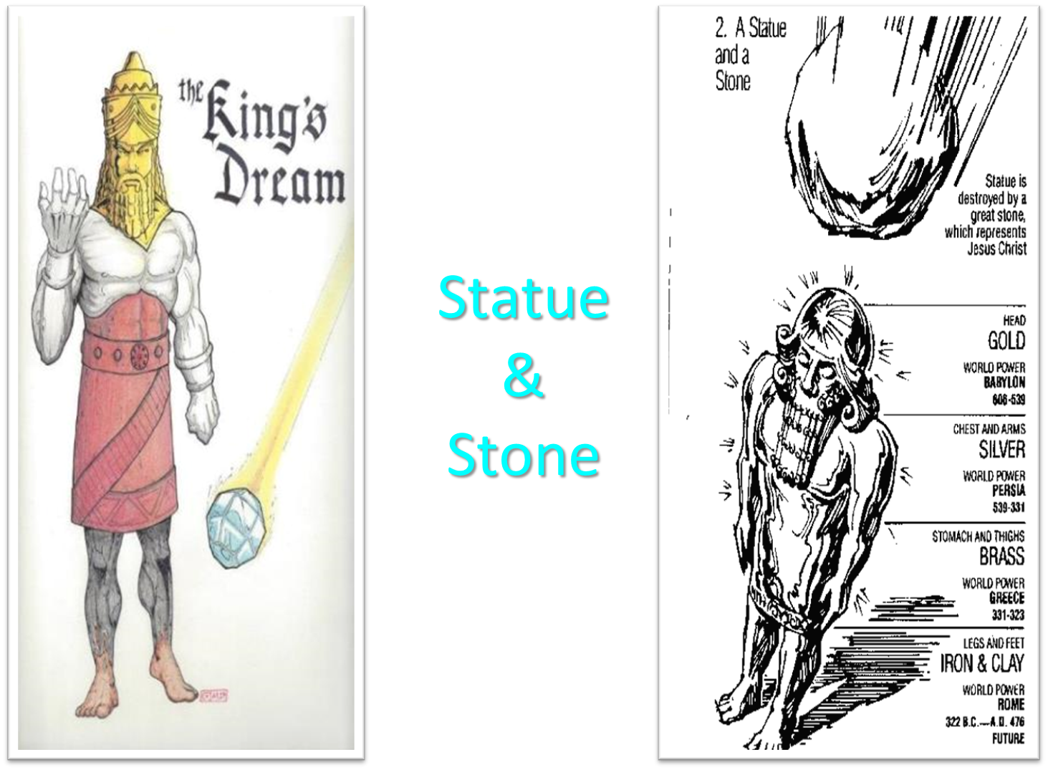

Slide 27
Daniel 2:18-19, 27-30
“¹⁸ so that they might request compassion from the God of heaven concerning this mystery, so that Daniel and his friends would not be destroyed with the rest of the wise men of Babylon. ¹⁹ Then the mystery was revealed to Daniel in a night vision. Then Daniel blessed the God of heaven; . . . ²⁷ Daniel answered before the king and said, “As for the mystery about which the king has inquired, neither wise men, conjurers, magicians nor diviners are able to declare. . .

Slide 28
Daniel 2:18-19, 27-30
... it to the king. . . ²⁸ However, there is a God in heaven who mysteries, and He has made known to King Nebuchadnezzar what will take place in the latter days. This was your dream and the visions in your mind while on your bed. ²⁹ As for you, O king, while on your bed your thoughts turned to what would take place in the future; and He who reveals mysteries has made known to you what will take place. ³⁰ But as for me, this mystery has not been revealed to me for any wisdom. . .

Slide 29
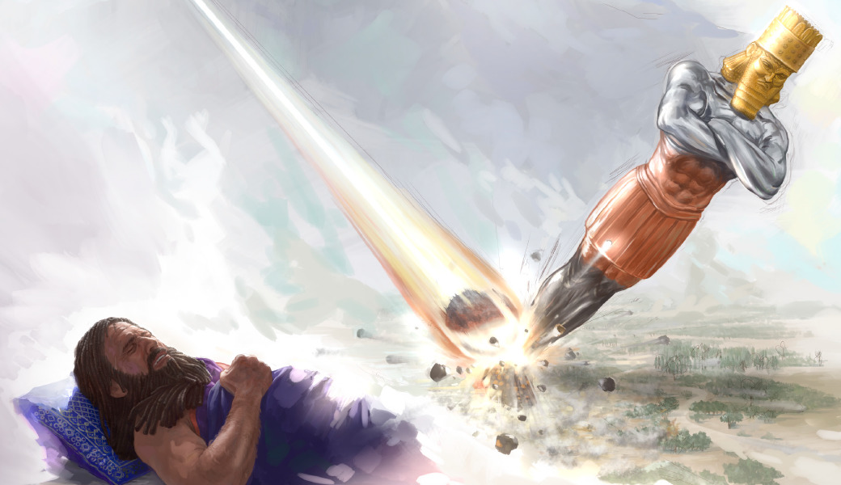
Daniel 2:18-19, 27-30
... residing in me more than in any other living man, but for the purpose of making the interpretation known to the king, and that you may understand the thoughts of your mind.”

Slide 30
Reasons for Disclosure Genesis 18:17-19
Question (17)
Reasons (18-19)
Abrahamic Covenant: Fulfillment (18a)
Channel of blessing (18b)
Intimacy with God (19a)
Transgenerational teaching (19b)
Abrahamic Covenant: reiterated (19c)

Slide 31
Reasons for Disclosure Genesis 18:17-19
Question (17)
Reasons (18-19)
Abrahamic Covenant: Fulfillment (18a)
Channel of blessing (18b)
Intimacy with God (19a)
Transgenerational teaching (19b)
Abrahamic Covenant: reiterated (19c)

Slide 33
Reasons for Disclosure Genesis 18:17-19
Question (17)
Reasons (18-19)
Abrahamic Covenant: Fulfillment (18a)
Channel of blessing (18b)
Intimacy with God (19a)
Transgenerational teaching (19b)
Abrahamic Covenant: reiterated (19c)

Slide 34
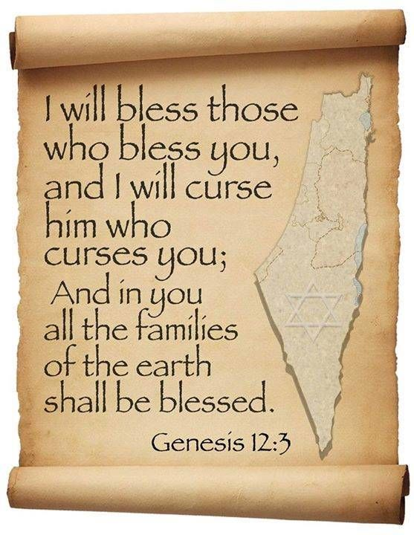
Genesis 12:3
“And I will bless those who bless you, And the one who curses you I will curse. And in you all the families of the earth will be blessed.”

Slide 35
VI. 8 New Promises Genesis 12:1-3
Land (Gen. 12:1b)
Great nation (Gen. 12:2a)
Personal blessing (Gen. 12:2b)
Great name (Gen. 12:2c)
Blessing to others (Gen. 12:2d)
Blessing to blessers (Gen. 12:3a)
Cursing to cursers (Gen. 12:3b)
Blessing to the world (Gen. 12:3c)

Slide 36
Reasons for Disclosure Genesis 18:17-19
Question (17)
Reasons (18-19)
Abrahamic Covenant: Fulfillment (18a)
Channel of blessing (18b)
Intimacy with God (19a)
Transgenerational teaching (19b)
Abrahamic Covenant: reiterated (19c)

Slide 37
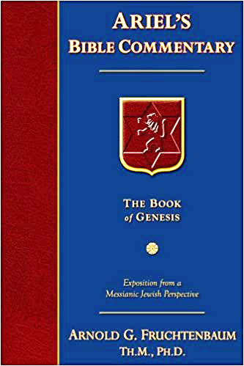
Dr. Arnold G. Fruchtenbaum
The Book of Genesis, 315
“For I have known him. The Hebrew word for known is ‘to know by experience,’ ‘intimate knowing.’ It was because of His intimate relationship with Abraham that Abraham became known as the friend of God.”

Slide 38
James 2:23
“and the Scripture was fulfilled which says, ‘And Abraham believed God, and it was reckoned to him as righteousness,’ [Gen. 15:6] and he was called the friend of God.” [Gen. 18:17]

Slide 39
John 15:14-15
“¹⁴ You are My friends if you do what I command you. ¹⁵ No longer do I call you slaves, for the slave does not know what his master is doing; but I have called you friends, for all things that I have heard from My Father I have made known to you.”

Slide 40
John 2:23-25
“²³ Now when He was in Jerusalem at the Passover, during the feast, many believed in (pisteuō eis) His name, observing His signs which He was doing. ²⁴ But Jesus, on His part, was not entrusting Himself to them, for He knew all men, ²⁵ and because He did not need anyone to testify concerning man, for He Himself knew what was in man.”

Slide 41
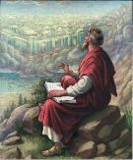
John 20:30-31
“³⁰ Therefore many other signs Jesus also performed in the presence of the disciples, which are not written in this book; ³¹ but these have been written so that you may believe (pisteuō eis) that Jesus is the Christ, the Son of God; and that believing you may have life in His name.”

Slide 42
 | SALVATION | FRIENDSHIP
CONDITION | FAITH | OBEDIENCE
Scripture | John 3:16 | John 15:14
Phase of Salvation | Justification | Sanctification
Benefit | Salvation From Sin’s Penalty | Divine Insight

Slide 43
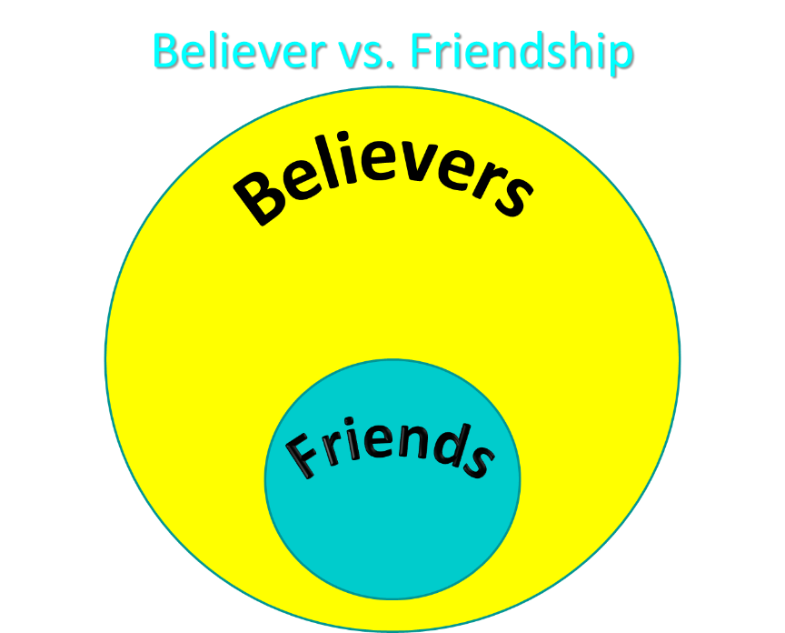

Slide 44
Reasons for Disclosure Genesis 18:17-19
Question (17)
Reasons (18-19)
Abrahamic Covenant: Fulfillment (18a)
Channel of blessing (18b)
Intimacy with God (19a)
Transgenerational teaching (19b)
Abrahamic Covenant: reiterated (19c)

Slide 45
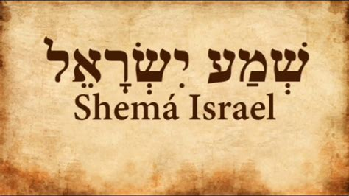
Deuteronomy 6:4-7
“⁴ Hear, Israel! The Lord is our God, the Lord is one!... ⁶ These words, which I am commanding you today, shall be on your heart. ⁷ You shall teach them diligently to your sons and shall talk of them when you sit in your house and when you walk by the way and when you lie down and when you rise up.”

Slide 46
Reasons for Disclosure Genesis 18:17-19
Question (17)
Reasons (18-19)
Abrahamic Covenant: Fulfillment (18a)
Channel of blessing (18b)
Intimacy with God (19a)
Transgenerational teaching (19b)
Abrahamic Covenant: reiterated (19c)

Slide 48
Prophecy Genesis 18:16-21
Departure (16)
Reasons for disclosure (17-19)
Reasons for Coming Destruction (20-21)

Slide 49
Reasons for Coming Destruction Genesis 18:20-21
Sodom’s Sin (20)
God’s Investigation (21)

Slide 50
Reasons for Coming Destruction Genesis 18:20-21
Sodom’s Sin (20)
God’s Investigation (21)

Slide 51
Dr. Arnold G. Fruchtenbaum
The Book of Genesis, 315
“In Genesis 18:20–21 is the actual revelation, with verse 20 focusing on the sin of Sodom and Gomorrah: Because the cry of Sodom and Gomorrah is great. The word cry is zaakah, which makes a word play with the Hebrew word for ‘righteousness,’ tzedakah. In place of tzedakah, righteousness, it is zaakah, a cry, because their sin is very grievous.”

Slide 52
Reasons for Coming Destruction Genesis 18:20-21
Sodom’s Sin (20)
God’s Investigation (21)

Slide 53
Dr. Arnold G. Fruchtenbaum
The Book of Genesis, 315
“Verse 21 is God’s investigation: I will go down now, and see, for the purpose of destruction as in 11:5 and 11:7, whether they have done altogether according to the cry of it, which has come unto me; and if not, I will know. It was not an admission that God did not already know these things, but the point is to show that God had carefully scrutinized every detail. Therefore, when God performs a massive judgment, it does not come out of any ignorance. This will show that the punishment came after a very full investigation and a very full account.”

Slide 54
Conclusion

Slide 55
Genesis 18‒19 Sodom & Gomorrah
Visitation (18:1-15)
Prediction (18:16-33)
Destruction (19:1-38)

Slide 56
Prediction Genesis 18:16-33
Prophecy (16-21)
Intercession (22-33)

Slide 57
Prophecy Genesis 18:16-21
Departure (16)
Reasons for disclosure (17-19)
Reasons for Coming Destruction (20-21)

Slide 58
Prediction Genesis 18:16-33
Prophecy (16-21)
Intercession (22-33)

Slide 59
“The Lord bless you and keep you; the Lord make his face shine on you and be gracious to you; the Lord turn his face toward you and give you peace.” (NIV)

